Slide 1
Paget's disease of the breast.
- Dr. Vishal Bharadava

Slide 2
Clinical History
A 53 year-old woman presented to our hospital with a 6-month history of eczematous skin lesions in her left breast nipple.
No significant complaints in right breast.
No significant past history or family history.

Slide 3
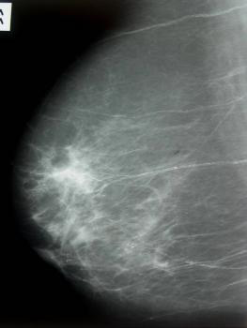
Imaging Findings
Groups of pathological calcifications in the subareolar area and the lower outer quadrant of the left breast.No associated mass or thickening of the nipple and the areola.

Slide 4
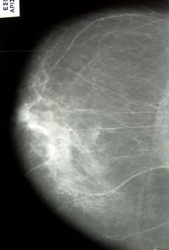
Subareolar microcalcifications. Absence of architectural distortion or nipple retraction.
Calcified blood vessels.

Slide 5
Discussion
About 1-4% of female breast carcinoma cases are associated with Paget's disease (PD) of the nipple,
the areola, and the surrounding skin; nearly 100% of mammary PD cases are associated with an
underlying carcinoma, either in situ (intraductal, 10%) or infiltrating cancer (90%). Occasional
cases of PD have been reported in ectopic breast or supernumerary nipples. The average age range
of diagnosis is 53-59 years. Mammary PD occurs almost exclusively in females. PD of the male
breast is extremely rare and sometimes is associated with Kleinefelter's syndrome. Mammary
Paget's disease is widely accepted as an underlying intraductal carcinoma of the breast with
retrograde extension into the overlying epidermis through the lactiferous ducts and ductules.

Slide 6
THANK YOU

