Slide 1
ANAPHYLAXIS
Dr. Chinar Patel
Professor,
Dept.Of Anaesthesia,
S.B.K.S.M.I.R.C.,Piparia
Fatima Al-Awadh

Slide 2




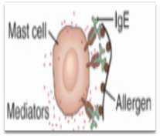
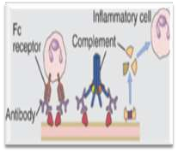
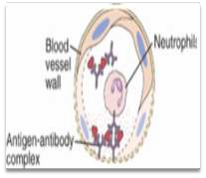
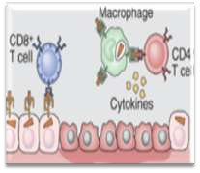
Types of hyper sensitivity reactions
Immediate hypersensitivity
Antibody- mediated
immune complex diseases
T cell-mediated diseases
Mast cell release histamine and other mediators
Antibodies directed against cell or tissue antigens
Antibody- antigen complex deposit in blood vessels
Reactions of T lymphocytes

Slide 3
Anaphylaxis
Ana (without), phylaxis (protection).
Acute multi-systemic allergic reaction involving the skin, airway, vascular system, and GI.
Sever immediate (type I) hypersensitivity reaction.
True & pseudo-anaphylaxis.

Slide 4









Etiology
Causes of anaphylaxis in a study of 266 patients (Data from Kemp et al)
2%
Food
7%
Idiopathic
34%
20%
Drugs
Exercise
37%
Latex, hormons, ins ect bites

Slide 5

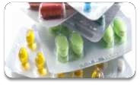

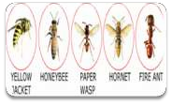



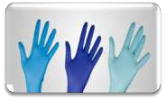
Etiology
Pharmlogic agents
Antibiotics (penicillin)
Nonsteroidal anti-inflammatory drugs (Asprin)
intravenous (IV) contrast agents
Stinging insects
Ants, bees, hornets, wasps, and yellow jackets.
Food
Peanuts, seafood, and wheat
Latex
Rare
No latex-associated deaths

Slide 6





Pathophysiology
First exposure
Activation of TH2 cell → Stimulate IgE switiching
Allergen
B Cell
TH2 Cell

Slide 7


Pathophysiology
First exposure
IgE production
IgE secreting B cell
IgE

Slide 8





Pathophysiology
First exposure
IgE bind to mast cell
 | Mast cell
 | FcɛRI
 | IgE

Slide 9











Pathophysiology
Second exposure
Recognition
Allergen
 | Mast cell
 | FcɛRI
 | IgE

Slide 10












Pathophysiology
Second exposure
Activation of mast cell to release histamine
and other mediators
Allergen
 | Mast cell
 | FcɛRI
 | IgE
Mediators

Slide 11






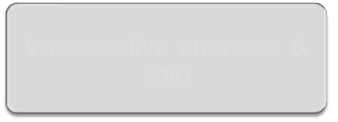





Pathophysiology
Mediators
Vascoactive aminase & lipid
Cytokines
Immediate hypersensitivity reaction (minutes)
Late phase reaction (6- 24 hours)

Slide 12
Signs & Symptoms
SKIN
Itching
Flushing
Urticaria
swelling
Itching
fushing
hives (urticaria)
swelling

Slide 13
Signs & Symptoms
EYES
Itching
Watering
Redness
Periorbital edema
Itching
tearing
redness
swelling around theeyes

Slide 14
Signs & Symptoms
NOSE AND MOUTH
Sneezing
Runny nose
Nasal congestion
Swelling of tongue
Metallic taste
g
runny nose
nasal congestion
swelling of the
tongue
metallic taste

Slide 15
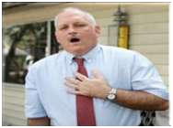
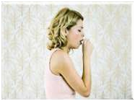
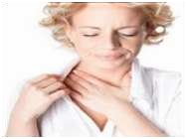
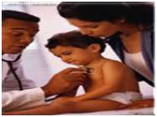


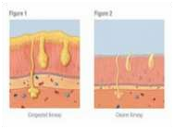
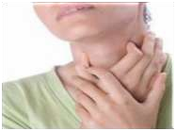

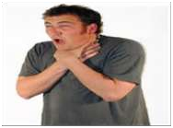




Signs & Symptoms
Lungs and throat
Difficulty breathing
coughing
chest tightness
wheezing or other
sounds
increased mucus production
throat swelling or itching
change in voice
or a sensation of choking

Slide 16
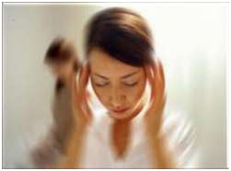
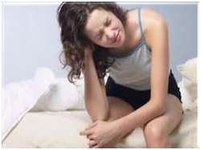
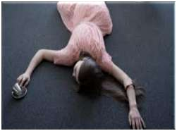


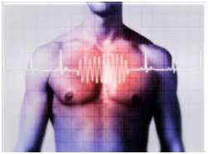
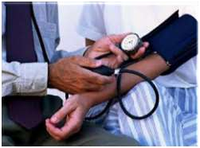

Signs & Symptoms
Heart and circulation
Dizziness
weakness
fainting
rapid, slow, or
irregular heart rate
low blood pressure

Slide 17
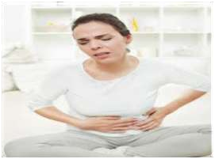
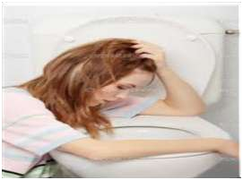


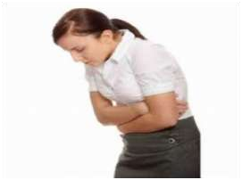



Signs & Symptoms
Digestive system
Nausea
vomiting
cramps
diarrhea

Slide 18
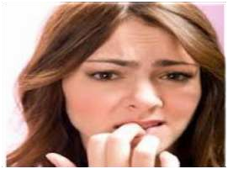





Signs & symptoms
Nervous system
Anxiety
confusion
sense of impending doom

Slide 19
Diagnosis
The diagnosis of anaphylaxis is based upon symptoms that occur suddenly after being exposed to a potential trigger.
Differential diagnosis
severe asthma attack
heart attack
panic attack
food poisoning
An increased amount of tryptase protein can be measured in a blood sample collected during the first three hours after anaphylaxis symptoms have begun.
tryptase levels are seldom elevated in food-induced anaphylaxis

Slide 20
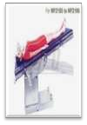
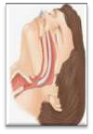
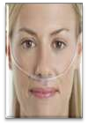

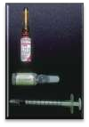
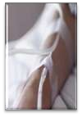
First Aid
Place patient in Trendelenburg position.
Establish and maintain airway.
Give oxygen via nasal cannula as needed.
Place a tourniquet above the reaction site.
Epinephrine at the site of antigen injection.
Start IV to rise BP.

Slide 21
Treatment
EPINEPHRINE
Benadryl (diphenhydramine) - H1 antagonist
Tagamet (cimetidine) - H2 antagonist
Corticosteroid therapy
In severe anaphylaxis, observe for 6 hours or longer

Slide 22
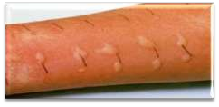


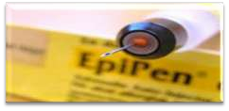
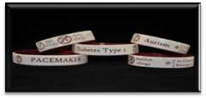


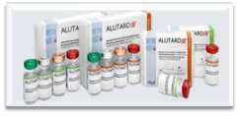
Prevention
Avoid the responsible allergen (e.g. food, drug, latex, etc.).
Keep an adrenaline kit (e.g. Epipen) and
Benadryl on hand at all times.
Wear medic Alert bracelets .
Venom immunotherapy is highly effective in protecting insect-allergic individuals.

Slide 23
Thank You

