Slide 1

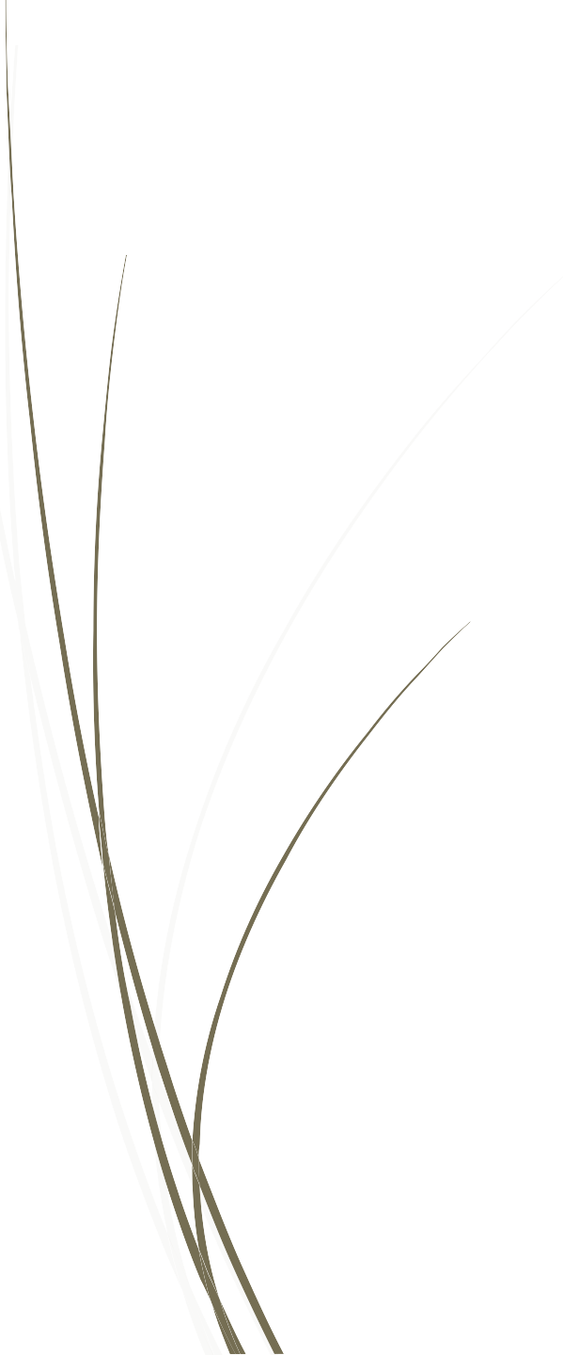
Anatomy of Uvea
By-Dr.Punit Singh

Slide 2
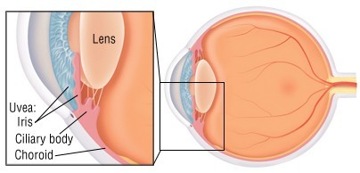
Introduction
Uveal tissue constitutes the middle vascular coat of the eyeball. From anterior to posterior its divided into three parts, namely, iris, ciliary body and choroid.

Slide 3
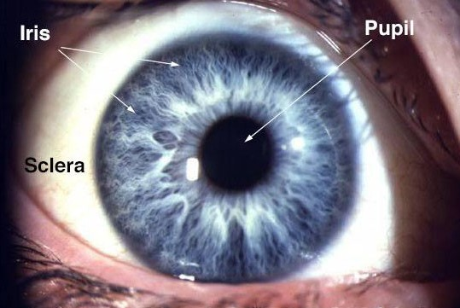
The Iris
×
Iris is anterior most part of the uveal tract. It’s a thin circular disc and in its centre is an aperture called the pupil which regulates the amount of light reaching the retina.
At its periphery, the iris is attached to the middle of anterior surface of the ciliary body.
The iris also divides the space between cornea and lens into anterior and posterior chambers.
×
×

Slide 4
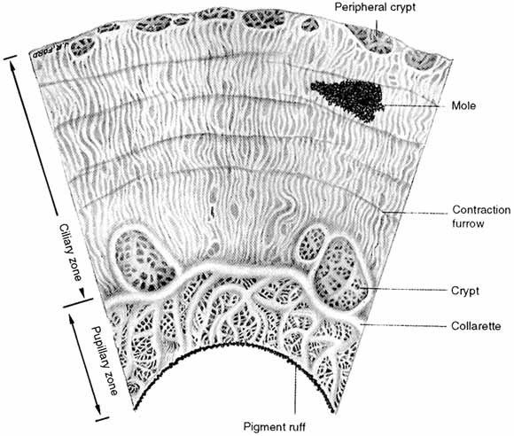
Macroscopic appearance
Anterior surface of uvea can be divided into a ciliary zone and a pupillary zone by a zigzag line called collarette.
Ciliary zone- It presents series of radial streaks due to underlying radial blood vessels and crypts which are depressions where superficial layer of iris is missing.
Pupillary zone- This part of the iris lies between the collarette and pigmented pupillary frill and is relatively smooth and flat.

Slide 5
Microscopic structure- consist of 4 layers, they are
Anterior limiting layer- it’s the anterior most condensed part of the stroma. It consists of melanocytes and fibroblasts. Definitive colour of the iris depends on this layer.
Iris stroma- It consists of loosely arranged collagenous network in which are embedded the sphincter pupillae, dilator pupillae, vessels, nerves, pigment cells and other cells.
  Sphincter Pupillae- forms a broad circular band in the pupillary part of iris, supplied by parasympathetic fibres through third nerve. It constricts the pupil.
  Dilator Pupillae- lies in the ciliary zone of iris, supplied by cervical sympathetic nerves. It dilates the pupil.

Slide 6
Anterior Epithelial layer- It’s the anterior most continuation of the pigment epithelium of retina and ciliary body. This layer gives rise to the dilator pupillae muscle.
Posterior Pigmented Epithelial layer- It’s the anterior continuation of the non-pigmented epithelium of ciliary body. At the pupillary margin it forms the pigmented frill and becomes continuous with the anterior pigmented epithelial layer.

Slide 7
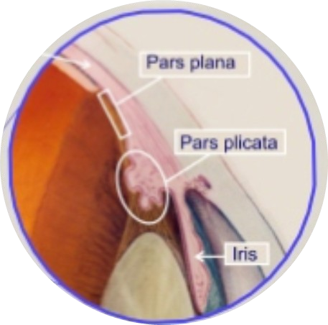
Ciliary body
×
Ciliary body is the anterior most continuation of the choroid at ora serrata.
It forms a part of the angle of anterior and posterior chambers, the iris is attached to it and the inner side is divided into two parts,
Anterior part having finger-like ciliary processes called the pars plicata,
Posterior part which is smooth called the pars plana.
×

Slide 8
Microscopic structure- consists of 5 layers, they are
Supraciliary lamina- it’s the outermost condensed part of the stroma and consists of pigmented collagen fibres.
Stroma of the ciliary body- it consists of connective tissue of collagen and fibroblasts. Embedded in this are ciliary muscle, vessels, nerves, pigment and other cells.
Ciliary muscle occupies most of the outer part of ciliary body. It’s a non striated muscle and is supplied by parasympathetic fibres through the short ciliary nerves. It has three parts,
  Longitudinal fibres- which help in aqueous outflow,
  Circular fibres- which help in accommodation,
  Radial fibres- which also help in aqueous outflow

Slide 9
3. Layer of pigmented epithelium- it’s the forward continuation of the retinal pigment epithelium.
Layer of non-pigmented epithelium- it consists of mainly low columnar or cuboidal cells and it’s the forward continuation of the sensory retina.
Internal limiting membrane- it’s the forward continuation of the internal limiting membrane of the retina.
Functions of the ciliary body-
  Formation of aqueous humor
  Ciliary muscles help in accommodation.

Slide 10
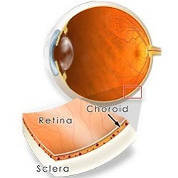
Choroid
Choroid is posterior most part of uvea, extending from the optic disc to the ora serrate. Its inner surface is smooth, brown and lies in contact with pigment epithelium of the retina. The outer surface is rough and lies in contact with the sclera.

Slide 11
Microscopic Structure- from without inwards, it is
Suprachoroidal lamina- it’s a thin membrane of condensed collagen, melaoncytes and fibroblasts. The potential space between and sclera is the suprachoroidal space.
Stroma of the choroid- It consists of loose collagenous tissue with some elastic and reticulum fibres containing pigment cells and plasma cells, in addition vessels are found and are arranged in 3 layers
  Layer of large vessels ( Hallers layer)
  Layer of medium vessels ( Sattlers layer)
  Layer of choriocapillaries.
1. Basal lamina- its also called the Bruch’s membrane and lines the layer of choriocapillaries.

Slide 12
Blood Supply of uvea
Arterial supply- its supplied by three sets of arteries
Short posterior ciliary arteries- arise as two trunks from the ophthalmic artery . Each trunk divides into 10 to 20 branches and supply the choroid in a segmented manner.
Long posterior ciliary arteries- these are two in number, nasal and temporal. They run forward in the suprachoroidal space to reach the ciliary muscle without giving any branch. At the anterior end of ciliary muscle these anastomose with each other and with anterior ciliary arteries and give rise to branches which supply the ciliary body.

Slide 13
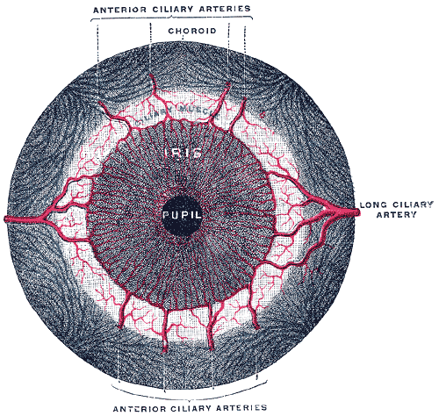
3. Anterior ciliary arteries- these are derived from the muscular branches of the ophthalmic artery. They enter the ciliary muscle by piercing the sclera near the limbus, here they anastomose with the two long posterior ciliary arteries to form the circulus arteriosus major, near the root of iris. Several branches arise from this and supply the ciliary processes. Similarly, many branches from this major arterial circle run radially through the iris towards pupillary margin where they anastomose with each other to form circulus arteriosus minor.

Slide 14
Venous drainage
A series of small veins which drain blood from iris, ciliary body and choroid join to form vortex veins. Vortex veins are four in number, namely, superior temporal, inferior temporal, superior nasal and inferior nasal. These drain into the superior and inferior ophthalmic veins which in turn drain into the cavernous sinus.
Thank you.

