Slide 1
UVEITIS
By Dr.Punit Singh

Slide 2
UVEITIS
Definition
♣
Inflammation of the uveal tract and adjacent intraocular structures
Uveal tract consists of iris, ciliary body and choroid
♣

Slide 3
Uveitis classification
Anatomical
•
•
Anterior uveitis (iritis) - inflammation of the iris
Intermediate uveitis - inflammation of the ciliary body, peripheral retina and vitreous base
Posterior uveitis - inflammation of the choroid and retina
Panuveitis - inflammation of the whole uveal tract
•
•

Slide 4
Uveitis aetiology
^{λ}Autoimmune
^{λ}Infectious
^{λ}Neoplastic masquerade syndrome (lymphoma)
^{λ}Traumatic/post-operative

Slide 5
Autoimmune uveitis
♣
♣
Idiopathic
Sympathetic ophthalmia Associated with systemic disease
HLA-B27 associated
Psoriatic arthropathy,Crohns disease, ulcerative colitis, ankylosing spondylitis, Reiters syndrome
Sarcoidosis Behcets disease
Juvenile idiopathic arthritis Collagen vascular disease
•
•
•
•
•
•
Wegener’s granulomatosis, polyarteritis nodosa

Slide 6
Infectious uveitis
Bacteria
♣
♣
♣
Syphilis Tuberculosis
Chronic post-operative endophthalmitis from propionobacterium acnes
Viruses
♣
♣
Herpes simplex Varicella zoster
Protozoa
♣
♣
Toxoplasmosis Toxocariasis
Fungi
♣
Candida

Slide 7
Uveitis
^{λ}Acute or chronic
^{λ}Unilateral or bilateral
^{λ}In 50% of cases no cause is identified and it is presumed autoimmune

Slide 8
Acute anterior uveitis
Symptoms
  Pain, redness, photophobia
Signs
  Circumcorneal hyperaemia/injection
  Miosis, posterior synechiae
  Cells and flare in the anterior chamber
  Keratic precipitates
  Sometimes high intraocular pressure

Slide 9
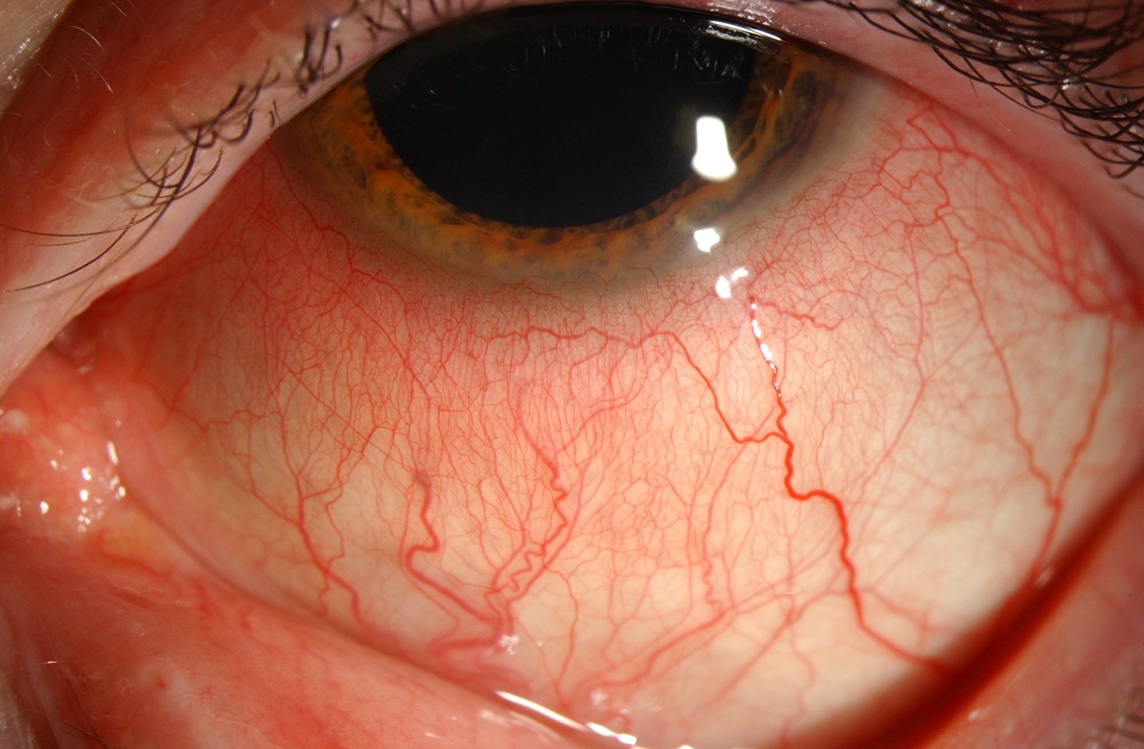
Acute anterior uveitis
Conjunctival and circumcorneal injection

Slide 10
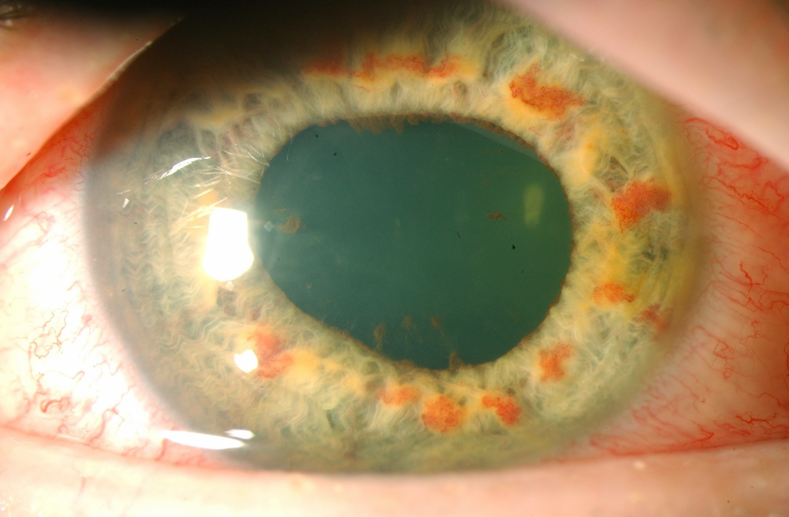
Acute anterior uveitis
Irregular pupil with posterior synechiae

Slide 11
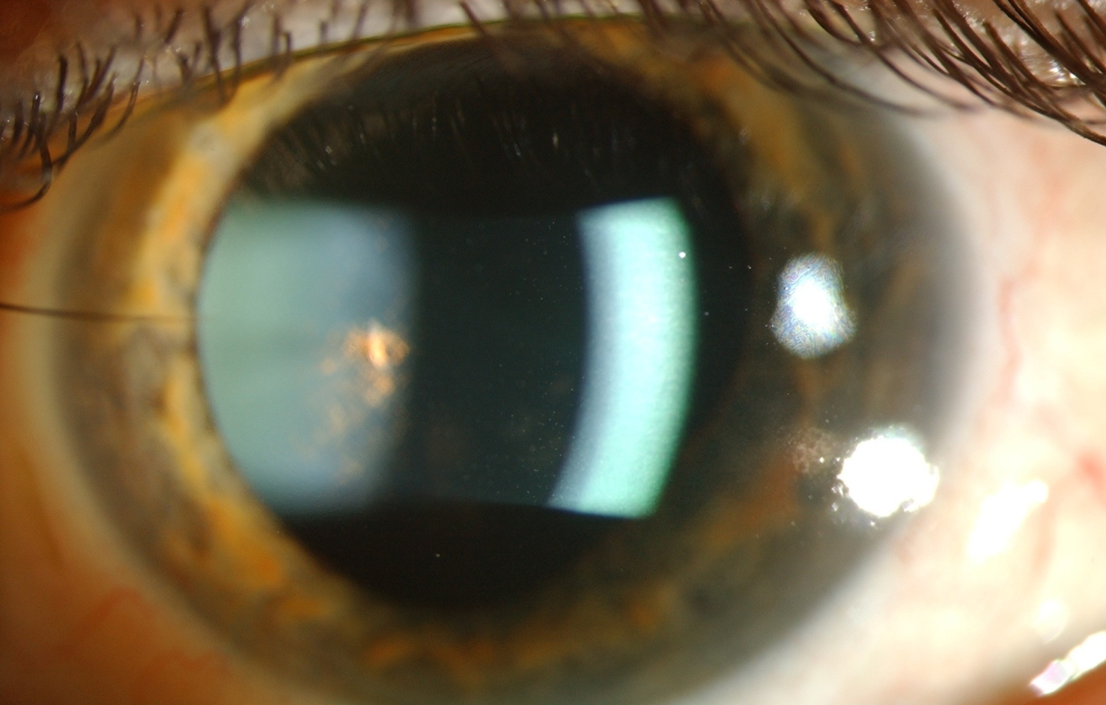
Acute anterior uveitis
Aqueous flare Inflammatory cells in the anterior chamber

Slide 12
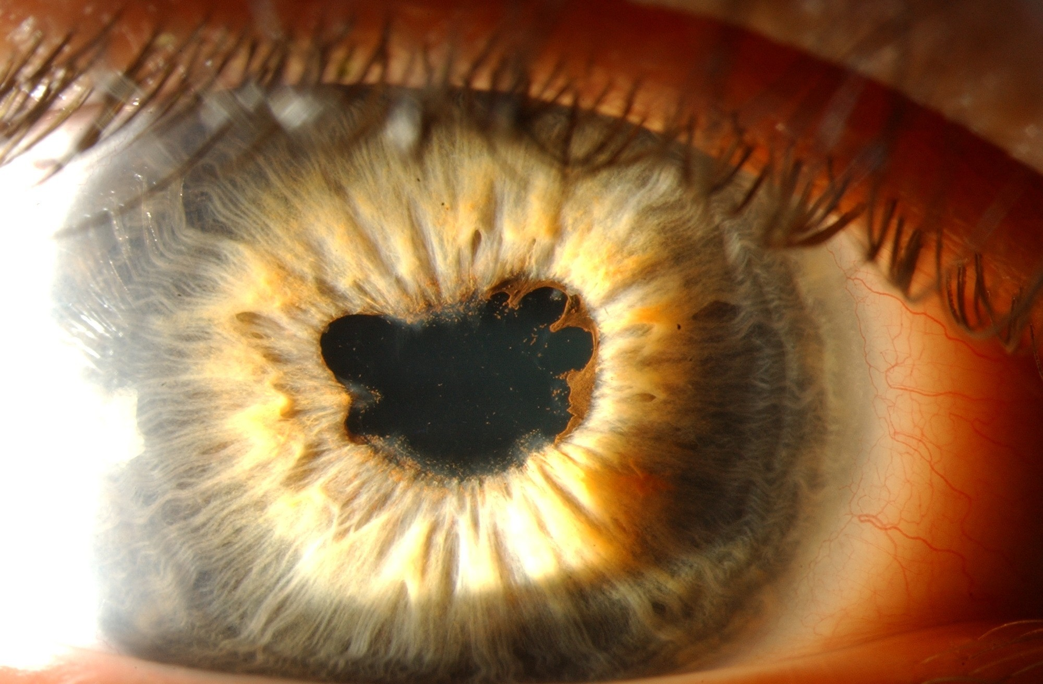
Acute anterior uveitis
Posterior synechiae

Slide 13
Intermediate uveitis
♣
Symptoms
♣
♣
♣
Floaters
Gradual blurring of vision painless
♣
Signs
♣
♣
♣
Inflammatory cells and opacities in the vitreous Cystoid macular oedema
Peripheral retinal vasculitis

Slide 14
Posterior and pan-uveitis
♣
Symptoms
♣
♣
♣
Acute or gradual blurring of vision Floaters
Sometimes pain
♣
Signs variable
♣
♣
♣
♣
♣
Choroiditis
Optic disc swelling Retinal vasculitis Vitritis
Anterior chamber inflammation in panuveitis

Slide 15
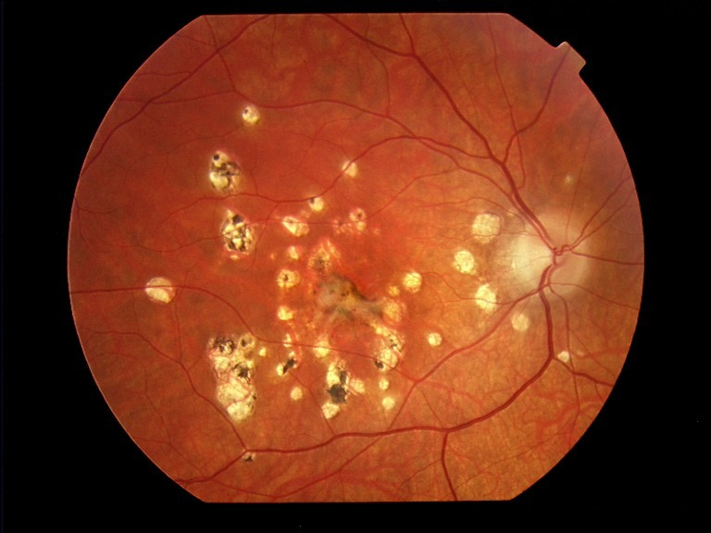
Posterior uveitis
Mulitifocal choroiditis

Slide 16
Assessing patients with uveitis
History and eye examination to classify according to anatomical diagnosis
Past medical history, review of systems, general medical examination to form differential diagnosis
Relevant investigations

Slide 17
Investigating uveitis
λ
Based on
λ
λ
Anatomical diagnosis Clinical characteristics
λ
λ
λ
λ
Patient age and demographics Onset of disease
Past medical history
Full review of systems considering known systemic disease associations
λ
Differential diagnosis following history and clinical examination
λ
Basic investigations performed on most patients
λ
λ
λ
FBC, ESR, CRP
Syphilis serology
Chest x-ray (to detect sarcoidosis)
λ
Others depend on differential diagnosis, e.g.
λ
λ
λ
λ
TB – mantoux, CXR
Sardoidosis – CXR, serum ACE, serum calcium Ankylosing spondylitis – sacoriliac joint x-ray, HLA B27
Wegeners granulomatosis – ANCA, CXR, CT of sinuses, renal investigations

Slide 18
Treatment of acute anterior uveitis
^{λ}Topical corticosteroids – intensive at first
^{λ}Dilating drops to prevent formation of posterior synechiae and relieve pain
^{λ}Cyclopentolate, atropine
^{λ}Antiglaucoma medications if necessary
^{λ}Subconjunctival steroid injection if fails to respond to drops

Slide 19
Treatment of posterior uveitis
^{λ}Corticosteroids
Periocular injections
Oral
Intraveous methylprednisolone in acute severe cases
^{λ}Systemic immunosuppression
Cyclosporin, tacrolimus, mycophenolote mofetil, azathioprine, methotrexate
Need close monitoring for side effects

Slide 20
Complications of uveitis
^{λ}Cataract
^{λ}Glaucoma
^{λ}Permanent visual loss
Optic neuropathy
Macular damage from chronic oedema
Retinal detachment

Slide 21
Ankylosing spondylitis
^{λ}More common in men
^{λ}Axial skeletal and sacroiliac joints affected
^{λ}Gradual flexion deformity due to bony fusion
^{λ}HLA B27 +
^{λ}Recurrent anterior uveitis

Slide 22
Fuch’s heterochromic cyclitis
Enigmatic disorder of unknown aetiology
Features
  Unilateral
  Painless chronic anterior uveitis
  Iris heterochromia
  No posterior synechiae
  Cataract formation
  Glaucoma
  Vitreous floaters
  Good prognosis

Slide 23
Sarcoid uveitis
Idiopathic multisystem disorder
Clinical features
  Lungs
    Hilar lymphadenopathy in 90%
    Parenchymal infiltrates, fibrosis
  Skin
λ
Granulomatous painful lesions (erythema nodosum)
Arthropathy
Hypercalcemia and elevated serum ace
Anterior, posterior or pan-uveitis

Slide 24
Toxoplasma chorioretinitis
^{λ} Caused by a protozoan called toxoplasma gondi
λ
Infection acquired by ingestion of undercooked meat or contact with cat faeces
Can be transmitted across placenta to fetus and cause congenital toxoplasmosis
Cat is primary host, humans and livestock are secondary hosts
Clinical features
λ
λ
Vitreous inflammation, focal chorioretinitis
^{λ} Treatment
λ
λ
λ
λ
Pyrimethamine plus sulfadiazine or Clindamycin
Oral corticosteroids Topical corticosteroids

Slide 25
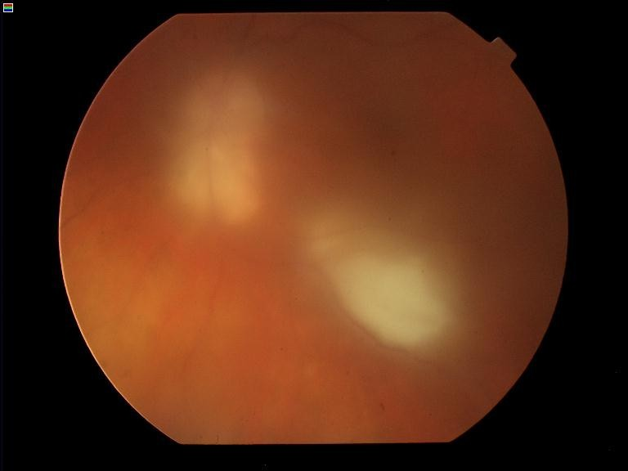
Toxoplasma chorioretinitis
Typical toxoplasma chorioretinitis Vitritis causes hazy fundal view

Slide 26
Behcet’s disease
Presumed autoimmune multisystem disease
Rare in Ireland
  Commonest along silk route from Mediterranean to Far East
Main clinical features
  Oral ulcers
  Genital ulcers
  Panuveitis and retinal vasculitis
  Acute anterior uveitis with hypopyon
  arthritis
Poor prognosis without aggressive immunosuppression

Slide 27
Sympathetic ophthalmia
Rare disorder in which penetrating ocular trauma leads granulomatous panuveitis in both eyes
Classic autoimmune disease
Can occur anytime after the initial injury
Managed with systemic steroids and immunousuppression

Slide 28
Uveitis in children
Toxocariasis
  caused by helminth toxocara canis
  acquired from contact with dog faeces
  Blinding panuveitis in children usually uniocular
Juvenile idiopathic arthritis associated uveitis
  Seronegative for rheumatoid arthritis but commonly ANA positive
  Deforming arthritis
  Asymptomatic until late in disease – screening important
  Poor prognosis in many
^{λ} Cataract, glaucoma, band keratopathy
Toxoplasmosis
Idiopathic intermediate uveitis

