Slide 1

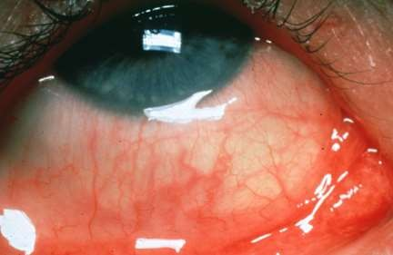
DR PUNIT SINGH

Slide 2
Allergic conjunctivitis:
Inflammation of conjunctiva due to allergic or hypersensitive reaction which may be immediate (humoral ) or delayed (cellular) to specific antigens

Slide 3
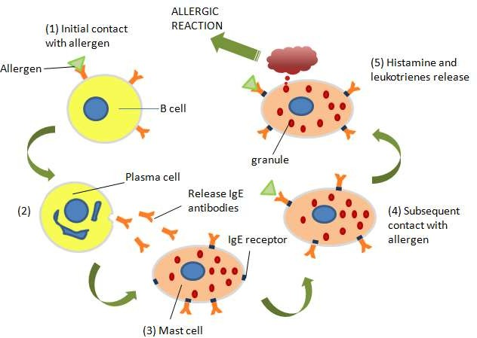
Allergic Reaction

Slide 4

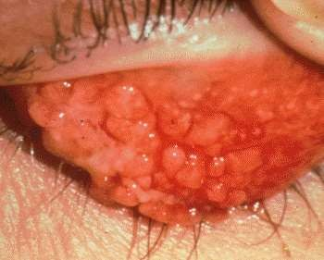
Allergic conjunctivitis:
Simple allergic conjunctivitis
-hay fever conjunctivitis
-seasonal allergic conjunctivitis (SAC)
-perennial allergic conjunctivitis(PAC)
Vernal keratoconjunctivitis (VKC)
Atopic keratoconjunctivitis (AKC)
Giant papillary conjunctivitis (GPC)
Phlyctenular keratoconjunctivitis (PKC)
Contact dermoconjunctivitis (CDC)

Slide 5

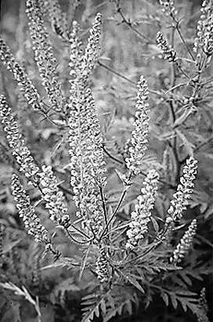
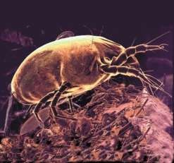
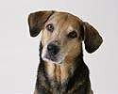

Mild ,non specific IgE mediated Type I hypersensitivity reaction
Etiology :
Hay fever conjunctivitis : associated with allergic rhinitis
Allergens : pollens , grass , animal dandruffs
SAC: common , d/t: grass pollens
PAC: not common , d/t: house dust and mites

Slide 6
Pathogenesis
Allergen enters tear film
Comes in contact with conjunctival mast cells that bear lgE antibodies.
Degranulation of mast cells releases histamine Histamine promotes vasodilatation & edema

Slide 7

Symptoms: - itching
-Redness
-burning sensation
- watery discharge and
-mild photophobia
Signs : -hyperemia and chemosis
-mild papillary reaction
-oedema of eyelids

Slide 8
Treatment (severity dependent)
  Elimination of allergens if possible
  cold compresses
  antihistamines oral/ topical (epinistine,fexofenadrine)
  mast cell stabilizers (sodium cromoglycate,lodaximide)
  Combination( ketotifen,patalon,azelastine)
  topical corticosteroids
  Immunosuppressant's (cyclosporin) for steroid resistant cases

Slide 9
Vernal keratoconjunctivitis or spring catarrh
Recurrent, Bilateral , self limiting allergic inflammation of the conjunctiva affecting children and young adults
more common in males
allergic disorder in which IgE and cell mediated immune mechanism play an important role

Slide 10
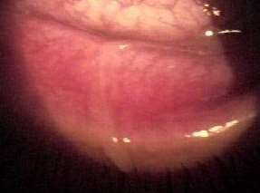
Clinical features :
– 98% bilateral, can be asymmetric
ropy discharge
Intense ocular itching, Lacrimation, Photophobia, blepharospasm, blurred vision, FB sensation , burning and difficulty opening eyes in the morning.
Thick mucous ropy discharge , Pseudoptosis due to large papillae.
Giant papillae on the superior Palpebral conjunctiva are the clinical hallmark.

Slide 11
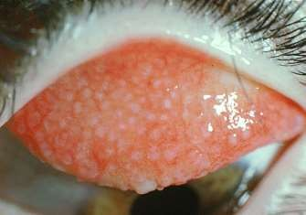
VKC Pathology:
Conjunctival epithelium : hyperplasia and downward projections into the
sub epithelial tissue
Adenoid layer : cellular infiltration by eosinophil's , plasma cells , lymphocytes and histiocytes .
Fibrous layer : proliferation which later undergoes hyaline changes
Conjunctival vessels: proliferation , increased permeability and vasodilation
ALL THESE LEADS TO MULTIPLE PAPILLAE
FORMATION IN UPPER TARSAL CONJUNCTIVA

Slide 12

palpebral
bulbar
mixed form

Slide 13
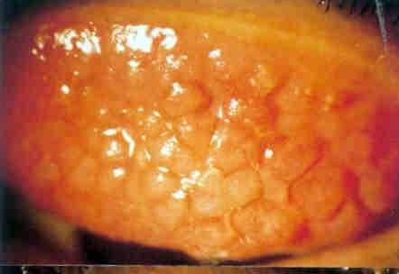
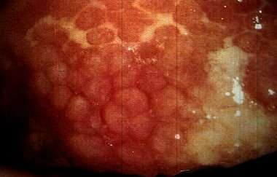
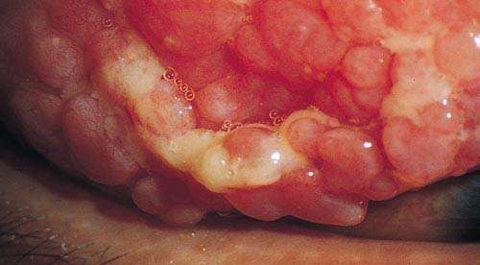
Palpebral form
Diffuse papillary hypertrophy, > on superior tarsus
Papillae have a flat- topped polygonal appearance resembling COBBLESTONES
Severe cases- Giant papillae, which may be coated with mucus

Slide 14
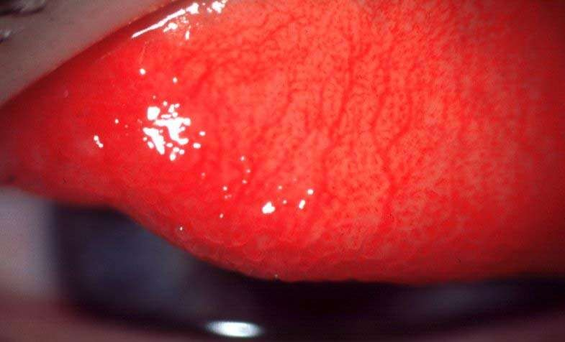
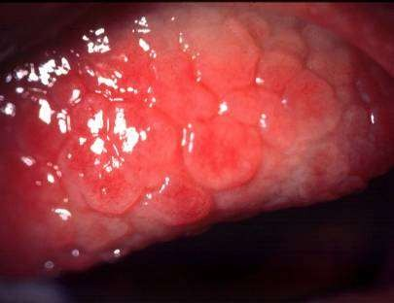
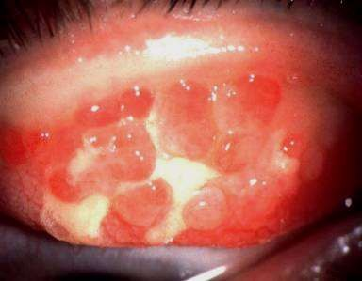
Progression of vernal conjunctivitis
Diffuse papillary hypertrophy, most marked on superior tarsus
 | lae
Formation of cobblestone papil |  | R | pture of septae - giant papillae
u

Slide 15
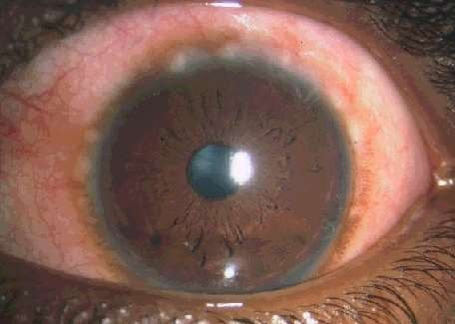
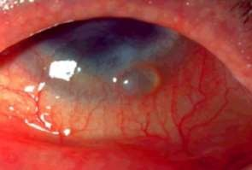
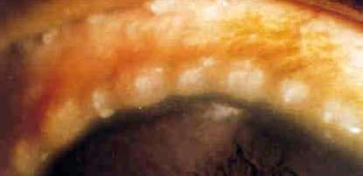
Limbal / Bulbar form
May start as a thickening & opacification of limbus
Limbal nodules - Mucoid nodules, which are gelatinous, elevated
Horner-Trantas dots – composed mainly of eosinophils and epithelial debris (limbal apices)

Slide 16
Limbal vernal
Mucoid nodule
Tranta's dots

Slide 17
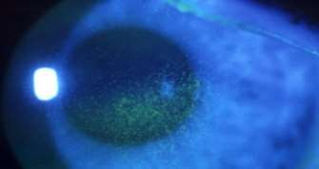
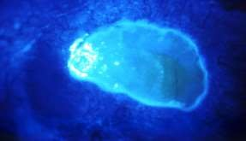
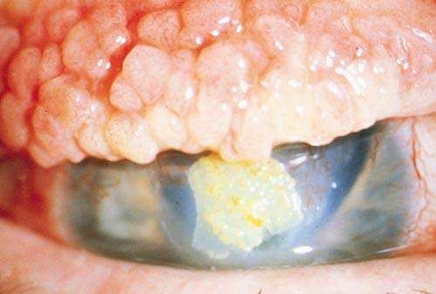
Vernal Keratopathy / Corneal involvement
Punctate epithelial erosions to macroerosions
Shield ulcers – Oval ulceration with thickened, opaque edges

Slide 18
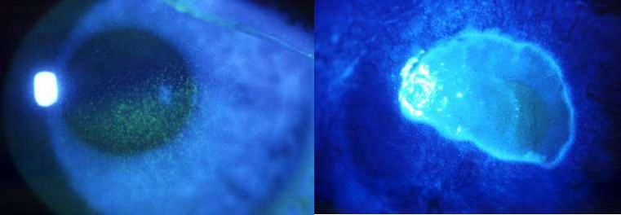
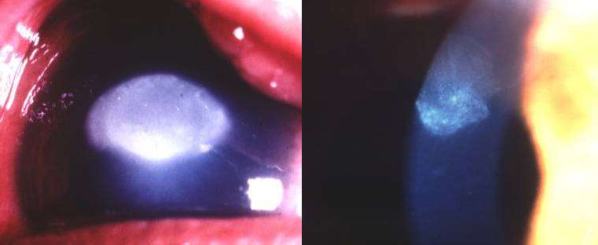
Progression of vernal Keratopathy
Punctate epithelopathy | Epithelial macroerosions
Plaque formation (shield ulcer) | Sub epithelial scarring

Slide 19
Treatment
Topical antihistamine
Mast cell stabilizers : sodium chromoglycate 2 % drops 4-5 times/day
Topical steroid : Every 4 hrs. for 2 days followed by 3-4 times a day for 2 weeks .
MONITOR IOP TO PREVENT STEROID INDUCED GLAUCOMA
Acetyl cysteine (0.5%)
Topical cyclosporine (1%): severe unresponsive case

Slide 20
Systemic :
Oral antihistamine : for itching
Oral steroid : short course for very severe non responsive case
Treatment of large papilla supratarsal injection of long acting steroid or surgical removal
General measures: dark goggles , cold compress , change of place from hot to cold

Slide 21
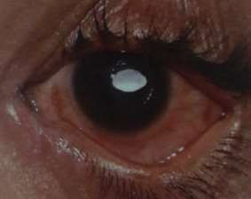
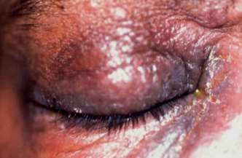
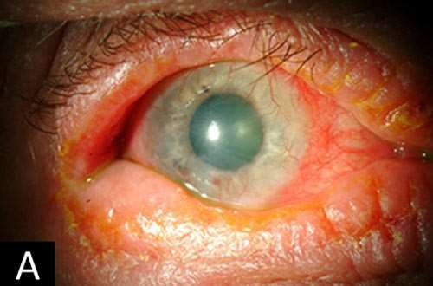
Atopic keratoconjunctivitis
AKC is rare bilateral that more common adult(30- 35Years)
Long history of eczema
May be associated with atopic dermatitis
Asthma is also common with AKC

Slide 22


Symptoms : itching , soreness , dry sensation , mucoid discharge, Hardening Eyelid, phtophobia or blurred vision
Signs :
lid margins: inflamed with round posterior borders
conjunctiva : inferiorly involve,watery discharge,milky appearance , very fine papilla , hyperaemia scarring with shrinkage
limbal: limbal involvement similar to limbal VKC
cornea-punctate epithelial keratitis in lower half, vascularization , plaque

Slide 23
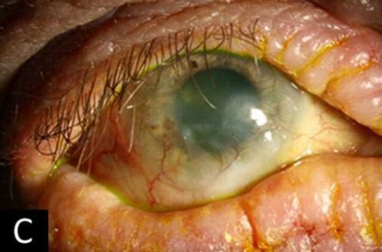
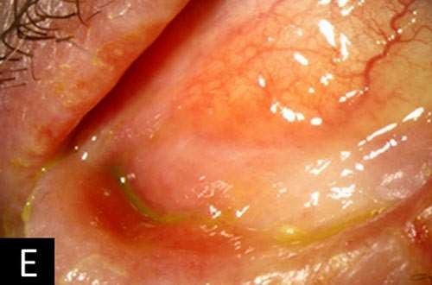
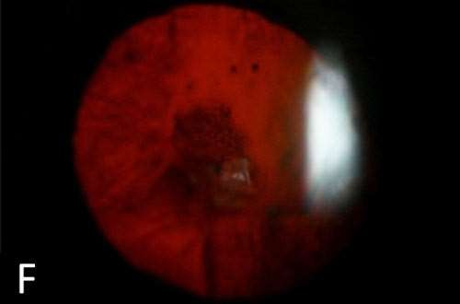
A :-periocular eczema and corneal haze
C:-progression of the disease; dense pannus entering visual axis E: symblepharon. F: posterior subcapsular cataract, which can be associated with atopic keratoconjunctivitis.

Slide 24
Treatment
Local:-
sodium chromoglycate
Antihistamine
Combination( antihistamine & mast cell strabilizer)
topical steroids ( fluromethalone 0.1%, loteprednol 0.2%)
Supratarsal steriod injection in severe others:-
treat facial eczema and lid margin disease
Immunosuppressive agents( cyclosporine,tacrolimus)

Slide 25
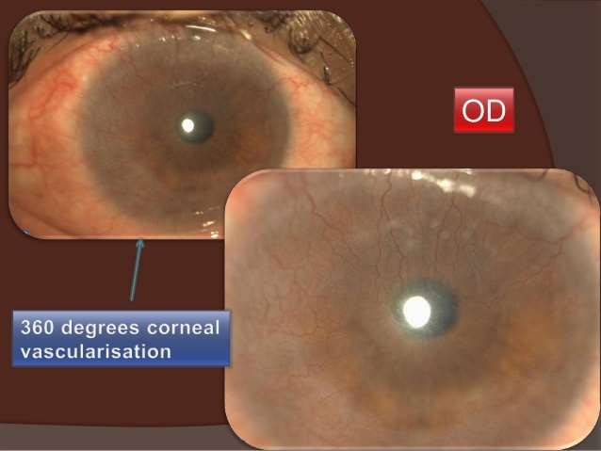
if untreated AKC can progress to ulceration, scarring, cataract, keratoconus, and corneal vascularization.

Slide 26
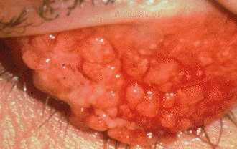
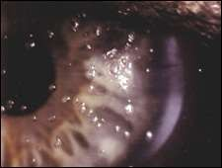
Giant papillary conjunctivitis
GPC most commonly develops after prolonged conjunctival contact with a foreign substance such as contact lens
Also reported with exposure to ocular sutures or prosthesis
Often it is not contact lens itself that causes GPC, but it is deposits or allergens
Soft contact lens cause GPC more commonly
which is caused by proteinaqueous deposits & cellular Debris on contact lens surface

Slide 27
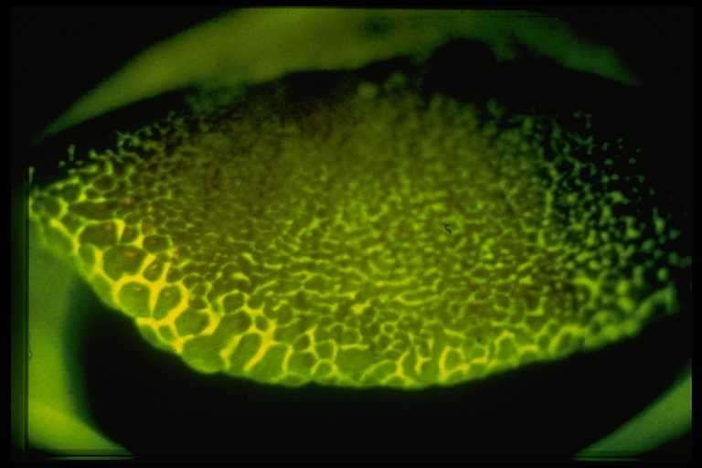
Papillary conjunctivitis-cobblestone-grade-2(flour)

Slide 28
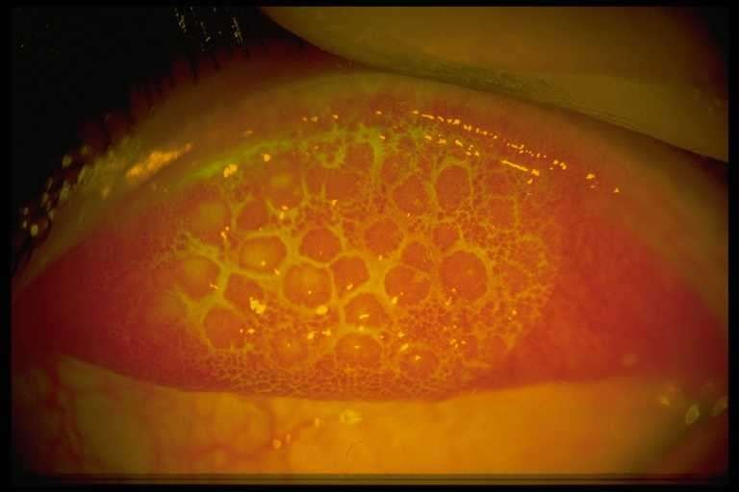
Papillary conjunctivitis-cobblestone-grade 3

Slide 29
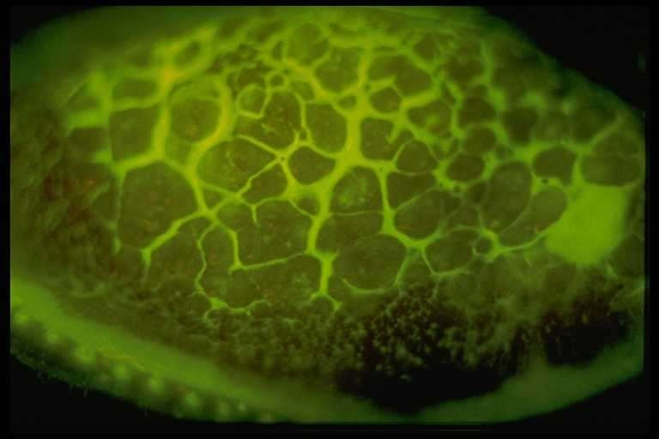
Papillary conjunctivitis-cobblestone-grade-4(flour)

Slide 30
SYMPTOMS AND SIGNS
  Thick mucous discharge, inflamed superior papillae and blurry vision, FB sensation, redness
  GPC staging
    Stage 1:itching and decreased lens tolerance
    Stage 2:blurred vision, superior tarsal papillae ( >0.3mm)
    Stage 3:excessive contact lens movement because tarsal papillae don’t allow smooth movement of lid over CL
    Stage 4:similar appearance to mild VKC
» Ref: illustrated ophthalmic pathologies-Dr. C. S. Miranda

Slide 31
Treatment :
Removal of cause
Discontinue contact lens wear & strong counseling
Antihistamin
Mast cell stabilizer
Disodium chromoglycate
Steroids can be use for Acute phase

Slide 32
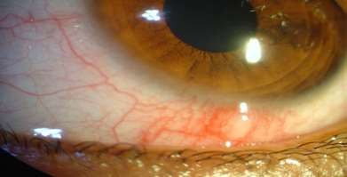
Phlyctenular conjunctivitis :
Nodular affection occurring as an allergic response by conjunctiva and corneal epithelium to some endogenous allergens .
Etiology -
– Delayed hypersensitivity ( type I ) response to endogenous microbial proteins : Tuberculous protein Staphylococcal protein , parasitic protein .

Slide 33
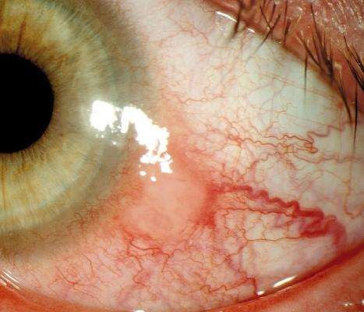
Pathology -
  Stage of nodule formation : exudation and infiltration of lymphocytes
  Stage of ulceration : Necrosis of apex of nodule leading to ulcer formation ,
  Stage of granulation
  Stage of healing .

Slide 34
Treatment -
  steroid eye drops ,
  Antibiotic drops ( secondary infection )
  specific therapy
    Tuberculosis
    septic focus should be treated
    parasitic infestation - stool examination .
  General measures - improve health of child .

Slide 35



Contact dermatoconjunctivitis is an allergic reaction in the conjunctiva and eyelid skin to medications (or other toxic products like cosmetics) applied there
Etiology: delayed type hyper sensitivity response to prolong contact with chemicals and ophthalmic medicines( atropine, neomycin, soframycin)

Slide 36
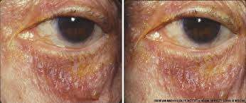
Clinical Features:
Cutaneous involvement: weeping eczema around the area involved with medication
Conjunctival response: lower fornix and lower palpebral conjunctiva

Slide 37
Treatment:
Discontinuing of causative chemical or medications
Antihistamine
NSAID
Topical steroid eye drops
Steroid ointment in involved surrounding area

Slide 38
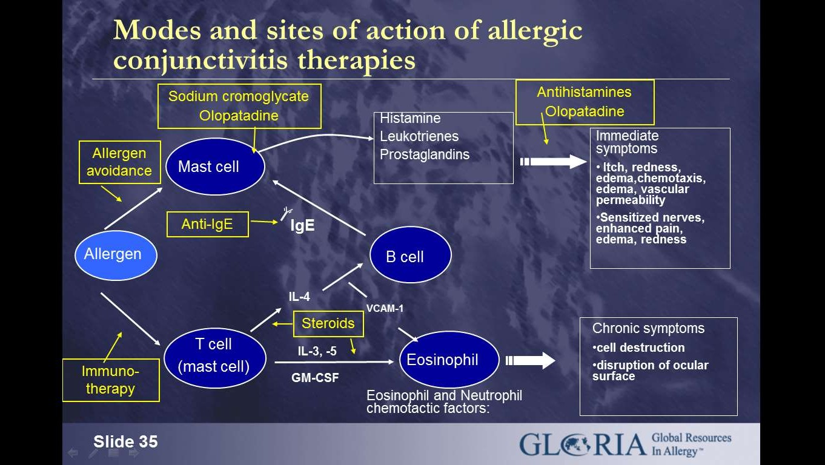
Effect of treatment :

Slide 39
REFERENCES
Comorehensive Ophthalmology-A.K.Khurana
Clinical ophthalmology-Jack.J.Kanski
Lippincott’s microbiology
Internet

Slide 40



