Slide 1
TRACTION
Dr Maitri

Slide 2
Objectives
At the end of the session students should be able to:
Enumerate indications
List out types of traction
Methods of applying traction
Difference between skin and skeletal traction

Slide 3
Traction
Traction/: “process of drawing or pulling”

Slide 4
Indications
1. Reduction of fractures and dislocations and their maintenance
2. For immobilising a painful, inflamed joint
3. For prevention of deformity by counteracting the muscle spasm associated with painful joint contracture
4. For the correction of soft tissue contractures by pulling them out

Slide 5
For effectiveness of any traction, a counter traction is necessary.
Depending upon what act as counter traction, a traction can be fixed or sliding traction

Slide 6
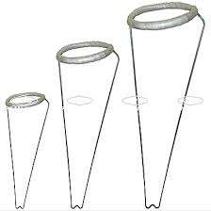
Types
Fixed traction: counter traction is provided by part of the body
E.g. Thomas splint fixed traction, the ring of the splint comes to lie against the ischial tuberosity and provide the counter traction

Slide 7
Sliding traction: the weight of the body act as a counter traction
E.g. traction given for a pelvic fracture, where the weight of the body act as counter traction; made effective by elevating the foot end of the bed

Slide 8
Method of applying traction
Skin traction:
An adhesive straps is applied on the skin and traction applied.
Traction force is transmitted from the skin through the deep fascia and intermuscular septae to the bone

Slide 9
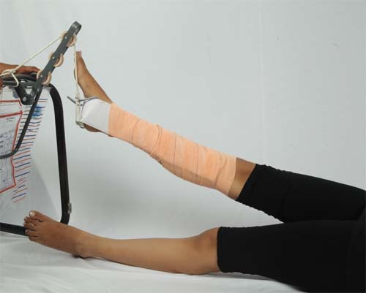
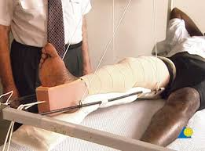

Slide 10
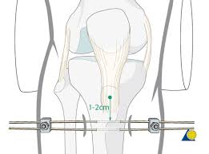
2. skeletal traction:
The traction is applied directly on the bone by inserting a K- wire or Steinmann pin through the bone

Slide 11
Comparison between skin and skeletal traction
point | Skin traction | Skeletal traction
Required for | Mild-moderate force | Moderate-severe force
Age | Children | Adults
Applied with | Adhesive plasters | Steinmann pin, K-wire
Applied on | On skin | Through bone
Common site | Below knee | Upper tibial pin traction
Weight permitted | Up to 3-4 kg | Up to 20 kg
Used for | Short duration | Long duration

Slide 12
Daily care of a patient in traction
Should be as comfortable as possible
Proper functioning of traction unit must be ensured.
Traction weight should not be touching the grounds
see the ropes are in the groves of the pulleys
the foot of the patient or end of the traction device should not be touching the pulley

Slide 13
3. Terminal part of the limb in traction is warm and of normal colour, sensations over toes and fingers should be normal, any numbness or tingling may point to a traction palsy of the nerve
4. Swelling over fingers and toes: tight bandage or slipped skin traction
5. A pin tract infection: detected by gentle tapping at the site of the pin insertion
6. X- rays in traction: proper position of the #

Slide 14
7. Physiotherapy of the limb in traction should be continued to minimize muscle wasting
8.General complications: bed sores, chest congestion, UTI, Constipation
9. Diversion therapy: suggesting the patient to do something he likes: reading, craft, games etc

Slide 15
Thank you

Slide 16
Evidence
P: patients with mechanical neck pain
I: Studies using mechanical traction techniques, whether combined with other therapies or not
C: conventional treatment
O: pain relief, disability/function, patient satisfaction, and global perceived effect.

Slide 17
Title | MECHANICAL TRACTION FOR MECHANICAL NECK DISORDERS: A SYSTEMATIC REVIEW
Author | Nadine Graham BA, BHScPT, Anita R. Gross, BScPT, MSc Charlie Goldsmith, PhD
Journal | J Rehabil Med 2006; 38: 145/152
Objectives | To assess whether mechanical traction, either alone or in combination with other treatments, improves pain, function/disability, patient satisfaction and global perceived effect in adults with mechanical neck disorders.

Slide 18
 | .
Results: | Of the 10 selected trials, one study was of high quality. Our review revealed low-quality trials for mechanical neck disorders, showing evidence of benefit favouring intermittent traction for pain reduction
Conclusion: | Inconclusive evidence for continuous and intermittent traction exists due to trial methodological quality. Two clinical conclusions may be drawn, one favoring the use of intermittent traction and the other not supporting the use of continuous traction.

