Slide 1
Drugs Acting on Neuromuscular Junnction
Muscle Relaxants
Dr.Akhilesh Chhaya,
Aso. Professor,
Dept. of Anaesthesia,
S.B.K.S.M.I.R.C.,
Piparia

Slide 2
Neuromuscular Junction
The neuromuscular junction connects the nervous system to the muscular system via synapses between efferent nerve fibers and muscle fibers.
The neuromuscular junction comprised of a motor neuron and a motor endplate with a synaptic cleft or junctional gap dividing them .

Slide 3
The Motor Neuron
Motor neuron Control skeletal muscle activity.
Originate in the ventral horn of the spinal cord
Axons are surrounded by a myelin sheath
Each motor neuron connects to several skeletal muscle fibers

Slide 4
As the motor neuron enters a muscle, the axon divides into telodendria, the ends of which, the terminal buttons, synapse with the motor endplate.
In the junctional gap, release of the neurotransmitter acetylcholine occurs with consequent binding to the receptors that is nicotinic acetylcholine receptors.

Slide 5
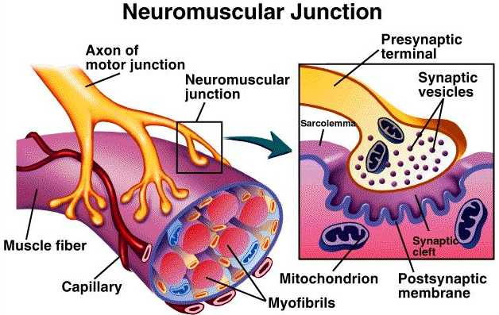

Slide 6
Nicotinic Acetylcholine Receptor
The nicotinic acetylcholine (ACh) receptor mediates neurotransmission postsynaptically at the neuromuscular junction.
The receptor is called nicotinic acetylcholine receptor because it is stimulated by both the neurotransmitter ACh and the alkaloid nicotine.

Slide 7
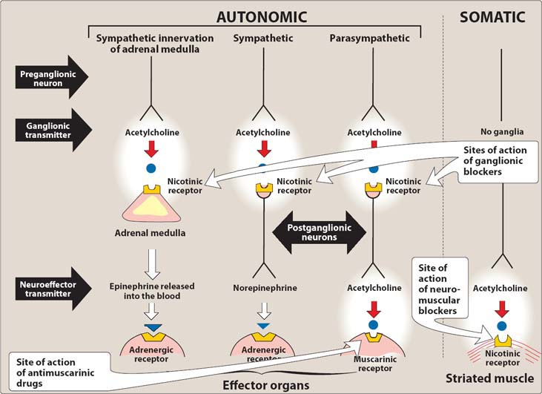

Slide 8
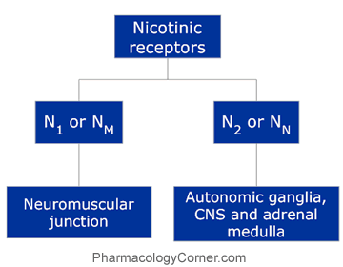

Slide 9
Transmission At the Neuromuscular Junction
Motor neuron depolarization causes action potential to travel down the nerve fiber to the neuromuscular junction
Depolarization of the axon terminal causes an influx of Ca²⁺ which triggers fusion of the synaptic vesicles and release of neurotransmitter (Acetylcholine; ACh)

Slide 10
ACh diffuses across the synaptic cleft and binds to post-synaptic ACh receptor (AChR) located on the muscle fiber at the motor end-plate.
Binding of ACh to the receptor opens the membrane channels causing an influx of Na and outflux of K leading to depolarization of the end plate membrane. This change in voltage is termed as the motor end plate potential.

Slide 11
Once threshold has been reached, a post synaptic action potential is generated and is propagated over the entire muscle cell membrane.
Unbound ACh in synaptic cleft defuses away or is hydrolyzed (inactivated) by acetylcholinesterase (AChE).

Slide 12
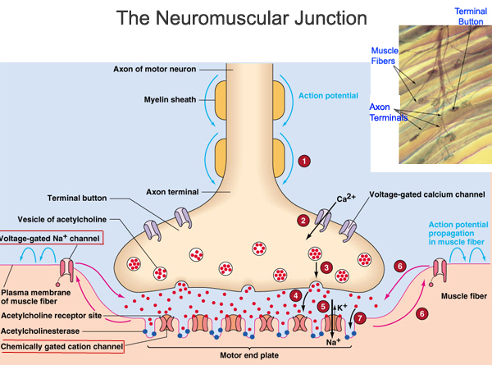

Slide 13
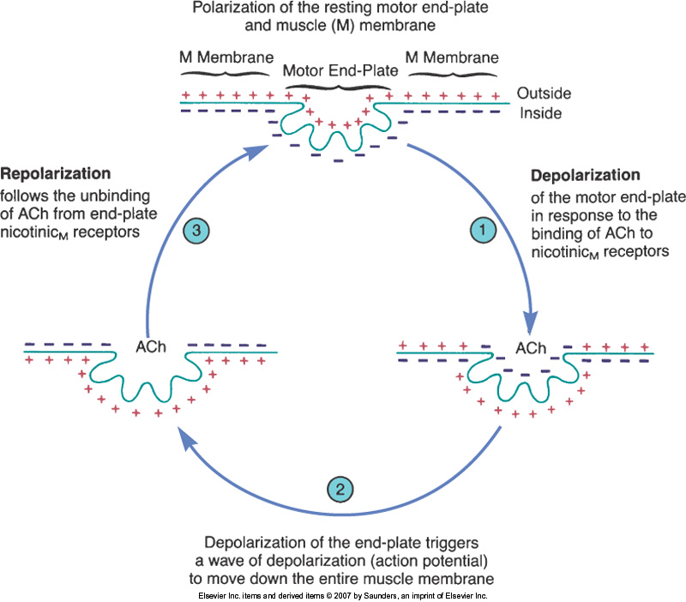
The depolarization-repolarization cycle of the motor end-plate and muscle membrane.

Slide 14
Neuromuscular Blockers
Drugs which relax skeletal muscles by acting at the neuromuscular junction.
Types:
Non Depolarizing
Depolarizing

Slide 15
Non Depolarizing Agents
They work by competitive blockade of the neuromuscular junction by limiting the access of acetylcholine to its NM receptor and prevent depolarization of the motor end plate.

Slide 16
Mechanism of Action

Slide 17
Because of the competitive nature of the postsynaptic blockade, transient relief of the block can be achieved by increasing ACh levels at the synaptic cleft (i.e. use cholinesterase inhibitors such as neostigmine).
Prototype of Non-depolarizing is Tubocurarine (new generation: pancuronium and gallamine). Others are Mivacurium, Atracurium, Rocuronium and Pipecuronium.

Slide 18
Therapeutic Use: Adjuvant drugs in surgical anesthesia.
Pharmacokinetics: Must be given by injection because they are poorly absorbed orally. Do not cross the BBB except Atracurium that cross BBB and may cause seizure.
Adverse Effects: Tubocurarine causes release of histamine from mast cells – decrease in blood pressure, bronchospasms, skin wheals.

Slide 19
Depolarising Agents
Depolarizers mimic the effect of acetylcholine at the neuromuscular junction, first causing muscle contractions (excessive depolarization of the motor end plate by causing excessive stimulation of the NM receptor) and then paralysing.
Succinylcholine, the only depolarizer in use, has the advantage of acting within 60 seconds.

Slide 20
Mechanism of Action
Phase I block:
Succinylcholine causes opening of the channels by :
Reacting with the nicotinic receptors (NM)
Opening the channel and increasing ionic conductance
This causes depolarization of the motor end plate which causes contraction. Because succinylcholine is not metabolized at the synapse, depolarization persists and the depolarized membranes remain unresponsive to subsequent impulses.

Slide 21
Phase II block (desensitization):
End-plate eventually repolarizes, but because succinycholine is not metabolized like ACh it continues to occupy the AChRs to “desensitize” the end-plate.
Because the mechanism of action of depolarizing drugs is similar to ACh, their blocking effects are augmented by AChE inhibitors.
Notes:
Phase II block (desensitization):
End-plate eventually repolarizes, but because succinycholine is not metabolized like ACh it continues to occupy the AChRs to “desensitize” the end-plate.
Because of the mechanism of action of depolazing drugs is similar to ACh, their blocking effects are augmented by AChE inhibitors.

Slide 22
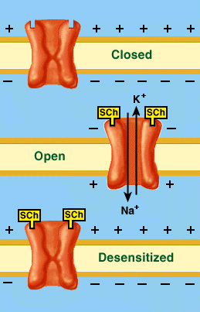

Slide 23
Therapeutic Use: Adjuvant drugs in surgical anesthesia
Pharmacokinetics: Duration of action is short because it is rapidly broken down by plasma cholinesterases (must be administered by continuous infusion)
Adverse Effects: When administered with halothane some genetically susceptible people experience malignant hyperthermia. Others include increased intraocular pressure, Increased Intragastric Pressure (causing emesis) and muscle pain.

Slide 24
Malignant Hyperthermia
Malignant hyperthermia (MH) is a life-threatening clinical syndrome of hypermetabolism involving the skeletal muscle.
It is triggered in susceptible individuals primarily by the volatile inhalational anesthetic agents (Halothane) and the muscle relaxant succinylcholine.
MH is not an allergy but an inherited disorder that is found both in humans and in swine.

Slide 25
Mechanism
In persons susceptible to MH, the ryanodine receptor in skeletal muscle is abnormal, and this abnormality interferes with regulation of calcium in the muscle. An abnormal ryanodine receptor that controls calcium release causes a buildup of calcium in skeletal muscle, resulting in a massive metabolic reaction.

Slide 26
This hypermetabolism causes increased:
carbon dioxide production
accelerated oxygen consumption
heat production
activation of the sympathetic nervous system
and multiorgan dysfunction and failure

Slide 27
Treatment
During an episode of malignant hyperthermia, wrapping the patient in a cooling blanket can help reduce fever and the risk of serious complications.
The current treatment of choice is the intravenous administration of Dantrolene, the only known antidote, and supportive therapy directed at correcting hyperthermia, and organ dysfunction.

Slide 28
Cholinesterase Inhibitors
They inhibit the Acetylcholinesterase enzyme from breaking down Ach, thereby increasing the level and duration of action of neurotransmitter Acetylcholine.

Slide 29
Examples: Neostigmine, edrophonium.
Mechanism of Action: Inhibit cholinesterase
Therapeutic Use:
Antidote for nondepolarizing blockers
Treatment of myasthenia gravis (neostigmine)
Diagnosis of myasthenia gravis (edrophonium)

Slide 30
Muscle Relaxants

Slide 31
Muscle Relaxants
Muscle relaxants are not really a class of drugs, but rather a group of different drugs that each has an overall sedative effect on the body. These drugs do not act directly on the muscles; rather they act centrally in the brain.
Typically, muscle relaxants are prescribed early in a course of back pain, on a short-term basis, to relieve back pain associated with muscle spasms.

Slide 32
Types of skeletal muscle relaxants
2 groups
Neuromuscular Blocker
Relax normal muscles
Interfere with transmission at the motor end plate
No central nervous system activity.
Used primarily as a part of general anesthesia.
Spasmolytics
Reduce spasticity
Centrally acting (except dantrolene which act on the skeletal muscle peripherally)
Used in a variety of neurologic conditions

Slide 33
Types
Centrally Acting Spasmolytics
Diazepam
Baclophen
Tizanidine
Gabapentin
Methocarbamol
Peripheral Acting Spasmolytics
Dantrolene
Botulinum Toxins

Slide 34
Diazepam
Centrally acting Benzodiazepine that facilitate GABA action on Spinal Cord and CNS.
Because of its sedative effect and physical dependence, abuse potential, and likelihood for multiple drug interactions, diazepam is usually not a first-line agent.

Slide 35
Baclofen
Baclofen is a gamma-amino butyric acid (GABA) derivative that acts as an agonist of the GABA receptor thereby activating potassium channels leading to hypotonia and muscle relaxation. Baclofen acts primarily at the level of the spinal cord, inhibiting synaptic reflexes.
Baclofen reduces the number and severity of muscle spasms and relieves pain, clonus and muscle rigidity due to spasticity.

Slide 36
Baclofen is indicated primarily for treatment of spasticity from spinal cord injuries and multiple sclerosis.
The most common side effects of baclofen are nausea, drowsiness, confusion, dizziness and fatigue.

Slide 37
Gabapentin
Gabapentin is basically an antiepileptic drug that shows spasmolytic effect by enhancing the inhibitory effect of GABA in SC.
Use in combination with other antispasticity agents. Combination of Gabapentin with Baclofen may produce better results than either drug alone.

Slide 38
Tizanidine
Alpha-2 adrenergic agonist
Drug binds selectively to alpha-2 receptor in the CNS and SC.
Stimulation of alpha-2 receptors inhibits firing of the interneurons that relay information to alpha motor neurons
Tizanidine decreases excitability by both pre and post synaptic inhibition

Slide 39
Methocarbamol
Methocarbamol is a centrally acting muscle relaxant. Its exact mechanism of action is unknown.
In dogs, cats, and horses, methocarbamol is indicated as adjunct therapy of acute inflammatory and traumatic conditions of skeletal muscle and to reduce muscle spasms.

Slide 40
Dantrolene
Mechanism of action:
Dantrolene inhibits muscle contractions by decreasing the release of calcium from the sarcoplasmic reticulum in target tissue.
Dantrolene is used for the treatment of chronic spasticity and treatment for and prophylaxis against malignant hyperthermia (based upon its ability to block calcium release, which is the initiating event in malignant hyperthermia).

Slide 41
Indications:
Muscle spasticity
Malignant hyperthermia:
Following administration of one of the triggering agents (general anesthetics or succinylcholine) there is a sudden and prolonged release of calcium, with massive muscle contraction, lactic acid production, and increased body temperature.
Common side effects include weakness, nausea, drowsiness, fatigue and dizziness.

Slide 42
Botulinum Toxins
Injection of Botulinum toxin used to control localized hyperexcitability of muscle.
Toxin enters presynaptic terminal at skeletal neuromuscular junction and binds strongly to presynaptic acetylcholine vesicles
Once bound by toxin, Vesicles are unable to release acetylcholine from the synaptic cleft
Decrease muscle excitation by disrupting synaptic transmission at neuromuscular junction

Slide 43
Indications:
Upper motor neuron syndrome
Migraine
Cosmetics
Cervical dystonia

Slide 44
References
Lipincot Pharmacology, 5th Edition
The Goodman Gillman Pharmacology, 11th Edition
www.ncbi.nlm.nih.gov › ... › Indian J Dermatol › v.55(1); Jan-Mar 2010.
J R Soc Med. Jul 2002; 95(7): 363–367.
ceaccp.oxfordjournals.org

Slide 45
Author | Title | Journal details | Absract | Level of evidence | Conclusion
Visoiu M et al | Anesthetic drugs and onset of malignant hyperthermia | Anesth Analg. 2014 Feb;118(2):388-96. doi: 10.1213/ANE.0000000000000062. | The time between the beginning of anesthetic administration and recognition of the first sign of malignant hyperthermia (MH) (MH onset time) could differ among anesthetic drugs. | 1B | The onset of MH has been observed later during desflurane and isoflurane anesthesia than during exposure to sevoflurane. Since 1998, MH signs have more often appeared later, in the second or third hour of anesthesia, than they did before 1998.

Slide 46
Q1. Malignant hyperthermia is associated with?
1 propofol
2 thiopentone
3 atracurium
4 succinylcholine
Q2. Drug used to reverse the effect of non-depolarizing agent?
1 propofol
2 thiopentone
3 neostigmine
4 succinylcholine
Q3. Which of the following is not neuromuscular blocking agent?
1 atracurium
2 vecarunium
3 succinylcholine
4 acetylcholine
Q4. Which of the following is depolarizing blocking agent?
1 atracurium
2 vecarunium
3 succinylcholine
4 acetylcholine
Q5. Which of the following is non-depolarizing agent?
1 propofol
2 thiopentone
3 atracurium
4 succinylcholine

