Slide 1
Peripheral Joint Mobilization
Conducted by
Dr. Noel (PT)

Slide 2
OBJECTIVES
At the end of the session the student would be able to
Define about Peripheral Joint Mobilzation
Enumerate Limitations of Range of Motion
List down different joint shapes
Explain about different types of Motion
Describe about Indications, Contraindications Limitations and Precautions of Peripheral Joint Mobilization.
List down grades of Mobilization

Slide 3
Contents
Introduction
Limitations of Motions
Joint Shapes
Types of Motion
Indication
Limitations
Contra indication
Precautions
Grades or Dosages

Slide 4
Introduction
Also known as manipulation.
Manual therapy techniques that are used to modulate pain and treat joint impairments that limit range of motion (ROM) by specifically addressing the altered mechanics of the joint.

Slide 5
Limitation of Range of Joint Motion
Does any one knows about them?

Slide 6
Limitation of Range of Joint Motion
The altered joint mechanics may be due to :
Pain and muscle guarding,
Joint effusion,
Contractures or adhesions in the joint capsules or supporting ligaments,
Tightness of skin, superficial fascia or scar tissue,
Muscular weakness or inefficiency,
Displacement or tearing of an intra capsular fibro cartilage or presence of foreign body in joint,
Cartilaginous or bony destruction,
Unknown/ Idiopathic cause of Joint Limitation

Slide 7
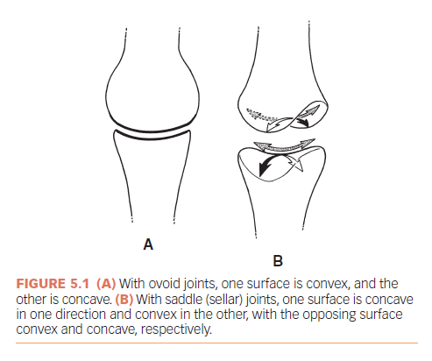
Joint shapes Contd.

Slide 8
Joint shapes
The type of motion occurring between bony partners in a joint is influenced by the shape of the joint surfaces. The shape may be described as ovoid or sellar.
In ovoid joints one surface is convex, and the other is concave.
In sellar (saddle) joints, one surface is concave in one direction and convex in the other, with the opposing surface convex and concave, respectively—similar to a horseback rider being in complementary opposition to the shape of a saddle.

Slide 9
Types of Motion
The movement of the bony lever is called swing and is classically described as flexion, extension, abduction, adduction, and rotation.
The amount of movement can be measured in degrees with a Goniometer and is called ROM.
Motion of the bone surfaces in the joint is a variable combination of rolling and sliding, or spinning.
These accessory motions allow greater angulation of the bone as it swings.
For the rolling, sliding, or spinning to occur, there must be adequate capsule laxity or joint play.

Slide 10
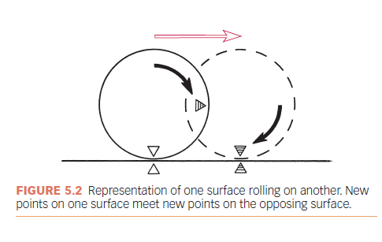
Roll

Slide 11
Roll
Characteristics :
The surfaces are incongruent.
New points on one surface meet new points on the opposing surface.
Rolling results in angular motion of the bone (swing).
Rolling is always in the same direction as the swinging bone motion whether the surface is convex or concave.

Slide 12
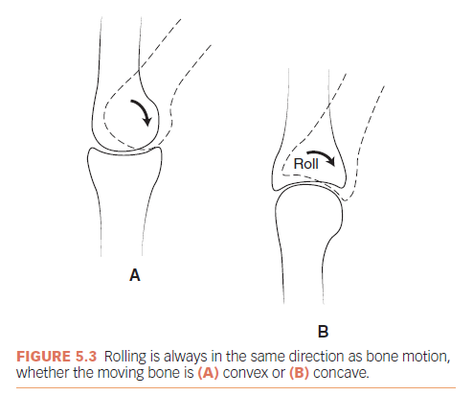
Roll contd.

Slide 13
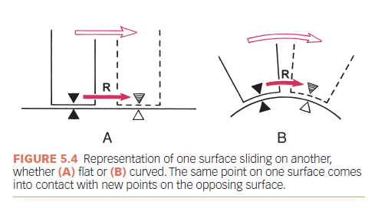
Sliding

Slide 14
For a pure slide, the surfaces must be congruent, either flat (Fig. 5.4 A) or curved (Fig. 5.4 B).
The same point on one surface comes into contact with the new points on the opposing surface.
Pure sliding does not occur in joints, because the surfaces are not completely congruent.

Slide 15
Concave Convex Rule
The direction in which sliding occurs depends on whether the moving surface is concave or convex.
Sliding is in the opposite direction of the angular movement of the bone if the moving joint surface is convex (Fig. 5.5 A).
Sliding is in the same direction as the angular movement of the bone if the moving surface is concave

Slide 16
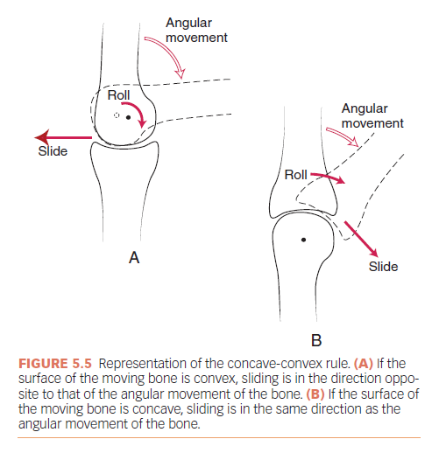
Concave Convex Rule

Slide 17
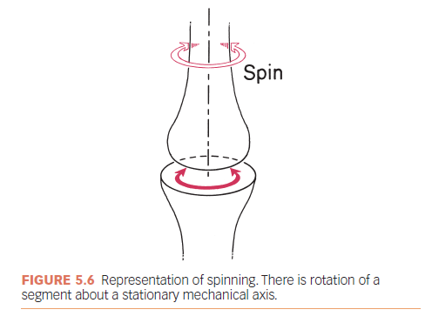
Spin

Slide 18
Spin
There is rotation of a segment about a stationary mechanical axis (Fig. 5.6).
The same point on the moving surface creates an arc of a circle as the bone spins.
Spinning rarely occurs alone in joints but in combination with rolling and sliding.
Three examples of spin occurring in joints of the body are the shoulder with flexion/extension, the hip with flexion/extension, and the radiohumeral joint with pronation/supination (Fig. 5.7).

Slide 19
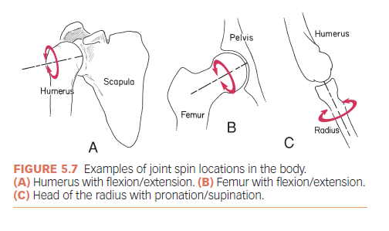
Joint spin in the Body

Slide 20
Other Accessory Motions
Compression is the decrease in the joint space between bony partners.
Compression normally occurs in the extremity and spinal joints when weight bearing.
Some compression occurs as muscles contract, which provides stability to the joints.
As one bone rolls on the other (see Fig. 5.3), some compression also occurs on the side to which the bone is angulating.
Normal intermittent compressive loads help move synovial fluid and, thus, help maintain cartilage health.
Abnormally high compression loads may lead to articular cartilage changes and deterioration.

Slide 21
Other Accessory Motions Contd.
Traction/Distraction
Whenever there is pulling on the long axis of a bone, the term long-axis traction is used.
Whenever the surfaces are to be separated, the term distraction, joint traction, or joint separation is used.

Slide 22
Indication
Pain, Muscle Guarding, and Spasm
Reversible Joint Hypomobility
Positional Faults/Subluxations
Progressive Limitation
Functional Immobility

Slide 23
Limitation
It cannot change the disease process of disorders such as rheumatoid arthritis or the inflammatory process of injury.
skill of the therapist affects the outcome.
If the maneuvers are applied too vigorously for the condition, joint trauma or hypermobility may result.

Slide 24
Contra indication
The only true contraindications to mobilization/manipulation stretching techniques are hypermobility, joint effusion, and inflammation.

Slide 25
Precaution
Mobilization may be used with extreme care in the following conditions if the signs and the patient’s response are favorable.
Malignancy.
Bone disease detectable on radiographs.
Unhealed fracture.
Excessive pain.
Hypermobility in associated joints.
Total joint replacements
Newly formed or weakened connective tissue such as immediately after injury, surgery, or disuse or when the patient is taking certain medications such as corticosteroids.

Slide 26
Systemic connective tissue diseases such as rheumatoid arthritis, in which the disease weakens the connective tissue.
Elderly individuals with weakened connective tissue and diminished circulation.

Slide 27
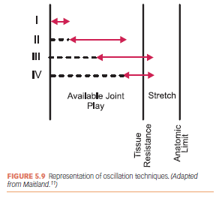
Grades or Dosages of Movement for
Non-Thrust Oscillation Techniques

Slide 28
Grade I. Small-amplitude rhythmic oscillations are performed at the beginning of the range. They are usually rapid oscillations, like manual vibrations.
Grade II. Large-amplitude rhythmic oscillations are performed within the range, not reaching the limit. They are usually performed at 2 or 3 per second for 1 to 2 minutes.
Grade III. Large-amplitude rhythmic oscillations are performed up to the limit of the available motion and are stressed into the tissue resistance. They are usually performed at 2 or 3 per second for 1 to 2 minutes.
Grade IV. Small-amplitude rhythmic oscillations are performed at the limit of the available motion and stressed into the anatomic limit.

Slide 29
Comparision of Manual Therapy Techniques with Therapeutic Exercise in the treatment of Shoulder Impingement: A RCT
Author & Year of Publication | PICO | Methodology | Results | Conclusion | Level of Evidence
Kachingwe et al. 2008 | P- Shoulder Impingement I- Manual therapy Techni C-Therapeutic Ex O-ROM | 38 Subjects were included who were diagnosed with primary shoulder impingement were randomly assigned to one of these four groups, 1) supervised exercise only, 2) supervised exercise with glenohumeral mobilizations, 3) supervised exercise with a mobilization-with-movement (MWM) technique, or 4) a control group receiving only physician advice. Outcome Measures: (VAS), pain with the Neer and Hawkins-Kennedy tests, shoulder (AROM), and shoulder function (SPADI) | The 3 interverntion group had higher degree of improvement | Performing GH Mobilization with MWM in combination with a Supervised exercise program result in better ROM | 2b

Slide 30
Questions
Q 1. Peripheral Joint Mobilization is which type of technique?
Active
Passive
Resisted
None of the Above
Q 2. Which is not a reason for Limitation of Range of Joint Motion?
Pain
Tightness of Skin
Contracture and Adhesions
Ligament Laxity

Slide 31
Q 3. Which one is not the Indications of Peripheral Joint Mobilization?
Pain
Reversible Joint Hypomobility
Functional Immobility
Joint Effussion
Q 4. Which statement is True for Sliding?
The surfaces are incongruent.
Same point on one surface meet new points on the opposing surface.
Sliding results in angular motion of the bone (swing).
Sliding is always in the same direction as the swinging bone motion whether the surface is convex or concave.

Slide 32
Q 5. Concave Convex rule is applicable in ?
Ovoid Joint
Sellar or Saddle Joint
Both A and B
None of the Above

