Slide 1
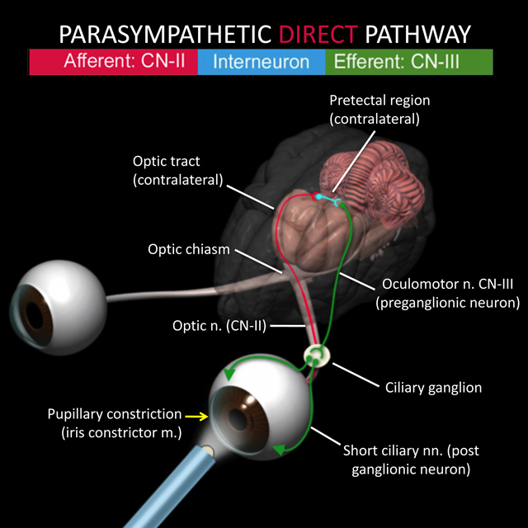
:~Pupillary reflexes &pathways
By:- Dr Amisha Jain

Slide 2
BIBLIOGRAPHY
Neuro ophthalmology by Bajandas 5th edition.
Kanski’s clinical ophthalmology 8th edition.
Wolff’s anatomy of the eye and orbit 8th edition.
Oxford Handbook of Ophthalmology 3rd edition.
Manual of Ocular Diagnosis and Therapy sixth edition by Deborah pavan-Langston
INTERNET SOURCES.

Slide 3
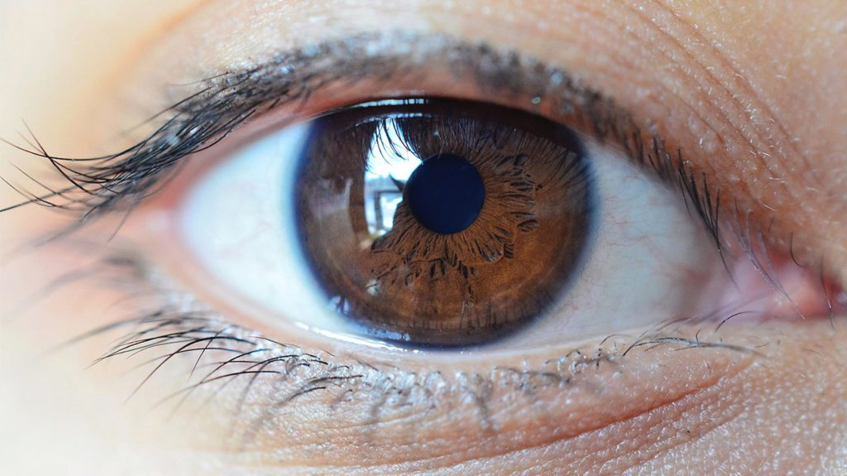
What is pupil ?
Pupil Is an aperture present in centre of the iris.
Light enters the eye through the pupil, and the iris regulates the amount of light by controlling the size of the pupil.

Slide 4
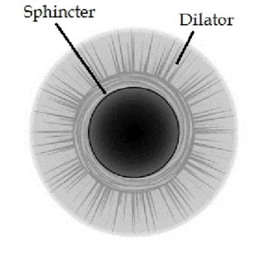
Pupil is formed by the muscles and pigmented stroma of anterior uveal tract.
Two groups of smooth muscles- a circular group called the sphincter pupillae found in the margin of iris and a radial group, which runs from the iris margins to the root of iris called the dilator pupillae
These muscles control the size of the pupil.

Slide 5
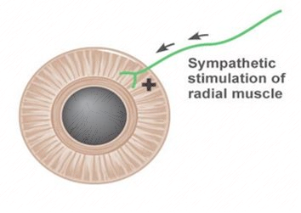
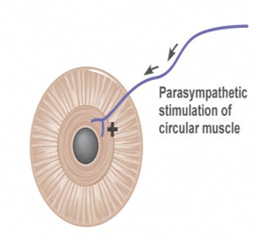
Dilator puppilae (radial muscles) are innervated by sympathetic Nerveous system.
Sphincter puppilae (circular muscles) are innervated by Parasympathetic Nerveous system.

Slide 6
Size of pupil*
Normal pupil size varies from 3 to 4 mm depending upon illumination
Miotic pupils are less then 2 mm.
Mydriatic pupils are greater then 7 mm.
Pupil size also varies with age
Relatively small at birth
Largest at adolescence,
slowly becomes smaller with increasing age

Slide 7
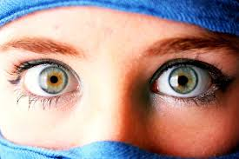
Isocoria: This is the term that defines equal size of both pupils.
Difference in size of pupil of both eye of same individual if more than 0.3 mm then it is known as Anisocoria.
.

Slide 8
Slight Anisocoria (1/10th of mm) is present in significant percentage of normal pupil
Physiological changes in size ~ Pupil tends to dilate during emotional stress and constrict during sleep.

Slide 9
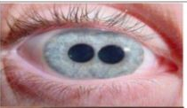
Normally there is one pupil.
If there more than one termed as polycoria.

Slide 10
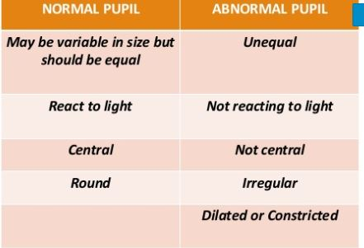

Slide 11
NORMAL PUPILLARY RELXES
~ Light reflex
~ Near reflex
~ Darkness reflex
~ psychosenosry reflex

Slide 12
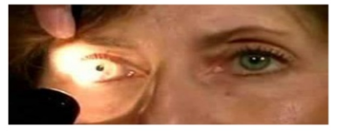
THE LIGHT REFLEX
When light is shown in 1 eye, both pupils constrict-
Direct light reflex – constriction of the ipsilateral pupil when the ipsilateral eye is stimulated by light.

Slide 13
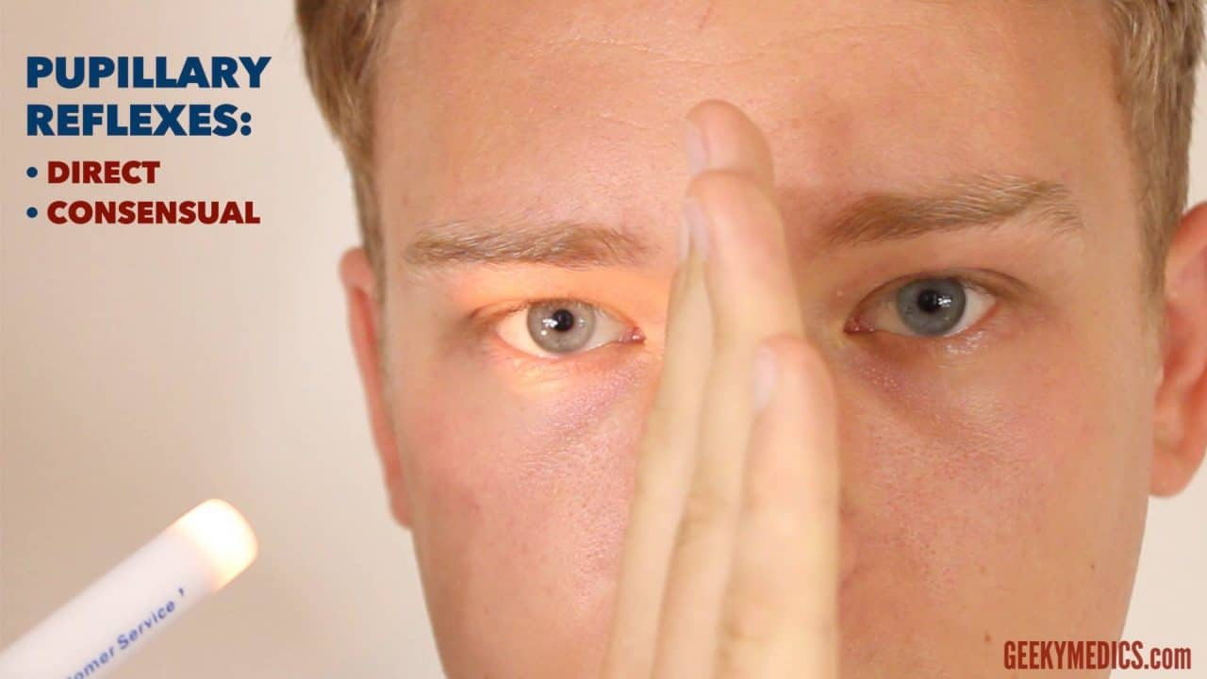
consensual (indirect) light reflex – constriction of the contralateral pupil when the ipsilateral eye is stimulated by light.

Slide 14
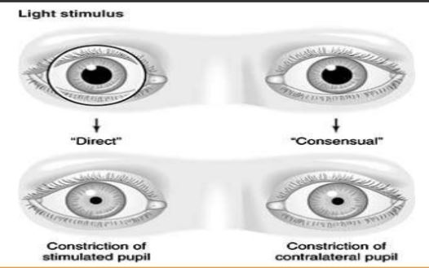

Slide 15
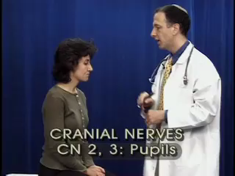

Slide 16
Normally , the direct and consensual reactions are almost always identical in time , course and magnitude.
If both the pupils are illuminated simultaneously , the response summates, i .e . The constriction of each pupil is greater than the the constriction noted when only one pupil is illuminated.

Slide 17
The pupil light reflex consists of three major divisions of neurons that integrate the light stimulus to produce a pupil contraction-
1. Afferent division.
2. An interneuron division.
3. Efferent division.

Slide 19
The Afferent pupillary pathway is made up of-
Retina
Optic nerve
Optic chiasm
Optic tract
Pretectal nucleus
Edinger-Westphal nucleus

Slide 20
The Efferent pupillary pathway is made up of-
Edinger - westphal Nucleus(accessory lll CN Nucleus)
III cranial nerve
Ciliary ganglion leading to the short ciliary nerves
Iris sphincter muscle

Slide 21
Light enters the pupil and stimulates the retina.
The Afferent neurons carry sensory signals to the brain.

Slide 22
Pupillary light reflex begins in the retina with the photoreceptor cells(Rods and Cones) ,to the Bipolar cells and to the Retinal Ganglion cells.
Retinal ganglion cells transmit the light signal to the optic nerve.

Slide 23
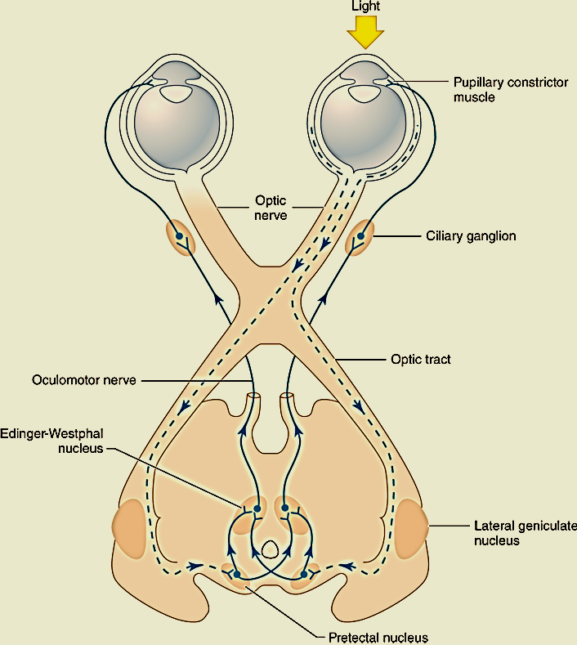
The fibres from the nasal retina decussate and travel along the opposite optic tract to terminate in the contralateral pretectal nucleus.

Slide 24
While the fibres from the temporal retina remain uncrossed and travel along the optic tract of the same side to terminate in the ipsilateral pretectal nucleus.

Slide 25
Few points about the decussation of nasal retinal fibres:
Fibres from each eye decussate at the chiasm with 53% of the fibres crossing and 47% remaining ipsilateral.
Inferior peripheral nasal fibres cross in the infero- anterior part of the chiasm and arch into the medial aspect of the opposite optic nerve for a short distance. This loop is called the anterior knee of von Willebrand.

Slide 26
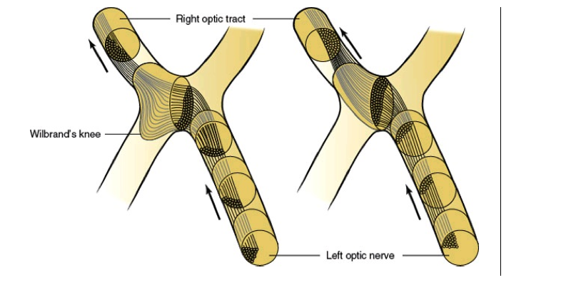
Superior peripheral nasal fibres cross to the opposite optic tract in the superoposterior part of the chiasm,
but arch first for a short distance into the optic tract of the same side. This loop is called the posterior knee of von Willebrand.

Slide 27
As Pupillary fibres are crossed in the chiasma damage to one optic tract will abolish neither the direct nor the consensual light reflex.
Damage to the Optic Nerve abolishes both, the direct as well as consensual light reflex

Slide 28
INTERNUNCIAL
(INTERNUCLEAR) FIBRES
They connect each pretectal nucleus with Edinger-westphal nuclei of both sides.
Half of the postsynaptic fibres from the pretectal area curve around the periaqueductal grey matter to terminate in the Edinger-Westphal nucleus of the same side.

Slide 29
The other half cross via the posterior commissure to the Edinger-Westphal nucleus of the opposite side.
This connection forms the basis of consensual light reflex.

Slide 30
THE EFFERENT PUPILLARY PATHWAY
Once the brain receives the afferent (sensory) signal and interprets it, it sends out an efferent (motor) message to adjust the pupil’s size.

Slide 31
The Efferent pupillary pathway is made up of-
Edinger - westphal Nucleus(accessory lll CN Nucleus)
III cranial nerve
Ciliary ganglion leading to the short ciliary nerves
Iris sphincter muscle

Slide 32
The sphincter pupillae is supplied by cholinergic nerves of the parasympathetic system through the third cranial nerve.

Slide 33
The fibres start in the Edinger Westphal nucleus near the third nerve nucleus in the floor of the aqueduct of sylvius.
This nucleus has connections with the dilator centre as well as with the frontal and occipital cortex.
The fibres emerge from it and pass out of the mid brain to run in the main trunk of the third nerve as far as the orbit.

Slide 34
Here the fibres pass into the branch which supplies the inferior oblique muscle, leaving it by the short root of the ciliary ganglion.
ciliary ganglion the fibres pass by the short ciliary nerves to the eye, piercing the sclera around the optic nerve accompanied by the short posterior ciliary arteries.
then pass forward in the choroid and ciliary body to the iris.

Slide 35
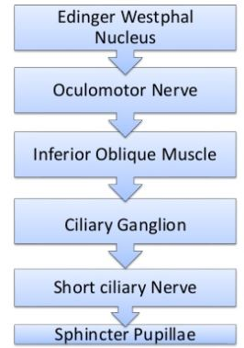
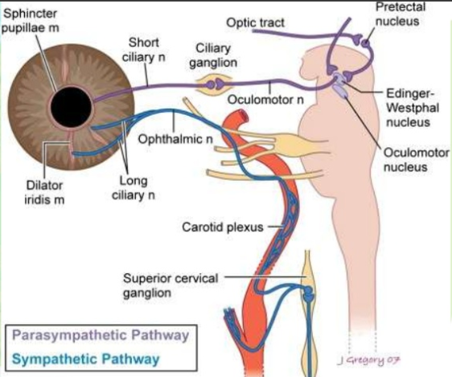

Slide 36
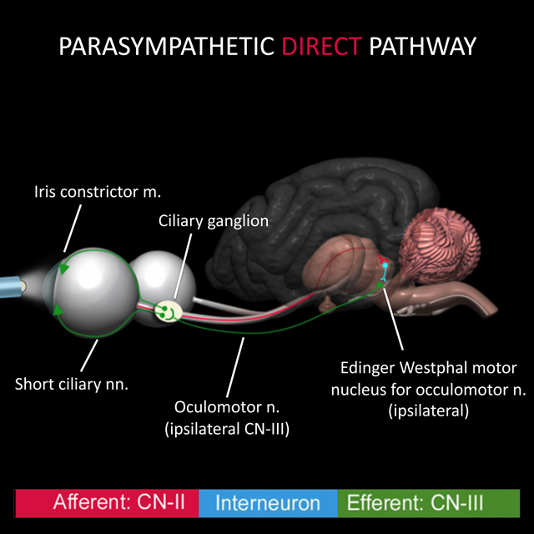


Slide 37
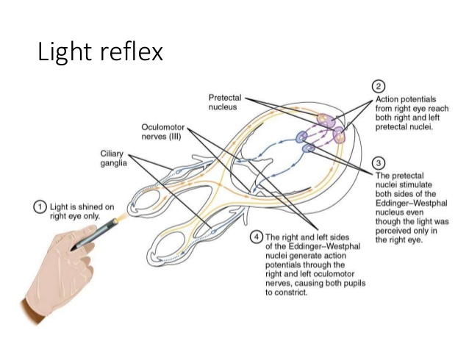

Slide 38
Why pupil constricts during sleep ?
Normally , there is a tonic inhibitory input from the cerebral cortex to the Edinger-Westphal nucleus. Diminision of this input results in pupillary constriction during sleep.

Slide 39
SYMPATHETIC PUPILLARY PATHWAY
1.CENTRAL
2.PRE GANGLIONIC SYMPATHETIC
3.POST GANGLIONIC SYMPATHETIC

Slide 40
CENTRAL
From the hypothalamic centers , the dilatory fibres pass downwards through the medulla oblongata into the lateral columns of the spinal cord.

Slide 41
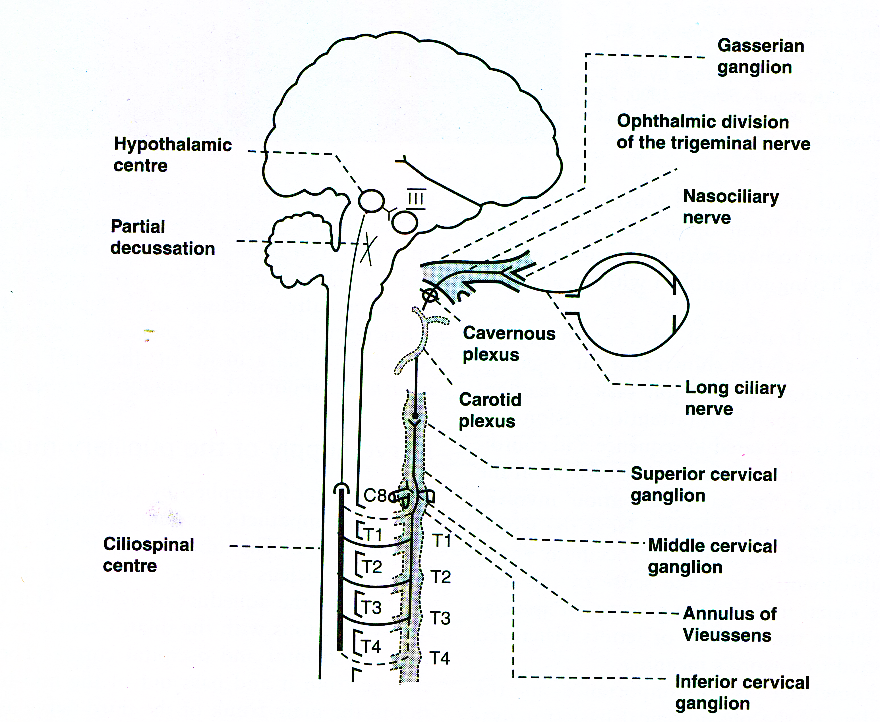
From the Hypothalamic spinal tract the fibres proceed ahead with a partial decussation in the mid brain so that each hypothalamic centre supplies each ciliospinal- centre ,especially the contralateral.

Slide 42
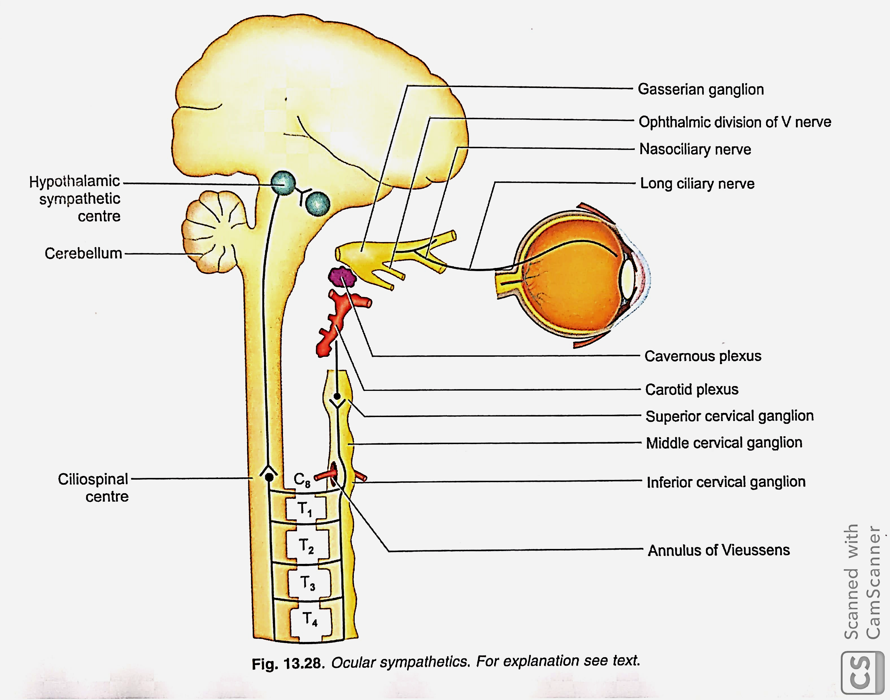
PRE GANGLIONIC SYMPATHETIC
A synapse is formed at the Ciliospinal centre of budge in the intermediolateral tract of the grey matter of the spinal cord.
These post-synaptic fibres leave the cord by the ventral roots of the last 2 cervical and the first 3 thoracic nerves.

Slide 43
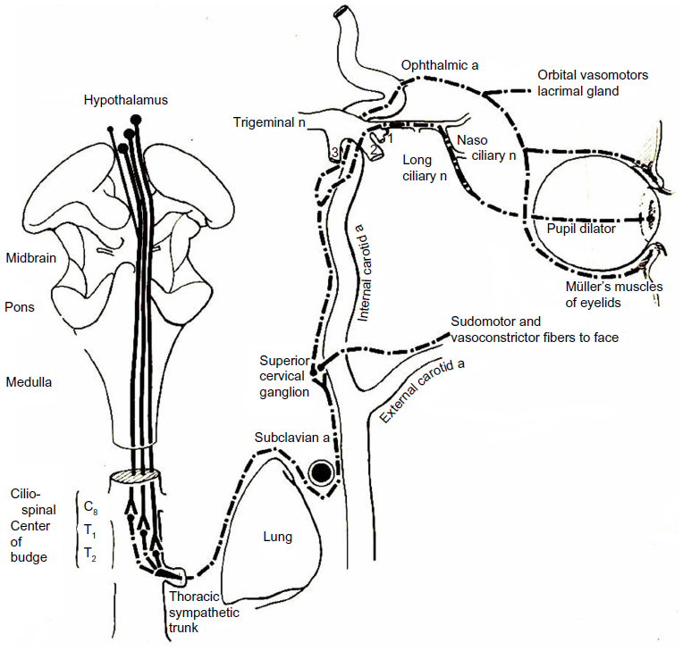
They enter the rami communicantes and run to the first thoracic or stellate ganglion, to the Cervical sympathetic chain in which the fibres traverse the inferior cervical ganglion and the anterior subclavian loop (ansa of vieussens)
They run up the neck to the superior cervical ganglion.

Slide 44
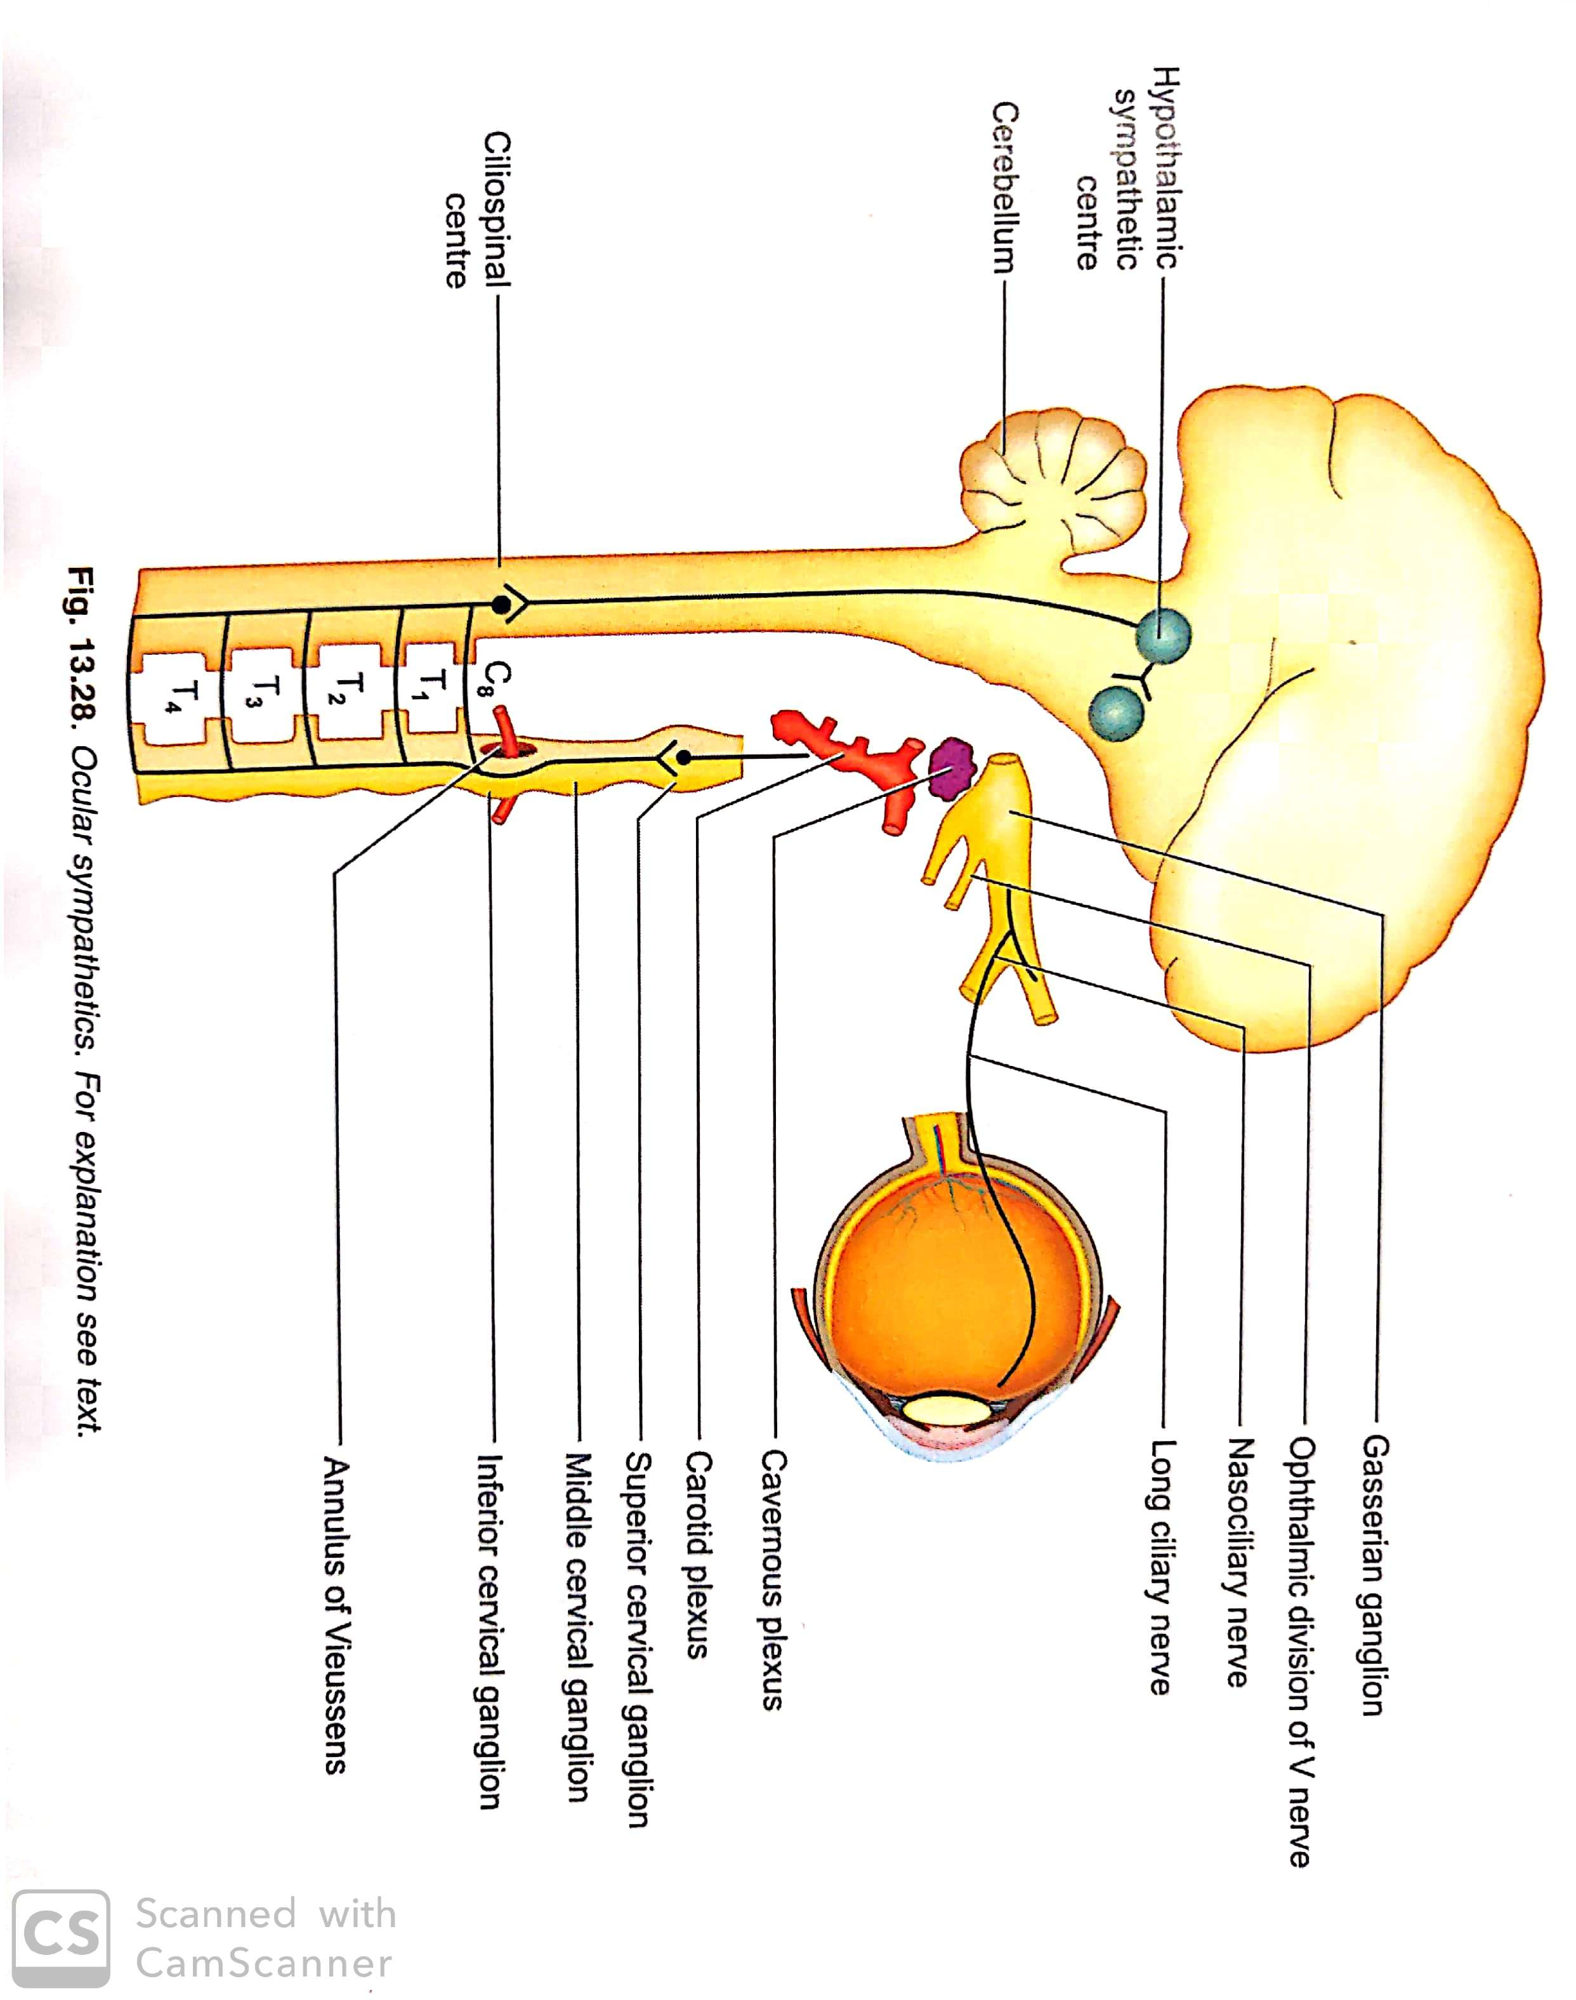
POST GANGLIONIC SYMPATHETIC
After terminating in the superior cervical ganglion ,enter the skull with the carotid plexus and cavernous plexus.
They run over the anterior part of the Gasserian ganglion(Trigeminal ganglion) and pass into the Ophthalmic division(V1) of the Trigeminal nerve(CN V) to the nasociliary nerve.

Slide 45
The long ciliary nerves ,run forward between the choroid and sclera ,enter the ciliary body reach the iris and terminate in the dilator muscle.

Slide 46
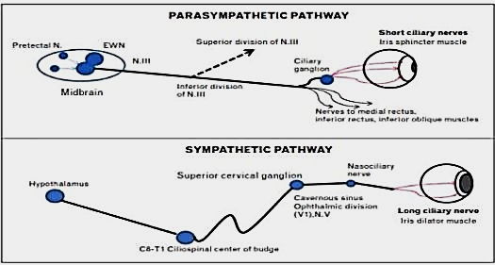

Slide 47
NEAR REFLEX
Consists of 2 components-
1.Convergence Reflex: convergence of visual axis and associated constriction of pupil.
2.Accmmodation Reflex: Increased accomodation and associated constriction of pupil.

Slide 48
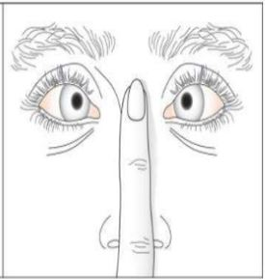
The Near Reflex Triad consists of-
1.Accomodation
2. Convergence
3.Miosis
.

Slide 49
PATHWAY OF CONVERGENCE REFLEX
It is initiated mainly by fibres from the medial rectus muscle which contract on convergence.
It is assumed that the afferents from the medial recti travel via the oculomotor nerve to the mesencephalic nucleus of the CN V, to a presumptive convergence centre in the tectal or pretectal region.

Slide 50
From this convergence centre they go to the Edinger-Westphal nucleus.
Efferent pathway of the convergence reflex is along the third nerve similar to that of the light reflex.
From the CN III the fibres relay in the accessory ganglion and there reach the sphincter pupillae.

Slide 51
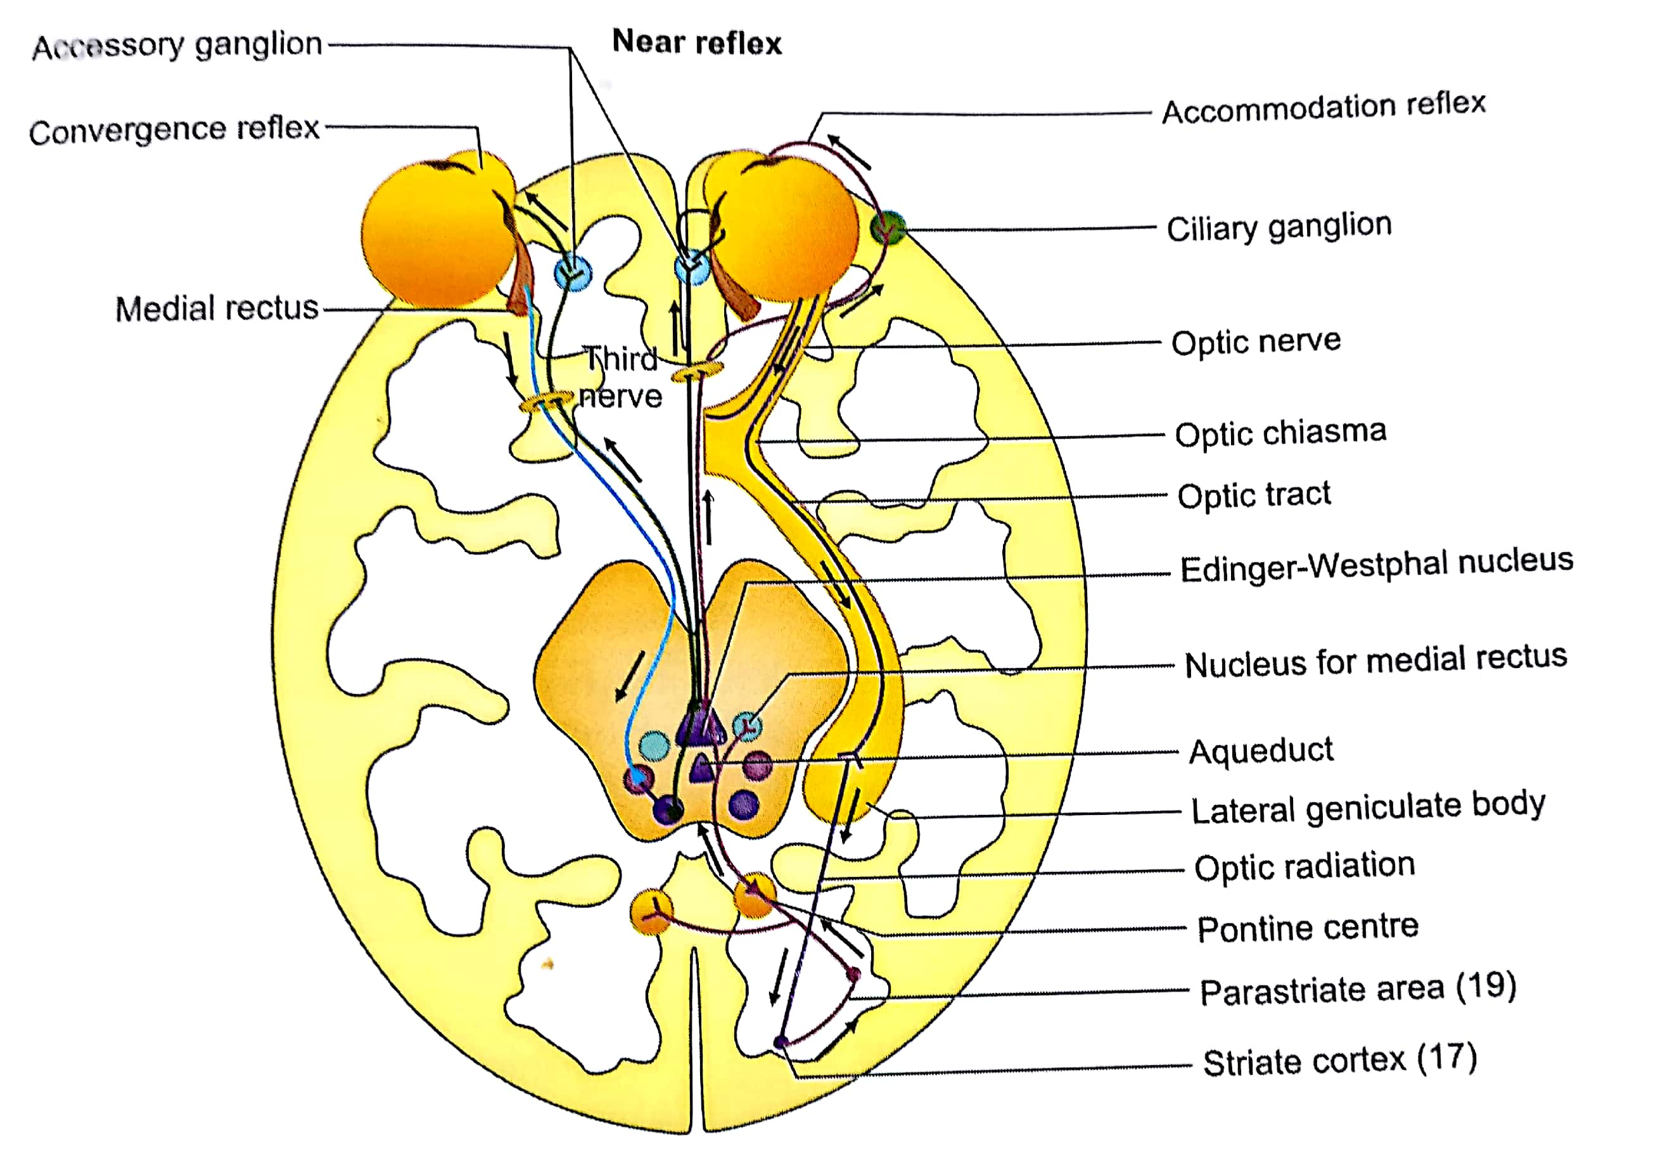

Slide 52
PATHWAY OF ACCOMODATION REFLEX
Three regions make up the accommodation neural circuit
1.The affrent fibres.
2.The internuncial fibres.
3. The efferent limb.

Slide 53
The Afferent limb of the circuit
This contains the main structures-
The retina that contains the retinal ganglion axons,
optic nerve , chiasm and optic tract,
lateral geniculate body, and
visual cortex.

Slide 54
The Internuncial fibres
They relay the impulses from the parastriate cortex to the Edinger-Westphal Nucleus of both sides via the occipito-mesencephalic tract and the pontine centre.

Slide 55
The Efferent limb of the circuit
This limb includes Edinger-Westphal nucleus and the oculomotor neurons.
The main function of the Edinger-Westphal nucleus is to send axons in the oculomotor nerve to control the ciliary ganglion which in turn, sends its axons in the short ciliary nerve to control the iris and the ciliary muscle of the eye.

Slide 56
THE DARKNESS REFLEX

Slide 57
THE DARKNESS REFLEX
If we go from a lighted environment to darkness , the pupils dilate.
Two causes for dilatation:
1.Abolition of light reflex with consequent relaxation of the sphincter pupillae.
2. Contraction of the dilator pupillae supplied by sympathetic nervous system.
The pathways involved in the dark reflex are presumably the same as those of light reflex.

Slide 58
PSYCHOSENSORY REFLEX

Slide 59
PSYCHOSENSORY REFLEX
They refer to the dilatation of the pupil in response to sensory and psychic stimuli.
Their mechanism is complex and their pathways have not been elucidated.
It is believed that the mechanism is a cortical one and is made up of 2 components-sympathetic discharge to the dilator pupillae and inhibition of the parasympathetic discharge to the sphincter pupillae.

Slide 60
Other pupillary reflexes

Slide 61
Other pupillary reflexes
~ CILIOSPINAL REFLEX

Slide 62
The ciliospinal reflex (pupillary-skin reflex) consists of dilation of the ipsilateral pupil in response to pain applied to the neck, face, and upper trunk.
If the right side of the neck is subjected to a painful stimulus, the right pupil dilates (increases in size 1-2mm from baseline).

Slide 63
ciliospinal reflex is absent in Horner's syndrome and lesions involving the cervical sympathetic fibers.

Slide 64
AFFERENT PATHWAY DEFECTS

Slide 65
TOTAL AFFERANT PATHWAY DEFECT(TAPD) OR AMAUROTIC PUPIL
Caused by a complete optic nerve or retinal lesion leading to total blindness on the affected side.
Characterized by the following:
~The involved eye is completely blind (no light perception)
Absence of direct light reflex on the affected side and absence of consensual light reflex on the normal side.

Slide 66
When the normal eye is stimulated both pupils react normally.
The near reflex is normal in both eyes.

Slide 67
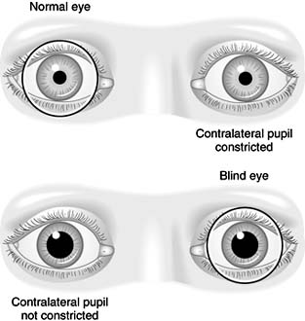

Slide 68
RELATIVE AFFERENT PUPILLARY DEFECT(RAPD)

Slide 69
It is the paradoxical response of a pupil to light in the presence of a relative afferent pathway defect.
Caused by an incomplete optic nerve lesion or a severe retinal disease.
It is best tested by “swinging flashlight test”.

Slide 70
SWINGING FLASHLIGHT TEST
Use a bright torch which can be focused to give a narrow, even beam of light.
Perform the test in a semi-darkened room.
If the room is too dark it will be difficult to observe the pupil responses, particularly in heavily pigmented eyes.

Slide 71
Ask the patient to look at a distant object, and to keep looking at it.
This is to prevent the Near reflex
(a constriction in pupil size when moving focus from a distant to a near object). While performing the test, take care not to get In the way of the fixation target.

Slide 72
Move the whole torch deliberately from side to side so that the beam of light is directed directly into each eye.
Do not swing the beam from side to side around a central axis (e.g. by holding it in front of the person's nose) as this can also stimulate the near response

Slide 73
Keep the light source at the same distance from each eye to ensure that the light stimulus is equally bright in both.
Keep the beam of light steadily on the first eye for at least 3 seconds. This allows the pupil size to stabilize. Note whether the pupil of the eye being illuminated reacts briskly and constricts fully to the light.

Slide 74
Move the light quickly to shine in the other eye. Again, hold the light steady for 3 seconds. Note whether the pupil being illuminated stays the same size, or whether It gets bigger. Note also what happens to the other eye.
As there is a lot to look at, repeat the test, observing what happens to the pupils of both eyes when one and then the other eye is illuminated.

Slide 75
Then the flashlight is quickly moved to the contralateral pupil and response is noted.
Normally, both pupils constrict equally .

Slide 76
The pupil to which light is transferred remains tightly constricted.
In the presence of RAPD in one eye, the affected pupil will dilate when the flashlight is moved from the normal eye to the abnormal eye.

Slide 77
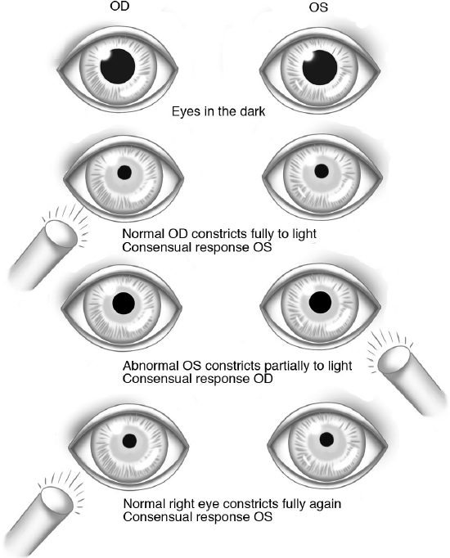

Slide 78
It usually takes less than a second to swing the light source from one eye to another.
Too great a time interval between stimulation of the eyes results in pupil dilatation in the intervening ‘dark period ’ causing a false negative test in eyes with mild optic nerve disease.

Slide 79
Significant cataract in one eye causes the stimulating light to scatter and increase the pupillomotor effectiveness of the stimulus in that eye.
This may induce an apparent RAPD in the opposite eye.

Slide 80


Slide 81
clinical Grading of
Relative afferent pupillary defect:-

Slide 82
Grading Scale:
RAPD Grade I: A weak initial pupillary constriction followed by greater redilatation.
Grade II: An initial pupillary stall followed by greater redilatation.
Grade III: An immediate pupillary dilatation.

Slide 83
Grade IV: An immediate pupillary dilatation following prolonged illumination of the good eye for 6 seconds.
Grade V: Immediate pupillary dilatation with no constriction at all.

Slide 84
Conditions Leading to a RAPD
.

Slide 85
Conditions Leading to a RAPD
Optic nerve disorders: Unilateral optic neuropathies are common causes of an RAPD. If a condition is bilaterally symmetrical, there will not be an RAPD.
Optic neuritis: Even very mild optic neuritis with a minimal loss of vision can lead to a very strong RAPD.

Slide 86
Ischemic optic neuropathies: These include arteritic (Giant Cell Arteritis) and non-arteritic causes. Usually there will be a loss of vision or a horizontal cut in the visual field.
Glaucoma: While glaucoma normally is a bilateral disease, if one optic nerve has particularly severe damage, an RAPD can be seen.

Slide 87
Traumatic optic neuropathy: This includes direct ocular trauma, orbital trauma, and even more remote head injuries which can damage the optic nerve as it passes through the optic canal into the cranial vault.
Radiation optic nerve damage

Slide 88
Optic nerve tumor
: This is a rare cause
Includes primary tumors of the optic nerve (glioma, meningioma) or
Tumors compressing the optic nerve (sphenoid wing meningioma, pituitary lesions, etc.).

Slide 89
Orbital disease:
This could include compressive damage to the optic nerve from
thyroid related orbitopathy (compression from enlarged extraocular muscles in the orbit), orbital tumors, &
vascular malformations.

Slide 90
Symmetrically bilateral retinal disease will not show an RAPD. Usually, retinal disease has to be quite severe for an RAPD to be clinically evident.
Ischemic ocular disease (Ocular ischemic syndrome): This usually arises from obstruction of the ophthalmic or carotid artery on one side.

Slide 91
Ischemic retinal disease
-Ischemic central retinal vein occlusion,
-central retinal artery occlusion,
-severe ischemic branch retinal or arterial occlusions,
-severe ischemic diabetic or sickle-cell retinopathy.

Slide 92
Retinal detachment: An RAPD can often be seen if the macula is detached, or if at least two quadrants of retina are detached.
Severe macular degeneration: If unilateral and severe, an RAPD can be seen.

Slide 93
Some of the common diseases cause abnormal pupillary reflex may include:
1- Holmes–Adie syndrome: is a neurological disorder characterized by a tonically dilated pupil that reacts slowly to light but shows a more definite response to accommodation (i.e., light-near dissociation)

Slide 94
                Argyll Robertson pupils: -
Bilateral small pupils that reduce in size on a near object
(i.e., they accommodate), but do not constrict when exposed to bright light (i.e., they do not react to light).
- They are a highly specific sign of neurosyphilis.

Slide 95
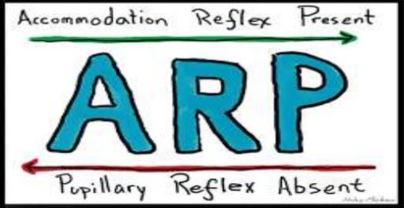

Slide 96
Reverse Argyll Robertson Pupil
Very rare.
Pupils react to light but not to accommodation.
Due to lesion in occipitotectal tract eg., encephalitis lethargica, Diphtheria.

Slide 97
- Horner's syndrome: is a combination of symptoms that arises when a group of nerves known as the sympathetic trunk is damaged. It is characterized by:
miosis (a constricted pupil),
partial ptosis (a weak, droopy eyelid),
anhidrosis (decreased sweating)

Slide 98
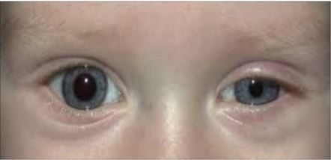
Horner's syndrome

Slide 99
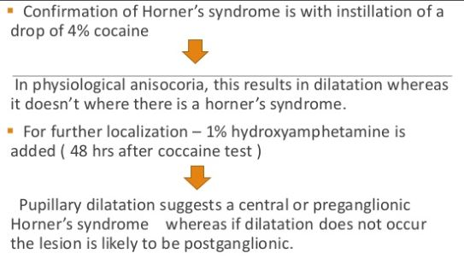

Slide 100
Hemianopic pupil ( Wernicke’s pupil )
Seen in optic tract lesions with hemianopia. Stimulating the blind(non functioning) half of retina pupil shows no reaction.
Stimulating seeing (functioning) half of retina pupil shows reaction.
Difficult to elicit – due to scattering & diffusion of light.
Use a narrow streak of light.

Slide 101
Adie’s Tonic Pupil
This describes a unilateral ( 80% of the cases ) mydriatic pupil in otherwise healthy patients ( typically young adults, especially women )

Slide 102
Cause – Denervation of the postganglionic supply to the sphincter pupillae and the ciliary muscle, which may follow a viral illness (eg., herpes zoster).

Slide 103
Pupil in Diabetes
-Constricted
-Sluggishly reactive due to Glycogen infiltration of sphincter.
-Autonomic denervation.
-Arteriosclerosis of radial iris vessels.

Slide 104
pupils in the Emergency Room

Slide 105
Head injury / In an unconscious patient
Normally reacting equal pupils – Reassuring sign, No intracranial catastrophe.

Slide 106
Unequal pupils – Single most important physical sign indicating that a herniated temporal lobe is stretching the III C.N on that side and prompt treatment is necessary.

Slide 107
Bilateral dilated pupils – The final stage of progressive tentorial herniation. The chances of patient recovering at this stage are very poor.

Slide 108
Bilateral pinpoint pupils - Indicates a massive intra pontine hemorrhage.
Opiates produce similar pupillary abnormalities but cause depressed reflexes.

Slide 109
Hutchinson’s pupil
Hutchinson's pupil is a clinical sign in which the pupil on the side of an intracranial mass lesion is dilated and unreactive to light, due to compression of the oculomotor nerve on that side.
These can be due to concussion injury to the brain and is associated with subdural hemorrhage and unconsciousness.

Slide 110
Hutchinson’s pupil - Stages
Stage 1, the parasympathetic fibers on the side of injury are irritated, leading to constriction of pupil on that side.

Slide 111
stage 2
The parasympathetic fibers on the side of injury are paralysed, leading to dilatation of pupil. The fibers on the opposite oculomotor nerve are irritated, leading to constriction on opposite side.

Slide 112
stage 3
The parasympathetic fibers on both sides are paralysed leading to bilateral pupillary dilatation. Pupils become fixed. This indicates grave prognosis.

Slide 113


