Slide 1
Physiology of
Autonomic Nervous System
Dr. Hetal Parikh
Professor & Head,
Dept.of Anaesthesia,
S.B.K.S.M.I.R.C.,Piparia

Slide 2
AUTONOMIC NRVOUS SYSTEM
Definition : It is the system for involuntary subconscious functions , it controls the internal environment to maintain homeostasis .
DIVISION OF NERVOUS SYSTEM :
1- Central nervous system :
a) Brain b) Spinal cord
2- Peripheral nervous system :
a) Cranial nerves Autonomic (involuntary)
Somatic (voluntary)
b) Spinal nerves Autonomic
Somatic

Slide 3
Autonomic N .S (involuntary) | Somatic N .S (voluntary)
1) Supply smooth muscles, Cardiac and Glands | 1) Innervate skeletal muscles
2) Has 2 neurons connected by synapse between C.N.S & organ | 2) One neurone between C.N.S and effector organ
3) Efferent preganglionic arises from lateral horn cells . | 3) Efferent arises from ventral horn cell.
4) Either acetyl cholin or norepinephrine. | 4) Chemical transmitter Acetyl choline

Slide 4
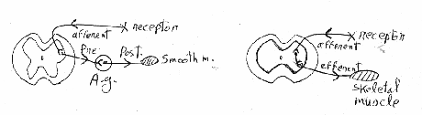
A.N.S differs from Somatic N.S in :-In A.N.S there is :
Autonomic ganglia
Connector neurone is outside CNS
It regulates smooth muscles
Q: Discuss and differentiate the two divisions of A.N.S

Slide 5
A.N.S
Sympathetic Parasympathetic
1- ORIGIN: Thoraco-Lumber Cranio - sacral
(Tl - T12 , LI,2,3) 3,7,9,10 S2 , 3 , 4
1- ORIGIN: Thoraco-Lumber Cranio - sacral
(Tl - T12 , LI,2,3) 3,7,9,10, s2,3,4,
2-FUNCTION: Stress muscular exercise - Digestion and sleep,
fear Empting
fight micturation flight defication
- Catabolic - Anabolic
(energy lost from the body) (energy preserved)
4- DISTRIBUTION: widspread Localised
5- DISCHARGE : as one unit (most actions) To each system
at the same time) separetly

Slide 6
RELATIONSHIP BETWEEN SYMP ATHETC AND PARASYMPATHETIC
1- RECIPROCAL : once sympathetic is stimulated, parasympaethetic is
inhibited and vise - versa
2- COMPLEMENTAL : e.g micturation and defication reflex. sympathetic for FILLING and parasympathetic for EVACUATION
N.B both sympathetic and parasympathetic together help acurate control over an organ's activity.

Slide 7
AUTONOMIC GANGLIA
DEFINITION : It is the site of physiological contact between pre and post
ganglionic fibers .
TYPES:
a) lateral (sympathetic)
b) collateral (mixed) or pure sympathetic
c) terminal ( parasympathetic )
Lateral ( paravertebral) 23 ganglia:
3 = cervical sympathetic chain
12 = thoracic
4 = lumber
4 = sacral

Slide 8


Collateral: Around large .B.V as:
Caeliac ganglion
Superior mesentric ganglion
Inferior mesentric ganglion
Terminal (in the wall of organ, no post-ganglionic as vagus or may be present very short post-ganglionic fiber

Slide 9
Pathway of pre-ganglionic sympathetic fibers:
1- May synapse in first sympathetic
chain ganglion, it enters.
2- Synapsing in other sympathetic
chain ganglia up or down.
3- Synapse in collateral ganglia.
4- Synapse in substance of adrenal
medulla itself.

Slide 10

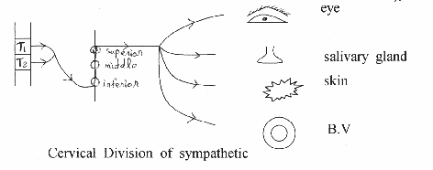
Function :
1) Distributing center: Sympathetic Parasympathetic
1 : 32 1:9 or 1:2 ??
2)- Relay station between pre and post ganglionic fiber
Localization : To diagnose site of relay, by Nicotine test: (Langlay's test) painting the ganglia with large doses of nicotine to block the site of relay, after that if it gives no post - ganglionic response = relay
Cervical Division of sympathetic

Slide 11
DESTRIBUTION OF SYMPATHETIC NERVOUS SYSTEM
1) CERVICAL DIVISION:
Origin :It arises from lateral horn cell of Ti and T2 and end in superior cervical ganglion
A) EYE :
a) dilatorpupilllary muscels = pupillary dilatation
= Mydriasis
b) Tarsal m.=elevation of eye lid = widening of
eye superior
inferior
c) Muller's m. = Exophthalamos = Protrusion of
eye ball in animals
d) Blood vessels of eye = V.C
e) relaxation of the ciliary muscle for vision

Slide 12
B) SALIVARY GLANDS :
a) Secretion of small amount of saliva, rich in organic matters (enzymes)
i.e viscus saliva .
b) Squeezing around acinin of salivary glands push saliva outside
C) SKIN :
a) Erector pilae m = erection of hairs
b) Vaso-conistriction of blood vessels = pallor
c) Sweat :Secretion = mental sweat.
D) Cerebral blood vessels
= vaso-conistriction

Slide 13
HORNER'S SYNDROME
It Is Cerviacl Sympathectomy : characterized by :
1-PTOSIS : drop of upper eyelid .
2- MIOSIS : pupillary constriction .
3- ANHYDROSIS : dryness of skin
4-Emrophthalamos
5- Flushing of the face .
ALL THESE EFFECTS ARE AT SAME SIDE OF
LESHON

Slide 14
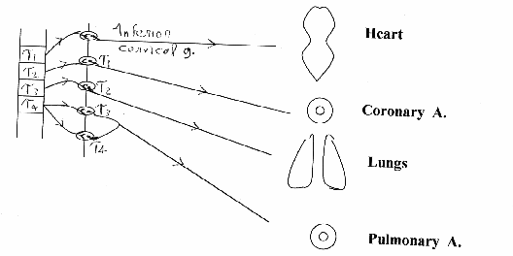
2) CARDIQ-PULMONARY DIVISION :
Segments and end in 3rd cervical and upper
4 thoracic ganglia
A) HEART : increase all cardiac prosperities as:
- positive inotropic effects = ↑ contractility
- positive chronotropic effect = ↑ Heart rate.
- = ↑ Conductivity - = ↑ Excitability
B) CORONARY BLOOD VESSELS vasodilatation
C) LUNG : a) bronco-dilatation .
b) inhibits bronchial glands secretion of
mucous
D) PULMONARY BLOOD VESSELS: vasoconstriction.

Slide 15
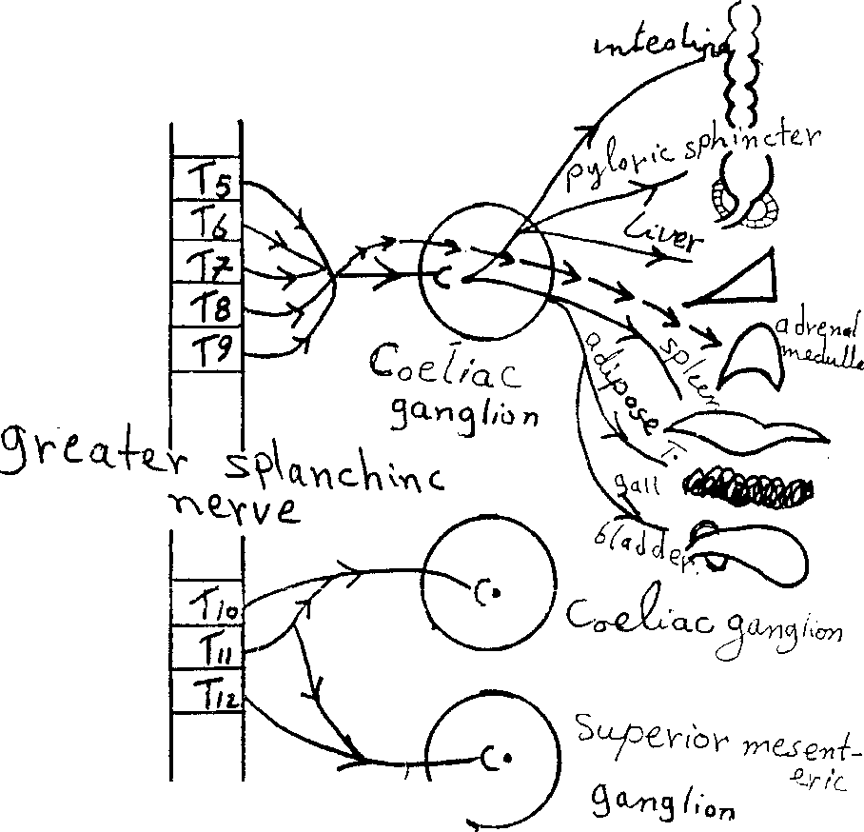
3- SPLANCHIC DIVISION:-
To Abdomen and pelvis

Slide 16
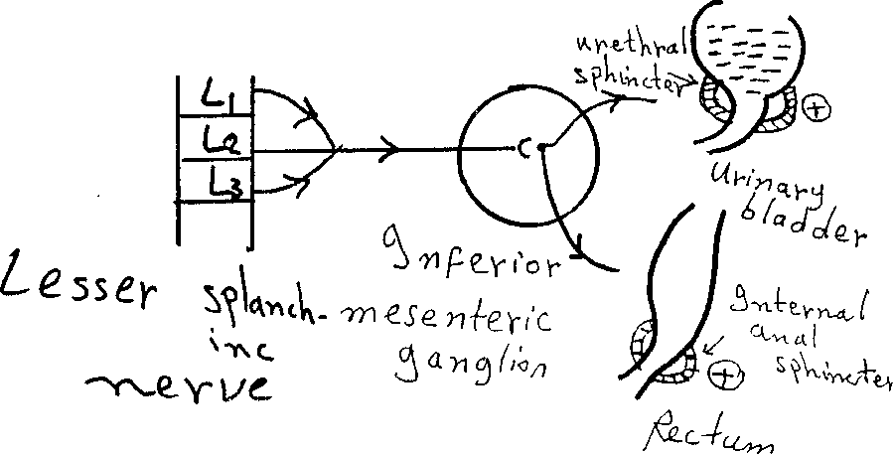

Slide 17
  A) Greater Splanchic Nerve : it supplies the abdomen e.g :
  (From T₅–T₉, relay in caeliac ganglion)
    a) wall of G.I.T → relaxation of its walls = retention ↓ motility.
    b) sphincters → its contraction e.g pyloric sphincter of stomach
    c) liver → glycogenolysis = glycogen converted to glucose .
    d) adrenal medulla → release of epinephrin and nor epinephrine .
    e) spleen → contraction & release of RBCs in case of heamorrhage
    f) adipose tissues → lipolysis .
  g) inhibite the intestinal juice secretion
  h) relaxation of gall bladder and contraction of
  its sphincter.
  N.B Stimulation of greater splanchic nerve causes two peaks rise in blood pressure :
    a) First rise due to V.C of visceral blood vessel
  b) Second peak due to release of catecholamin
  into blood.

Slide 18
ADRENAL MEDULLA:
Supplied by pre-ganglionic sympathetic fibers (greater splanchnic nerve).
The circulating catecholamin have same effects of direct sympathetic stimulation, but more prolonged , So body organs can be stimulated by 2 ways, Nervous (direct) & Hormonal (indirect), Also catecholamines can stimulate sites not supplied by direct sympathetic nerves .

Slide 19
N.B adrenal meddulla is modified by sympethetic ganglion because :
1- No post-ganglionic fibers
2- Causes release of 80% epinephrin. 20% nor epinephrin.
N.B Selective secretion of adrenal medulla:
a) More epinephrine in unexpected stresses as haemorrhaege
b) More nor-epinephrine in familiar stresses as hypoxia

Slide 20
B) Lesser splanchnic nerve:-
From LI - L3, relays in inferior mesentric ganglion It supplies the pelvis e.g :-
a) Rectum → retention of stool (+) of internal anal sphincter
b) Urinary bladder → retention of urine by relaxation of its wall and contraction of internal uretheral sphincter.
c) Sex organs → ejaculation .
External genitalia:
In males : Inhibition of erection (v.c of erectile tissue)-Ejaculation of semen
(contraction of vas deferens, prostate and ejaculatory duct(
In females:- Contraction or relaxation of female genital organ according to the stage of menstrual cycle and level of hormones in blood. N.B Small splanchnic nerve (from T10 – T12, relayes in caeliac and superior mesentric ganglion(

Slide 21
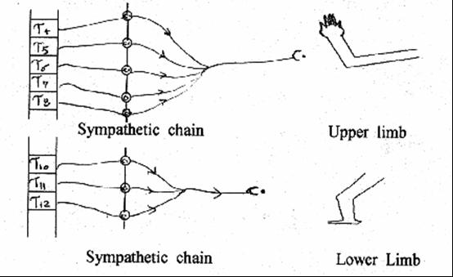
4- SOMATIC DIVISION :
(Orbelli phenomenon(
It is sympethetic supply of limbs, upper limbs
(T4- Ts) lower limbs (T10T12), both relay in sympathetic chain = Sympethetic stimulation delays fatigue of muscle due to vasodilatation of skeletal blood vessels

Slide 22
ORGANS SUPPLIED BY SYMPATHETIC ONLY :
1- Ventricles (vagal escape).
2- Skin structures
3- Skeletal B.V.
4- Dilator pupillary muscles .
5- Adrenal medulla

Slide 23
ORGANS SUPPLIED BY PARASYMPATHETIC
1- Constrictor pupillary muscle .
2- Oesophagus .
3- Gastric glands .
4- Erectile tissue .
N.B Sympethetic → causes V.C of all blood vessels, except
1. Coronaries.
2. Skeletal blood vessels.

Slide 24

DISTRIBUTION OF PARASYMPATHETIC
1- CRANIAL DIVISION .
A) Oculomotor nerve ( III n ):
It arises from occulomotor nucleus , relays in ciliary ganglion
FUNCTION = responsible for near
visions:

Slide 25
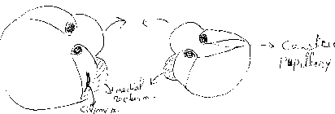
During fixation of eyes to near object, III nerve causes :
a) Contraction of ciliary muscle → Increases convexity of the eye lens .
b) Contraction of medical rectus muscle → medial convergence of both eyes together.
c) Contraction of constrictor pupillae muscle → papillary constriction

Slide 26
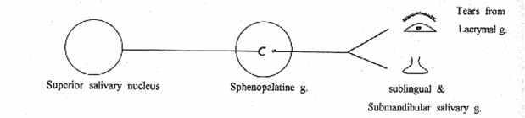
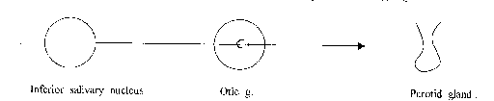
B) Fascial Nerve (VII n.):
It arises from superior salivary nucleus, relays in sphenopalatine ganglion.
FUNCTION : secretion of tears and saliva which is watery, poor in enzymes and big in amount .
C) Glossopharyngeal Nerve (IX n.):
It arises from inferior salivary nucleus 9 relays in optic ganglion .
FUNCTION : secretion of saliva

Slide 27
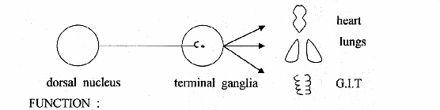
D) Vagus Nerve (XN):
75% of parasympathetic fibers of the body are the vagus nerve. It arises from dorsal nucleus, relays in terminal ganglia.
FUNCTION :
1- Inhibition (supression) of heart rate and
contractility.
2- Broncho-constriction and inhibition of
inspirartory center and secretion of
mucous from bronchial glands.
3- Stimulation (excitation) of G.I.T motility
and secretions .

Slide 28
EFFECT OF VAGUS NERVE
1-) ON HEART
* Inhibits all cardiac roperties, but it does not supply the ventricles (vagus escape).
* Tonic (continuous) effect on the heart , which is more marked in athelets.
* Coronary vaso-constriction (V.C ) .
2) ON LUNGS:
Mentioned before .
3) ON G.I.T:
* Evacuation of food (stimulation of G.I.T . motility ).
* Evacuation of gall bladder.
* Stimulates secretion of: gastric juice , bile , pancreatic juice and mucus (Brunner's glands)
* Increased hepatic blood flow.
N.B Vagus nerve has no post-ganglionic fibers

Slide 29
WHY IT'S CALLED VAGUS ?
Because it has :-
1- Afferent & efferent
2- Stimulatory & inhibitory
3- Widely distributed

Slide 30
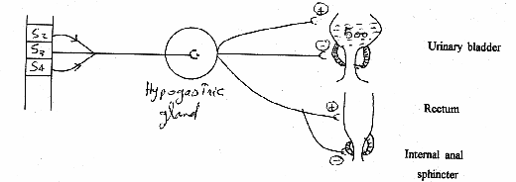
II- SACRAL DIVISION OF
PARAS YMPATHETIC
( nerve erigentis) It is 82 ,3,4 and called pelvic nerve and relays in hypogastric ganglia.
FUNCTION :
1- It supplies urinary bladder → causes micturation
2- distal 2/3 of large intestine and rectum → causes
defecation
3- Male and female sex organs → erection by vasodilatation of blood vessels of penis (♂) or clitoris (♀)

Slide 31
MICTURATION:
Pelvic nerve causes contraction of wall of urinary bladder and relaxation of internal uretheral sphincter → passage of urine

