Slide 1
SVT from enhanced automaticity
Dr. Malini Mehta
Professor,
Dept.Of Anaesthesia,
S.B.K.S.M.I.R.C.,Piparia

Slide 2
SVT from enhanced automaticity
Cells with automatic properties.
Cells with pacemaking properties exhibit diastolic depolarization characterized by a slowly rising slope during phase 4 of the action potential. Once threshold potential is reached, the cells discharge automatically.
(non-pacemaking cells-phase 4 is flat and resting potential never reaches threshold)
Automatic properties -1.Sinus node,
2.Atrioventricular (AV) junction
3.AV conduction system except midportion of the AV Node
(cells of the AV conduction system have automatic properties and are capable of discharging spontaneously, their rate of discharge is slower than that of the sinus node. These cells therefore are depolarized by the propagated sinus impulse and serve as backup or latent pacemakers)

Slide 3
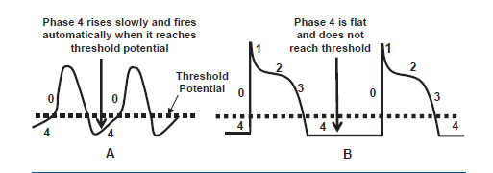
(A) Pacemaking cells.
(B) Non-pacemaking cells-action potential never reaches threshold.
Ordinary myocytes in atria and ventricles-no phase 4 diastolic depolarization
Pathologic(ischemia or injury)-exhibit phase 4 diastolic depolarization

Slide 4
SVT due to enhanced automaticity
1. Pathologic sinus tachycardia-
Enhanced automaticity of the sinus node cells
(clinically difficult to differentiate from physiologic sinus tachycardia)
2. Atrial tachycardia-
Site-Atrial appendage,
Large veins draining into the atria (pulmonary veins, vena cava, coronary sinus)
Mitral or Tricuspid annulus
A)Focal-Single focus in atria or
Venous connection contiguous to the atria such as the pulmonary veins or
vena cava
B) Multifocal atrial tachycardia- several ectopic foci in the atria
3.AV junctional tachycardia-
Site-AV junction( AV node down to the bifurcation of the bundle of His)
A) Nonparoxysmal junctional tachycardia-focus in the AV junction(slow 70 to 120bpm)
B) Paroxysmal junctional tachycardia-starts abruptly and terminates suddenly (fast120 to 180 bpm)

Slide 5
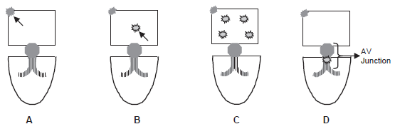
A- Pathologic or inappropriate sinus tachycardia.
B- Focal atrial tachycardia
C- Multifocal atria tachycardia
D- Junctional tachycardia

Slide 6
FAT
‘’Any tachycardia originating from a single focus in the atria that spreads circumferentially is focal atrial tachycardia regardless of the mechanism of the tachycardia’’
Mechanism-Enhanced automaticity (automatic atrial tachycardia),
Intra-atrial micro-reentry (intraatrial reentrant tachycardia)
Triggered automaticity (atrial tachycardia with 2:1 AV block).
The mechanisms underlying these tachycardias cannot be differentiated from one another with ECG. Because these tachycardias all look similar.
Nonsustained focal atrial tachycardia- seen during cardiac monitoring in the coronary
or intensive care units
Sustained focal atrial tachycardia- rare, occurring in 0.5% of symptomatic patients. slightly more common in children than in adults but is also a rare clinical entity.
The tachycardia can be incessant (persists more than 12 hours per day), which can result in
tachycardia-mediated cardiomyopathy

Slide 7
ECG FINDINGS
1. Regular narrow complex tachycardia 100 bpm.
2.Ectopic P waves, which are different in morphology from sinus P waves, precede the QRS complexes usually with a PR interval >0.12 seconds.(impulse has to travel within the atria and across the AV node before reaching the ventricles)
3.The P waves are uniform(from single focus) and the atrial rate varies to as high as 250 bpm. The baseline between the P waves is usually flat or isoelectric and not wavy or undulating as in atrial flutter.
4. Second-degree or higher grades of AV block may occur because the tachycardia is not dependent on the AV node.
5. The tachycardia terminates with a QRS complex in contrast to AVNRT and AVRT which terminates with a retrograde P wave.
PR as well as the R-R interval may vary during the tachycardia, especially if the SVT is due to enhanced automaticity. This is in contrast to reentrant SVT, where these intervals are usually fixed and regular because the reentrant SVT follows a fixed pathway.

Slide 8
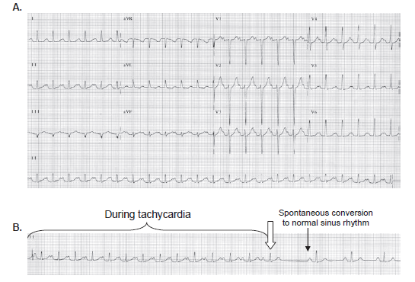
P waves-uniform in configuration,upright in I, II, III, aVF, and V1.
The tachycardia can be mistaken for sinus tachycardia.
B-Lead II rhythm strip showing spontaneous conversion of the tachycardia to normal sinus rythm.
P wave morphology is different during tachycardia and during normal sinus rhythm. Tachycardia terminated with a QRS complex

Slide 9
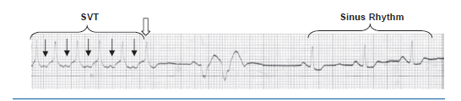
Arrows-focal atrial tachycardia with P waves between QRS complexes
The tachycardia terminated spontaneously followed by a sinus P wave and back to back ventricular complexes.
Tachycardia terminated with a ventricular complex rather than a P wave.
SVT terminating with a QRS complex is usually from focal atrial tachycardia.
This type of SVT may not respond to adenosine.

Slide 10
Right atrial origin:
1.P waves are inverted in V1.
2.If biphasic in V1, the P waves are initially positive (upright) and terminally negative
3.In lead aVL, the P waves are upright or biphasic
Left atrial origin:
1.P waves are upright in V1.
2.If V1 is biphasic, the P waves are initially negative (inverted) and terminally positive (upright).
3.In aVL, the P waves are negative or isoelectric (flat)
Superior origin:
(atrial appendages and superior pulmonary veins)
P waves are upright in II, III, and aVF.
(difficult to differentiate from sinus tachycardia)
Inferior origin:
P waves are inverted in leads II, III, and aVF
IVC and coronary sinus orifice as well as the inferior pulmonary veins.

Slide 11
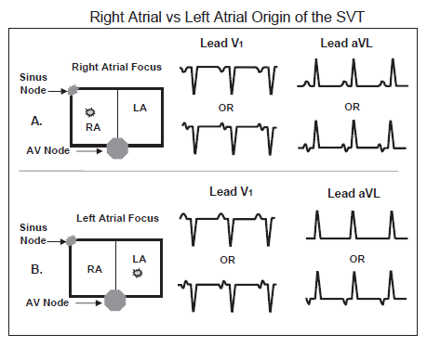
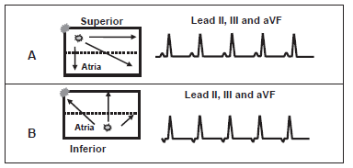

Slide 12
Size of the P wave
AVNRT & AV junctional tachycardia- Narrow
(Because the AV node is in the lower mid-atria and both atria are activated simultaneously)
FAT or AVRT – Broader
Cause
1.Acute myocarditis, chronic cardiomyopathy, atrial tumor.
2.Can occur spontaneously in muscle sleeves of veins directly draining into the atria such as the pulmonary veins, vena cava, and coronary sinus
3.Pharmacologic agents such as catecholamines, theophylline, caffeine, nicotine.
digitalis toxicity(associated with 2:1 AV block)
Vagal maneuvers and AV nodal blockers (ABCD) can slow down the ventricular rate by causing AV block, but may not terminate the arrhythmia. However, if the mechanism of the SVT is due to micro-reentry or triggered activity, the tachycardia may be responsive to adenosine or verapamil.

Slide 13
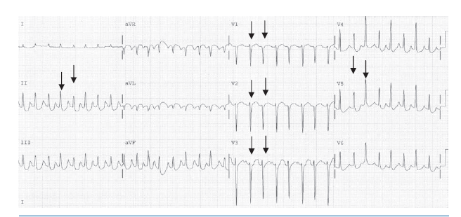
P waves are inverted in aVL and are upright in leads II, III, and aVF -superior left atrial origin.
Electrical alternans is seen in leads II and in all precordial leads
Although electrical alternans is frequently associated with AVRT, it is also seen in other types of SVT.

Slide 14
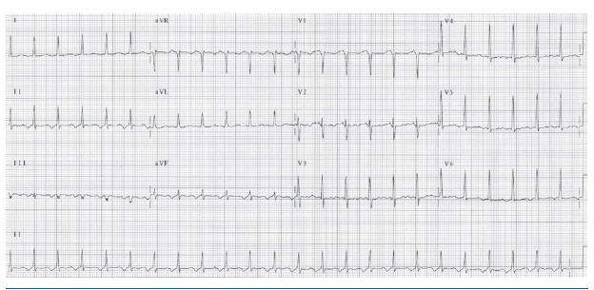
1.P-inverted in leads II, III, and aVF and upright in V1
2.PR interval-0.12 seconds and the RP >PR interval.
FAT from the inferior wall of the left atrium
(Difficult to differentiate from atypical AVNRT, atypical AVRT, or junctional tachycardia)
Because the P waves are broad, the SVT is more likely the result of FAT or AVRT rather than AVNRT or junctional tachycardia.

Slide 15
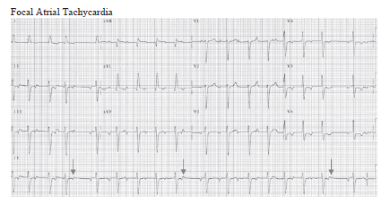
There is gradual prolongation of the PR interval until a ventricular complex is dropped (arrows).
Because second-degree AV block is present,AVRT is not possible and AVNRT is highly unlikely.

Slide 16
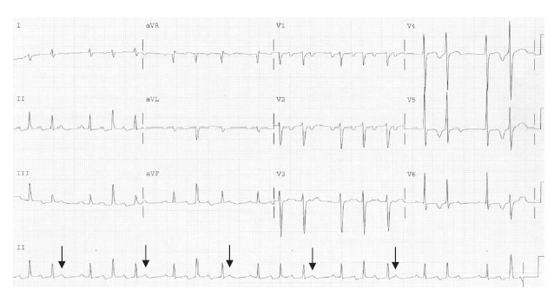
FAT with second-degree AV Wenckebach
Thought to be IART because the patient had previous ASD repair, which is a possible focus of reentry.
The patient was successfully cardioverted electrically to normal sinus rhythm.
Focal atrial tachycardia from enhanced automaticity does not respond to electrical cardioversion.
The presence of AV block excludes AVRT and upright Pwaves in II, III, and aVF makes AVNRT unlikely

Slide 17
Acute Treatment
Regular narrow complex tachycardia, and difficult to distinguish from atypical AVNRT and atypical AVRT. Thus, the acute treatment is similar to any regular narrow complex SVT.
Vagal maneuvers,ABCD
Microreentry or triggered activity- respond to Adenosine or Verapamil
Enhanced automaticity- will not respond to adenosine.
Class IA (procainamide)
Class IC (flecainide and propafenone)
Class III (sotalol, amiodarone)
( should be considered If adenosine and other AV nodal blocking agents are not effective)
Electrical cardioversion- not effective in enhanced automaticity
effective in intra-atrial reentry or triggered activity
Intractable to drugs- electrical ablation (or if not feasible, surgical excision) of the arrhythmogenic focus
1.Digitalis toxicity-
-should be discontinued
-electrolyte abnormalities (hypokalemia, hypomagnesemia, and hypercalcemia)should be corrected
-digoxin binding agents
2. Tachycardia is also precipitated by metabolic and blood gas disorders-correct

Slide 18
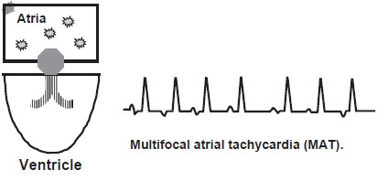
MAT
MAT is most probably due to enhanced automaticity.
1. At least three consecutive P waves with different morphologies
with a rate 100 bpm should be present.
2. The PR as well as the R-R interval is variable with isoelectric
baseline between P waves.

Slide 19
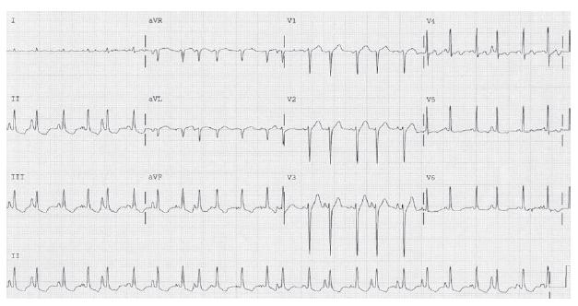
Rate is irregular, the PR intervals are variable
Baseline between two P waves is isoelectric.

Slide 20
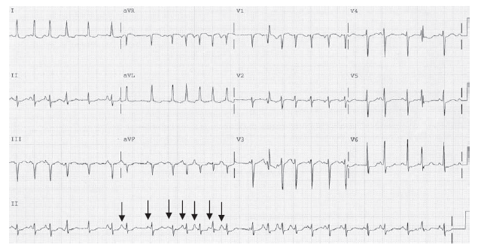

Slide 21
Clinical Implications
Chaotic atrial tachycardia
Rate<100 bpm-chaotic atrial rhythm or multifocal atrial rhythm.
Mistaken for atrial fibrillation.
Seen in-Acute exacerbations of COPD
Electrolyte or metabolic abnormalities
Pulmonary infection.
Theophylline or Beta agonists.

Slide 22
Acute Treatment
Treat the underlying cause.
Theophylline or beta agonist should be discontinued.
Any electrolyte, blood gas, or metabolic abnormality should be corrected.
Any associated cardiac disease or pulmonary infection should be treated.
1.Diltiazem (20 mg IV) or Verapamil (5 to 10 mg IV)
Diltiazem continued as an IV infusion drip at 5 to 15 mg per hour after the rate has been controlled with the initial bolus.
2. Beta blockers are effective but are contraindicated because MAT is frequently seen in bronchospastic pulmonary disease.
3. Amiodarone if the arrhythmia has not improved with the above agents.
4. Magnesium IV when other agents have failed even in the absence of hypomagnesemia.
MAT is an example of SVT from enhanced automaticity and electrical cardioversion will not be effective.
MAT frequently deteriorates to atrial fibrillation. The rate in atrial fibrillation may be easier to control than the rate in MAT; however, anticoagulation may be necessary.

Slide 23
Junctional tachycardia
Repetitive impulses originating from the AV node or bundle of His.
The impulse follows the normal AV conduction system resulting in narrow QRS complexes.
1.Nonparoxysmal junctional tachycardia:
Slower rate of 70 to 120 bpm
(Despite the very slow rate of 100 bpm, the arrhythmia is considered a tachycardia since the intrinsic rate of the AV junction is exceeded, which is usually 40 to 60)
AV junctional rhythm with a rate 100 bpm-accelerated junctional rhythm
nonparoxysmal with a slow onset and termination.
Enhanced automaticity or Triggered activity
2.Paroxysmal or focal junctional tachycardia:
Rare, more in children
called junctional ectopic tachycardia or automatic junctional tachycardia.
110 to 250 bpm,paroxysmal with sudden onset and abrupt termination.
Enhanced automaticity or Triggered activity.

Slide 24
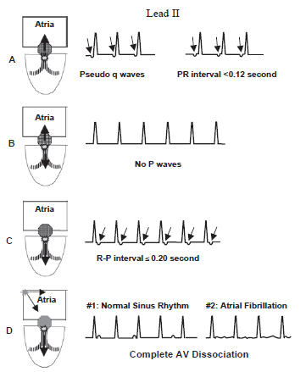
ECG of AV junctional tachycardia
1.Because the tachycardia is not dependent on the atria or ventricles, the relationship between the P wave and the QRS complex is variable.
2.The retrograde P waves are narrow, occur before or after the QRS complex or synchronous with the QRS complex(P waves are not visible)

Slide 25
Nonparoxysmal Junctional Tachycardia
When the retrograde P wave precedes the QRS complex-PR interval <0.12 seconds
Width of the retrograde P wave is-thinner than a normal sinus P wave, because the impulse originates from the AV node & both atria are activated simultaneously.
When it follows the QRS complex-R-P interval is<0.20 seconds.

Slide 26
ECG Findings of Junctional Tachycardia
ECG findings of nonparoxysmal and paroxysmal or focal junctional tachycardia are similar except for the difference in rate, onset, and termination of the tachycardia
1.Narrow QRS complexes( except preexistent BBB or aberration)
2. Regular QRS complexes
3.Focal junctional tachycardia-110 to 250 bpm.
Nonparoxysmal junctional tachycardia-70 to 130 bpm.
4. P waves may occur synchronously with the QRS complex and may not be visible
5.P waves are present-retrograde and inverted in leads II, III, and aVF.
The retrograde P waves may occur before or after the QRS complexes.
Before -PR interval is short <0.12 seconds
After- R-P interval<0.20 seconds
6.Complete AV dissociation may occur -The sinus node captures the atria,ventricles are separately controlled by the junctional tachycardia resulting in complete AV dissociation
7. can also occur in the presence of atrial fibrillation resulting in regularization of the R-R interval since the ventricles are completely dissociated from the atria.

Slide 27
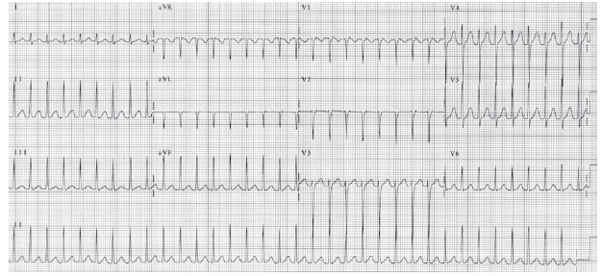
Paroxysmal tachycardia with a rate of 206 beats per minute.
No P waves
Paroxysmal junctional tachycardia

Slide 28
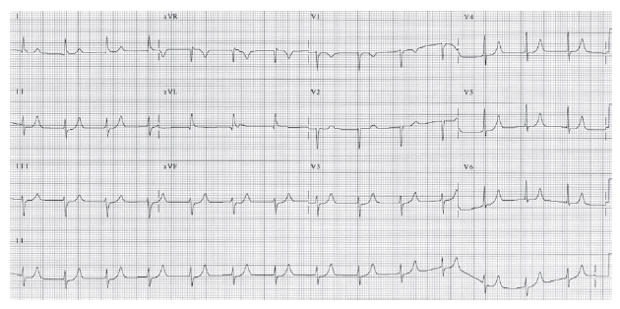
Nonparoxysmal Junctional Tachycardia. No P waves

Slide 29


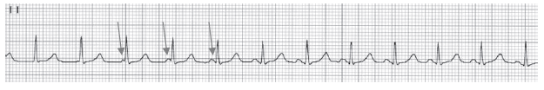

NJT-Accelerated junctional rhythm (87 )Retrograde P waves just before the QRS complexes(pseudo-Q waves) P waves are narrow <0.05 seconds.
NJT-Accelerated junctional rhythm(73) P waves after the QRS complexes and narrow (P waves occur during ventricular systole, this can result in cannon A waves)
NJT-initial half shows NJT of 106 beats per minute.
There is isorhythmic atrioventricular dissociation (arrows) until the sinus P waves capture the QRS complexes at a slightly higher rate of 110
Accelerated Junctional Rhythm with Complete Atrioventricular Dissociation
atrial and ventricular rates are almost similar at 80.Sinus P waves are completely dissociated from the QRS complexes. Arrows point to the P waves.

Slide 30
Clinical Implications
Nonparoxysmal Junctional Tachycardia
self-limiting lasting for a few hours to a few days even without therapy.
benign and may not be associated with any hemodynamic abnormalities
may be a marker of a serious underlying cardiac condition setting of acute inferior MI,myocarditis, CHF, hypokalemia,
digitalis toxicity, dobutamine sympathomimetic agents.
after cardiac surgery.
It may be a manifestation of sick sinus syndrome
Rate is slow so tolerable
Because the QRS complexes are not preceded by P waves, the tachycardia may result in hemodynamic deterioration because of loss of atrial contribution to left ventricular filling especially in patients-low cardiac output and hypotension.
P waves follow the QRS complex-cannon A waves-hypotension and low cardiac output mimicking pace maker syndrome

Slide 31
Focal Junctional or Paroxysmal Junctional Tachycardia
rare in adults. It is also rare, but is more common in children
Seen in congenital heart disease(ASD,VSD),structurally normal hearts,postoperative period.
more than 12 hours per day- tachycardia-mediated cardiomyopathy especially in children

Slide 32
Acute treatment
Nonparoxysmal Junctional Tachycardia
- Does not need any drug therapy (slow rate, tolerated, self-limiting)
- Underlying abnormality should be corrected
Nonparoxysmal junctional tachycardia or accelerated junctional rhythm may be a sign of underlying sinus node disease. When sinus node dysfunction is suspected, the junctional rhythm should not be suppressed.
Digitalis toxicity-
<100 bpm and hemodynamically stable-monitor
1.Phenytoin 5 to 10 mg/kg IV as 250-mg bolus diluted with saline and injected over 10 minutes, followed by 100 mg IV every 5 minutes as needed (max 1g)
(Phenytoin is effective only if the tachycardia is digitalis induced)
2.Beta blockers
3.Digoxin >10ng/ml or unstable or life threatening-Digoxin immune Fab fragments
-Not due to Digitalis-similar to focal junctional tachycardia
4.Mimicking pacemaker synd-temporary atrial or AV sequential pacing

Slide 33
Focal Junctional Tachycardia
Treated like any regular narrow complex tachycardia
ECG findings mimic AVNRT, AVRT,FAT and are more responsive to adenosine.
Thus, adenosine should be tried initially
BB,CCB
type IC (flecainide or propafenone)
type III (amiodarone or sotalol)
LVF-Amiodarone
Catheter ablation
(Risk of AV Block as foci involves AV Node and BOH)

Slide 34
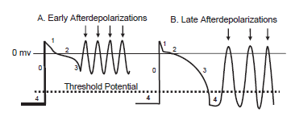
SVT from Triggered Activity
Early afterdepolarizations: Phase 2 or phase 3 of action potential
Late afterdepolarizations: Phase 4 of the action potential
After depolarisation- digitalis toxicity or excess calcium or catecholamines
Role of triggered activity as a cause of SVT is uncertain except in
1.Atrial tachycardia with 2:1 AV block
2.Nonparoxysmal junctional tachycardia.
Both arrhythmias are frequently associated with Digitalis toxicity

Slide 35
Atrial tachycardia with 2:1 AV block
Almost always from Digitalis toxicity (Reverse check or tick sign)
Digitalis excites atria and ventrical-atrial and ventricular tachycardia.
Digitalis also blocks the AV node atrial tachycardia with AV block usually in a 2:1
single focus in the atria close to the sinus node-P wave to be upright in leads II, III, and aVF, resembling sinus tachycardia
Varying degrees of AV block may occur in patients who are not on digitalis. mechanism for the tachycardia may be due to enhanced automaticity rather than triggered activity

Slide 36
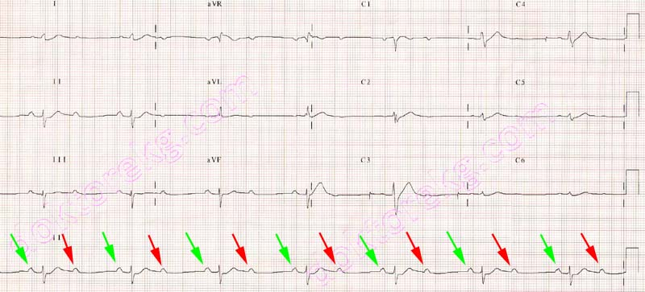
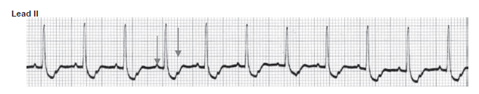

Slide 37
Approach to a Patient with Narrow
Complex Tachycardia
ECG should first be inspected for gross irregularity of the R-R intervals
Grossly irregular R-R intervals
Multifocal atrial tachycardia:
Distinct P waves of different configurations are present preceding each QRS complex.
Atrial fibrillation:
The baseline shows fibrillatory waves. No definite P waves or flutter waves are present.
Atrial flutter:
Flutter waves are present with a sawtooth or undulating baseline.

Slide 38
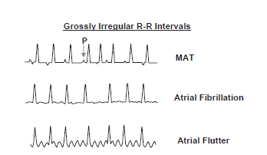

Slide 39


Slide 40
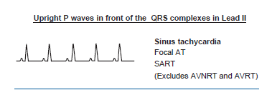
Narrow Complex Tachycardia with Regular R-R Intervals
1. Regular R-R intervals with upright P waves in front of the QRS complexes
Upright in lead II-retrograde activation of the atria (AVNRT or AVRT) is excluded
1.Sinus tachycardia
2.Focal atrial tachycardia
3.Sinoatrial reentrant tachycardia

Slide 41
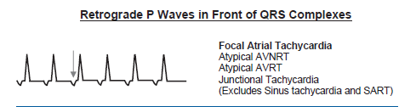
2. Regular R-R intervals with retrograde P waves in front of the QRS complexes
Retrograde P waves in front of the QRS complexes excludes sinus tachycardia and SART
1.Focal atrial tachycardia
2.Junctional tachycardia (paroxysmal or nonparoxysmal)
3.Atypical AVNRT
4.Atypical AVRT

Slide 42
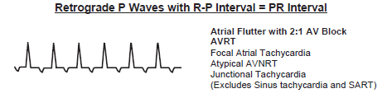
3. Retrograde P waves between QRS complexes
Retrograde P waves between QRS complexes with R-P interval equal to PR interval.
This excludes sinus tachycardia and SART
Atrial flutter with 2:1 AV block is a distinct possibility with the second flutter wave embedded within the QRS complexes

Slide 43
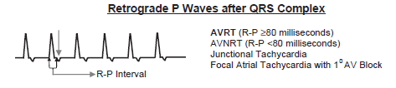
4. Regular R-R intervals with retrograde P waves after the QRS complexes
When R-P interval is shorter than PR interval, the possible arrhythmias
1.AVRT: (R-P interval 80 milliseconds)
2.AVNRT: (R-P interval 80 milliseconds)
3.Junctional tachycardia (paroxysmal or nonparoxysmal

Slide 44

5. Complete AV dissociation with regular R-R intervals
When there is complete AV dissociation with regular R-R intervals, AVRT is not possible and AVNRT is highly unlikely.
This is almost always due to
Junctional tachycardia with complete AV dissociation
P waves are upright in lead II and are completely dissociated from the QRS complex.
The upright P waves represent normal sinus rhythm.

Slide 45

6. Retrograde P Waves with second-degree AV Wenckebach
This is almost always due to focal atrial tachycardia.
This excludes AVRT and makes AVNRT highly unlikely.
This is almost always from focal atrial tachycardia.
Focal junctional tachycardia is also possible, but is unlikely

Slide 46
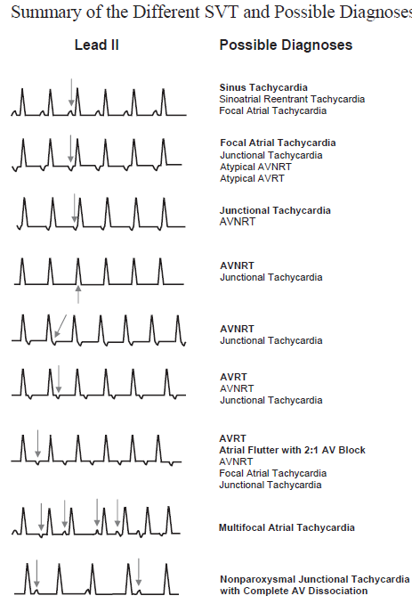

Slide 47
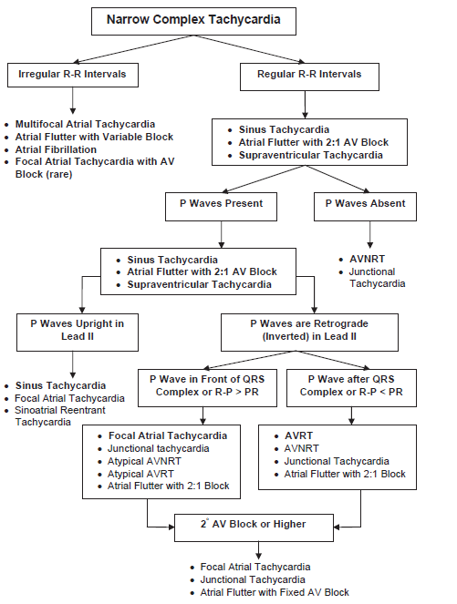

Slide 48
Thank you

