Slide 1

Template
Temperature monitoring in Anaesthesia
Dr. Dinesh Chauhan
Professor,
Dept.Of Anaesthesia,
S.B.K.S.M.I.R.C.,Piparia

Slide 2
WINTER
Introduction
Humans are homeothermic and require a nearly constant internal body temperature.
The homeostatic mechanisms for regulating body temperature represent the thermoregulatory system. Body temperature is controlled by balancing heat production against heat loss.
Anaesthetic-induced impairment of thermoregulatory control, combined with the operating room environment, imposes thermal stress on most patients.

Slide 3
WINTER
Studies have shown that mild hypothermia :
Template
triples the incidence of morbid cardiac outcomes,
triples the incidence of surgical wound infections,
increases surgical blood loss and the need for allogeneic transfusion by about 20%, and,
prolongs postanesthesia recovery and the duration of
hospitalization.
An understanding of normal and anesthetic-influenced thermoregulation will facilitate prevention and management of temperature-related complications.

Slide 4
WINTER
Fundamental Concepts of Heat Transfer
In The Body
The body is divided into a warm internal core and a cooler outer
Template
shell.
The internal body temperature is the temperature of the vital organs inside the head and trunk, which, together with a variable amount of other tissue, comprise the warm internal core. The temperature of the internal core of the body remains very constant, within +/- 1°F
The temperature of the outer shell is strongly influenced by the environment, and is not regulated within . The thermoregulatory responses strongly affect the temperature of the shell, especially its outermost layer, the skin.
Heat is transferred within the body
  from major sites of heat production to the rest of the body, and
  from the core to the skin

Slide 5
WINTER
The shell lies between the core and the environment, all heat leaving
Template
the body core, except heat lost through the respiratory tract, must pass through the shell before being given up to the environment.
Thus, the shell insulates the core from the environment.
Heat is transported within the body by two means:
conduction through the tissues depending upon thermal conductivity of tissues.
convection by the blood depending upon rate of blood flow

Slide 6
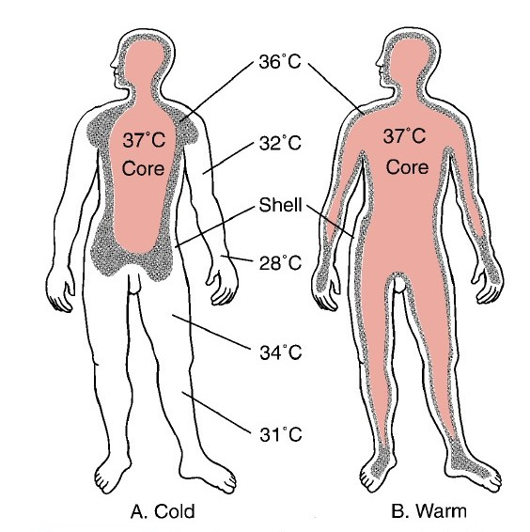
WINTER
Template

Slide 7
WINTER
Heat Production
Template
Heat production is a principal by-product of metabolism. The different factors that determine the rate of heat production, called the metabolic rate of the body include
1.basal rate of metabolism of all the cells of the body 2.muscle activity,
3.effect of hormones, such as thyroxine GH and testosterone 4.effect of epinephrine, norepinephrine,
and sympathetic stimulation on the cells
extra metabolism needed for digestion, absorption, and storage of food (thermogenic effect of food)

Slide 8

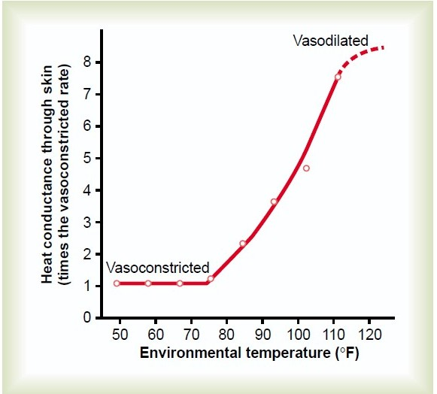
Control of heat conduction to the skin by sympathetic nervous system
Template
♣Heat conduction to the skin by the blood is controlled by the degree of vasoconstriction of the arterioles and the arteriovenous anastomoses that supply blood to the venous plexus of the skin.
♣This vasoconstriction is controlled almost entirely by the sympathetic nervous system in response to changes in body core temperature and changes in environmental temperature

Slide 9

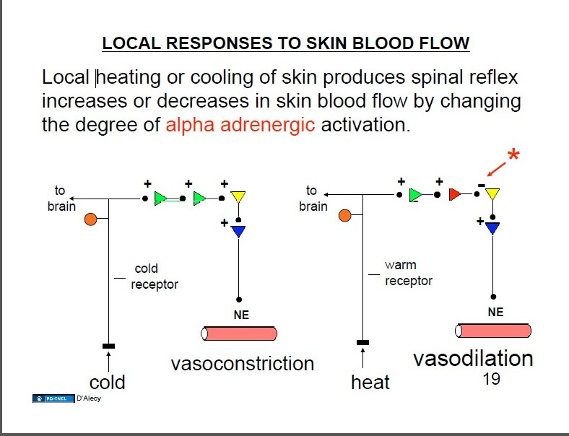
WINTER
Template

Slide 10
WINTER
Heat Loss
Heat loss occurs through 5 mechanisms
1. Radiation.
  Loss of heat by radiation means loss in the form of infrared heat rays. If the temperature of the body is greater than the temperature of the surroundings, a greater quantity of heat is radiated from the body than is radiated to the body.
Conduction
  Direct conduction from the surface of the body to solid objects : about 3%
  Conduction to air: under normal conditions about 15%
Convection
  The removal of heat from the body by convection air currents.
Evaporation
  Heat is lost from the body via sweat. Even when a person is not sweating, water still evaporates insensibly from the skin. It is independent of thermoregulatory control.
Respiration
  About 10% of heat loss takes place during respiration.

Slide 11

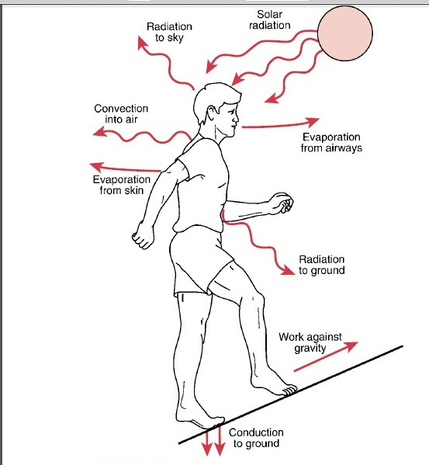
WINTER
Template
Exchange Of Energy With The Environment

Slide 12


core temperature relatively remain constant at 98.0°F 98.
6°F (37°C) even while
Template
Environment temperatures fluctuate from as low as 55°F to as high as 130 °F.
This is due to a remarkable thermoregulatory system that is conventionally organized into three components: afferent sensing, central control, and efferent responses.
1. Afferent Sensing
Temperature Receptors can be classified as central and peripheral thermoreceptors. The actual sensors appear to be a recently discovered class of transient receptor potential (TRP) protein receptors
Central Thermoreceptors
Temperature receptors are located in the spinal cord, mid brain, the lower brain stem,abdominal organ and skeletal muscle.
Peripheral Thermoreceptors
Warm and cold receptors exist in the skin.Cold impulses travel mainly in A- delta fibres and warm impulses in C fibres.

Slide 13

WINTER
2. Central Control
The hypothalamus is the primary regulatory control
The anterior hypothalamic preoptic area serves as a thermostatic body temperature control center.
The temperature sensory signals from the anterior hypothalamic-preoptic
area are also transmitted into this posterior hypothalamic area. Here the signals from the preoptic area and the signals from elsewhere in the body are combined and integrated to control the heat-producing and heat-conserving reactions of the body.
The precise manner by which the body establishes temperature thresholds is unclear, but it appears to involve the interactions of several neurotransmitters, including norepinephrine, dopamine, 5-HT (serotonin),ACh, PG E1, &
other neuropeptides.
Additional factors such as circadian rhythm, exercise, food intake, infection, thyroid dysfunction, menstrual cycle, anesthetics, and and other drugs are known to alter temperature thresholds

Slide 14

WINTER
3. Neuronal Effector Mechanisms That Regulate Body
Temperature
Template
The body responds to thermal perturbations via effector mechanisms that alter metabolic heat production or environmental heat loss.
When the Body Is Too Hot
Vasodilation of skin blood vessels
Sweating..
Decrease in heat production
When the Body Is Too Cold
Vasoconstriction of skin blood.
Piloerection: Sympathetic stimulation causes the arrector pili muscles attached to the hair follicles to contract.
Increase in thermogenesis (heat production). By promoting shivering, sympathetic excitation of heat production, and thyroxine secretion.

Slide 15
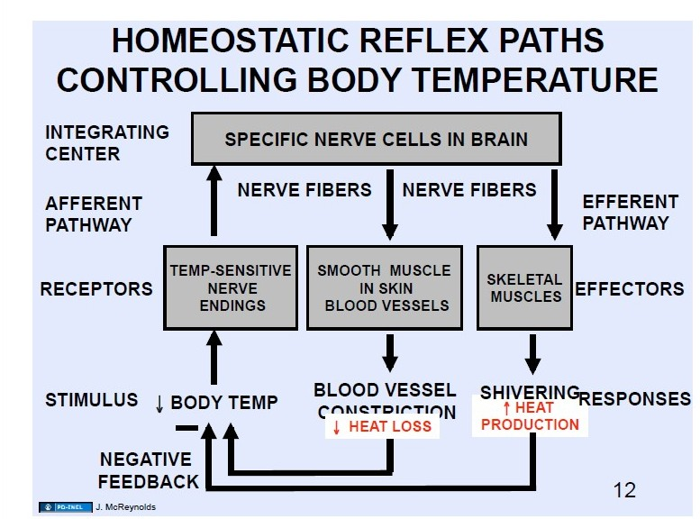
WINTER
Template

Slide 16

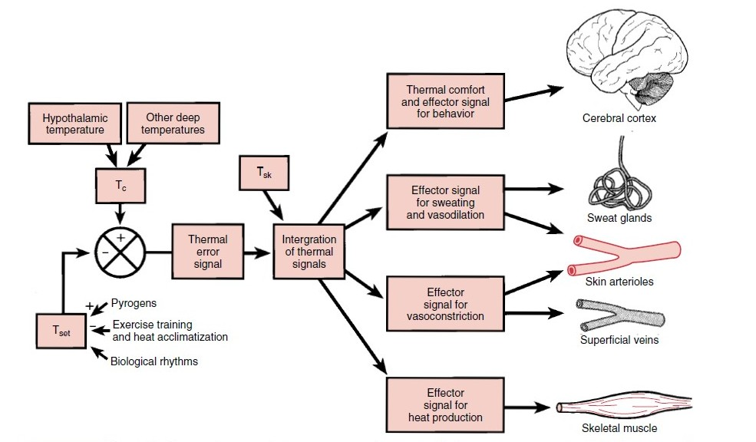
WINTER
Template
Control Of Human Thermoregulatory Responses

Slide 17
WINTER
Vasomotion—
Most metabolic heat is lost fromn skin surface
Cutaneous vasoconstriction,reduces this loss.
Arterio-venous shunts located in acral regions (fingers, toes, nose, etc.) are specialized thermoregulatory vessels. They are under alpha adrenergic control and are constricted by norepinephrine released from sympathetic nerves.
Most blood vessels constrict in response to local hypothermia, but arterio-venus shunts are relatively resistant regional temperature perturbations and appear to be almost exclusively controlled by central thermoregulatory status.

Slide 18

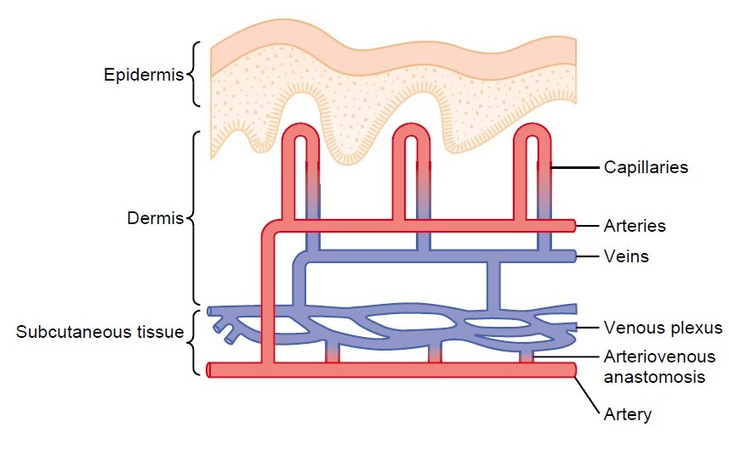
WINTER
Template
Thermoregulatory Arterio-Venous Shunts

Slide 19

WINTER
Sweating
Eccrine sweat glands, the domin an t ty pe
They are controlled through postganglionic sympathetic nerves that release acetylcholine.
Sweating is the only mechanism by which the body can dissipate heat in an environment exceeding core temperature.
Shivering
Shivering is an involuntary, oscillatory muscular activity that augments metabolic heat production.
Shivering does not occur in newborn infants and probably is not fully effective until children are several years old.
Shivering is elicited when the preoptic region of the hypothalamus is cooled .Efferent signals mediating shivering descend in the medial forebrain
bundle . Classically, a central descending shivering pathway was thought to arise from the posterior hypothalamus
Spinal alpha motor neurons and their axons are the final common path for
both coordinated movement and shivering.

Slide 20
Nonshivering
Thermogenesis
INTER
Tem
plate
Increases metabolic heat production without producing mechanical work.
Skeletal muscle and brown fat tissue are the major sources of nonshivering heat in adults.
The metabolic rate in both tissues is controlled primarily by norepinephrine released from adrenergic nerve terminals and is further mediated locally by an uncoupling protein.

Slide 21
WINTER
Thermoregulation During General Anesthesia
♣ With the exception of Ketamine all general anesthetics markedly impair normal
autonomic thermoregulatory control.
Several factors combine together to interfere with normal thermoregulation during GA e.g., abolition of behavioural responses, attenuation of hypothalamic functions,reduced metabolic rate, reduced effector responses and abnormally large thermal stresses.
Inhalational anaesthetics promote heat loss through vasodilation. Redistribute heat to the peripheral tissues and increase the potential for heat loss to the environment. Nitrous Oxide depresses thermoregulation to a lesser extent than equipotent concentrations of the volatile agents.
♣Atropine has numerous thermoregulatory actions.
♣Barbiturates,phenothiazines and butyro-phenones have both central and peripheral actions tending to decrease body temperature.

Slide 22
WINTER
♣ Opioids:
Older opioids such as morphine and meperidine promote heat loss through
Template
vasodilation.
Fentanyl and its derivatives, directly impair hypothalamic thermoregulation in a dose-dependent manner.
Opioids also depress overall sympathetic outflow, which further inhibits any
attempts at thermoregulation. This results in an elevated threshold for heat response, along with a diminished threshold for cold response such as vasoconstriction and shivering.
♣Neuromuscular blocking agents abolish shivering, so paralysed patients cool more rapidly
♣Benzodiazepines: Midazolam only slightly impairs thermoregulatory control.
♣Clonidine and Dexmedetomidine synchronously decreases cold-response thresholds while slightly increasing the sweating threshold.

Slide 23
Temperature Changes After I nduction of general Ana esthesia
Template
Phase 1 / Redistribution (steep drop of 1-2 °C)
This is due to vasodilatation causing redistribution of heat from core to periphery following induction of anaesthesia. Body heat content initially remains unchanged.
Phase 2 / Linear Phase
There is a more gradual reduction in core temperature of a further 1°C over the next 2-3hrs. This usually begins at the start of surgery as the patient is exposed cold theatre environment. Heat loss exceeds heat production.
Phase 3 / Plateau
Once core temperature falls below the thermoregulatory threshold, peripheral vasoconstriction increases and acts to limit the heat loss from the core. When
core heat production equals heat loss to the periphery, core temperature reaches a plateau. This may not be achieved in diabetics with autonomic
neuropathy and impaired vasoconstriction and also during combined general and regional anaesthesia.

Slide 24
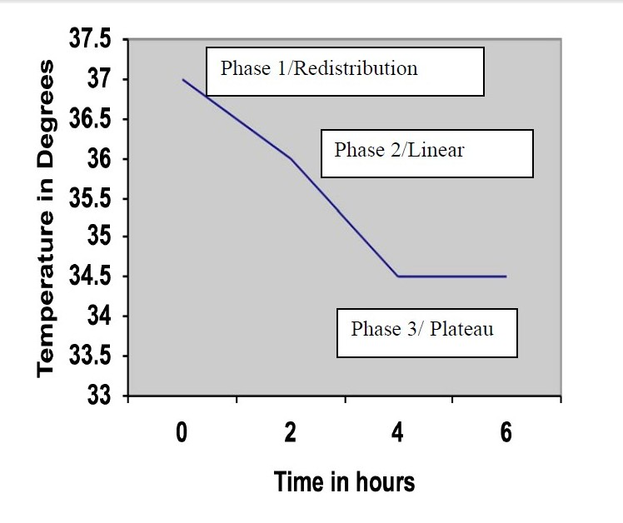
WINTER
Template
Temperature Changes After Induction Of General Anaesthesia

Slide 25
WINTER
Thermoregulation During Neuraxial Anesthesia
♣Autonomic thermoregulation is impaired during regional anesthesia, and the
Template
result is typically intraoperative core hypothermia.
♣Heat losses occur by vasodilatation, shivering and intravenous infusions of cold fluids.Epidural and spinal anesthesia each decrease the thresholds triggering vasoconstriction and shivering.
♣Neuraxial anesthesia is frequently supplemented with sedative and analgesic medications that impair thermoregulatory control.
♣The result is that cold defenses are triggered at a lower temperature than normal during regional anesthesia, defenses are less effective once triggered, and patients frequently do not recognize that they are hypothermic.
♣ Because core temperature monitoring remains rare during regional anesthesia, substantial hypothermia often goes undetected in these patients.

Slide 26
WINTER
HYPOTHERMIA & ITS CONSEQUENCES
Hypothermia is defined as a core temperature ,35° C and may be
classified according to severi
ty based on temperatures below this
Template
reading.
Classification | Temperature
Normothermia | 36°C - 38°C
Mild hypothermia | 32°C- 35°C
Moderate hypothermia | 28°C - 32°C
Severe hypothermia , | 28°C
•

Slide 27
WINTER
Deleterious Effects of hypothermia
Cardiac arrhythmias and ischaemia,bradycardia
Increased peripheral vascular resistance
Left shift of the hemoglobin-oxygen saturation curve, respi arrest
Decrease minute ventilation
Reversible coagulopathy (platelet dysfunction), increase bld vicosity
Postoperative protein catabolism and stress response , hyperglycemia
Altered mental status
Impaired renal function decreased GFR
Decreased drug metabolism
Poor wound healing
Increased incidence of infection
Delayed affects of neuromuscular blockade reversal (prolongation of neuromuscular blocking)

Slide 28
WINTER
Temperature Monitoring
It is standard for patients undergoing general anaesthesia
Heat loss in GA can b max- 30kcal/hr.
It is rarely indicated for moderate sedation but should be considered as high risk of hypothermia for patients such as
small children, the elderly, and others who are noticeably frail.
Various methods and sites can be used for temperature recording e.g. conventional clinical mercury thermometer, skin electronic forehead
thermometer, thermistor probes etc.
Sites of Measurement
One or two of the following measurement can be used.
1 . Nasopharyngeal: A thermistor probe in this position is a less reliable measure of cerebral temperature than correctly placed oesophageal probe. Leakage of gases around tracheal tube may influence the measurement.

Slide 29
2 . Oesophageal: The lower 25% of the oesophagus gives the reliable
Template
approximation of blood and cerebral temperature provided the thoracic
cavity is not open. A distance of 24 cm beyond the corniculate cartilage has been recommended in adults. This method is not suitable in awake patients.BEST SITE
Rectal: It remains the most commonly used site for measuring the core body temperature, commonly reads 0.5-1.0°C higher and responds slow to changes in body temperature. So not suitable as a clinical monitoring during anaesthesia.
Urinary Bladder: Temperature probes in the indwelling urinary catheters have been used to measure core body temperature. They are more accurate when urinary flow is less than 20ml per hour.

Slide 30
5. Tympanic Membrane: tympanic membrane and aural canal temperature
provide a rapidly responsive and accurat
Template
e estimate of hypothalamic
temperature and correlate well with oesophageal temperature. Aural canal is the preferred site, probe is better tolerated, but there is risk of perforation to the tympanic membrane. For ECA
Blood: The thermistors of pulmonary artery catheters enable continuous measurement of blood temperature, the best estimate of core body temperature. MOST ACCURATE
Skin: Measurement of skin temperature gives no information other than local site, where probe is placed

Slide 31
WINTER
Methods Used For Control of Body
Temperature During Anaesthesia
Ambient Temperature(during anaesthesia)
Template
greater than 24°C--all patients remain normothermic (oesophageal temperature 36°C)
between 21-24°C -- 30% patients become hypothermic,
less than 21°C -- all patients become hypothermic
Prewarming
. The patient can be prewarmed before induction with forced-air systems to minimize the drop in core temperature that results from redistribution.
With prewarming of the extremities, patients will require less heat to warm them when the core-to-peripheral redistribution of heat occurs.
Warm cotton blankets will comfort the patient and will minimize normal heat loss by minimizing the patient’s skin exposure.

Slide 32
WINTER
Room Conditions
Template
The operating room temperature is the most important factor in influencing heat loss due to radiation and convection from skin, and to evaporation from surgical wounds when they are large.
The operating room should be warmed to greater than 24°C (ie,76°F) during induction and while the patient is prepped and draped.
Forced-air systems placed over patients are most effective.
Patient positioning is important in heat conservation. The more radially positioned the patient’s extremities,the greater the heat loss. Placing of the arms and legs medially and tucking the patients with blankets to maintain the extremities against the body will also diminish the amount of° heat loss.

Slide 33
Warming Mattresses and Blankets
INTER
anaesthesia and surgery. Combination of warming mattresses with a heater humidifier has been shown to be more efficient in preventing heat loss.
Humidifiers
This loss of heat during administration of dry anaesthesia gases can be totally prevented by adequate humidification of inspired gases.
Heat and Moisture Exchangers ( HMEs)
humidify, warm and filter inspired gas. Their incorporation into paediatric anaesthetic breathing system is recommended, However they can cause delay in the inhalational induction.
These are not very efficient when used alone to counter heat losses during

Slide 34
WINTER
Radiant Heaters
These have been used extensively in the postoperative period to speed
Template
rewarming and to suppress shivering. Core temperature increases more rapidly towards normal with a radiant heater, achieving an additional benefit of suppression of shivering, decreased oxygen uptake, carbon dioxide production and peripheral vasoconstriction.
Oesophageal Rewarmers
These devices consist of a double lumen oesophageal tube through which water is circulated at upto 42°C.
Intravenous Fluids and Blood Rewarmers
Warming of fluids can only help to minimize heat. Warm fluids are probably of benefit only when large amounts are administered for fluid replacement.
Warming of fluids can be accomplished by using fluid warmers attached to the intravenous tubing or with the use of warming cabinets.

Slide 35
WINTER
Anaesthetic Gas Delivery System
close circuit system is beneficial because it causes humidification and warming of inspired gases and there is less pollution of theatre atmosphere.
Extracorporeal Circulation
It is highly effective in patients who have suffered severe hypothermia, (core temperature less than 28°C) major trauma, accidental hypothermia, like drowning.

Slide 36
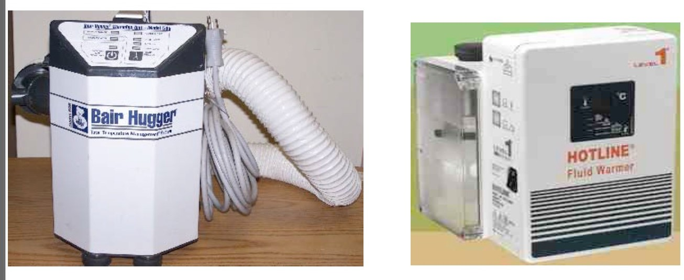
WINTER
Template
Forced air warming blanket
Intravenous fluid warmer

Slide 37
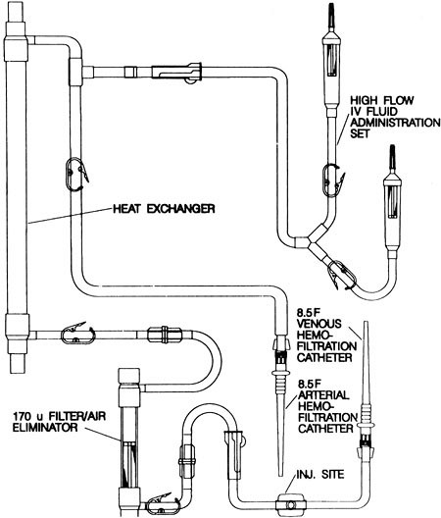
WINTER
Template
Countercurrent Heat Exchanging System

Slide 38
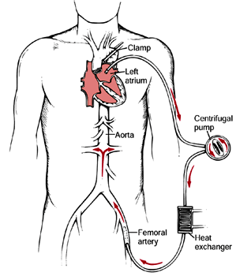
WINTER
Template
Extracorporeal Circulation

Slide 39
WINTER
Post Anaesthetic Shivering
♣
It is a potentially serious complication that increases oxygen
Template
consumption roughly 100% in proportion to intraoperative heat loss.
♣In addition to increasing IOP & ICP, postoperative shivering possibly aggravates wound pain by stretching incisional site.
♣The most important determinants of shivering risk are young age and low core temperature.
♣The etiology of postanesthetic shivering-like tremor is unclear. It may result from anesthetic-induced disinhibition of normal descending control over spinal reflexes.
♣ Intense shivering increases O2 consumption 5 fold, CO2 production , so decrease spo2 , hence increase risk of MI.

Slide 40
WINTER
Treatment
Template
Skin surface warming
Postanesthetic shivering can also be treated with a variety of drugs,
  Clonidine (75 µg IV) (alpha 2 adrenoreceptor agonist)
  Ketanserin (10 Mg IV) (selective serotonin receptor antagonist)
  Tramadol (1 mg/kg i.v) (opioid)
  Physostigmine (0.04 Mg/Kg IV),
  Nefopam (0.15 Mg/Kg) (non opioid , non steroidal centrally acting analgesic)
  Dexmedetomidine (1mcg/kg i.v) (alpha 2 adrenoreceptor agonist)
  MgSO₄ (30 Mg/Kg IV).
  Meperidine (0.1-1.0 mg/kg)(pethidine synthetic opioid)

Slide 41
WINTER
The specific mechanisms by which ketanserin, tramadol,
Template
physostigmine, and MgSO₄ stop shivering remain unknown.
Clonidine and dexmedetomidine comparably reduce the vasoconstriction and shivering thresholds, thus suggesting that they act on the central thermoregulatory system rather than preventing shivering peripherally.
Alfentanil, a pure µ-receptor agonist, significantly impairs thermoregulatory control. However, meperidine is considerably more effective in treating shivering than equi-analgesic doses of other µ-agonists.

Slide 42
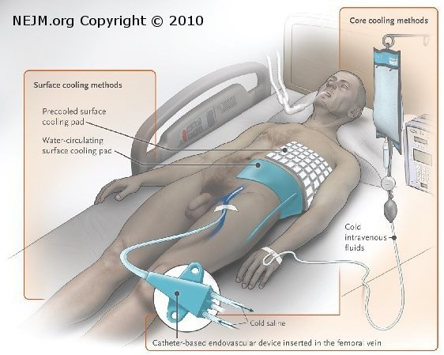
WINTER
Induced Hypothermia
Therapeutic hypothermia was first
Tem
plate
reported scientifically by Fay in 1940 for the treatment of head injury.
Induced hypothermia aims to avoid the complications associated with hypothermia.
It is principally used in comatose cardiac arrest survivors, head injury, and neonatal encephalopathy.

Slide 43
WINTER
Mechanisms Of Action
Template
It has been established that induced hypothermia has the following mechanisms of action that lead to its neuroprotective effect:
Reduction in cerebral metabolism (CMRO2)
Promotion of cerebral vasoconstriction,which can directly decrease ICP. Also vascular permeability and therefore oedema.
Prevention of neuronal injury leading to programmed cell death (apoptosis) mainly by inhibition of caspase activation.
Suppression of the inflammatory cascade and decreased nitric oxide, cytokine and leukotriene production. Leukocyte migration from the damaged endothelium is diminished

Slide 44
WINTER
.
Template
Improved ionic homeostasis and blockage of the destructive neuroexitotoxic cascade consequent to glutamate accumulation and receptor activation, and subsequent intracellular calcium overload.
Decreased free radical formation.
It allows for the cerebral regional temperature differences of 2–3°C that are known to exist (cerebral thermopooling). Thus, the likelihood of some areas of the brain being hyperthermic(which is known to worsen outcome) is reduced.

Slide 45
WINTER
Side-effects Of Induced hypothermia
1. Cardiovascular System
increase in catecholamines leads to an increase in cardiac output and oxygen demand.
With further hypothermia, decreases in heart rate and the slowing of metabolism reduce cardiac afterload and oxygen demand.
SVR is increased and CVP increases
ECG changes
  Widened PR interval,
  widening of the QRS complex,
  appearance of the Osborne or ‘J wave’
  Arrhythmias: AF is usually followed by refractory VF when the temperature is decreased to <28C.

Slide 46
WINTER
2. Respiratory system
Template
There is a higher incidence of pneumonia in hypothermic patients.
3. Haematological
Bleeding time will be lengthened as a result of a reduction in the number and function of platelets.
The coagulation cascade may also be impaired, although the direct tests
such as PT and APTT may not reflect these changes, as they are performed at 37° C.
The white cell count also decreases.
** Therefore, the use of hypothermia in polytrauma patients is controversial as deleterious effects of induced hypothermia on the whole body may outweigh the benefits of neuroprotection..

Slide 47
WINTER
4. Renal system
Template
Diuresis results from decreased absorption of solute in the ascending loop of Henle´.
Electrolyte Imbalance: Intracellular movements of K+, Mg2+&PO4- during induced hypothermia lead to lowered serum concentrations of these ions.
5. Acid–base Imbalance
As temperature decreases, the solubility of gases in blood increases. Hypothermia presents a problem in the interpretation of arterial blood gases (ABG) as when theABG sample is adjusted to compensate for the low temperature, patients appear to have a respiratory alkalosis.

Slide 48
WINTER
6.Other Side-effects
Template
Induced hypothermia impairs immune function; nosocomial pneumonia will occur in over half of patients who are hypothermic for >7 days. Wound healing may be delayed.
The risk of infection is compounded by poor glycaemic control due to insulin resistance and decreased insulin release.
Decreased gastrointestinal motility
Serum amylase and liver enzymes are frequently raised
Metabolic acidosis also occurs as a result of increase in lactate concentrations and increased production of free fatty acids, ketones and glycerol.
Rarely pancreatitis can ensue.

Slide 49

WINTER
Techniques Used For Induced Hypothermia
(i) Antipyretics.
Template
Fans.
Ice packs to the femoral area, major vessels, and armpits.
Cold fluids, for eg. Crystalloid solution 30 ml kg at 4°C for more than 30 min.
Water filled blankets or garments
Forced cold air.
Intravascular line.
Cooling caps—these are mainly used in neonates and infants.

Slide 50
WINTER
Clinical applications
Template
Cardiac arrest
Traumatic head injuries
Newborn hypoxic–ischaemic encephalopathy
Neurosurgery
Cerebrovascular accident (stroke)

Slide 51
WINTER
Hyperthermia
Hyperthermia is a generic term simply indicating a core body
temperature exceeding normal values. In contrast, fever is a regulated increase in the core temperature targeted by the thermoregulatory system.
Passive Hyperthermia and Excessive Heat Production—
Passive intraoperative hyperthermia results from excessive patient heating and is most common in infants and children.
Hyperthermia is aggravated by the frequent use of atropine.
Passive hyperthermia, does not result from thermoregulatory intervention.
Consequently, it can easily be treated by discontinuing active warming and removing excessive insulation.

Slide 52
WINTER
Fever
Template
Fever is mediated by endogenous pyrogens which increase the thermoregulatory target temperature (“setpoint”).
Endogenous pyrogens include interleukin-1, tumor necrosis factor, interferon alpha, endothelin-1, and macrophage inflammatory protein-1.
Fever is relatively rare during general anesthesia. The reason could be that volatile anesthetics per se inhibit expression of fever, as do opioids.
Infection is the most common cause of fever.
Perioperative fever also occurs in response to mis-matched blood transfusions, blood in the fourth cerebral ventricle, drug toxicity, and allergic reactions.
Treatment depends on the etiology.

Slide 53
WINTER
HEAT STROKE (failed compensation)
Medical emergency -core temperature rises to point that hypothalamic integrating center ceases to function.
Sign - absence of sweating.

Slide 54
WINTER
Malignant Hyperthermia
Template
It is characterized by hyper metabolic response to potent inhalation agents and
succinylcholine resulting in increased CO2 production, oxygen consumption, fever, muscle hypercatabolism, rigors & if untreated may lead to death.
It is malignant due to rapid progression of irreversibility inspite of withdrawl of original stimulus.
Described by – Denborough and Loveli
Common in United States.
Genetics
♣Three modes of inheritance: Autosomal dominant Autosomal recessive Unclassified
♣ The Gene for MH is located on Chromosome 19, which is also the genetic
coding site for Ryanodine receptors ( Calcium release channel) of skeletal muscle from sarcoplasmic reticulum
Some reports regarding chromosome 17.

Slide 55
Non-triggering Agents
Triggering Agents
Volatile gaseous inhalation anesthetics
Propofol Ketamine Nitrous oxide
All local anesthetics All narcotics
Non-depolarizing muscle relaxants
Vecuronium Rocuronium Pancuronium
•
•
•
•
•
•
Isoflurane Sevoflurane Desflurane Halothane Enflurane Methoxyflurane
Ether
•
•
•
Succinylcholine

Slide 56

WINTER
Pathophysiology
MH is a syndrome caused by dysregulation of excitation-contraction (EC) coupling in skeletal muscle.
Patients susceptible to MH have a defective calcium channel on the sarcoplasmic reticulum of the skeletal muscle cells.
Fulminant MH syndrome is associated with a persistent increase in intracellular Ca²⁺. The increased activity of pumps and exchangers trying to correct the increase in Ca²⁺ causes a need for ATP, which in turn produces heat. Thus, the end result is hyperthermia.
The rigidity that is frequently seen during a fulminant MH episode is the result of the inability of the Ca²⁺ pumps and transporters to reduce the unbound myoplasmic Ca²⁺ below the contractile threshold, so there is sustained muscle contraction due to troponin inhibition.
Dantrolene is therapeutic because it reduces the concentration of myoplasmic Ca²⁺.

Slide 57
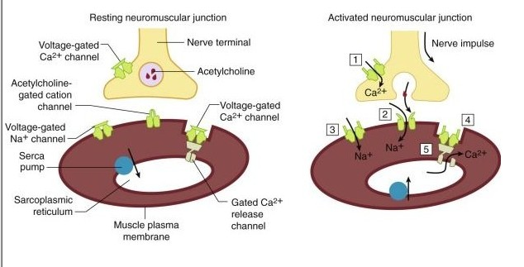
WINTER
Template
Excitation-Contraction Coupling

Slide 58
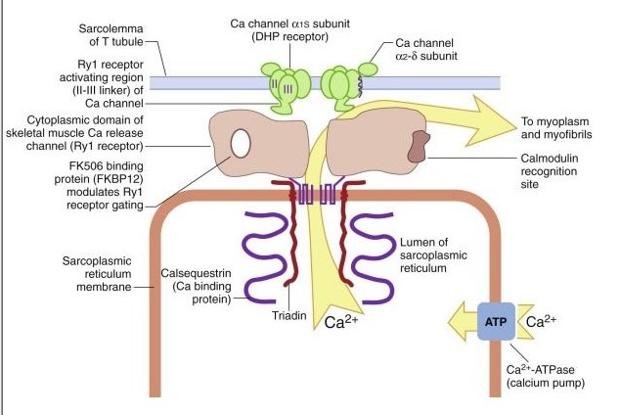
WINTER
Template
Ryanodine Receptor

Slide 59
WINTER
Clinical Features-signs of MH
Marked increase metabolism
CO2 production (Increased in EtCO₂ with adequate ventilation.)(60%)
O2 consumption
Unexplained decrease in O₂ saturation .
body temperature above 38.8 degree celcius with no obvious cause(fever n sweatin)
Unexpected metabolic and respiratory acidosis
Cyanosis(70%)
Mottling(20%)
sympathetic activity
Unexplained sinus tachycardia (96%)
ventricular arrhythmias.(70%)
hypertension(85%)
Tachypnea if spontaneous ventilation is present .(85%)
Muscle damage
Masseter Spasm (MMR)(inability to open jaw,forceful contraction)
generalized rigidity(80%)
Increased serum levels of K, ionized Ca, CK, PO4, Na, Mg
Myoglobinemia, myoglobinuria (dark colourd urine)

Slide 60
WINTER
Investigations
Template
Capnograph: Rising EtCO2
Pulse oximeter: Falling saturation
ECG monitor:
Tachycardia Arrythmias
- Ventricular bigemeny
-Multifocal premature beats
-Ventricular fibrillation
-Ventricular tachycardia
ABG:
Arterial hypoxemia PO2
Hypercarbia ( 100 to 200 mm of Hg )
Respiratory & metabolic acidosis( Ph 7.15 to 6.8) pH

Slide 61
WINTER
Electrolytes:
Hyperkalemia ( > than 6 mEq)
Hypernatremia
hyperphosphatemia
Plasma & urine myoglobin elevated
Raised transaminase enzymes
Markedly elevated CK ( > 20,000 IU/L)
  ( peak levels after 12 to 24 hours of the episode and 12- 18hrs after anaesthesia)
lactate, pruvate, LDH
COMPLICATIONS
-AKI -seizures
-DIC -hepatic failure
-cerebral oedema -death

Slide 62

WINTER
Treatment
Discontinue all anaesthetic agents, succinylcholine and hyperventilate with 100% oxygen.
Administer dantrolene (2.5 mg/kg intravenously [IV] to a total dose of 10 mg/kg IV) diluted in NS every 5 to 10 minutes until symptoms subside (highly alkaline)
  it is hydantoin derivitive- inhibit caion release n binds to Ryr1 receptor.
  Other uses –thyroid storm -neuroleptic malignant syndrome.
  ADR-respiratory insuffiiciency - phlebitis in small periphery veins. (so use in central line)
  Contains mannitol – 3gm /20mg bottle
Administer bicarbonate (2 to 4 mEq/kg IV) to correct the metabolic acidosis with frequent monitoring of blood gases and pH.
Control fever by administering iced fluids, cooling the body surface, cooling body cavities with sterile iced fluids, and if necessary, using a heat exchanger with a pump oxygenator ,cooling blankets, iced saline lavage

Slide 63
Monitor urinary output and establish diuresis (furesemide) to protect the kidney from probable myoglobinuria.End tidal co2 monitoring.
Treatment of hyperkalemia with glucose and insulin should be slow, dextrose 25-50gm iv and if require antiarrhythmic agents.
Don’t give CCB.
Analyze coagulation studies (e.g., INR, platelet count, prothrombin time, fibrinogen, FDP)
CONFIRMATION OF DIAGNOSIS
Fresh biopsy of living skeletal muscle
Expose it to caffeine, halothane or combination bath
Caffeine- halothane contracture test- zero false negative, 10% false positive
Then genetic testing and testing of family members

Slide 64
DIFFERENTIAL DIAGNOSIS
Malignant hyperthermia
Neuroleptic malignant sydrome
Thyroid storm (hypotension n hypokalemia)
Pheochromacytoma (no increase in CO2 or EtCO2)
Drug induced hyperthermia
Serotonin syndrome (confusion due to MAOI)
Iatrogenic hyperthermia
Brainstem/ hypothalamic injury
Sepsis (localised infected site)
Transfusion reaction(h/o BT)
ASSOCIATED DISORDERS
King denborough syndrome
Duschene muscular dystrophy
Myotonia congenita
Osteogenesis imperfecta
Glycogn storage disorders etc

Slide 65
WINTER
Conclusion
♣Thermal balance during anaesthesia is as important as maintaining other
Template
vital signs like pulse, blood pressure,respiration, oxygenation and capnography of the patient.
♣ By minimizing the thermal stresses imposed on the patient and by providing a warm operation theatre, adequately heated humidified inspired gases and warm intravenous fluids, a thermal balance can be achieved.
♣Temperature monitoring is always desirable during major surgical procedures particularly when controlled hypothermic techniques are being used.
♣Post anaesthesia period cannot be overlooked in this regard, as shivering is potentially dangerous especially in children and patients with limited cardiopulmonary reserve.
♣Temperature monitoring should continue during this period and shivering treated by warming mattresses and blankets, warm air, radiant heating of the skin, administration of oxygen and opioid like Pethidine.

