Slide 1
SUPRAGLOTTIC AIRWAY DEVICES
Dr.Akhilesh Chhaya
Aso. Professor,
Dept.Of Anaesthesia,
S.B.K.S.M.I.R.C.,Piparia

Slide 2
SUPRAGLOTTIC AIRWAY DEVICES
The word “supraglottic” means “above the glottis” or “above the larynx”.
Sometimes authors refer to these products as "extraglottic” devices.

Slide 3
History
Advantages
Indications
Contraindications
Complications
Desirable features of LMA
Role of LMA in difficult airway algorithm
Classification
Individual Devices

Slide 4
HISTORY
In 1988, DR. ARCHIE BRAIN introduced the first supraglottic airway device – the LMA.
He took the idea from Goldman dental nose piece.

Slide 5
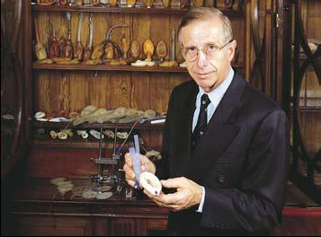
Dr. Archie Brain

Slide 6
ADVANTAGES OF SUPRAGLOTTIC AIRWAY DEVICES
1) All supraglottic airway devices avoid tube so that minimal resistance in the patient’s upper airway.
2) hemodynamic stability .
3) In advertant bronchial intubation is avoided.
4) Ease of insertion and smooth awakening.
5) These devices permit endotracheal intubation, if situation requires.
6) Allows spontaneous or assisted ventilation
7) Allow hands-free maintenance of an open airway

Slide 7
INDICATIONS
1) Supraglottic devices have been recommended as rescue airways.
2) Procedures outside the operating room-
    Radiology and MRI
    Radiation Therapy
    Diagnostic and short therapeutic procedures in children
    Cardiology

Slide 8
3) Head and Neck surgeries
4) Pulmonary medicine and Thoracic surgeries
- Laser surgery of the trachea
- Tracheobronchial stent placement
5) Neurosurgery

Slide 9
CONTRAINDICATIONS
1) Small oral aperture.
2) Any oropharyngeal, pharyngeal or hypopharyngeal mass.
3) Esophageal pathology- caustic ingestion
4) Full stomach patients, gross or morbid obesity, pregnancy, multiple injury, acute abdominal or thoracic injury, conditions of delayed gastric emptying.
5) limited value in patients of poor lung compliance.

Slide 10
complications
Minor complication- Sore Throat (10%)
Major complication- Aspiration (2 per 10000 cases)
Others- Neurovascular complications
- Perforation of esophagus

Slide 11
desirable features of lma
The device should be made of good quality, non-harmful materials.
A long shelf life is desirable.
Design should enable cleaning.
Emergence should be without complications.

Slide 12
ROLE OF LMA IN ASA’S DIFFICULT AIRWAY ALGORITHM
LMA has role in the management of difficult airway as:
A) ventilatory device
B) as a conduit to aid tracheal intubation
These 4 places are:
As an intubation conduit in the awake intubation limb
As an intubation conduit in the non-emergency pathway in anaesthetized patient.
As an airway device in the emergency pathway ( CVCI of the algorithm)
As an conduit to endotracheal intubation in the emergency pathway (CVCI)

Slide 13
CLASSIFICATIONS
First generation SADs
These fit the description of simple air ways
They include cLMA, flexible LMA and all LMA
In addition they include laryngeal tube(LT) and cobra perilaryngeal air way.
They may or may not protect aspiration in the event of regurgitation

Slide 14
Second-generation SADs
SADs that have been
for safety
to reduce the risk of aspiration a
Good ventillation without leak
These include:
PLMA
i-gel
Supreme LMA(SLMA)
LARYNGEAL SUCTION 11

Slide 15
Clasiification based on lumens
Single lumen- LMA classic, LMA unique, ILMA , C trach.
Double lumen – proseal LMA, combitube, laryngeal tube suction(LTS)
Triple lumen- elisha airway device

Slide 16
Clasiification based on sealing mechanisms (millers in 2004)
Cuffed perilaryngeal sealers – a) Non directional sealers: LMA, ILMA, LAD, Soft seal
b) Directional sealers : PLMA
2. Cuffed pharangeal sealers- a) without oesophageal sealing: COPA, PAX
b) With oesophageal sealing: combitube lt, LTS
3. Cuffless pre shaped sealers: SLIPA( stream lined liner of pharangeal airway), I gel, Baska mask

Slide 17
Individual devices

Slide 18
LMA CLASSIC
LMA Classic™ was first introduced in the U.K. in 1988 and in the U.S. in 1992 as an alternative to the face mask.
Curved tube ( shaft) connected to an elliptical spoon- shaped mask ( cup) at a 30˚ angle.
Two flexible vertical bars to prevent the tube from being obstructed by epiglottis.
An inflatable cuff
An inflation tube
Self sealing pilot baloon

Slide 19
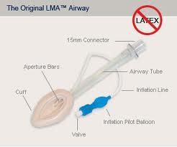

Slide 20
The limtations of c LMA are largely that
  controlled ventilation is not possible due to the moderate pharyngeal seal
  there is a risk of pulmonary aspiration of regurgitant material.
Clinical benefits:
More secure than a face mask
Allows single-handed ventilation
Rapid, blind insertion (no laryngoscopy)

Slide 21
Due to the low-pressure seal between the cLMA and the pharynx (median 20 cm H₂O, rarely 30 cm H₂O)
when the airway pressure increases above the pharyngeal seal (during controlled ventilation), ventilating gas is lost

Slide 22
How might the cLMA be improved?
(i) Improve protection against aspiration in the event of regurgitation
(ii) Improve the ability to deliver positive pressure ventilation in a variety of patients and position.

Slide 23
AVAILABLE LMA CLASSICS
LMA SIZE | PATEINT SIZE
1 | Neonates/ infants <5 kg
1.5 | Infants between 5-10 kg
2 | Infants/ children 10-20 kg
2.5 | Children 20-30 kg
3 | Children 30-50 kg
4 | Adults 50-70 kg
5 | Adults 70- 100 kg
6 | Adults >100 kg

Slide 24
insertion technique
STANDARD TECHNIQUE- midline or diagonal.
  Head in extension and neck in flexion.
  Jaw should be pulled down.
  Pen holding manner with the index finger pressing on the joint between cup and shaft.
  The tip of the cuff is placed against the inner surface of the upper incisors and gums.
  As the LMA is advanced, the mask portion is pressed against the hard palate.

Slide 25
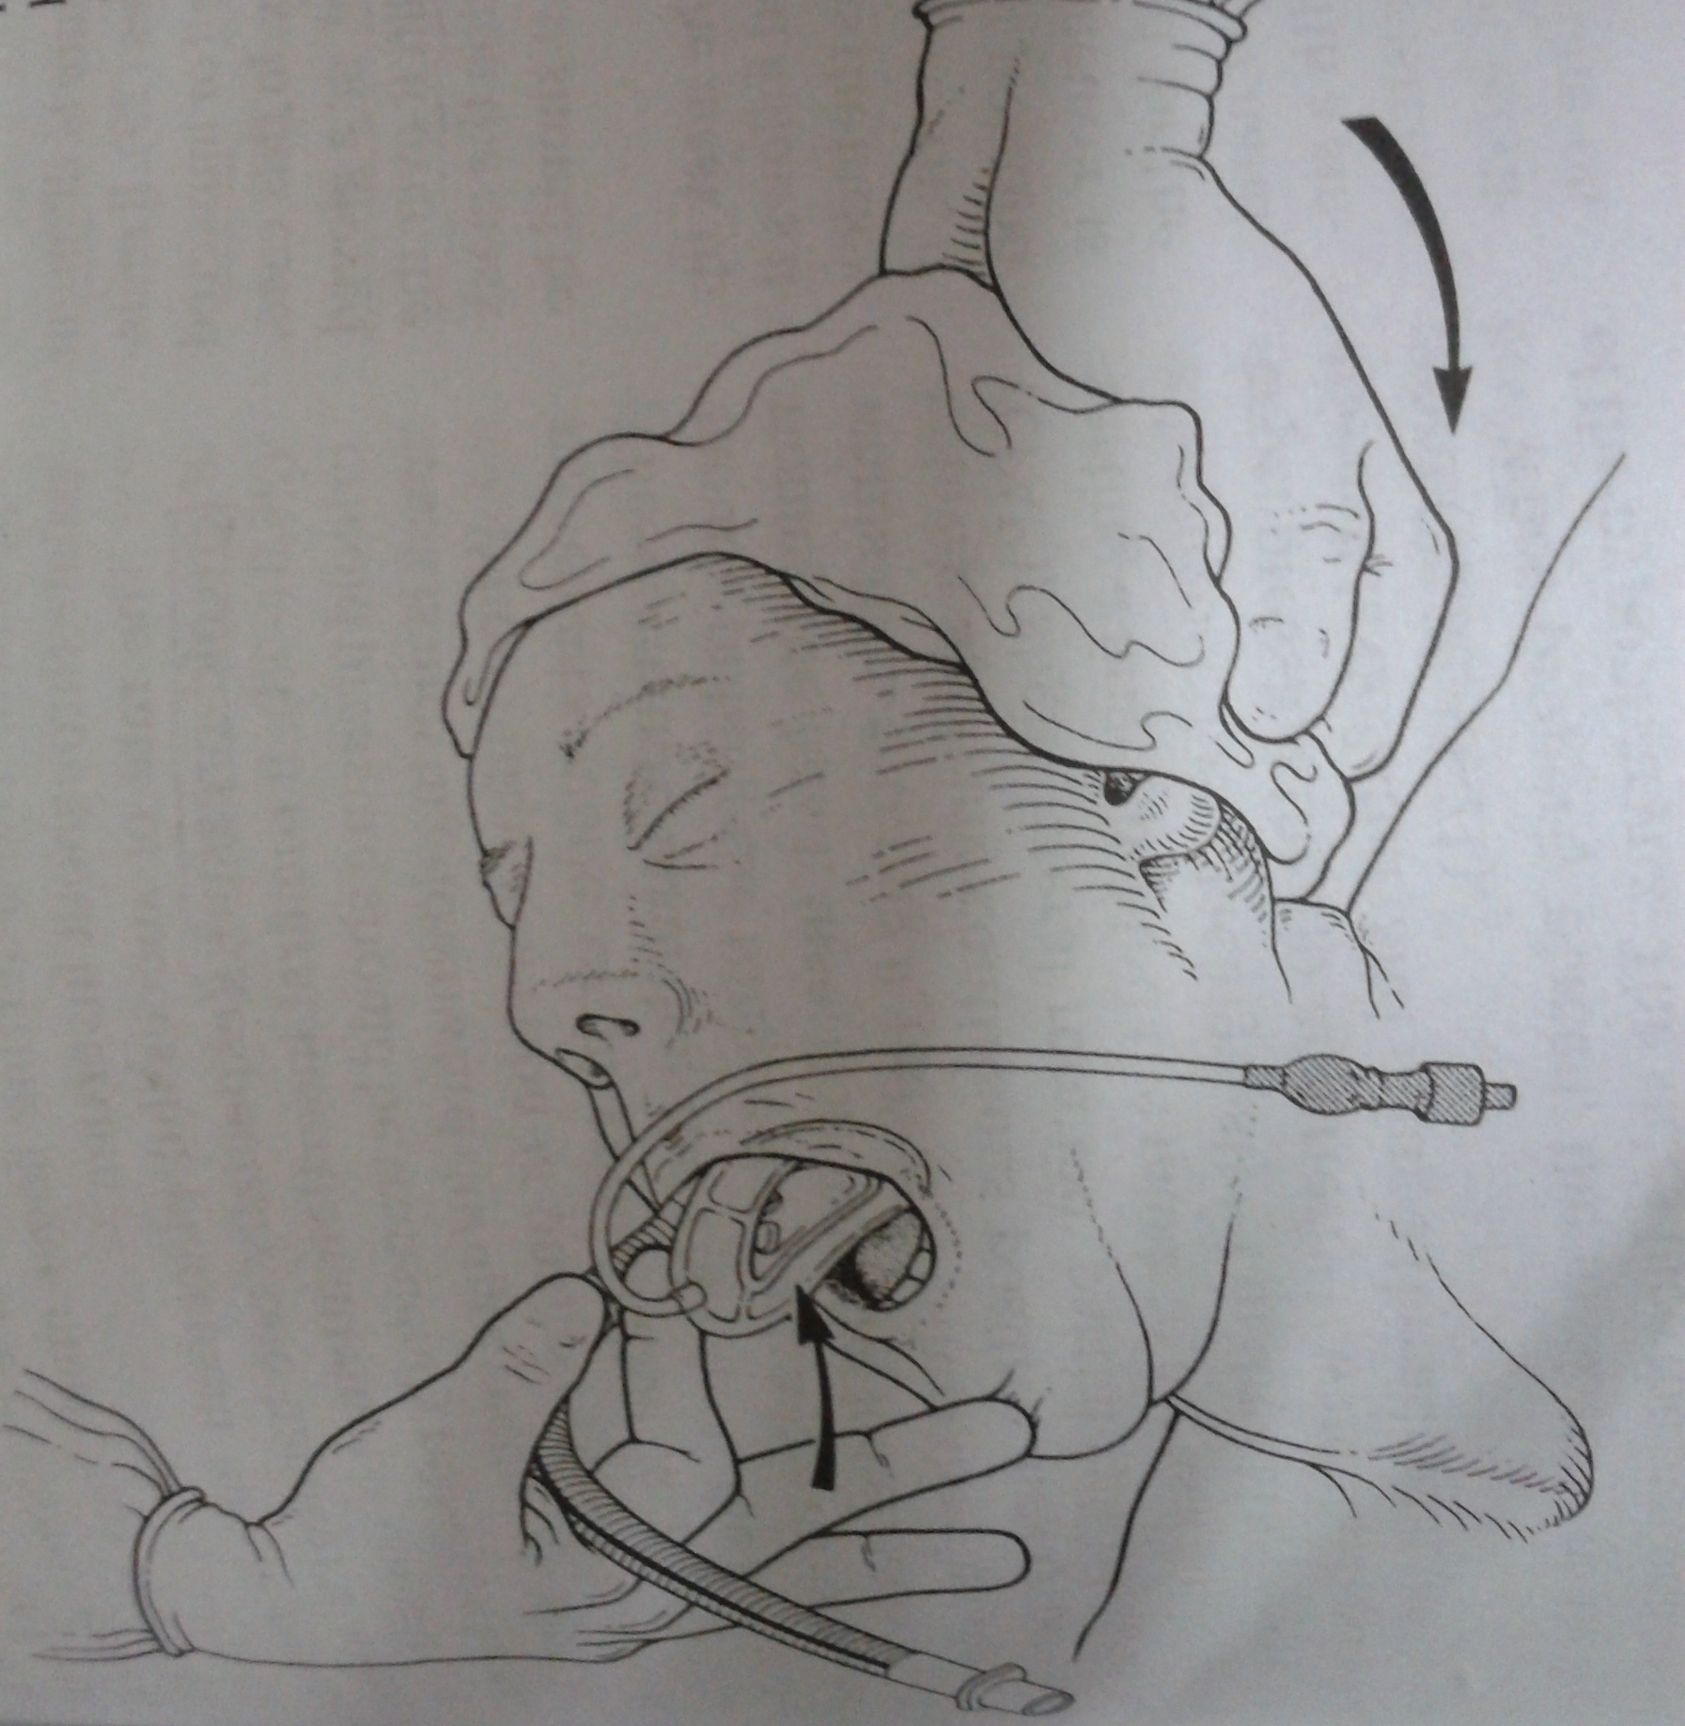

Slide 26
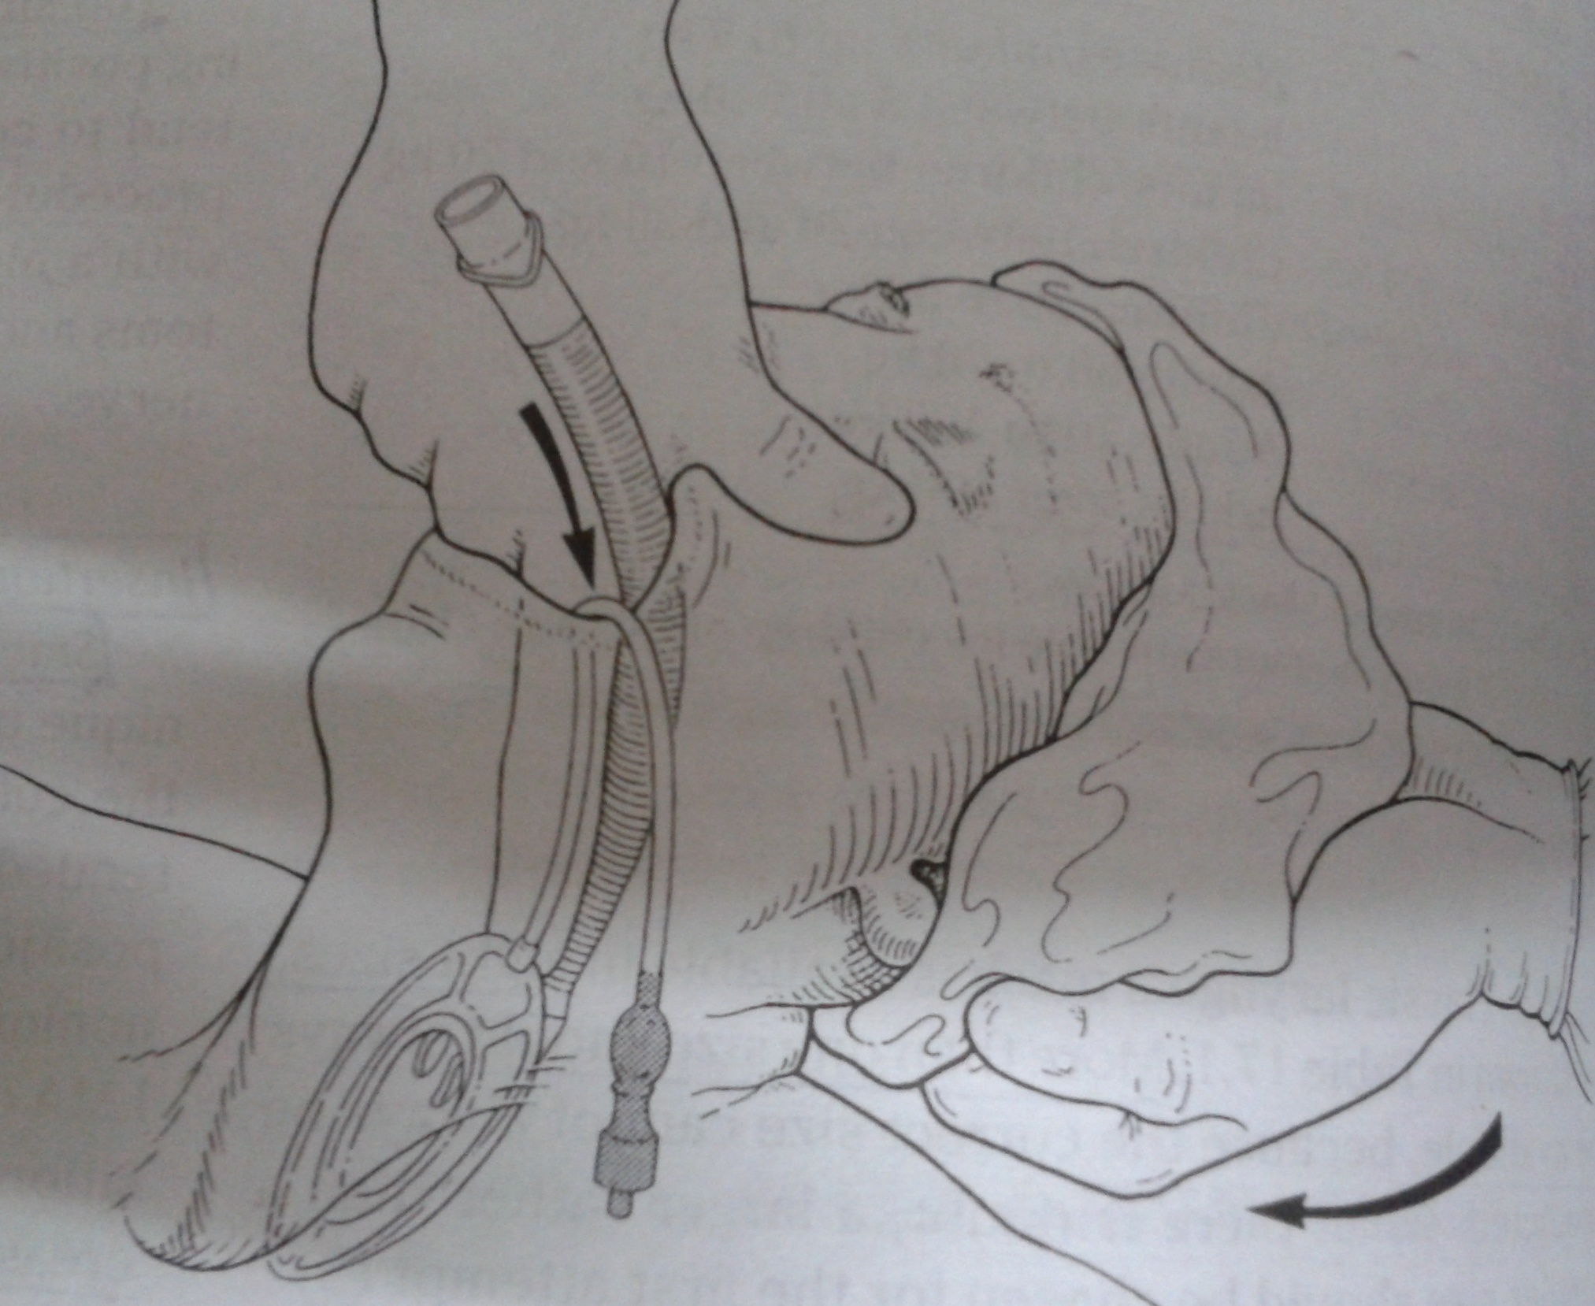

Slide 27
STANDARD THUMB INSERTION TECHNIQUE :
Used where access to the pt.’s head is impossible from behind.
The LMA is held with the thumb and index finger in the standard position and advanced to its fullest extent.
The pushing action of thumb in against hard palate serves to press the head into extension.
Neck flexion is maintained with head support.

Slide 28
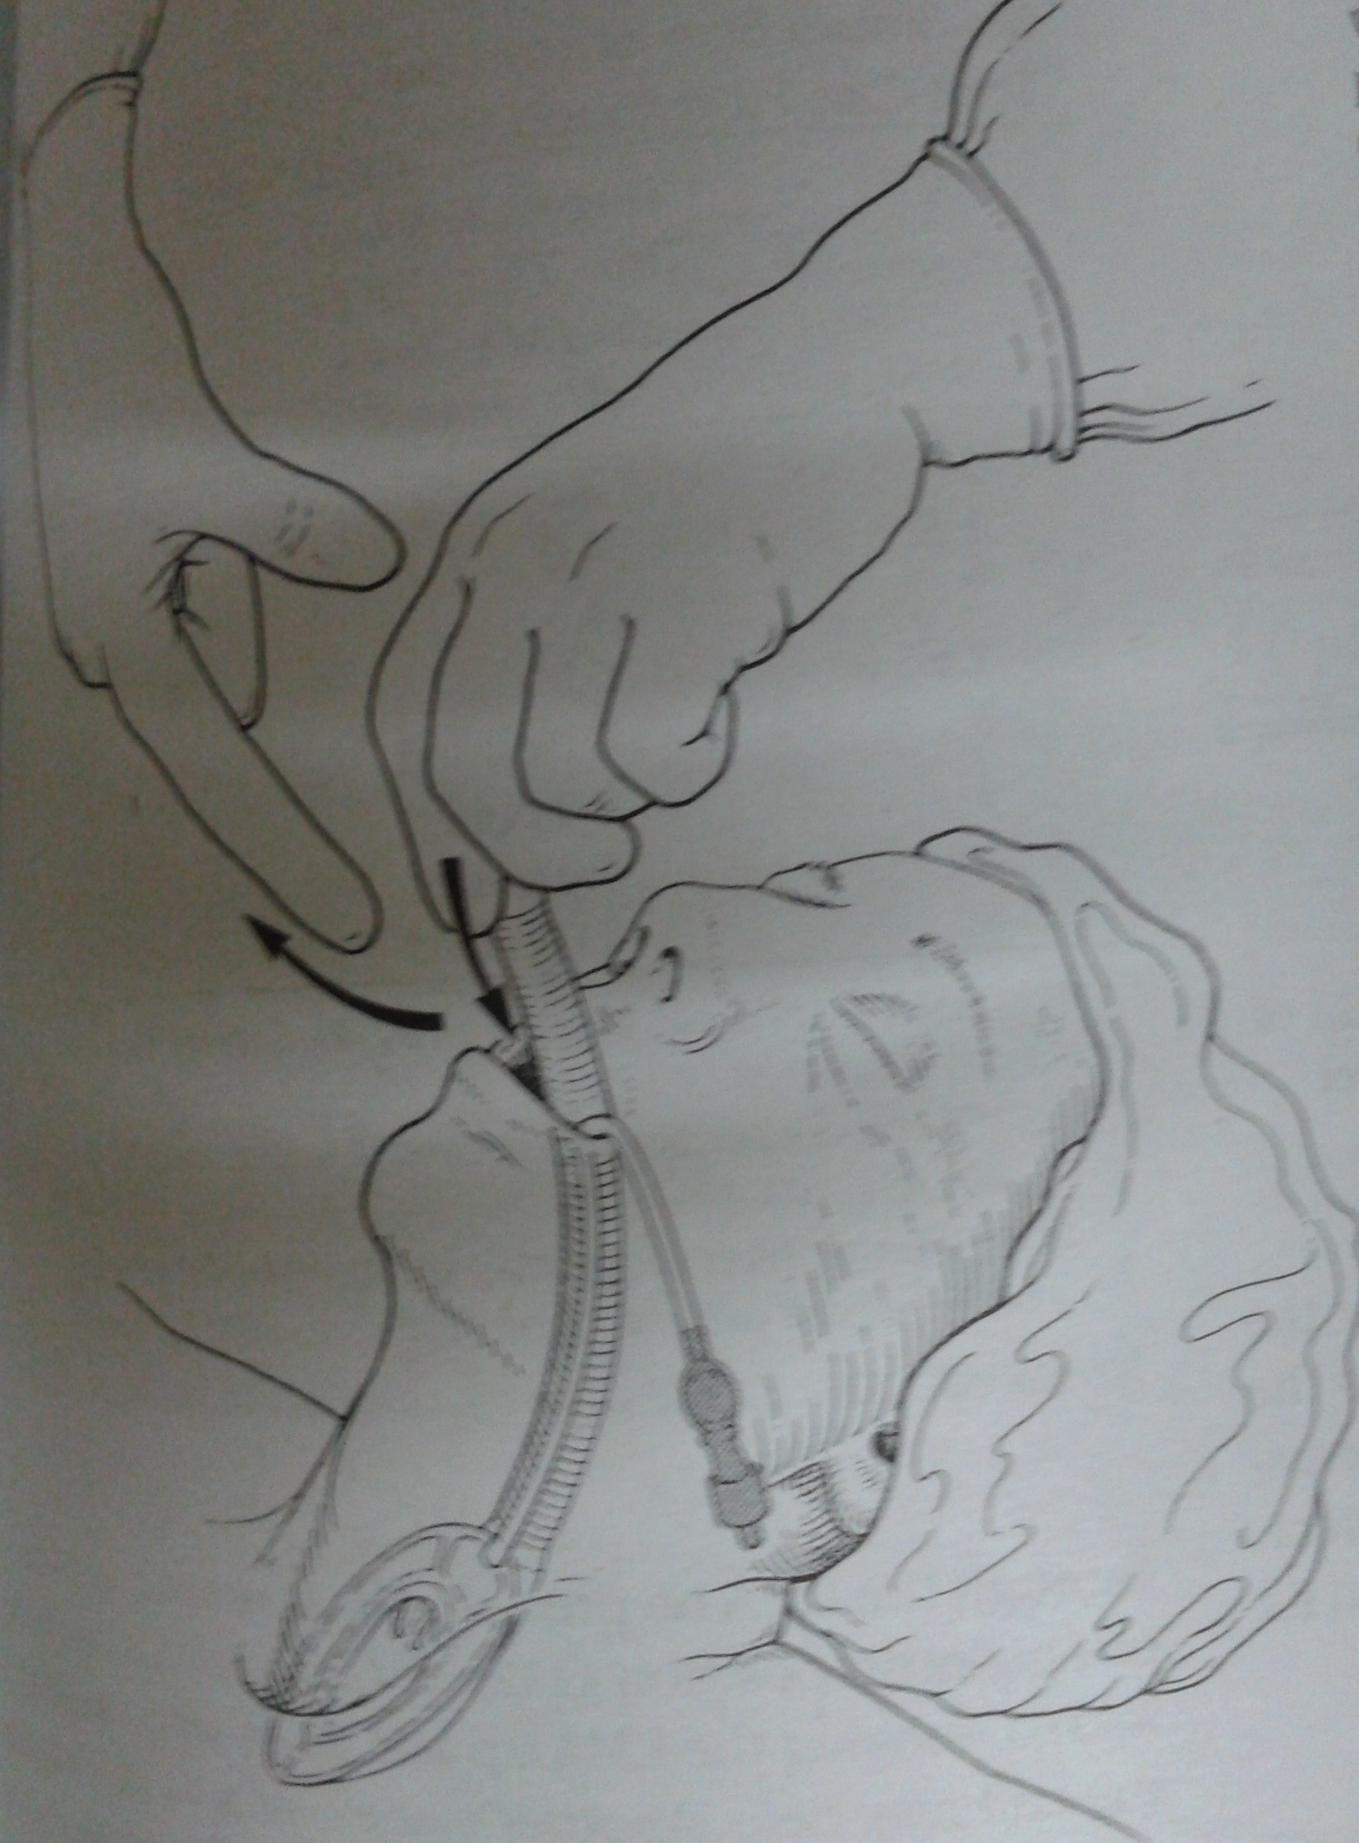

Slide 29
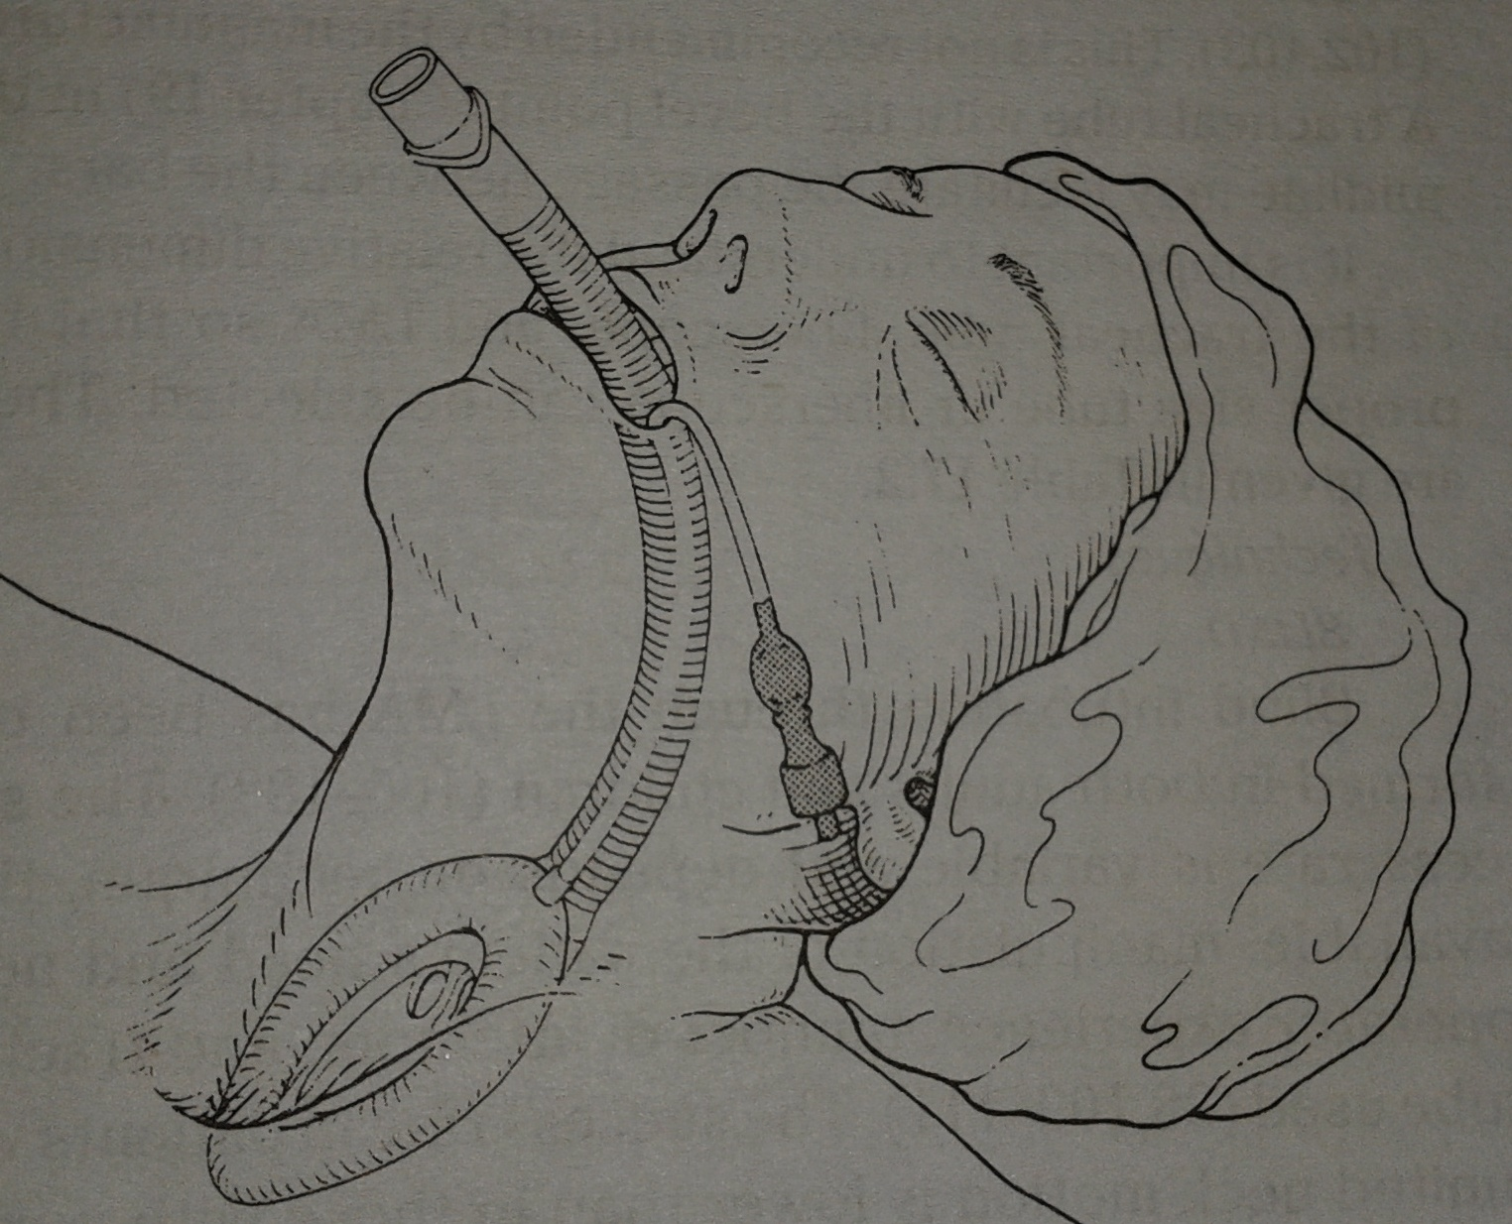
laryngeal mask in place

Slide 30
WHAT ARE THE MODIFICATIONS OF cLMA?

Slide 31
Proseal lma
Introduced by Dr. Archie Brain in 2000.
Has two separate tubes separate GI and respiratory tracts.
Three dimensional inflation of cuff
Holds a better cuff seal pressure.
Drainage Tube- facilitate gastric tube insertion.
The PLMA airway tube is flexible and wire reinforced.
It has built-in bite block at the proximal end.

Slide 32
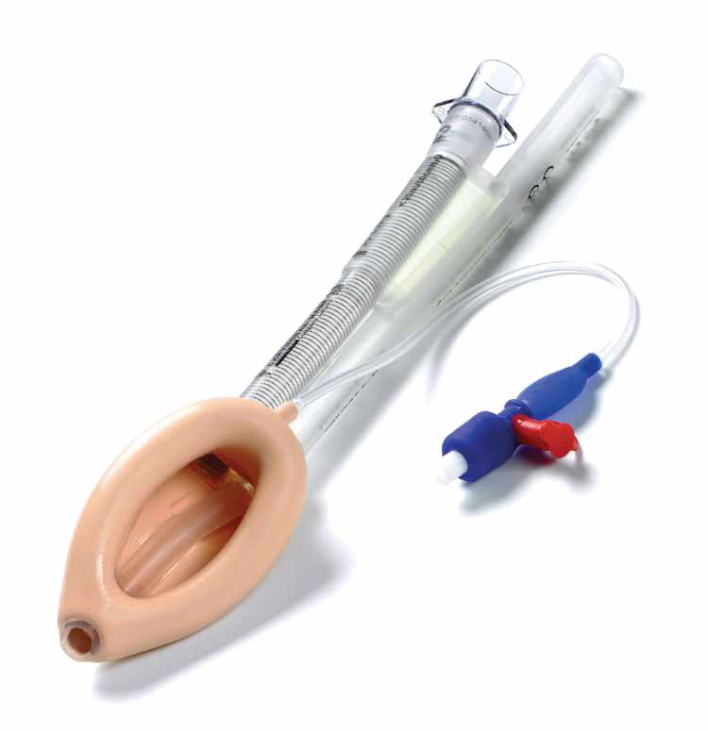
proseal lma

Slide 33
INSERTION-
INTRODUCER TECHNIQUE
DIGITAL METHOD
GUIDED METHOD

Slide 34
SIZE OF LMA | WEIGHT OF THE PATIENT (IN KG) | SIZE OF GASTRIC TUBE
1.5 | 5-10 | 10
2 | 10-20 | 10
2.5 | 20-30 | 14
3 | 30-50 | 16
4 | 50-70 | 16
5 | 70-100 | 18

Slide 35
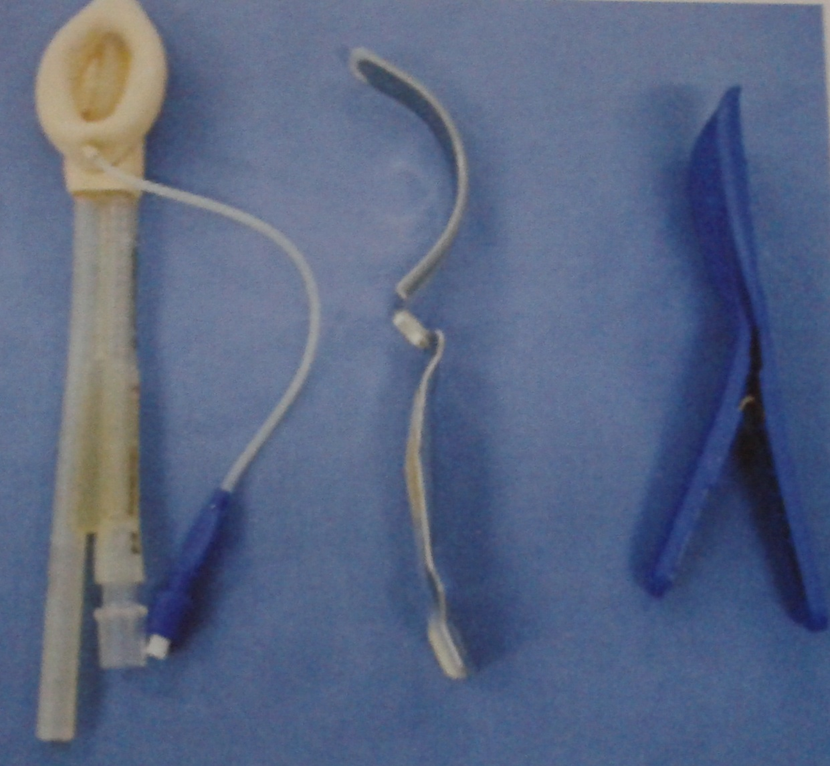

Slide 36
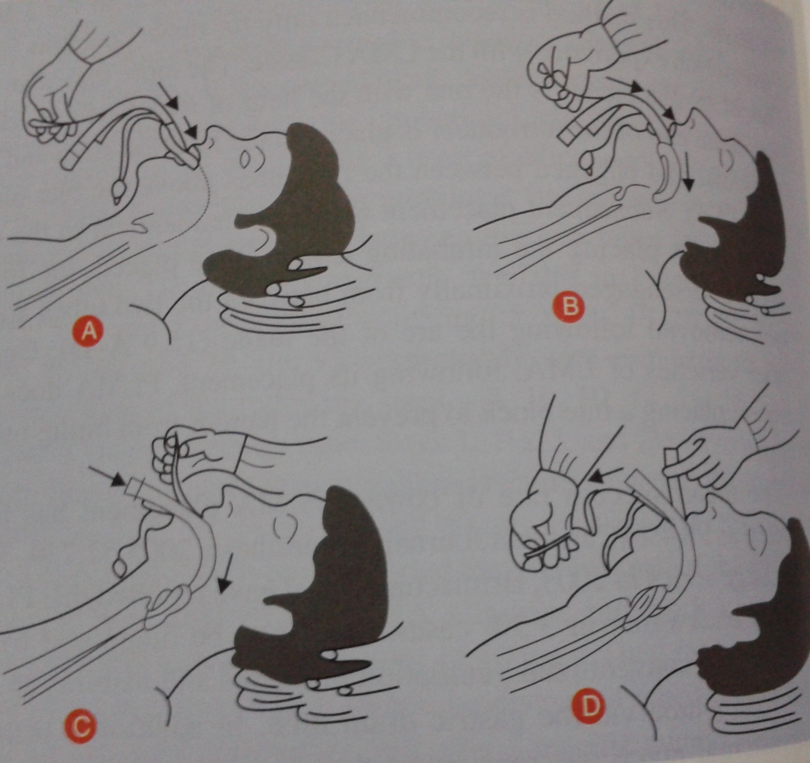

Slide 37
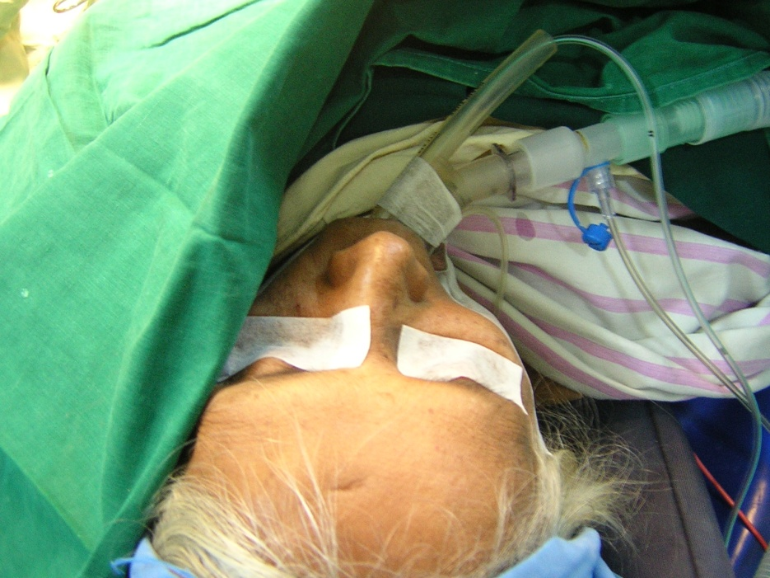

Slide 38
ProSeal LMA
The PLMA shows several modiﬁcations from the cLMA:
(i) oesophageal drain tube
(ii) posterior inﬂatable cuff
(iii) reinforced airway tube
(iv) integral bite block
(v) introducer
The posterior cuff and the increased bulk of the PLMA , increase the pharyngeal seal
The seal pressure has been shown to be signiﬁcantly higher than the cLMA (27–31 compared with 16–20 cmH2O)

Slide 39
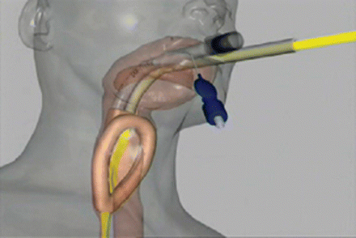

Slide 40
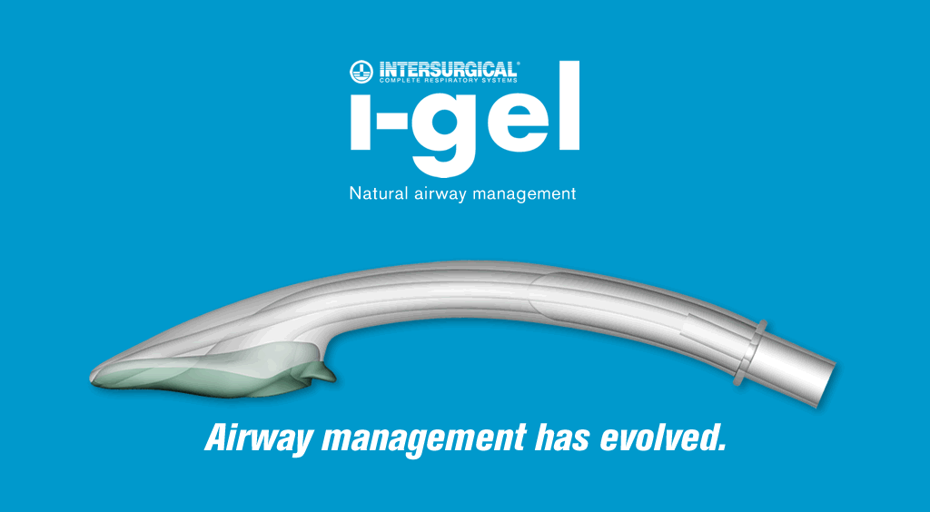

Slide 41
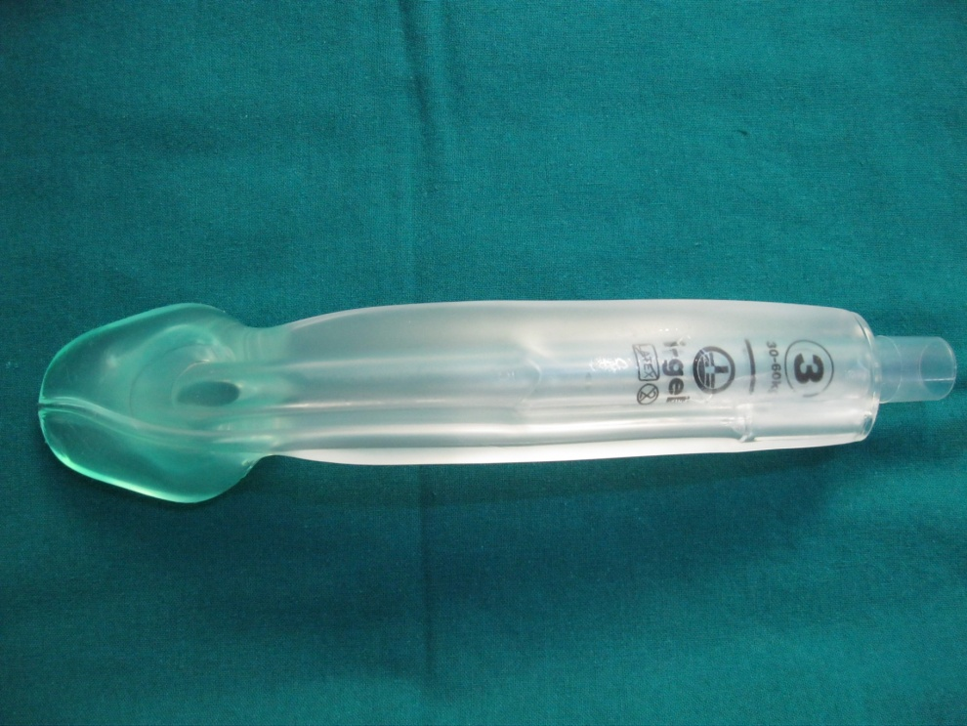
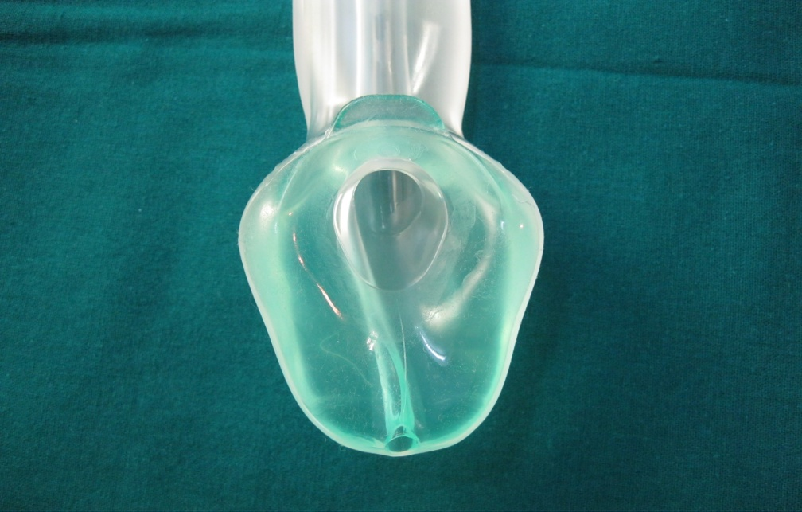
I-GEL
Invented by mahammed nasir uk anaesthetist
Single use, cuffless
3 sizes- 3, 4, 5 for ET # 6, 7 and 8 respectively.
Integral gastric channel
Epiglottic blocking ridge
Built-in bite block
Moulding feature
Narrow bore oesophageal drain tube

Slide 42
There are case reports of complications — tongue trauma and nerve damage
Truncated tip reduces post-use dysphagia
Oesophageal seal is low

Slide 43
SUPREME LMA
The SLMA is a second-generation SAD
It is described as a ‘single-use
It is like ProSeal LMA’ but it has important differences in design and function.
it has features of the PLMA (drain tube, large mask),
ILMA (rigid stem, insertion technique), and the LMA-Unique (PVC material and single use)

Slide 44
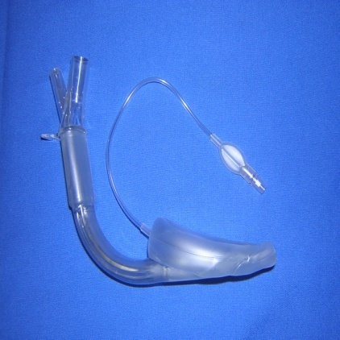
LMA Supreme

Slide 45
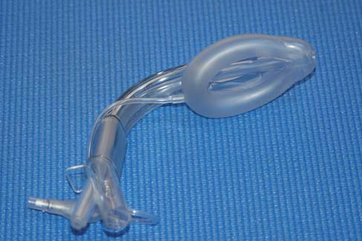

Slide 46
the SLMA drain tube runs through the middle of the airway tube (rather than next to it in the PLMA) dividing it in to two narrow lumens.
This limits its use for airway inspection
and for use as a conduit for intubation

Slide 47
lma c-trach
It is similar to LMA Fastrach in construction.
It has 2 built-in channels,
One to convey light from and
The other to convey the image to the viewer.
The fiberoptic system can be autoclaved.
The monitor is attached to the LMA-Ctrach via a magnetic latch connector.
Sizes- 3,4, 5.
USE- It is lubricated and inserted without viewer attached, airway secured, ventilated, then viewer attached.

Slide 48
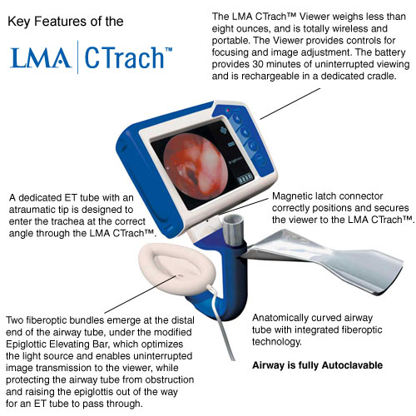

Slide 49
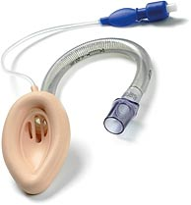
lma flexible

Slide 50
lma flexible
Wire- reinforced LMA
longer and narrower tube. It can be bent to any angle. It is less likely to be displaced during head rotation.
USE- Head n neck surgeries, surgeries of upper torso.
INSERTION – difficult to insert
Smaller tube causes increased resistance.
A stylet, small tracheal tube other device is to be inserted into the tube to stiffen it.

Slide 51
NAME THE LMA WHICH IS USEFULL IN EMERGENCY MEDICINE AND CRITICAL CARE?

Slide 52
Intubating lma
It has a short, curved stainless steel shaft.
Metal handle is bonded to the shaft to facilitate one handed insertion, position adjustment.
USES-
1) Tracheal intubation
2) Blind intubation
3) Blind nasal intubation
4) Fiberscopic guided intubation
5) Light guided intubation
Recommended in both difficult airway and Resuscitation

Slide 53
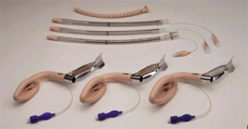

Slide 54
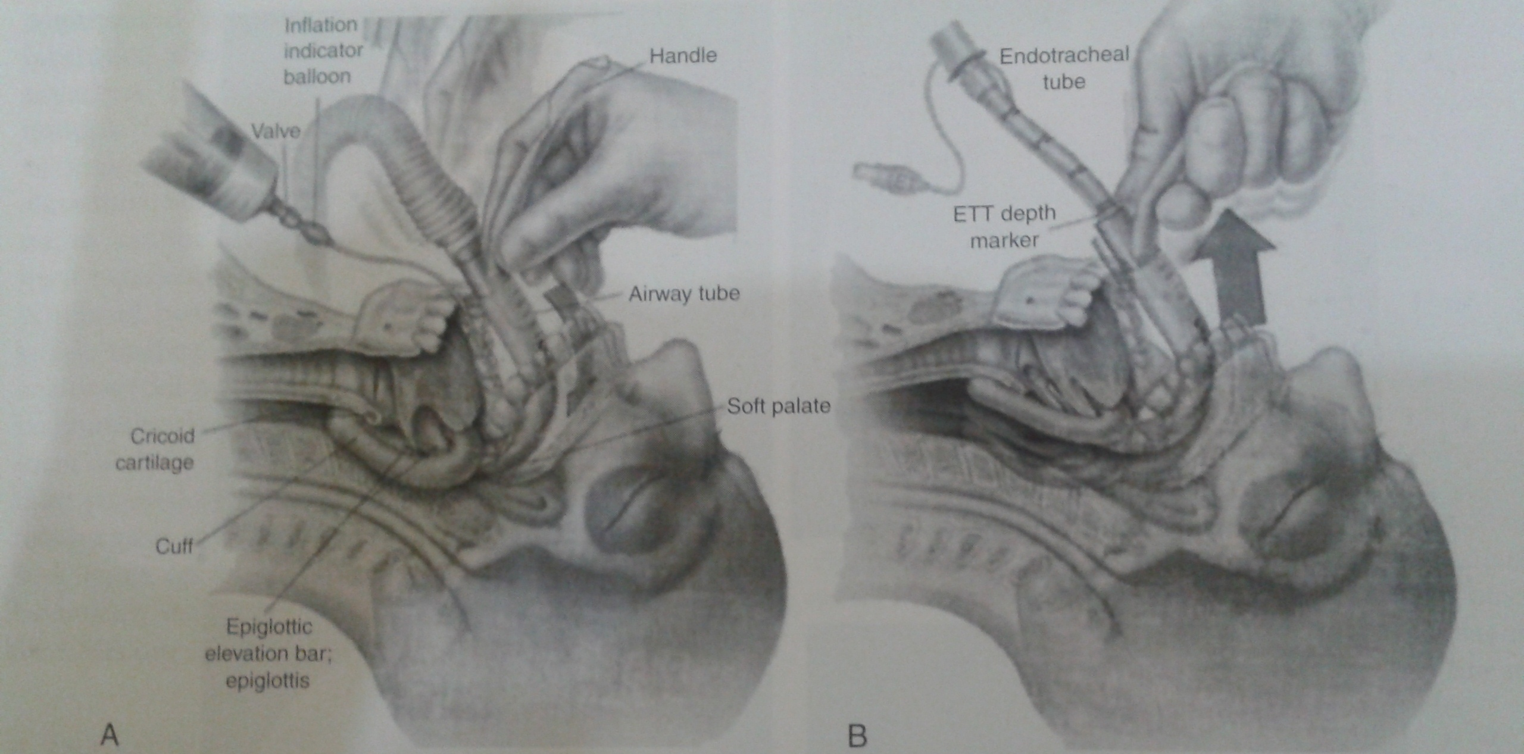

Slide 55
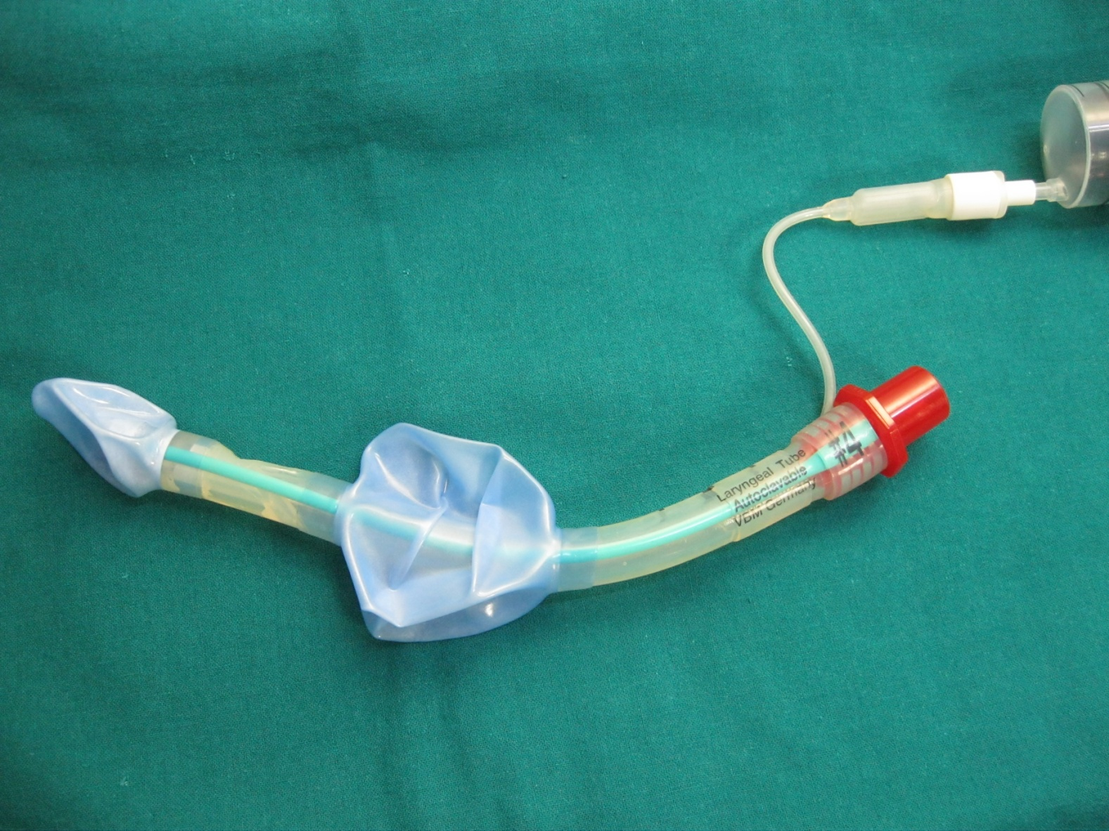
Laryngeal Tube / KING LTS Tube

