Slide 1


Refractive errors of eye
BY DR DIPAK PATEL
OPHTHALMOLOGY

Slide 2
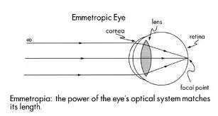
emmetropia
Normal
Parallel beam 4m infinity focused on retina with accommodation at rest

Slide 3
Basic Optics
Optics is the properties of light as it is acted on by optical systems
Geometric optics: uses line diagrams to depict the behavior of light
Wavefront optics: uses principles of waves to describe the behavior of light

Slide 4
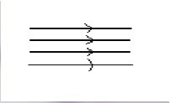
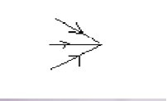
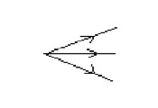
Prallel Beam
Convergence
Divergence

Slide 5
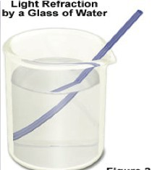
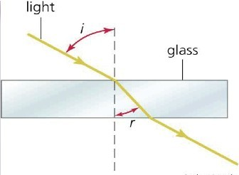
REFRACTION
Refraction of light occurs when light passes from one medium to another of different refractive index (ie. density)

Slide 6
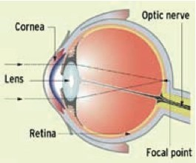
Refractive Components of the Eye
Cornea: responsible for the majority of the refractive power of the eye (40 D)
Lens: 20 D of refractive power, changes with accommodation
Axial length

Slide 7
REFRACTIVE PHYSIOLOGY
Light rays are focused on the retina because they are refracted by passing through the cornea and lens (Snell’s Law)
Corneal refractive power is constant
Lens refractive power is modifiable with accommodation
Axial length of the eye is constant except under certain conditions

Slide 8
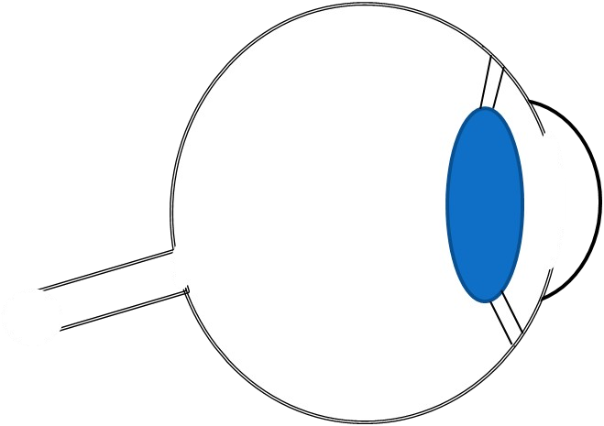
Fovea
Light rays

Slide 9
Emmetropia
Adequate correlation between axial length and refractive power
Parallel light rays fall on the retina (no accommodation)

Slide 10
Ametropia (Refractive error)
Mismatch between axial length and refractive power.
Parallel light rays don’t fall on the retina (no accommodation)
  Nearsightedness (Myopia)
  Farsightedness (Hyperopia)
  Astigmatism
  Presbyopia

Slide 11
ametropia
Parallel rays donot focus on retina

Slide 12
etiology
Axial ametropia
↑ length of globe→myopia
↓ length of globe→hypermetropia
Curvature ametropia
Strong curvature→myopia
Weak curvature→hypermetropia
Index ametropia
↑ refractive index→myopia
↓ refractive index→hypermetropia
Abnormal position of lens
Forward displaced→myopia
Backward displaced→hypermetropia

Slide 13
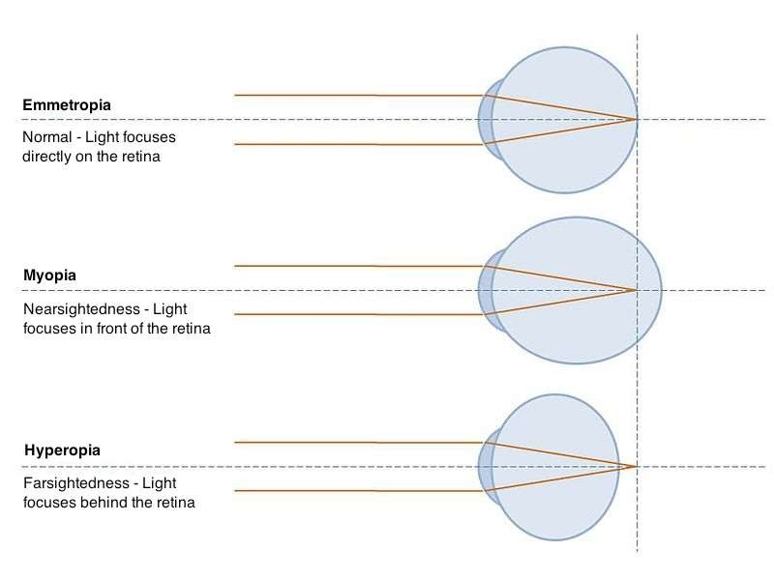

Slide 14




MYOPIA
NEAR SIGHTEDNESS

Slide 15
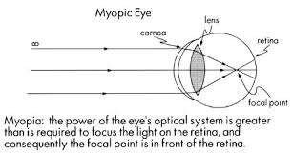
myopia
Short sightedness
Diopteric condition
Incident parallel rays are focused in front of retina
with accommodation at rest

Slide 16
Etiological classification
commonest
Axial myopia
etiological
Curvatural
myopia
Nuclear sclerosis
Index myopia
Positional myopia
Spasm of accomodation
Due to excessive accomodation

Slide 17
Clinical classification
Congenital
Simple / developmental
Pathological degenerative
Acquired
  Post traumatic
  Post keratitic
  Drug induced
  Pseudomyopia
  Night myopia
  Consecutive
  space

Slide 18
Congenital myopia
Present at birth diagnosed at 2-3 yrs
u/l commonly ( anisometropia)……..b/l (rare)
b/l-→convergent squint

Slide 19
Simple myopia
Commonest
School myopia
Not associated with any d/s

Slide 20
Etiology of simple myopia
Axial TYPE→physiological
→precocious neurological growth in chid hood
Curvatural →underdevelopment of eyeball
Genetics
Role of diet
Excessive near work

Slide 21
symptoms
Short sightedness
Asthenopia (eyestrain)
Half shutting of eye

Slide 22
signs
Prominent eye ball
Deeper ac
Large sluggish reacting people
Normal fundus
Temporal myopic cresent
magnitude

Slide 23
Pathological myopia
Progressive/degenerative
Starts in childhood (5-10 yrs) ➔ high myopia in early adult life(-15 to -20D)

Slide 24
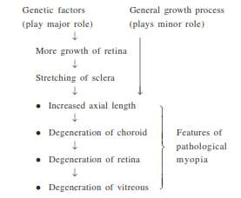
etiology

Slide 25
symptoms
Defective vision
Muscae volitantes
degenerated viscus→floating black opacities
Night blindness in high mypopes(due to degenerative changes)

Slide 26
signs
Prominent eyeballs
largecornea
Deep ac
Large pupilssluggish rn to light

Slide 27
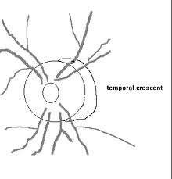
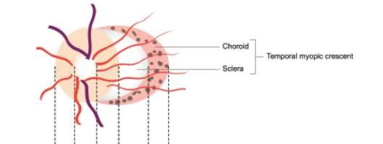
Fundus examination
Optic disc→large & pale with myopic crescent at its temporal

Slide 28
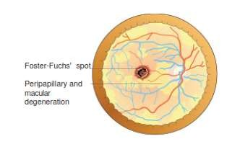
Choreo retinal degenrations
Foster fuchs spots →dark red circular patch➔due to subretinal neovascularization &
choroidal haemorrhage
Cystoid degeneration at periphery

Slide 29
Posterior staphyloma
Degenerative changes in vitreous Liquefaction
Vitreous opacitis
Posterior vitreous detachment

Slide 30
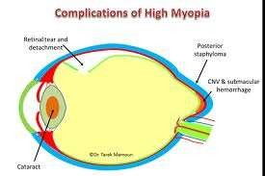
complications

Slide 31
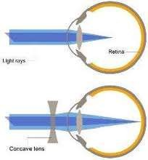
treatment
Optical correction
Concave glasses

Slide 32
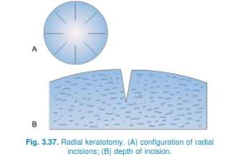
Surgical correction
Radial keratotomy
Multiple peripheral cuts in cornea→ ↓ increased curvature of kornea on
healing

Slide 33
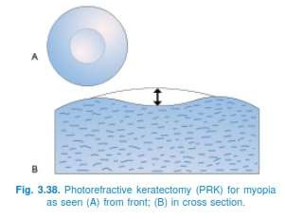
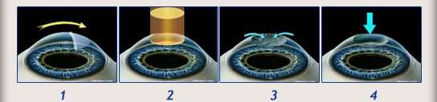
Surgical correction
Photorefractive keratectomy
excimer laser on central cornea→photoablation of central corneal stroma Disadvantages
More expensive than RK
Residual corneal haziness
Post operative recovery is slow

Slide 34
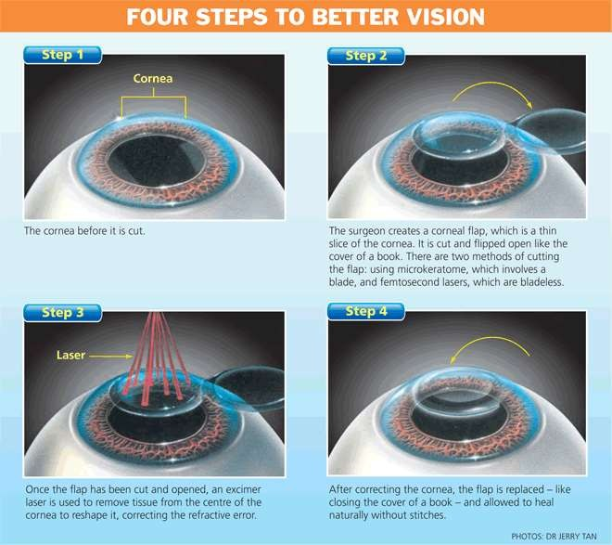
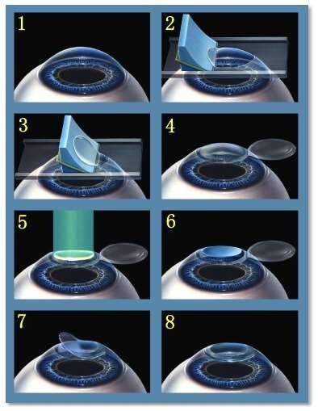
Surgical correction
Laser in situ keratomileusis (LASIK)

Slide 35
USED FOR
Patients >20 yrs
Absence of corneal pathology
Motivated patient
Stable refaraction for atleast 12 months

Slide 36
advantages
Minimal / no post operative pain
Early recovery
No risk of perforation as in RK
No residual haziness as in PRK
Correct up to -12D

Slide 37
DISADVANTAGES
more expensive
greater surgical skill
flap related complications
intraoperative flap amputation
wrinkling of flap on repositioning
post operative flap subluxation
epithelilisation of flap bed interface
irregular astigmatism

Slide 38
EXTRACTION OF CLER CRYSTALLINE LENS
Myopia of -16D to -20D
U/L

Slide 39
Phakic intra ocular lens
Myopia <12D

Slide 40
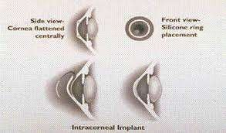
Intercorneal ring implantation
Into peripheral cornea→flattening of cornea

Slide 41
orthokeratology
Non surgical
Molding cornea with overnight rigid gas permeable contact lens

Slide 42
HYPERMETROPIA
LONG SIGHTED NESS

Slide 43
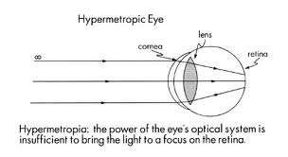
HYPERMETROPIA
Parallel rays from infinity focused behind retina
With accommodation at rest

Slide 44
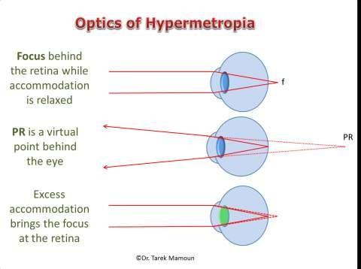

Slide 45
etiology
Axial hypermetropia
Axial shortening of eyeball
Curvatural hypermetropia
Curvature of cornea/lens is
flatter
etiology
Index hypermetropia
Decrease in refractive
index
Posterior dislocation of lens
Positional hpermetropia
aphakia
Congenital/acquired
→high hypermetropia

Slide 46
Clinical types
Commonest
Biological variation in
Clinical types
Simple/developmental
development
Axial & curvatural hypermetropia
pathological
functional

Slide 47
Simple/developmental
Commonest
Biological variation in development
Simple/developmental Axial & curvatural hypermetropia

Slide 48
Pathological hypermetropia
Congenital/acquired
  Index hypermetropia(cortical sclerosis)
pathological
Positional hypermetropia(postr subluxn of lens)
Aphakia
Consecutive (overcorrection of myopia)

Slide 49
Functional hypermetropia
Paralysis of accommodation in pts with3rd nerve palsy
& internal ophthalmoplegia

Slide 50
Components of hypermetropia
Latent hypermetropia
Total hypermetropia
Manifest
hypermetropia

Slide 51
Total hypermetropia is the total amount of refractive error ,which is estimated after
complete cyclopegia with atropine.

Slide 52
Latent
hypermetropia
Manifest
hypermetropia
Total
hypermetropia
amount of hypermetropia which
remaining portion of total
is normally corrected by the
hypermetropia.
inherent tone of ciliary
2 components-
muscle. It gradually decrease
facultative and
with the age.
the absolute hypermetropia

Slide 54
Facultative Hypermetropia: It is that part of hypermetropia which can be corrected
by the effort of accommodation.
Absolute Hypermetropia: Which cannot be overcome by the effort of accommodation.

Slide 55
Total hypermetropia= Latent hypermetropia + Manifest hypermetropia
(Facultative+Absolute).

Slide 56
symptoms
1. Asymptomatic
2. Asthenopic symptoms
Associated with near work & increase in evening
Tiredness of eyes
Frontal / frontotemporal head ache
Watering
photophobia
3. Defective vision with asthenopic symptoms
4. Defective vision only
Not fully corrected with voluntary
accomodation

Slide 57
signs
Size of eye ball may appear small as a whole
Cornea may be slightly smaller than normal
Anterior chamber is comparatively shallow
Fundus examination→small optic disc
pseudopapilliris
◆
retina as a whole may shine due to greater brilliance
of light reflections (shot silk appearance).

Slide 58
complications
1. Recurrent styes,blepharitis or chalazia (due to constant rubbing )
2. Accomodative convergent squint (↑use of accommodation)
3. Amblyopia
4 Predisposition to develop primary narrow angle glaucoma
◆
in hypermetropes small eye
with a shallow anterior chamber.
Due to regular increase in the size of the lens
with increasing age, → narrow angle glaucoma. This point should be kept in mind while instilling mydriatics
in elderly hypermetropes.

Slide 59
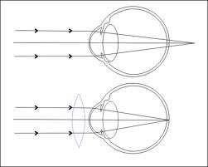
treatment
Spectacles→convex
Contact les→unilateral cases

Slide 60
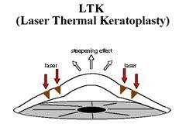
surgical
Holmium laser thermoplasty➔low degree of hyperopia
In this technique, laser spots
_{central st} are applied in a ring at the periphery to produce eepening.
DISADVANTAGES
Regression effect and
induced astigmatism

Slide 61
Hyperopic PRK
DISADVANTAGES
Regression effect
prolonged epithelial healing

Slide 62
HYPEROPIC LASIK
UP TO +4D

Slide 63
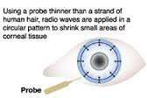
CONDUCTIVE KERATOPLASTY
nonablative and
nonincisional procedure in which cornea is steepened by collagen shrinkage through the radiofrequency energy applied through a fine tip inserted into the peripheral corneal stroma in a ring pattern.

Slide 64
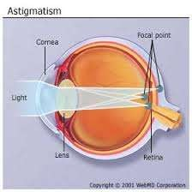
ASTIGMATISM

Slide 65
ASTIGMATISM
light fails to come to a single focus on the retina to produce clear vision.
Blurred
Instead, multiple focus points occur, either in front of or behind the retina (or
vision
both).

Slide 66
etiology
Unequal curvature of cornea in different meridians
Decentering of lens

Slide 67
With the rule
Regular
astigmatism
Against the rule
irregular

Slide 68
REGULAR ASTIGMATISM
IRREGULAR ASTIGMATISM
Direction of greatest & least curvature at
right angles to each other
Can be corrected by lenses
Corneal surface is irregular (after corneal
ulcer)
Cannot be corrected by lenses

Slide 69
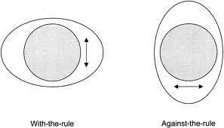
Types of regular astigmatism
RULE: NORMALLY CORNEA IS FLATTER FROM SIDE TO SIDE PERHAPS BECAUSE OF PRESSURE BY EYE
LIDS vertical is more curved
With the rule astigmatism
as in normal cornea
Against the rule astigmatism

Slide 70
etiology
Corneal (common)
curvatural
Oblique tilting
of lens
astigmatism
Lenticular
positional
Different
index
index in diff
meridia
Oblique placement
macular
of macula

Slide 71
Optics of regular astigmatism
sturm’s conoid
Refraction through regular astigmatic surface (toric surface)
The more curved meridian will have greater power less curved

Slide 72
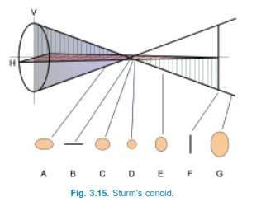

Slide 73
At A ➔ vertical rays are more converging than horizontal rays (horizontal oval)
At B ➔ vertical rays are focused …..horizontal are converging….(horizontal Line)(FIRST FOCUS)
At c ➔ vertical rays are diverging ….but less than convergence of horizontal (horizontal oval)
At D ➔ divergence of vertical ray=convergence of horizontal ray
At E ➔ divergence of vertical > convergence of horizontal
At F ➔ horizontal are focused(vertical line) (second focus)
Distanceb/w B & F = focal interval of sturm
Whole shape=sturms conoid

Slide 74
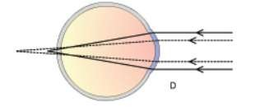
If retina is at any point A to F image will be blurred as rays are never focused at single point
If retina is at A
Both foci behind the retina
➔compound hypermetropic astigmatism

Slide 75
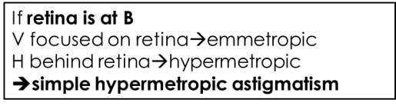
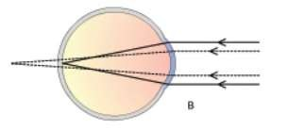

Slide 76
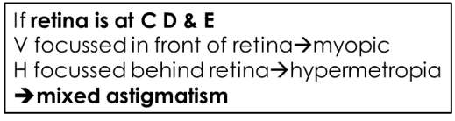
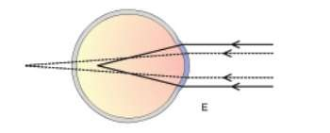

Slide 77
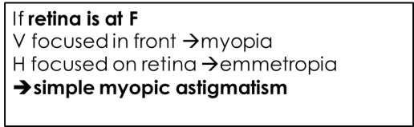
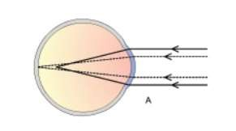

Slide 78
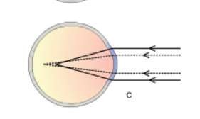
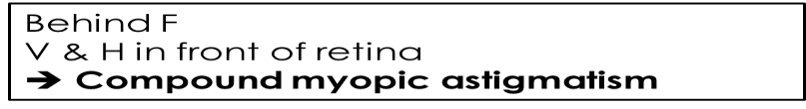

Slide 79
symptoms
Blurred defective visin
Asthenopic features

Slide 80
signs
Head tilt →torticollis to correct axes defects
Half closure of lid as in myopia

Slide 81
investigations
Retinoscopy ➔ different power in two meridian
Oval/tilted optic disc in ophthalmoscopy
Asigmatic fan test
Cross cylinder test

Slide 82
treatment
Regular with spectaclescylindrical
Contact lenses

Slide 83
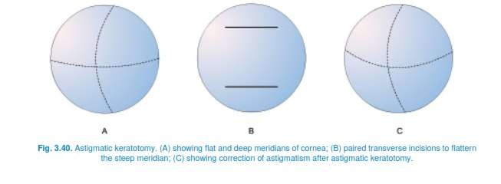
surgical
Astigmatic keratotomy

Slide 84
Photo astigmatic keratotomy(PARK)
USING EXCIMER LASER

Slide 85
LASIK up to 5D

Slide 86
APHAKIA

Slide 87
APHAKIA
Absence of crystalline lens

Slide 88
etiology
Congenital→rare
Surgical aphakia➔commonest
Traumatic extrusion 4m eye
Due to absorption of lens matter after trauma in children
Postr dislocation of lens in to vitreous

Slide 89
Loss of accommodation
Highly hypermetropic
Total power is reduced (+ 60D→44D)

Slide 90
symptoms
Defective vision far (due to hypermetropia)& near(loss of accommodation)
Erythropsia(IR Radn)&cyanopsia(UV radiation)

Slide 91
signs
Limbal scar→surgical
Deep AC
Iridodonesis (tremor of iris)
Jet blac pupil
Only 2 purkinje images
Fundus examination→hypermetropic small disc
Retinoscopy→high hypermetropia

Slide 92
treatment
Spectacles (convex lens)
Contact lens
Intra ocular lens implantation
Refractive corneal surgery

Slide 93
spectacles
Advantages➔ cheap, easy & safe
Disadvantages
magnified image→diplopia in u/l cases spherical & chromatic aberration limited field of vision
cosmetic
roving ring scotoma (jack in the box)

Slide 94
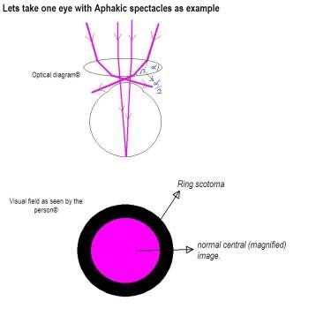
Roving ring scotoma
roving Ring Scotoma: The edge of a convex lens acts as a prism and the higher the power of the convex lens the greater is the prism angle (alpha). The light falling on the prism bends towards its base by an angle alpha/2 , therefore, greater the angle alpha the more will be the bending. In aphakic spectacles, the angle alpha being large, the light falling at the edge of the lens bends towards the center of the lens (base of prism) and does not reach the pupil and is, therefore, not seen. This results in an area of the visual field which is not visible to the patient, or scotoma. And because the edge of the lens is present all around the lens like a ring, so it gives rise to a ring shaped scotoma. The position of this scotoma is not
fixed in the visual field because the eye keeps moving (or roving) in relation to the aphakic spectacle

Slide 95

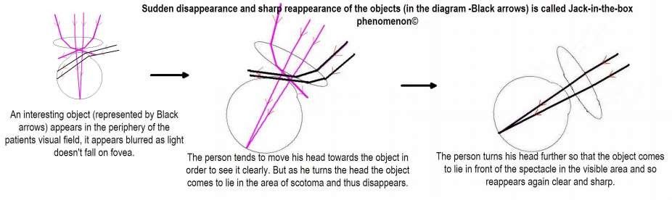
Jack in the box

Slide 96
Contac lens
Advantages
No aberration Better field of vision Cosmetic good
Less magnified

Slide 97
Disasdvantages
Costly
Cumbersome to wear
Cornel complications

Slide 98
Intraocular lens
Best method

Slide 99
Refractive corneal surgery
Keratophakia
Lenticule made 4m donor cornea is placed in b/w lamella of cornea

Slide 100
Epikeratophakia
lenticule 4m donor cornea on the surface of cornea after removing epithelium

Slide 101
Hyperopic lasik

Slide 102
PSEUDOPHAKIA
INTRAOCULAR LENS

Slide 103
signs
Limbal scar
Deep AC
Mild iridodonesis
Pupil blackish
Reflex can be seen

Slide 104
Refractive status
Emmetropia
Consecutive hypermetropia
Consecutive myopia

Slide 105
ANISOMETROPIA

Slide 106
ANISOMETROPIA
When the total refraction of the two eyes is unequal the condition is called
anisometropia.
<2.5 D WELL TOLERATED
2.5D-4D}INDIVIDUAL SENSITIVITY
>4D}NOT TOLERATED

Slide 107
ETIOLOGY
CONGENITAL & DEVELOPMENTAL(differential growth of eye balls)
ACQUIRED(removal of cataractous eye & wrong IOL)

Slide 108
Simple anisometropia: one eye=emmetropic
other eye=myopic/hypermetropic
Compound → both eyes are myopic/hypermetropic (one with higher
refractive error than other
Mixed→ one eye =hypermetropic
other =myopic
Simple astigmatic anisometropia
Compound astigmatic anisometropia both eyes = astigmatic,but varying
degree

Slide 109
Small degree of anisometropia→Binocular single vision
High degree→anisometropic amblyopia-→uniocular vision
Alternate vision
one eye →myopic } near vision Other→hypermetropic } distant vision

Slide 110
diagnosis
retinoscopy

Slide 111
treatment
Spectacles upto4D
Contact lens>4D
IOL implantation in case of aphakia
Lens removal in high myopia
Refractive corneal surgery

Slide 112
ANOMALIES OF
ACCOMODATION

Slide 113
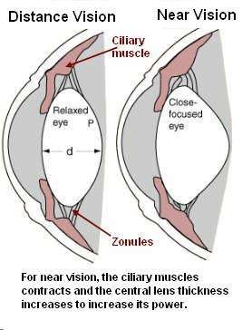
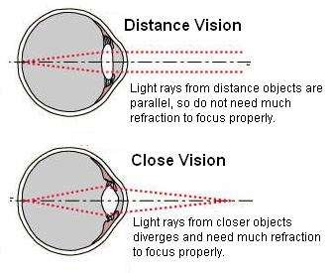
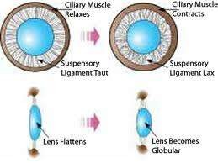
accomodation

Slide 114
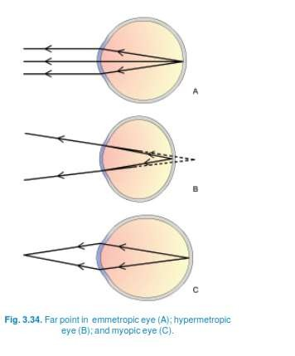
Far point of eye

Slide 115
Range of accomodation
The distance between the near point and the far point.

Slide 116
Amplitude of accomodation
The difference between the dioptric power needed to focus at near point (P) and
far point (R).
A = P – R

Slide 117
Anomalies of accomodation
Presbyopia
Insufficiency of accommodation
Paralysis of accommodation
Spasm of accomodation

Slide 118
PRESBYOPIA

Slide 119
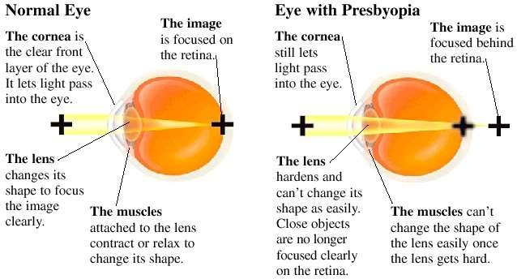
presbyopia

Slide 120
Far point remains at infinity & Near point increases with age
Failing near vision with age

Slide 121
causes
Age related change in lens
↓ Elasticity of lens capsule
↑ Size & hardness of lens
Age related ↓ ciliary muscle power

Slide 122
Causes of premature presbyopia
Uncorrected hypermetropia
Premature sclerosis of crystalline lens
c/c simple glaucoma
General debility→presenile weakness of ciliary muscle

Slide 123
symptoms
Difficulty in near vision
Asthenopic symptonms

Slide 124
TREATMENT
Optic treatment
Convex lens for near vision

Slide 125
Spasm of
accomodation

Slide 126
causes
Drug induced➔ecothiophate,DFP
Spontaneous spasm in children with refractive errors

Slide 127
Clinical features
Induced myopia→defective vision
Asthenopic symptoms

Slide 128
diagnosis
Refraction under atropine

Slide 129
treatment
Atropine→relaxation of ciliary muscles

Slide 130
Paralysis of
accomodation

Slide 131
Paralysis of accommodation (cycloplegia)
Drugs=atropine,homatropine,,,,,
3rd nerve palsy Diphtheria
Syphilis
Internal
Dm
ophthalmoplegia
Alcoholism Cerebral/meningeal d/s

Slide 132
Clinical features
Blurring of near vision
photophobia

Slide 133
treatment
Self recovery in drug induced
Dark glasses→ ↓ glare
Convex lens for near vision

Slide 134
Correction of refractive errors
Far point
  point on the visual axis conjugate to the retina when accommodation is completely relaxed
placing an object or imaging an object at far point will cause a clear image of that object t o be relayed to the retina
use correcting lenses to form an image of infinity at the far point , correcting the eye for distance
•
•

Slide 135
What is the Far Point
The farthest an eye can see
An emmetrope it is infinity or 20 feet
4.00D myope without glasses it is 25cm in front of the eye
1.00D myope without glasses it is 1meter in front of the eye
3.00D hyperope without glasses 33.3 cm behind the eye

Slide 136
What is the Near Point
The closest the eye can see
The near point is the sum of the power of the eye and accommodation
An emmetrope with 10.00D of accommodation and a -4.00D error without glasses has a near point of 14.00D or 7.15cm in front of the eye

Slide 137
What is the Near Point
A 50 year old with 2.00D of accommodation and a -1.00D error without glasses has a far point of 1 meter and a near point of
33.3 cm
With glasses on the far point is infinity or 20 feet and the near point is 50cm in front of the eye

Slide 138
What is the Near Point
A +3.00D without glasses hyperope with 6.00D of accommodation has a far point of
33.3 cm behind the eye and a far point of
33.3 cm in front of the eye.
With glasses on the far point is infinity and the near point 16.6 cm.

Slide 139
Remember!!
A myope has too much plus in their eyes
Whereas a hyperope has too much minus

Slide 140
Diagnosis:
Diagnosis of refractive errors is made by an optician or ophthalmologist.
Instruments used to diagnose refractive errors include:
pinhole glasses
Autorefractor (measures how light changes as it enters the eye).
-Retinoscope (measures the refractive condition of the eye).

Slide 141
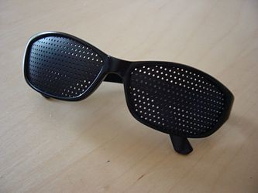
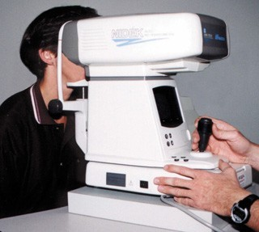
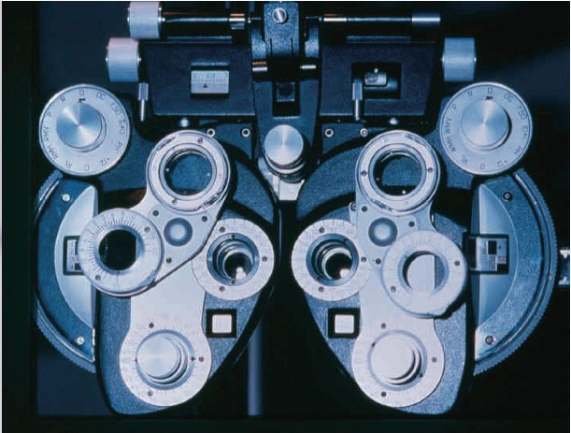

Pinhole glasses
Autorefractor
Phoropter
View through an autorefractor

Slide 142
Spectacles &
contact lens

Slide 143
Types of optical correction
Spectacle lenses
  Monofocal lenses : spherical lenses , cylindrical lenses
  Multifocal lenses Contact lenses:
  higher quality of optical image and less influence on the size of retinal image than spe ctacle lenses
  indication : cosmetic , athletic activities , occupational , irregular corneal astigmatism , h igh anisometropia , corneal disease.
  Can be: soft, hard, gas-permeable

Slide 144
Contact lenses
disadvantages : careful daily cleaning and disinfection , expense
complication : infectious keratitis , giant papillary conjunctivitis , corneal vascularization
, severe chronic conjunctivitis
Intraocular lenses
replacement of cataract crystalline lens
give best optical correction for aphakia , avoid significant magnification and distortion caused by spectacle lenses

Slide 145

Hard lenses:
Plastic polymer. Most durable.
Rigid, therefore may scratch the cornea.
Not gas permeable → corneal hypoxia → corneal ulcers. Cannot be worn continuously.
Difficult to get used to (because they are very rigid). Less susceptible to infection + allergy.
Best for treating astigmatism (smoothes out the uneven curvature).

Slide 146
Soft lenses:
High water content.
Less durable.
Permeable for both gases + liquids.
Could be worn for long periods.
Tolerated much better.
They do not correct astigmatism.
Are the most comfortable lenses.
Are the least durable lenses (must be replaced more often).
Susceptible to accumulation of deposits (because they absorb more water, which binds proteins). This accumulation of protein deposits leads to allergic conjunctivitis and other allergies.

Slide 147
Gas permeable lenses (Semi- rigid):
They are permeable only to gases.
They are more comfortable than hard lenses, but less than soft ones.
They are more durable than soft lenses, but less than hard lenses.
Allow oxygen to pass, but also allow proteins to deposit.
More durable than soft lenses, but less durable than hard ones.

Slide 148
Toric lenses:
Are similar to soft contact lenses, but have a couple of extra characteristics:
They have 2 powers in them: 1 for spherical correction + 1 for astigmatism.
They are designed to keep the lens in a stable
position even on movement.
They offer the comfort of soft lenses ,and at the same time they correct astigmatism, but their disadvantage is that the lens will sometimes rotate, and this creates a very irritating change in vision as the lens rotates.

Slide 149
Refractive Surgery Techniques
Radial Keratotomy (RK)
Freeze keratomileusis
Photorefractive Keratectomy (PRK)
Laser Epithelial Keratomileusis (LASEK)
Laser-assisted in-situ Keratomileusis (LASIK)
Others:
  Astigmatic Keratotomy (AK)
  Intracorneal ring segments (Intacs)
  Phakic Intraocular Lens Implants
  Refractive lensectomy

Slide 150
Laser technology
Excimer laser: EXCited dIMER
AKA “cool laser beam” because little thermal damage to adjacent tissues.
193nm wavelength ultraviolet laser with sufficient energy to disrupt intermolecular bonds within the corneal stromal tissue (photoablative decomposition).
First excimer lasers FDA approved in 1995, with beam width 4-5mm, now available less than 100 microns.
Each laser pulse removes a given volume of stroma
Three types of laser application: wide-area ablation, scanning slit, and flying spot lasers.

Slide 151
Laser technology
In myopia, laser flattens central cornea to decrease its focusing power to bring secondary focal point back to retina.
In hyperopia, the laser removes peripheral corneal tissue thereby secondarily steepening the central cornea, increasing the focusing power of the cornea.
Astigmatism treated with elliptical or cylindrical beams that flatten the steepest corneal meridian.
To minimize glare and halos, optical zone should be larger than the dilated pupil.

Slide 152
THANK YOU …
STAY HOME, STAY SAFE …

