Slide 1

Anaesthetic
Implications of Congenital
Diaphragmatic Hernia
Dr.Malini Mehta,
Professor,
Dept.of Anaesthesia,
S.B.K.S.M.I.R.C.,
Piparia

Slide 2

Congenital Diaphragmatic
Hernia
▪Herniation of abdominal contents in the thoracic
cavity thru a cong defect in the diaphragm
▪Respiratory distress and cyanosis - warrants
emergency care
▪Associated with multiple cong defects (CVS, CNS)
▪High mortality

Slide 3
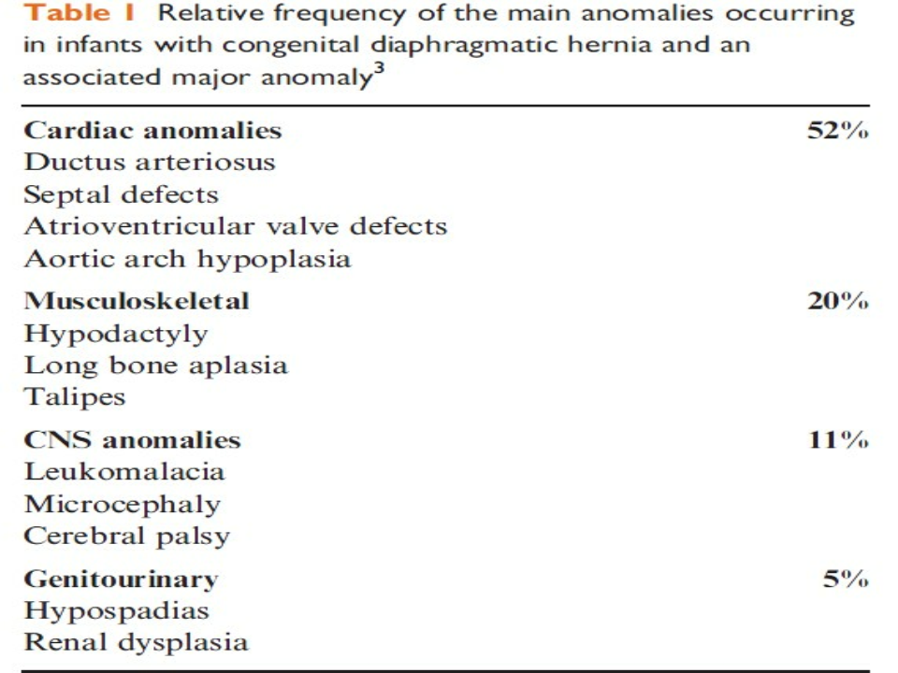

Slide 4
CDH
▪Incidence:- 1:5000
▪M:F : 2:1
▪Lt : Rt : 5:1

Slide 5
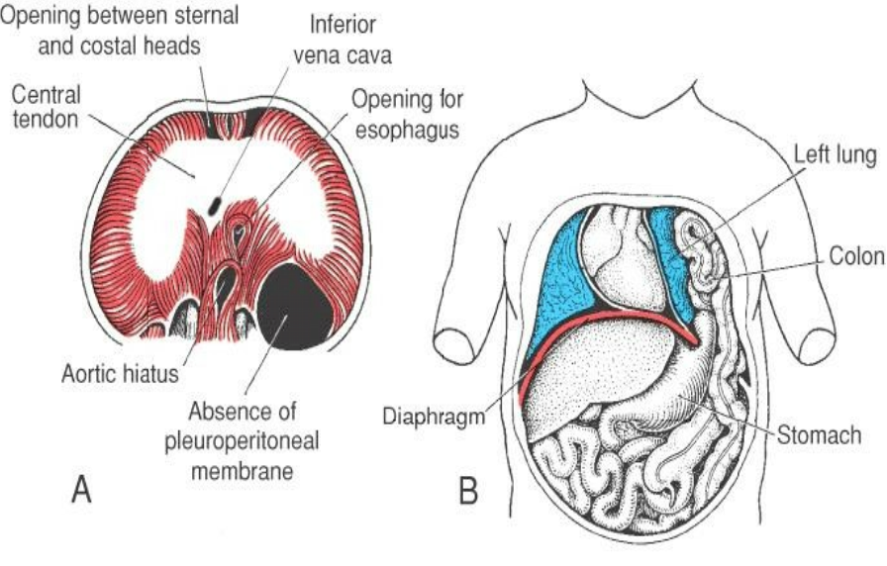
Defects in diaphragm

Slide 6
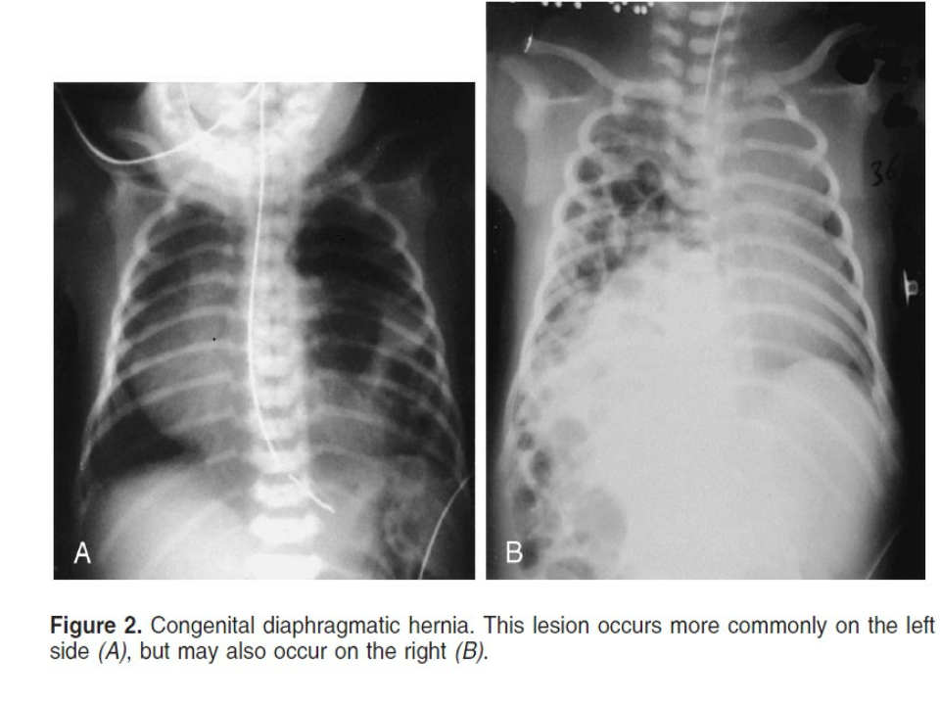

Slide 7
Classification
Based on anatomic position of the defect-
• Posterolateral defect of Bochdalek (80%)
• Esophageal hiatus (15%)
• Anterior foramen of Morgagni (2%)
Eventration of diaphragm- absence of muscular
component of the diaphragm, may be
asymptomatic to s/s similar to Bochdalek hernia

Slide 8
Common pathology
▪Foramen of bochdalek- usu a 2×3 cm post slit
in the diaphragm which may extend from lat
chest wall to esophageal hiatus
▪Lt >rt (80%)
▪Hernial sac may contain colon, stomach
spleen, kidney, on lt side
▪and liver on rt side

Slide 9
Embryology
•
1
month-
single pleuroperitoneal cavity
st
•
4 wks
mesentry of foregut meet
in midline to form central tendon of diaphragm
- septum transversum & dorsal
•
B\w 4 to 9 wks
membrane forms, thus
completing the formn of diaphragm after body wall and
cervical myotomes’ (2,3,4) contributions
-
pleuroperitoneal
•
Also at 9 wks
– developing gut returns from yolk sac to
peritoneal cavity

Slide 10
Embryology
Thus CDH may result from:
1. Early return of midgut to peritoneal cavity
2. Delayed closure of pleuroperitoneal canal

Slide 11
Development of lung
• Development begins at 4 wks; and airway
development b/w 10 to 16 wk, f/b alveolar
development
th
th
• By 16 wk, number of airway generations similar to
adult & alveolar development begins
th
• Thus anatomical defects of lung in CDH depends
on time of migration and amount of hernial content

Slide 12
Defect in lung
-loss of generations of bronchi & bronchioles by
about 50 % in severe cases
-decrease total no of alveoli
-smaller dysplastic pulm art at hilum causing PHTN
-precocious distal growth of smooth msl, ie, medial
hyperplasia in pulm arterioles
-23- 75 % of normal wt of lung

Slide 13
Pathophysiology
1 ̊ cause of death – hypoxemia and acidosis which
is d/t-
• atelectasis 2 ̊ to compression of lungs
• Persistent pulmonary hypoplasia
• PPHN ,inc R to L shunting thru PDA/FO
Varying degree of hypoxemia, hypercarbia and
acidosis along with pulmonary hypoplasia results
in high PVR and high PA pressure( ie,both
reversible and irrev causes)

Slide 14
Pathophsiology
▪If PA pressure > systemic pressure, there is R
to L shunting across PDA lowering post
ductal PaO2
▪Shunting increases RV overload which inc RA
pressure leading to enhanced shunting thru
PFO leading to furthur hypoxemia, acidosis
and systemic hypotension

Slide 15
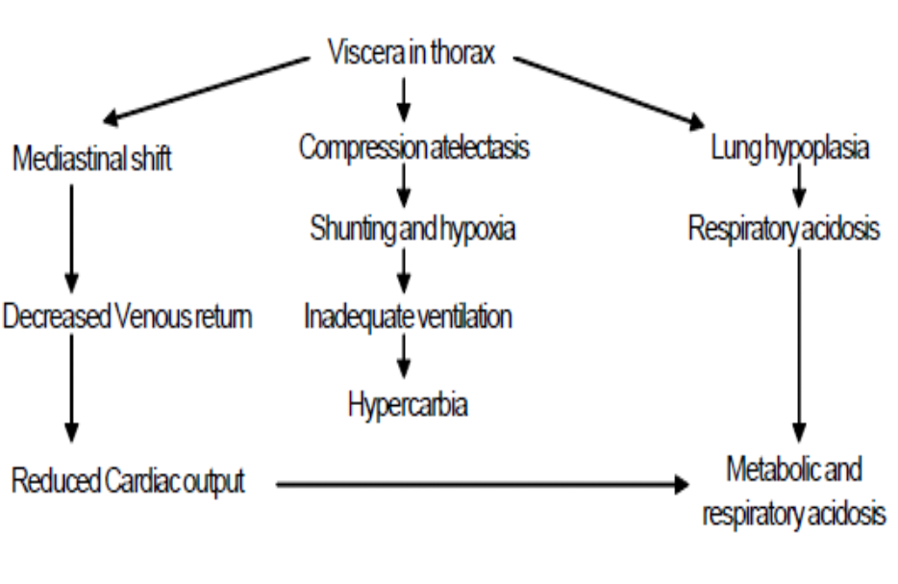
pathophysiology

Slide 16
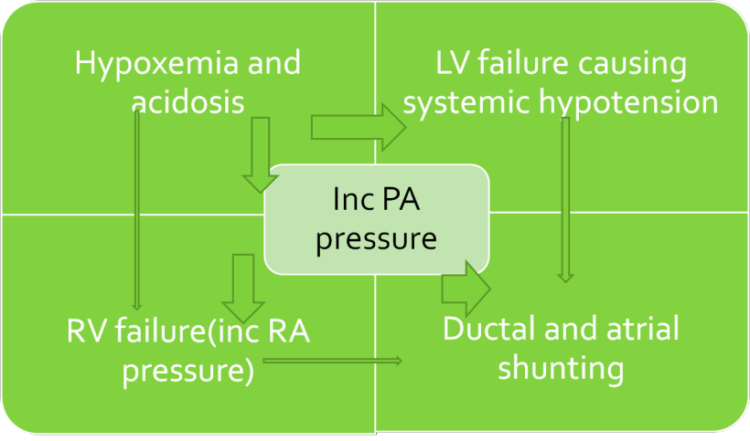
Vicious cycle

Slide 17
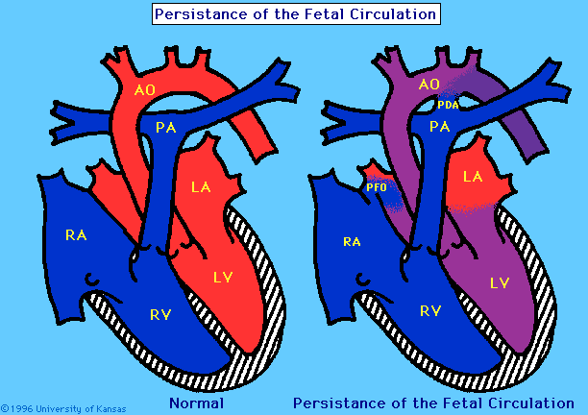
Right to left shunting

Slide 18
diagnosis
▪ 59% antenatal detection with average age 24.2 weeks.(Garne et al,
Ult Obst Gyn, 2002
Polyhydramnios Intrathoracic stomach or liver
Lung-to-head ratio and lung/transverse thorax ratio. Usually at
prenatal ultrasound (15 weeks).
▪ Recently fetal MRI and fetal echocardiography, helpful to determine
degree of pulmonary hypoplasia. (MRI lung volumetry, left
ventricular mass and pulmonary artery diameter)
▪ Postnatal diagnosis, on CXR with gastric air bubble or intestine in the
chest.
▪ Amniocentesis is recommended to provide informationregarding
possible chromosomal abnormalities.

Slide 19
Clinical features and
diagnosis
• Prenatal diagnosis-
charac by polyhydramnios
in 30%, diagnosed by USG, ultrafast fetal MRI
-Fetal surgeries like FETO are done if
diagnosed in time
• Postnatal diagnosis
History- RD in immediate postnatal period
charac by tachypnea, dyspnea, chest wall
retraction, nasal flaring, cyanosis

Slide 20
C/f and diagnosis contd…
On examination-
• Cyanosis as soon as the cord is clamped or
after several hours
• Scaphoid abdo,
• Barrel chest,
• Bowel sounds in chest,
• Shifting of heart sounds to rt,
• No breath sounds in i/l chest, etc

Slide 21
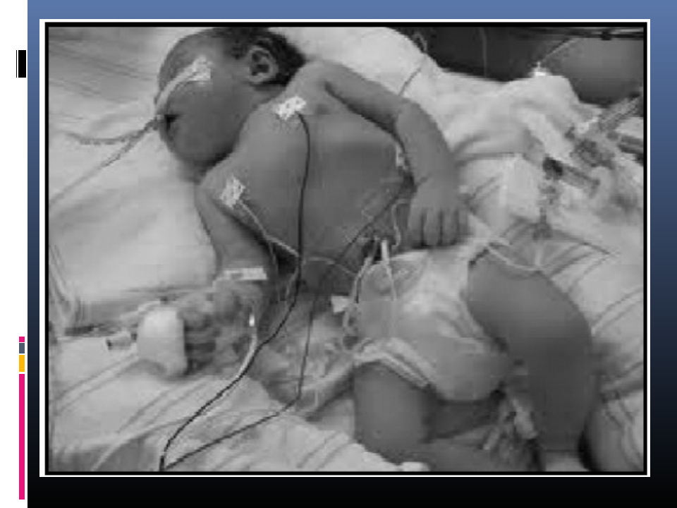

Slide 22
Diagnosis
▪CXR- intestinal loops in thorax
-i/l lung compressed into mediastinum,
which is shifted to c/l hemithorax
▪Dye thru NG tube to delineate stomach and
intestine in thorax

Slide 23
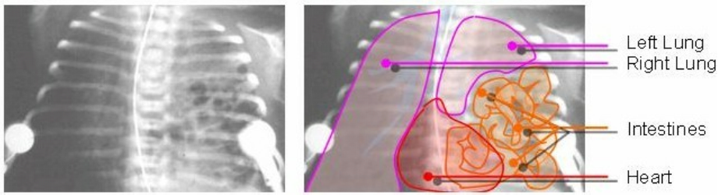
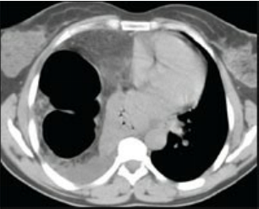
Chest x-ray and
CT

Slide 24
Investigations
• Haemogram
• ABG- mixed resp and metabolic acidosis and
severe hypoxemia, hypercarbia
• Serum electrolytes- Na, K, Ca
• Blood sugar
• Cross matching
• Chest x-ray
• CT thorax

Slide 25
Diagnosing shunt
▪In significant shunting thru PDA, preductal
PaO2 > postductal PaO2 by atleast 20 mm Hg
▪Severe shunting is difficult to detect by ABG:
may be diagnosed by ECHO with color doppler,
cardiac catheterisation or pulmonary
angiography

Slide 26
Assessment of severity of
pulmonary hypoplasia
• AaDO2 >500 mm Hg on Fio2 1.0- predicts
nonsurvival; 400-500-uncertain survival; <400-better
prognosis
• Ventilation or oxygenation index
(MeanAP x Fio2 x 100/PaO2) ≥40 signifies poor
prognosis
• Bohn/ventilatory index (mean AP x RR) –
if paco2<40; VI<1000- good survival,
if paco2>50;VI<1000 or paco2<40; VI >1000-poor
survival

Slide 27
Problems
▪Pulmomary HTN
▪Right to left shunt(thru PDA & FO)
▪Hypoxia and hypercarbia (hypoplastic lung)
▪Mixed acidosis (resp & metabolic)
▪Asso cong malformations
▪Rt and lt ventricular failure
▪Systemic hypotension

Slide 28
Prenatal management
Open fetal surgery:
remove the compression of the abdominal viscera. High
risk for fetus and the mother. No survival advantage.
(Harrison et al, J Ped Surg, 1997)
Fetal tracheal occlusion:
stimulation of lung growth with accumulation of fluid.
Result in larger but persistent abnormal lung. (Flake et
al, Am J Obst Gyn, 183, 2000).
Steroids therapy weekly to improve lung function is
controversial (risk of brain and body development
problems). (Ford et al., Ped Surg Int, 2002)

Slide 29
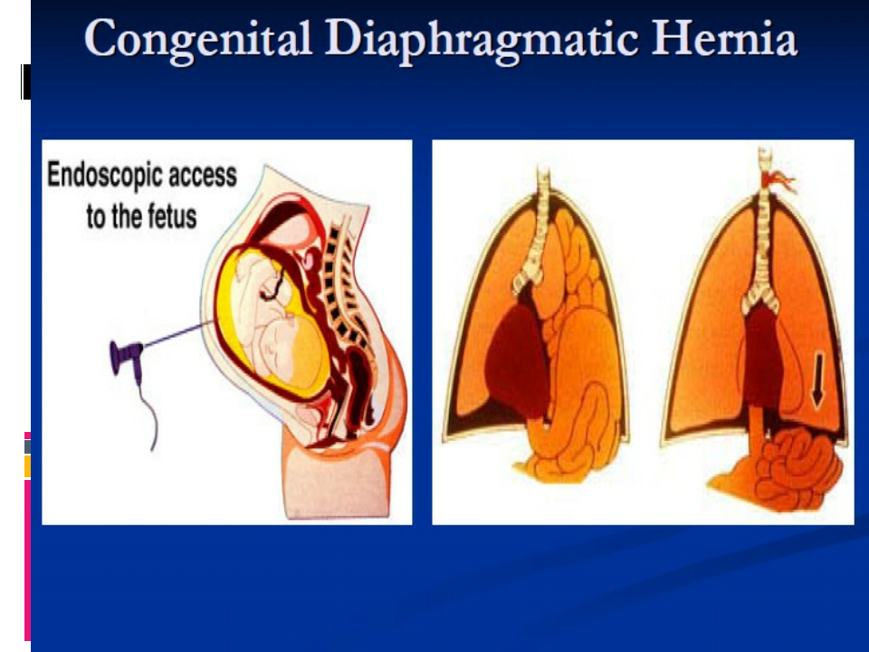

Slide 30
Postnatal management
▪Stabilization of cardiorespiratory system.
▪Endotracheal intubation is critical
▪Nasogastric or Orogastric tube placement.
▪Delayed repair (24 to 72 hours) improves survival
when compared with early emergent repair. Allows
stabilization of the infant before surgical repair.
(Andrewet al., J Ped Surg, june 2004).
▪1/3 of patients will require ECMO. Head US to r/o
hemorrhage prior to ECMO.

Slide 31
Surgical repair
Abdominal subcostal
Thoracotomy
▪ Laparoscopic vs Thoracoscopic
MIS ideal for Morgagni hernias but can be challenging because the
peumoperitoneum widens the defect. Laparoscopy for Bochdalek’s
has a high failure rate and is associated with ↑pCO2 and acidemia
Contraindicated if very high pCO2.
▪ Thoracoscopy is better approach for Bochdalek hernias with
▪ recurrence of 14%. Open approach 3-22%.(Marjorie et al, J Ped Surg,
Nov 2003.)
▪ Small defect can be repaired primarily. Large defect will require
abdominal or thoracic muscle flaps, or prosthetic patch (tension free).

Slide 32
Initial management
Approach should be first medical stabilization of the pt for
improving respiratory and general status and then proceeding for
surgery after stabilization
GOALS
1.Reverse persistent pulm HTN to decrease rt to lt shunting
2.Improvement in ventilation & oxygenation
3.Correction of acidosis
4.Correction of systemic hypotension
• Time taken to stabilize varies from 24-48 hrs to 7-10 days, and upto
3 wks in some neonates
• Repair of hernia in emergency when the contents are incarcerated

Slide 33
Stabilization and preop mx
1.Early placement of NG tube to remove the air from the gut
2.Oxygenation by
a) face mask/hood on spontaneous ventilation
b) IPPV with ETT
c) ECMO
Avoid bag and mask ventilation, nasal CPAP
3.Correction of met acidosis
NaHCO3 = BW X Bdeficit X 0.2

Slide 34
Stabilization contd…
4.Control persistent pulm HTN by maintaining
normoxia,
hypocarbia,
alkalosis
and by using
Pulm Vasodilators
- morphine, talazoline ,arachidonic acid
metabolites, prednisolone, bradykinin, Ach,
PGE1,PGI1,PGD2,CCB, NO(20-80ppm), etc
5.Patients who fail medical management are candidates
for ECMO which can be started preoperatively in a
neonate.

Slide 35
Other preop preparations
• IV fluid administration thru peripheral venous access
in upper limb
• art cannulation for frequent ABG
• Central venous access for CVP monitoring (thru
umbilical/ femoral vein)
• Inotropes if required (hypotension, CHF)
• Hypothermia mx

Slide 36
Premedication
▪Neonates do not require routine premed
▪Atropine @ 0.02mg/kg iv may be given to
reduce harmful vagal reflexes and to reduce
secretions

Slide 37
Induction & intubation
▪Awake intubation
▪Anesthesia is induced with inhalational
agents preferably sevoflurane and trachea
intubated without any msl relaxant
▪Bag & mask PPV avoided till intubation
▪N2O also avoided

Slide 38
Maintainence of anaesthesia
• O2 ± air +inhalational agent (sevo/halo)
• Opiods- fentanyl preferred in dose of
1-3 µg/kg
• Must be relaxed completely after tracheal
intubation with NDMRs preferably
atracurium(0.5 mg/kg), rocuronium (0.6),
vecuron (.1), etc

Slide 39
Monitoring
• Precordial/esophageal stethoscope
• Continuos ECG monitoring
• Spo2 both above and below nipple
• Capnography
• Inspiratory pressures
• Frequent ABG: corrections if reqd
• NIBP
• Fio2 values
• CVP monitoring
• Temperature monitoring : avoid hypothermia
• Estimation of blood loss

Slide 40
Inraop…
Mechanical ventilation to maintain-
▪Pao2 of 80-100 mm Hg
▪Paco2 of 25-30 mm Hg
▪O2 sat-95-98%
▪pH- 7.55-7.6
▪FiO2 depending on PaO2
▪Low airway pressures– @ 15-20 cms of H2O

Slide 41

Fluid management
• Correct deficit : Isolyte P @ 4 ml/kg/hr x no
of hrs, its 50% to be given in first hour, 25% in
next hour & 25% in 3 hour
rd
• Maintenance with 5D in N/2 @4ml/kg/hr
• Third space losses with isotonic
solution/colloid @8ml/kg/hr

Slide 42
Other intraop
considerations
PNEUMOTHORAX
Signs–
• sudden decrease in compliance &Spo2
• Hypotension
• bradycardia ----- immediate ICD
Prevention -- low airway pressures to be kept

Slide 43
Surgical complications
• One stage surgery--- After pulling back of
herniated contents in abdomen and
correction of diaphragmatic defect, the
abdomen is closed
• Sometimes, the closure of abdo wall may
cause RD and decreased VR, separate
temporary silastic pouch may be formed and
abdomen is closed in a second stage surgery
later

Slide 44
Postop care
• Postoperatively elective ventilation is planned
depending on preop respiratory status, size of defect,
tension on abdo wall, asso CHD, etc
• High doses of opiods and adequate msl relaxation to be
injected if the pt is kept on ventilator
• Ventilation & FiO2 adjusted to maintain-
pao2- 80-100 mm Hg,
paco2 - 25-30
pH - 7.55
With low TV & airway pressures & high RR

Slide 45
Post op
• Monitor the pt for pH& electrolytes
• T/t of acidosis,PHTN
• ECMO may be reqd if PaO2 not maintained
• Care of nutrition- iv hyperalimentation
• Fluids @ 2-4 ml/kg/hr
• Awake extubation to be planned when pt is
maintaining PaO2 on minimum FiO2 with adequate
respiratory efforts

Slide 46
Mortality & morbidity
• 30-60% in various studies
• ECMO- improves overall mortality, however
incidence of neurological sequelae increase
• Factors- degree of pulm hypoplasia, asso
malformations, inadequate periop care
• Long term follow up reqd- 10% incidence of
delayed milestones

Slide 47
ECMO (Extra Corporeal Membrane
oxygenator)
• Most commonly indicated for pts with severe
hypoxemia, hypercarbia,acidosis & pulm HTN
who do not respond to max conventional resp
and pharmacological intervention– mainly seen
in children with MAS, CDH, pneumonia,
sepsis,etc
• In CDH- employed in cases with severe lung
hypoplasia with PaO2<50 at FiO2 100%

Slide 48
Advantages ECMO
• Eliminates R to L shunting by diversion of 80% of cardiac
output
• Decreases Rt vent workload d/t dec PBF and pressure
• Decreases pvr as hypoxia and acidosis corrected
• Growth of hypoplastic lung
• Overall survival of ECMO treated infant is good, CDH-
60%

Slide 49
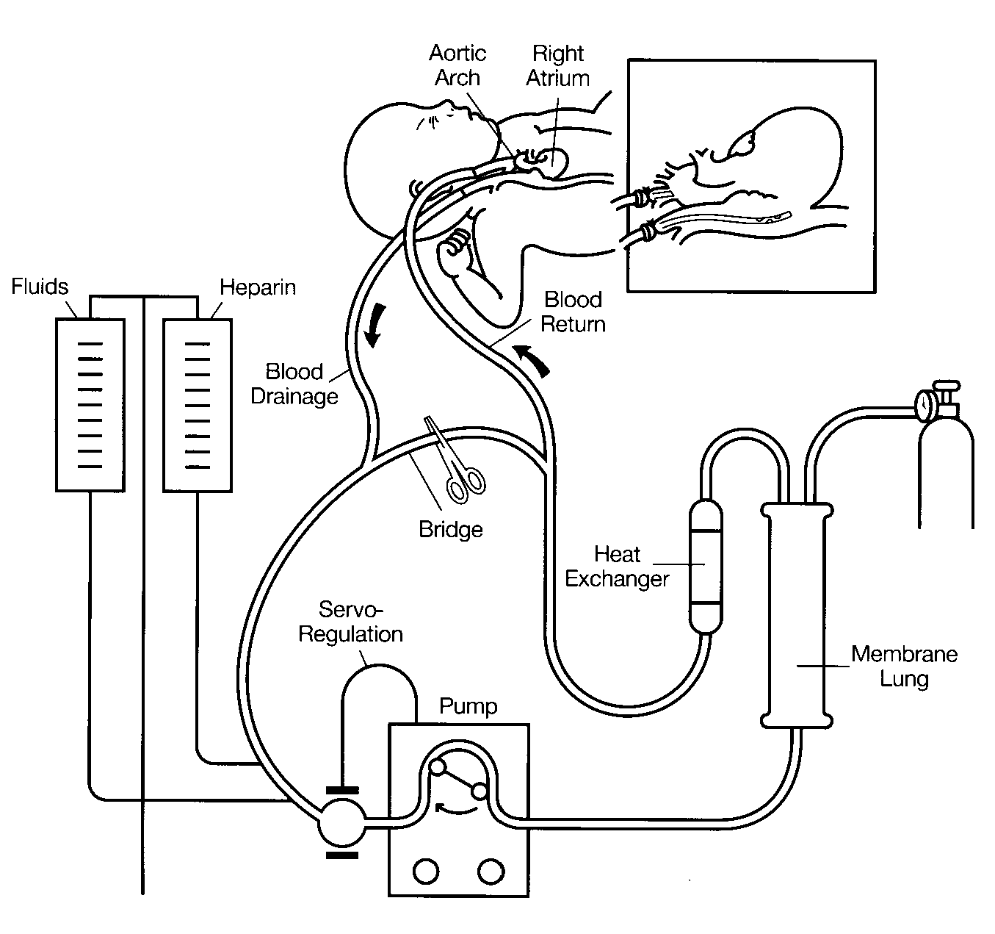
Circuit

Slide 50
Management
• Flow started @ 50 ml/min---- inc to 60-80% of
predicted CO (300-400 ml/min)
• PaO2 > 60 (80-100)
• Venous SpO2 > 70%
• PCO2- n range
• Msl relaxant discontinued to evaluate
neurological fn, sedation must

Slide 51
Management…..
Clotting abnormalities----
• Pt heparinised to prevent clotting
• ACT maintained b/w 190-260 seconds
• Platelet transfusion may be reqd if going for
surgery--- maintained at 1 lac/cc
• Fibrinogen --- FFP/ cryoppt, require regular ACT
monitoring

Slide 52
Working
Venoarterial bypass –
▪Rt IJV cannulated---- roller pump---- membrane
oxygenator---- warming at 37’c----- blood
returned to infant via carotid art cannula
Venovenous bypass –
▪Can also be used but it requires n myocardial fn,
which is often lacking in these patients

Slide 53
Discontinuation of ECMO
• Adequate oxygenation & ventilation with ECMO
rate@50 ml/hr
• Low pressures and n rates during mech vent
maintains adequate gas exchange for 2 hrs
------- cannulas can be removed and
heparinisation discontinued
• ACT monitoring continued and trachea
extubated 2-3 days later

Slide 54
Complications
▪Technical – clotting in the circuit, failure of
oxygenation/pump, ruptured tubings,
dislodged cannulae, etc
▪Others – hemorrhage( CNS,GI) ,seizures,
brain death, renal failure, cardiac arrythmias,
hypertension, etc.

Slide 55
conclusion
▪ CDH is a congenital anomaly with a high mortality. Usually
associated with pulmonary hypoplasia and hypertension.
▪ Surgical repair is only treatment. Delayed surgery until the
patient is stable is associated with better outcomes.
▪ Congenital cardiac and renal diseases, hypoxemia and
hypercapnia increases mortality.
▪ HFOV, ECMO, iNO has improved the survival of CDH.
▪ Permissive hypercapnia with acceptable pO2 has shown to
improve survival.
▪ Long term follow up is necessary to detect complications.
▪ Tracheal occlusion in utero, keeps lung expanded but is a
abnormal lung.
▪ Primary repair is small defect, patch if large defect.

Slide 56
Thank You

