Slide 1


EMERGENCY DRUGS
DR. RISHABH NAVIN SHAH
BDS, MDS, FCCS
Cleft & Cranio-Maxillofacial Surgeon
Department Of Oral And Maxillofacial Surgery
K M Shah Dental College And Hospital
Sumandeep Vidyapeeth

Slide 2
Syncope
Seizure
Epilepsy
CNS
Cardiac Arrest
Angina Pectoris
Myocardial infarction
Hypertension
Hypotension
Respiratory
system
Asthmatic Attack
Hyperventilation
Airway Obstruction
CVS
Classification
Drug toxicity
Anaphylaxis
Drug Related
Other
Haemorrhage
Hypoglycaemic coma

Slide 3
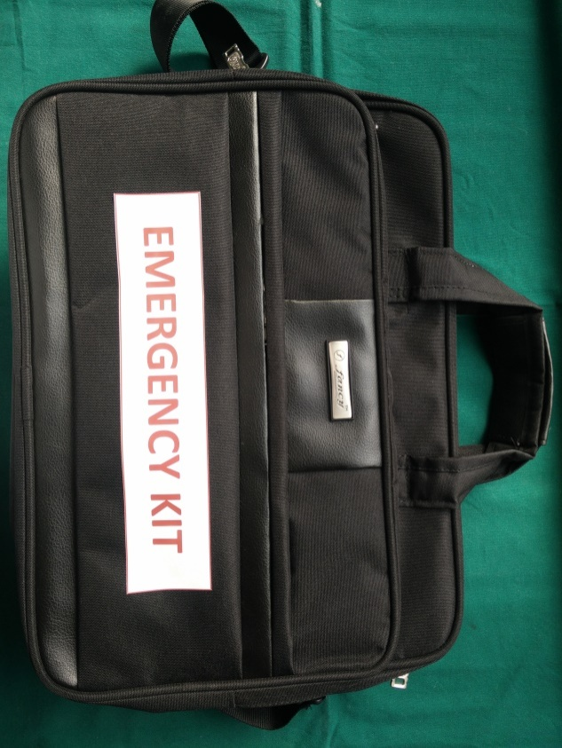
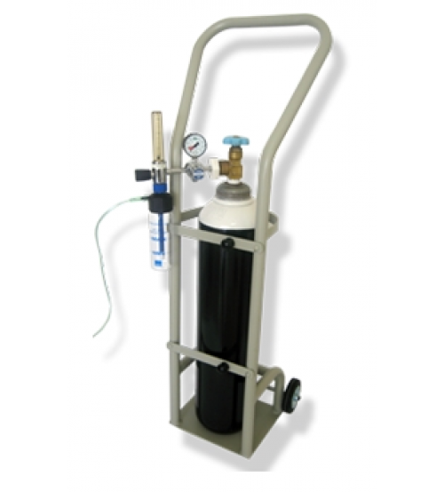
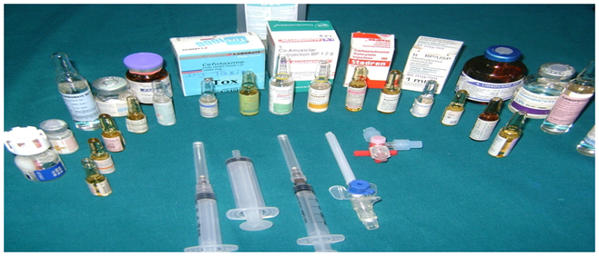
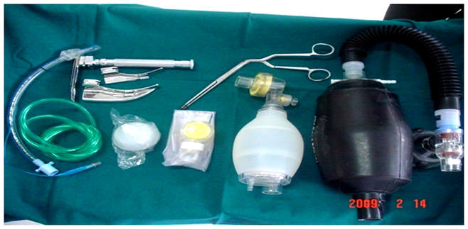
Emergency Kit and Equipment
Notes:
We have designed an emergency kit with SOPs for the management of all the medical emergencies.

Slide 4
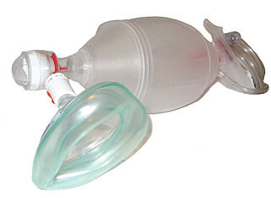
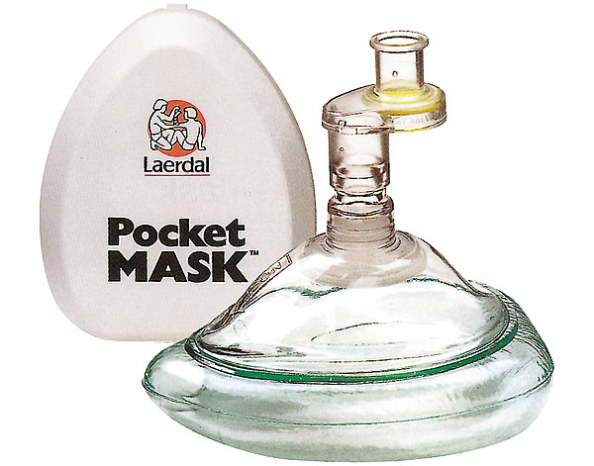
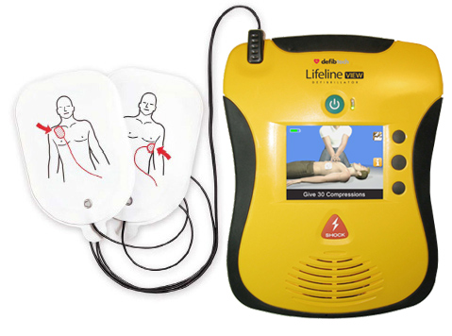
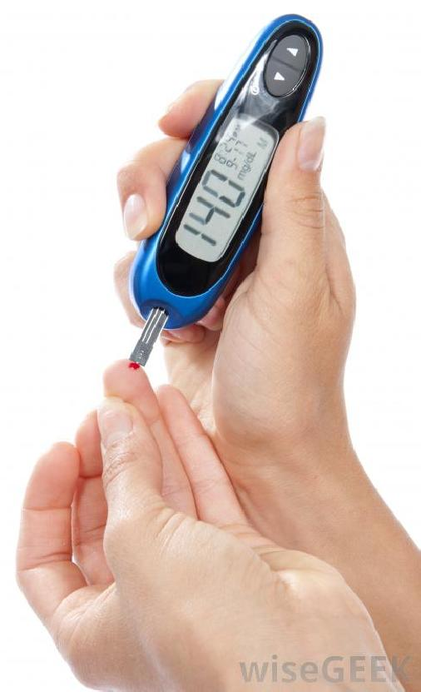
Ampocket
mask with one way valve
Ambu bag mask
Blood glucose meter
AUTOMATED EXTERNAL DEFIBRILLATOR (AED)

Slide 5
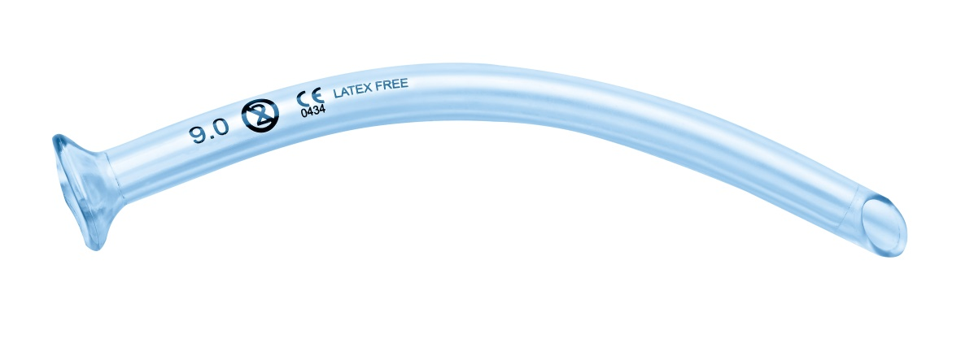
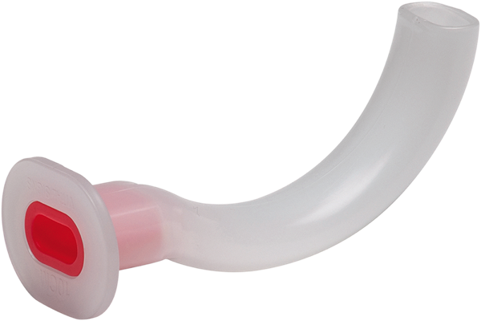
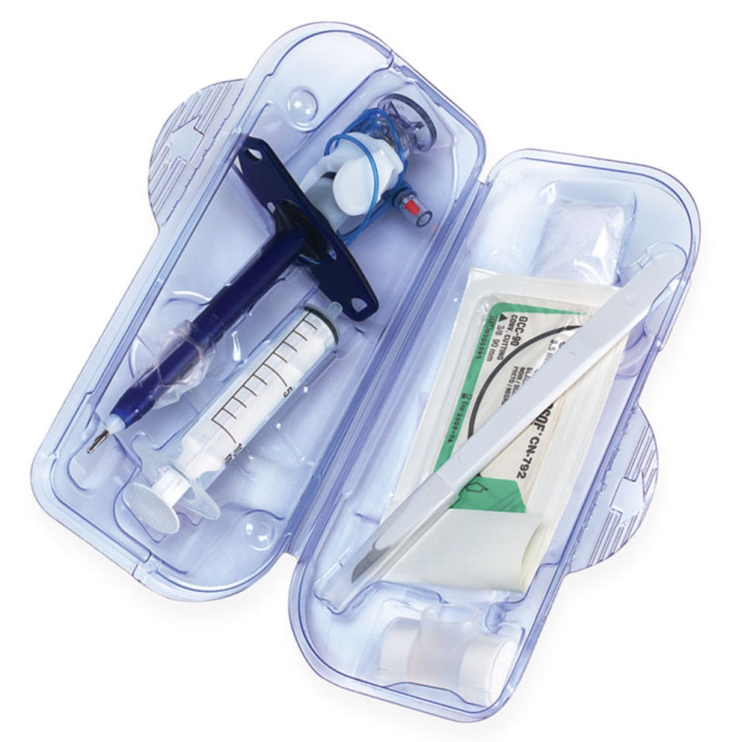
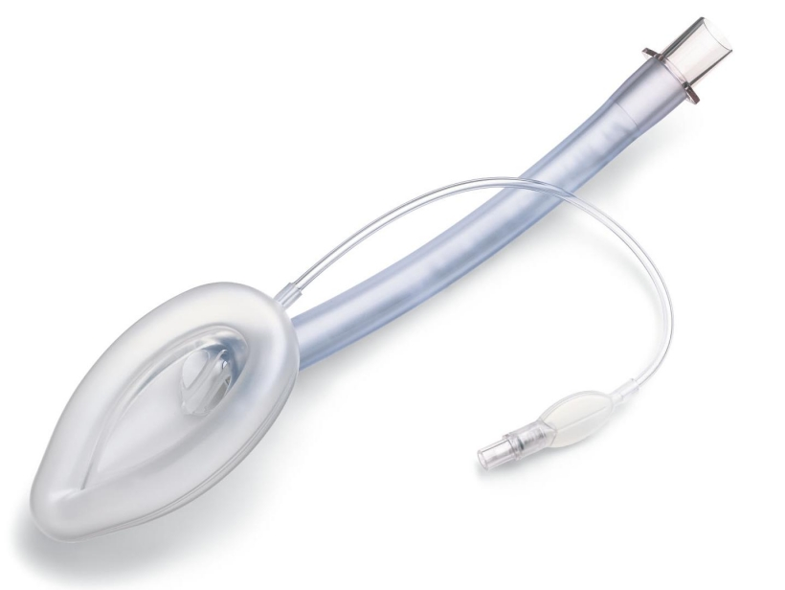
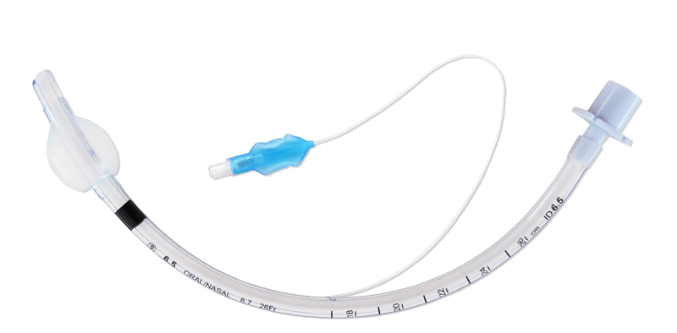
Oropharyngeal airway
Nasopharyngeal airway
Endotracheal tube
Laryngeal mask airway
Cricothyrotomy kit

Slide 6
A
B
otroclot
eta blocker
drenaline
tropine
vil
minophylline
spirin
c
D
opamine
examethasone
extrose
iazepam
eriphyllin
alcium gluconate

Slide 7
E
thamsylate
ptoion
F
Ortwin
ulsed
H
G
emolok
ydrocortisone
lucagon
lucose
M
ephentine
orphine
etoprolol
idazolam
Miscellaneous

Slide 8
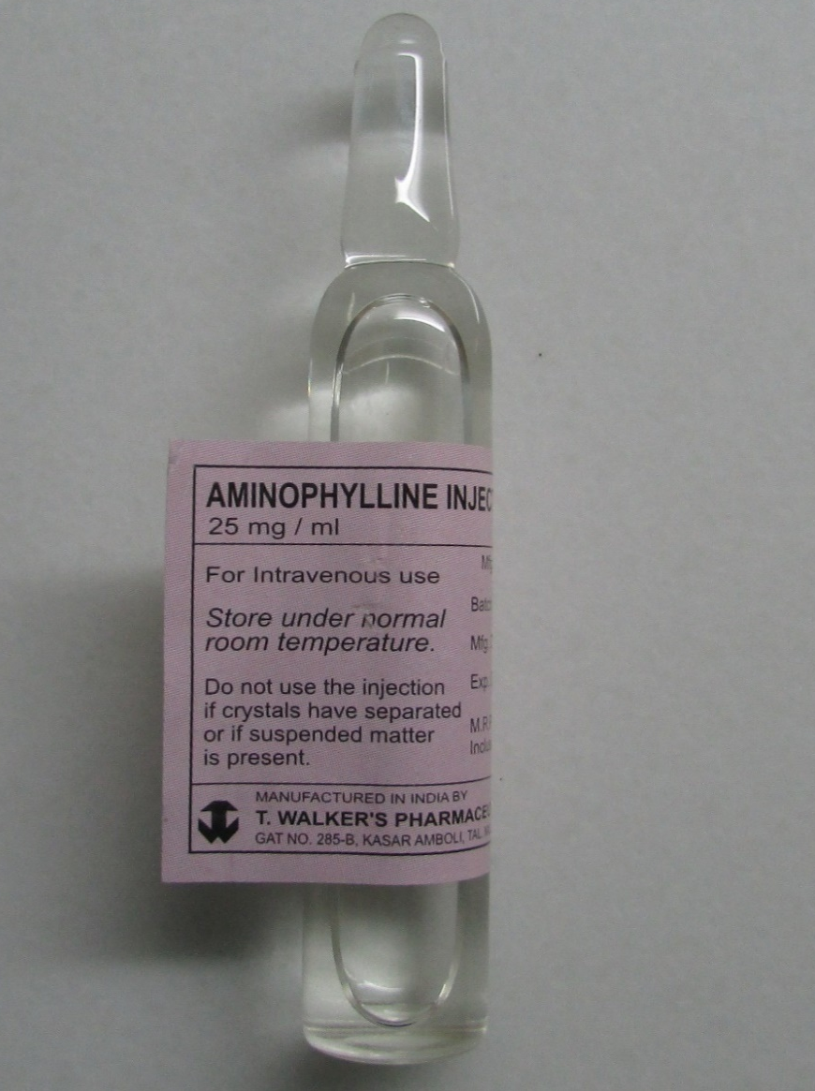
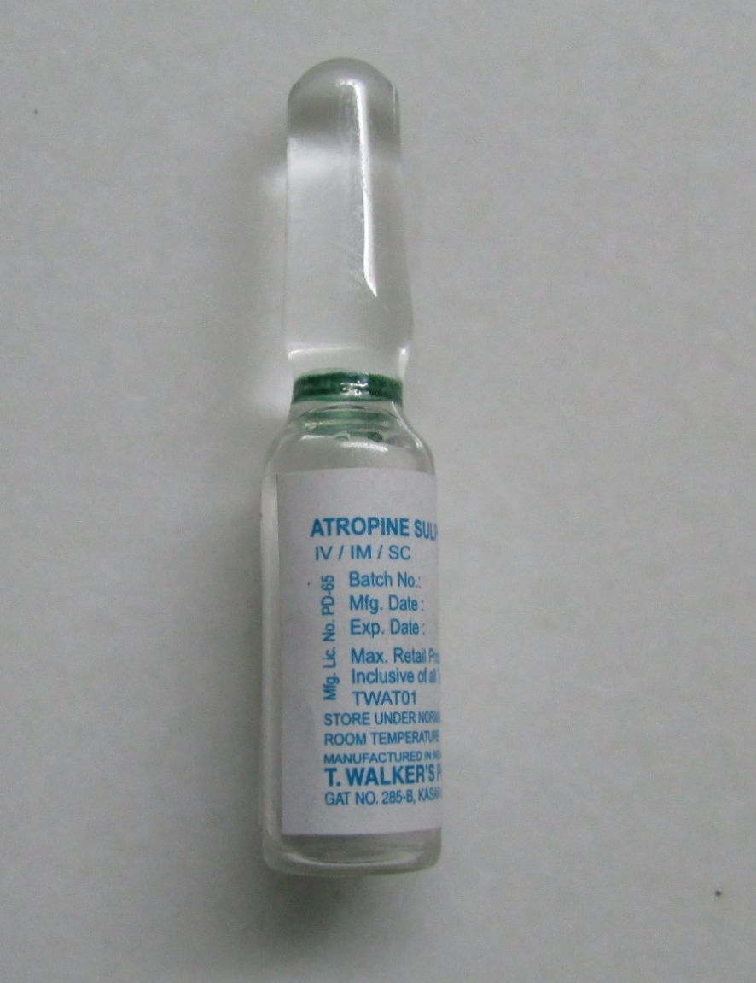
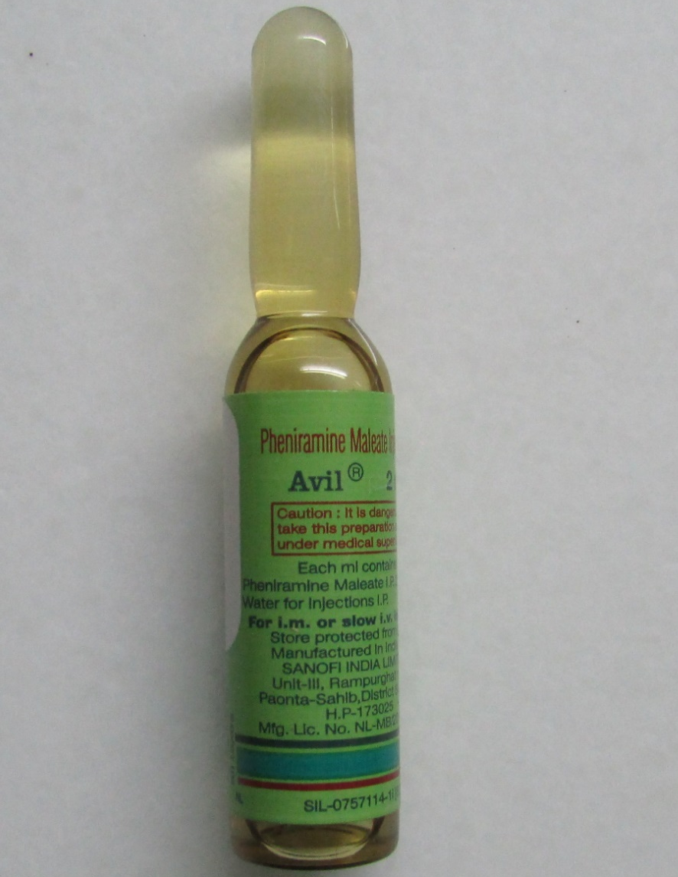
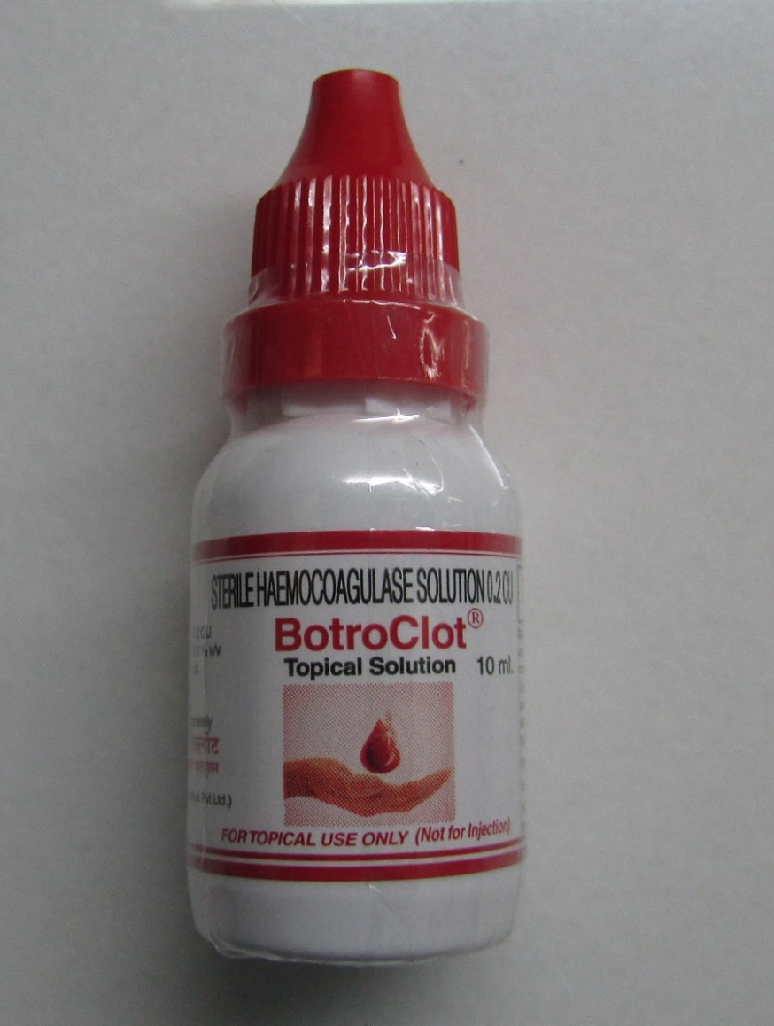
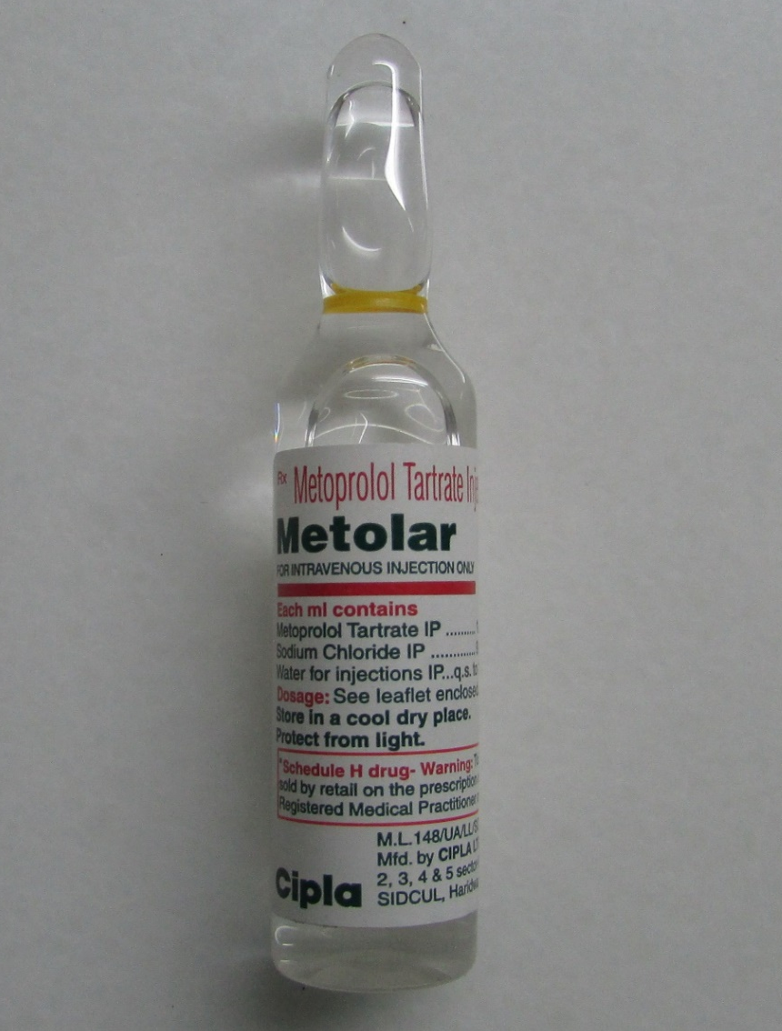
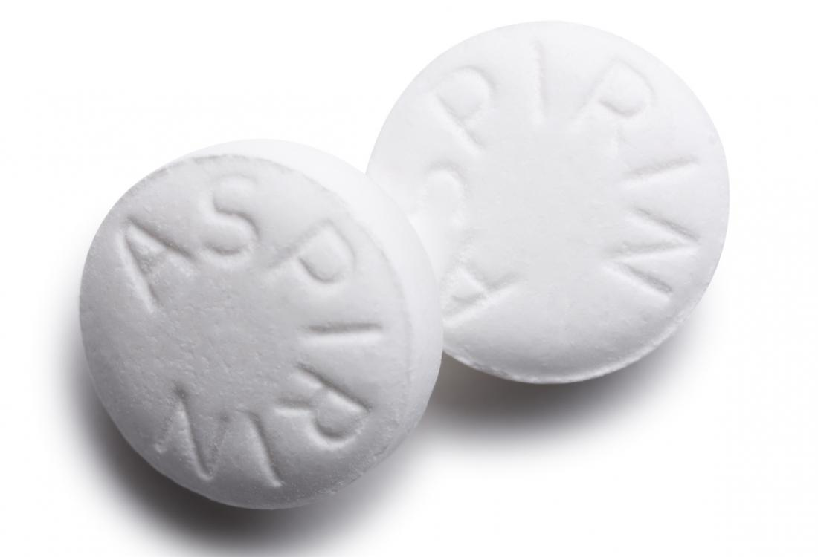
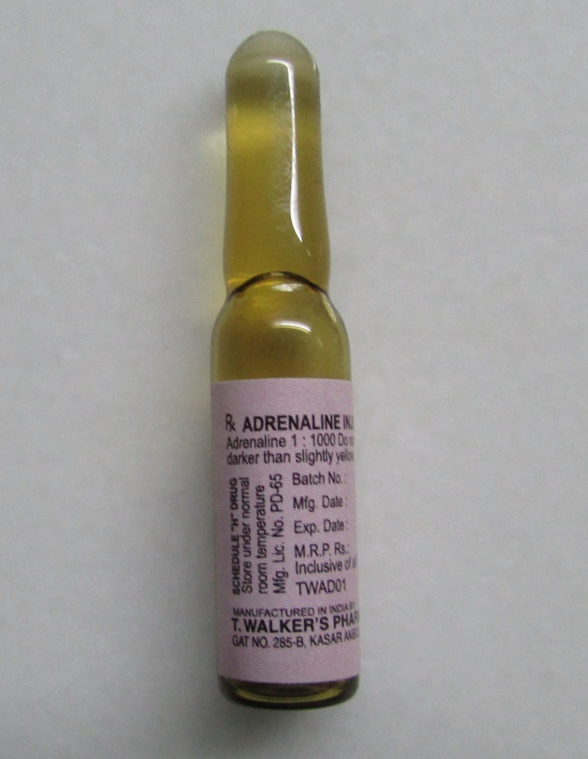
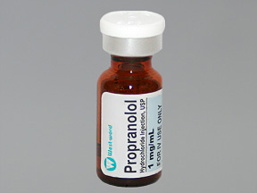
Drug | Dose | Route | Indications
Avil | 25MG | IM/IV | Anaphylactic shock Drug allergy
Aspirin | 75-325mg | SL | Severe Angina Pericarditis
Propranolol | 1mg/ml | IV | Cardiac arrhythmia Hypertension Angina pectoris
Metoprolol | 1 mg | IV | Hypertension
Adrenaline | 0.5mg of 1:1000 1:10000 | SC/IM IV | Anaphylaxis Cardiac arrest
Botroclot | Few drops | Topical application | Uncontrolled bleeding
Aminophylline | 25mg/ml | IV | Bronchial asthma COPD
Atropine | 0.6mg-2mg | IM/IV/SC | Syncope Hypotension

Slide 9
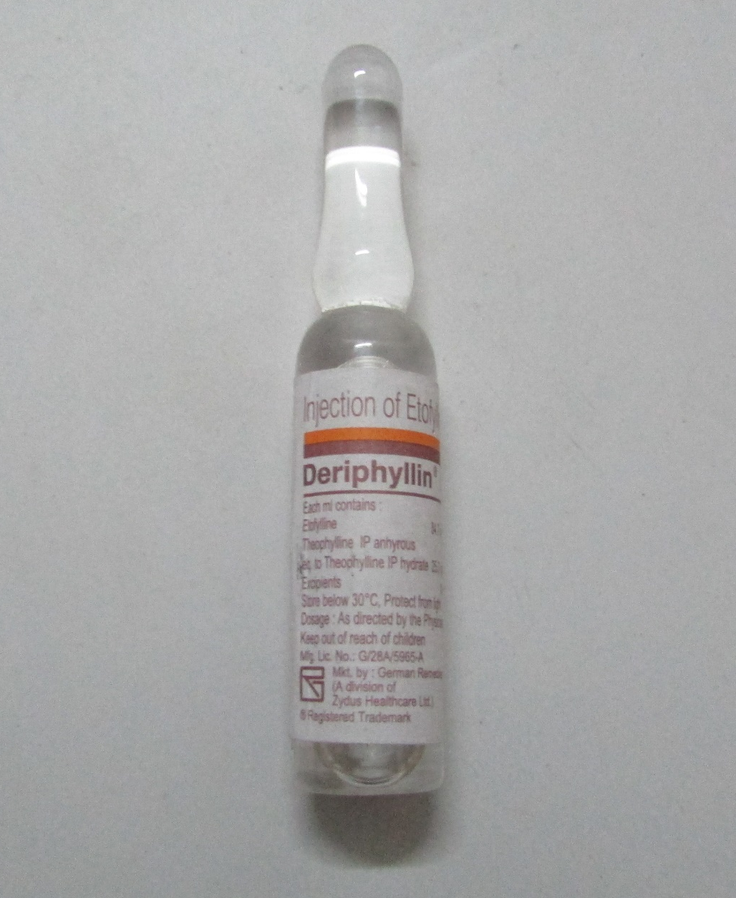
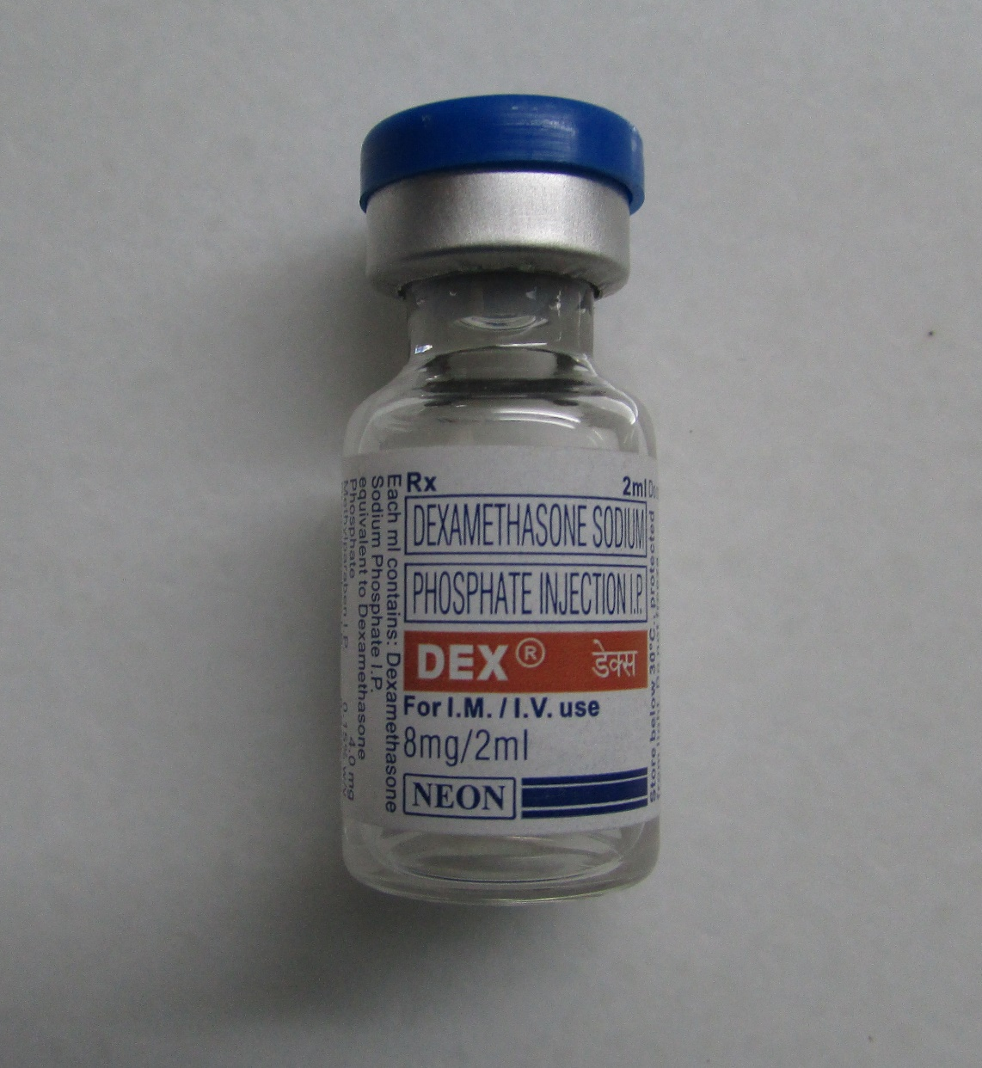
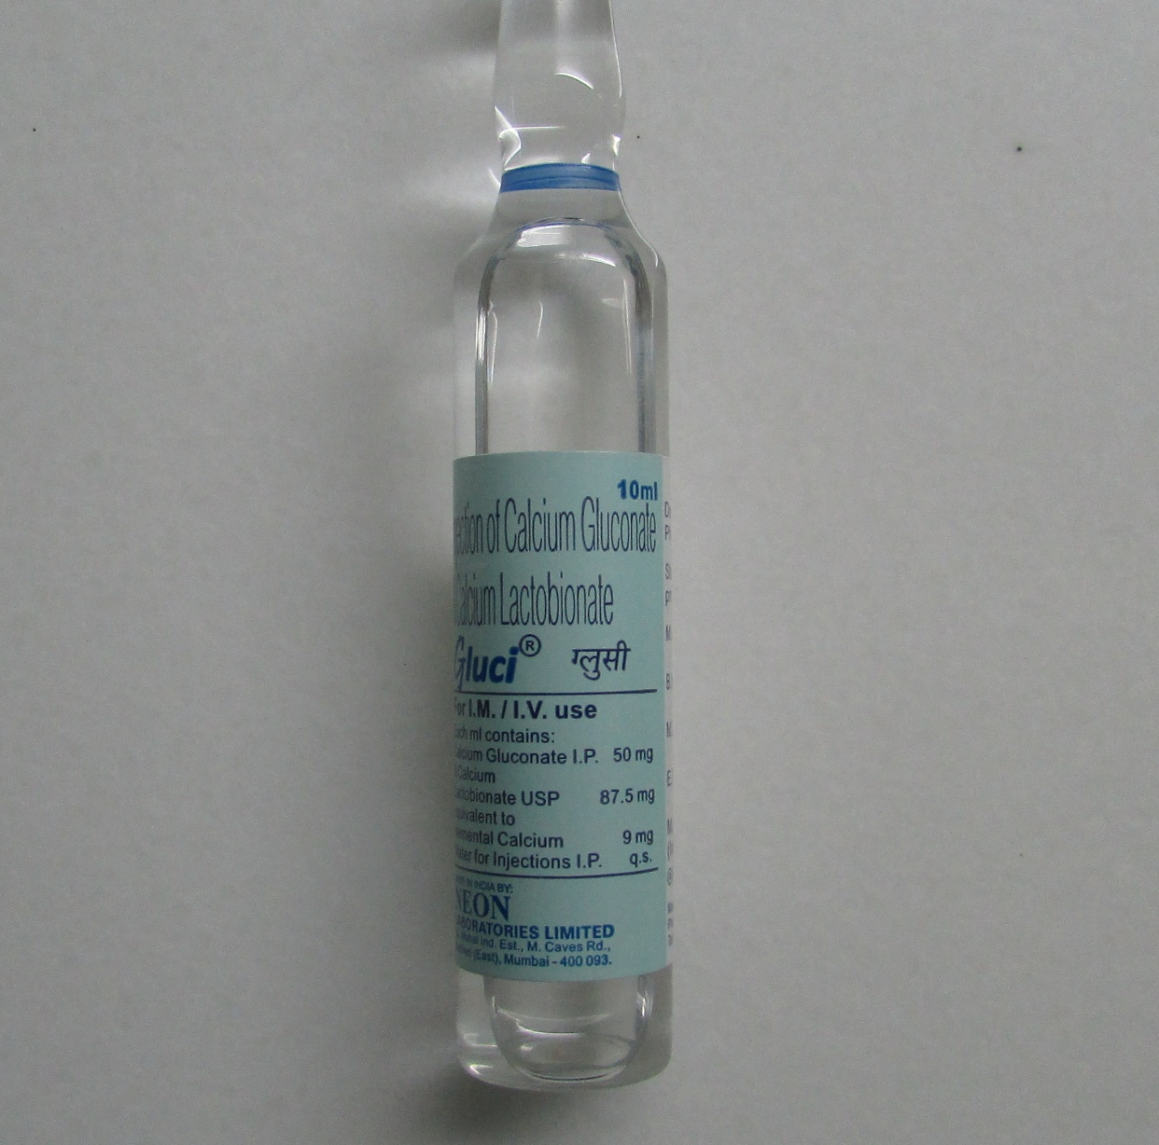
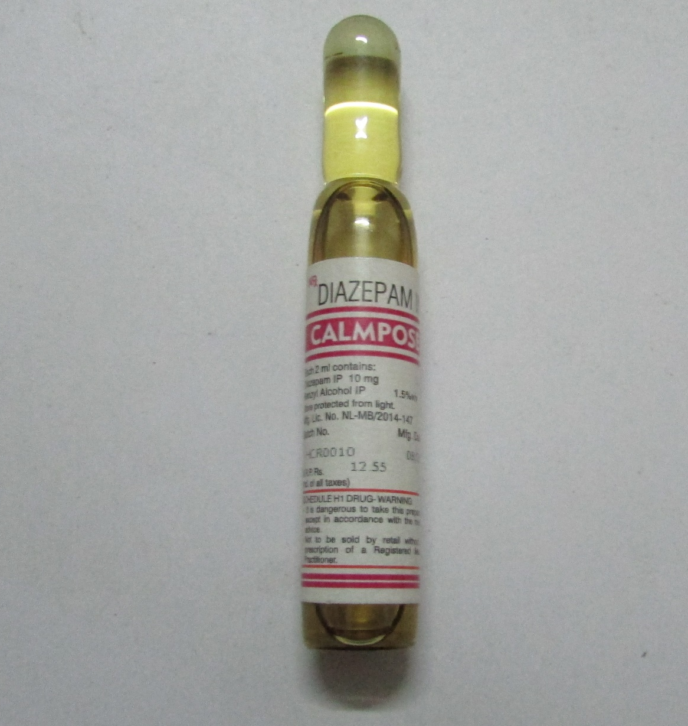
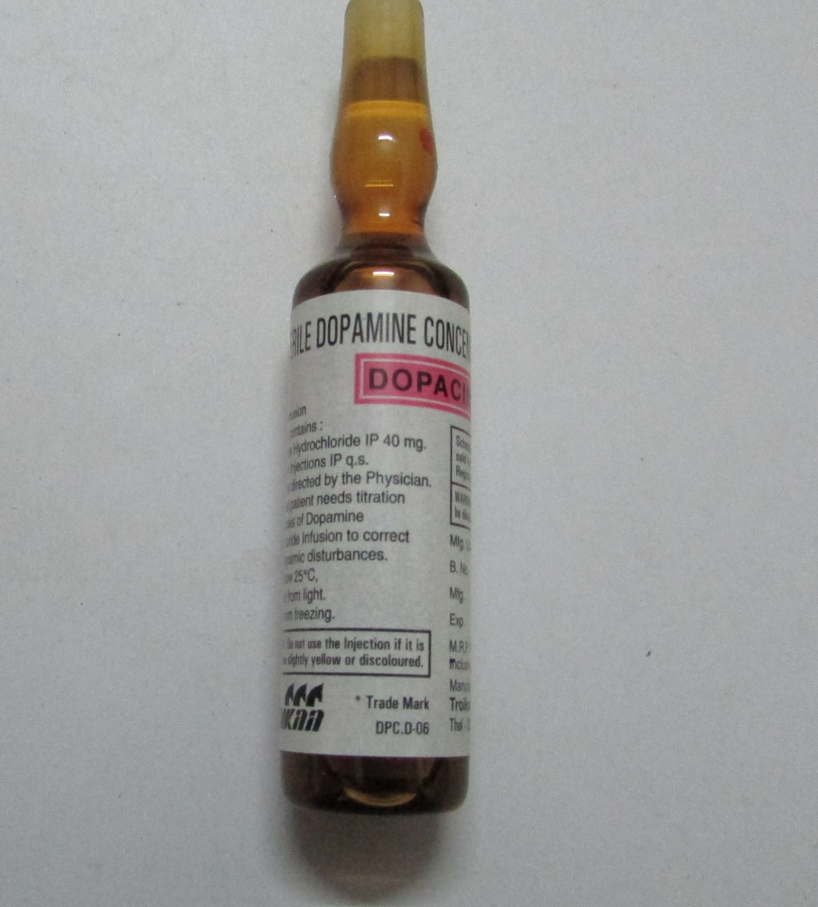
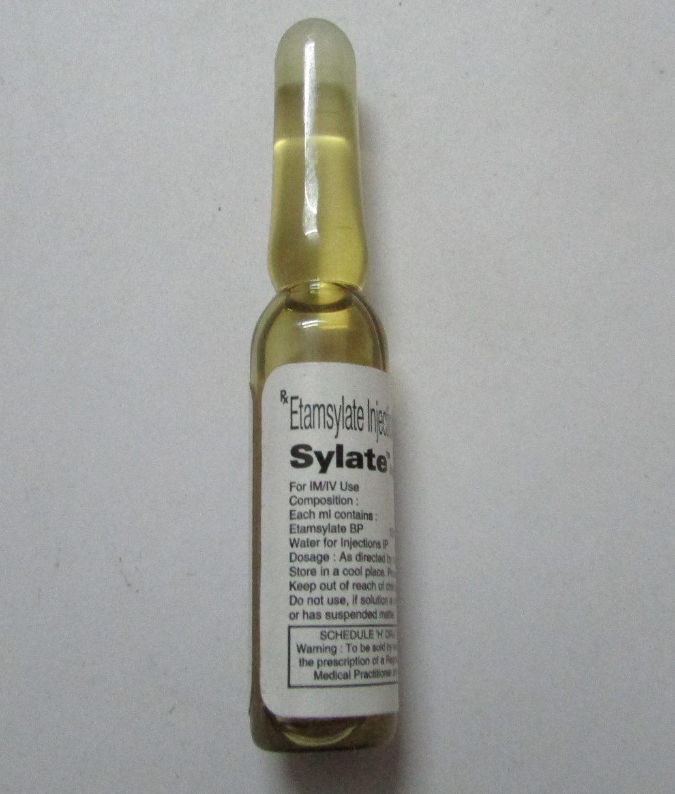
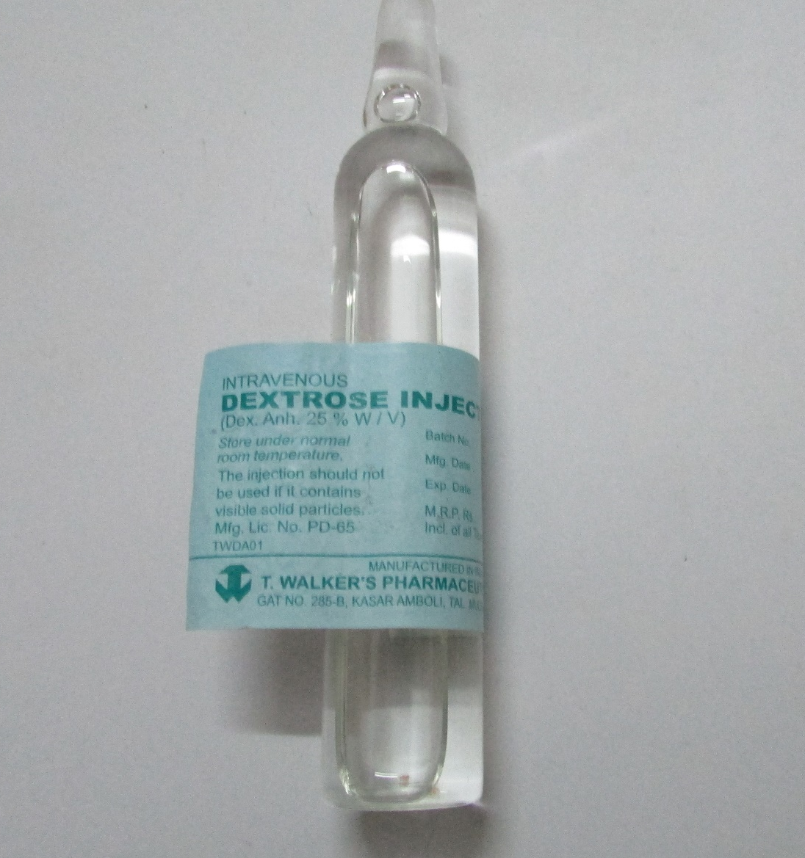
Drug | Dose | Route | Indications
25% Dextrose | 2-20 mg/kg/min | IV | Hypoglycaemic shock
Ethamsylate | 2ml | IV/IM | Uncontrolled bleeding
Calcium gluconate | 100 ml 3hry | IM/IV | Tetany
Dopamine | 0.2-1 mg | IV | Hypotension CCF
Dexamethasone | 8 mg/day | IV/IM | Allergic reactions
Diazepam | 2.5-5 mg | IM/IV | Epileptic fits Toxicity
Deriphyllin | 2-10 mg | IV | Acute asthmatic attack

Slide 10
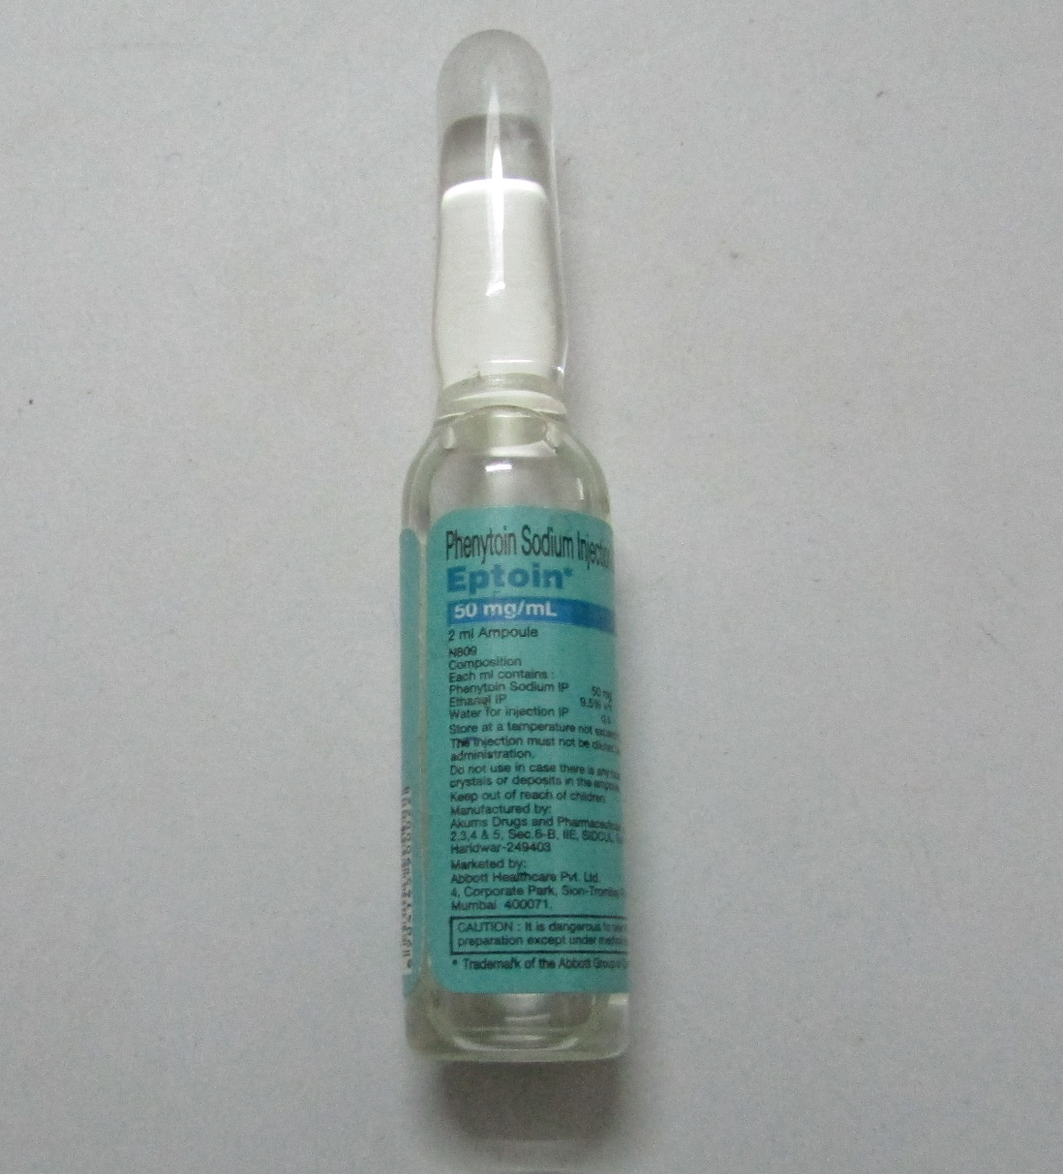
Drug | Dose | Route | Indications
Fortwin | 0.5-1 mg/kg | IM/IV | Moderate to severe pain
Eptoin | 50mg/ml | IV | Epileptic attack
Fulsed | 0.25-0.5 mg/kg 1-5 mg | IV | Anxiety LA Toxicity Epileptic attack
Glucagon | 1 mg | IV | Severe hypoglycaemia Diabetes mellitus
Hemolok(Feracrylum) | 1%/100ml | Topical application | Heavy bleeding

Slide 11
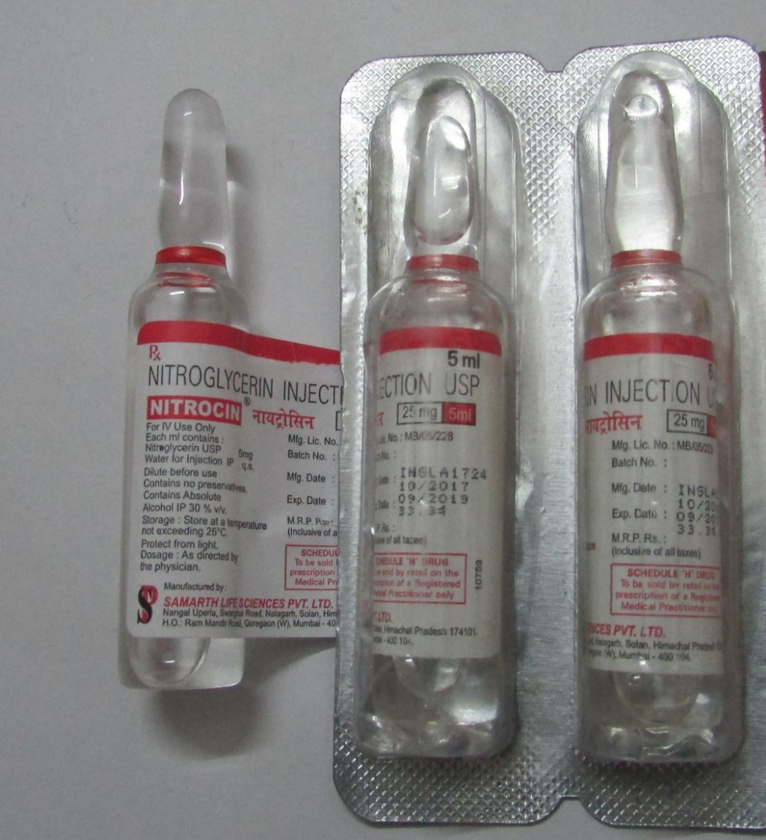
Drug | Dose | Route | Indications
Hydrocortisone | 100 mg | IV/IM | Anaphylactic Shock Status asthamaticus
Nitroglycerin | 0.5mg 0.4-0.8mg | S.L S.L spray | Angina Hypertension
Morphine | 2-10 mg Bolus | IV/IM | Acute pain Potent analgesia
Mephentine | 10-20 mg or | IM or IV infusion | Hypotension shock in MI

Slide 12
STRESS REDUCTION PROTOCOL
Premedicate - evening before / just before surgery.
Morning appointment schedule.
Minimize patient waiting time.
Psychosedation during therapy.
Adequate pain control during therapy.
Post op pain and anxiety control.

Slide 13

PREVENTION

