Slide 1

SOLDERING AND WELDING IN ORTHODONTICS
Dr. Romil Shah
Professor & PG Guide,
Dept. of Orthodontics and Dentofacial Orthopaedics,
KMSDC&H, SVDU

Slide 2
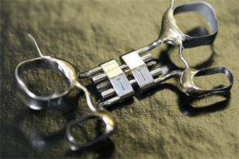
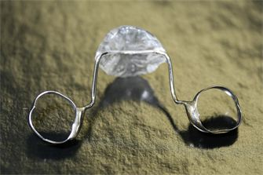
SOLDERING
Soldering – It is defined as the joining of metals by the fusion of filler metal between them, at a temperature below the solidus temperature of the metals being joined and below 450°C.

Slide 3
If fusion temperature exceeds 450 degrees- brazing
Principle: flow of molten filler metal due to capillary attraction between metallic parts to be joined

Slide 4
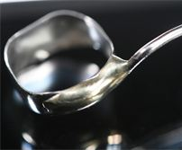
COMPONENTS OF SOLDERED JOINT
PARENT METAL
FLUX AND ANTIFLUX
SOLDER OR FILLER METAL

Slide 5
PARENT METAL
The parent metal is the metal or alloy to be joined.
It is also known as substrate metal or base metal.
The soldering operation is same for any substrate metal.

Slide 6
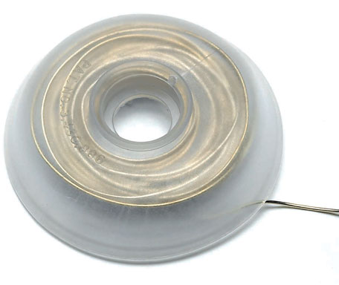
DENTAL SOLDERS
Filler metal which join 2 or more metallic parts:
Requisites:
Excellent Tarnish And Corrosion Resistance
Fusion Temp Lower Than That Of Metal To Be Joined
Free Flowing And Wet The Metal Parts
Strength Similar To The Metals To Be Joined
Color Match

Slide 7
CLASSIFICATION OF SOLDERS
SOFT SOLDERS
They are alloys of Tin, Bismuth, Lead.
It can be easily melted with narrow gas flame or electric soldering irons.
They have low fusion range of about 260°C or less.
Soft solders lack corrosion resistance, so they are impractical for dental use.

Slide 8
HARD SOLDERS
Hard solders have higher meting temperature & possess greater hardness and strength.
Heating is done with gas torch or special devices.
Two types of hard solders are used in dentistry:
a. gold solder & silver solder.
b. Precious metal solders & Non-Precious metal solders

Slide 9
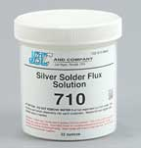
FLUX
“Latin word- flow”
Functions:
Flux aids in removing oxide layer on parent metal thus increasing the flow of solder
Dissolves surface impurities
Reduces the melting point of solders.
Composition
Borax glass, boric acid and silica

Slide 10
CLASSIFICATION OF FLUX
According to their primary purpose / activity
1)Protective type
2)Reducing type
3)Solvent type
According to their composition
1)Borax fluxes
2)Fluoride fluxes
According to the pH of the flux
1)Acidic fluxes 2)Basic fluxes
3)Neutral fluxes

Slide 11
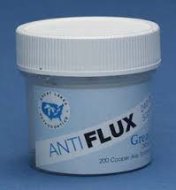
ANTIFLUX
Confines flow of molten solder over metals being joined.
Examples: lead pencil markings, graphite lines

Slide 12
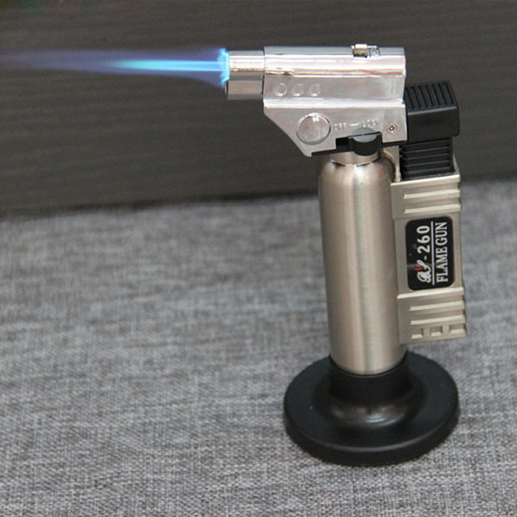
HEAT SOURCE

Slide 13
The most common instrument used as heat source is gas- air or gas- oxygen torch. The type of torch depends on the type of fuel.
The fuels used are
Hydrogen-low heat content, so heating is slow.
Natural gas- heat content is four times that of hydrogen.
Acetylene

Slide 14
Propane- is the best choice. Have highest heat content& good flame temperature.
Butane- has similar flame temperature and heat content.
Both are readily available. Both are uniform in quality, virtually water free and burn clean.

Slide 15
TYPES OF SOLDERING
SOLDERING
INVESTMENT
FREE HAND

Slide 16
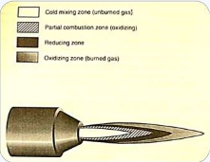
FLAME
The flame can be divided in to four zones:
Cold mixing zone
Partial combustion zone
Reducing zone
4)Oxidizing zone
The portion of the flame that is used to heat the soldering assembly should be the neutral or slightly reducing part, because this produces the most efficient burning process and most heat.

Slide 17
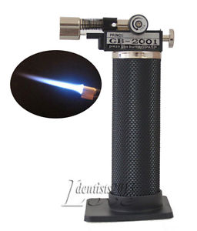
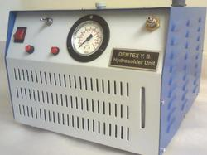
INSTRUMENTS
HYDROSOLDER UNIT
SOLDERING TORCH

Slide 18
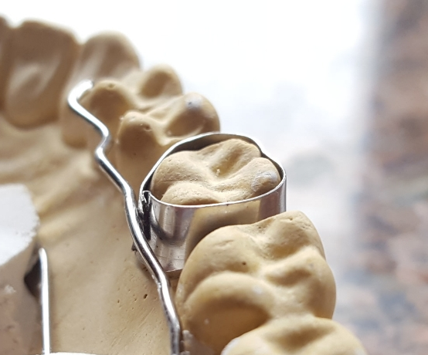
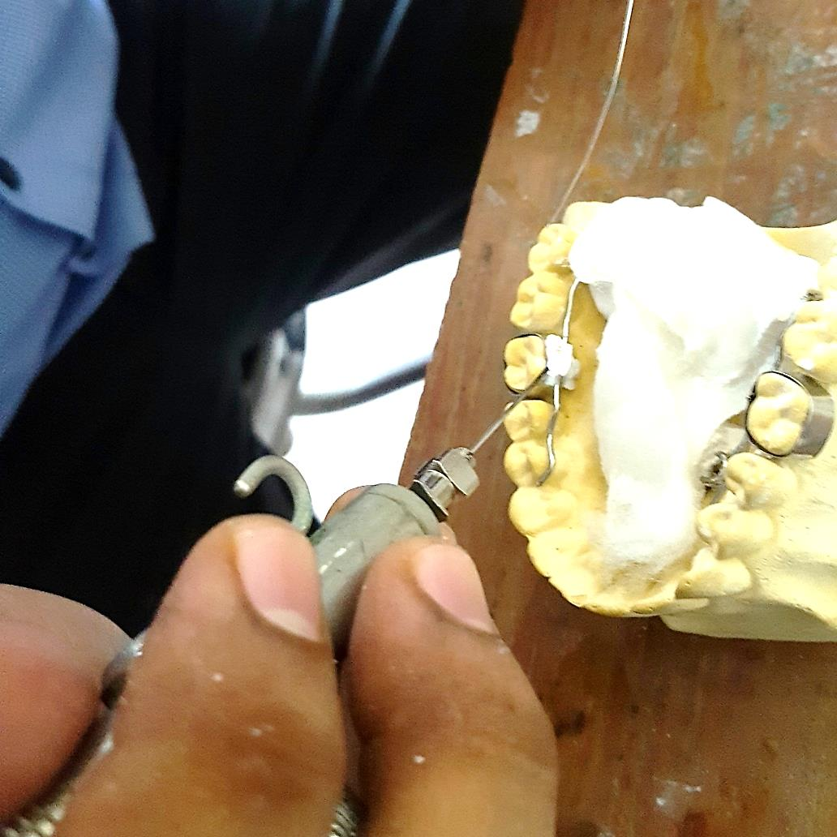
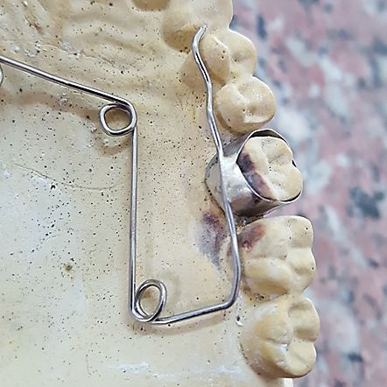
SOLDERING

Slide 19
WELDING
Joining 2 or more metal pieces directly under pressure without introduction of filler metal
Use heat of sufficient intensity to melt the metals.
Done using spot welders

Slide 20
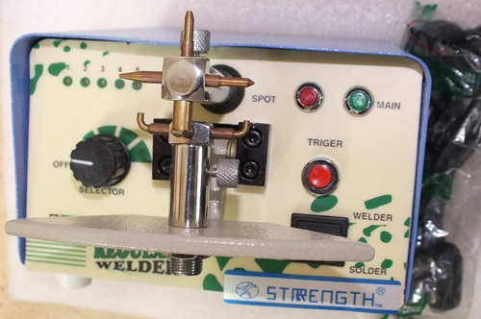
PRINCIPLE
Heat and pressure
Electric current pass through step down transformer
Conducted through copper electrodes on either side of metals to be joined

Slide 21
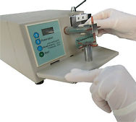
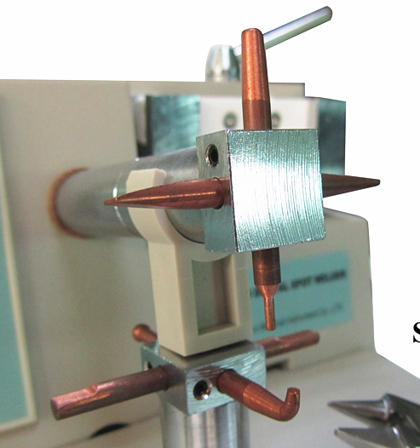

Metal pieces to be joined receive high temp, thus metal becomes plastic.
Copper electrodes simultaneously apply pressure thus squeeze metal pieces

Slide 22
DURATION
Current passage at weld spot – very short duration not more than 1/10th of second
If long – carbide precipitation

Slide 23
COPPER ELECTRODE
Transmit current to metals to be welded
Help in holding the metals together
Apply pressure on metals
Conduct heat away from area so properties of metal around the joint not affected

Slide 24
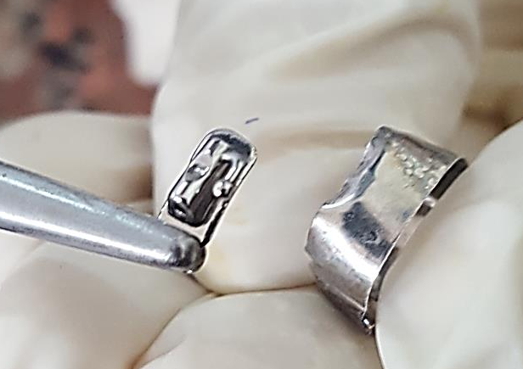
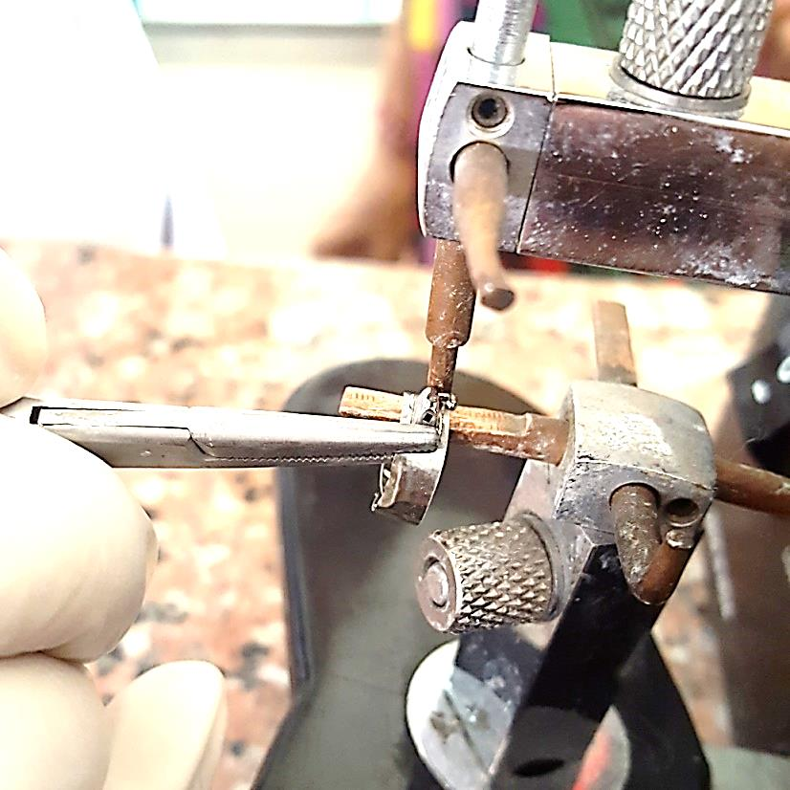
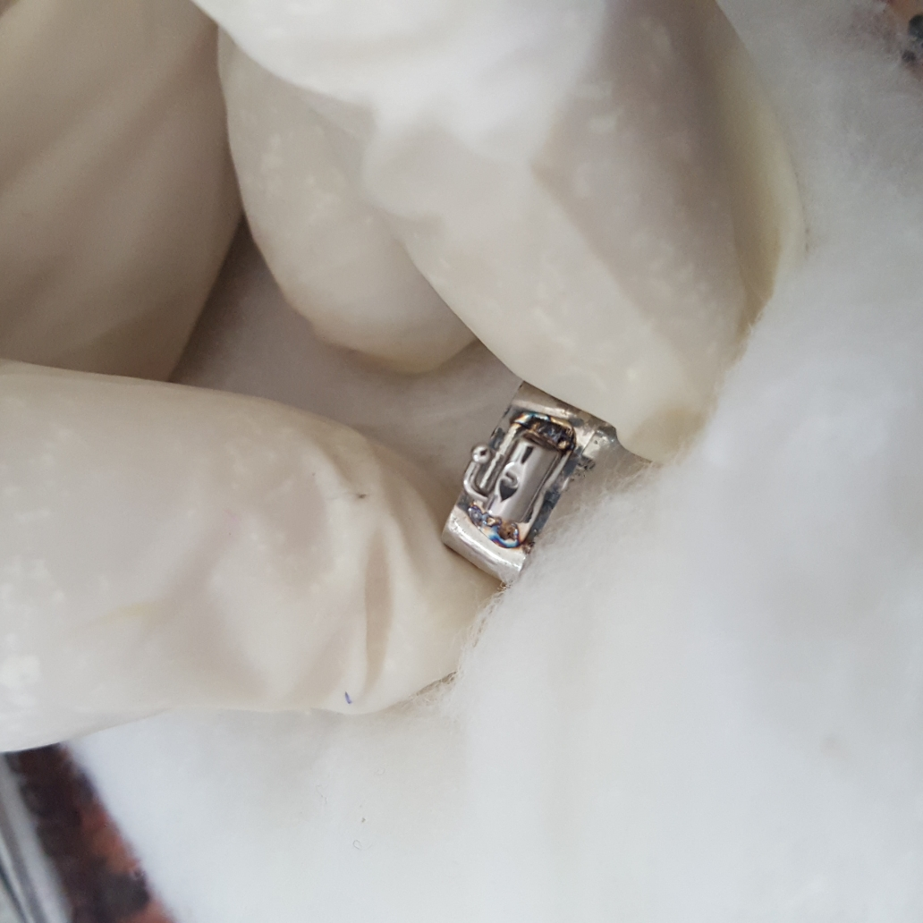
WELDING

Slide 25
Laser welding
Nd YAG laser- high energy in short time
Advantages:
No solder and flux needed
Weld is more precise
More homogenous weld joint- more strength
Depth of weld -3mm, conventional -0.6mm

Slide 26
MULTIPLE CHOICE QUESTIONS
What is the flame used for soldering ?
A: 250 degrees
B: 300 degrees
C: less than 450 degrees
D: greater than 450 degrees

Slide 27
2. Which zone of flame needs to be used for soldering??
A: Blue zone
B: Mixing zone
C: Cold zone
D: oxidizing zone

Slide 28
3. Solder material should have
A: excellent tarnish and corrosion resistance
B: should have good shade match and color
C: should have adequate strength
D: all of the above

Slide 29
4. Flux helps in:
A: restricting the flow of solder material
B: removing the oxide layer on parent material
C: increasing the fusion temperature of solder
D: all of the above

Slide 30
5. Following is an anti-flux
A: Graphite
B: Borax
C: Silica
D: all of the above

Slide 31
Fracture strength of different soldered and welded orthodontic joining configurations with and without filling material
Authors | Journal | Level of evidence | Aims and objective | Results & Conclusion
Jens Johannes Bock; Jacqueline Bailly | Journal of Applied Oral Science VOL 16 0CT 2008 | Level 4 | The aim of this study was to compare the mechanical strength of different joints made by conventional brazing (soldering), Tungsten inert gas welding, laser welding with and without filling material. | Significant differences between brazing and TIG or laser welding were found in each joint configuration. The highest fracture strength means were observed for laser welding with filling material. In conclusion, the fracture strength of welded joints was positively influenced by the additional use of filling material. TIG welding was comparable to laser welding except for the impossibility of joining orthodontic wire with orthodontic band

