Slide 1
Lecture 89 Osteomalacia
Dr Chirag Kapoor
Dept of Orthopaedics, Dhiraj Hospital
SBKS MIRC, Sumandeep Vidyapeeth
Vadodara

Slide 2
OSTEOMALACIA
Normal bone metabolism
CALCIUM 99% in bone. Main functions- muscle /nerve function, clotting. Plasma calcium- 50% free, 50% bound to albumin.
Dietary needs- Kids- 600mg/day, Adolesc.-1300mg/day, Adult-750mg/day, Pregnancy-1500mg/day, Breastfeeding-2g/day, Fractures- 1500mg/day
Absorbed in duodenum (active transport) and jejunum (diffusion), 98% reabsorbed in kidney prox. tubule, may be excreted in stool.

Slide 3
OSTEOMALACIA
Normal bone metabolism
PHOSPHATE 85% in bone. Functions-metabolite and buffer in enzyme systems.
Plasma phosphate mainly unbound. Daily requ. 1-1.5g/day

Slide 4
OSTEOMALACIA
Regulation of Calcium & Phosphate Metabolism:
Peak bone mass at 16-25 years.
Bone loss 0.3- 0.5% per year (2-3% per year after 6th decade).
Parathyroid Hormone (PTH)
Vitamin D3
Calcitonin
Other Hormones: Estrogen: Prevents bone loss Corticosteroids: Increases bone loss Thyroid hormones: Leads to osteoporosis Growth hormones: Cause positive calcium balance Growth factors

Slide 5
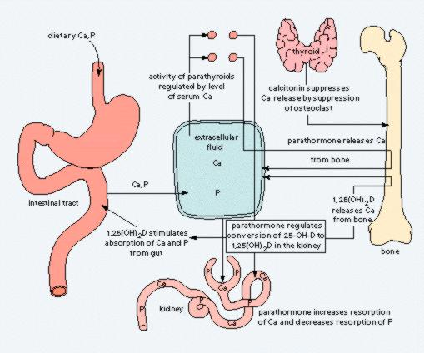

Slide 6
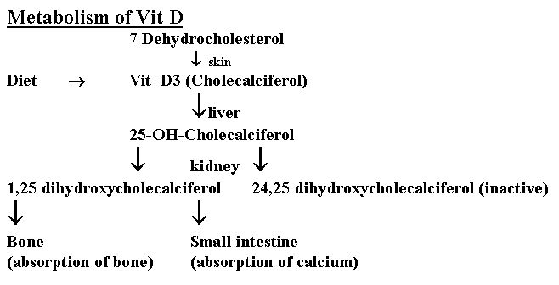

Slide 7
Osteomalacia
Definition?
Rickets - growth plates affected, children
Osteomalacia - incomplete mineralisation of osteoid, adults
Types - vit D def, vit-D resist (fam hypophos)
Aetiology?
Decr intake/production(sun/diet/malabs)
Decreased processing (liver/kidney)
Increased excretion (kidney)

Slide 8
OSTEOMALACIA
PATHOLOGY:
Sufficient osteoid, poor mineralization
(Rickets is found only in children prior to the closure of the growth plates, while OSTEOMALACIA occurs in persons of any age. Any child with rickets also has osteomalacia, while the reverse is not necessarily true).

Slide 9
OSTEOMALACIA
CAUSES:
Nutritional deficiency
  Vit D
  chelators of calcium- phytates, oxalates, phosphorous
  Antacid abuse, causing reduced dietary phosphate binding
GI Absorption defects
  Post gastrectomy
  Biliary disease (reduced absorption of Vitamins )
  Small bowel disease
  liver disease
Renal tubular defects
Renal osteodystrophy
Miscellaneous causes

Slide 10
Osteomalacia
Types
Vitamin D deficient
Hypophosphataemic
  growth decr +++ and severe deformity with wide epiphyses
  x-linked dominant
  decreased tubular reabs of PO4
  Ca normal but low PO4
  Rx PO4 and vit D

Slide 11
OSTEOMALACIA
CLINICAL FEATURES:
Rickets - Tetany , convulsions, failure to thrive, restlessness, muscular flaccidity. Flattening of skull (craniotabes), Thickening of wrists from epiphyseal overgrowth, Stunted growth, Rickety rosary, spinal curvature, Coxa vara, bowing, # of long bones
Osteomalacia, - Aches and pains, muscle weakness loss of height, stress #s.

Slide 12
Osteomalacia
Clinical features?
In child
In adult
Investign
Ca/PO4 decr, alk ph incr, Ca excr decr
Ca x PO4 <2.4
Bone biopsy

Slide 13
OSTEOMALACIA
INVESTIGATIONS:
BLOOD TESTS Calcium Reduced, Phosphate reduced Alkalline Phosphatase increased Urinary excretion of calcium diminished
Calcium phosphate products (= serum [Ca] x serum [PO4]) normally 30. In rickets and osteomalacia is less than 24

Slide 14
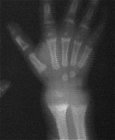

OSTEOMALACIA
XRAY FINDINGS:
RICKETS Thickening and widening of physes, Cupping of metaphysis, Wide metaphysis, Bowing of diaphysis, Blurred trabeculae.

Slide 15
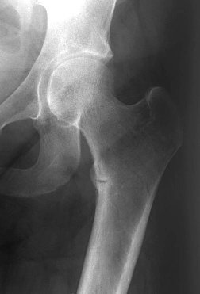
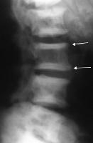
OSTEOMALACIA
XRAY FINDINGS:
OSTEOMALACIA
Loosers zones - incomplete stress # with healing lacking calcium, on compression side of long bones.
Codfish vertebrae due to pressure of discs
Trefoil pelvis, due to indentation of acetabulae stress #s

Slide 16
Osteomalacia vs osteoporosis
Osteomalacia Osteoporosis
Ageing fem, #, decreased bone dens
Ill Not ill
General ache Asympt till #
Weak muscles normal
Loosers nil
Alk ph incr normal
PO4 decr normal
Ca x PO4 <2.4 Ca x PO4 >2.4

Slide 17
Hyperparathyroidism
Excessive PTH
Due to prim (adenoma), sec (hypocalc), tert (second hyperact -> autonomous overact)
Osteitis due to fibr repl of bone
Clin feat - hypercalc
Invest - Calc incr, PO4 decr, incr PTH
Rx surg

Slide 18
Renal osteodystrophy
Combination of
osteomalacia
secondary PTH incr
osteoporosis/sclerosis
CF - renal disorder, depends on predom pathology
Rx - vit D or 1,25-DHCC
renal disorder correction

Slide 19
Pagets
Bone enlargement and thickening
Incr o-clast/blast activity -> increased tunrover
Aet - unknown but racial diff ?viral
CF - M=F, >50, ache but not severe unless fracture or tumour
Inv - x-ray app characteristic, alk ph is increased and increased hydroxyproline in urine
Rx - bisphos, calcitonin

Slide 20
Endocrine disorders
Cushings
Hypopituitarism - GH def - prop dwarf or Frohlich adiposogenital syndrome
Hyperpituitarism - gigantism or acromegaly
Hypothyroidism - cretinism or myxoedema
Hyperthyroidism - o’porosis
Pregnancy - backache, CTS, rheumatoid improves SLE gets worse

Slide 21
OSTEOMALACIA
MANAGEMENT:
Depends on the cause
Nutritional Vitamin D deficiency Dietary chelators of calcium
Phytates
Oxalates Phosphorus deficiency (unusual)
Antacid abuse
Treatment- vitamin D (5000u) and Calcium (3g/day)

Slide 22
OSTEOMALACIA
MANAGEMENT:
Depends on the cause
Gastro-intestinal absorption defects Post-gastrectomy Biliary disease Enteric absorption defects
Short bowel syndrome
Rapid onset (gluten-sensitive enteropathy) Inflammatory bowel disease
Crohns
Celiac

Slide 23
OSTEOMALACIA
MANAGEMENT:
Depends on the cause
Renal tubular defects Vitamin D dependant
type I
type II
Treatment; High levels of vit D
Vitamin D resistant (familial hypophosphatemic rickets)
Treatment; Phosphate 1-3 gm daily, Vit D3 high dose Fanconi syndrome I, II, III Renal tubular acidosis

Slide 24
RICKETS, OSTEOMALACIA
MANAGEMENT:
Depends on the cause
Renal Osteodystrophy – in chronic renal failure
Miscellaneous Hypophosphatasia Anticonvulsant therapy
SURGERY
For deformities

Slide 25
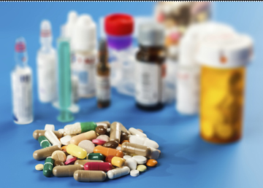
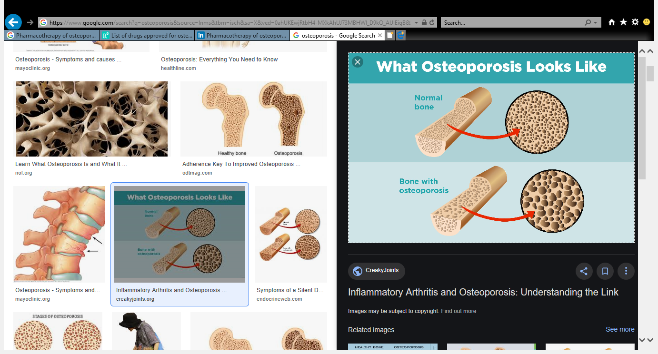
ACKNOWLEDGEMENTS
Drugs for Osteoporosis and Osteomalacia
By Dr. Maulin Mehta
Associate Professor
Department of pharmacology

Slide 26
Introduction
Osteoporosis
Condition with low bone mass and microarhcitectural disruption that results in fractures with minimal trauma

Slide 27
Osteomalacia
Abnormalities in calcitriol synthesis or response
In contrast to osteoporosis, organic matrix (Osteoid) is normal

Slide 28
Two types of osteoporosis:
1) Primary: type I and type II
Type I: loss of trabecular bone; estrogen lack at menopause
Type II: loss of cortical and trabecular bone in men and women;
Dietary inadequacy, activation of parathyroid axis with age and remodelling inefficiency.
2) Secondary: systemic illness or chronic use of medications
(Steroids phenytoin furosemide antiandrogen aromatase inhibitors)

Slide 29
Drugs for osteoporosis
Mainly divided into three parts according to its mechanism:
1) Anti-resorptive agent (Slowing the rate of bone loss)
2) Anabolic agent (Promoting bone formation)
3) Dual action bone agent

Slide 30
Antiresorptive agents:
Calcium
Vitamin D
Bisphosphonates
SERM (Selective Estrogen Receptor Modulator)
Calcitonin
Denosumab

Slide 31
2. Anabolic agents:
1) Teriparatide
2) Anabolic steroids
3) Romosozumab
3. Dual action bone agent:
1) Strontium ranelate
Notes:
abaloparatide

Slide 32
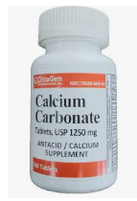
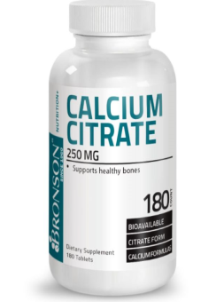
Anti-resorptive agents
Calcium:
Higher intake of calcium in third decade is related to final phase of bone acquisition
Daily requirement: 0.8 to 1.5 g,
Notes:
Carbonate most frequently prescribed and should be taken with meal to facilitate dissolution and absorption

Slide 33
Recommended dietary allowance
-Children 1-10 years | 0.8 – 1.2 g
-Young adult 11-24 yr, pregnant and lactating women | 1.2-1.5 g
-Men and women 25-65 (if women taking HRT) | 1.0 g
-Women 51-65 without HRT, Everyone > 65 yrs | 1.5 g
-For osteoporosis | 0.8-1.0 g
By National Institute of Health

Slide 34
Different calcium preparation
Calcium salts | Elemental calcium
Calcium carbonate | 40%
Calcium citrate | 21%
Calcium chloride | 27%
Calcium gluconate | 09%
Essentials of Medical Pharmacology (KD Tripathi)

Slide 35
Comparison of two different formulation
 | Calcium carbonate | Calcium citrate
Elemental calcium | Provides highest amount of calcium that is 40% | Provides 21% elemental calcium, more doses required
Effect of meal | Well absorbed when taken with meal | Can be taken on empty stomach
Effect of pH | Limited solubility in high gastric pH | Better absorption in even high pH
Effect of other drugs | PPI or H2 receptor blockers should be avoided | Not required

Slide 36
Other calcium supplements
Coral Calcium:
Calcium supplements derived from natural sources (Coral exoskeletons)
Its not proven better than calcium from other sources
Concern: Excess lead
Egg shell Calcium:
Half egg shell is enough for daily recommended calcium (1000 mg)
Concern: Source of infection, other metals

Slide 37
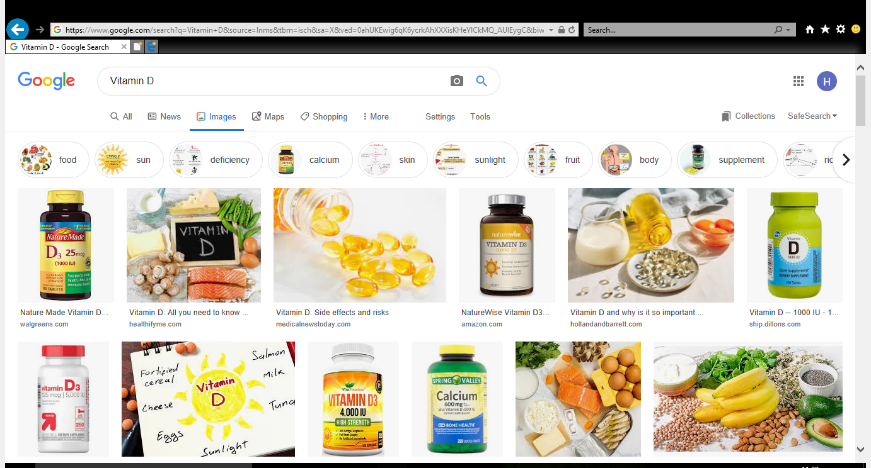
2) Vitamin D and its analogues:
Rationale for using vitamin D is both
  increase in Calcium absorption and
  suppression of high parathyroid function and bone turnover

Slide 38
Different formulations
  1. Cholecalciferol (Vit D3). 60000 IU in 1g of granules for oral ingestion and oily base for im injection
  2. Ergocalciferol (Vit D2) available as solution in oil filled in gelatin capsules
  3. Calcitriol. 0.25 to 1 μg cap and also in injectable form available
  4. Alfacalcidol. 1 to 2 μg,1 α- OHD3. useful in renal bone disease, equally effective to calcitriol
  *D3 is better absorbed than D2

Slide 39
Therapeutic indications
1) Osteoporosis:
400-800 IU of cholecalciferol or 0.25-1.0 μg of calcitriol for 36 weeks
2) Osteomalacia:
Prophylactic 400 IU (in obstructive jaundice, steatorhhea) cholecalciferol
Therapeutic 4000 IU orally daily or 50000 IU per week for 6-12 weeks,
6,00,000 IU cholecalciferol single IM injection once in 2-6 months
Notes:
Renal rickets: calcitriol

Slide 40
Side effects of Vitamin D+Calcium: Hypercalcemia
Close scrutiny of patients and doses are required to avoid hypercalcemia

Slide 41
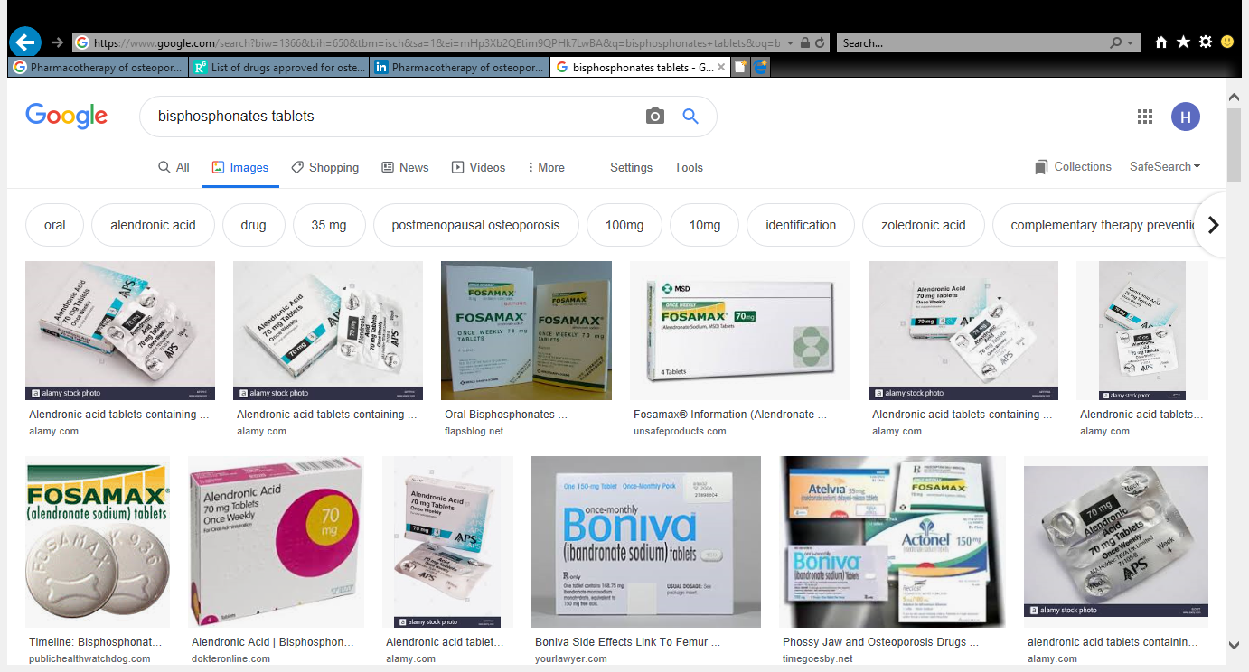
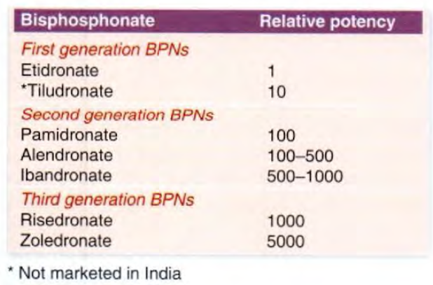
3) Bisphosphonates:
Essentials of Medical Pharmacology (KD Tripathi)

Slide 42
Most frequently used drugs, both for prevention and treatment of osteoporosis:
Oral formulations:
Alendronate: 10 mg/day to 70 mg/week
Risedronate: 5 mg/day to 35 mg/week
Ibandronate: 2.5 mg/day to 150 mg/month, 3 mg IV every 3 months
Parenteral formulations:
Zoledronate: 5 mg infusion over 15 minutes once in a year
Notes:
Alendronate: 10 mg/day to 70 mg/week, risedronate: 5 mg/day to 35 mg/week
Ibandronate: 2.5 mg/day to 150 mg/month
Pamidronate: 60-90 mg 2 to 4 hours infusion weekly or mothly depending on the condtion, zoledronate: over 15 minutes initially weekly then monthly

Slide 43
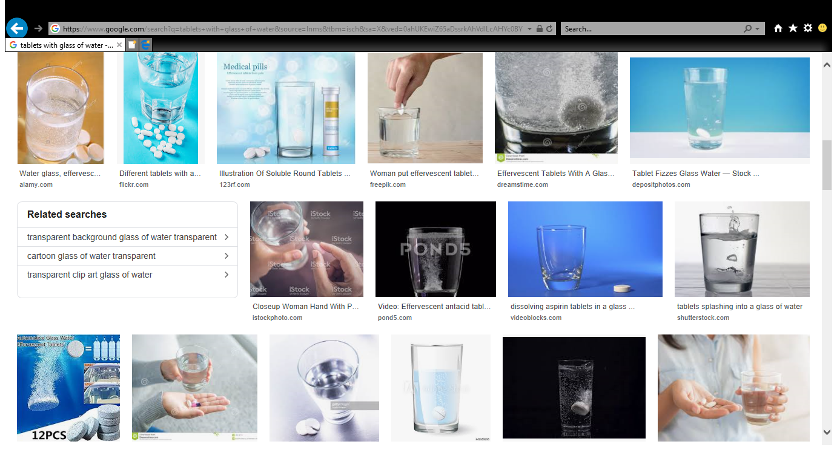
Oral bisphosphonates:
  Taken in early morning on empty stomach with full glass of water
  Avoid lying down or taking food for at least 30 min
  Avoid calcium, iron, antacids, mineral water, tea, coffee, fruit juices

Slide 44
Long skeletal retention (Half-life upto 10 years)
Contraindications: Renal impairment (ClCr<35ml/min-Alendronate),
Oesophageal erosions, GERD

Slide 45
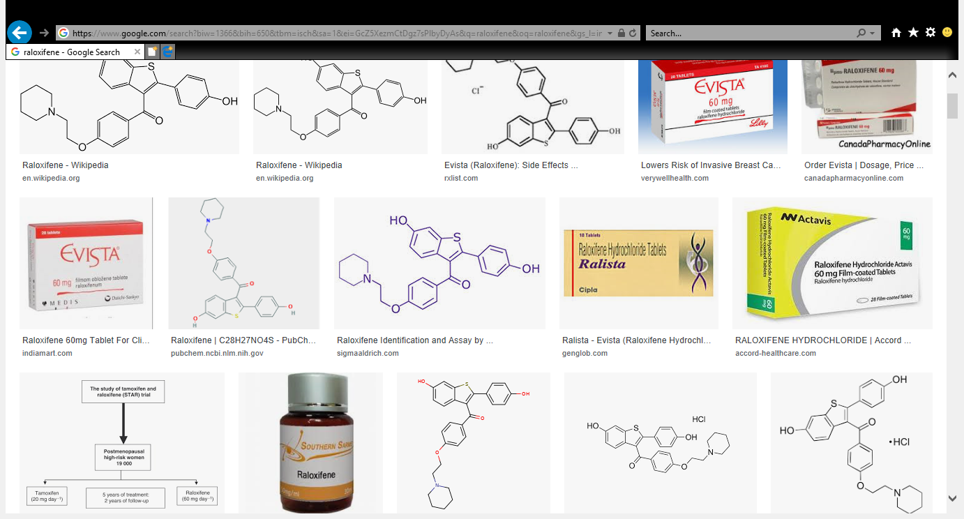
4) SERM: Selective Estrogen Receptor Modulators (Raloxifene)
Tissue – selective Estrogen (Bone)
In postmenopausal women, it increases BMD and reduces risk of vertebral compression fracture
Dose: 60 mg/day
Contraindications: DVT and pulmonary embolism
Notes:
CEE, Tibolone

Slide 46
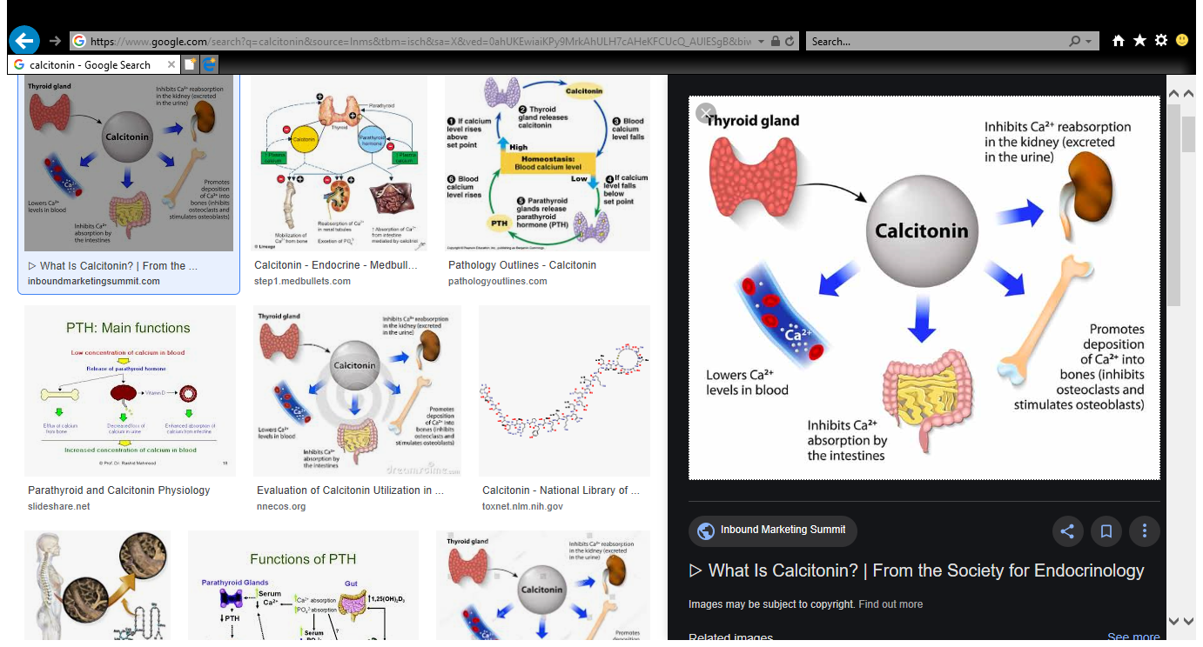
5) Calcitonin:
Useful in patients with high bone turnover rate
Synthetic salmon calcitonin
Used as nasal spray in postmenopausal osteoporotic women (200 IU one spray in alternate nostril daily)
Malignancy associated with long-term use outweighs the benefits
Notes:
hyperparathyroidism

Slide 47
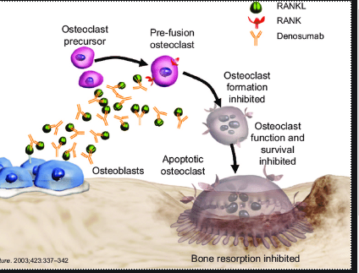
6) Denosumab:
Human monoclonal antibody that binds to RANKL

Slide 48
Dose: 60 mg subcutaneously once every 6 months for 3 to 5 years
Side effects: flu-like symptoms, initial fall in Ca²⁺, susceptibility to infection (suppression of RANKL), rarely osteonecrosis of jaw
Useful when bisphosphonates are contraindicated (severe renal disease)

Slide 49
Anabolic agents
1) Teriparatide, Abaloparatide:
More effective on trabecular site and less on cortical sites, approved for osteoporotic postmenopausal women
Dose: 20 μg SC injection once daily in the thigh or abdominal wall for 12-18 months (80 μg SC-Abaloparatide)
Drawback: high cost and daily SC injection

Slide 50
2) Anabolic steroids: Nandrolone, Oxymetholone, Stanozolol
Preferred in elderly males (Anabolic > Androgenic)
Nandrolone decanoate: 25-100 mg IM once every 3 weeks
Therapy is limited in osteoporotic women due to virilising side effects
Side effects: jaundice, high lipid profile, prostate complications
Notes:
decadurabolin

Slide 51
3) Romosozumab: (FDA approved in April, 2019)
Inhibiting the activity of sclerostin
Osteoporosis in postmenopausal women with history of fracture
Dose: 210 mg once in month for 12 months
Bone forming effect wanes after 12 doses (1 year), so more than 12 doses should not be used
Precautions: CV events

Slide 52
Dual action bone agent
1) Strontium ranolate:
Side Effects: serious cardiovascular diseases
Reserved drug for osteoporosis, when bisphosphonates and others are contraindicated
Dose: 2 g/day, avoid food for 2 hours before and after
Notes:
2 g /day avoid food for 2 hours after and before

Slide 53
Adequate level of magnesium and phosphate
Adequate magnesium is required for Vitamin D activation and also for calcium absorption
Adequate phosphate along with calcium is required for bone formation (Deficiency leads to osteomalacia)
Both are available in different formulations along with Vitamin D and calcium.
Notes:
Antacids can obstruct Phosphate absorption

Slide 54
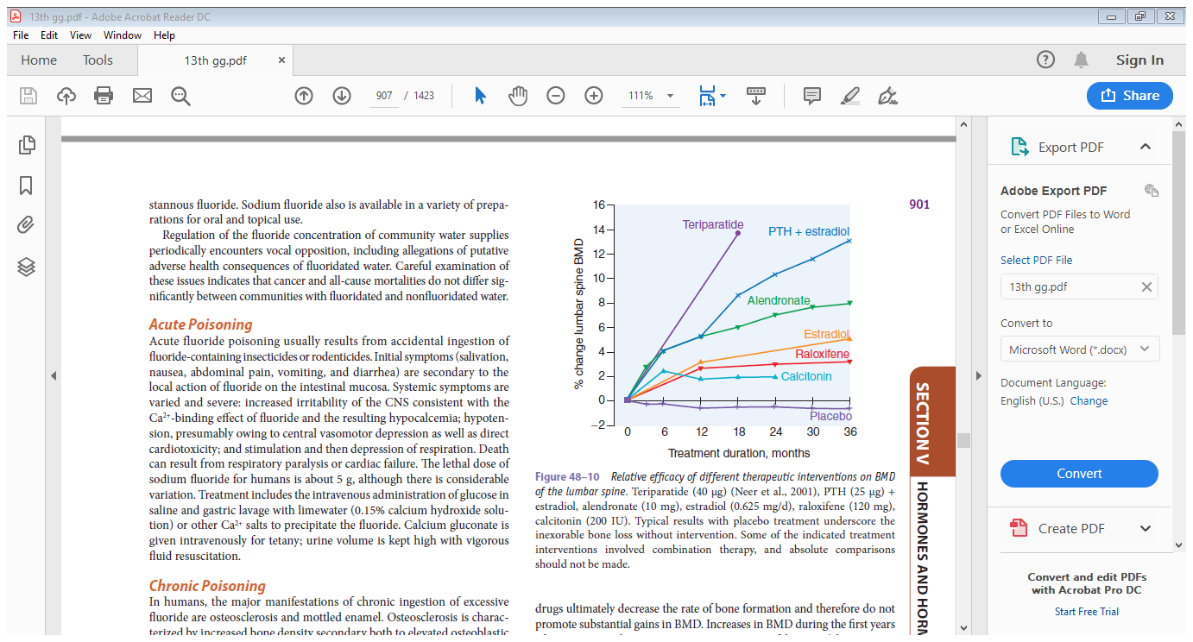
Relative efficacy of different therapeutic intervention on BMD
The Pharmacological basis of therapeutics by goodman & gilman
Notes:
Goodman & gilman; section V; hormones and hormone antaonists page no. 901, some of the treatment intervention involved combination therapy, so absolute comparison should not be made

Slide 55
Relative cost of different therapeutic intervention
No. | Name of drug | Formulation | Price range
1. | Alendronate | 70 mg – 4 tab/month | 50-100/-
 | Risedronate | 35 mg – 4 tab/month | 100-200/-
 | Ibandronate | 150 mg-1 tab/month | 100-200/-
 | Zoledronate | 5 mg/yr (month) | 1500-3000/- (125-250/-)
2. | Raloxifene | 60 mg-30 tab/month | 200-400/-
3. | Calcitonin | 6000 IU Nasal spray/month | 3000-3500/-
4. | Denosumab | 120 mg/yr | 25000-30000/- (2500/-)
5. | Teriparatide | 250-750 μg/3 ml/month | 5000-10000/-
Drug index

Slide 56
Relative safety of different therapeutic intervention
No. | Drug therapy | Side effects
1. | Bisphosphonate | Oral : esophagitis, gastric irritation, renal toxicity
 |  | Parenteral: Pain at the site, flu-like symptoms, renal toxicity
2. | Denosumab | Osteonecrosis of jaw, susceptibility to infection
3. | SERM | DVT, Pulmonary embolism, hot flashes, breast pain,
4. | Calcitonin | Nausea, vomiting, flushing, allergic reaction, malignancy
5. | Teriparatide | Pain at injection site, dizziness, headache,
6. | Anabolic steroids | Jaundice, high lipid profile, prostate complications, Virilization
Essentials of Medical Pharmacology (KD Tripathi)

Slide 57
Combination therapy
Antiresorptive (BPN) with Bone forming (Teriparatide)
No additional benefit
BPN reduces bone forming capacity of teriparatide
Sequential treatment with Teriparatide or Romosozumab followed by alendronate increases BMD than either of drug alone

Slide 58
Herbal Products
Herbal products:
Red Clover, Herba epimedii (Not Proven about their efficacy)

Slide 59
Non-pharmacological measures
1. Exercise
2. Avoid smoking and alcohol
3. High Calcium
(Milk and Milk products, green leafy vegetables, ragi, bengalgram, sunflower seeds, gingelly seed, amaranth)
and
protein in diet

Slide 60
Based on current evidences
Following observations can be made:
1) Bisphosphonates remain the drug of choice, Vitamin D+ Cal adjuvant.
2) Second line will be teriparatide for 18 months followed by bisphosphonates to reduce fracture incidence
3) Because of side effect profile, denosumab, Calcitonin are reserved drug
3) Abaloparatide and romosozumab are options for future

Slide 61
Recent advances
1) Cathepsin K inhibitor: Odanacatib, nonapproval based on CV events
2) Calcilytics: Short acting CaSR antagonist in parathyroid glands
3) Statins: Cholesterol synthesis and osteoclast activation inhibitiors
www.drugwatch.com & clinicaltrials.gov

Slide 62
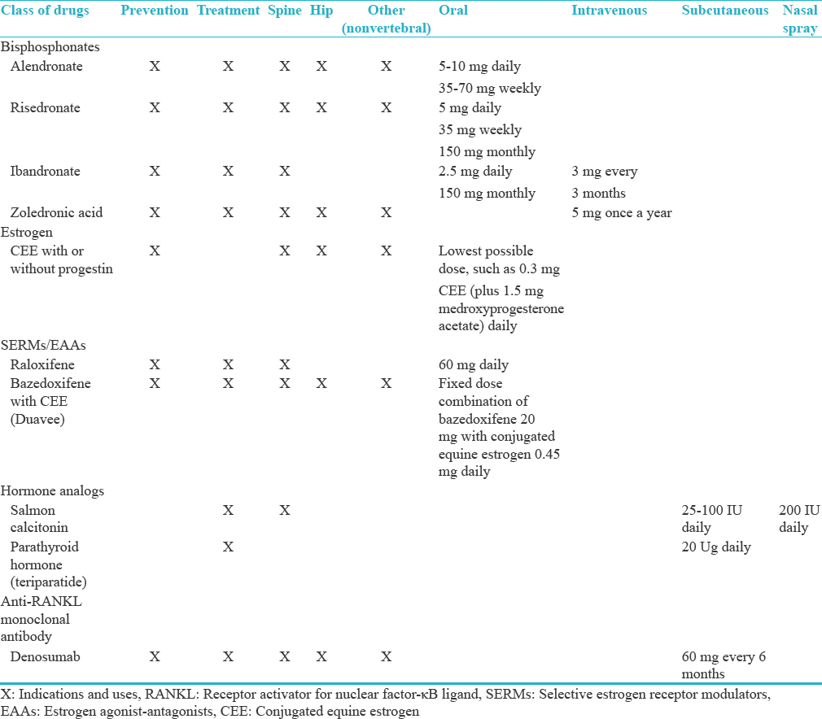

Slide 63
Author/Year | Study Design | Level | Results | Outcome
Evidence for efficacy of drugs affecting bone metabolism in preventing hip fracture. J. A. Kanis, O. Johnell, | Retrospective, population based, case-control study by questionnaire. | III | After adjustment for differences in other risk factors, the relative risk of hip fractures was 0.55 (95% confidence interval 0.31 to 0.85) in women taking oestrogens, 0.75 (0.60 to 0.94) in those taking calcium, and 0.69 (0.51 to 0.92) in those taking calcitonin. The fall in risk was not significant for anabolic steroids (0.6 (0.29 to 1.22)). Neither vitamin D nor fluorides were associated with a significant decrease in the risk of hip fracture. | Oestrogen, calcium, and calcitonins significantly decrease the risk of hip fracture. Short term intervention late in the natural course of osteoporosis may have significant effects on the incidence of hip fracture.

Slide 64
MCQ 1
What is the recommended daily intake of calcium?
1000mg
500 mg
1500 mg
750 mg
2000 mg

Slide 65
MCQ 2
What is the plasma concentration of calcium?
2.2-2.6mmol/L
2.6-3 mmol/L
2-2.2 mmol/L
3-3.2 mmol/L
3.2-3.6mmol/L

Slide 66
MCQ 3
How is calcium excreted?
Kidneys
Intestine
Sweat
Heart
Lungs

Slide 67
MCQ 4
How are calcium levels regulated?
PTH
Vitamin D
Both of the above
None of the above
Thyroid

Slide 68
MCQ 5
Alkaline phosphatase levels are normal in
Osteomalacia
Osteoporosis
Ricketts
Osteomyelitis

Slide 69
Thank you

