Slide 1
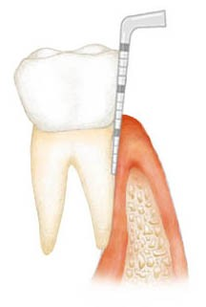

Periodontal Pocket
Dr. Monali Shah
Professor and Head, Dept of Periodontology
KMSDCH

Slide 2
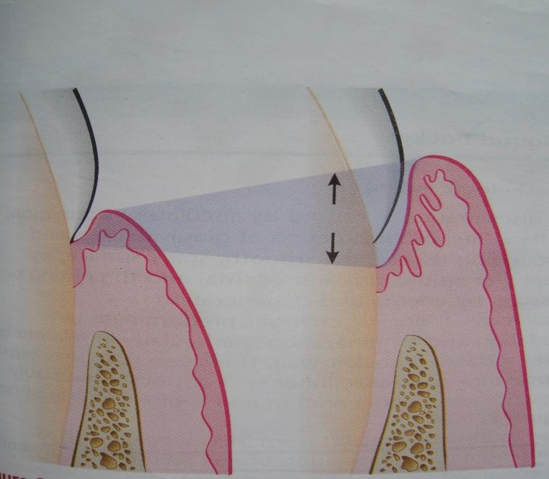
DEFINITION
pathological deepening of the gingival sulcus bounded by the tooth surface on 1 side and soft tissue wall on the other.

Slide 3
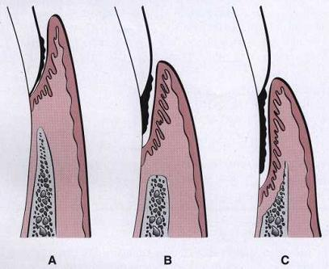
CLASSIFICATION
Gingival Pocket/ Pseudopocket
Periodontal Pocket :
Suprabony Infrabony
Supracrestal Subcrestal
Suprabony Intrabony

Slide 4
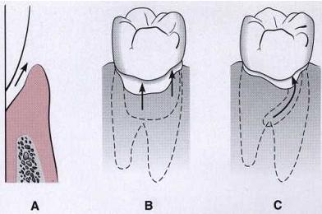
According to tooth surface involved
Simple
Compound
Complex

Slide 5
According to soft tissue wall
Edematous
Fibrous
According to disease activity
Active
Inactive

Slide 6
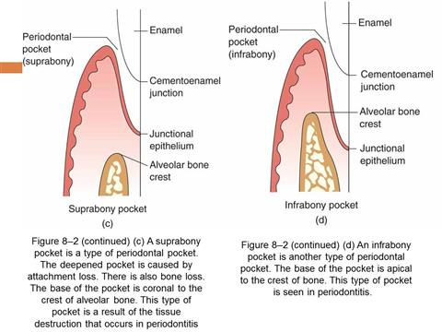
Differences between Intrabony and Suprabony Pockets
Suprabony Pockets | Infrabony Pockets
Base of pocket is coronal to alveolar bone | Base of pocket is apical to the crest of alveolar bone
Bone destructive pattern is horizontal | Pattern of bone destruction is vertical
More prevalent in anterior region | More prevalent in posterior region
Results are unpredictable after regenerative therapy | Results are more predictable after regenerative therapy

Slide 7
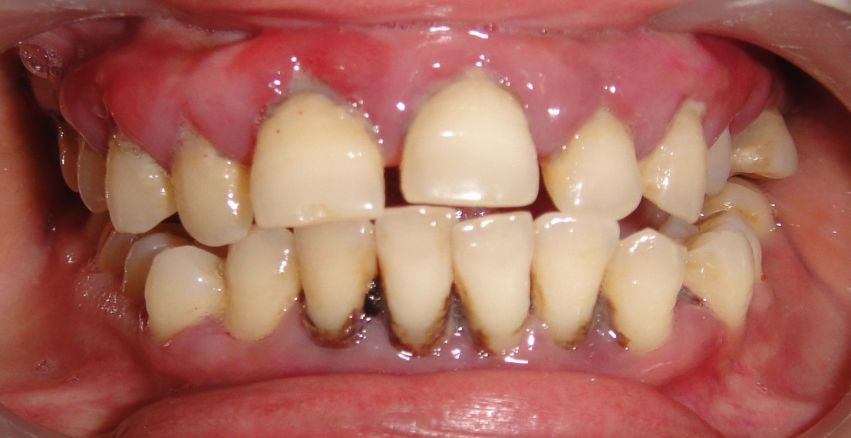
CLINICAL FEATURES
Bluish-red marginal gingiva with rolled edge
Reddish blue vertical zone
Break in the faciolingual continuity of interdental gingiva
Shiny, discolored and puffy gingiva
Gingival bleeding.
Purulent exudate
Looseness, extrusion and migration of teeth.
Diastema formation

Slide 8
PATHOGENESIS
The dental plaque initiates gingival inflammation,
Periodontal pocket formation and progression depend multiple factors.
Once the periodontal breakdown initiated, it will lead to loss of marginal periodontal ligament fibers, apical migration of the junctional epithelium, and allows apical spread of the bacterial biofilm along the root surface.

Slide 9
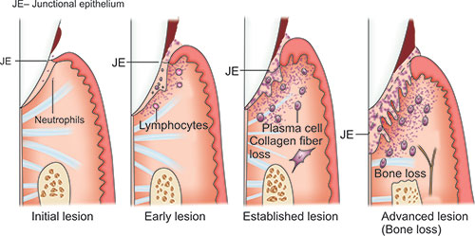

Slide 10
HISTOPATHOLOGY
SOFT TISSUE WALL
BACTERIAL INVASION
MICROTOPOGRAPHY OF GINGIVAL WALL
PERIODONTAL POCKET AS HEALING LESIONS
POCKET CONTENTS
ROOT SURFACE WALL

Slide 11
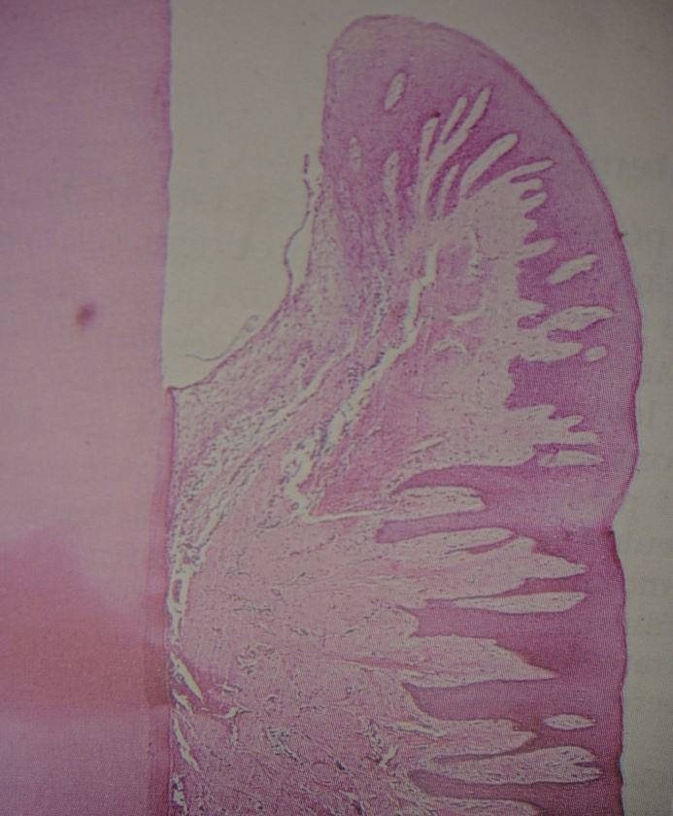
Soft tissue wall
Edematous connective tissue is densely infiltrated with plasma cells (approximately 80%), lymphocytes, and a scattering of Pmn's.
The blood vessels - increased in number, dilated, and engorged.
The junctional epithelium at the base of the pocket is usually much shorter than that of a normal sulcus.
The most severe degenerative changes in the periodontal pocket occur along the lateral wall.

Slide 12
BACTERIAL INVASION
Filaments, rods and coccoid organisms with gram negative cell walls- epithelium
Some may even invade the subepithelial connective tissue

Slide 13
Microtopography of the Gingival Wall of the Pocket
  1. Areas of relative quiescence (Demonstrating boundaries of the epithelial cells with occasional shedding of cells)
  2. Areas of bacterial accumulation (Demonstrating depression on the epithelial surface with abudant debris and a fibrin like material. Bacterial plaque was seen penetrating into enlarged intercellular spaces of the pocket epithelium)

Slide 14
Microtopography of the Gingival Wall of the Pocket
  3.Areas of emergence of leukocytes (located at the area peripheral of leukocyte-bacteria interaction)
  4. Areas of leukocyte-bacteria interaction (numerous leukocytes emerging from intercellular space covered by bacteria in process of phagocytosis)

Slide 15
Microtopography of the Gingival Wall of the Pocket
  5. Areas of intense epithelial desquamation (semi-loosened and folded epithelial squames with one end attached and one loose inpocket space)
  6. Areas of ulceration (exposed connective tissue)
  7. Areas of hemorrhage (with numerous erythrocytes)

Slide 16
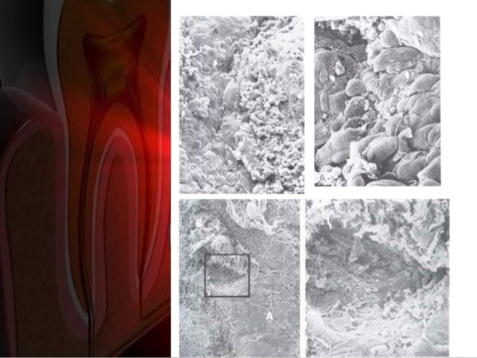
Bacterial leukocyte interaction
Bacterial Accumulation
Area of Hemorrhage
Pocket epithelium in a Quiescent state
Connective tissue fibers and cells in the bottom of ulcer

Slide 17
PERIODONTAL POCKET AS HEALING LESIONS
Periodontal pockets
Chronic inflammatory lesions
Undergoing constant repair
But…..
Complete healing does not occur
Persistent bacterial attack
Continuous stimulation of inflammatory response

Slide 18
POCKET CONTENTS
    Microorganisms and their products (enzymes, endotoxins, and other metabolic products),
    Food remnants,
    Salivary mucin,
    Gingival fluid,
    Desquamated epithelial cells, and
    Leukocytes
  Plaque covered calculus usually projects from the tooth surface.
  Purulent exudate, if present, consists of living, degenerated, and necrotic leukocytes; living and dead bacteria; serum; and a scant amount of fibrin.

Slide 19
Root surface wall
Plaque causes degradation of collagen fibers embedded in cementum
Acidic environment soften the cementum
  Areas of increased mineralization (can be found in areas where saliva is in constant contact)
  Areas of demineralization (can be found in areas where plaque is in constant contact
  Areas of cellular resorption of cementum and dentin

Slide 20
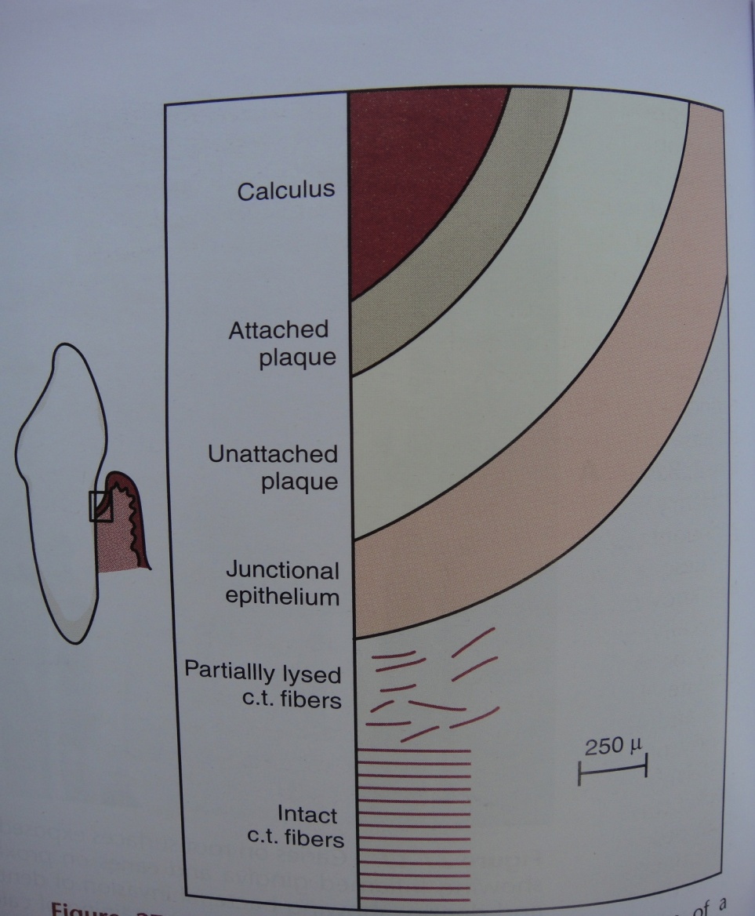
Surface morphology of tooth wall

Slide 21
CORRELATION OF CLINICAL AND HISTOPATHOLOGIC FEATURES OF POCKET
Clinical Feature Histopathology
Bluish Red Dicolouration Circulatory Stagnation
Flaccidity Destruction Of Gingival Fibers &CT
Smooth Shiny Surface Atrophy Of Epithelium & Edema
Pitting On Pressure Edema & Degeneration
Bleeding On Probing Increased Vascularity, Thinning & Degenration Of Epithelium,
Proximity Of Engorged Vessels
Inner Aspect Of Pocket Painful Ulceration Of Inner Aspect Of Pocket.
Expression Of Pus From Pocket Suppurative Inflammation Of Inner Wall.

Slide 22
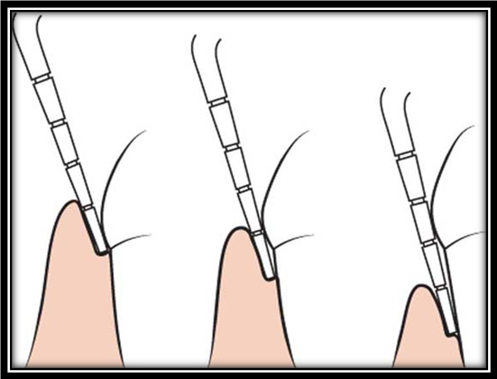
RELATION OF ATTACHMENT LOSS AND BONE LOSS TO POCKET DEPTH
Pocket formation causes loss of attachment of the gingiva and denudation of the root surface.
The degree of attachment loss depends on the location of the base of the pocket on the root surface, whereas the pocket depth is the distance between the base of the pocket and the crest of the gingival margin.

Slide 23
Different Pocket Depths with same amount of attachment loss
Pockets of different depths may be associated with the same amount of attachment loss

Slide 24
AREA BETWEEN THE BASE OF THE POCKET AND THE ALVEOLAR BONE
The distance between the apical extent of calculus and the alveolar crest in human periodontal pockets is most constant, having a mean length of 1.97 mm
The distance from attached plaque to bone is never less than 0.5 mm and never more than 2.7 mm.

Slide 25
Site specificity of periodontal pocket
The periodontal pocket formation is associated with few teeth at a given point of time and maybe only on a few sites around the tooth.
The periodontal destruction can be observed adjacent to a tooth with no periodontal breakdown.
The severity of the disease may increase by formation of new pocket as well as increase in existing pocket depth.

Slide 26
To conclude

Slide 27


