Slide 1

PERIODONTAL LIGAMENT

Slide 2
STUDENTS WILL LEARN
Definition
Types of Periodontal fibers
Cellular elements
Ground substance
Function of periodontal ligament

Slide 3
THE PERIODONTIUM CONSISTS OF THE INVESTING AND SUPPORTING TISSUES OF THE TOOTH - GINGIVA, PERIODONTAL LIGAMENT, CEMENTUM, AND ALVEOLAR BONE.
Carranza F A, Clinical Periodontology 9th edition. Page 36 . The Tooth Supporting Structure

Slide 4
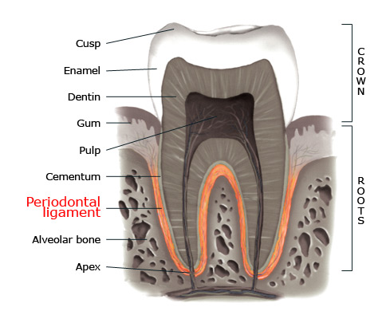

Slide 5
PERIODONTAL LIGAMENT
PERIODONTAL FIBERS
CELLULAR ELEMENTS
GROUND SUBSTANCE

Slide 6
INTRODUCTION
A ligament is bond, usually linking two bones together. The root of the tooth is connected to its socket in alveolar bone by dense connective tissue which can be regarded as ligament.

Slide 7
It is the dense fibrous connective tissue that occupies the periodontal space between the root of the tooth and the alveolus.
Derived from Dental follicle

Slide 8
SYNONYNMS :
Periodontal membrane
Alveolo-dental ligament
Desmodent
Pericementum
Dental periosteum
Gomphosis

Slide 9
DEFINITION
The Periodontal ligament is the connective tissue that surrounds the tooth root and connects it to the bone.
It is continuous with the connective tissue of the gingiva & communicates with the marrow spaces through vascular channels in the bone.
Carranza F A, The tooth supporting structure. Page 36
Clinical periodontology 9th edition.

Slide 10
SHAPE AND WIDTH OF PDL :
Average width – 0.15 to 0.38 mm
Shows a progressive decrease with age
The average width is 0.21 mm at 11-16 years of age
0.18 mm at 32 – 52 years
0.15 mm at 51 – 67 years.
Average width of pdl space- 0.2mm

Slide 11
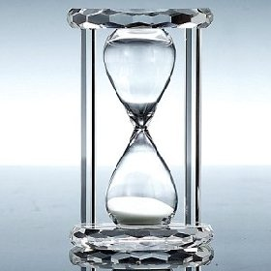
Maximum width-teeth in heavy function
Tooth mobility-if width is increased, if ligament is partly lost
Periodontal ligament- shaped like an hour glass- narrowest in the region of axis of rotation.
Periodontal ligament- thinner on the mesial root surface

Slide 12
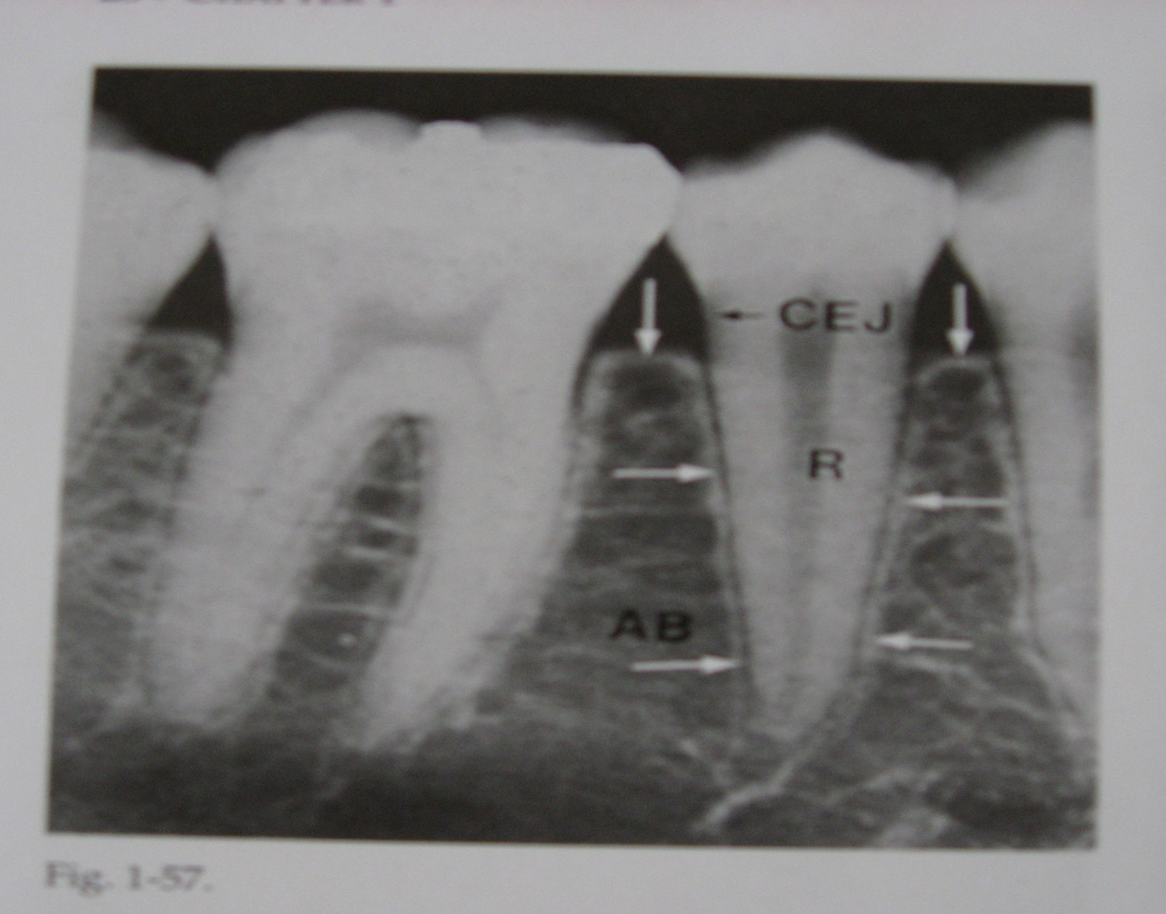
PDL space is detectable in radiographs as a radiolucent line paralleling the root surface.
Space Reduced in non-functional and unerupted teeth.
Increased in teeth subjected to heavy occlusal stress.

Slide 13
STRUCTURE OF PDL :
PDL
Cells
Extracellular substances
Progenitor cells
Differentiated cells
Others
-Epithelial rests of Malassez
- Defence cells
Fibers
Collagen fibers
Oxytalan fibers
Ground substance
Glycosaminoglycans
Glycoproteins
Synthetic cells
Osteoblasts
Fibroblasts
Cementablasts
Resorptive cells
Osteoclasts
Fibroblasts
Cementaclasts

Slide 14
CELLULAR ELEMENTS
Four types of cells have been identified-
- Connective tissue Cells - Fibroblast,
cementoblast
osteoblast
- Epithelial cell rests
- Cells associated with neurovascular elements
- defense cells

Slide 15
Role of fibroblast-
synthesize & secretion of collagen of different types
to produce the structural connective tissue proteins collagen , elastin , glycoproteins and glycosaminoglycans.
capacity to phagocytose old collagen fibres by the production of collaganase
capacity to degrade extracellular matrix by the production of matrix metalloproteinases.

Slide 16
b)Osteoblasts and cementoblasts as well as osteoclasts and odontoclasts-seen in the cemental and osseous surface of periodontal ligament.
c)Epithelial cell rests of Mallassez- lattice work in the periodontal ligament- isolated cluster of cells or interlacing strands.
These rests are distributed close to the cementum- numerous in the apical and cervical areas

Slide 17
Diminish in number with age
d)Defense cells- neutrophils, lymphocytes, macrophages, mast cells and eosinophils.

Slide 18
GROUND SUBSTANCE:
Fills the spaces between the fibre and cells
Two main components:
1) Glycosaminoglycans, such as hyaluronic acid
2) proteoglycans, glycoproteins such as fibronectin and laminin.
High water content (70%).
Contain calcified masses called cementicles
Cementicles may develop from calcified epithelial rests

Slide 19
PERIODONTAL LIGAMENT FIBRES
The most important elements of PDL are principle fibres which are collagenous(90% of the PDL fibres). Small amount of oxytalan and reticulin fibres are also present.
- arranged in bundles - follow a wavy course
fibre bundles consist of individual fibres
the terminal portions of principle fibers that are inserted in to cementum and bone are called as sharpeys fibers
PRIMARY
SECONDARY
IMMATURE

Slide 20
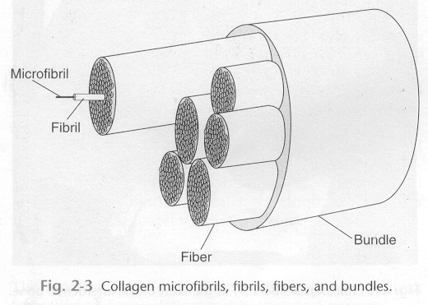

Slide 21
Principle fibres- arranged in six groups-
-Transeptal group
-Alveolar crest group
-Horizontal group
-Oblique group
-Apical group
-Inter radicular group

Slide 22
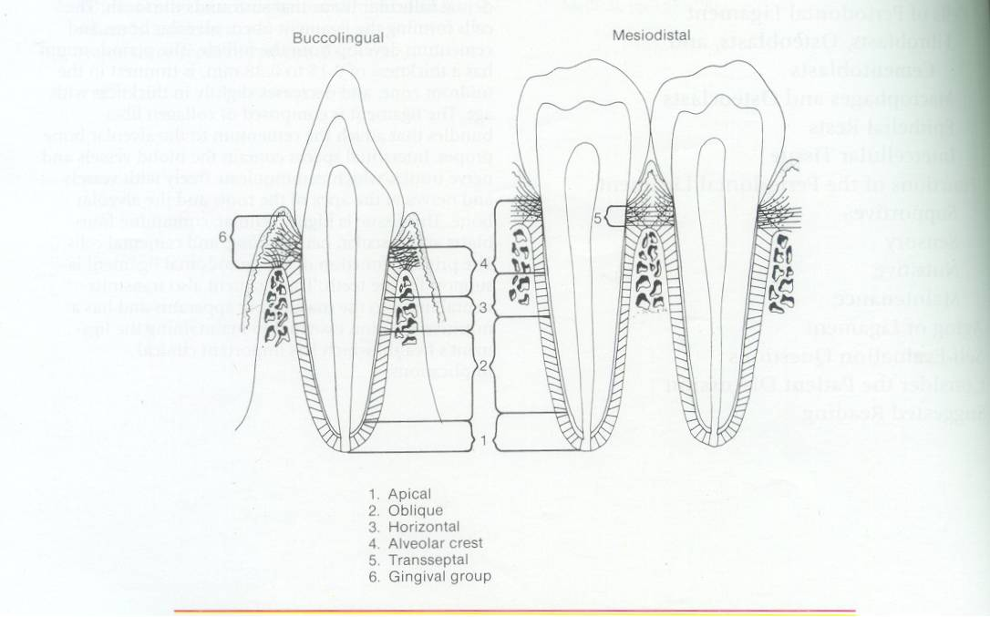
PRINCIPLE FIBRES OF THE PERIODONTAL LIGAMENT
Apical fibres
Oblique fibres
Horizontal fibres
Alveolar crest fibres
Trans-septal fibres

Slide 23
Fibre Group | Origin and insertion | Supposed function
1) Alveolar crest | Extend obliquely from the cementum just beneath the junctional epithelium to the alveolar crest and to the fibrous layer of the periosteum covering the alveolar bone. | Retains tooth in the socket Oppose lateral forces Prevents extrusion of tooth. Protects deeper periodontal ligament structures
2) Horizontal group | They extend from cementum to alveolar bone in horizontal direction at right angles to long axis of tooth. Occupy 10-15 % of coronal root surface. | Restrain lateral tooth movements.
3) Oblique group | Largest group of PDL fibres. Occupy 80-85% of root surface. Extend from cementum in a coronal direction obliquely to the bone. | They bear the brunt of vertical masticatory stresses and transform them into tension on alveolar bone and resist axially directed force.

Slide 24
Fibre Group | Origin and insertion | Supposed function
4) Apical group | The apical fibres radiate in a rather irregular fashion from cementum to the apical region of the socket They donot occur in incompletely formed roots. | Prevent tooth tipping Resist luxation. Protect blood, lymph and nerve supplies to tooth.
5) Inter radicular group. | They fan out from the cementum to the tooth in the furcation areas of multirooted teeth. | Aid in resisting tipping and torquing and resist luxation.

Slide 25
SECONDARY FIBRES
Located between and among the principal fibre groups
Non-directional and randomly oriented collagen bundles of unknown function.
May represent newly formed Collagenous elements
Often appear to traverse the periodontal ligament space coronoapically

Slide 26
Two immature forms are found-
1) Oxytalan- run parallel to the root surface in a vertical direction and bend to attach to cementum.
2) Eluanin
Small collagen fibres run in all directions forming a plexus called “Indifferent fibre plexus”

Slide 27
FUNCTIONS OF PERIODONTAL LIGAMENT
PHYSICAL
FORMATIVE & REMODELLING
NUTRITIONAL
SENSORY

Slide 28
FUNCTIONS OF PERIODONTAL LIGAMENT
1) Physical functions
Provision for soft tissue “casing” to protect the vessels and nerves from injury by mechanical forces.
Attachment of teeth to bone.
Maintenance of gingival tissues in proper relationship to the teeth.
.

Slide 29
Transmission of occlusal forces to bone.
Resistance to impact of occlusal forces. (Shock absorption).

Slide 30
SHOCK ABSORPTION
Three theories:
1)Tensional theory
2)Viscoelastic theory
3)Thixotropic theory

Slide 31
Tensional theory:
The tensional theory of tooth support ascribes to the principle fibres of the periodontal ligament the major responsibility in supporting the tooth and transmitting forces to the bone.

Slide 32
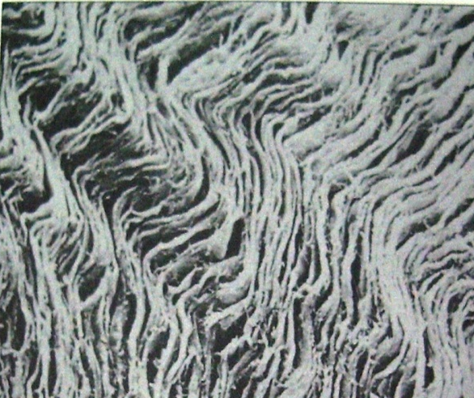
When a force is applied to the crown ↓
principle fibres first unfold and straighten ↓
transmit the forces to the alveolar bone ↓
elastic deformation of the bony socket ↓
when the alveolar bone has reached the limits, the load is transmitted to the basal bone.
THEORY -----INSUFFICIENT

Slide 33
2)Viscoelastic system:
Displacement of teeth controlled by FLUID MOVEMENT
When forces are transmitted to the tooth the extra cellular fluid passes from the periodontal ligament into marrow spaces of bone through foramina in the cribriform plate.

Slide 34
These perforations of the cribriform plate link PDL with cancellous portion of alveolar bone-
more abundant in the cervical third than in the middle and apical thirds.

Slide 35
3)Thixotrophic theory:
Claims that the periodontal ligament has the rheologic behaviour of a thixotrophic gel
Schroeder- the presence of organised collagen fibres makes the theory untenable.

Slide 36
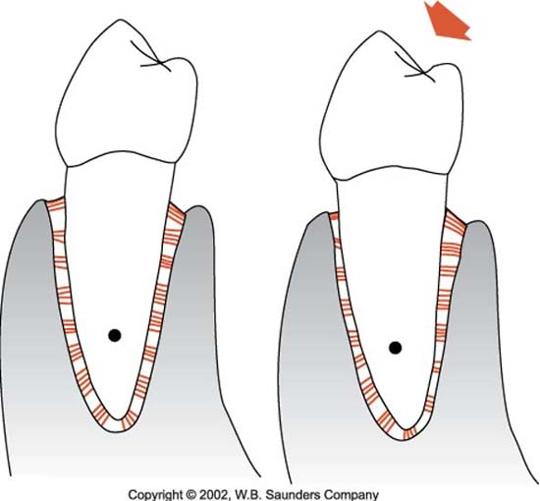
TRANSMISSION OF OCCLUSAL FORCES TO BONE
Axial force to the tooth
displacement of the root into the alveolus
oblique fibres alter their wavy, untensed pattern; assume their full length and sustain the major part of the axial force.

Slide 37
HORIZONTAL OR TIPPING FORCE
↓
Two of phases of tooth movement
↓
Within the confines of PDL Displacement of
facial and lingual
bony plate
Areas of tension→ fibres bundles are taut rather than wavy

Slide 38
Areas of pressure → fibres are compressed → tooth is displaced → distortion exists in the direction of root movement.
Pdl which is shaped like an hour glass is narrowest in the region of axis of rotation.
Physiologic mesial migration → Pdl, thinner on
the mesial root surface

Slide 39
FORMATIVE AND REMODELLING FUNCTION
Cells of Pdl participate in the formation and resorption of cementum and bone
Mitotic activity can be observed in the fibroblasts and endothelial cells.
Fibroblasts form the collagen and the residual mesenchymal cells develop into osteoblasts, cementoblasts

Slide 40
NUTRITIONAL AND SENSORY FUNCTIONS
Supplies nutrients→ cementum, bone and gingiva by blood vessels
Lymphatic drainage from the inferior and superior alveolar arteries → reaches the periodontal ligament from three sources –Apical vessels, penetrating vessels from alveolar bone and anastomosing vessels from the gingiva.
Apical vessels supply the apical region of the periodontal ligament

Slide 41
Nerve supply
Abundantly supplied with sensory nerve fibre.
Nerve bundles pass into the periodontal ligament from the periapical area and through channels from the alveolar bone that follows the course of the blood vessels.
They divide into single myelinated fibres which ultimately lose their myelin sheaths and end in one of four types of neural termination.

Slide 42
Free nerve endings
Ruffini like mechanoreceptors
Coiled Meisner’s corpuscles also mechanoreceptors found mainly in the mid root region and
spindle like pressure and vibration endings are surrounded by a fibrous capsule and located mainly in the apex.

Slide 43
Must know | Desirable | Good
Periodontal fibers Types of fibers Cellular elements Ground substance Function of periodontal ligament Periodontal ligament in health and disease | Collagen types and biosynthesis Development of periodontal ligament | Regeneration

Slide 44
author | Year/ Journal | Methodology | Conclusion | Remarks | Level of evidence
Ohta S et al. | Journal of Periodontal Research 2008; 43: 595–603. | In vitro | Mesenchymal stem cells and hematopoietic stem cells in the bone marrow are not involved in the regeneration of the periodontium. Cells that migrated from the residual periodontal ligament regenerated new alveolar bone at the early stage, and the regeneration around the dentin in the cavity was later than in other parts | Further similar in vitro studies are required to confirm the results | 5

Slide 45


THANK U ALL
THANK U

Slide 46
REFERENCES
Biology of periodontal tissues.
P. Mark Bartold and A.SampathNarayanan
Fundamentals of Periodontics, 2nd Edition.
Thomas G. Wilson, Kenneth S. Kornman

Slide 47
Carranza’s clinical periodontology-9th edition
Lindhe – Textbook of periodontology
Tencate oral histology.
Periodontal ligament in health and disease.
Berkovitz 2nd Edition.

