Slide 1
Anatomy of female genital tract

Slide 2
External Genitalia
Vulva:
  Consists of following structures
    Labia majora
    Mons pubis
    Labia minora
    Clitoris
    Vestibule
    Skene’s glands
    Greater vestibular glands (bartholin’s glands)

Slide 3
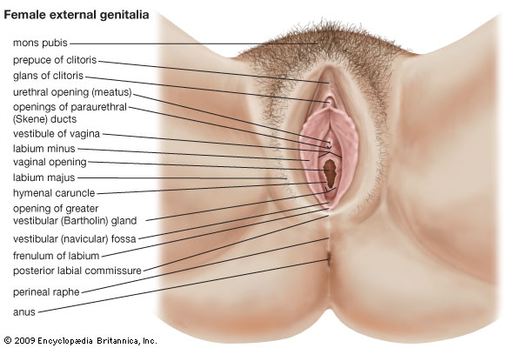
Anatomical structure of Vulva

Slide 4
Labia majora
  Folds of skin and subcutaneous tissue
  Ant. : join to form mons pubis
  Post.: join to form posterior commissure
  Female counterpart of scrotum

Slide 5
Clitoris:
  Erectile tissue analogous to penis
Labia minora:
  Smaller folds
  Inner: mucosal surface and outer cutaneous surface
  Ant.: join to form clitorial prepuce
  Post: join to form post. commissure

Slide 6
Vestibule:
  Space between labia minora
  Penetrated by openings of:
    Urethral meatus
    Para urethral glands of Skene
    Ducts of bartholin’s gland
    Hymen is a thin translucent membrane covering the vagina

Slide 7
Bartholin’s glands:
  Lower third of vagina
  Compound racemose types of glands
  Lined by columnar epithelium
  Gonococcal infection
  Bartholins abscess

Slide 8
Skene’s glands:
  Analogus to prostate

Slide 9
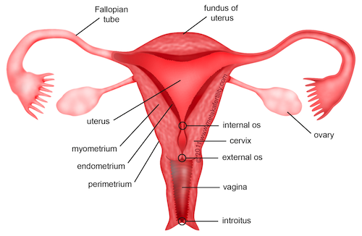
Internal Genitalia of female

Slide 10
Female urethra:
  Small- 3.5-4 cm long
  Lined by: stratified squamous epithelium in distal part
  transitional epithelium in proximal part
  Lack of columnar epithelium
    Relatively resistant to gonococcal infection

Slide 11
Vagina
  Extends from vestibule to cervix
  Anteriorly : 9 cm
  posteriorly: 11.5 cm
  Rugose structure
  Lined by str. Sq. epi. Rich in glycogen acidic environment less susceptible to penetration by STD

Slide 12
Uterus
  Cervix uteri
    Neck of the uterus
    Lined by columnar epi. Susceptible to gonococcal inf.
    Divides vagina into fornices pooled secretions used for isolation of pathogens

Slide 13
Uterus
  Body of uterus
    Three layers:
    Endometrium:
      Innermost layer
      Builds lining that is periodically shed if pregnancy doesn’t occur menstrual bleeding
      Gets affected by ascending infections: endometritis
    Myometrium:
      Smooth muscle layer
    Perimetrium:
      Loose connective tissue around uterus

Slide 14
Fallopian tubes:
  10-14 cm long
  4 parts
    Interstitium: intrauterine part 1.25 cm
    Isthmus: 2.5 cm straight and narrowest part
    Ampulla: 5 cm longest part. Fertilisation most commonly occurs
    Infundibulum: 1.25 cm
  Opens into peritoneal cavity in the vicinity of the ovaries
  Lined by ciliated columnar epi

Slide 15
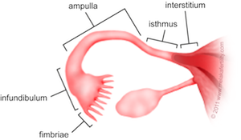

Slide 16
Ovaries:
  Whitish in colour
  Situated in waldeyer’s fossa
  Only structure in the abdomen which isn’t lined by peitoneum

Slide 17
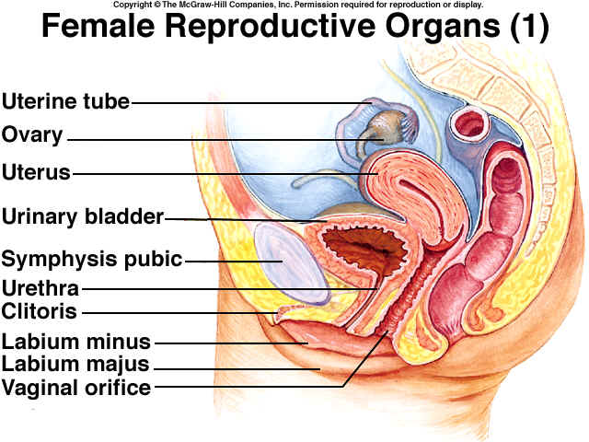
Sagittal section

Slide 18
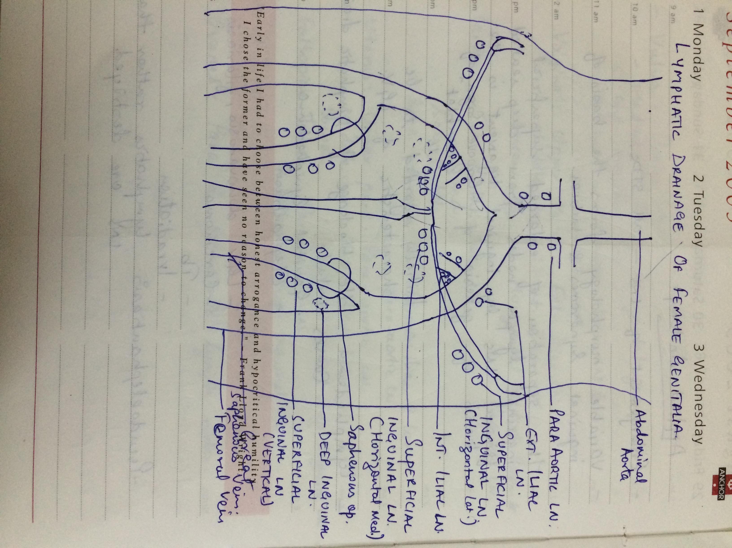
Lymphatic drainage

Slide 19
Superficial inguinal LNs
  three groups:
    Horizontal lat
      Drain external genitalia except clitoris, lower parts of vagina below hymen
    Horizontal med
      Drains from abdominal wall below umbilicus
    Vertical
      From thigh and leg

Slide 20
Deep inguinal LNs
  Within the femoral canal
  Aka node of Cloquet
  Clitoris directly drain into deep lymphatics
  Deep and superficial inguinal LN ext and int iliac LNs common iliac and para aortic LNs

Slide 21
Vulva:
  Med chain of horizontal sup inguinal LNs
  Vestibule: common iliac and sacral LNs
Vagina:
  Upper third: ext and int iliac LNs
  Middle third: int iliac LNs
  Lower third: horizontal med sup inguinal LNs

Slide 22
Cervix
  Ext and int iliac LNs
  Also sacral LNs
  Some drain directly into common iliac and lower para aortic LNs
Uterus
  Upper part: para aortic LNs
  Middle: ext iliac LNs
  Lower: horizontal med sup inguinal LNs

Slide 23
Fallopian tubes:
  Para aortic LNs
  Isthmus: sup inguinal LNs
Ovaries:
  Para and pre aortic LNs

Slide 24
Applied anatomy
Enlargement of LNs- seen in all STDs
The separation of enlarged sup. Inguinal LNs from deep seated femoral LNs by inguinal ligament is the basis of genesis of “GROOVE SIGN OF GREENBLAST”, which was initially regarded to be characteristic of LGV.
Lymphedema: d/t blockage og lymphatic drainage:
  Elephantiasis
  LGV, donovanosis, filariasis
  Carcinoma
  TB
  irradiation

Slide 25
Vaginal discharge:
  Normal discharge may appear clear, cloudy white and/or yellowish.
  Changes may occur d/t menstrual cycle, emotional stress, nutritional status, pregnancy, birth control pills
  At birth: sterile
  Infant: glycogen content is increased d/t mother’s estrogen content
  Premenarchal female: pH neutral : 7.0
  At puberty till menopause: increased estrogen, glycogen and lactobacilli
  acidic pH: 4.5

Slide 26
  After menopause: decreased estrogen, glycogen and lactobacilli
  pH > 6.0

Slide 27
Vaginal flora
  At birth: sterile
  Infant: lactobacilli along with CONS, streptococci, E. coli, other intestinal bacteria
  Adult: lactobacilli are predominant
  Menopausal women: mixed flora. Reduced lactobacilli. Mycoplasma species and anaerobic bacteria are present

Slide 28
Why female genital tract is more prone to infections?
  Short urethra
  Proximity to anus
  Decreased estrogen at menopause loss of protective microbial flora
  Vaginal atrophy after menopause
  Use of IUDs

Slide 29
THANK YOU

