Slide 1

DIET AND DERMATOLOGY

Slide 2
Introduction
Diet has a unique place in dermatology, particularly in a country like India, where most people are convinced that their skin condition is intimately connected to their dietary habits and will improve on modifying the same.
There are a number of other skin conditions where diet may have a role to play and these may be classified as follows:

Slide 4
1. Dermatologic disorders in which diet has a definite role
Dermatitis herpetiformis

Slide 5
2. Dermatologic disorders in which diet has a probable role in etiopathogenesis
Atopic dermatitis
Acne vulgaris
Psoriasis vulgaris
Pemphigus
Urticaria
Pruritus
Allergic contact dermatitis

Slide 6
3. Dermatologic disorders in which specific factors in the diet are directly implicated in the etiopathogenesis of the disorder
Fish odor syndrome
Toxic oil syndrome
Fixed drug eruption

Slide 7
4. Genetic and metabolic disorders wherein either an elimination diet is mandatory or dietary supplementation of specific factors is beneficial
Phenylketonuria
Tyrosinemia
Homocystinuria
Galactosemia
G ₆ PD deficiency
Xathomas
Gout
Porphyria
Refsum’s disease

Slide 8
5. Disorders related to deficiency or excess of specific nutrients
Kwashiorkar
Acrodermatitis enteropathica
Marasmus
Carotenemia
Phrynoderma
Lycopenemia
Pellagra
Scurvy
Notes:
lycopenemia (due to excessive consumption of tomatoes)

Slide 9
6. Miscellaneous disorders with an uncertain relationship to diet
Rosacea
Vitiligo
Aphthous ulcers
Cutaneous vasculitis
Telogen effluvium

Slide 10
Dermatitis Herpetiformis (DH)
A gluten-free diet (GFD) is the mainstay of treatment in celiac disease.
It alleviates GI symptoms much more rapidly than the rash
The rash of DH is gluten-dependent and there are several advantages to a GFD in the management of DH.
Advantages of GFD
  (1) the need for medication is reduced or abolished,
  (2) there is resolution of enteropathy,
  (3) a general feeling of well-being,
  (4) protective effect against development of lymphoma.
Notes:
The increased risk of developing lymphoma in the gastrointestinal tract may be due to polyclonal stimulation of lymphocytes, by gluten, giving rise to malignant transformation.

Slide 11
Patients with DH often have malabsorption.
A GFD improves absorption of essential nutrients and prevents alimentary deficiencies of iron, vitamin B12 and folate.
Foodstuffs containing gluten, and hence to be avoided, are wheat, rye, oats and barley.
Rice, corn and potatoes are safe for consumption.
Iodine-containing food (fish, iodized salt and vitamin) may be avoided in patients who do not respond to a GFD, as iodides worsen DH by local chemotaxis and stimulating neutrophil migration.

Slide 12
Atopic Dermatitis (AD)
Role of diet in AD
The role of diet in the cause and treatment of AD is very controversial.
Pediatricians and allergologists are convinced of the causative role of food in the onset of AD, while dermatologists are convinced of the contrary.

Slide 13
Arguments in favor of the role of diet in AD include the fact that…
  Some foods provoke AD,
  An elimination diet can heal AD,
  Diet manipulation can prevent allergy in newborns at risk for atopy,
  Presence of specific serum immunoglobulin (ig) E for food allergens (positive radio-allergo-sorbent-test [RAST]),
  Positive prick tests to foods,
  The presence of intestinal mast cell degranulation and IgE, tumor necrosis factor (TNF)-alpha, eosinophil chemotactic protein and alpha-1 antitrypsin (a1-AT) in the feces.

Slide 14
Corresponding arguments against the hypothesis that foods aggravate AD are the fact that
  AD can persist despite elimination diets,
  Diet manipulation can delay but not prevent allergy in newborns at risk for atopy,
  Positive RAST and prick test results may be irrelevant or unrelated to AD
  Gastrointestinal symptoms are absent in spite of the presence of various proinflammatory cytokines in the feces.

Slide 15
Food allergy plays a role in 20% of children under the age of 4 years with AD.
A direct effect on eczema is observed in four of 10 children with AD and proven food allergy.
DIETARY RESTRICTION:-
Ninety percent of food allergy is caused by six foods
Wheat,
Milk,
Soy,
Fish,
Eggs and
Peanut.

Slide 16
The mechanisms of aggravation of AD by food are:
•Increased binding of antigen to immature gut microvillus, along with increased intestinal permeability can initiate and perpetuate prompt immune responses in atopic patients with primarily altered antigen transfer.
•The role of pathogenic bacteria in the gut may be similar to the role of Staphylococcus aureus in the skin of AD patients, both as an infectious agent as well as a super antigen.

Slide 17
Dietary interventions in AD
A recent randomized controlled trials of food allergy in patients with AD showed that there appears to be no benefit of an egg and milk-free diet in unselected participants with atopic eczema.
There appears to be little benefit in eliminating cow's milk from the diet

Slide 18
Dietary therapy
Fish oil :- containing omega 3 fatty acids that is eicosapentanoic acid & docosahexaenoic acid is effective as less of pro imflammatory mediators .
Evening primrose oil :- corrects the reduced level of GLA(Y-linoleic acid) which inc DGLA act by inhibiting the production of pro inflammatory cytokines. Def of delta 6 saturase enzyme in AD.
Supplementation of 'probiotic' intestinal bacteria. (Probiotics are selected from members of the normal healthy intestinal microbiota, most of them belonging to Lactobacillus or Bifidobacterium ).hinese
Chinese herbal tea.

Slide 19
Acne
General view held by modern-day dermatologists with regard to diet and acne is that diet is unrelated to etiopathogenesis of acne.
Advice to avoid chocolate, fats, sweets and carbonated beverages was commonly given to patients as part of acne therapy.
There is the occasional patient who insists that his or her acne is exacerbated by a certain food item.

Slide 20
The four main The four main pathogenetic factors in acne are believed to be
(1) increased proliferation of basal keratinocytes within the pilosebaceous duct along with incomplete separation of ductal corneocytes from one another via impairment of apoptosis and subsequent obstruction of the pilosebaceous duct,
(2) androgen-mediated increases in sebum production,
(3) colonization of the comedo by Propionibacterium acnes and
(4) inflammation, both within and adjacent to the comedo.

Slide 21
Keratinocyte proliferation and corneocyte desquamation
Chronic consumption of high glycemic load carbohydrates may cause long-term hyperinsulinemia and insulin resistance.
Insulin influences circulating concentrations of free IGF-1 and insulin-like growth factor binding protein-3 (IGFBP-3), which in turn directly regulate keratinocyte proliferation and apoptosis.
Hyperinsulinemia in turn may initiate an endocrine cascade that affects the sebaceous gland and follicular keratinization and involves IGF, IGFBP-3, androgens and retinoid signaling pathways.
Notes:
The influence of diet on acne may be discussed with respect to three of the pathogenic factors:

Slide 22
Development of hyperinsulinemia and insulin resistance also elicits a pathological rise in serum concentrations of non-esterified free fatty acids (NEFAs), which in turn has been shown to cause an overexpression of the epidermal growth factor receptor.
A low glycemic load diet has been shown to be beneficial in patients with acne vulgaris.

Slide 23
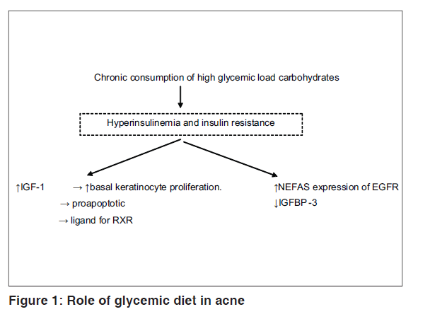

Slide 24
Androgen-mediated sebum production
Hyperinsulinemia may promote acne by its well-established androgenic effect.
Both insulin and IGF-1 stimulate the synthesis of androgens in ovarian and testicular tissues.
Insulin and IGF-1 inhibit the hepatic synthesis of sex hormone-binding globulin (SHBG), thereby increasing the bioavailability of circulating androgens to tissues.
Sebum production is also stimulated by insulin and IGF-1

Slide 25
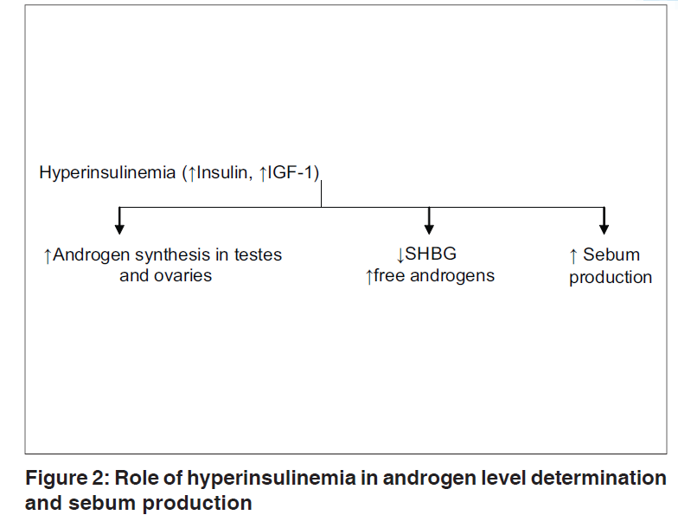

Slide 26
Inflammation
An important dietary factor that influences inflammation is the relative intake of ω-6 and ω-3 polyunsaturated fatty acids (PUFAs) in food.
A typical western diet has a significantly higher concentration of w-6 PUFAs at the expense of w-3 PUFAs because of the predominance of ω-6 PUFAs in most vegetable oils and processed foods made with these oils.
In the current US diet, the ratio of ω-6/ω-3 PUFA has risen to 10:1, whereas in non-westernized diets it has been estimated to be between 2 and 3:1.
Notes:
non-westernized diet almost entirely comprises unprocessed fresh fruits, vegetables, lean meats, fish and sea food.

Slide 27
Relationship of dietary PUFA to cytokine and eicosanoid profiles in acne
Typical western diet: ω-6/ω-3 PUFA = 10:1 (vegetable oils and processed foods) | Non-westernized diet: ω-6/ω -3 PUFA = 2:1 or 3:1
↑ω-6 + ↓ω-3 → proinflammatory cytokines and eicosanoid profile | ↓ω-6 + ↑ω-3 → LOW inflammatory cytokines and eicosanoids (↓IL-1β, IL-1α , TNF-α , IL-6, IL-8, PGE2, LTB4)

Slide 28
Average western diet - proinflammatory cytokine and eicosanoid profile that underlies the development of a variety of inflammatory disorders, including acne.
Non-westernized diet - beneficial effect in acne is free of processed food, cereal grains, dairy products, refined sugar and refined oil,
increased consumption of dietary ω-3 PUFA may be therapeutic, suppress inflammatory cytokine production.
dietary ω-3 fatty acids -inhibit synthesis of proinflammatory eicosanoids prostaglandin E2 and leukotriene B4.

Slide 29
Psoriasis
While susceptibility to psoriasis is inherited, the disease is influenced by environmental factors such as infections and stress, and possibly diet.
The dietary factors that may play a role in psoriasis are as follows:
Dietary restrictions
Dietary therapy

Slide 30
Energy intake
Fasting period, low calorie diet, vegetarian diet – dec AA, dec CD4 cell activation , dec oxidative stress & inc anti- inflammatory cytokines improve psoriasis.
Psoriasis also has a positive correlation with body mass index , hence, weight reduction is recommended in obese psoriatic patients.
The link between psoriasis, obesity and subsequent cardiovascular mortality is responsible for the higher risk of myocardial infarction seen among relatively young, severely affected psoriatic patients

Slide 31
Alcohol
Alcohol stimulates histamine release and may thereby aggravate skin lesions.
Intake of alcohol is associated with a concomitant increase in intake of fatty foods and reduced consumption of fresh vegetables and fruits.
Hence, alcohol intake should be restricted in psoriasis
GFD diet also show improvement in psoriasis.

Slide 32
PUFAs
Beneficial effect of fish and fish oil supplementation (rich in ω-3 PUFAs) on psoriasis and psoriatic arthritis. .
Basis for the anti-inflammatory effect of fish oil supplementation is the replacement of proinflammatory arachidonic acid in membrane phospholipids by anti-inflammatory ω-3 PUFAs (EPA and DHA)
PUFA intake in psoriasis
• Daily intake (170 g) of oily fish.
• EPA/DHA 1.8 g/day or fish oil (10 capsules three times a day)
• Parenteral infusion of EPA and DHA 4.2 g/day –useful in acute
guttate psoriasis.
• Combined ω-3 and ω-6 fatty acid supplementation
(rationale: low concentration of PUFA in membranephospholipids, increased saturated fatty acids and decreased ω-6 fatty acid in psoriatic arthritis, high doses of linoleic acid suppressing LTB4 production).

Slide 33
Oxidative stress and antioxidants
Presence of oxidative stress and the resultant increase in free-radical generation may play a role in the inflammatory mechanism of psoriasis.
Consumption of fresh fruits and vegetables, such as carrots and tomatoes, may be beneficial in psoriasis because of their high content of carotenoids, flavonoids and vitamin C.

Slide 34
General nutritional status
Extensive psoriasis is known to result in nutritional deficiencies through the loss of proteins and other nutrients in the scales, resulting in hypoproteinemia and macrocytic anemia.
Methotrexate decreases the appetite and is contraindicated in patients with a poor nutritional status.
administration of cyclosporine along with grape fruit juice increases its oral bioavailability and can lead to toxicity.
Patients on oral retinoids should be advised to avoid foods rich in vitamin A, such as liver.

Slide 35
Pemphigus
Substances such as thiols, thiocyanates, phenols and tannins can precipitate the pemphigus in a genetically predisposed individual.
A near-complete list of foods containing these substances includes:
  Vegetables: garlic, onion, mustard, turnip, broccoli, radish, cabbage, cauliflower, potato, tomatoes, ginger
  Fruits and nuts: mango, raspberry, cherry, cashew, banana, cranberry, pear, blackberry, walnut, peach
  Stimulants: coffee, tea, betel nut leaf, katha, cassava
  Beverages: beer, wine, soft drinks

Slide 36
  Miscellaneous: ice cream, candy, baked foods, spices (red chillies), sodium benzoate, tartrazine, coloring agents, nutritional supplements
  Water: high tannin content in Brazil river water may be the reason for endemicity of fogo selvagem. Tannins can be removed by chlorination, which would explain why the incidence of fogo selvagem has decreased with urbanization.

Slide 37
Allergic Contact Dermatitis
Partial cross reactivity exists between latex and fruits like banans, chestnut and avocado as latex-fruit syndrome
Food allergy should be ruled out in latex sensitive persons and vice versa.
oral intake of nickel can induce systemic contact dermatitis in nickel-sensitive individuals.
A flare-up of a recurrent vesicular hand eczema is most common clinical manifestation of systemic nickel contact dermatitis.

Slide 38
Food, water and cooking utensils are all sources of nickel in diet.
Certain foods are routinely high in nickel content, such as cocoa and chocolate, soya beans, oatmeal, nuts and almonds, and fresh and dried legumes.
Diet low in balsam of peru. (specifically found in tomato product ketchup.

Slide 39
URTICARIA
Food most commonly implicated are cow milk, dairy products, fish, eggs, nuts, preservatives, coloring agents.

Slide 40
Diet are directly implicated in the etiopathogenesis of the disorder
DISEASE | DIET
Fish odor syndrome | Avoid:- choline rich products such as eggs, peas, soyabean, sea food , reduce excretion of TMA and reduce odor
Toxic oil syndrome | Rapeseed oil denatured with castor oil, methylene blue or aniline lead to toxicity resembling scleroderma & graft versus host disease
Fixed eruption | Legumes, lentils, strawberries , cheese crisps ,artificial flavors, colors and preservatives in foods as well as dyes

Slide 41
Elimination diet is mandatory or dietary supplementation of specific factors is beneficial
Disease | Diet
Phenyketonuria & tyrosenemia | Restrict :- natural proteins Supplement :- essential fattyacids , minerals, vitamins
Homocystinuria | Restrict :- milk, milk products, meat, fish , pulses, wheat maize , dried fruits, nuts
Galactosemia | Exclusisn of galactose & lactose from diet in infancy & childhood
Refsum disease | Reduce :- fish , beef, lamb, dairy products – dec phytanic acid
G6PD def | Restrict :- fava beans , green beans , chick peas
Xanthomas | Restrict :- cholestrol rich food such as egg, meat, dairy products
Porphyrias | Supplement :- carotene containing foods such as carrot & green leafy vegetables

Slide 42
Deficiency or excess of specific nutrients
DISEASE | DIET
PELLAGRA | Restrict :- leucine containing food such as maize , jowar
lyco

Slide 43
Rosacea
Tea, coffee, hot beverages, tobacco, alcohol and spicy food are known to precipitate episodes of flushing in rosacea

Slide 44
Pruritus
Some foods like banana and brinjal may cause pruritus with or without obvious urticarial lesion.
Low protein diet helps in reducing uraemic pruritus.
Patient of cholestatic jaundice may be benefited by diet rich in polyunsaturated fatty acid.

Slide 45
Vitiligo
Widely held belief in India is that foods that are excessively sour should be avoided by vitiligo patients.
These foods include citrus fruits, sour yoghurt, sour pickles etc.
Simultaneous consumption of milk and fish is also discouraged.
Although there are numerous websites that host dietary advice for vitiligo patients, there is no scientific data to support or refute these beliefs.
It has been found that oral supplementation with antioxidants containing alfa-lipoic acid and vitamin B ₁₂ before and during NB-UVB broadband UVB significantly improves the clinical effectiveness of phototherapy.

Slide 46
Telogen Effluvium
Although hair loss has been linked to iron deficiency, there is insufficient evidence to recommend giving iron supplementation therapy to patients with hair loss and iron deficiency in the absence of iron deficiency anemia.
Both cicatricial and non-cicatricial hair loss for iron deficiency.
Lean meats, especially beef, have high iron contents that are highly bioavailable.

Slide 47
Non-animal foods that are high in iron include nuts, seeds, legumes, bean products, dark green leafy vegetables, whole grains and iron-fortified cereals.
Studies in PEM, starvation and eating disorders show a positive correlation with hair loss.
Profuse hair loss has been seen to occur 2-5 months after starting a vigorous weight reduction program.
Rigorous caloric restriction with subsequent inadequate energy supply of the hair matrix is thought to be the cause for precipitation of the TE of crash dieter.
Deficiencies of zinc and biotin have also been associated with hair loss; however, there is no concrete evidence to prove their role.

Slide 48

THANKS

