Slide 1
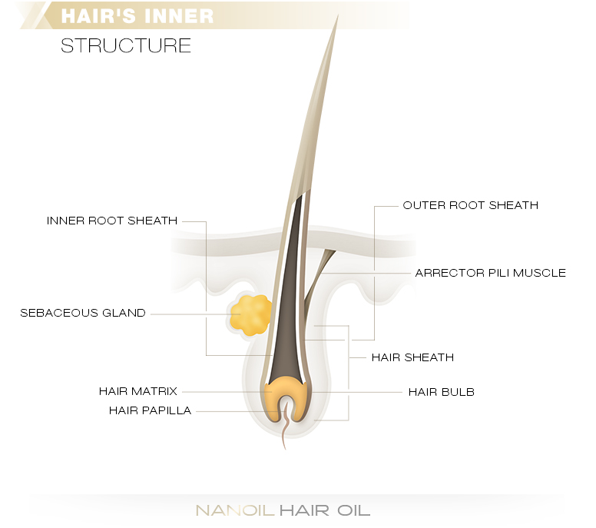
HAIR FOLLICLE
AND
HAIR GROWTH CYCLE

Slide 2
MORPHOLOGICAL VARIANTS OF HAIR
1.TERMINAL HAIR
-large in diameter > 0.03 mm and 1 cm in length.
- pigmented
- medullated
- they are rooted in subcutaneous tissue or deep dermis
- vellus like hair : terminal hair miniaturised to vellus hair
: seen in alopecia areata or androgenetic alopecia

Slide 3
2. VELLUS HAIR
- Small in diameter <0.03 mm and less than 1 cm in length
- lack melanin and lack medulla
- have thin external root sheaths
- short stela in upper dermis
3. LANUGO (WOOL – LIKE ) HAIR
- cover the fetal skin
- shed at fetal age of 8-9 months or after birth
- thin, unmedullated , light coloured
- longer than vellus hair

Slide 4
4. INTERMEDIATE HAIR
- terminal hairs
- thinner
- hair bulb is situated in reticular dermis and not in subcutis
5. SEBACEOUS HAIR FOLLICLES
- have multilobed sebaceous glands
- they produce different type of hair shafts
- changing from lanugo to vellus to terminal ( axilla and pubis )
- lanugo to terminal to vellus ( scalp )

Slide 5
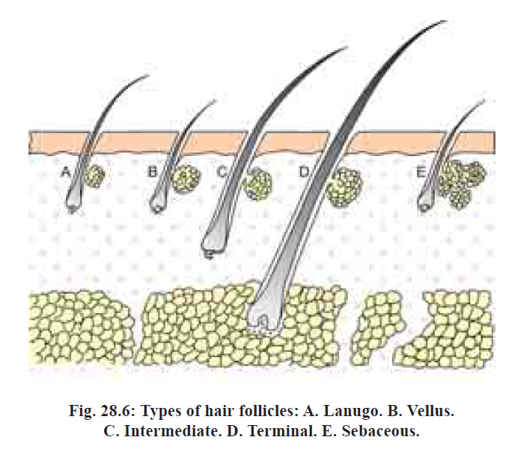

Slide 6
Histologically hair is divided into two regions in relation to insertion of arrector pili muscle :
Upper part = infundibulum + isthmus
Lower part = stem + hair bulb

Slide 7
ANATOMY OF ANAGEN HAIR
4 parts
Superficial
infundibulum constant structures
isthmus
suprabulbar area undergo repeated episodes of
hair bulb regression and regeneration during
deep hair cycle

Slide 8
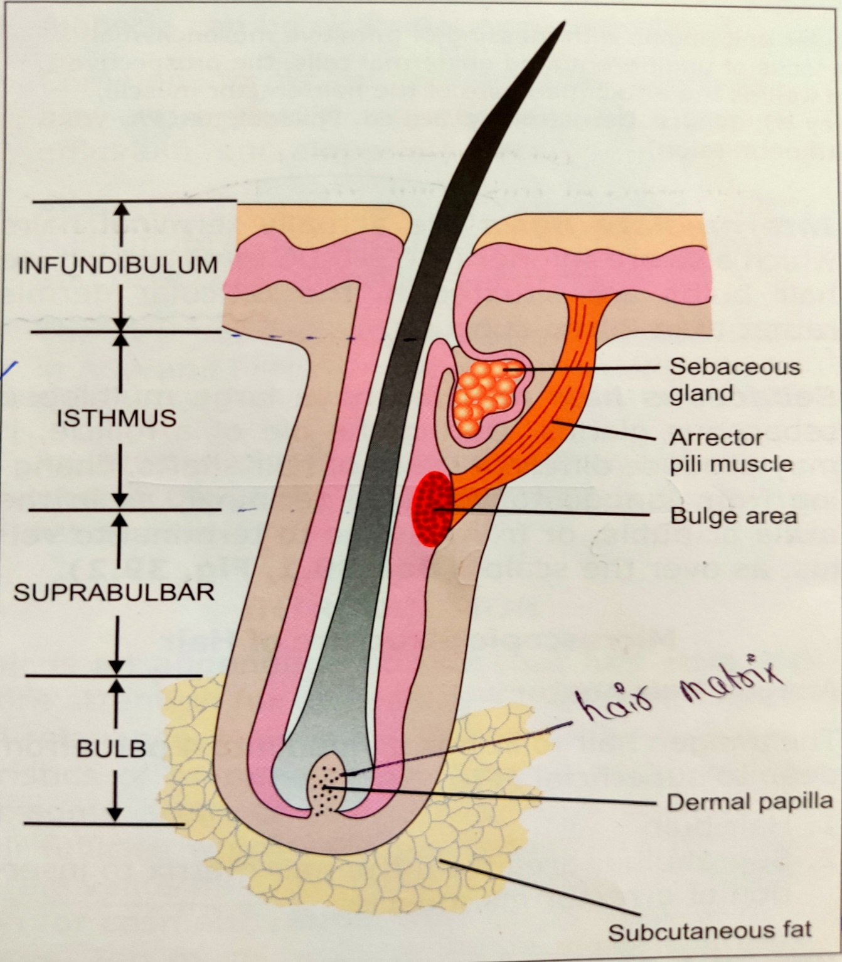
INFUNDIBULUM : follicular orifice to sebaceous gland
ISTHMUS : sebaceous gland duct opening to insertion of arrector pili muscle
SUPRABULBAR AREA : insertion of arrector pili muscle to hair matrix
HAIR BULB : dermal papilla surrounded by hair matrix

Slide 9
PILOSEBACEOUS UNIT :
>_3 follicles in group (follicular unit) + sebaceous gland + arrector pili muscle

Slide 10
DERMAL PAPILLA
Flask shaped structure
Made up of - fibroblast like cells
- ECM : basement membrane proteins
: proteoglycans
- capillary vessels
Role in induction and maintenance of follicular epithelial differentiation
Size of hair shaft is determined by volume of dermal papilla
Primary target for androgen action in hair follicle in AA

Slide 11
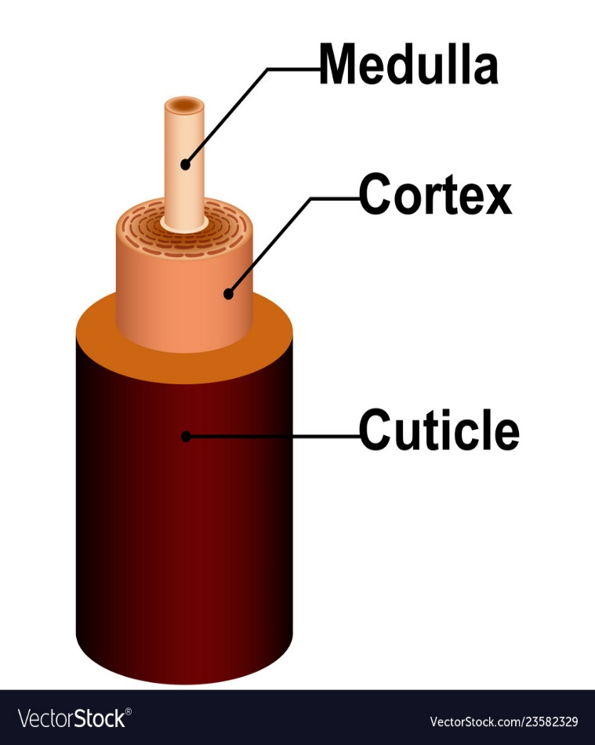
SUPRABULBAR ZONE
Transverse section shows / from innermost to outermost layers are :
1. Hair shaft - medulla / cortex / cuticle
2. Inner root sheath - cuticle / Huxley’s layer / Henle’s layer
3. Glassy (vitreous)layer
4. Fibrous root sheath

Slide 12
HAIR SHAFT MEDULLA
- continuous , discontinuous or absent
- Mature medulla cells have a spongy structure with amorphous material with air spaces
HAIR SHAFT CORTEX
- made up of hard alpha keratin intermediate filaments
CUTICLE
- hair shaft cuticle appear as single anatomical layer of
inner root sheath cuticle interlocking flattened cells
- Function : barrier and maintains integrity of the hair shaft.

Slide 13
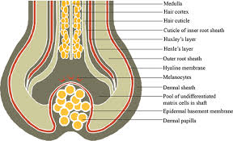

Slide 14
INFUNDIBULUM
In latin means “ funnel”
At skin surface it merges with epidermis
Infundibular epithelium differentiates in similar manner as epidermis which desquamates into follicular epithelium

Slide 15
ISTHMUS
Transition zone of follicular keratinization
Mid portion of isthmus :
inner root sheath desquamates
separation between hair shaft and the follicular wall
cells of the outer root sheath cornify without formation of a granular layer
..known as trichilemmal keratinization
HAIR FOLLICLE SKIN CELLS
- Reside in the lower part of isthmus close to insertion of arrector muscle
- show distinct biochemical properties
- proliferate only during onset of anagen phase

Slide 16
Moving from inwards to outwards
1.Dermal hair papilla
2.Hair matrix
3. Hair ( medulla,cortex,hair cuticle)
4.Inner root sheath
( cuticle,Huxley’s layer,Henle’s layer)
5.Outer root sheath
HAIR BULB has all the 5 layers
STEM has 3,4,5 layers
ISTHMUS has 3 and 5 layer…lacks inner root sheath
INFUNDIBULUM is nearly identical to epidermis ..not a component of root sheath.

Slide 17
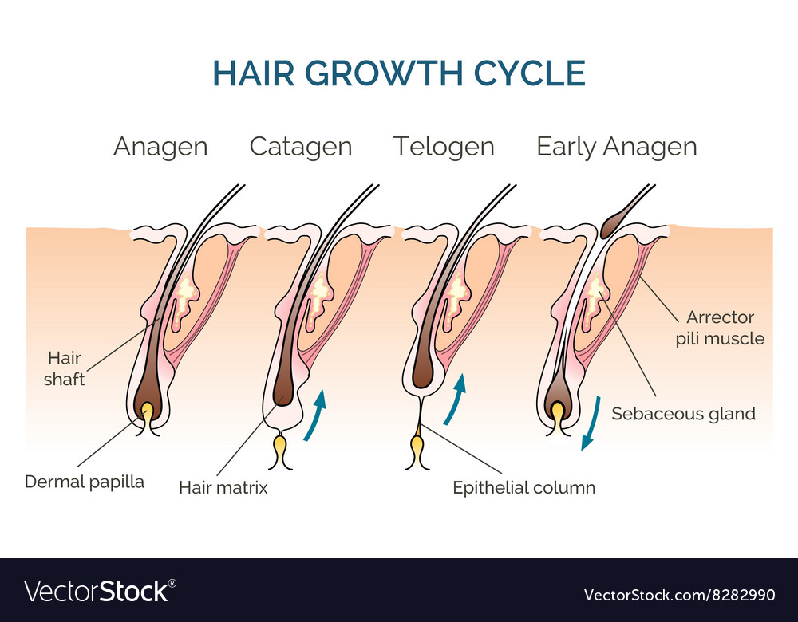
ANATOMY OF CATAGEN HAIR
Hair matrix disappears
Epithelium of the hair follicle undergoes disintegration by apoptosis
Vitreous and the fibrous root sheath are thickened
Hair papilla moves upwards into the dermis – collapsed fibrous root sheath is left behind …known as stela ( in Greek means pilar )

Slide 18
ANATOMY OF TELOGEN HAIR
Dermal papilla becomes a condensed ball of spindle shaped nuclei
It lies just below the epithelium …known as secondary hair germ
On transverse section it appears like as asterisk

Slide 19
HAIR MELANIN
Formed by melanocytes situated in hair bulb ; basal layer of epidermis ; in outer root sheath in the lower portion of follicle.
These cells are DOPA negative and non melanized act as melanocyte reservoir in the skin.
Hair colour depends on the amount and ratio of
EUMELANIN(black,high molecular weight, insoluble) and
PHEOMELANIN (red,low molecular weight,soluble) and number and size of melanosomes

Slide 20
Red and blonde hair = spherical melanosomes.
Brown and black hair = ellipsoidal melanosomes.

Slide 21
INNERVATION OF HAIR FOLLICLE
Free nerve endings
Pilo-ruffini nerve endings
Merkel nerve endings
Other species :
richly innervated sinus hair follicles..known as vibrissae follicles having lamellated nerve endings
specialized sensory function

Slide 22
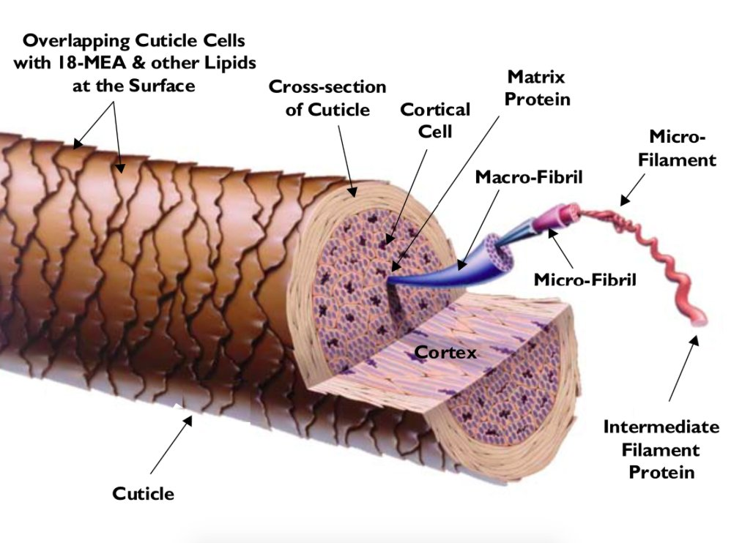
ULTRASTRUCTURE
Hard keratin with high sulfur content – extraordinary tensile strength
Consists of macrofibrils arranged in longitudinal lamellated fashion
Macrofibrils consist of smaller microfibrils and protofibrils

Slide 23
Matrix consists of S-S linkages of cystine
Xray diffraction study of hair reveals the the fibrils consists of alpha keratin chains arranged in the form of three to seven intertwined helices. Thus , with hair stretching there occurs straitening of the helices
INNER ROOT SHEATH contains trichohyaline granules which are rich in arginine and with cornification ..rich in citrulline

Slide 24
HAIR CYCLE
Hair follicles undergo repetitive sequence of growth and rest known as hair cycle.
Five phases of hair growth cycle are recognized
ANAGEN
KENOGEN CATAGEN
EXOGEN
TELOGEN

Slide 25
ANAGEN PHASE
Active growing period
Subdivided into six substages
I-V are proanagen
VI is meta anagen defined by emergence of hair shaft above the skin surface. The final length of hair follicle depends on this stage.
On scalp it lasts between 2 and 7 years.
80% - 90% of hair follicles on human scalp are in anagen at any one time.
Keratin 6 and stat 3 are required for this phase.

Slide 26
CATAGEN PHASE
At the end of anagen, epithelial cell division declines and stops and follicle enters this phase of involution..known as catagen
Proximal end of hair shaft – keratinizes – forms a club shaped structure.
Lower end –involutes by apoptosis.
FGF-5, EGF , Neurotropins , TGF – B are needed for this phase.
Lasts for about 2-3 weeks
About 1 %of scalp hair are in catagen phase.

Slide 27
TELOGEN PHASE
The column of epithelial cells connecting the bulb of follicle and papilla shrinks further – to move the papilla upwards close to the bulb of follicle.
The period between completion of follicular regression and onset of next anagen phase is termed telogen.
This phase lasts for 3 months
8%-9% of scalp hair are in telogen phase at any one point.

Slide 28
EXOGEN PHASE
The club hair is shed thru an active process - exogen or teloptosis.
The exogen shaft base is shrunken
has elongated shape and
scalped and pitted margin

Slide 29
KENOGEN PHASE
This is the phase when some follicles remain empty after hair shedding.
It has been observed in prepubertal children and in patients with androgenetic alopecia.

Slide 30
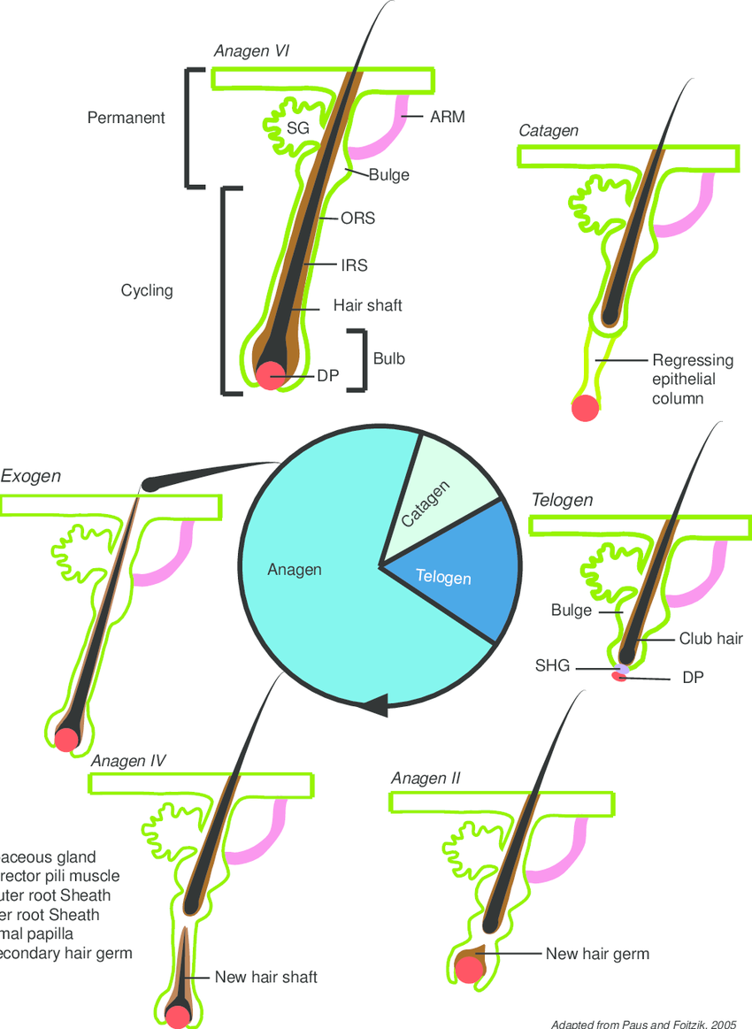

Slide 31
HAIR SHEDDING
Asynchronous in humans and is established by the end of first year of life.
Rarely synchronous in humans in utero and in Meijeres trio group.
First hair shedding - in utero
- as a wave beginning from frontal line to occipital
area
- shedding occurs till 8-12 weeks postnatally …
known as neonatal alopecia

Slide 32
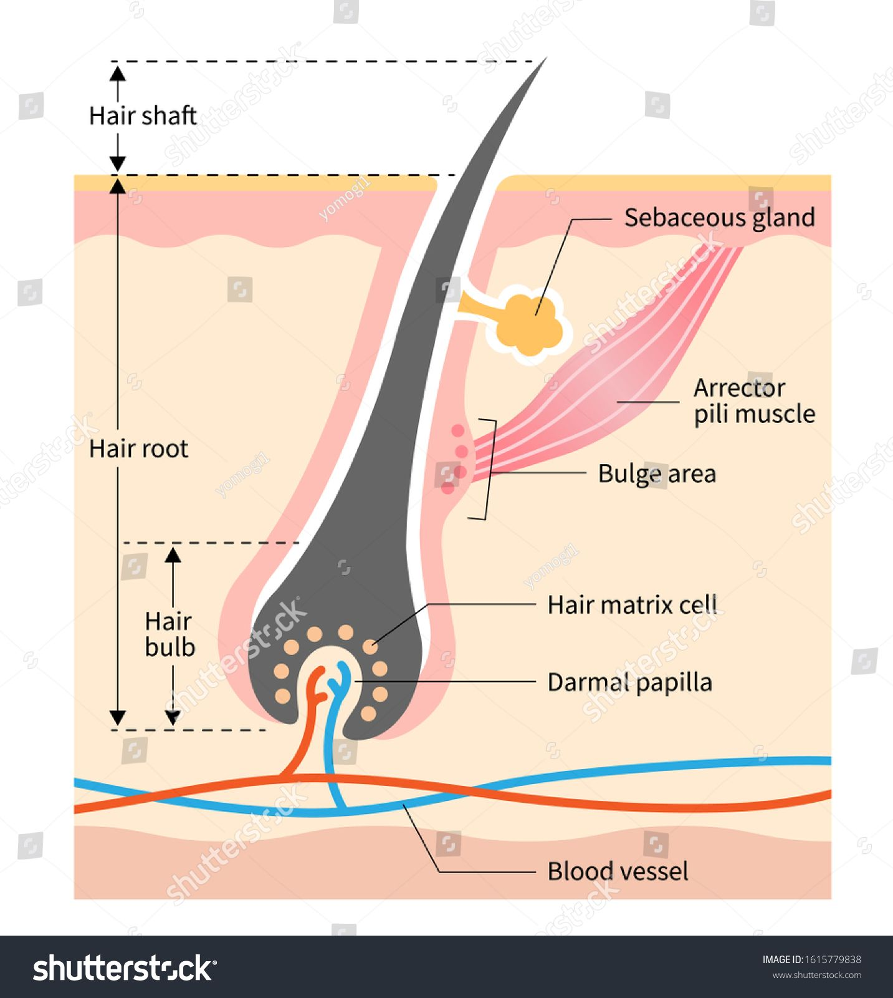
BULGE ACTIVATION HYPOTHESIS
This is the most widely accepted theory to explain cyclic activity of hair follicle.
This theory proposes that the stem cells of the follicle reside not in the bulb matrix but in the bulge region at the insertion of the arrector pili muscle (the lowermost permanent part of the hair follicle)

Slide 33
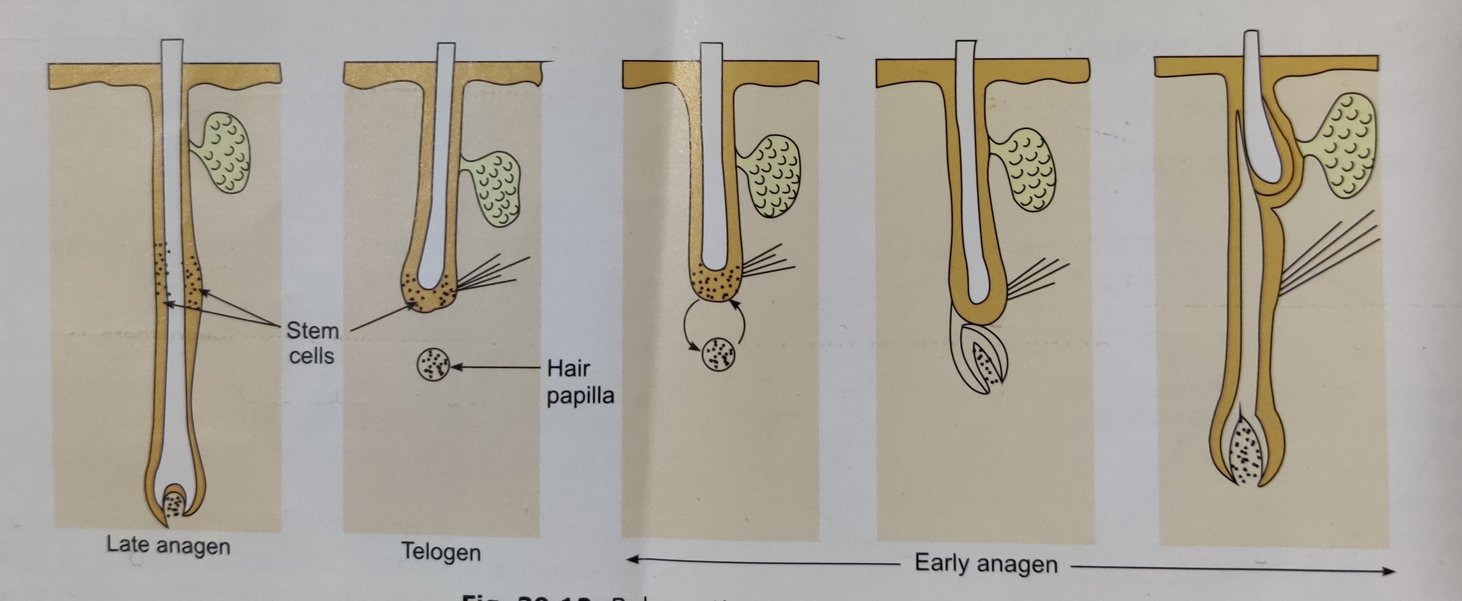

Slide 34
The stem cells divide at the end of telogen phase to give rise to “transient amplifying cells” that multiply to form matrix cells.
The dermal papilla moves upwrds during telogen to interact with the bulge cells and their activation occurs .
The variation in length of anagen depends on the variation in the proliferative capacity of transient amplifying cells.
The keratinocytes in the bulge area express
- keratin 19
- a3b1 integrin
- have slow cycing nature

Slide 35

THANK YOU

