Slide 1

COLOR
Dr. Neha Anand Khaire
Senior Lecturer
Department of Prosthodontics and Crown & Bridge
K..M. SHAH Dental College & Hospital

Slide 2
LEARNING OBJECTIVES
To understand the mechanism of perception of color.
To understand composition of color
To grasp the concepts of reflection, refraction, absorption, translucence
To understand the relevance of color perception in relation to dental materials

Slide 3
INTRODUCTION
DEFINITION:
Color:- The property possessed by an object of producing different sensations on the eye as a result of the at it reflects or emits light.

Slide 4
DIMENSIONS OF COLOR
HUE- is the color tone (red, blue, green). Refers to the dominant wavelengths in the spectral distribution.
VALUE- is the relative lightness(brightness) or darkness of the hue. Increases towards top and decreased towards bottom. (varies vertically)
CHROMA- Intensity or saturation of the color tone(hue). (varies radially)

Slide 5
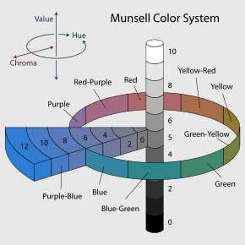

Slide 6
FACTORS AFECTING COLOR
SOURCE OF EMITTED LIGHT- (northern exposure daylight) metamerism
ENVIRONMENT- (Bezold-Brucke effect)
THE TOOTH (textures and layers)
RECEIVER’S EYE – color blindness, sex, age, clinical experience, color memory, binocular difference
Presence of retinal fatigue – (neural component)
Color of the background

Slide 7
VISIBLE SPECTRUM
“CONES” of the human eye perceive on the wavelengths in the visible spectrum of light i.e. 400-700 m.
Nerve impulse is generated when light is incident upon the retina from an object
For an object to be visible it must reflect/transmit (dental materials) light.

Slide 8
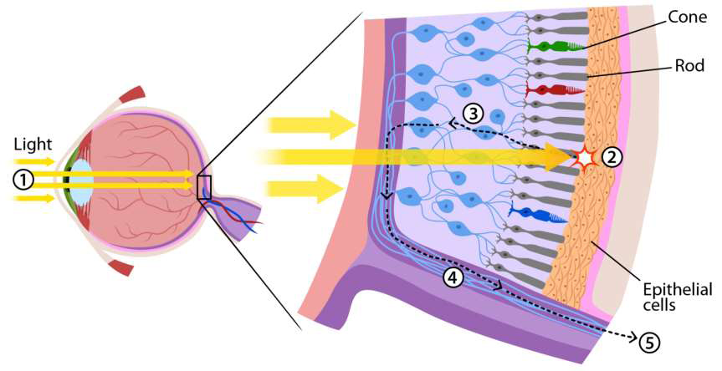

Slide 9
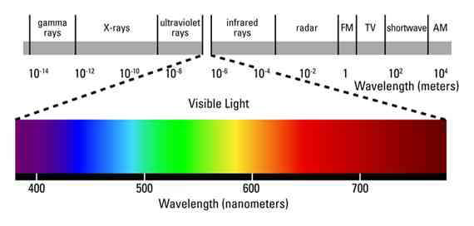

Slide 10
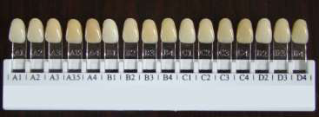
Color matching
Shade guide
Color matching
Shade guide
Hue
A B C D
A red-brown
B red-yellow
C gray
D red-gray
Value
1 2 3 4
1 lightest
4 darkest

Slide 11
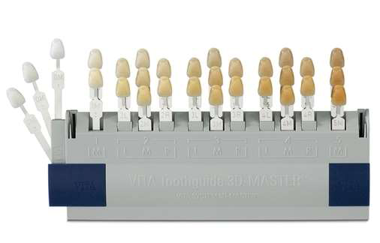
Vita 3D Master shade guide

Slide 12
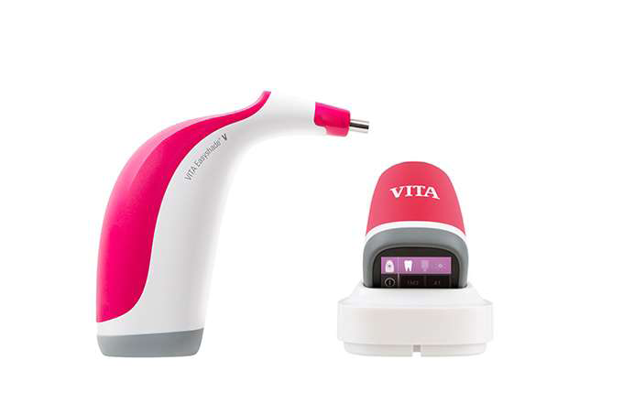

Slide 13
THANK YOU

