Slide 1
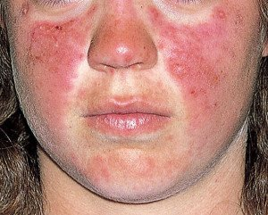
SYSTEMIC LUPUS
ERYTHEMATOSUS
(SLE)

Slide 2
DEFINITION
Systemic lupus erythematosus (SLE) is an autoimmune systemic disorder characterized by multisystem organ involvement , most commonly skin, joint and vasculature, in which organs and cells undergo damage initially mediated by tissue-binding autoantibodies and immune complexes.

Slide 3
AGE : females 15-44 years age group.
people of all age , gender and ethinicity are susceptible
INCIDENCE : 3.8 per 1,00,000 per year in U.K
Male:female- 1:7 to 1:15 (90 percent of patients are women of child bearing age)
Three times more common in black people

Slide 4
Pathogenesis and Etiology
Interaction between susceptibility genes and environmental factors result in abnormal immune responses which vary between different patients:
Activation of innate immunity ( dendritic cells,monocytes/macrophages) by CpG DNA, DNA in immune complexes, viral DNA/RNA and RNA in RNA/protein self antigens.
Lower activation thresholds and abnormal activation pathways in adaptive immunity cells.
Ineffective regulatory CD4+ and CD8+ T cells, B cells and myeloid derived suppressor cells.
Reduced clearance of immune complexes and apoptotic cells.

Slide 5
autoantibodies and immune complexes are formed
Bind target tissues
activation of complement system and release of various cytokines,chemokines, VAP, oxidants and proteolytic enzymes.
Activation of multiple tissue cells and influx of T/B cells,monocytes /macrophages/dendritic cellsinto target tissues
Chronic inflammation and tissue damage

Slide 6
Environmental factors( triggering factors)
Ultraviolet radiation (most important)
viruses (EBV)
bacterial infections
physical or mental stress
drugs (hydralazine, procainamide, quinidine)
tobacco smoking
hormones (oestradiol,prolactin,testosterone)

Slide 7
ACR CRITERIA
Need four or more over any span of time for diagnosis:
Malar rash
Discoid rash
Photosensitivity
Oral ulcers (oral or nasopharyngeal)
Arthritis (nonerosive, involving 2 or more joints)
Serositis (pleuritis: + pleuritic pain or rub, OR pleural effusion, OR pericarditis, OR pericardial effusion)
Renal disorder (persistent proteinuria > 500mg per day OR cellular CASTS)
Neurologic disorder (seizures OR psychosis)

Slide 8
Hematologic disorder (hemolytic anemia w/ reticulocytosis OR Leukopenia < 4,000 on two or more checks OR Lymphopenia < 1,500 on two or more checks OR thrombocytopenia <100,000)
Positive anti-nuclear antibody (in absence of drugs known to be associated with "drug-induced SLE")
Anti-dsDNA or anti-Smith antibody (OR positive antiphospholipid antibody OR false positive serologic test for syphilis known to be + for at least 6 months and confirmed by fluorescent Treponema pallidum antibody absorption test)
The diagnosis of SLE is made if four or more of the manifestations are present, either serially or simultaneously, during any interval of observations.

Slide 9
Systemic Lupus International Collaborating Clinics classification criteria (SLICC) for systemic lupus erythematosus (SLE), 2015
CLINICAL CRITERIA
1. Acute or subacute cutaneous lupus
2. Chronic cutaneous lupus
3. Oral ulcers/nasal ulcers
4. Non‐scarring alopecia
5. Inflammatory Synovitis : Involving ≥ 2 joints characterized by effusion/ swelling/tenderness
with morning stiffness.
6. Serositis
7. Renal disorder : persistent proteinuria (>500 mg/day) or red blood cells.
8. Neurological disorder : Seizures, psychosis, mononeuritis multiplex, myelitis or acute
confusional state in the absence of other causes.
9. Haemolytic anaemia
10.Leukopenia (<4000/ mm 3 at least once) OR lymphopenia (<1500/mm3 )
11.Thrombocytopenia (<100 000/mm3 at least once)

Slide 10
Immunological criteria
ANA above reference laboratory range
Anti‐dsDNA antibody above reference laboratory range (or more than twofold the reference range if tested by ELISA)
Anti‐Sm: presence of antibody to Sm nuclear antigen
Antiphospholipid antibody positivity :- lupus anticoagulant, false –positive test for syphilis, anticardiolipin- at least twice normal or medium high titre, anti-B 2 glycoprotein 1.
Low complement (low C3, C4 or CH50)
Direct Coombs’ test in the absence of haemolytic anaemia
Classify a patient as having SLE if he or she satisfies four of the criteria, including at least one clinical criterion & one immunological criteria,
or
if he or she has biopsy‐proven nephritis compatible with SLE in the presence of ANAs or anti‐dsDNA antibodies.

Slide 11
2015 ACR/SLICC revised criteria for diagnosis of SLE
Acute/subacute cutaneous lupus rash Up to 2 points
Malar rash 2.p
Subacute cutaneous Lupus erythematosus (SCLE) rash 1.p
Palpable purpura or urticarial vasculitis 1.p
Photosensitivity 1.p
Discoid lupus erythematosus (DLE) or hypertrophic Lupus rash 1.p
Non-scarring frank alopecia 1.p
Oral/nasal ulcers 1.p
Joint disease 1.p
Pleurisy and/or pericarditis 1.p

Slide 12
Psychosis and/or seizure and/or acute confusion 1.p
Kidney involvement Up to 2 points
proteinuria≥ 3+ or ≥ 500 mg/day or urinary casts 1.p
Biopsy-proven nephritis compatible with SLE 2.p
Hematologic Up to 3 points
WBC count < 4000/mm3 or lymphocyte count < 1500/mm3 on ≥ 2 occasions
or WBC count < 4000/mm3along with lymphocyte count < 1500/mm3 in 1.p
one occasion
Thrombocytopenia < 100,000/mm3 1.p
Hemolytic Anemia 1.p

Slide 13
Serologic tests Up to 3 points
Low titer positive ANA 1.p
High titer ANA with homogenous or rim 2.p
Positive anti-ds DNA 2.p
Positive anti-Sm 2.p
Anti-phospholipid antibodies (aPLs) 1.p
Low serum complement (C3 and/or C4 and/or CH50 ) 1.p
The patients with 4 points out of 16, have definite diagnosis of SLE.
With 3 points highly suggestive SLE,
with 2 points probable SLE
with 1 point possible SLE are the diagnosis

Slide 14
CUTANEOUS FEATURES
The Gilliam Classification of Skin Lesions Associated with Lupus Erythematosus
LE-Specific Skin Disease [Cutaneous LE (CLE)]
A. Acute cutaneous LE (ACLE)
1. Localized ACLE (malar rash; butterfly rash)
2. Generalized ACLE (lupus maculopapular lupus rash, SLE rash, photosensitive
lupus dermatitis)
B. Subacute cutaneous LE (SCLE)
1. Annular SCLE (syn. lupus marginatus, symmetric erythema centrifugum,
autoimmune annular erythema, lupus erythematosus gyratus repens)

Slide 15
2. Papulosquamous SCLE (syn. disseminated DLE, subacute disseminated LE, superficial
disseminated LE, psoriasiform LE, pityriasiform LE, and maculopapular photosensitive
LE)
C. Chronic cutaneous LE (CCLE)
1. Classic discoid LE (DLE) a. Localized DLE b. Generalized DLE
2. Hypertrophic/verrucous DLE
3. Lupus profundus/lupus panniculitis
4. Mucosal DLE a. Oral DLE b. Conjunctival DLE
5. Lupus tumidus (urticarial plaque of LE)
6. Chilblain LE (chilblain lupus)
7. Lichenoid DLE (LE/lichen planus overlap, lupus planus)

Slide 16
LE-Nonspecific Skin Disease
Cutaneous vascular disease
1. Vasculitis
a. Leukocytoclastic (1) Palpable purpura (2) Urticarial vasculitis
b. Periarteritis nodosa-like cutaneous lesions
2. Vasculopathy
a. Degos disease-like lesions
b. Secondary atrophie blanche (syn. livedoid vasculitis, livedo vasculitis)
3. Periungual telangiectasia
4. Livedo reticularis
5. Thrombophlebitis
6. Raynaud phenomenon
7. Erythromelalgia (erythermalgia)

Slide 17
B. Nonscarring alopecia
1. “Lupus hair”
2. Telogen effluvium
3. Alopecia areata
C. Sclerodactyly
D. Rheumatoid nodules
E. Calcinosis cutis
F. LE-nonspecific bullous lesions
G. Urticaria
H. Papulonodular mucinosis
I. Cutis laxa/anetoderma
J. Acanthosis nigricans (type B insulin resistance)
K. Erythema multiforme
L. Leg ulcers
M. Lichen planus

Slide 18

ACUTE CUTANEOUS LUPUS ERYTHEMATOSUS
ACLE almost always occurs in the setting of acutely flaring SLE.
malar rash develops or gets exaggerated after sun exposure ,
lasting only hours, days, or weeks
Postinflammatory pigmentary change is most prominent in patients with heavily pigmented skin.
Scarring does not occur unless the process is complicated by secondary bacterial infection.
rarely, acute eruptions similar to toxic epidermal necrolysis
Or erythema multiforme major ( Rowell’s syndrome) develops
Malar rash
Sparing of nasolabial folds

Slide 19
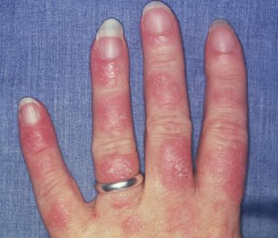
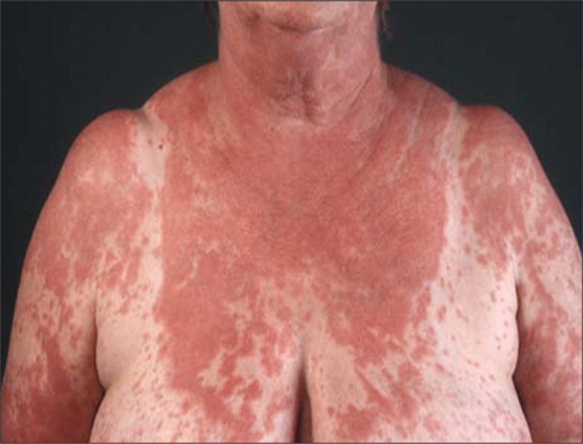
Characteristic sparing of knuckles in generalized
ACLE
Generalised ACLE with accentuation of leisons in UV exposed sites

Slide 20
SUBACUTE CUTANEOUS LUPUS ERYTHEMATOSUS
First described by Sontheimer et al. in 1979
Initially erythematous macules and/or papules that evolve into hyperkeratotic
papulosquamous or annular/polycyclic plaques.
Leisons are characteristically photosensitive commonly involves the V area of neck, shoulders, upper extremities, trunk and the lateral face, with sparing of the central, malar regions.
SCLE lesions tend to be less transient, less edematous and more hyperkeratotic than ACLE lesions.
Antibodies to the Ro/SS‐A antigen are an almost universal finding
resolve without scarring to leave grey‐white hypopigmentation and telangiectases

Slide 21
Associated autoimmune diseases :
Sjögren’s syndrome,
rheumatoid arthritis,
Hashimoto’s thyroiditis.
Sweet syndrome,
porphyria cutanea tarda,
gluten-sensitive enteropathy,
Crohn’s disease.
.
Risk factors for development of SLE in patients with SCLE
papulosquamous type of SCLE
leu-kopenia
high titer of antinuclear antibody (ANA) (>1:640)
anti-dsDNA antibodies.

Slide 22
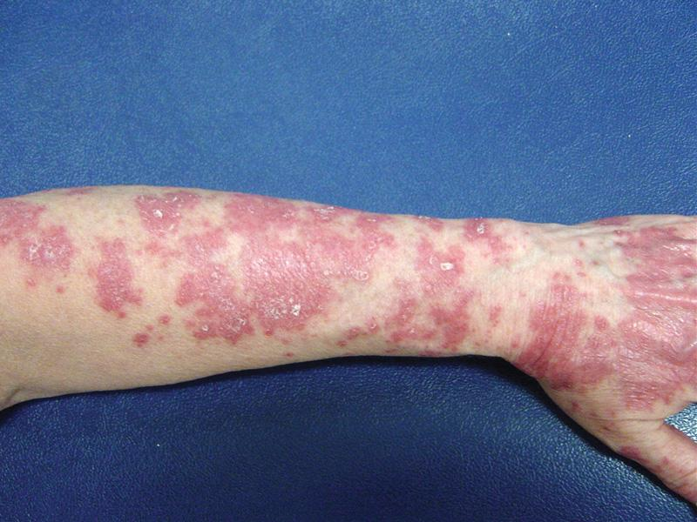
Papulosquamous SCLE over extensor aspect of forearm

Slide 23
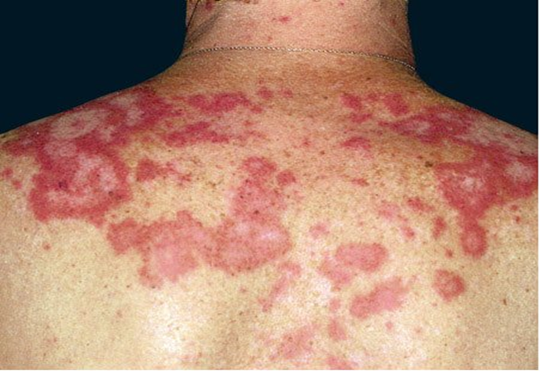
Central area of hypopigmentation without scarring
Annular SCLE leisons over upper back

Slide 24
CHRONIC CUTANEOUS LUPUS ERYTHEMATOSUS
the most common form of CCLE is classic DLE which can be
A. localized ( head and neck)
B. disseminated ( above and below neck)
sharply demarcated, discoid, erythematous plaques covered by a prominent, adherent scale that extends into the orifices of dilated hair follicles
keratotic spikes similar in appearance to carpet tacks can be seen to project from the undersurface of the scale (i.e., the “carpet tack” sign)
The risk of developing SLE
disseminated DLE is 22%
localized DLE is 1-2%

Slide 25
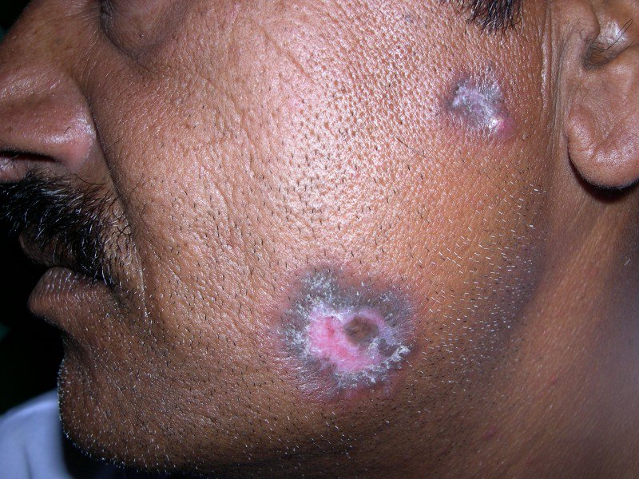
Sharply demarcated, round-to-ovoid slightly indurated, erythematous plaques on the face showing hyperkeratosis,dermal atrophy. Noninflamed areas of hypopigmentation and scarring mark the sites of prior lesions

Slide 26
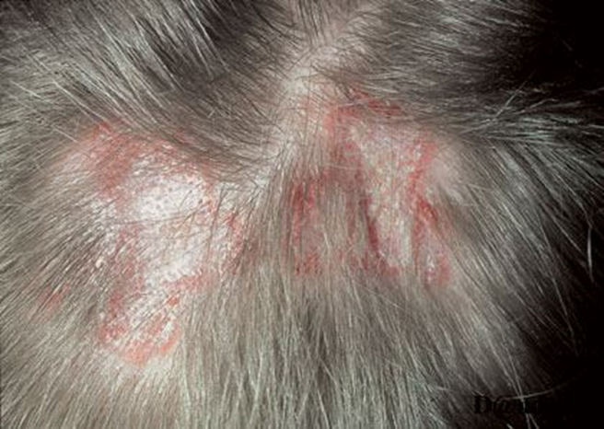
Confluent lesions on the scalp have resulted in scarring alopecia

Slide 27
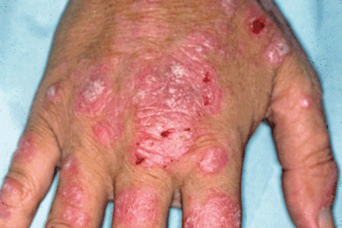
Eythematous plaques over dorsum of hand in disseminated DLE

Slide 28
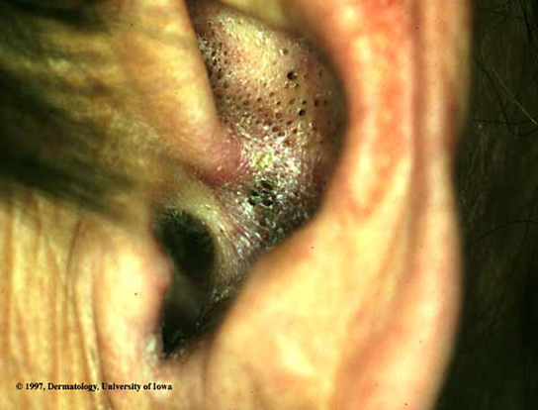
Plaque of DLE in ear showing follicular plugging and scarring

Slide 29
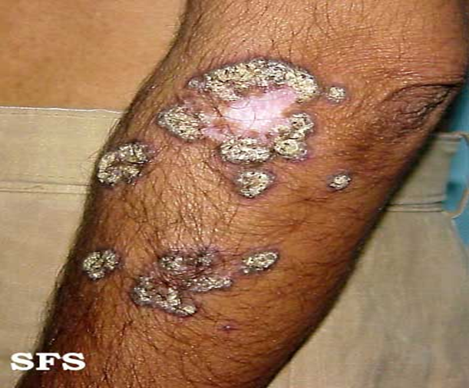
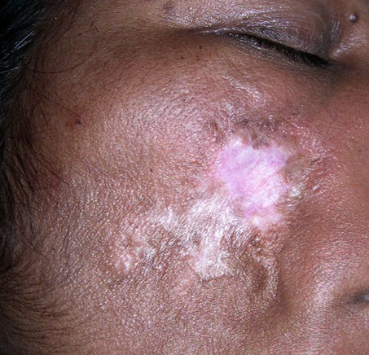
Lupus profundus showing atrophy and deep saucerized depressions
Hypertrophic/verrucous DLE

Slide 30
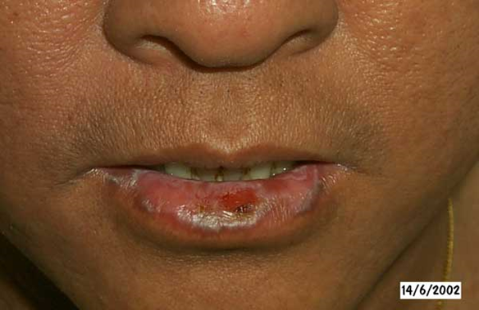
Plaque of DLE involving the mucosal surface of lower lip

Slide 31
Differential diagnosis
Actinic Lichen planus, lichen planopilaris
Jessner’s lymphocytic infiltrate
Polymorphous light eruption
Sarcoidosis
Lymphocytoma cutis
Granuloma faciale
Lupus vulgaris

Slide 32
HISTOPATHOLOGY
Hyperkeratosis with Follicular plugging
Apoptotic keratinocytes
Epidermal atrophy
Basement membrane thickening (greatest in discoid lupus erythematosus)
Hydropic degeneration of the basal layer is seen with upper dermal oedema
Lymphocytic interface dermatitis with basal layer liquifective degeneration
Perivascular and periadnexal lymphohistiocytic infiltrate
Dermal mucinosis

Slide 33
2 out of 3 essential for diagnosis:
Liquefactive degeneration of basal cell layer of epidermis
Degenerative changes in the connective tissue consisting of halinization, oedema and fibrinoid change, most marked immediately below the epidermis
Patchy dermal lymphocytic infiltrate with few plasma cells and histiocytes, around the appendages, which may be atrophic

Slide 34
EXTRACUTANEOUS MANIFESTATIONS
1. General : Fever, fatigue, malaise, weight loss , anorexia
Musculoskeletal: Symmetric small joint arthralgia, arthritis, (non deforming and deforming), morning stiffness, Myalgia/myositis, Tendinitis, Avascular (aseptic) bone necrosis.
Hematologic : Anemia (Normocytic, normochromic /Hemolytic)
Leukopenia ( <4000/µl )
Lymphopenia ( <1000/µl )
thrombocytopenia ( <1,00,000/µl )
lymphadenopathy
splenomegaly

Slide 35
Cardiopulmonary : Pleurisy, pleural effusions, aseptic pneumonitis, pulmonary,
hemorrhage . Pericarditis, tachycardia, cardiomegaly, congestive
heart failure, arrhythmias, conduction defects, coronary arteritis,
Libman-Sacks endocarditis
Renal: proteinuria ≥500mg/24 hr, cellular casts
nephrotic syndrome
end-stage renal disease
Neuropsychiatric: cognitive disorder, mood disorder, headache, seizures, mono-poly
neuropathy, stroke , TIA, acute confusional state, acute meningitis,
myelopathy
Gastrointestinal : nonspecific ( nausea, abd pain , diarrhea ), mesenteric vasculitis
Pancreatitis Peritonitis, ascites Hepatomegaly, chronic active hepatitis

Slide 36
8. Ocular : Conjunctivitis, episcleritis Blindness secondary to central retinal artery
occlusion, Keratoconjunctivitis sicca
9. Thrombosis : venous, arterial

Slide 37
Drug induced systemic lupus erythematosus
Drugs inducing SLE
Hydralazine (high risk) valproate
Minocycline infliximab
Isoniazid procainamide(high risk)
Penicillin chlorpromazine
Penicillamine terbinafine
Phenytoin
Mechanism :
Inhibits binding of complement c4 with subsequent lack of complement activity
DNA methylation inhibition

Slide 38
Difference between drug-induced SLE and spontaneous SLE
1. uncommon in black people,
older age group
renal and central nervous system involvement infrequent
antihistone antibodies are frequent
anti‐DNA antibodies are absent
serum complement is normal
Skin lesion is uncommon

Slide 39
SLE in pregnancy
higher risk of complicated pregnancies regardless of activity status.
Worsening of SLE is uncommon
Clinical remission or minimal lupus activity in the 6 months before conception lowers the chances of a significant flare
Active lupus nephritis poses the greatest risk
20% pre‐eclampsia, one‐third will have preterm delivery and one third will have a caesarian section
immune complex deposition on the trophoblast basement membrane or the transplacental passage of APAbs.

Slide 40
Neonatal lupus eyrthematosus
caused by the transplacental passage of maternal antibodies.
Affects offsprings of mothers positive for anti-Ro/SS-A with or without clinical evidence of lupus or sjogren syndrome
The most frequent clinical manifestations are cutaneous lesions and congenital heart block (CHB).
Incidence and prevalence : Congenital heart block -1–2% neonatal lupus -8–10% in
children born to mothers positive for the Ro antibody

Slide 41
Age : Neonates may present up to the age of 12–16 weeks postpartum.
Sex : The condition affects the sexes equally.
The presence of the Ro/SSA antibody is strongly associated with NLE, being present in 82–100% of infants and 92–100% of mothers
Cutaneous features : a. leisons may be present at birth or occur in the first few weeks of life.
b. The most common finding is an erythematous, slightly scaly eruption on the
face and periorbital skin (raccoon sign/owl eye) with the scalp,
trunk, extremities, neck and intertriginous areas involved in decreasing
frequency.
Cardiac features : a. Complete heart block is most common.
b. Associated features :-pericardial effusions, pleural effusions, ascites,
intrauterine growth retardation and hydrops fetalis
Thrombocytopenia, hepatomegaly and splenomegaly may also be present.

Slide 42
Differential diagnosis
skin rash may be confused with congenital infections or inherited disorders such as Bloom, Cockayne or Rothmund–Thompson syndromes
Complications
pneumonitis, haemochromatosis , aseptic meningitis , myelopathy , transient myasthenia gravis, spastic paraparesis and chondrodysplasia punctata
Investigations
skin biopsy is usually required to confirm the diagnosis; exclusion of infection, or the rare
inherited syndromes mentioned above
b. Antibody testing in both child and mother.
c. Cardiac investigation to assess cardiac status

Slide 43
Management
1. monitoring of at‐risk pregnancies.
Oral steroids or antimalarials(first 16 weeks of pregnancy) / Plasmaphoresis three times
weekly with systemic steroids during gestation given to the mother may influence both
cutaneous and cardiac pathology
2. Cutaneous lesions : Sun avoidance
low‐potency topical steroids
Antimalarials (for persistent skin disease.)
Persistent telangiectasia (tunable dye laser)
3. Cardiac problems : pacing for congenital heart block

Slide 44
ANTIBODIES IN SYSTEMIC LUPUS ERYTHEMATOSUS
ANTIBODY
PREVALANCE %
ANTIGEN RECOGNISED
CLINICAL UTILITY
Anti nuclear antibody 98 multiple nuclear best screening test repeated negative tests make SLE unlikely
Anti –ds DNA 70 DNA specific correlates with disease activity, nephritis, vasculitis
Anti-Sm 25 protein complexed to specific nuclear U1 RNA no clinical correlation
Anti-RNP 40 protein complexed to not specific U1 RNA more common in blacks than whites
Anti-Ro(SS-A) 30 protein complexed to not specific hY RNA associated with sicca syndrome predisposes to SCLE and to neonatal lupus with congenital heart block decreased risk for nephritis

Slide 45
Anti-La(SS-B) 10 protein complexed with decrease risk of nephritis hY RNA
Antihistone 70 histone protein more frequent in drug-induced lupus
Antiphospholipid 50 phospholipids, beta 1 predisposes to clotting, fetal loss, thrombocytopenia glycoprotein, prothrombin
Antierythrocyte 60 erythrocyte mb measured as direct comb test
Antiplatelet 30 antigens on platelets associated with thrombocytopenia
Antineuronal 60 neuronal and lymphocyte positive test in CSF correlates with CNS lupus surface antigens
Antiribosomal P 20 ribosomal proteins correlates with depression or psychosis

Slide 46
ANA pattern detected by fluorescent antibody techniques
ANA pattern | Predominant Ag | Diagnosis
Homogenous | ds DNA, Histone | SLE, drug induced SLE
Speckled | RNP | SLE, MCTD, SSc, Sjogren’s, DM(dermatomyositis)
Nucleolar | Nucleolar RNP/ components | SSc, DM-SSc overlap
Peripheral / membranous | ds DNA | SLE

Slide 47
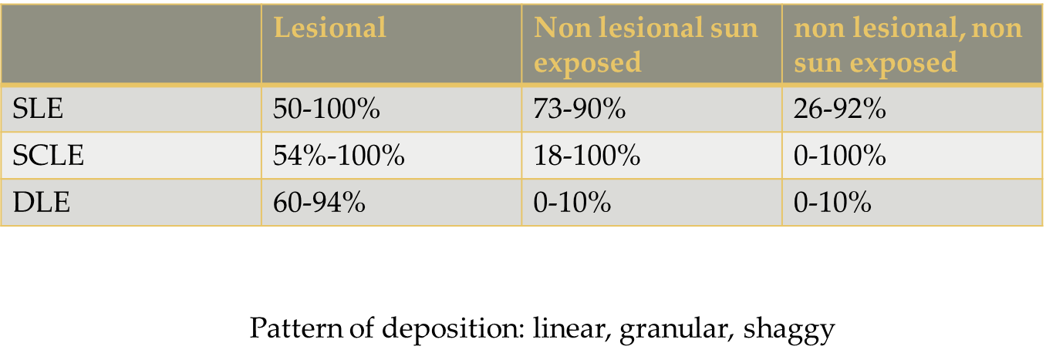
LUPUS BAND TEST
It’s a diagnostic procedure used to detect immunoglobulins and complement component deposits along the dermo-epidermal junction demonstrable as a linear band in lupus erythematosus

Slide 48
LE CELL PHENOMENON
Positive in 80% of patients
LE cells are polymorphonuclear leukocytes which have ingested nuclear material from the degenerative white cells in the presence of an antibody to deoxyribonucleoprotein (LE cell factor)
Highly suggestive of SLE
Also seen in chronic DLE, SSc, Rheumatoid arthritis, drug induced LE

Slide 49
Management
AIM : to induce remissions of acute flares and then maintain improvements with
strategies that suppress symptoms to an acceptable levels and prevent organ
damage

Slide 50
DIAGNOSTIC APPROACH
History
Physical examination
Complete blood counts
ESR, CRP
Hematocrit
Direct coomb’s test
KFT, Urine analysis
Antinuclear antibodies
Anti Sm Abs
Complement levels
Skin biopsy
Antiphospholipid antibodies
LE cell test

Slide 51
History and examination
to make the diagnosis of SLE , identify precipitating factor and rule out internal organ involvement.
Ask and examine for
malar rash chest pain/ shortness of breath
Photosensitivity rash hypertension
Discoid rash signs of nephritis
Fatigue lymphadenopathy/splenomegaly
Weight loss venous/arterial thrombosis
Fever abdominal pain, vomiting , diarrhoea
Oral/nasal ulcers CNS signs
Alopecia family history of SLE
Arthralgia/arthritis tobacco smoking
Raynauds phenomenon

Slide 52
Laboratory investigations
Complete blood count- anemia, leukopenia, thrombocytopenia
Urinanalysis- proteinuria >500mg/day, dip-stick 3+, casts
ESR, CRP- markers of inflammation
Antinuclear antibody- ( titers > 1:64 by fluorescent antibody techniques ) most important finding
Anti double stranded DNA antibody- specific
Anti-Sm antibody- specific
Anti Ro/ anti- La – associated with secondary sjogren, SCLE, neonatal lupus with CHB, increased tendency of photosensitivity
Anti phospholipid antibody- venous /arterial thrombosis, recurrent fetal loss
C3,c4 levels- hypocomplementemia
Thyroid studies
Lipid profile
Blood sugar
Coombs test
LDH , CPK
Urine spot protein/ spot creatinine ratio.
If any systemic involvement :- X-RAY, ECG, ECHO, CT scan , MRI scan

Slide 53
Treatment
1. General measures :
Protection from sunlight and artificial sources of UVR
Wear tightly woven clothing and broadbrimmed hats, and regularly
Use broad-spectrum, water-resistant sunscreens [SPF ≥30 )with an efficientUVA blocking agent.
Avoid the use of potentially photosensitizing drugs such as hydrochlorothiazide , tetracycline, griseofulvin, and piroxicam
2. Specific measures :
a. Local/topical therapy :LOCAL GLUCOCORTICOIDS
TOPICAL CALCINEURIN INHIBITORS
INTRALESIONAL GLUCOCORTICOIDS(2.5–10.0 mg/cc)

Slide 54
dosage : Class I steroid qd–bid for 2 weeks alternating with pimecrolimus 1% or
tacrolimus 0.1% bid for 2 weeks
class I steroid- superpotent steroid, clobetasol propionate 0.05% or
betamethasone dipropionate 0.05%
alternating regime is to minimize steroid induced skin atrophy and
telengiectasias
b. Systemic therapy:
1. ANTIMALARIALS-
Hydroxychloroquine 6.5 mg/kg/day ideal body weight
Chloroquine 3.0–3.5 mg/kg/day ideal body weight
Quinacrine (if monotherapy fails, add100 mg daily (available at compounding pharmacies)quinacrine to either hydroxychloroquine or chloroquine)

Slide 55
Side effects: retinal toxicity, headache, G.I disturbances, hematological toxicity, pruritus, lichenoid drug eruption, mucosal or cutaneous pigmentary deposition.
baseline tests : complete ophthalmological examination, complete blood count, liver
function test, kidney function test.
2. Corticosteroid:
a. Resistant cases
b. Life threatening or organ threatening symptoms (e.g. renal, systemic vasculitis or neurological involvement)
Low‐dose oral prednisolone (0.1–0.2 mg/kg) may be useful in patients with mild SLE and musculoskeletal manifestations resistant to other therapies
High doses of oral prednisolone (1–1.5 mg/kg) or IV methylprednisolone 1 g daily for 3 days (pulse therapy) may be useful for severe disease with major organ involvement

Slide 56
3. Thalidomide 50 –200 mg/day; , as adjunctive therapy for refractory CLE
4. Azathioprine 1.5–2.5 mg/kg/day PO
5. Mycophenolate mofetil 2.5–3.5 g/day PO
6. Methotrexate 7.5–25 mg PO /wk
7. Dapsone 50–200 mg/day effective for urticarial vasculitis & bullous LE .
8. Accutane 0.5–2 mg/kg/day
9. Acitretin 10–50 mg/day
10.Gold Work up to 50 mg weekly, taper after 1 g

Slide 57
11.biologicals :
belimumab (a B‐lymphocyte stimulator inhibitor)
Efalizumab (Raptiva)
Leflunomide (Arava)
Antitumor necrosis factor agents
Rituximab(monoclonal antibody to CD20) (Rituxan)
Abatacept T‐cell inhibitor ( fusion protein of the T‐lymphocyte‐associated antigen 4 and modified Fc portion of human immunoglobulin )
Epratuzumab
Anti-interferon-α agents
Tocilizumab(an IL‐6 receptor inhibitor)

Slide 58
Treatment of lupus nephritis
Remission with IV cyclophosphamide & glucocorticoids and maintainance of remission with azathioprine.
Treatment of non-nephritis SLE
Above regimes with methotrexate, calcineurin inhibitors such as cyclosporine, IV immunoglobulins & plasmapheresis.
Anticoagulantion is advised for thrombotic cases.

Slide 59
THANKS

