Slide 1
TINEA CAPITIS

Slide 2
Introduction
Dermatophytosis is a superficial fungal infection of the keratinized tissue. The infection is commonly designated as tinea.
Three genera:
Microsporum, Trichophyton, and Epidermophyton of Deuteromyceta or fungi imperfecti.
According to site of infection:
Tinea Capitis, T. Barbae, T. Corporis, T. Cruris, T. Pedis, T. Manuum, T. Unguium, T. Faciei, and T. Incognito

Slide 3
Tinea Capitis
Infection of the scalp and hair with a dermatophyte.
Prepubertal children over the age of 6 months.
Boys : Girls = 5 : 1
Predisposing factors:
  Trauma
  Overcrowded areas
  Low socioeconomic and hygienic status
  Malnutrition
Communicability:
Close personal contact, shared brushes, combs, bed linen.

Slide 4
Classification
Tinea capitis
Based on inflammation
Inflammatory
Non-Inflammatory
Based on spores
Ectothrix
Endothrix
Kerion
Favus
Grey Patch
Black Dot

Slide 5
Pathogenesis
The fungus proliferates initially on the surface of the scalp and then grows down the sides of the follicles to the portion of the hair at which keratinization is just beginning to take place.
At that place, the hair is invaded by the fungus filaments, which grow upward with the hair.

Slide 6
Hair is susceptible to infection with ectothrix dermatophytes during the mid-to-late anagen phase. The infection usually begins in the perifollicular stratum corneum.
Hyphae grow only upto the keratogenous zone, they never enter the nucleated zone.
The terminal tuft of hyphae is termed Adamson’s fringe.
With endothrix infections, the arthrospores are formed rapidly and with time, replace much of the intrapilary keratin while leaving the cortex intact.
Endothrix infection is often termed “black dot ringworm.”

Slide 7
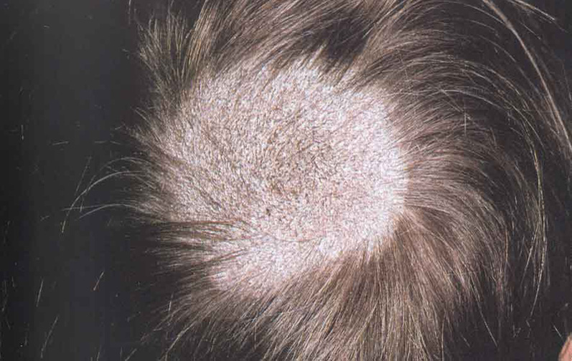
Gray Patch
Presents as patches of partial hair loss, often circular in shape and show numerous broken-off hair that are dull gray and lustreless in appearance due to the overcoating by arthrospores.
Epidemics in
schools
Microsporum
audouinii

Slide 8
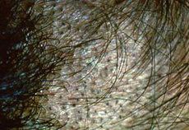
Black Dot
The hair shaft is extremely brittle and breaks at the level of the scalp. The remnant of the hair left behind in the infected follicle appears as a black dot on clinical examination.
Diffuse scaling with minimal
hair loss or inflammation.
Endothrix organisms like
T. tonsurans, T. violaceum,
T. soudanense.

Slide 9
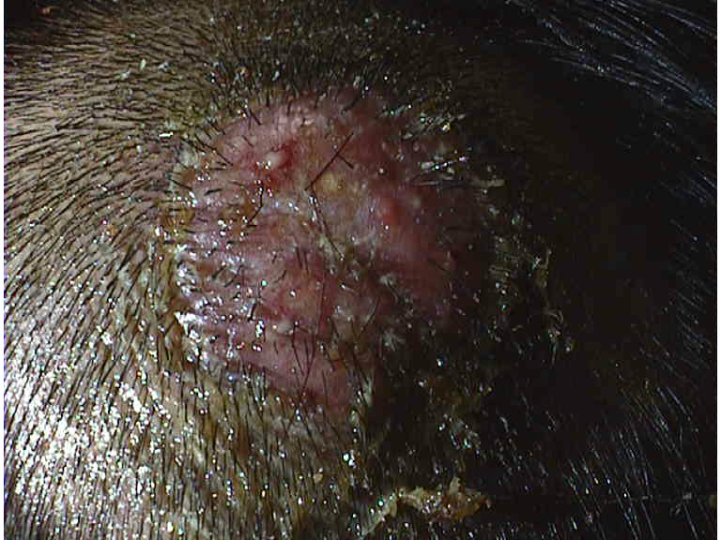
Kerion
Inflamed boggy and indurated tender swelling at is studded with broken or unbroken hair, vesicles and pustules.
Sinus formation and thick crusting with matting of adjacent hair.
Lymphadenopathy and
secondary bacterial
infection.
T. verrucosum,
T. mentagrophytes

Slide 10
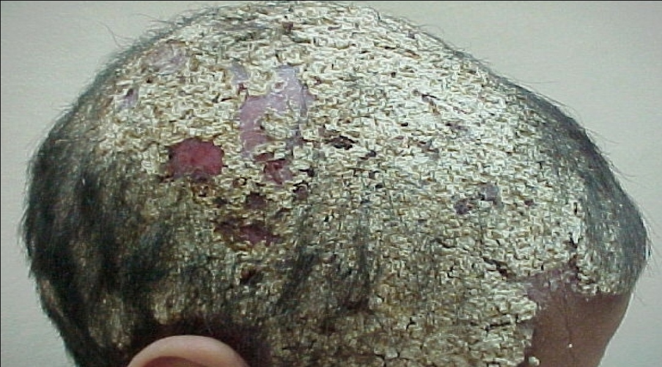
Favus
Yellow cup-shaped crust known as scutulum due to its shape like a shield.
Dense mat of mycelia and epithelial debris
The concavity of the cup faces upwards and is pierced by a hair, around the orifice of which the cup has developed.
Characteristic
mousy odour
T. schoenleinii,
T. violaceum,
M. gypseum

Slide 11
Differential Diagnosis
Alopecia areata
Trichotillomania
Secondary syphilis
Pseudopelade of Brocq
Seborrheic dermatitis
Psoriasis
Atopic dermatitis
Primary pyodermas
Pyodermas secondary to pediculosis or folliculitis decalvans
Lichen planopilaris
Discoid lupus erythematosus

Slide 12
Diagnosis
Clinical
Direct light microscopic examination
Wood’s lamp examination
  Bright green fluorescence in ectothrix caused by M. canis, M. audouinii, M. ferrugineum.
  Dull green fluorescence in favus caused by T. schoenleinii
  Negative in all others

Slide 13
Treatment
Mainstay is oral antifungals
Topical therapy as an adjunct
Griseofulvin 15-25 mg/kg per day
(6 to 8 weeks)
Fluconazole 3-6 mg/kg per day
(6 weeks)
Terbinafine pulse therapy 250 mg per day for >40 kg
Itraconazole pulse treatment 5 mg/ kg per day for 7 days

Slide 14
Adjuvant therapy
Oral antibiotics
Oral corticosteroids
Removal of matted crusts followed by routine, frequent shampooing
Examination of close contacts of patients
Antifungal shampoo containing ketoconazole or selenium sulfide
Counselling of children regarding not to share caps, combs, toys etc.

Slide 15
THANK YOU

