Slide 1
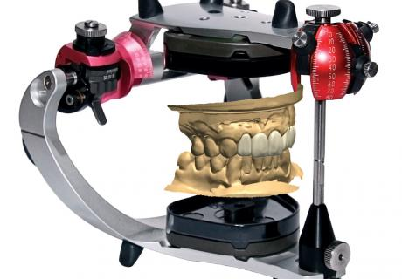
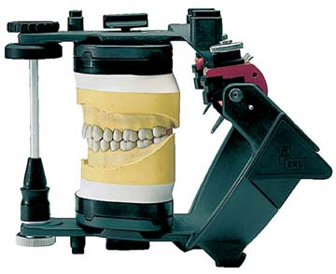

Virtual articulators & Concept of Digital Occlusion
Dr. Sameer Chauhan
Senior Lecturer,
Department of Prosthodontics and Crown & Bridge
K. M. Shah Dental College and Hospital

Slide 2
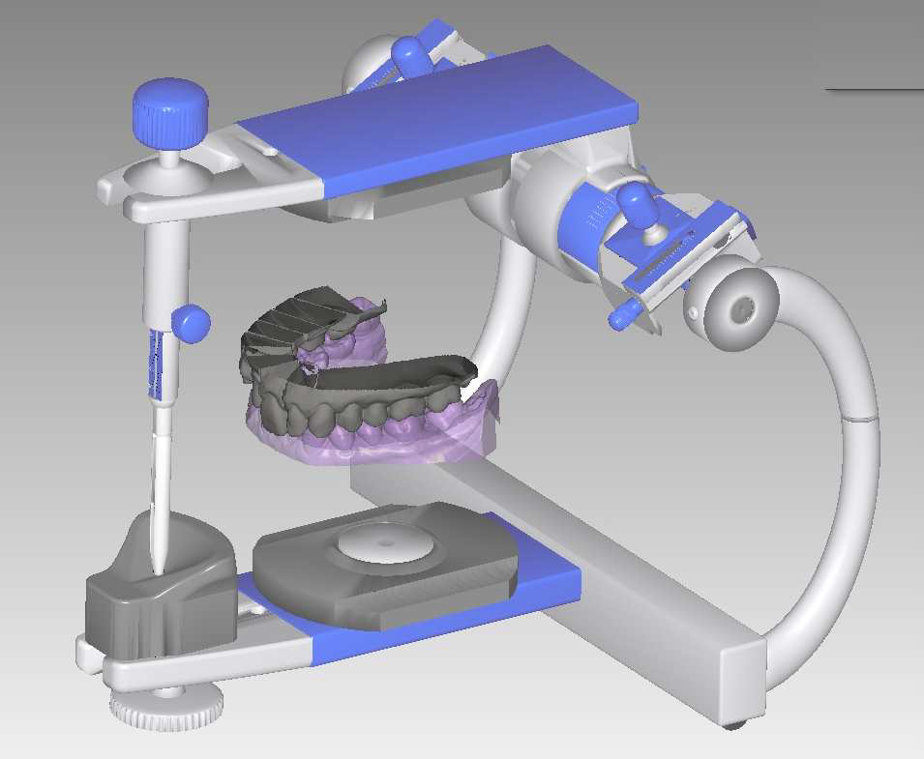
Contents
Introduction
Limitations of CAD/CAM
Need of Virtual articulators
Types of virtual articulators
Step by step procedure
Summary
Conclusion
References

Slide 3
Introduction
Dental CAD/CAM systems constitute a new way to produce dental prostheses. The dentists who already offer the most advanced technologies at their dental laboratories are starting to call “dentistry of single visit”. In a few minutes, the dentist is able to obtain the necessary electronic impression with a scanner and then, it will take about 20 minutes to have the tooth designed and an hour to fabricate prosthesis from a ceramic block.
Advantages of CAD/CAM technology:
Accuracy of final restoration.
Immediate 3D images remove the need for taking time-consuming impressions of teeth
Computer sculpting creates a much healthier restoration for the tooth in a matter of minutes
Short sculpting time allows the dentist to place your dental restoration during the same visit, instead of requiring two visits
CAD/CAM restorations are better-fitting, more durable and more natural looking than previously made restorations.

Slide 4
Limitations……..
However, considering the limited accuracy of the occlusal surface, this type of restoration can only match the possibilities offered by simple occludators. (Static design).
A survey done by Durban et al in 2007 showed 80% of the CAD/CAM restorations fabricated by static occlusion systems in USA which requires modifications before cementation.
The system can not take into consideration functional movements, so the occlusal surface of the new tooth has to be manually trimmed to these movements in the mouth or in an articulator.
Even a really high-tech-system such as the Cerec3, the latest CAD/CAM development, presents only maximum intercuspation position to fabricate a prosthesis.

Slide 5
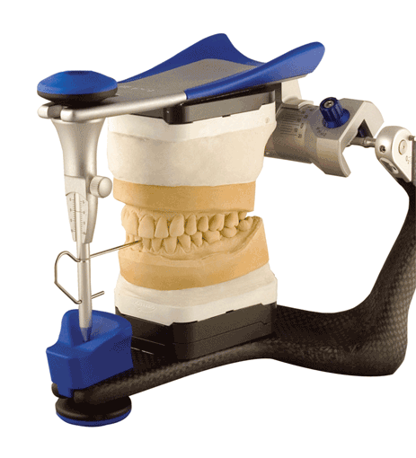

Virtual articulators…..
More accurate fabrication of occlusal surface
Reduce chair side time
Reduce chances of errors during jaw movements
Reduce patient’s discomfort

Slide 6
The Virtual Articulators are able to design prostheses kinematically. They are capable of:
simulating human mandibular movements,
moving digitalized occlusal surfaces against eachother according to these movements, and
correcting digitalized occlusal surfaces to enable smooth and collision-free movements.

Slide 7
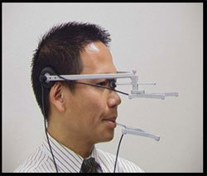
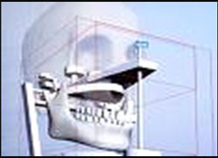
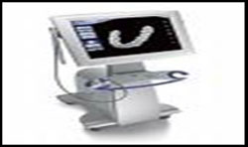
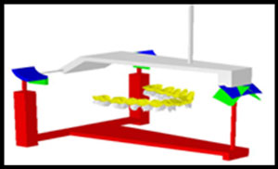
Types of virtual articulators
COMPLETELY ADJUSTABLE
KORDASS AND GAERTNER
MATHEMATICALLY SIMULATED
SZENTPETERY’S DESIGN
Records exact movement path of the mandible
Records exact movement path of the mandible

Slide 8
Kordass and Gaertner Concept
Greifswald University in Germany
It was first developed in 2002 by Kordass and later modified by Gaertner.
Completely adjustable.
It was designed to record the exact movement paths of the mandible with an electronic jaw movement registration system called Jaw Motion Analyser and move digitized dental arches along these movement paths on the computer.
Able to calculate and visualize static and kinematic occlusal collisions.
However, the electronic jaw recording system required by this virtual articulator is very sophisticated and expensive.

Slide 9
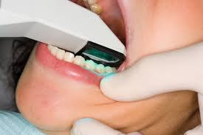
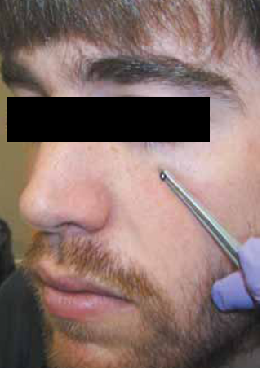
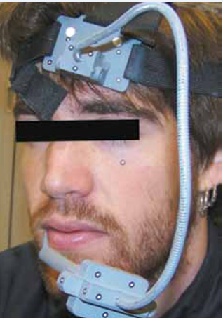
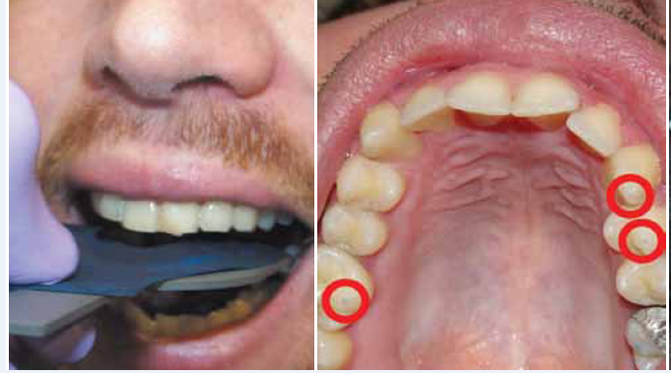
T
E
C
H
N
I
Q
U
E
1
Scan the dental arch for a digital impression
2
Mark points 1 & 2– TMJ points
3—Infraorbital point
4
Mark points 4,5,6-most prominent cusps on maxillary occlusal surface using bitefork with a sensor
3
3-D spatial relation obtained with optical scanner

Slide 10
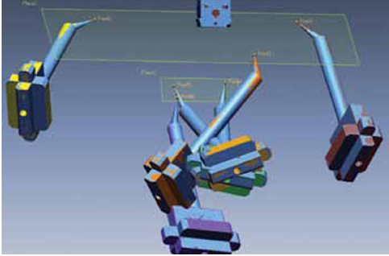
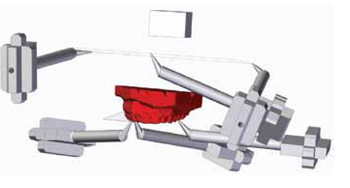
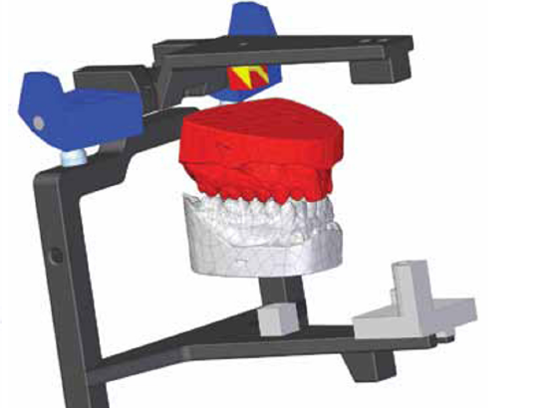
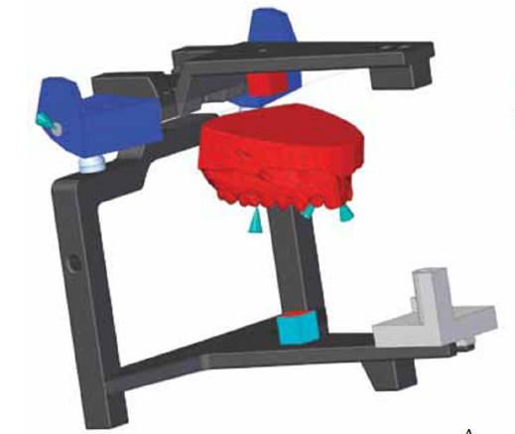
5
6
Align and blend different surfaces of
the scanned maxillary cast into a
single virtual model
Scan and transfer these points into the same co ordinate system
7
Transfer the cast to the virtual
articulator software & the cranial &
occlusal co ordinates should coincide
with the virtual articulator system
8
Scan and position the mandibular
cast towards maxillary cast in the
virtual articulator in centric occlusion

Slide 11
SZENTPETERY’S DESIGN
MartinLuther University
Mathematically stimulated design.
Developed in 1999 by Szenpetery.
It is based on a mathematical simulation of the articulator movements. It is a fully adjustable 3D virtual dental articulator capable of reproducing the movement of an articulator.
It offers possibilities that are not offered by some of the mechanical articulators as curved Bennet angle movements which make it more versatile than mechanical articulator.

Slide 12
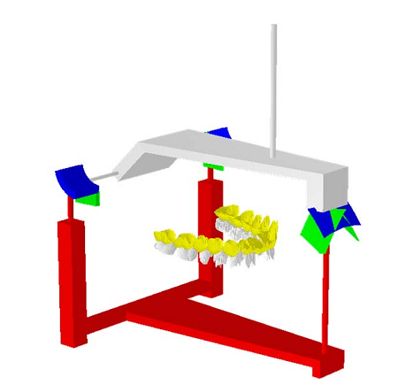
Limitation:
  Since it is a mathematical approach, it behaves as an average value articulator and so not possible to obtain easily the individualized movement paths of each patient.
  It is not based on the actual orientation of jaws.

Slide 13
Virtual articulator based on mechanical dental articulator
It was introduced by graphic design and engineering project developments, the University of the Basque in 2009.
It is more simple approach than the virtual articulator developed by Kordass and Gaertner and at the same time more accurate result can be obtained than the Szentpetery’s virtual articulator.
Various mechanical articulators have been made virtually to simulate the same condition present in the articulator.
Whip Mix Company have produced Hanau H2 model and Wide vue model. However Wide-vue model has been taken back by the company due to technical errors.
Other articulator include Ivoclar Stratos 200, Whipmix Denar, Artex

Slide 14
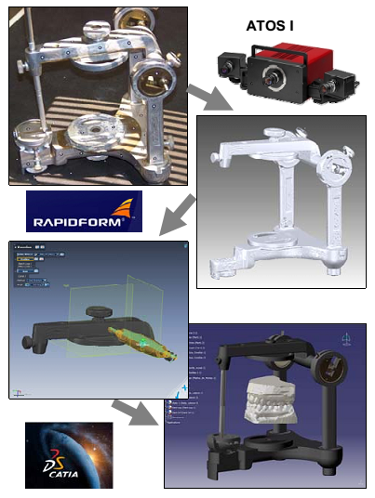
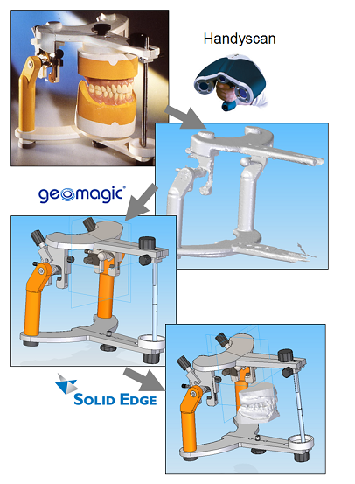

Slide 15
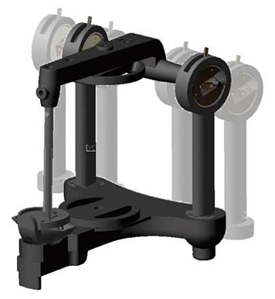
Hanau H2 Model
It uses the Rapidform software to operate the virtual articulaotr.
The parts of the articulator and positioning of the casts are scanned by ATOS I type of scanner.
The process is similar as mechanical articulator.
Necessary steps:
  Accurate upper and lower jaw models
  Facebow transfer from the patient’s mouth
  Maximum intercuspation bite records and protrusive records.

Slide 16
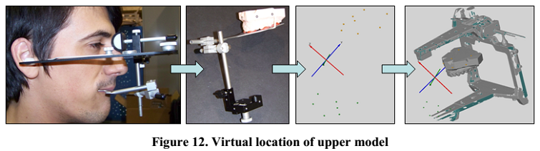
Real case in virtual environment
The clinical procedure is similar as manual method.
First, models are scanned accurately by laboratory based digital or laser scanner.
Then, a physical face bow is used to locate the occlusal plane. The location is taken from the patient, and the reference points of the transferring table and the upper model are scanned. This scanning allows location the upper model on the articulator

Slide 17
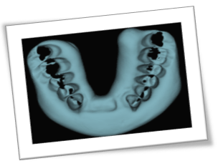
To locate the lower model with respect to the already located upper model, the bite of maximum intercuspidation is scanned. The scanned bite is placed in the position with the scanned upper jaw.
With the help of RE software, accurate placement of lower jaw is done.
Afterwards, the paremetres of the articulator are adjusted with the help of the lateral and protrusive bites. This involves generating reference elements in new positions.

Slide 18
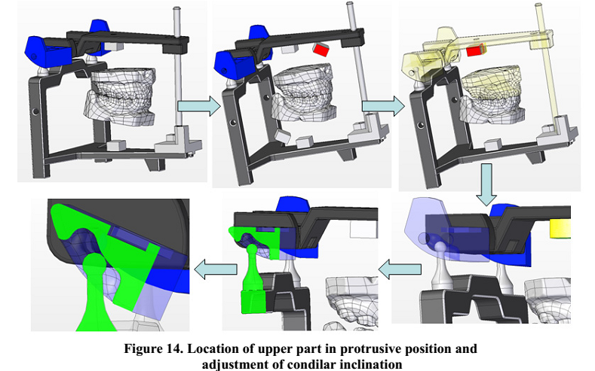

Slide 19
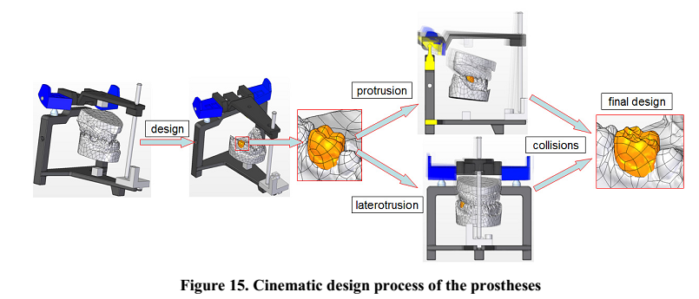
Simulating Kinematics: After the articulator was modeled, the simulation was run and any possible interference on the designed prosthesis were checked out and if they are present corrected accordingly.

Slide 20
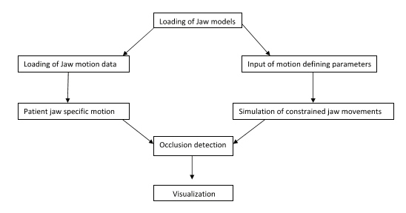

Slide 21
ADVANTAGES:
Make real life more virtual.
Possible to do all the movements.
Less time consuming reduces mechanical error, material, Control of several parameters.
DISADVANTAGES:
Much expensive
Special type of programmed equipment's
Knowledge of software

Slide 22
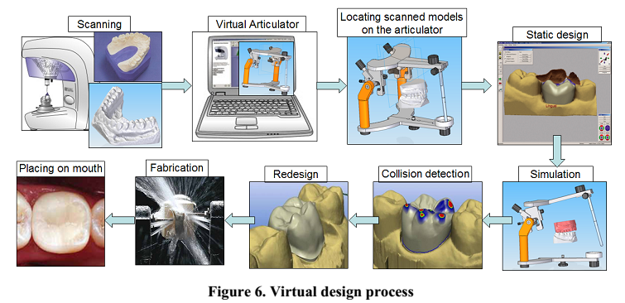
Summary

Slide 23
Conclusion
Virtual reality enables new perspective in visualizing complex relationship in the diagnosis of the occlusion and function. It provides interesting modules for presenting and analyzing the dynamic contact of the occlusal surface of the maxilla and mandible and the relation to the condylar movement. To improve the functional occlusion, the occlusal profile of the teeth can be designed with increased or decreased cusps to eliminate occlusal interferences of the dynamic pattern.
The CAD-CAM manufacture dental restoration. The concept of Virtual Articulator will change conventional ways of production and communication in dentistry and begin to replace the mechanical tools.

Slide 24
REFERENCES
Bisler A, Bockholt U, Kordass B, Suchan M, Voss G. The virtual articulator. International Journal of Computerized Dentistry2002;5:101 -6.
Solaberrieta E, Etxaniz O, Minguez R, Muniozguren J, Arias A, editors. Design of a
Virtual Articulator for the Simulation and Analysis of Mandibular Movements in Dental CAD/CAM.
2009: Cranfield University Press.
Solaberrieta E, Arias A, Barrenetxea L, Etxaniz O,Minguez R, Muniozguren J. A virtual dental prostheses design method using a virtual articulator. Proceedings of the 11 th International Design Conference 2010:443-52.
Virtual Articulators in prosthodontics Gugwad.R.S, Basavakumar.M, Abhijeet.K, Arvind.M, Sudhindra.M, Ramesh.C :International Journal Of Dental Clinics 2011:3(4):39-41.
Virtual articulator for the analysis of dental occlusion: An update : Laura Maestre-Ferrín 1, Javier Romero-Millán Med Oral Patol Oral Cir Bucal. 2012 Jan 1;17 (1):e160-3.
Edinger D, Rall K, von Schroeter PH, et al. Computer-aided single tooth restoration. In: Lemke MW, Inamura K, Jaffe C, et al, editors. Computer assisted radiology. New York: Springer; 1995. p. 994–6.

