Slide 1
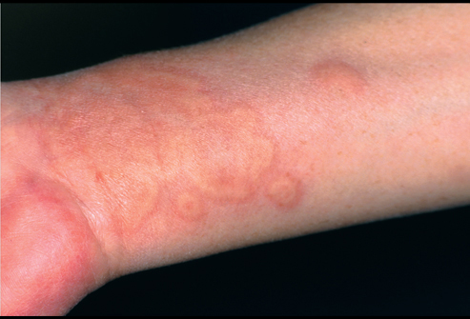
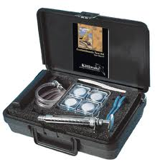
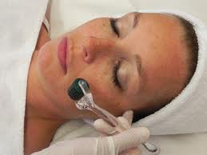
Chronic Urticaria : Advanced management
Chronic Eczema: Patch testing
Dermarollers: For acne scars
Chemical peeling: To give glow on your face

Slide 2
Urticaria (Hives)
Is a kind of skin rash notable for pale red, raised, itchy bumps.
Can cause a burning or stinging sensation.
Frequently caused by allergic reactions
Most cases last less than six weeks (acute urticaria)
Chronic urticaria (lasting longer than six weeks)

Slide 3
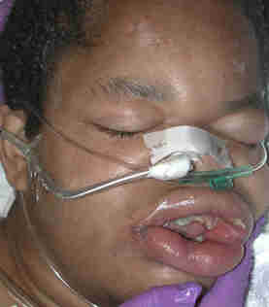
Angioedema (Swelling)
Edema of the deep layers of the dermis and subcutaneous tissue.
Non-pitting edema
Skin is not hot
Non-dependent areas
It is not: “pre-tibial pitting edema

Slide 4
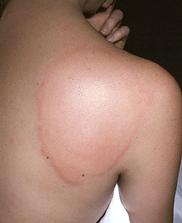
It is a Common problem
  Affects up to 20% of the population
Characteristics:
Pruritic (itchy)
Blanche with pressure
Fleeting (“Leaves no trace”)
  -No scarring

Slide 5
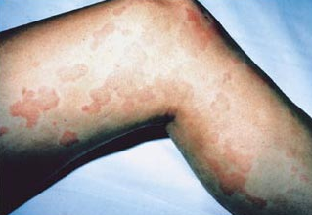
Acute Urticaria
Definition: Hives lasting less than 6 weeks
Common triggers:
  Foods
  *Shellfish, peanut, wheat, egg,
  fresh fruits, milk
  Infections
  More common in children
  Animal dander
  Pollens
  Drugs
  Aspirin, NSAIDS, antibiotics
  Occupational
  Stinging Insects

Slide 6
Chronic Urticaria & Angioedema
Definition: Hives occurring greater than 6 weeks
  Hives and Angioedema (40%)
  Hives alone (40%)
  Angioedema alone (20%)
Etiology:
Difficult to determine, cause rarely found
Common in 3rd and 4th decade of life
Usually not foods, drugs, pollens, infections, “dyes”
May last years

Slide 7
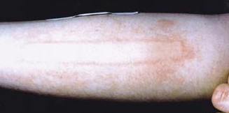
Dermatographism
A Physical Urticaria
Scratching skin results in hives lasting 30 mins to 2 hour

Slide 8
Physical Urticarias
Reproducible by environmental factors
  Physical stimuli
Most frequently in young adults
Episodic and often limited to areas of inciting stimulus
Usually, unresponsive to corticosteroids
Overall, treatment with non-sedating antihistamines

Slide 9
Examples of Physical Urticarias
Dermatographism
Cold-induced urticaria
Cholinergic urticaria or localized heat urticaria
Delayed pressure-induced urticaria & angioedema
Vibratory-induced urticaria

Slide 10
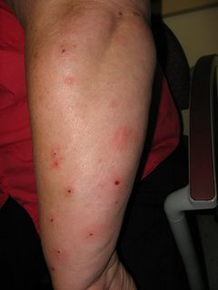
Papular urticaria
A hypersensitivity reaction to the bites of mosquitoes, fleas, bedbugs, and other insects causes papular urticaria

Slide 11
Chronic Urticaria Diagnostic Evaluation
History & Physical Exam
  Diary
  Relationship of hives with menstrual cycle?
Provocative tests for physical causes
Laboratory tests:
(Not proven to be cost effective)
  CBC with diff, ESR, CRP, UA, LFTs
  Thyroid function, anti-thyroid antibodies
  Skin tests
  Complements

Slide 12
Skin biopsy?
  Generally, not helpful
Indications:
  Lesions lasting more than 24 to 48 hours
  Atypical?
  Scarring
  Red blood cell extravasation
  Cutaneous vasculitis
  Urticaria pigmentosa

Slide 13
Chronic Autoimmune Urticaria
Recently described subset of chronic urticaria.
Severe and continuous whealing associated with malaise, indigestion and sensation of hot and cold.
P/H or F/H of other autoimmune diseases or urticaria
It is associated with antithyroid antibodies in 27% of patients
or
with other autoimmune conditions such as vitiligo, rheumatoid arthritis, pernicious anemia and insulin-dependent diabetes mellitus.

Slide 14
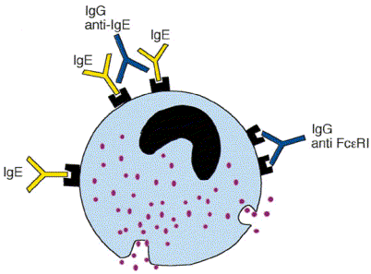
Chronic Autoimmune Urticaria
Functional antibody (IgG)
to the alpha subunit of the
high affinity IgE receptor (30%)
Functional anti-IgE antibody (5-10%)
Diagnosis
  Autologous serum skin testing (ASST)

Slide 15
  Autologus serum skin testing (ASST)
2 ml of venous blood - in a sterile glass tube and allowed to clot for 30 min.
The serum is then separated by centrifugation at 500× g for 15 min and used immediately for ASST.
Histamine diphosphate 10 µg/ml for positive control and sterile saline (0.9%) for negative control are used

Slide 16
0.05 ml each
autologous serum
histamine diphosphate
sterile physiological saline
is injected separately intradermally over volar aspect of the left forearm.

Slide 17
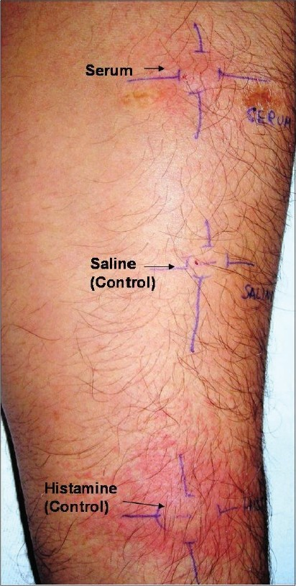
Most Proxymally
Gap of 5 cm
Most distally

Slide 18
After 30 min (15 min for histamine), the wheal formed at each injection site is measured at two perpendicular diameters (d ₁ and d ₂ ) and the average of the two is calculated.

Slide 19
Wheal area can also be calculated according to the formula ð [(d₁ +d ₂ ) ² /4].
The surrounding flare is often ignored but the redness response is measured as ' redness score.
Positive ASST is the one with serum-induced wheal which has both redness score = 2 and a diameter (average of d ₁ and d ₂ ) of ≥1.5 mm as compared to the saline-induced wheal at 30 min

Slide 20
Management of Chronic Urticaria/Angioedema
Avoidance or treatment of underlying cause
Avoidance of potentiating factors
  Alcohol
  Non-steroidal anti-inflammatory drugs
Main therapy
  H1 anti-histamines
    Non-sedating, long-acting antihistamines
Combination of therapies
  Triple drug therapy: H1 & H2 antagonists plus leukotriene blockers
  Tricyclic antidepressants

Slide 21
IMMUNOTHERAPY
During active disease 60% of patients with chronic ''idiopathic'' urticaria (CIU) have circulating histamine releasing-activity (HRA).
HRA is due to IgG autoanti-bodies directed against the high-affinity IgE receptor, Fc&unknown;R1 (23% of patients) or against IgE (5.5%).
A further subset of patients has a mast cell-specific HRA

Slide 22
  Immunomodulators (e.g. steroids, cyclosporine)
    Tried with “?”
    benefit:
    Hydroxychloroquine,
    dapsone
    calcium channel blockers
    methotrexate
    Colchicine
    Pentoxyfilline
    Cyclophosphamide
    Relative and Absolute Contraindications to Immunotherapy
Pregnancy*
Autoimmune disease
Unstable coronary artery disease
Use of beta-adrenergic blocking agents
Unstable asthma
FEV₁ or peak flow below 70% of predicted value
Age under 5 years

Slide 23
Application of PATCH TESTING in Chronic Eczema (Treatment resistant Eczema)
A patch test is a method used to determine if a specific substance causes allergic inflammation of the skin.
Any individual with eczema suspected of having allergic contact dermatitis and/or atopic dermatitis needs patch testing.

Slide 24
Patch testing helps identify which substances may be causing a reaction in a patient.
It is intended to produce a local allergic reaction on a small area of back where the diluted chemicals are planted.
The chemicals included in the patch test kit are the offenders in approximately 85-90 percent of contact allergic eczema.
They include chemicals present in metals (e.g. nickel), rubber, leather, hair dyes, formaldehyde, lanolin, fragrance, preservative and other additives.

Slide 25
The most frequent allergen recorded in many research studies all around the world is NICKEL.
Nickel allergy is more prevalent in young women and it is especially associated with ear Piercing or any nickel-containing watch, belt, zipper or jewelry.

Slide 26
Interpretation
(usually 48 and 72/96 hour readings).
The result for each test site is recorded.
One system used is as follows:
Negative (-)
Irritant reaction (IR)
Equivocal / uncertain (+/-)
Weak positive (+)
Strong positive (++)

Slide 27
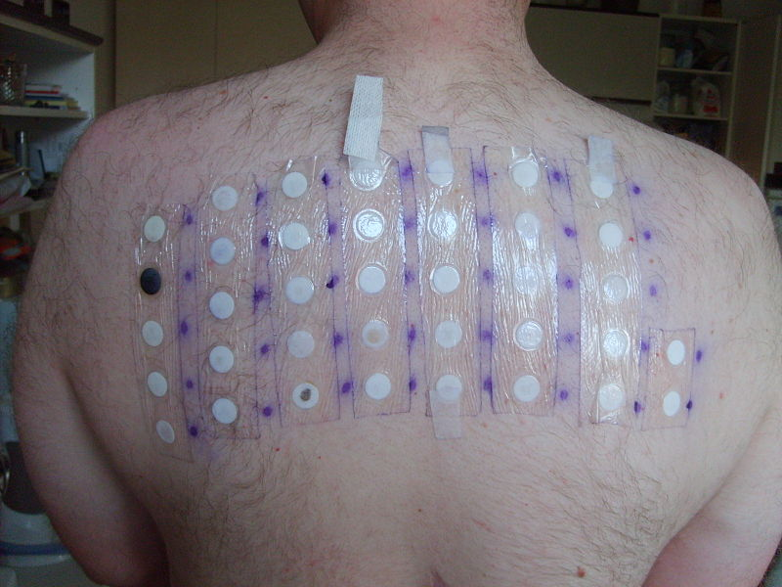
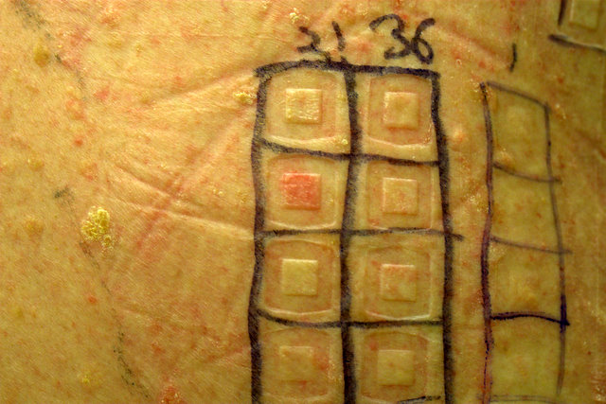
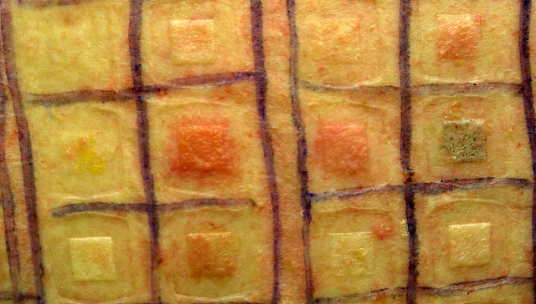
Weakly positive:
Strongly positive:

Slide 28
A positive patch test(s), might not explain the present skin problem since the test only indicates that the individual became allergic during the encounters with that chemical(s) at some point in their life.
Relevance, therefore, has to be established by determining the casual relationship between the positive test(s) and the eczema
There is often an assumption that certain foods can cause or worsen skin complaints like eczema.
However, there is very little evidence that cutting out foods such as milk and eggs actually improves eczema.

Slide 29
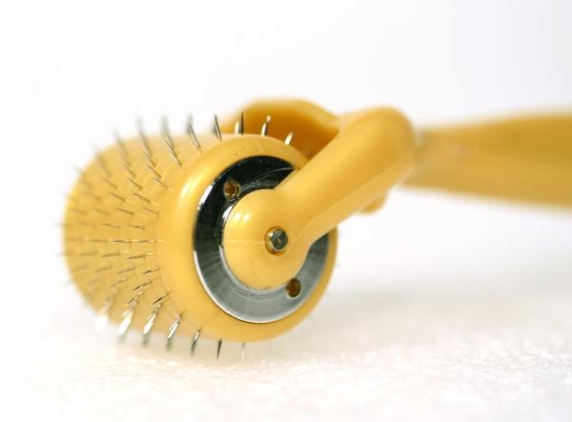
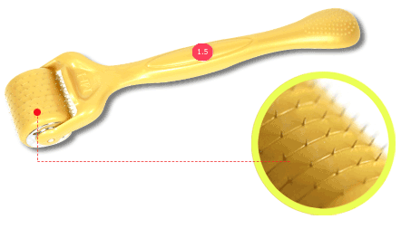
Dermaroller
Derma rollers are used for a treatment process called micro needling or skin needling.
It is a form of collagen induction therapy.
Unlike other treatments for acne scars, stretch marks and wrinkles, derma rollers do not damage the skin or remove the epidermis layer.

Slide 30
Applications:
Wrinkles
Anti ageing
Acne scars
Pitted scars
Stretch marks
Hair loss
Thinning of hair

Slide 31
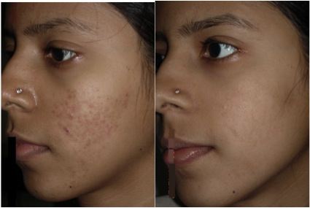
Acne scars
BEFORE
AFTER

Slide 32
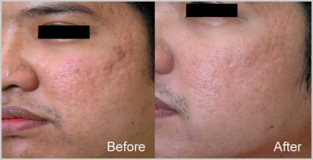
Acne scars

Slide 33
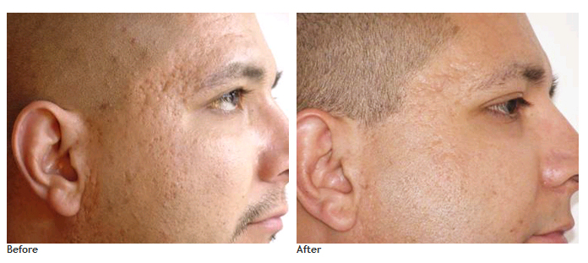
Acne scars

Slide 34


