Slide 1

STABILITY
IN
COMPLETE DENTURES
Dr Piyush Javiya
Reader, Dept. of Prosthodontics, Crown & Bridge,
KMSDCH, SVDU

Slide 2
Lesson Plan
Target: II BDS students
Duration: 45 Minutes
Topic: Stability in Complete dentures
Content | Duration in Minutes
Introduction | 05
Definitions | 05
Factors affecting Stability | 20
Summary and Conclusion | 05
Discussion | 05
CCES | 05

Slide 3
CONTENTS
Introduction
Definition
Factors affecting Stability
  Relationship of denture base to underlying tissues
  Relationship of external surface and periphery to surrounding orofacial musculature
  Relationship of opposing occlusal surfaces
Summary and Conclusion
References

Slide 4
INTRODUCTION

Slide 5
Biological Factors
Physical Factors
Mechanical Factors
Retention
Stability
Support
Psychological Comfort
Physiological Comfort
Longevity
Success of Prosthesis

Slide 6
Stability is defined as “The quality of a prosthesis to be firm, steady or constant, to resist displacement by functional, horizontal or rotational stresses.” (GPT)
It is usually the distinguishing factor between success and failure.

Slide 7
FACTORS AFFECTING STABILITY
Relationship of the denture base to the underlying tissues.
Relationship of the external surface and denture border to the surrounding oro-facial musculature.
Relationship of the opposing occlusal surfaces.

Slide 8
Relationship of the Denture Base to Tissues
Accuracy of the impression procedures.
Adequate extension of the denture border as limited by the movable tissues……
Nature of the overlying soft tissues…..
Ridge surface right angle to the occlusal plane.
Types of underlying tissue…..

Slide 9
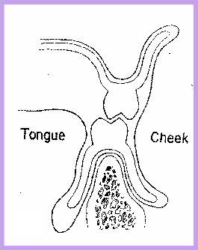
Mandibular Lingual Flange
At 90° to the occlusal plane.
Effectively resists horizontal forces.

Slide 10
MYLOHYOID MUSCLE

Slide 11
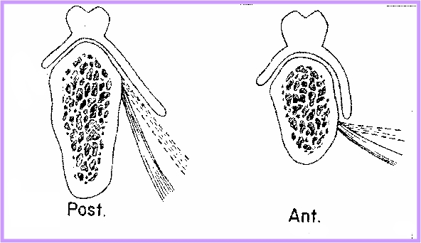

Slide 12
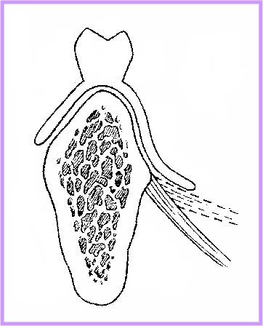

Slide 13
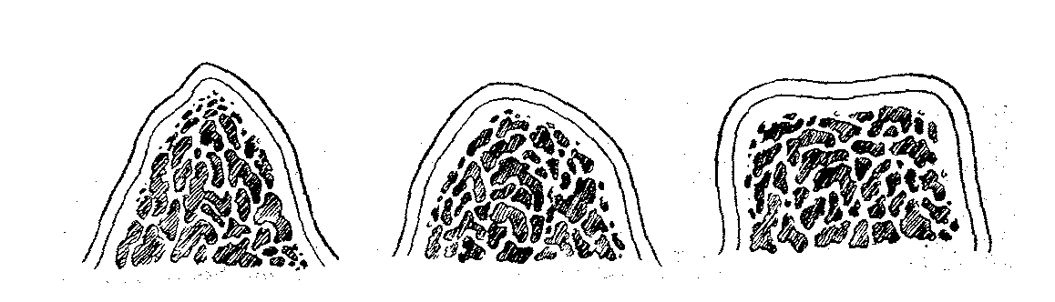
RESIDUAL RIDGE ANATOMY
Large, square, broad ridges ………
Small, rounded irregularities…….. Alveoloplasty …………

Slide 14
ARCH FORM
  Square or Tapered arches ………..
SHAPE OF PALATAL VAULT
  Limited by length and angulation of palatal ridge slopes
  Steep palatal vault……….

Slide 15
Relationship of the External Surface and Periphery to Surrounding Oro-facial
Musculature
Jacobson (1983) states that the orofacial musculature and
the polished surface of the denture can facilitate the
stability in two ways –
  The action of certain muscle groups must be permitted to occur with out interference by the denture base .
  The normal functioning of some muscle groups is to
  be recognize and can be used to enhance stability.

Slide 16
Fish (1933): “ it is not so widely understood that the actual shape of the whole of the buccal, labial and lingual surfaces can wreck the stability of a denture just as completely as a bad impression or wrong bite.”

Slide 17
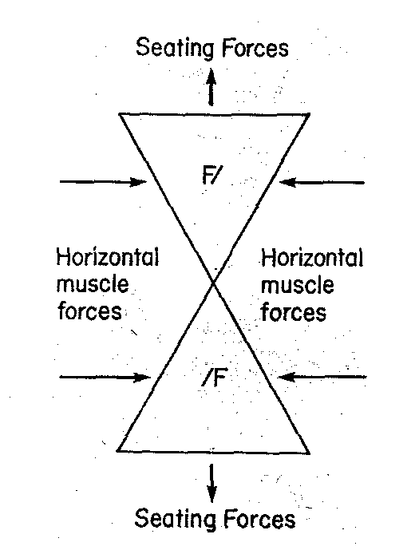
Influence of Oro-facial Musculature
Basic geometric design – Triangular
In frontal cross section ……….

Slide 18
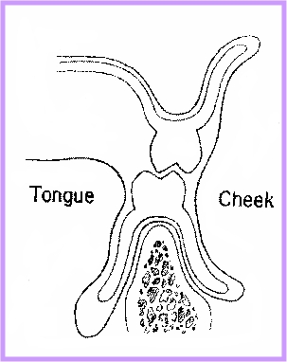
Seating action by Tongue Lingual flange inclined medially

Slide 19
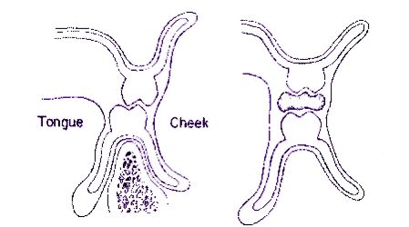
flanges concave positive seating

Slide 20
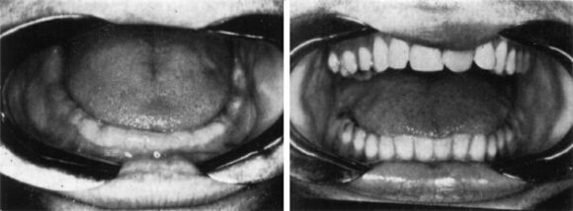
TONGUE The tongue fills the floor of the mouth completely, and lateral borders extend onto the occlusal surfaces of the mandibular teeth.
Normal Tongue position
Edentulous mouth
With natural teeth

Slide 21
Although everyone has a normal tongue position at birth, some lose it, and as a result they acquire a retracted tongue position.
When natural teeth are present, a retracted tongue position has little effect on the ordinary functions of the mouth. It is only when a person attempts to achieve perfection in some specific function or becomes edentulous that a retracted tongue position becomes a problem.

Slide 22
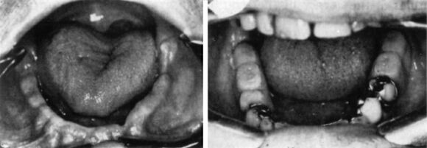
Retracted tongue positions
Failure of the tongue to fill
the floor of the mouth
Lateral borders inside the
mandibular posterior teeth

Slide 23
Patients who have a retracted tongue position are given a series of tongue exercises which help to strengthen the larger muscles responsible for keeping the tongue in its normal position.
The dentures should be removed and the exercises practiced twice daily for periods of five to ten minutes.

Slide 24
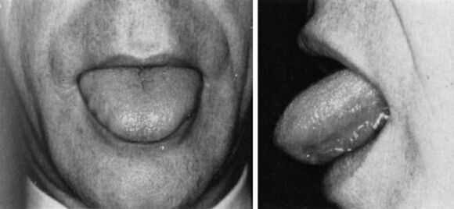
Tongue exercise No. 1. The tongue is thrust out and in rapidly.

Slide 25
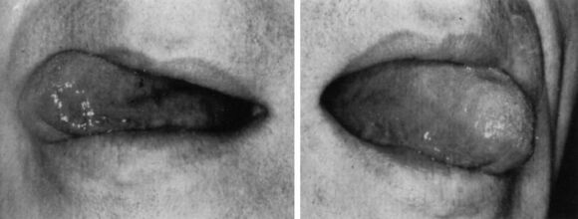
Tongue exercise No. 2. The tongue is swung rapidly from side to side.

Slide 26
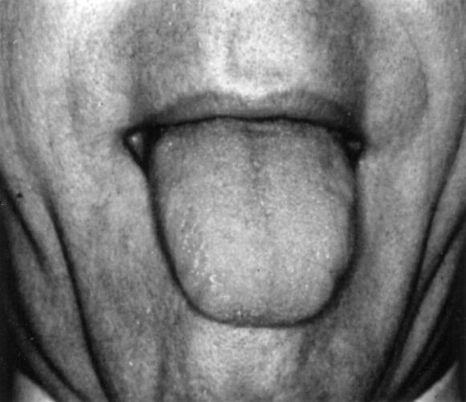
Tongue exercise No. 3.
The tongue is fully extended and then quickly retracted.

Slide 27
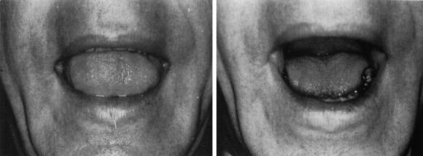
Tongue exercise No. 4. The tongue is first raised to its highest position well forward in the mouth (left) as the sound “ee” is articulated and dropped down (right) as the sound “yuh” is articulated.

Slide 28
Significance of Modiolus and
Associated Musculature
A conical prominence present near the corner of the mouth,
Intersection of several muscles of the cheeks and lips.
These include Orbicularis oris,
Triangularis,
Buccinator,
Risorius and
Zygomaticus major.

Slide 29
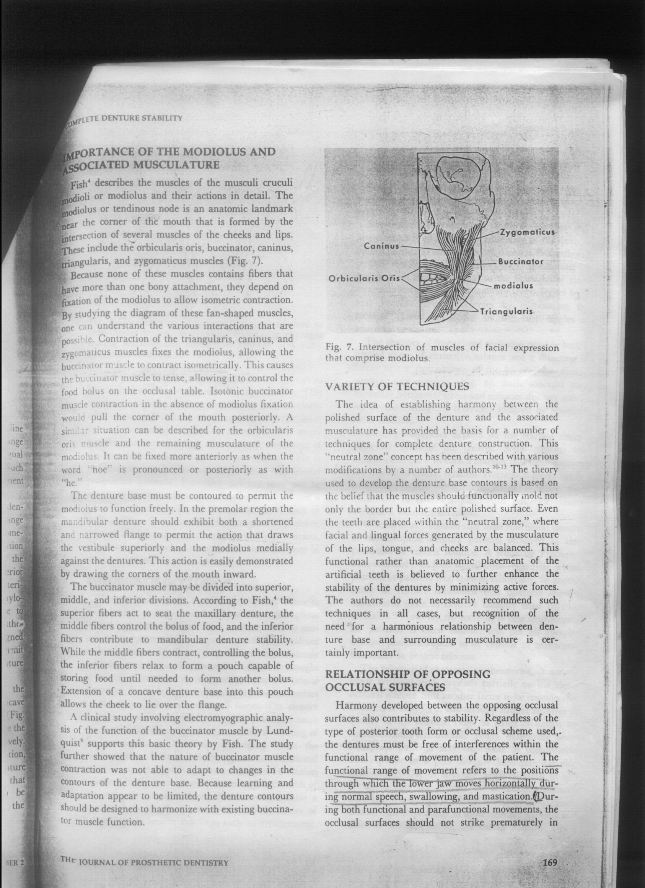
The denture base must be contoured to permit the modiolus to function freely.
In the Premolar region
Dentures should exhibit shortened and narrowed flange to permit the action that draws the vestibule superiorly and modiolus medially against the dentures.

Slide 30
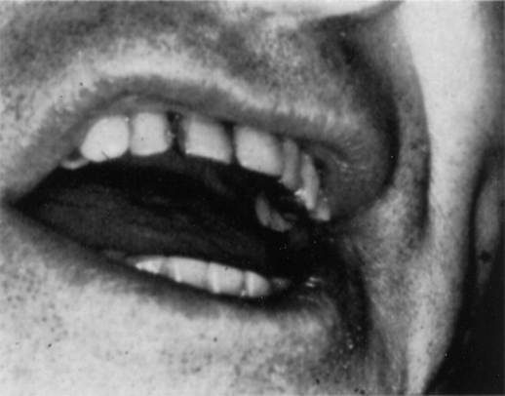
The corner of the mouth is in contact with the buccal surface of the mandibular first bicuspid.

Slide 31
Significance of buccinator muscle
The buccinator is a broad band of muscle forming the entire wall of the cheek from the corner of the mouth and passing along the outer surface of the maxilla and mandible till it reaches the ramus.
It can be divided into -
Superior
Middle
Inferior

Slide 32
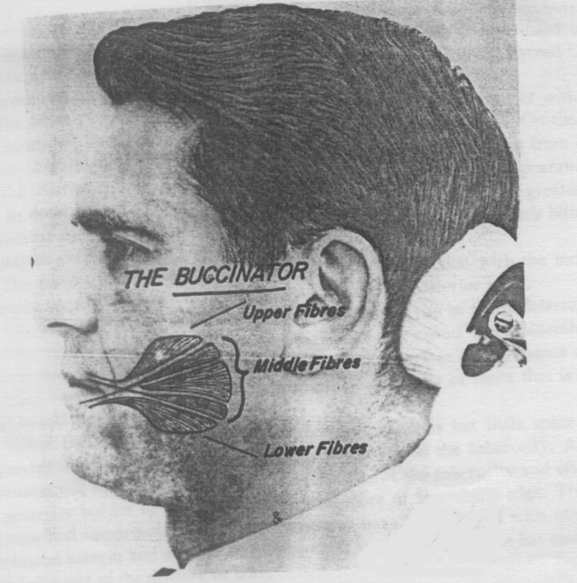
Schematic drawing of Buccinator muscle

Slide 33
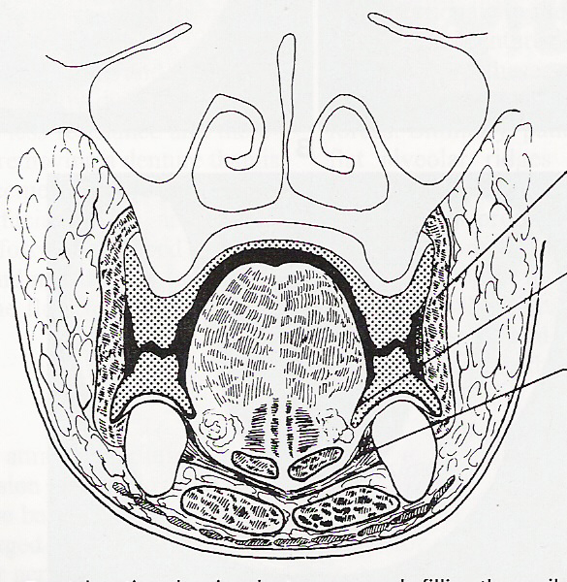
NEUTRAL ZONE

Slide 34
The upper and lower denture must be narrow in the bicuspid region to avoid lifting by corners of the mouth and posterior teeth must not encroach on the tongue space.
The lower denture will be unstable if –
It is too wide in bicuspid region.
If incisors are set too far labially.
If the molars encroach on the tongue space.
If buccal and lingual flanges were parallel and affect normal functioning of buccinator and tongue muscles.

Slide 35
“The most common cause of instability of lower denture is violation of the neutral zone by incorrect arrangement of teeth or incorrect form of labial and lingual angles of the polished surface ”

Slide 36
Relationship of Opposing Occlusal Surfaces
Harmony between the opposing occlusal surfaces will play a major role in the complete denture stability, regardless of the type of posterior tooth form or occlusal scheme used. The dentures must be free of interferences within the functional range of movement of the patient.
Bilateral simultaneous contact of the posterior teeth in centric relation is essential to enhance the denture stability.

Slide 37
SELECTION OF TEETH
The selection of anatomic, semi-anatomic, or non-anatomic artificial teeth depends on the occlusal scheme.
The unfavourable ridges exhibiting severe resorption patterns may contribute to compromised stability due to poor denture base to residual ridge relationship.

Slide 38
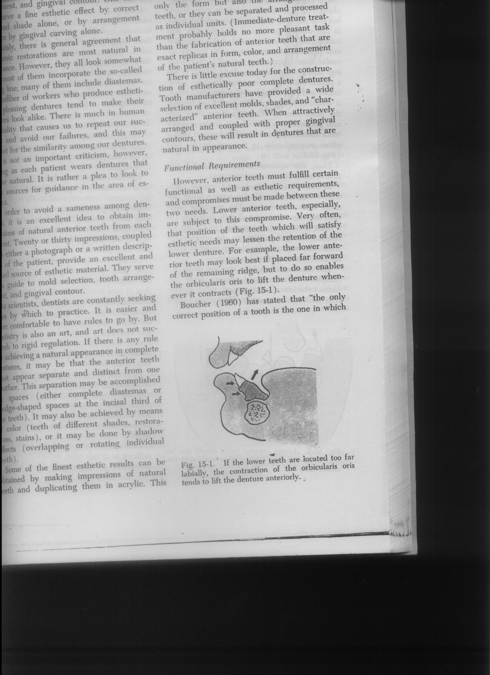
Tooth Position and Occlusal Plane
Anterior teeth:
The anterior teeth arrangement must fulfill certain functional as well as esthetic requirements.
The lower anteriors if placed far forward of the remaining alveolar ridge, the orbicularis oris muscle will lift the lower denture when it contacts.

Slide 39
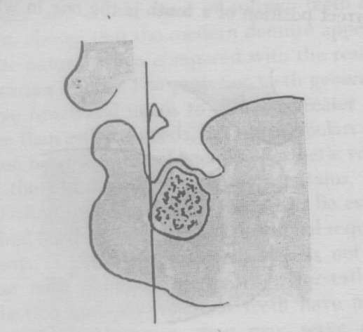
Boucher (1960) stated that “The only correct position of a tooth is the one in which, it was placed by the nature.”
In general the lower anteriors teeth should not be set further forward than a plane perpendicular to the mucobuccal fold.

Slide 40
Posterior teeth:
The posterior teeth bear the functional burden for the occlusion. By their proper arrangement they serve to aid in retention and stability and preserve the health of masticatory tissues.
The buccolingual position of the lower posterior teeth is determined by the needs of retention and stability.

Slide 41
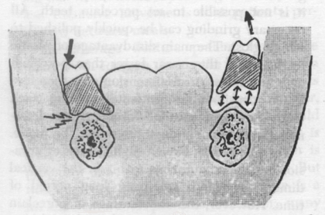
If they are located buccal to ridge…….
If the teeth arranged too far lingually…….

Slide 42
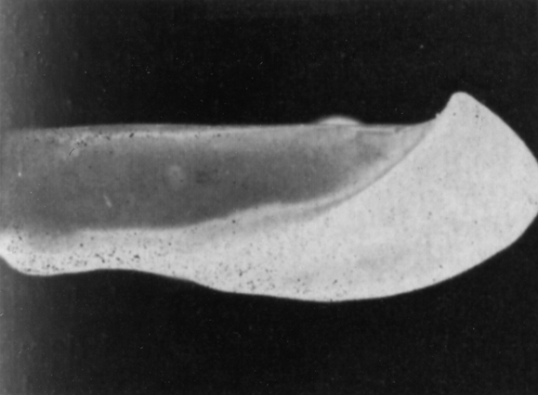
Significance of Occlusal Plane
The anterior height ……
The posterior height ………

Slide 43
Mandibular occlusal plane set too high
Can result in Reduced Stability
Reasons
The laterally tilting forces directed against the teeth are magnified and the muscular support from the tongue will be obliterated.
forces the tongue into a higher position which raise the floor of the mouth and creating undue pressure on the border of the lingual flange resulting in a partial loss of the border seal.

Slide 44
Ridge relationship and denture stability
Excessive amount of interridge space
Small amount of interridge space.
Ridges that are not parallel to each other will cause the movement of the denture bases when the teeth are occluded because of unfavourable distribution of the forces.
The anteroposterior and lateral ridge relationship will also influence the stability of the denture. The amount of resorption which occur when the natural teeth are removed will affect these relationships –
Maxillary ridge resorption
Mandibular ridge resorption

Slide 45
Jacobson (1983) stated that “Stability is a problem in prognathic and retrognathic patients. The Class III patients frequently displays a lower arch anterior to the upper arch in centric relation. Sufficient mandibular occlusion must be developed so that contact against the maxillary denture extends posteriorly more than half the distance from the incisive papilla to the hamular notch without this contact the maxillary denture would tip anterosuperiorly, traumatizing the maxillary anterior ridge and loosening the maxillary denture”.

Slide 46
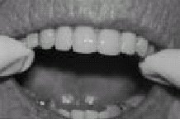
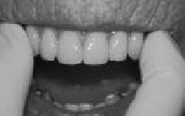
Assessment of Stability
To check the stability put two fingers on either side of the quadrant and light pressure is applied alternatively on each side. This pressure must be directed at right angle to the occlusal surface. if pressure on one side causes the denture to tilt and rise from the ridge on the other side then the denture is not stable.

Slide 47
CONCLUSION
The factors of stability involve the tissue, occlusal and polished surfaces of the denture. Care must be taken in the development of all three of these surfaces to ensure optimal stability of the final prosthesis.

Slide 48
REFERENCES
Zarb - Bolender : Prosthodontic treatment for edentulous patients. Twelfth edition, 2004.
Jacobson T.E. : Contemporary review of factors involved in the complete dentures. J. Prosthet. Dent. 49: 165, 1983.
Corwin R.Wright, :Evaluation of factors necessary to develop stability in mandibular dentures. J. Prosthet. Dent. 92:509-518,2004
Arthur R.F. : Complete denture stability related to tooth position. J. Prosthet. Dent. 1961; 11: 1031-1037.
Strain C.J. : Establishing stability for mandibular complete denture. J. Prosthet. Dent. 21: 359, 1969.
Victor E. and Frank J. :The neutral zone in complete dentures, J. Prosthet. Dent. 1976;36 :356-365

Slide 49
7.Victor E. and Frank J. :The neutral zone in complete dentures, J. Prosthet. Dent. 1976;36 :356-365
8.Rahn and Heartwell : Textbook of complete denture, 5th edition, 1993.
9.Sharry J.J. : Complete denture prosthodontics, 1968.
10.Thomas E. :Stabilizing lower dentures on unfavourable ridges. J. Prosthet. Dent. 12: 420-424, 1962.
11.H.R.B. Fenn :Clinical dental prosthodontics, 1st edition, 1986.
.

