Slide 1
Mediastinum
Mrs. Priyanka Sharma
Assistant Professor
Department of Anatomy
S.B.K.S.M.I. & R.C.

Slide 2
The mediastinum (L. middle septum) is the median septum
of thoracic cavity between the two pleural cavities.
It consists of all the viscera and structures of the thoracic cavity (e.g.,
heart and its great blood vessels, esophagus, trachea and
principal bronchi, aorta, mediastinal lymph nodes, etc.)
except the lungs.
The mediastinum occupies the central compartment of the thoracic cavity.
is a broad central partition, which separates the two laterally
placed pleural cavities . It is covered on either side by the mediastinal pleura.

Slide 3
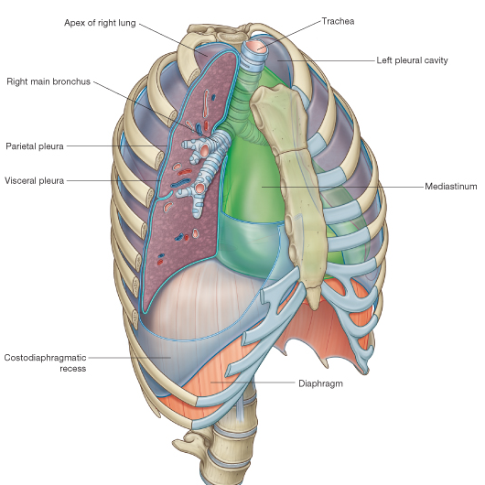

Slide 4
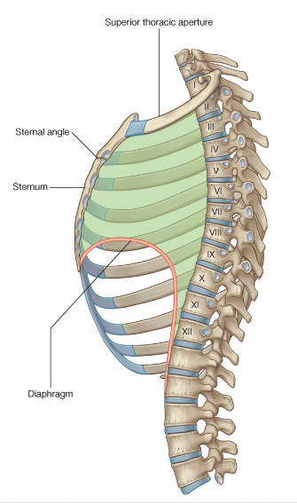
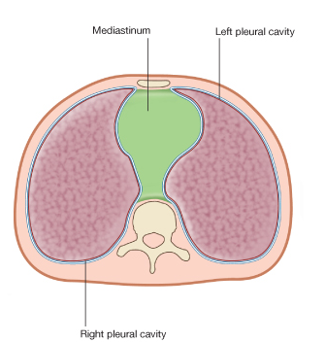
MEDIASTINUM

Slide 5
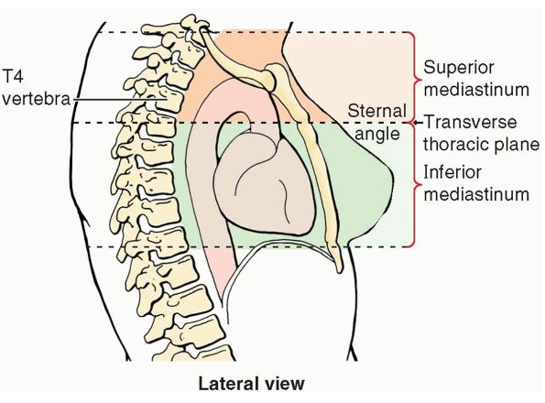
DIVISIONS OF MEDIASTINUM

Slide 6
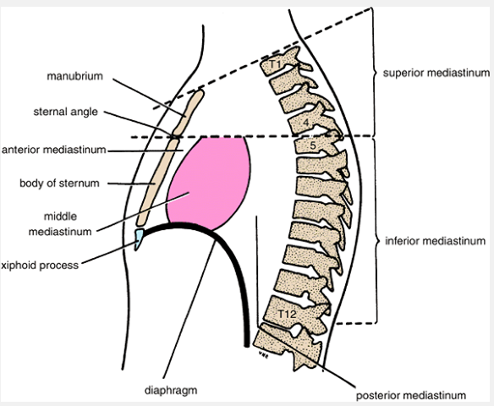
DIVISIONS OF MEDIASTINUM

Slide 7
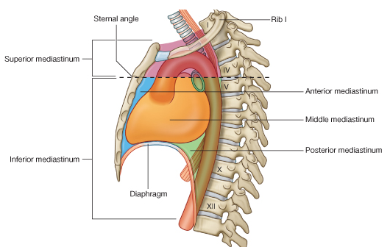
DIVISIONS OF MEDIASTINUM

Slide 8
1. Arteries
(a) Arch of aorta.
(b) Brachiocephalic artery.
(c) Left common carotid artery.
(d) Left subclavian artery.
2. Veins
(a) Right and left brachiocephalic veins.
(b) Upper half of the superior vena cava (SVC).
(c) Left superior intercostal vein.
3. Nerves
(a) Phrenic nerves (right and left).
(b) Vagus nerves (right and left).

Slide 9
c) Sympathetic trunks and cardiac nerves (right and
left).
(d) Left recurrent laryngeal nerves.
4. Lymphoid organs and lymphatics
(a) Lymph nodes.
(b) Thoracic duct.
(c) Thymus.
5. Tubes
(a) Trachea.
(b) Esophagus.
6. Muscles
(a) Sternohyoid.
(b) Sternothyroid.
(c) Longus colli.

Slide 10
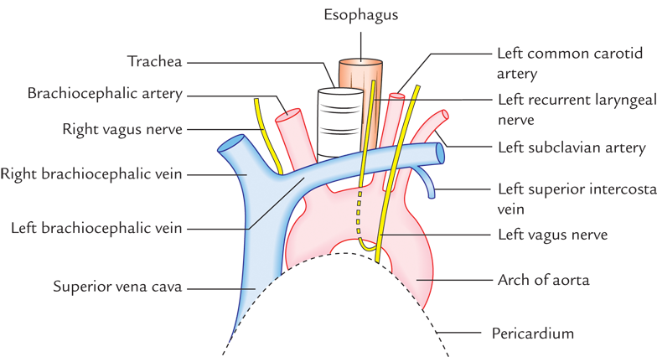
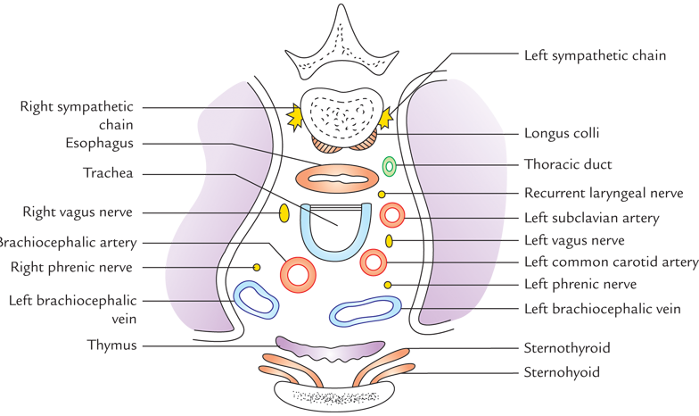
SUPERIOR MEDIASTINUM

Slide 11
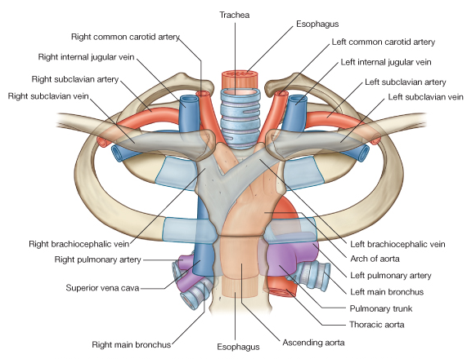
SUPERIOR MEDIASTINUM

Slide 12
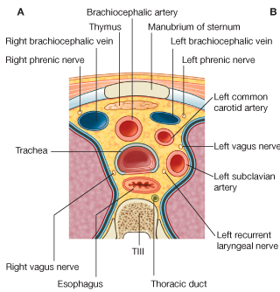
SUPERIOR MEDIASTINUM

Slide 13
APPLIED ASPECT
Prevertebral layer of deep cervical fascia extends to the superior mediastinum and is attached to T4. : infection present in neck behind this fascia can pass down into sup. Mediastinum BUT NOT LOWER DOWN.
Pretracheal fascia of neck extends to sup. Mediastinum, where it blends with arch of aorta. : neck infections b/w pretracheal & prevertebral fasciae spread into sup. Mediastinum, through it into post. Mediastinum - MEDIASTINITIS

Slide 14
ANTERIOR MEDIASTINUM

Slide 15
contents
1. Loose areolar tissue.
2. Superior and inferior sternopericardial ligaments
stretching between sternum and pericardium.
3. Three or four lymph nodes.
4. Mediastinal branches of internal thoracic (mammary)
arteries.
5. Lower portion of thymus (in children).

Slide 16
MIDDLE MEDIASTINUM

Slide 17
1. Heart
2. Pericardium
3. Arteries:(a) Ascending aorta
(b) Pulmonary trunk dividing into two pulmonary arteries
(c) Pericardiophrenic arteries
4. Veins:
(a) Superior vena cava (lower half)
(b) Azygos vein (terminal part)
(c) Pulmonary veins (right and left)
5. Nerves:
(a) Phrenic nerves
(b) Deep cardiac plexus
6. Lymph nodes:Tracheobronchial lymph nodes
7. Tubes:(a) Bifurcation of trachea
(b) Right and left principal bronchi

Slide 18
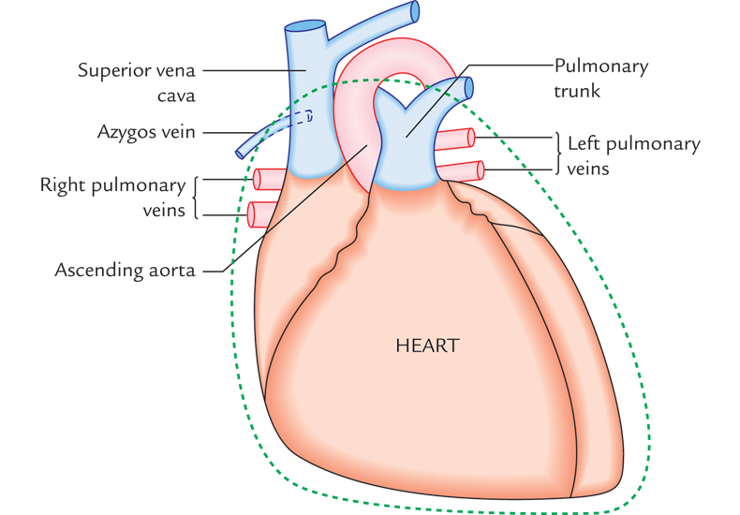
MIDDLE MEDIASTINUM

Slide 19
POSTERIOR MEDIASTINUM

Slide 20
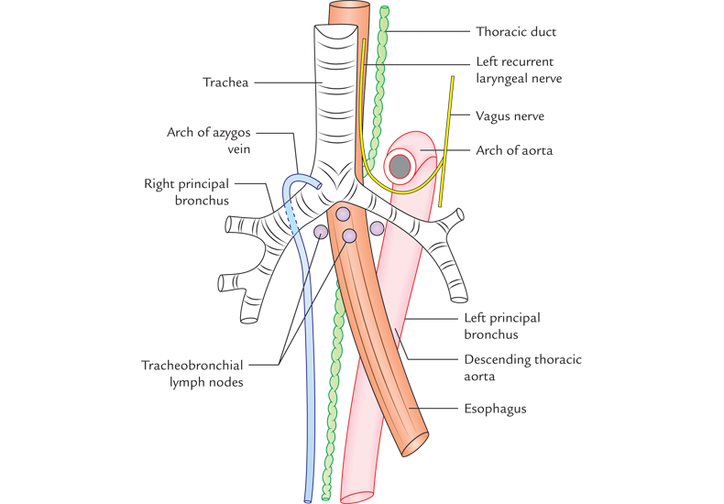
POSTERIOR MEDIASTINUM

Slide 21
MEDIASTINUM SYNDROME
Obstruction of SVC – engorgement of veins in upper half of body
Pressure over trachea – dyspnoea, cough
Pressure on oesophagus – dysphagia
Pressure on recurrent laryngeal nerve – hoarseness of voice
Pressure on phrenic nerve – paralysis of diaphragm on that side
Pressure on intercostal nerves – girdle pain
Pressure on vertebral column – erosion of vertebral bodies.

Slide 22
Causes of mediastinum syndrome
Bronchogenic carcinoma
Hodgkin’s disease causing enlargement of mediastinal lymphnodes
Aneurysm or dilatation of aorta

Slide 23
MCQ:1
Which are the borders of the superior mediastinum?
Anterior: the body of the sternum
b. Anterior: the manubrium of the sternum
c. Posterior: the first four thoracic vertebras
d. B & C

Slide 24
2. Name the structures located inside the superior mediastinum?
a. Thymus
b. Oesophagus
c. Trachea
d. All of above

Slide 25
3.Name the structures located inside the middle mediastinum?
a. Bifurcation of Trachea
b. Ascending aorta
c. Pericardium and heart
d. All of above

Slide 26
4. Name the structures located inside the posterior mediastinum?
a. Descending thoracic aorta
b. Oesophagus
c. Thoracic Duct
d. all of above

Slide 27
5. Name the structures located inside the anterior mediastinum?
a. Trachea
b. Lower part of Thymus glands
c. Internal thoracic vessels
d. B & C.

Slide 28
MURRAY REBNER, BARRY H. GRoSS,t JOHN M. ROBERTSON, DAVID R. PENNES,
DAVID L. SPIZARNY and GARY M. GLAZER
Department of Radiology, University of Michigan Medical Center, Ann Arbor, MI 48109-0030, U.S.A.
MURRAY REBNER, BARRY H. GRoSS,t JOHN M. ROBERTSON, DAVID R. PENNES, DAVID L. SPIZARNY and GARY M. GLAZER | CT EVALUATION OF MEDIASTINAL MASSES* | Retrospective review of our patient records from 1 July, 198 1 through 30 September, 1984 disclosed 132 patients with CT-demonstrated mediastinal masses and histologic proof of radiologic findings. For the purpose of this study, a mediastinal mass was defined as an abnormal soft tissue structure that exceeded 1 cm in short axis dimension, thus avoiding confusion with normal mediastinal lymph nodes | Mediastinal masses could be appreciated on conventional radiographs in 62 of 90 patients (69%) with available chest radiographs (Table 2). The rate of detection varied with the mediastinal compartment, ranging from 48% (10/21) for the middle mediastinum to 100% (4/4) for posterior mediastinal masses. The smallest mass visualized was 2 x 2 x 2 cm in size in the anterior mediastinum and represented adenopathy in a patient with sarcoidosis. | Axillary adenopathy favors lymphoma as a diagnosis and a focal. pulmonary mass, focal liver lesions, or bone lesions suggest metastatic disease. Although CT cannot differentiate soft tissue mediastinal masses, it is clearly superior to conventional chest radiography at detecting and characterizing these masses.

Slide 29
MURRAY REBNER, BARRY H. GRoSS,t JOHN M. ROBERTSON, DAVID R. PENNES,
DAVID L. SPIZARNY and GARY M. GLAZER
Department of Radiology, University of Michigan Medical Center, Ann Arbor, MI 48109-0030, U.S.A.
MURRAY REBNER, BARRY H. GRoSS,t JOHN M. ROBERTSON, DAVID R. PENNES, DAVID L. SPIZARNY and GARY M. GLAZER | CT EVALUATION OF MEDIASTINAL MASSES* | Retrospective review of our patient records from 1 July, 198 1 through 30 September, 1984 disclosed 132 patients with CT-demonstrated mediastinal masses and histologic proof of radiologic findings. For the purpose of this study, a mediastinal mass was defined as an abnormal soft tissue structure that exceeded 1 cm in short axis dimension, thus avoiding confusion with normal mediastinal lymph nodes | Mediastinal masses could be appreciated on conventional radiographs in 62 of 90 patients (69%) with available chest radiographs (Table 2). The rate of detection varied with the mediastinal compartment, ranging from 48% (10/21) for the middle mediastinum to 100% (4/4) for posterior mediastinal masses. The smallest mass visualized was 2 x 2 x 2 cm in size in the anterior mediastinum and represented adenopathy in a patient with sarcoidosis. | Axillary adenopathy favors lymphoma as a diagnosis and a focal. pulmonary mass, focal liver lesions, or bone lesions suggest metastatic disease. Although CT cannot differentiate soft tissue mediastinal masses, it is clearly superior to conventional chest radiography at detecting and characterizing these masses.

