Slide 1
Foldings of Embryo
Dr.Hetal Vaishnani
Associate Professor
Department of Anatomy
S.B.K.S.M.I. & R.C.

Slide 2
Allantois
Amniotic cavity
Amniotic membrane
Buccopharyngeal membrane
Lateral plate mesoderm : Somatopleure & Splanchnopleure
Intraembryonic coelom
Cardiogenic area
Septum transversum
Connecting stalk

Slide 3
FORMATION OF ALLANTOIS
16th day
    It is a small diverticulum which arises from the caudal wall of yolk sac and extends into connecting stalk
    Associated with development of urinary bladder
Involved in early blood formation

Slide 4
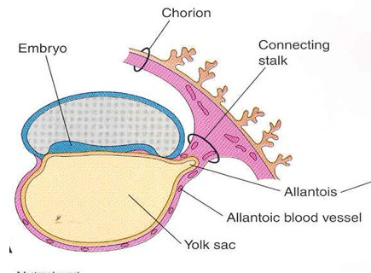

Slide 5
REMNANTS OF ALLANTOIS
a) As bladder enlarges it becomes Urachus and is represented in adults by median umbilical ligament
b) Blood vessels of allantois become umbilical arteries and veins

Slide 6
3RD WEEK EMBRYO
At the end of gastrulation, the embryo is a flat trilaminar disk which is in contact with the extraembryonic tissues at all of its surfaces.

Slide 7
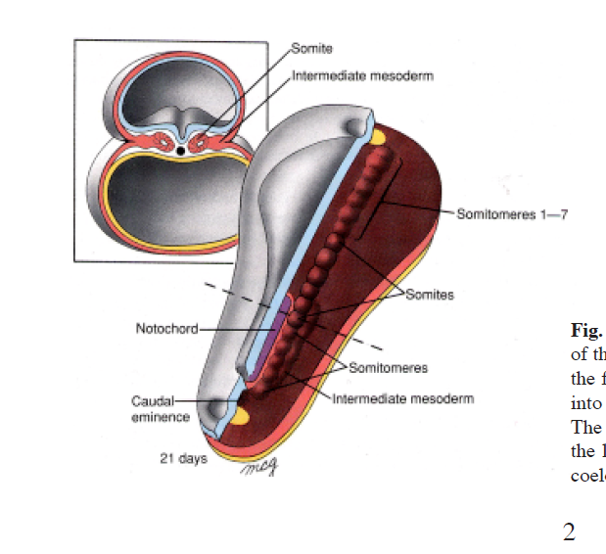

Slide 8
4TH WEEK : Differential growth rate
During the 4th week - differential growth of selected parts of the embryo.
The amnion and embryonic disc grow rapidly but the yolk sac does not.
Because the yolk sac is attached to the ventral rim of the disc, the expanding embryonic disk balloons into a more or less cylindrical shape.

Slide 9
Folding of Embryo
The dorsal structures of notochord, brain and somites stiffen this axis such that the flexion takes place at the thin, flexible outer rim of the disc.
Cephalocaudal and lateral flexion commence at approximately the same time (days 22-28)

Slide 10
Rostral end of Disk - Before Folding
The cranial rim of the embryo contains the buccopharyngeal membrane (BPM)
Cranial to the BPM is the cardiogenic area (gives rise to the heart) & septum transversum

Slide 11
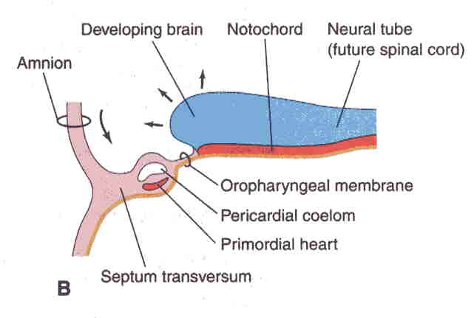

Slide 12
Head folding
Due to the rapid growth of the forebrain (cephalic neural plate) the cranial region starts to fold ventrally (day 22)
The primordial of forebrain, which was previously craniodorsal, now comes cranioventral.
At the same time, the cardiogenic mesoderm and the septum transversum, which were cranial, come somewhat ventrally and caudally.

Slide 13
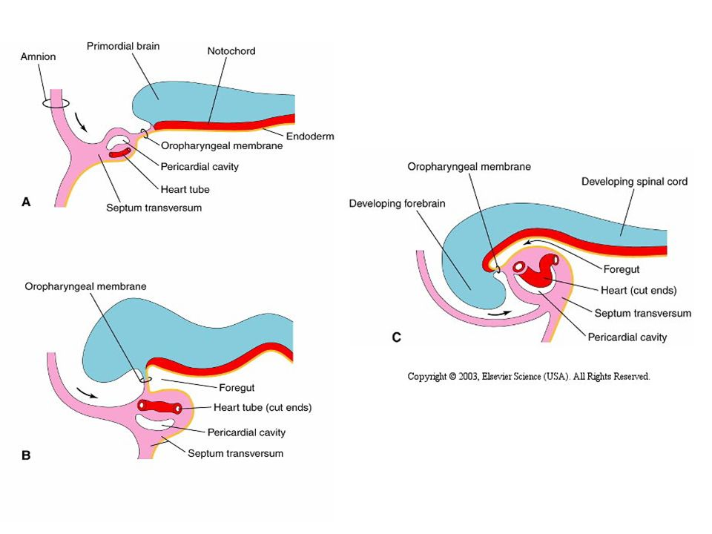

Slide 14
Head folding
So now the forebrain overhanging the developing heart.
the septum transversum, a special type of mesenchyme, is caudal to the heart. This will later on form the central tendon of the diaphragm

Slide 16
Head folding
Before folding, the pericardial coelom, derived from the intraembryonic coelom is dorsal to the heart and caudal to the septum transversum.
After the head fold, it becomes ventral to the heart and cranial to the septum transversum.
Septum Transversum partitions the coelom into thoracic and abdominal cavities

Slide 17
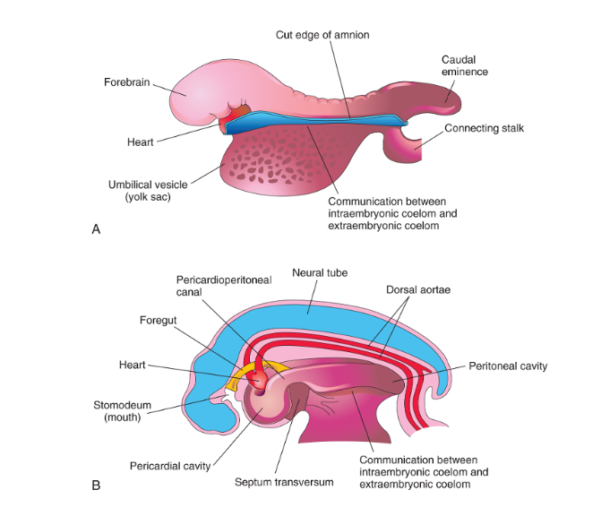

Slide 18
Head folding
endoderm that is incorporated in the embryo due to Head folding is the foregut
At this juncture, the oropharyngeal membrane is separating an ectodermal derivative called the stomodaeum (which will later on form the oral cavity) from the Foregut.
In the fourth week, it ruptures and permit free communication between the mouth and the developing gut.

Slide 19
Tail folding
Starting on day 23 a similar process occurs at the caudal edge of the embryo.
This folding occur due to rapid growth of the distal part of the neural tube

Slide 20
Before tail fold
Primitive streak is limited caudally at the cloacal membrane, and is cranial to that membrane.
The caudal end of the disk is continuous with connecting stalk

Slide 21
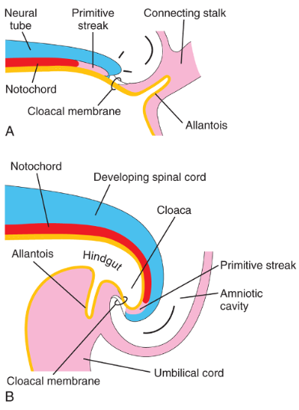

Slide 22
Tail folding
The caudal flexion brings the cloacal membrane onto the ventral surface of the embryo, cranial to the primitive streak.
It also results in the more ventral location of the connecting stalk so that it merges with the neck of the yolk sac
The allantois, a diverticulum of the umbilical vesicle will be incorporated inside the embryo as the cloaca, which will form the urinary bladder later on

Slide 24
Tail folding
Endoderm incorporated in the embryo as the hindgut (primordial of the colon and the rectum).
Cloacal membrane separates upper part of the anal canal (endoderm), from proctodeum (ectoderm).
In the 7th week, cloacal membrane ruptures, allowing free communication between these two

Slide 25
Lateral Folding
Rapid growth of somites causes the lateral folds of the embryonic disc ventrally, towards the midline
The flaps of lateral plate mesoderm folds, meet and merge at ventral mid-line everywhere but at the umbilical cord .

Slide 26
Lateral Folding
As they fold, the space between the two is maintained and becomes the intraembryonic coelom.
The net effect is to produce, a cylindrical tube, in which the ventral body wall has formed.

Slide 27
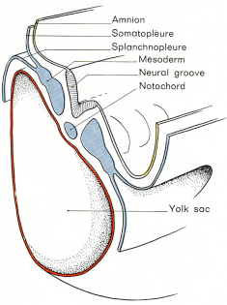
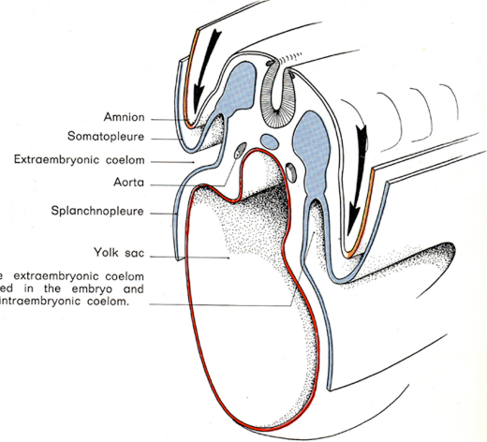

Slide 28
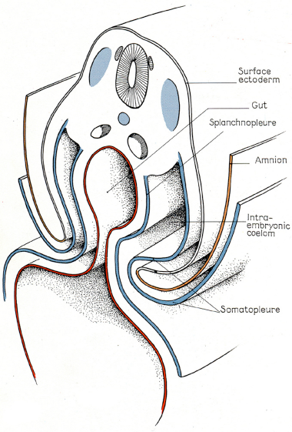
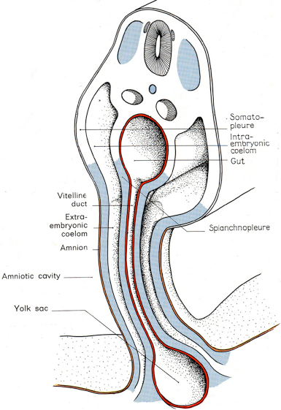

Slide 29
Lateral Folding
The ectoderm and amniotic membrane continue to undergo rapid growth.
The ectodermal sheet will also meet at midline and fuse such that the entire surface of the body is now covered with ectoderm except at the umbilicus

Slide 30
Lateral Folding
The endodermal layer is incorporated in the embryo as the gut tube
This gut tube is complete except at the midgut level. Here the gut tube remains open via the vitelline duct (omphaloenteric duct) to the yolk sac
This connection that progressively becomes smaller.

Slide 31
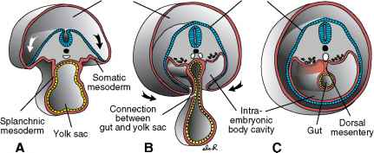

Slide 32
Lateral Folding
The amnion is now surrounds the embryo everywhere & connected to the embryo ventrally in the umbilical region .
Now the embryo is lying inside the amnion.
The connecting stalk now forms an umbilical cord.
This formation limits the communication between the intra and the extraembryonic coelomic cavities

Slide 33
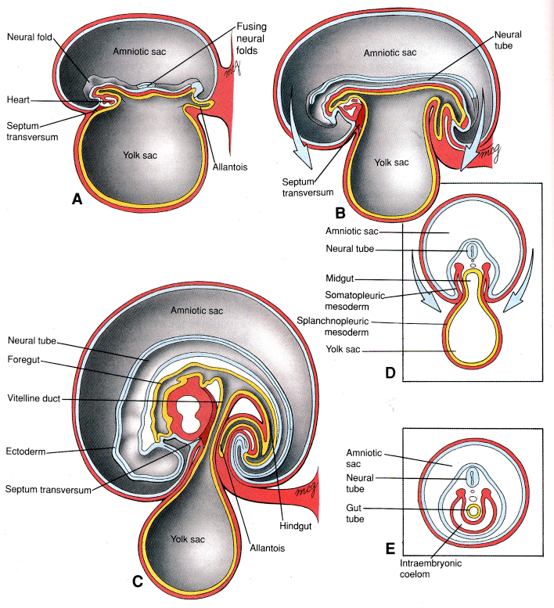

Slide 34
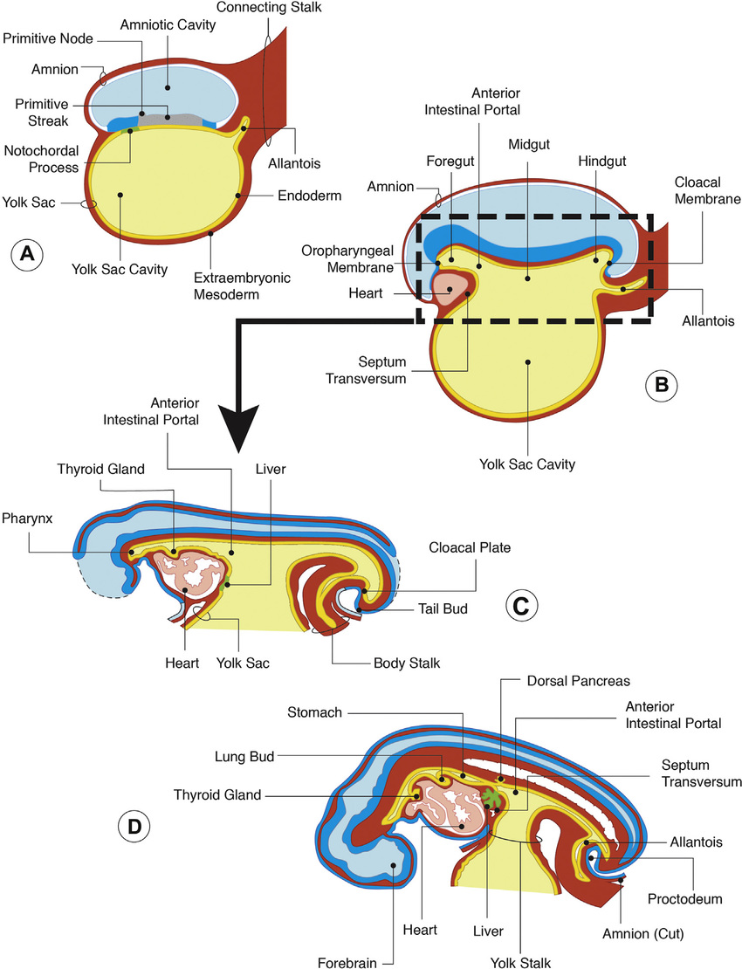

Slide 35
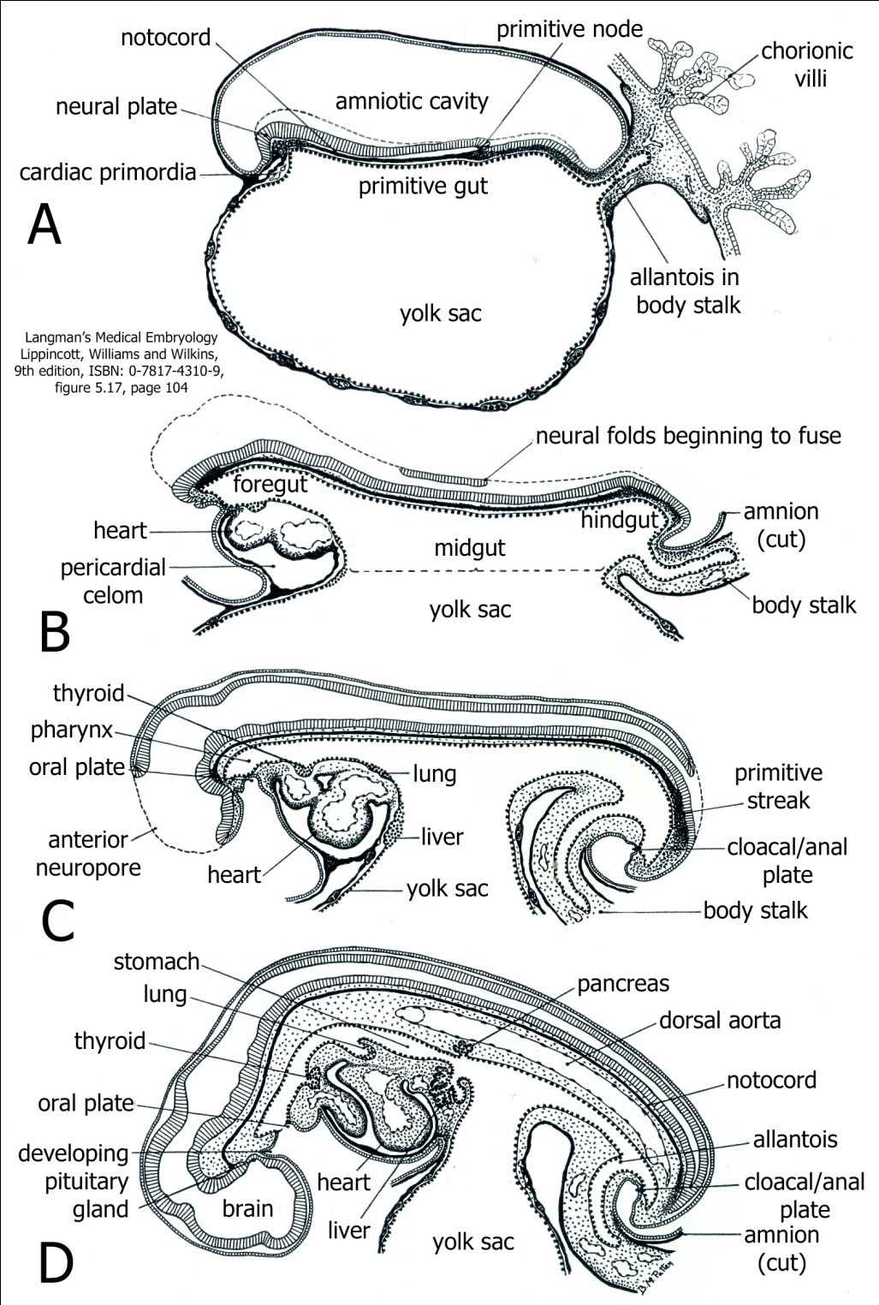

Slide 36
Q1 Head folding begins at --- day
22
23
27
28

Slide 37
Q 2 After tail folding hindgut is separated from proctodeum by
Buccopharyngeal membrane
cloacal membrane
Primitive streak
allantois

Slide 38
MCQ
Q.3 After head folding pericardial coelom lies_____ to developing heart
Ventral
Dorsal
Cranial
Caudal

Slide 39
MCQ
Q.4 Tail fold includes all structures except
a) Connecting stalk containing allantois
b) Cloacal membrane
c) Caudal end of primitive streak
d) stomatodeum

Slide 40
Q 5 Which of the following is NOT the result of folding of embryo
Allantois incorporated inside the embryo
endodermal layer is incorporated in the embryo as the gut tube
septum transversum becomes ventral to the developing heart
amnion surrounds the embryo everywhere

Slide 41
Title | Author / Journal | Material | Result | Conclusion
Heart and extra-embryonic mesodermal defects in mouse embryos lacking the bHLH transcription factor Hand1 | Anthony B. Firulli , David G. McFadden , Qing Lin , Deepak Srivastava & Eric N. Olson Nature Genetics volume18, pages266–270 (1998) | The basic helix-loop-helix (bHLH) transcription factors, Handl and Hand2 (refs 1,2), also called eHand/Hxt/Thing1 and dHand/Hed/Thing2 (refs 3,4), respectively, are expressed in the heart and certain neural-crest derivatives during embryogenesis. | We have generated a germline mutation in the mouse Handl gene by replacing the first coding exon with a β-galactosidase reporter gene. Embryos homozygous for the Hand1 null allele died between embryonic days 8.5 and 9.5 and exhibited yolk sac abnormalities due to a deficiency in extraembryonic mesoderm. Heart development was also perturbed and did not progress beyond the cardiac-looping stage. | Our results demonstrate important roles for Handl in extraembryonic mesodermal and heart development.

