Slide 1
ECT
By: Dr Lakhan Kataria
Deprartment of Psychiatry

Slide 2
ELECTROCONVULSIVE THERAPY(ECT)
PRESENTED BY:-
DR.BHARTI T TALREJA(R 1 PSYCHIATRY)
DISCUSSION BY:-
DR. LAKHAN KATARIA
(ASSISTANT PROFESSOR PSYCHIATRY)

Slide 3
Everyone has certain idea on ECT and majority of them have lot of misconceptions about the treatment .
Following are some of the ideas of the general population about ECT.

Slide 5

ECT is inhuman and degrading treatment which belongs to past.

Slide 6
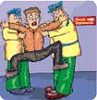
ECT is painful and barbaric

Slide 7

Patients are locked up against their will and continually shocked.

Slide 8

Various claims of brain damage have been made for which ECT should be banned.

Slide 9

Side effects of ECT are severe and these are hidden from public

Slide 10

ECT is a dangerous treatment used to punish dangerous prisoners and patients.

Slide 11
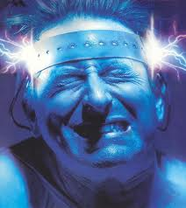
ECT results in unlimited life threatening seizures.

Slide 12

ECT is contraindicated in pregnancy

Slide 13

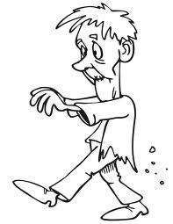

Most of people turn into brain damaged zombie post ect.

Slide 14
On giving ECT the patient jumps up and down on the cot.

Slide 15

IS ECT CURSE OR CURE?

Slide 16
ECT may have been a dangerous procedure in past centuries but today it is a bonafide, safe and effective procedure. Today, a lot more is known about the therapy and both delivery and safety have been refined and improved to near perfection.
Unlike it is depicted in movies it is not sadistic procedure and it is absolutely painless.
Around 100000 patients receive ECT annually in USA

Slide 17
QUERIES
What is ECT?
What is full form of ECT?
Is ECT used nowadays?
Is ECT effective?
Upto what extent ECT is helpful?
Is ECT safe?
What is mechanism of action?
What are indications of ECT?
What are complications of ECT?
Is ECT done in Dhiraj general hospital?
How frequently ECT is done ?

Slide 18
Despite, the treatment being more than 70 years old, the myths surrounding ECT continue to grow.
Most of the myths surrounding ECT are based from the 1950s.
The reason for bad reputation of ECT is because the delivery of ECT in the older days was never controlled and complications were never anticipated.

Slide 19
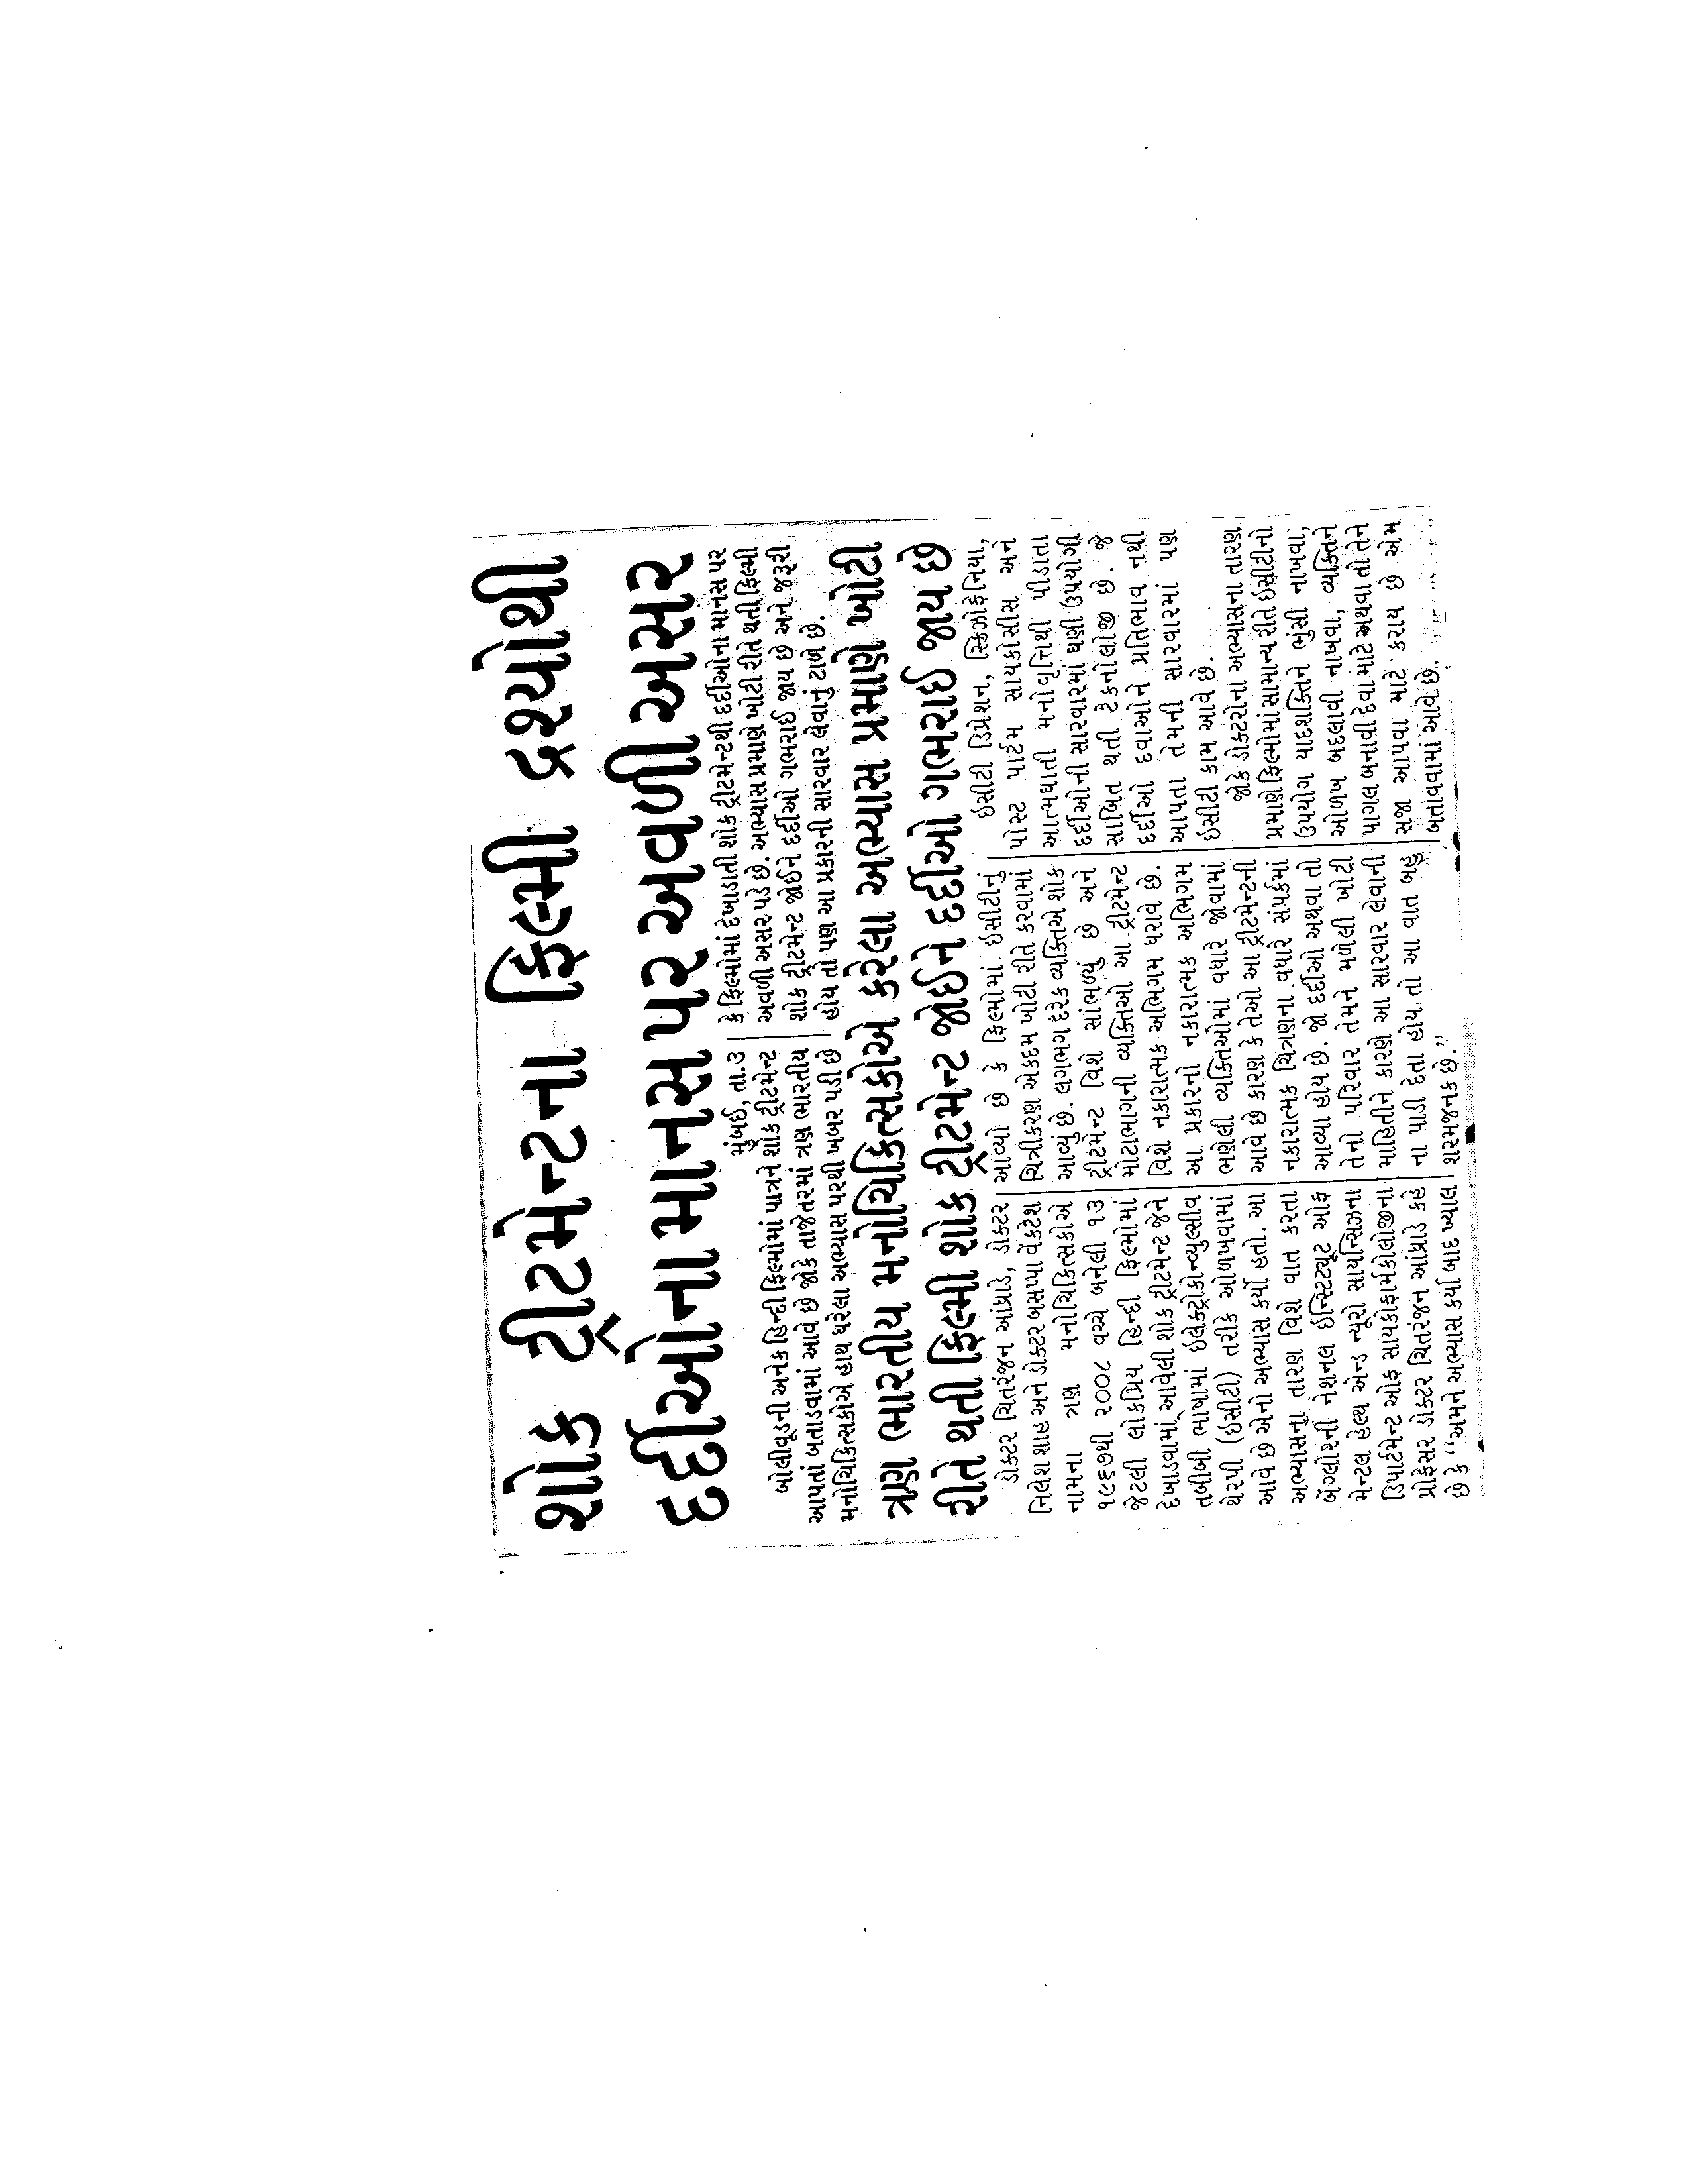

Slide 20
ECT is not used to punish any individual and like any procedure requires consent and approval. The patient has absolute right to refuse for procedure and not the government doctor or any other person can force this procedure on anyone.
ECT has been thoroughly analysed and there is no evidence that there is any brain damage.
ECT is safe and efficacious procedure in pregnancy for both mother and fetus.

Slide 21
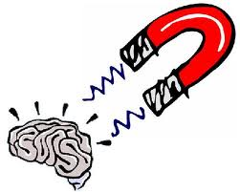
DEFINITION
ECT is a form of brain stimulation in which induction of a seizure occurs when an applied electrical stimulus creates an electrical field with flow of current in the excitable tissue of the brain sufficient to depolarize cell membranes of neurons synchronously.

Slide 22
HISTORICAL OVERVIEW
In 1500s, Swiss physician Paracelsus induced seizures by administering camphor(orally) to treat psychiatric illness.
In 1934, the first catatonic psychotic patient was successfully treated by Hungarian neuropsychiatrist Ladislas Von Meduna, using intramuscular injection of camphor in oil to produce therapeutic seizures.
In 1938, Lucio Bini and Ugo Cerletti conducted the first electrical induction of a series of seizures in a catatonic patient and produced a successful treatment response.
In 1940s, A.E.Bennett developed the use of curare for the prevention of fractures that had previously resulted from severe muscle contraction associated with tonic phase of seizure induction.

Slide 23
In 1950s,ECT device, the prototype of modern devices, was developed.
In the 1960s, randomized clinical trials of the efficacy of ECT versus medications in the treatment of depression showed response rates that were significantly higher with ECT.
In 1976, a constant current, brief pulse n ECT, with the goal of establishing standards for consent and the technical and clinical aspects of the conduct of ECT
In 1978, the APA published the first Task Force Report oIn 1950s, brief general anaesthesia with succinylcholine had replaced curare.
In 1988, randomized controlled clinical trials of ECT versus lithium showed both were equally effective in treating mania.
In 2000, Sarah Lisanby and colleagues from Columbia University induced convulsive treatment with magnetic stimulation.

Slide 24
MECHANISM OF ACTION
  The mechanism of action of ECT, the oldest somatic treatment currently in use in the field of psychiatry, continue to be an active area of hypothesis and research. Proposed mechanisms include:
BIOCHEMICAL ACTION:
Effects on noradrenergic pathway
Effects on serotonergic system
Effects on dopaminergic system
Effect on GABA, adenosine and opiate receptors

Slide 25
NEUROPHYSIOLOGY:
It is known that large increase in global cerebral blood flow(CBF) and cerebral metabolic rate(CMR) increases along with increased blood-brain barrier permeability during generalized seizures, including those electrically induced. In post ictal period, there is functional suppression, with decrease in CBF, CMR and varying degree of bioelectric suppression on EEG.
The magnitude of reduction in CBF is related to the efficacy of ECT.
Changes are also topographically distributed.

Slide 26
These observations are important in clarifying:
Which brain regions are critical to the efficacy of the treatment
To understanding the dose-response relationship of electrical stimulation above seizure threshold to efficacy that has been observed for right unilateral ECT.
In investigating networks related to the cognitive effects of treatment (eg:- involvement of medial temporal lobe in anterograde amnesia and points to prefrontal cortex involvement in retrograde amnesia).

Slide 27
  NEUROPLASTICITY (STRUCTURAL CHANGES):
In animals, electroconvulsive stimulation has been associated with following changes,..
Synaptic plasticity in hippocampus, including mossy fiber sprouting, alteration in cytoskeletal structure, increased connectivity in perforant pathways, the promotion of neurogenesis and the suppression of apoptosis have been observed.
It is unknown whether such changes occur clinically and, if they do, what significance to efficacy and cognitive side effects might be discovered.

Slide 28
INDICATIONS

Slide 29
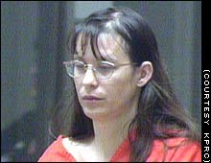


Slide 30
Major depressive disorder
Acute phase.
Suicidal ideation.
Resistant to treatment
Melancholic and psychotic depression.

Slide 31


Slide 32


Slide 33
Manic or mixed episodes
  ECT may be considered for patients with severe or treatment-resistant mania.
  Severe mania during pregnancy.
  Suicidal patients.
  Rapid cycling bipolar disorder.

Slide 34
^{schizophrenia}
Catatonic schizophrenia
Schizoaffective disoder
Acute schizophrenia
Not responded to treatment with antipsychotics.

Slide 36
Other indications
Catatonia
Neuroleptic malignant syndrome:
Parkinson’s disease
Epilepsy
Movement disorders: e.g.- tourette’s syndrome.
Clinical indications:
Primary use:
Rapid definitive response required on medical or psychiatric grounds.
Risks of alternative treatments outweigh benefits
Patient preferance

Slide 37
Past history of poor response to psychotropics or good response to ECT.
Secondary use
Failure to respond to pharmacotherapyin the current episode
Intolerance of pharmacotherapy in the current episode
Rapid definitive response necessitated by deterioration of the patient’s condition.

Slide 38
PROCEDURE

Slide 39

Pre-treatment evaluation
Informed consent

Slide 40
No routine set of laboratory tests for patients before undergoing ECT has been established. Commonly ordered tests include the following:
  Complete blood count
  Serum chemistry
  Renal function
  Electrocardiogram
  Urinalysis
  Chest radiograph (especially with cardiovascular or pulmonary disease or history of smoking)
  Electroencephalogram (guided by history and examination)
  Neuroradiological/neuropsychological tests (guided by history and examination)
  Spinal radiograph (especially with known or suspected spinal disease)
  Consultation with medical specialties such as cardiology, neurology, neurosurgery, or endocrinology as required by special medical conditions.

Slide 41
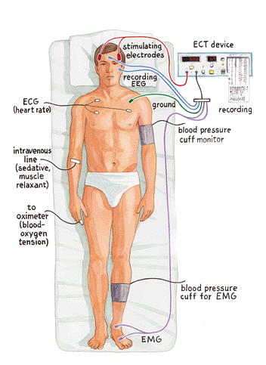
(Fink M. Electroshock revisited. American Scientist. March-April 2000.)

Slide 43
The procedure will most likely be performed in the recovery room of a hospital, in the operating room itself, or possibly in your hospital room. An intravenous (IV) is inserted to provide anaesthetic medication. The vital signs are taken initially and continuously throughout the procedure.
An anesthesiologist administers anaesthesia and after the patient is asleep, tube is put to place in throat to breath. A paralyzing agent called succinylcholine is then administered to prevent the seizure from spreading to body.

Slide 44
The electrodes are then applied to head with conducting jelly and a brief pulse (less than 2 seconds) is administered.
Mouth gag is kept in mouth to prevent damage to tongue and dental trauma.
There are two ways of evaluating seizure activity:EEG recording and manifestation of seizure activity ie convulsion.
On regaining consciousness there is mild disorientation which remains for transient period of time.
The patient is kept NBM for night before ECT.The patient is asked to pass urine before the patient is taken up for ECT.

Slide 47
CALCULATION
1.)Determine
Current(mA) -0.8mA(fixed)
Pulse width(ms)-1 ms(fixed)
No of pulses per second-70 Hz(fixed)*2(bidirectional)
Stimulus durations
2.)Number of pulses delivered=
no. of pulses per second * stimulus duration(s) =70 * 2 * 1= 140
3.)Total time=pulse width(ms)* no. of pulses delivered=1*140=140ms
3.)charge(mc)=current(mA) * total time(ms)=
0.8 * 140= 112mc

Slide 48
Patient’s age(yr)
5
10
15
20
25
30
35
40
45
50
chargedelivered(mc)
25
50
75
100
125
150
175
200
225
250

Slide 49
XI 55
XII 60
XIII 65
XIV 70
XV 75
XVI 80
XVII 85
XVIII90
XIX 95
XX 100
275
300
325
350
375
400
425
450
475
500

Slide 50
Anaesthesia:
ECT is performed under short general anesthesia with brief pulse constant current.The goal is to produce a "light level" of anesthesia. Excessive anesthesia may cause problems such as prolonged unconsciousness and cardiovascular complications, and too little anesthesia may cause problems such as incomplete unconsciousness and autonomic arousal.
Ultra brief general anesthetics are used to induce unconsciousness, e.g.: methohexital, thiopental, propofol, etomidate, ketamine.

Slide 51
Anticholinergics:
Prior to anesthesia, administration of anticholinergics (eg, atropine, glycopyrrolate) can reduce the risk of vagally mediated bradyarrhythmias or asystole¹ and minimize oral and respiratory secretions.

Slide 52
Neuromuscular blockers
The preferred neuromuscular blocker is succinylcholine(depolarizing neuromuscular blocker).Atracurium, mivacurium, rocuronium, and rapacuronium are alternatives to succinylcholine.
Neuromuscular blockers are administered to prevent bone fractures and physical injury related to motor activity during the seizure

Slide 53
Stimulus electrode placement
Bifrontotemporal(commonly referred to as bilateral): electrodes are placed bifrontotemporally, with the center of each electrode about 1 inch above the midpoint of an imaginary line drawn from the tragus to the external canthus. More commonly used.It is also associated with more short term and long term adverse cognitive effects and is more likely to produce delirium.
Right unilateral: one electrode is typically placed over the nondominant frontotemporal area, and the other electrode is placed on the nondominant centroparietal scalp, just lateral to the midline vertex.Unilateral electrode placement is almost always over the right hemisphere. It has relatively better cognitive side effect profile.
Bifrontal: the placement of an electrode on each side of the head is more frontal than in standard bifrontotemporal placement. It is more likely to manifest EEG seizure without motor seizure.
Asymmetric bilateral:the left electrode is moved about 6 cm anterior from the standard frontotemporal position, and its lateral edge is medial to the bony intersection ridge between the temple and the forehead. The right electrode is in the standard frontotemporal position.

Slide 54
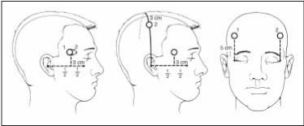
Bilateral RUL Bifrontal
Rasmussen KG et al. Mayo Clin Proc. 2002:77:552-556

Slide 55
Number of treatments:
The number of treatments needed to achieve a full clinical response in patients varies widely.
Although the typical number of treatments is 6-12, some patients may respond after a few treatments, and some patients may not respond until after 10 treatments. The total number should be a function of the patient's degree and rate of clinical improvement, as well as the severity of cognitive adverse effects
Treatment is stopped when maximal improvement is reached(remission of target symptoms) or when further improvement has not occurred over two or three sessions with optimal technique.

Slide 56
Continuation treatment:
Treatment for 6 mths beyond remission of an acute episode of illness to prevent relapse. Almost always given on OPD basis
Continuation treatment with medications is the predominant practice post ECT.
Suitable patient: should have recurrent illness, demonstrated response to ECT, intolerance of or relapse on continuation medication and ability to comply with continuation ECT protocols.
If patients remain well 2 mths or more, they are out of episode and discontinuation of continuation treatment can be entertained.

Slide 57
ADVERSE EFFECTS
Cognitive adverse effects
Cognitive adverse effects are the major limitations to the use of ECT.
The most severe effects are observed postictally, with a brief period of disorientation and impairments in attention, praxis, and memory.
The ECT technique used has a significant impact on cognitive deficits, and modifications may need to be made, such as switching to unilateral ECT, lowering the stimulus dose, increasing the time interval between treatments, or stopping medications that may increase cognitive adverse effects.
Anterograde and retrograde amnesia Postictal delirium rarely

Slide 58
Other adverse effects
Cardiovascular complications (eg, arrhythmias) and pulmonary complications are the leading causes of mortality due to ECT.
Asystole has been reported.
Prolonged seizures and status epilepticus may be more likely when patients receive medications that lower seizure threshold.
Prolonged apnea is rare but may occur in patients who slowly metabolize succinylcholine.
Headache is common. It can be treated with medications such as aspirin, acetaminophen, nonsteroidal anti-inflammatory drugs, sumatriptan and, rarely, more potent analgesics, such as codeine.
Muscle soreness and nausea.
Mania rarely.

Slide 59
Mortality
The mortality rate for electroconvulsive therapy (ECT) is estimated to be 1 per 10,000 patients or 1 per 80,000 treatments. This is about the same as that associated with minor surgery.

Slide 60
ECT IN SPECIAL POPULATION
ECT in pediatrics
The use of ECT in the pediatric population is controversial. The American Academy of Child and Adolescent Psychiatry published a practice parameter for the use of ECT with adolescents in December 2004.
Diagnostic considerations for ECT in an adolescent patient include severe or persistent major depression or mania with or without psychotic features, schizoaffective disorder, schizophrenia, catatonia, or neuroleptic malignant syndrome. The symptoms must be severe, persistent, and significantly disabling, and they may include life-threatening symptoms.
⁴

Slide 61

ECT in geriatrics
A high proportion of patients who receive ECT are in the geriatric age group. In elderly patients, ECT has been used to treat catatonia,bipolar mania,and psychotic disorders.⁷⁷
Generally, geriatric patients with depression have better outcomes with ECT than do younger patients. ECT is especially indicated for patients with depression who are at risk for harm because of psychosis, suicidal ideation, or severe malnutrition,but it is also helpful for treatment-resistant nonpsychotic major depression.

Slide 62
Seizure threshold may rise with increasing age, and effective seizures may be hard to induce. Geriatric patients may be at a higher risk for persistent confusion and greater memory deficits during and after ECT.
A 2003 Cochrane Database review of ECT for elderly patients with depression found that solid conclusions could not be drawn regarding whether ECT was more effective than antidepressants or regarding the safety and adverse effects of ECT in these patients.

Slide 63
ECT in pregnancy
ECT should be considered for women who wish to avoid extended exposure to psychotropics during pregnancy or whose symptoms fail to respond to standard therapy. Obstetric consultation should be obtained and fetal monitoring should be used, when appropriate.
Patients in late pregnancy should lie on their left side during ECT to ensure adequate blood flow to the fetus. Hyperventilation should be avoided.
Transmission of anesthesia medications across the maternal-fetal barrier is considered to be minimal. ECT is considered relatively safe in terms of teratogenicity and neonatal toxicity.

Slide 64
ECT is safe and efficacious for the mother and fetus in the treatment of major depressive disorder during pregnancy. ECT is a potential treatment for patients with bipolar disorder who are experiencing mixed episodes severe mania, or severe depression during pregnancy.
Because of an increased risk of gastric reflux and possible aspiration, pregnant women may be premedicated with a nonparticulate antacid, such as sodium citrate.
Generally, breastfeeding does not need to be interrupted during ECT. Anesthetic agents pose little risk to the nursing infant. Exposure of nursing infants to medications may be decreased if the mother delays feeding for several hours after an ECT treatment. Alternatively, breast milk may be collected and stored before an ECT treatment to give via bottle after an ECT treatment.

Slide 65
References - General
Abrams R. Electroconvulsive Therapy, 3rd Edition. New York: Oxford University Press, 1997.
Rasmussen KG et al. Electroconvulsive therapy and newer modalities for the treatment of medication-retractory mental illness. Mayo Clin Proc. 2002; 77:552-556.
Fink M. Meduna and the origins of convulsive therapy. Am J Psychiatry. 1984; 141:1034-1041.
National center for biotechnology information(NCBI)www.ncbi.com
The American Psychiatric Association's Practice Guidelines for the Treatment of Psychiatric Disorders

Slide 66
References - Electrode Placement
Sackheim HA et al. Effects of stimulus intensity and electrode placement on the efficacy and cognitive effects of electroconvulsive therapy. NEJM. 1993; 328:839-846.
Bailine SH et al. Comparison of bifrontal and bitemporal ECT for major depression. Am J Psychiatry. 2000; 157:121-123.
BMC PSYCHIATRY(www.biomedcentral.com)

Slide 67

I AM SHOCKED!!

