Slide 1
Kidney
Mrs. Priyanka Sharma
Assistant Professor
Department of Anatomy
S.B.K.S.M.I. & R.C.

Slide 2
Definition
Kidneys are a pair of excretory organs situated on the posterior abdominal wall, one on each side of the vertebral column, behind the peritoneum.

Slide 3
Location
The kidneys occupy the epigastric, hypochondriac, lumbar and umbilical regions.

Slide 4
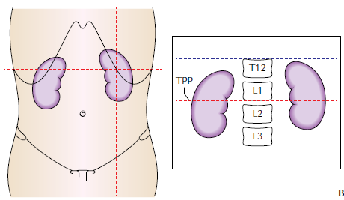

Slide 5
Shape, Size, and Weight
Shape: Bean shaped.
Measurements:-
Length: 11 cm.
left kidney is slightly longer and narrower.
Width: 6 cm.
Thickness: 3cm antero-posterior.
Weight: 150 gms in males
135 gms in females

Slide 6
Extension
Opposite T12–L3 vertebrae

Slide 7
Orientation
Right kidney lies at a slightly lower level than the left one due to the presence of liver
Both kidneys move downward in vertical direction for 2.5 cm during respiration.
Transpyloric plane passes through the upper part of the hilum of the right kidney and through the lower part of the hilum of the left kidney.

Slide 8
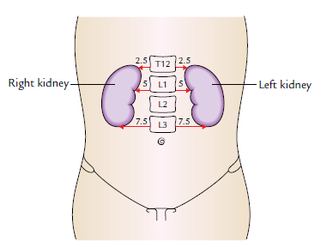
Orientation
Long axes are slightly oblique (being directed downward and laterally)
The upper poles are 2.5 cm away from the midline
The hilum are 5 cm away from the midline
The lower poles are 7.5 cm away from the midline

Slide 9
EXTERNAL FEATURES
1. Two poles : Superior
Inferior.
2. Two surfaces : Anterior
Posterior.
3. Two borders : Medial
Lateral.
4. A hilum

Slide 10
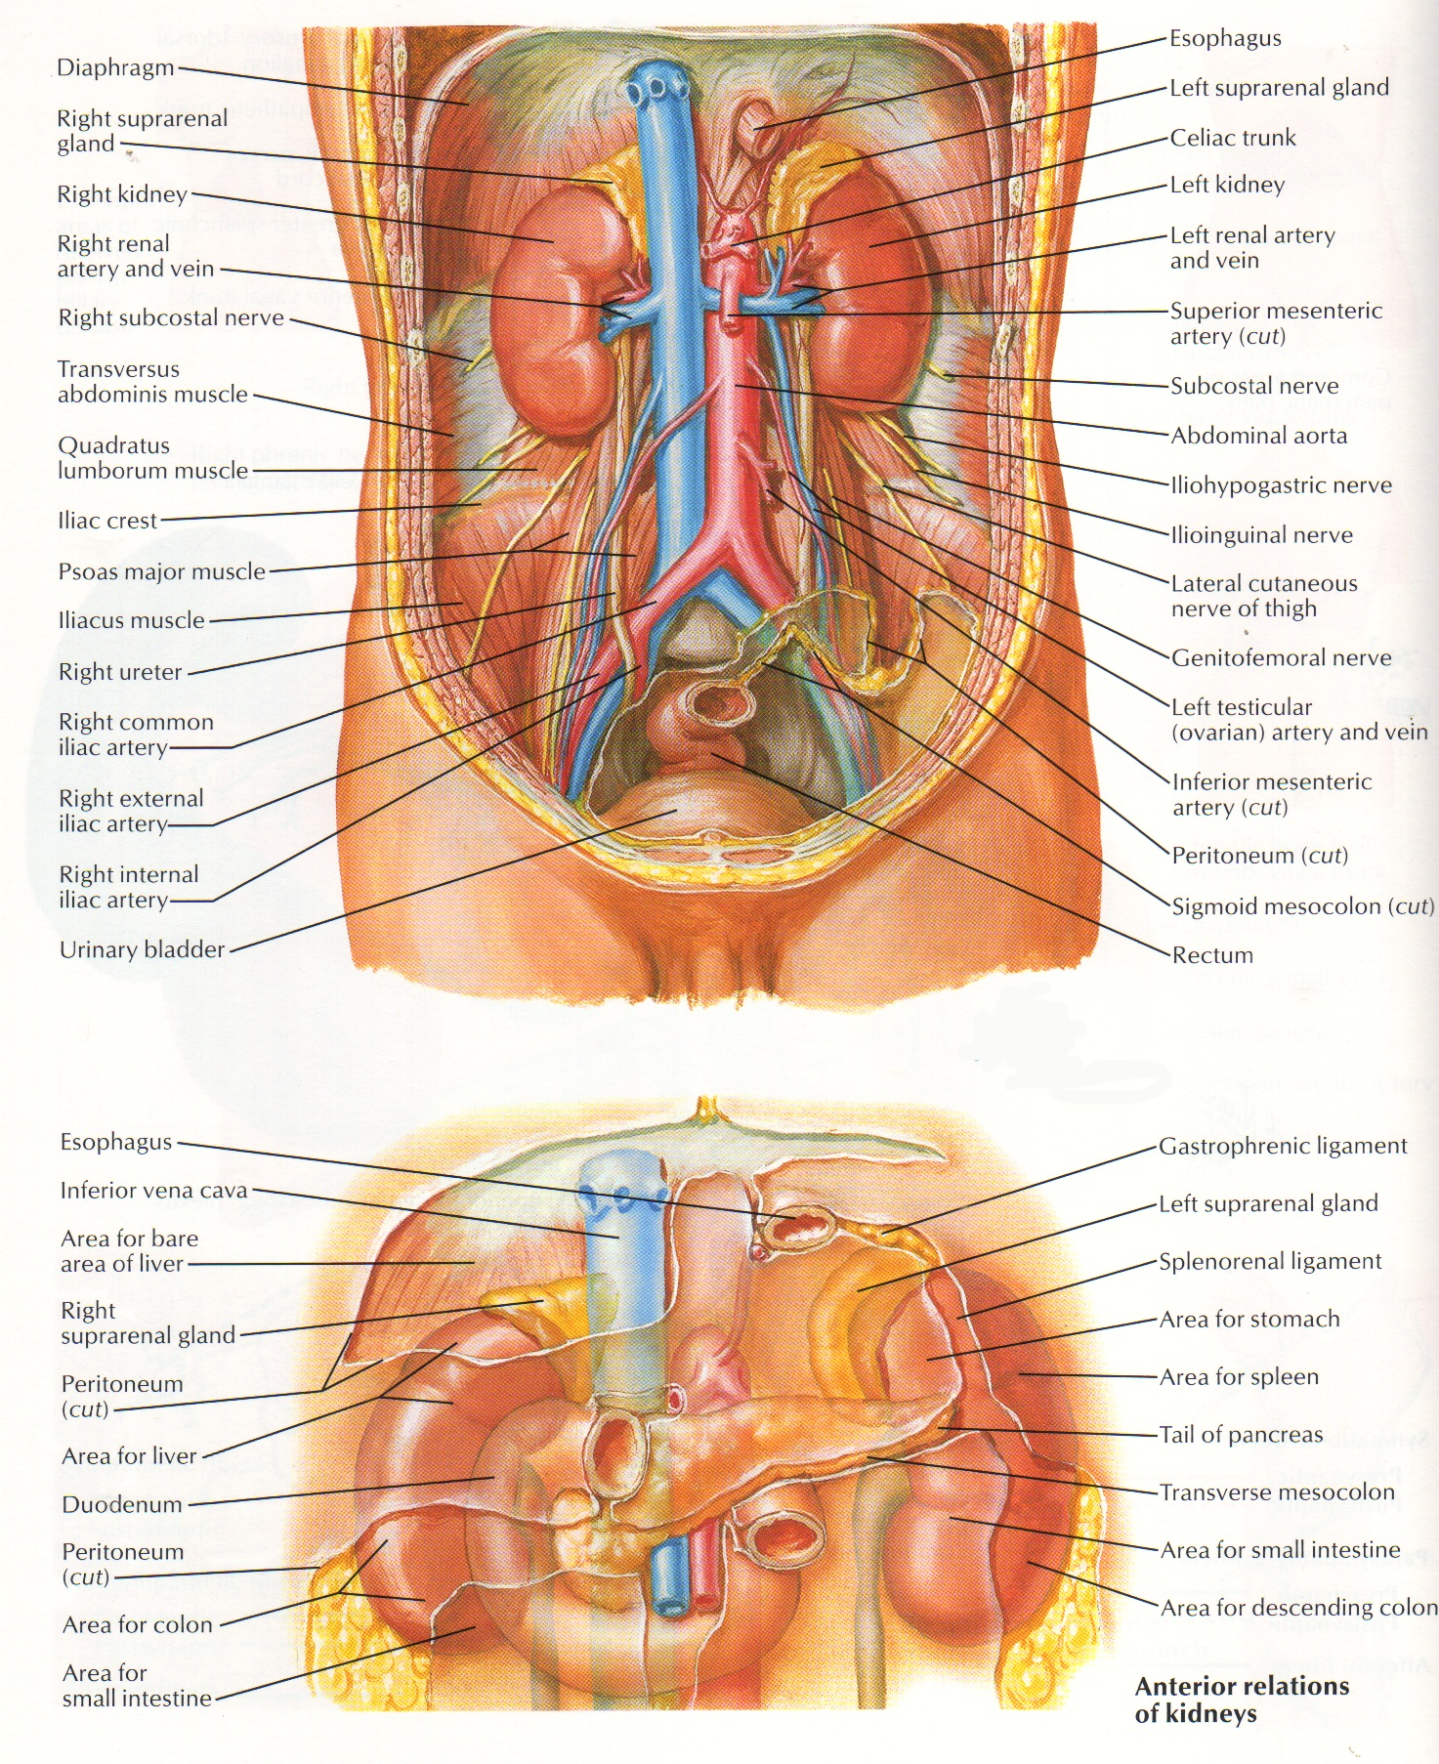
Poles
Superior pole is thick and round and lies nearer to the median plane than the inferior pole
Related to the suprarenal gland
Inferior pole is thin and pointed and lies 2.5 cm above the iliac crest

Slide 11
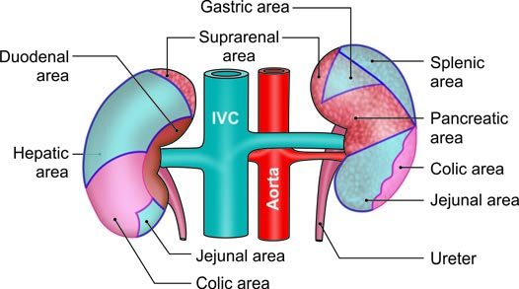
Anterior Surfaces
Anterior relations of the kidneys. Areas covered by peritoneum are shaded

Slide 12
Anterior Relations of Right Kidney
1. Right suprarenal gland
2. Liver
3. Second part of duodenum
4. Hepatic flexure of colon
5. Small intestine

Slide 13
Anterior Relations of the Left Kidney
1. Left suprarenal gland
2. Spleen
3. Stomach
4. Pancreas
5. Splenic vessels
6. Splenic flexure and descending colon
7. Jejunum

Slide 14
Posterior relation of both kidneys
The posterior surfaces of both kidneys are related to the following.
a. Diaphragm
b. Medial and lateral arcuate ligaments
c. Psoas major
d. Quadratus lumborum
e. Transversus abdominis
f. Subcostal vessels
g. Subcostal, iliohypogastric and ilioinguinal nerves.
In addition, the right kidney is related to twelfth rib, and the left kidney to eleventh and twelfth ribs.

Slide 15
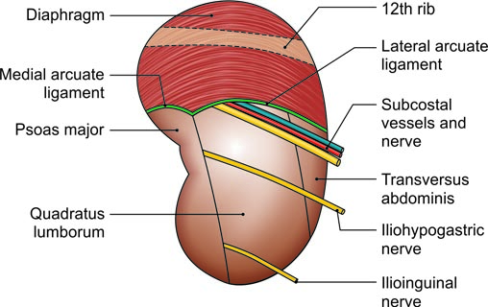
Posterior relation of both kidneys

Slide 16
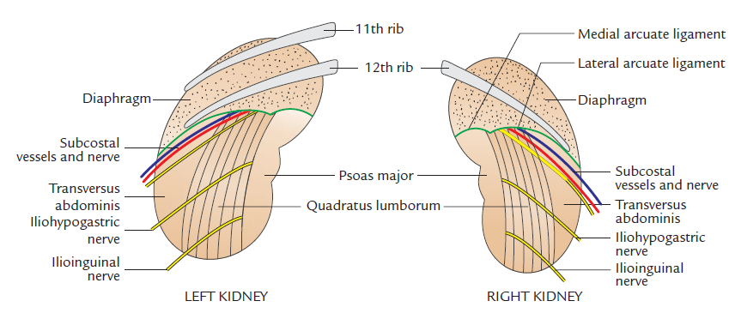

Slide 17
Borders
Lateral border- convex
Medial border of each kidney is related to:
The suprarenal gland, above the hilus, and
To the ureter below the hilus.
Hilum transmits, from before backward, the following structures:-
1. Renal vein
2. Renal artery
3. Renal pelvis

Slide 18
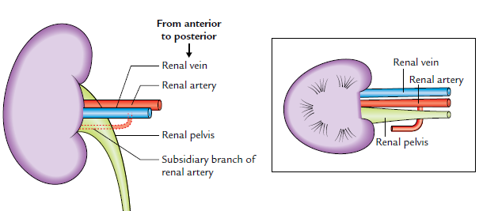
Hilum of kidney

Slide 19
Capsules or Coverings of Kidney (From within outside)
Fibrous capsule (true capsule)
Perirenal (perinephric) fat
Renal fascia (false capsule)
Pararenal (paranephric) fat

Slide 20
FIBROUS CAPSULE (TRUE CAPSULE)
It is a thin membrane which closely invests the kidney.
It is formed by the condensation of fibrous connective tissue in the peripheral part of the organ.
It is readily stripped off from the surface of the normal kidney.
If the kidney is inflamed, this capsule becomes firmly adherent to the organ and cannot be stripped off.

Slide 21
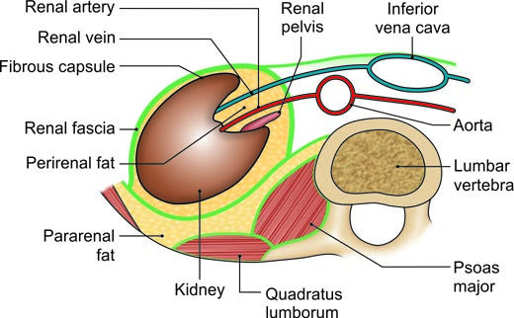
Transverse section through the lumbar region showing the capsules of the kidney

Slide 22
PERIRENAL (PERINEPHRIC) FAT
It is a layer of adipose tissue, surrounding the fibrous capsule of the kidney.
It fills the space inside the loosely fitting sheath of the renal fascia enclosing the kidney and suprarenal gland.
This fatty capsule is thickest at the borders of kidney and is prolonged through hilum into the renal sinus.

Slide 23
Transverse section through the lumbar region showing the capsules of the kidney

Slide 24
RENAL FASCIA (FALSE CAPSULE/ FASCIA OF GEROTA)
It is a fibroareolar sheath, which surrounds the kidney and perirenal fat.
It consists of the following two layers:
1. An ill-defined anterior layer (fascia of Toldt).
2. A well-defined posterior layer (fascia of Zuckerkandl)

Slide 25
Transverse section through the lumbar region showing the capsules of the kidney

Slide 26
Extensions
1. Superiorly, the two layers first enclose the suprarenal gland and become continuous with the diaphragmatic fascia.
2.Inferiorly, the two layers remain separate and enclose the ureter.
Anterior layer -is lost in the extraperitoneal tissue of iliac fossa
posterior layer-blends with the fascia iliaca.

Slide 27
3. Laterally, the two layers unite firmly and become continuous with the fascia transversalis
4. Medially-
Anterior layer passes in front of the kidney and renal vessels and merges with the connective tissue surrounding the aorta and inferior vena cava (IVC)
Posterior layer passes behind the kidney and is attached to fascia covering the quadratus lumborum and psoas major

Slide 28
PARARENAL (PARANEPHRIC) FAT
It is a layer of fat lying outside the renal fascia. It consists of considerable quantity of fat being more abundant posteriorly and toward the lower pole of the kidney
It fills the paravertebral gutter and forms a cushion for the kidney

Slide 29
Transverse section through the lumbar region showing the capsules of the kidney

Slide 30
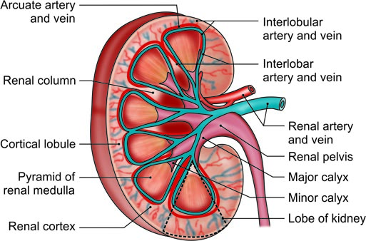
A coronal section through the kidney showing the naked eye structure including the blood supply of the kidney

Slide 31
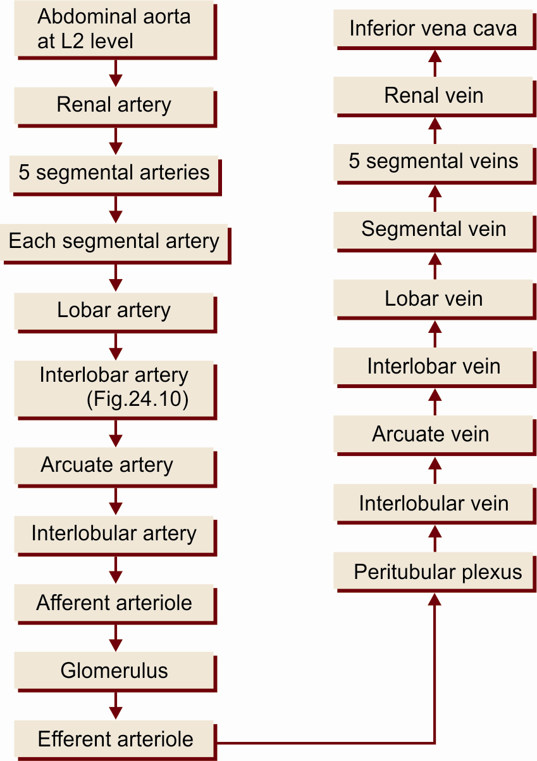
Blood supply

Slide 32
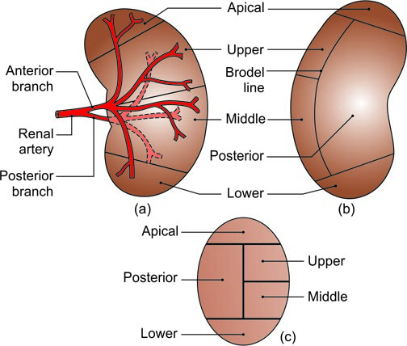
Vascular segments of the kidney as seen in a sagittal section

Slide 33
VENOUS DRAINAGE
The venous blood from the kidneys is drained by the renal veins (right and left)
The left renal vein passes in front of the aorta immediately below the origin of the inferior mesenteric artery

Slide 34
Inferior Vena Cava
The inferior vena cava is formed by the union of the right and left common iliac veins on the right side of the body of vertebra L5
It pierces the central tendon of the diaphragm at the level of vertebra T8, and opens into the lower and posterior part of the right atrium

Slide 35
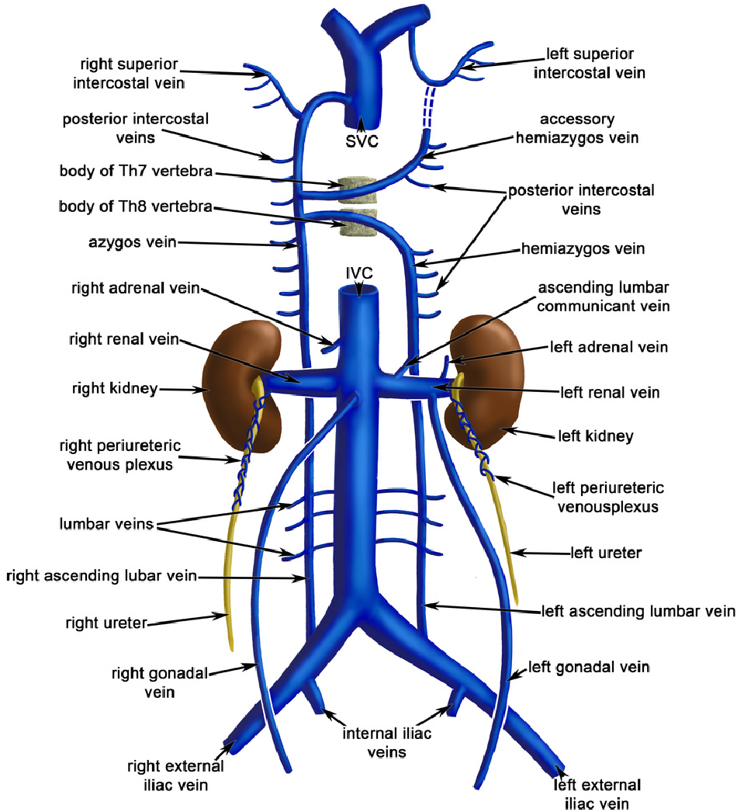

Slide 36
Tributaries
1. Common iliac veins
2. Third and fourth lumbar veins
3. Right testicular or ovarian vein
4. Renal veins
5. Right suprarenal vein

Slide 37
LYMPHATIC DRAINAGE
The lymphatics from the kidney drain into the para-aortic lymph nodes.
NERVE SUPPLY
Each kidney is supplied by the renal plexus of nerves which reach the kidney along the renal artery. The renal plexus consists of both sympathetic and parasympathetic fibres
Sympathetic fibres - from T10–L1 spinal segments
Parasympathetic fibres - from both vagus nerves

Slide 38
Renal pain
The renal pain is felt in the loin and often radiates downward and forward into the groin
The nature of pain varies from dull ache to severe spasmodic pain
The renal pain occur either due to stretching of the renal capsule or due to spasm of the smooth muscle in the renal pelvis
The pain is commonly referred along the subcostal nerve to the flank and anterior abdominal wall and along the ilioinguinal nerve (L1) into groin

Slide 39
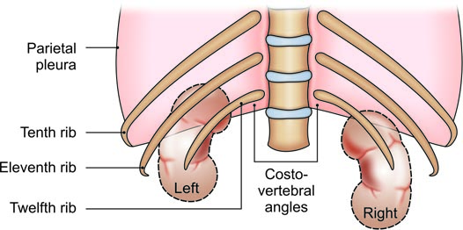
CLINICAL ANATOMY
Relation of twelfth rib to pleural cavity and kidney

Slide 40
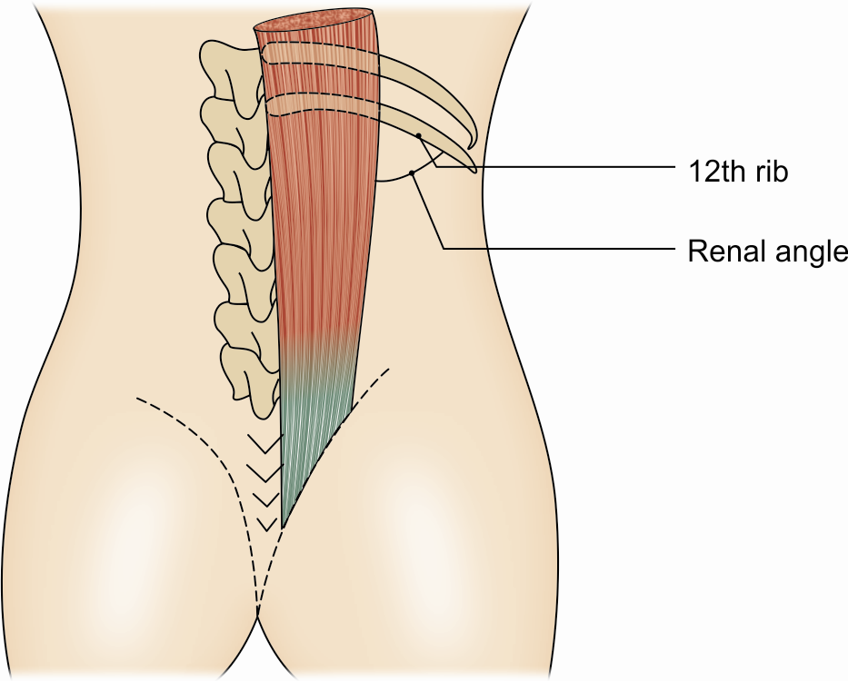
Renal angle

Slide 41
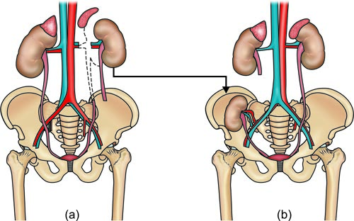
(a) Donor’s left kidney transplanted, and (b) recipient’s right kidney

Slide 42
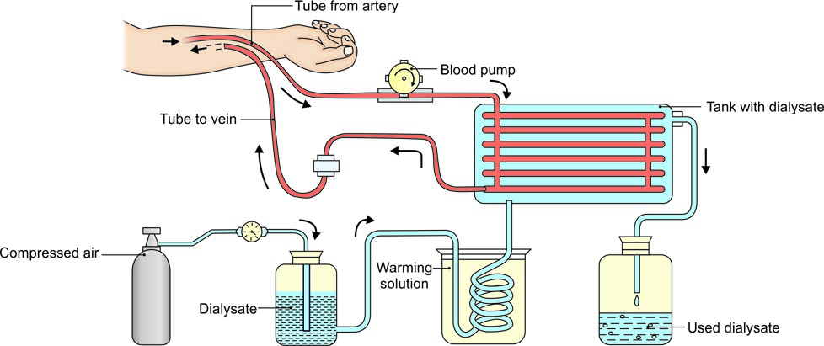
Haemodialysis

Slide 43
CLINICAL ANATOMY
• In surgical exposures of the kidney, when sometimes the 12th rib is resected for easier delivery of the kidney, danger of opening the pleural cavity must be borne in mind. The lower border of the pleura lies in between the 12th rib and the diaphragm.
• The order of structures from anterior to posterior side being diaphragm, pleura and rib. When the 12th rib is absent or is too short to be felt, the 11th rib may be mistaken for the 12th, and the chances of opening the pleural cavity are greatly increased. Lithotripsy has replaced conventional method to some degree.

Slide 44
• The angle between the lower border of the 12th rib and the outer border of the erector spinae is known as the renal angle. It overlies the lower part of the kidney. Tenderness in the kidney is elicited by applying pressure over this angle, with the thumb.
• Kidney may be transplanted in selected cases.
• In cases of chronic renal failure dialysis needs to be done. It can be done as peritoneal dialysis or haemodialysis.

