Slide 1
INTERSTITIAL LUNG DISEASE
RECENT ADVANCES IN MANAGEMENT.

Slide 2
RECENT ADVANCES IN CLASSIFICATION.

Slide 3
REVISED AMERICAN THORACIC SOCIETY/EUROPEAN RESPIRATORY SOCIETY CLASSIFICATION OF IDIOPATHIC INTERSTITIAL PNEUMONIAS: MULTIDISCIPLINARY DIAGNOSES

Slide 4
MAJOR
RARE
UNCLASSIFIABLE.

Slide 5
Major idiopathic interstitial pneumonias
Idiopathic pulmonary ﬁbrosis
Idiopathic nonspeciﬁc interstitial pneumonia
Respiratory bronchiolitis–interstitial lung disease
Desquamative interstitial pneumonia
Cryptogenic organizing pneumonia
Acute interstitial pneumonia
Rare idiopathic interstitial pneumonias
Idiopathic lymphoid interstitial pneumonia
Idiopathic pleuroparenchymal ﬁbroelastosis
Unclassiﬁable idiopathic interstitial pneumonias

Slide 6
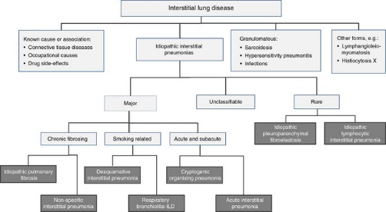

Slide 7
Multidisciplinary Approach

Slide 8
The process of achieving a multidisciplinary diagnosis in a patient with IIP is dynamic, requiring close communication between clinician, radiologist, and when appropriate, pathologist .
The multidisciplinary approach does not lessen the importance of lung biopsy in the diagnosis of IIPs; rather, it defines the settings where biopsy is more informative than high resolution computed tomography (HRCT) and those where biopsy is not needed.

Slide 9
CLASSIFICATION ACCORDING TO CLINICAL BEHAVIOUR.

Slide 10
TABLE 3. IDIOPATHIC INTERSTITIAL PNEUMONIAS:
CLASSIFICATION ACCORDING TO DISEASE BEHAVIOR*
CLINICAL BEHAVIOUR | Treatment Goal | Monitoring Strategy
Reversible and selflimited (e.g., many cases of RB-ILD) | Remove possible cause | Short-term (3- to 6-mo) observation to confirm disease regression
Reversible disease with risk of progression (e.g., cellular NSIP and some fibrotic NSIP, DIP, COP) | Initially achieve response and then rationalize longer term therapy | Short-term observation to confirm treatment response. Long-term observation to ensure that gains are preserved
Stable with residual disease (e.g., some fibrotic NSIP) | Maintain status | Long-term observation to assess disease course
Progressive, irreversible disease with potential for stabilization (e.g., some fibrotic NSIP) | Stabilize | Long-term observation to assess disease course
Progressive, irreversible disease despite therapy (e.g., IPF, some fibrotic NSIP) | Slow progression | Long-term observation to assess disease course and need for transplant or effective palliation

Slide 11
RECENT ADVANCES IN TREATMENT AND MANAGEMENT.

Slide 12
Deﬁnition IPF is deﬁned as a speciﬁc form of chronic, progressive ﬁbrosing interstitial pneumonia of unknown cause, occurring primarily in older adults, limited to the lungs, and associated with the histopathologic and/or radiologic pattern of UIP .
The deﬁnition of IPF requires the exclusion of other forms of interstitial pneumonia including other idiopathic interstitial pneumonias and ILD associated with environmental exposure, medication, or systemic disease.

Slide 13
IPF should be considered in all adult patients
with unexplained chronic exertional dyspnea,
with cough,
bibasilar inspiratory crackles, and
ﬁnger clubbing .
The incidence of the disease increases with older age, with presentation typically occurring in the sixth and seventh decades.
Patients with IPF aged less than 50 years are rare; such patients may subsequently manifest overt features of an underlying connective tissue disease that was subclinical at the time IPF was diagnosed .

Slide 14
RISK FACTORS.

Slide 15
Cigarette smoking
Environmental Exposure.
GERD
Microbiology
Genetic factor.

Slide 16
DEFINITION OF UIP PATTERN
UIP is characterized on HRCT by the presence of reticular opacities, often associated with traction bronchiectasis .
Honeycombing is common, and is critical for making a deﬁnite diagnosis.
Honeycombing is manifested on HRCT as clustered cystic airspaces, typically of comparable diameters on the order of 3–10 mm but occasionally as large as 2.5 cm.
It is usually subpleural and is characterized by well-deﬁned walls . Ground glass opacities are common, but usually less extensive than the reticulation. The distribution of UIP on characteristically basal and peripheral, though often patchy.

Slide 17
The presence of coexistent pleural abnormalities (e.g., pleural plaques, calciﬁcations, signiﬁcant pleural effusion) suggests an alternative etiology for UIP pattern. Micronodules, air trapping, nonhoneycomb cysts, extensive ground glass opacities, consolidation, or a peribronchovascular-predominant distribution should lead to consideration of an alternative diagnosis
Several studies have documented that the positive predictive value of a HRCT diagnosis of UIP is 90 to 100% .
(These studies are affected by selection bias because they only included patients with biopsy-proven diagnoses).

Slide 18
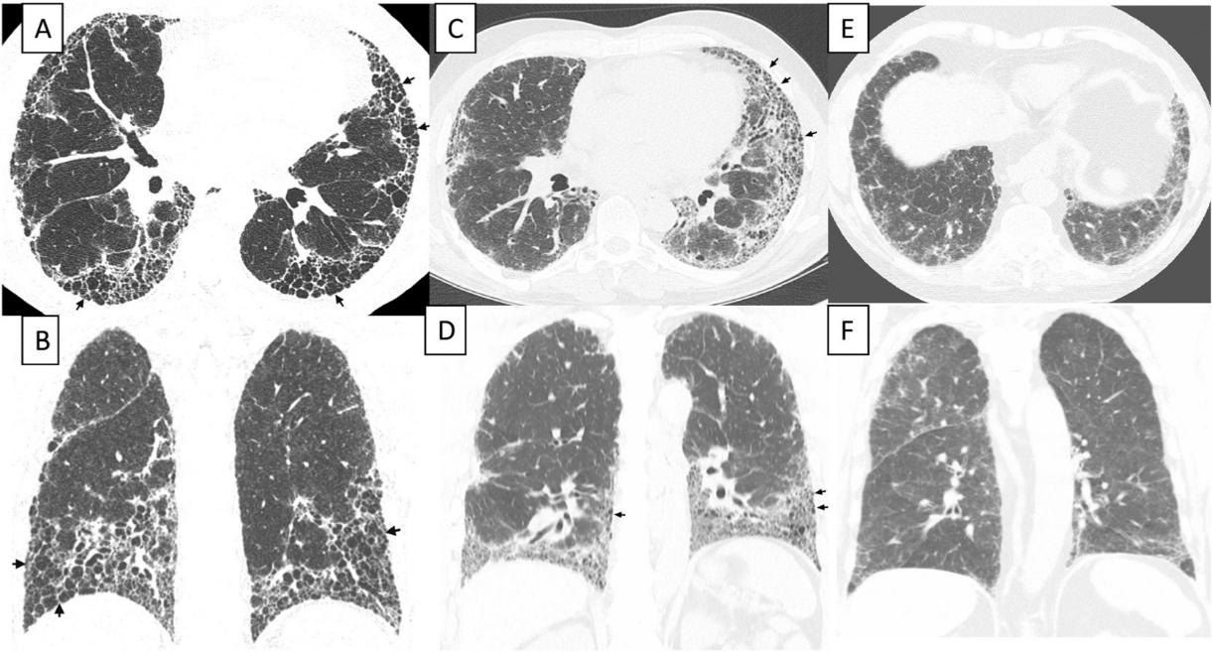

Slide 19
Figure 1. High-resolution computed tomography (HRCT) images demonstrating usual interstitial pneumonia (UIP) pattern and possible UIP pattern. (A and B) UIP pattern, with extensive honeycombing: axial and coronal HRCT images show basal predominant, peripheral predominant reticular abnormality with multiple layers of honeycombing (arrows). (C and D) UIP pattern, with less severe honeycombing: axial and coronal CT images show basal predominant, peripheral predominant reticular abnormality with subpleural honeycombing (arrows). (E and F) Possible UP pattern: axial and coronal images show peripheral predominant, basal predominant reticular abnormality with a moderate amount of ground glass abnormality, but without honeycombing

Slide 20
DIAGNOSIS ADVANCES AND RECOMMENDATION.

Slide 21
Given the high-quality evidence regarding HRCT specificity for the recognition of histopathologic UIP pattern, surgical lung biopsy is not essential .
In the appropriate clinical setting (as described in the clinical presentation section above; this includes a thorough medical, occupational/environmental and family history, physical examination, physiological testing, and laboratory evaluation), the presence of a UIP pattern on HRCT is sufficient for the diagnosis of IPF. Thus, the major and minor criteria for the clinical (i.e., nonpathologic) diagnosis of IPF have been eliminated.

Slide 22
Diagnostic Criteria
The diagnosis of IPF requires the following:
Exclusion of other known causes of ILD (e.g., domestic and occupational environmental exposures, connective tissue disease, and drug toxicity).
The presence of a UIP pattern on HRCT in patients not subjected to surgical lung biopsy.
Specific combinations of HRCT and surgical lung biopsy pattern in patients subjected to surgical lung biopsy .

Slide 23
HRCT | SURGICAL BIOPSY | IPF
UIP | UIP | YES
 | PROBABLE UIP
 | POSSIBLE UIP
 | NONCLASSIFIABLE FIBROSIS
 | NOT UIP | NO
POSSIBLE UIP | UIP | YES
 | PROBABLE UIP
 | POSSIBLE UIP | PROBABLE
 | NONCLASSIFIABLE FIBROSIS
 | NOT UIP | NO
INCONSISTENT WITH UIP | UIP | POSSIBLE
 | PROBABLE UIP | NO
 | POSSIBLE UIP
 | NONCLASSIFIABLE FIBROSIS
 | NOT UIP

Slide 24
DIAGNOSTIC MODALITIES AND RECOMMENDATION.

Slide 25
Question: Should BAL cellular analysis be performed in the diagnostic evaluation of suspected IPF?

Slide 26
In the evaluation of patients with suspected IPF, the most important application of BAL is in the exclusion of
chronic hypersensitivity pneumonitis; from NSIP;Prominent lymphocytosis ( 40%) should suggest the diagnosis.
Recent retrospective data suggest that 8% of patients with an HRCT UIP pattern may have BAL findings suggestive of an alternative diagnosis.
It is unclear whether BAL adds significant diagnostic specificity to a careful exposure history and clinical evaluation.
Recommendation: BAL cellular analysis should not be performed in the diagnostic evaluation of IPF in the majority of patients, but may be appropriate in a minority (weak recommendation, low-quality evidence).

Slide 27
Question: Should transbronchial lung biopsy be used in the evaluation of suspected IPF?
Transbronchial lung biopsy is useful in the evaluation of selected conditions (e.g., granulomatous disorders such as sarcoidosis).
A UIP pattern on HRCT makes these conditions unlikely .

Slide 28
In cases requiring histopathology, the specificity and positive predictive value of UIP pattern identified by transbronchial biopsy has not been rigorously studied. While transbronchial biopsy specimens may show all the histologic features of UIP the sensitivity and specificity of this approach for the diagnosis for UIP pattern is unknown.
It is also unknown how many and from where transbronchial biopsies should be obtained.
Recommendation: Transbronchial biopsy should not be used in the evaluation of IPF in the majority of patients, but may be appropriate in a minority (weak recommendation, low-quality evidence).

Slide 29
Question: Should serologic testing for connective tissues disease be used in the evaluation of suspected IPF?
There are no reliable data on the role of screening serologies in patients with suspected IPF. Connective tissue disease can present with a UIP pattern (124), and ILD has been described as the sole clinical manifestation of these conditions and can precede the overt manifestation of a specific connective tissue disease .
Recommendation: Serologic testing for connective tissue disease should be performed in the evaluation of IPF in the majority of patients, but may not be appropriate in a minority (weak recommendation, very low-quality evidence).

Slide 30
Remarks: Serologic evaluation should be performed even in the absence of signs or symptoms of connective tissue disease, and should include rheumatoid factor, anti-cyclic citrullinated peptide, and anti-nuclear antibody titer and pattern.
The routine use of other serological tests such as antisynthetase antibodies (e.g., Jo-1), creatine kinase and aldolase, Sjogren’s antibodies (SS-A, SS-B), and scleroderma antibodies (scl-70, PM-1) is of unclear benefit, but may be helpful in selected cases.

Slide 31
Patients with IPF may have a mildly positive antinuclear antibody titer and/or rheumatoid factor level without any other clinical features of connective tissue.
In the absence of additional serologic or clinical evidence to support a connective tissues diagnosis, the diagnosis of IPF is appropriate.
Repeat serologic and clinical evaluation during follow up may subsequently confirm the development of a connective tissue disease; in such cases, the diagnosis should be revised.

Slide 32
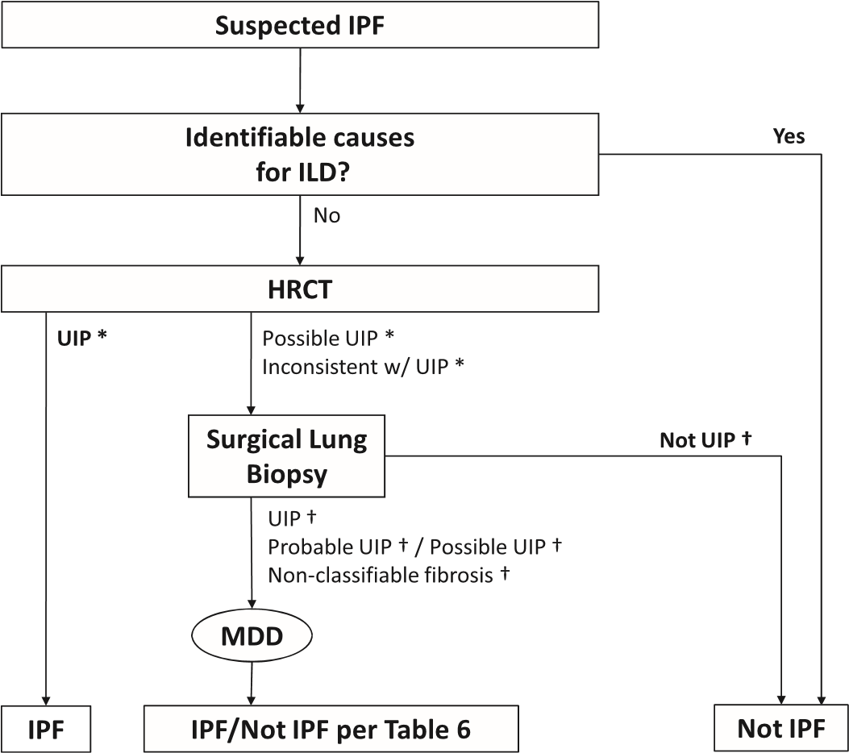
Diagnostic algorithm for idiopathic pulmonary fibrosis (IPF).

Slide 33
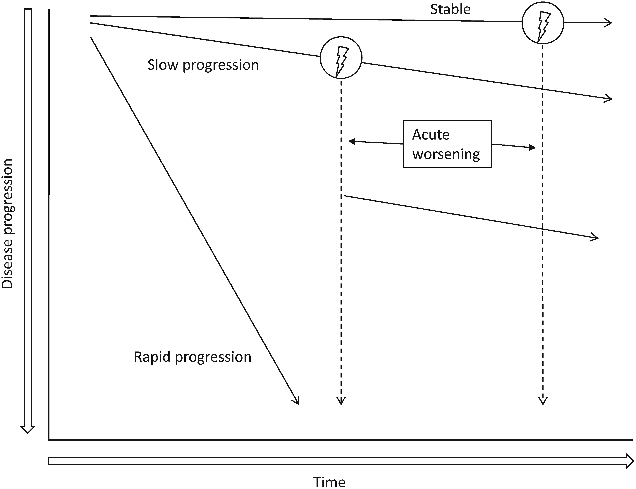
Natural history of lld.

Slide 34
TREATMENT ADVANCES AND RECOMMENDATION.

Slide 35
Question 1: Should Patients with IPF Be Treated with Anticoagulation?
Question 2: Should Patients with IPF Be Treated with Imatinib, a Tyrosine Kinase Inhibitor?
Question 3: Should Patients with IPF Be Treated with Combination Prednisone, Azathioprine, and N-Acetylcysteine?
Question 4: Should Patients with IPF Be Treated with Ambrisentan, a Selective ER-A Endothelin Receptor Antagonist?

Slide 36
Question 5: Should Patients with IPF Be Treated with Pirfenidone?
Question 6: Should Patients with IPF Be Treated with Antiacid Medication?
Question 7: Should Patients with IPF Be Treated with Sildenaﬁl, a Phosphodiesterase-5 Inhibitor?

Slide 37
Question 9: Should Patients with IPF Be Treated with Bosentan or Macitentan, Dual ERAs (ER-A and ER-B)?
Question 10: Should Patients with IPF Be Treated with N-Acetylcysteine Monotherapy?
Question 11: Should Patients with IPF Be Treated with Bilateral Lung Transplantation versus Single-Lung Transplantation?
Question 12: Should PH Be Treated in Patients with IPF?

Slide 38
Question 1: Should Patients with IPF Be Treated with Anticoagulation?
Studies have suggested a procoagulant state may be involved in promoting fibrosis via cell-surface receptor–mediated pathways providing biological plausibility for a mechanistic link between thrombosis and lung fibrosis . It is less clear what role systemic anticoagulants may have in preventing this effect in patients with IPF.

Slide 39
The 2011 guideline included one study
An open randomized trial that compared oral warfarin plus prednisolone against prednisolone alone in 56 patients with IPF treatment with warfarin led to a reduction in the secondary outcome of IPF acute exacerbation-associated mortality.

Slide 40
This trial was associated with significant methodological concerns, specifically the lack of a clear description of how randomization or concealment of allocation was undertaken, the lack of a description of how patient drop-out was managed, and a failure to exclude pulmonary embolus as a potential cause for clinical deterioration.
For these reasons, in addition to the absence of a placebo control, it was considered to have a high risk of bias and was excluded from pooled analysis in this treatment update.

Slide 41
Recommendation. We recommend that clinicians not use warfarin anticoagulation in patients with IPF who do not have a known alternative indication for its use (strong recommendation against, low confidence in estimates of effect).

Slide 42
Question 2: Should Patients with IPF Be Treated with Imatinib, a Tyrosine Kinase Inhibitor?
Imatinib is a potent inhibitor of lung fibroblast–myofibroblast differentiation and proliferation, as well as an inhibitor of extracellular matrix production through inhibition of PDGF and transforming growth factor-b signaling.
Recommendation. We recommend that clinicians not use imatinib in patients with IPF (strong recommendation, moderate confidence in estimates of effect).

Slide 43
Question 3: Should Patients with IPF
Be Treated with Combination Prednisone, Azathioprine, and N-Acetylcysteine?

Slide 44
Previously, immune suppression was considered important in the treatment of IPF .
It was thought that a two-drug regimen including glucocorticoids in addition to either azathioprine or cyclophosphamide may be superior to glucocorticoids alone .
Given some early studies in favor of N-acetylcysteine , clinicians and researchers have examined the potential benefit of this three-drug regimen for IPF.
The 2011 guideline included one RCT that compared N-acetylcysteine versus placebo in patients receiving prednisone and azathioprine .
In this study, 12-month declines in vital capacity and diffusing capacity of the lung for carbon monoxide (DL_{CO}) were significantly less with the addition of N-acetylcysteine, although no significant effect on mortality, dyspnea scores, or quality of life was observed.

Slide 45
Given the limitations of this study, specifically the lack of a true placebo group for all active therapies, a more recent RCT has been reported that randomized patients to combination therapy versus placebo for all active agents .
This multicenter study was stopped early after a signal for harm was seen in patients receiving combination therapy compared with placebo, with an increase in mortality and hospitalization (P , 0.001).
No significant difference between groups was seen in FVC change (moderate confidence), DL_{CO} change (low confidence), or quality-of-life indices (low confidence).
Recommendation -We recommend that clinicians not use the combination therapy of N-acetylcysteine, azathioprine, and prednisone in patients with IPF (strong recommendation, low confidence in estimates of effect).

Slide 46
Justification and implementation considerations
This recommendation is primarily based on the results of a single trial that was stopped early for harm . Although trials stopped early prompt concerns about the true underlying effect , a clear negative effect was seen for multiple patient-important outcomes after enrolling 50% of targeted patients to this study.
This recommendation places a high value on these potential adverse effects of the intervention.
The committee felt that this recommendation only applies to patients with IPF treated with the dose of agents used in the trial and may not necessarily be generalizable to other forms of interstitial lung disease or other doses of treatment medications.

Slide 47
There was no consensus on how to deal with patients with IPF who have been receiving a combination therapy long-term with good tolerance, as studies did not address stopping this treatment.
In such circumstances, the committee recommended that an informed discussion is necessary and should take place between the individual patient and practitioner discussing the potential harms of treatment in combination with considerations for the patient’s values and preferences.
Despite challenges in judging benefit in individual patients, with those who seemed to have responded to combination therapy, it is prudent to readdress the accuracy of the diagnosis of IPF and reconsider other disease processes that may be more responsive to this treatment.

Slide 48
Question 4: Should Patients with IPF Be Treated with Ambrisentan, a Selective ER-A Endothelin Receptor Antagonist
Clinically significant endothelin receptors fall into one of a few categories, including endothelin type A (ET-A) receptors, which induce vasoconstriction and are usually found on vascular smooth muscle cells, and the endothelin type B1 (ET-B1) receptors, located in the endothelial cells, which are known to stimulate the release of nitric oxide (NO) and prostacyclin to produce a vasodilating effect (15). ET-A receptorshave also been shown to propagate epithelial-to-mesenchymal transition through intermediary cytokines, leading to a profibrotic state (16). ET-B2 receptors antagonize ET-B1 receptors and vasoconstrict through an unknown mechanism .
Clinically available endothelin receptor antagonists (ERAs) include selective ET-A antagonists (e.g., ambrisentan) and dual antagonists that affect both ET-A and ET-B receptors (e.g., bosentan and macitentan). Increased ET-A and ET-B receptor levels have been found in IPF-affected fibrotic lung , and as such, both selective and dual antagonists have been investigated for potential benefit in treating patients with IPF

Slide 49
Recommendation. We recommend that clinicians not use ambrisentan, a selective ER-A endothelin receptor antagonist, in patients with IPF, regardless of the presence or absence of PH (strong recommendation against, low confidence in estimates of effect).

Slide 50
Question : Should Patients with IPF Be Treated with Pirfenidone?
Pirfenidone is an oral antifibrotic drug with pleiotropic effects. It has been shown to regulate important profibrotic and proinflammatory cytokine cascades in vitro while reducing fibroblast proliferation and collagen synthesis in animal models of lung fibrosis .
Recommendation. We suggest that clinicians use pirfenidone in patients with IPF (conditional recommendation, .

Slide 51
Question : Should Patients with IPF Be Treated with Sildenafil, a Phosphodiesterase-5 Inhibitor?
Sildenafil, an oral phosphodiesterase-5 inhibitor, has been studied in two RCTs that enrolled patients with IPF .
Recommendation. We suggest that clinicians not use sildenafil, a phosphodiesterase-5 inhibitor, for treatment of IPF (conditional recommendation against, moderate confidence in estimates of effect

Slide 52
Should patients with IPF be treated with acetylcysteine monotherapy?
Recommendation: The majority of patients with IPF should not be treated with acetylcysteine monotherapy, but this therapy may be a reasonable choice in a minority (weak recommendation, low-quality evidence).

Slide 53
Question: Should patients with acute exacerbation of IPF be treated with corticosteroids?
Although high-dose corticosteroids are commonly prescribed for the treatment of acute exacerbation of IPF ,there are no controlled trials on which to judge efficacy
Recommendation: The majority of patients with acute exacerbation of IPF should be treated with corticosteroids, but corticosteroids may not be reasonable in a minority (weak recommendation, very low-quality evidence).

Slide 54
Agent | 2015 Guideline | 2011 Guideline
New and revised recommendations
Anticoagulation (warfarin) | Strong recommendation against use* | Conditional recommendation against use‡
Combination prednisone 1 azathioprine 1 N-acetylcysteine | Strong recommendation against use† | Conditional recommendation against use†
Selective endothelin receptor antagonist (ambrisentan) | Strong recommendation against use† | Not addressed
Imatinib, a tyrosine kinase inhibitor with one target | Strong recommendation against use* | Not addressed
Nintedanib, a tyrosine kinase inhibitor with multiple targets | Conditional recommendation for use* | Not addressed

Slide 55
Agent | 2015 Guideline | 2011 Guideline
Pirfenidone | Conditional recommendation for use* | Conditional recommendation against use†
Dual endothelin receptor antagonists (macitentan, bosentan) | Conditional recommendation against use† | Strong recommendation against use*
Phosphodiesterase-5 inhibitor (Sildenafil) Unchanged recommendations | Conditional recommendation against use* | Not addressed
Antiacid therapy | Conditional recommendation for use‡ | Conditional recommendation for use‡
N-acetylcysteine monotherapy | Conditional recommendation against use† | Conditional recommendation against use†
Anti–pulmonary hypertension therapy for idiopathic pulmonary fibrosis-associated pulmonary hypertension | Reassessment of the previous recommendation was deferred | Conditional recommendation against use‡
Lung transplantation: single vs. bilateral lung transplantation | Formulation of a recommendation for single vs. bilateral lung transplantation was deferred | Not addressed

Slide 56
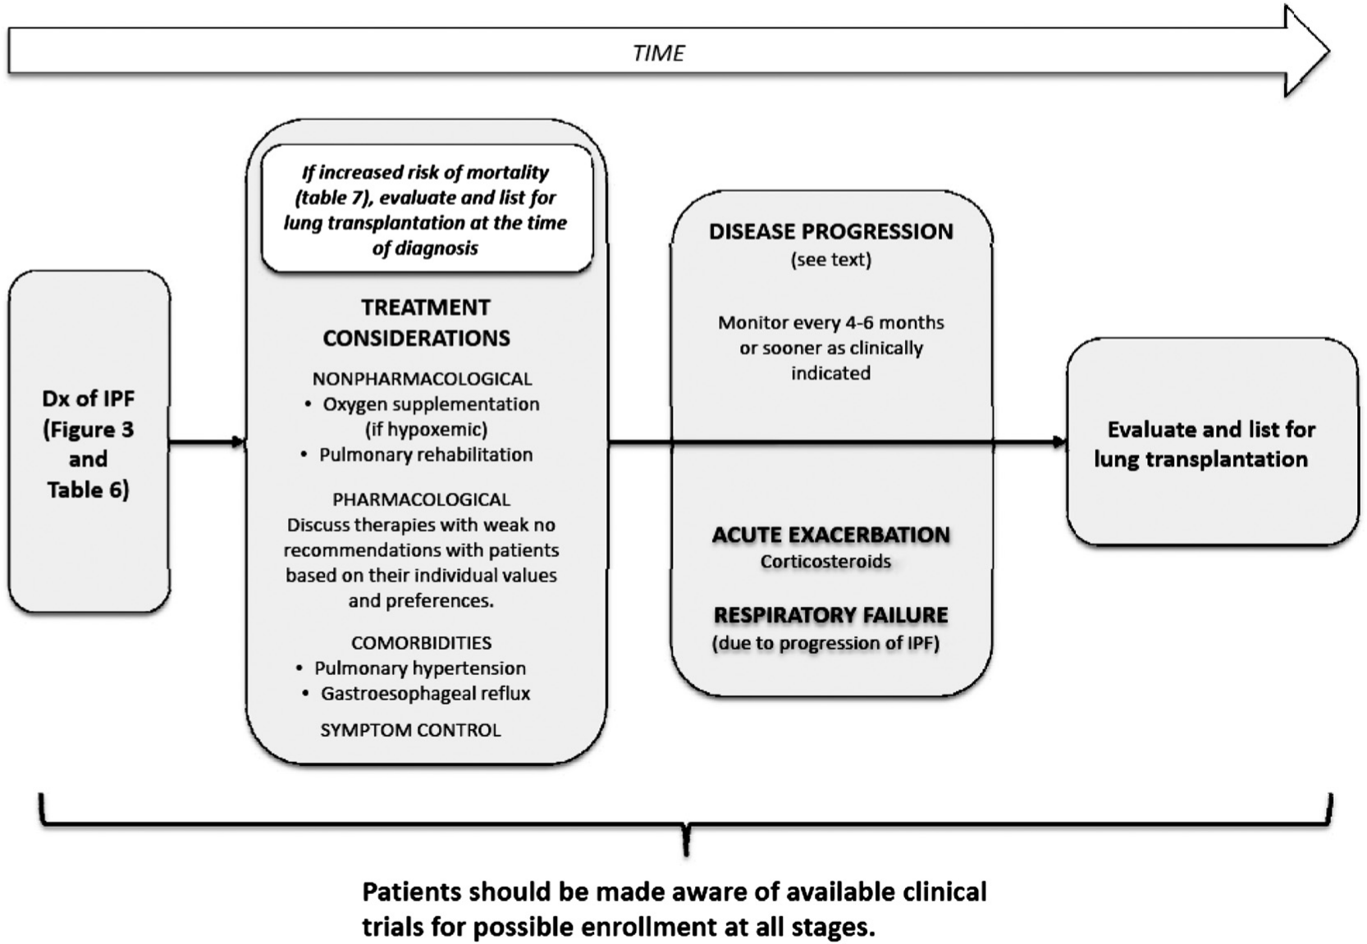

Slide 57
THANK YOU

