Slide 1
Antiretroviral drugs and recent changes in management of HIV & HIV + TB

Slide 2
What are HIV?
HIV stands for Human Immunodeficiency virus.
The virus compromises the body’s ability to handle disease and causes Aids.
An RNA based virus that causes AIDS
  Attacks the Immune system
  Destroys the body’s defenses against diseases
  Body becomes vulnerable to infections & cancers that don’t normally develop in healthy people.

Slide 3
HIV-1 AND HIV-2
HIV-1 AND HIV-2
  Transmitted through the same routes
  Associated with similar opportunistic infections
HIV-1 is more common worldwide.
HIV-2 is found primarily in West Africa, Mozambique and Angola.

Slide 4
HIV-1 AND HIV-2
Differences between HIV-1 AND HIV-2
  HIV-2 is less easily transmitted.
  HIV-2 develops more slowly.
  MTCT is relatively rare with HIV-2.

Slide 5
Variation in HIV-1
Most error-prone reverse transcriptase.
Variability of the gp 120 antigen.
Failure of the immune system to control the infection.

Slide 6
Transmission of HIV
HIV is transmitted by
Direct contact with infected blood.
Sexual contact: oral , anal or vaginal
Direct contact with semen or vaginal and cervical secretions
Mothers infected with HIV to infants during pregnancy , delivery and breastfeeding
Add (%)

Slide 7
Transmission of HIV
HIV cannot be transmitted by:
Coughing , sneezing
Insect bites
Touching , hugging
Water , Food
Kissing
Public baths/pools
Toilets
Handshakes
Work or school contact
Telephones
Cups, glasses, plates or other utensils.

Slide 8
Preventions of HIV Transmission
Public health strategies to prevent HIV transmission
Screen all blood and blood products.
Follow universal precautions.
Educate in safer sex practices.
Identify and treat STIs.
Provide referral for treatment of drug dependence.
Apply the comprehensive PMTCT approach to prevent transmission of HIV.

Slide 9
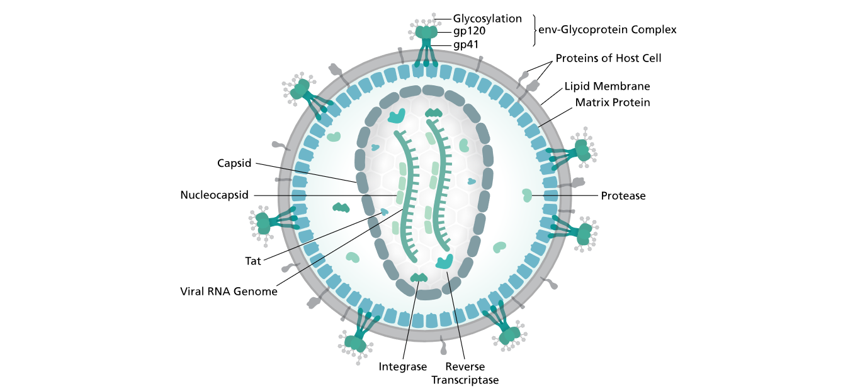
HIV structure

Slide 10
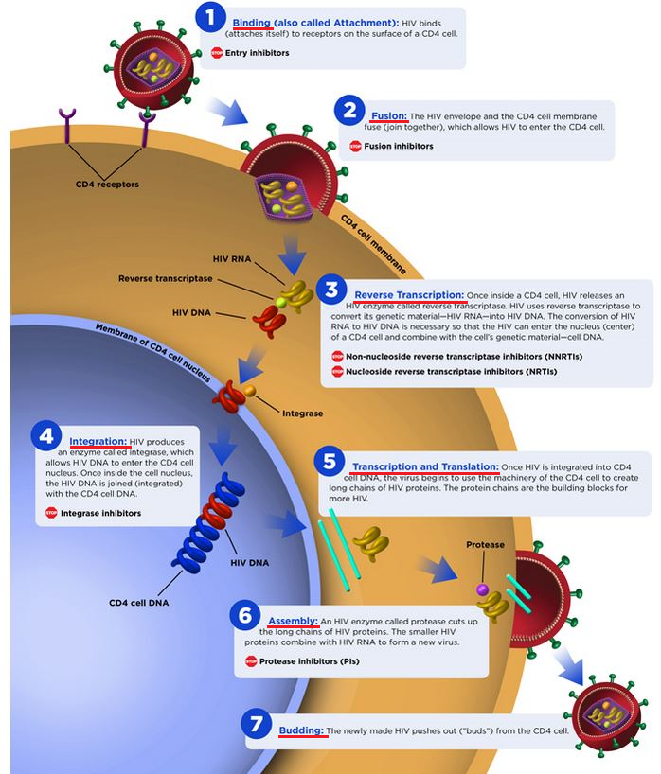
Notes:
Life cycle of hiv

Slide 11
Who clinical stages of hiv Aids
REVISED WHO CLINICAL STAGING OF HIV/AIDS FOR ADULTS AND ADOLESCENTS
Primary HIV infection
Asymptomatic
Acute retroviral syndrome
Clinical stage 1
Asymptomatic
Persistent generalized lymphadenopathy (PGL)

Slide 12
Clinical stage 2
Moderate unexplained weight loss (<10% of presumed or measured body weight)
Recurrent respiratory tract infections (RTIs, sinusitis, bronchitis, otitis media, pharyngitis)
Herpes zoster
Recurrent oral ulcerations
Papular pruritic eruptions
Seborrhoeic dermatitis
Fungal nail infections of fingers

Slide 13
Severe weight loss (>10% of presumed or measured body weight)
Unexplained chronic diarrhoea for longer than one month
Unexplained persistent fever (intermittent or constant for longer than one month)
Oral candidiasis
Oral hairy leukoplakia
Pulmonary tuberculosis (TB) diagnosed in last two years
      Clinical stage 3
Severe presumed bacterial infections (e.g. pneumonia, empyema, pyomyositis, bone or
joint infection, meningitis, bacteraemia)
Acute necrotizing ulcerative stomatitis, gingivitis or periodontitis

Slide 14
Unexplained anaemia (< 8 g/dl), and and or
thrombocytopenia (<50 000/ mm3) for more than one month
HIV wasting syndrome
Pneumocystis pneumonia
Recurrent severe or radiological bacterial pneumonia
Chronic herpes simplex infection (orolabial, genital or anorectal of more than one month’s
duration)
Oesophageal candidiasis
Extrapulmonary TB
Kaposi’s sarcoma
Central nervous system (CNS) toxoplasmosis
HIV encephalopathy

Slide 15
Extrapulmonary cryptococcosis including meningitis
          Clinical stage 4
Disseminated nontuberculosis mycobacteria infection
Progressive multifocal leukoencephalopathy
Candida of the trachea, bronchi, or lungs
Chronic cryptosporidiosis (with diarrhea)
Chronic isosporiasis
Disseminated mycosis (e.g., histoplasmosis, coccidioidomycosis, penicilliosis)
Recurrent nontyphoidal Salmonella bacteremia
Lymphoma (cerebral or B-cell non-Hodgkin)
Invasive cervical carcinoma
Atypical disseminated leishmaniasis

Slide 16
Symptomatic HIV-associated nephropathy
Symptomatic HIV-associated cardiomyopathy
Reactivation of American trypanosomiasis (meningoencephalitis or myocarditis)

Slide 17
Laboratory Diagnosis of HIV Infection
Methods utilized to detect:
  Antibody
  Antigen
  Viral nucleic acid
  Virus in culture
          1.ELISA Testing
Antibodies detected in ELISA include those directed against: p24, gp120, gp160 and gp41, detected first in infection and appear in most individuals
Different types of ELISA techniques used:
  indirect
  competitive
  sandwich

Slide 18
Other Screening Tests
2.Agglutination tests ( Ag – Ab DETECTION TEST)
3.Dot-Blot Testing
4.Indirect immunofluorescence-Can be used to detect both virus and antibody to it.
5.Detection of p24 HIV antigen- Detection of p24 HIV antigen-Most useful for the following:
  early infection suspected in seronegative patient
  newborns
  CSF
  monitoring disease progress
  6.Polymerase Chain Reaction (PCR)

Slide 19
7.Virus isolation
8.Viral Load Tests

Slide 20
Classification of Antiretroviral drugs
NRTI (Nucleoside Reverse Transcriptase Inhibitors)
NtRTI (Nucleotide Reverse Transcriptase Inhibitors)
NNRTI ( Non-Nucleoside Reverse Transcriptase Inhibitors)
PI (Protease Inhibitors)
Entry Inhibitors
Integrase Inhibitors

Slide 21
Mechanism of action
Different classes of antiretroviral drugs act on different stages of the HIV life cycle. These drugs act at various stages of the life cycle of HIV in the body and work by interrupting the process of viral replication.
(i) Block binding of HIV to target cell (fusion inhibitors)
(ii) Block viral RNA cleavage and one that inhibits reverse transcriptase (reverse transcriptase inhibitors)
(iii) Block the enzyme, integrase, which helps in the incorporation of the proviral DNA into the host cell chromosome (integrase inhibitors)
(iv) Block the RNA to prevent viral protein production
(v) Block the enzyme protease (protease inhibitors)
(vi) Inhibit the budding of virus from host cells

Slide 22
1. Nucleoside Reverse Transcriptase Inhibitors(NRTI)/Nucleotide Reverse Transcriptase Inhibitors (ntRTI)
a. Zidovudine (AZT/ZDV)*
b. Stavudine (d4T)*
C.Lamivudine (3TC)*
D.Didanosine (ddl)*
E.Zalcitabine (ddC)*
F.Abacavir (ABC)*
G.Emtricitabine (FTC)
(NtRTI)
A.Tenofavir (TDF)*
Side effect
A. Anemia , lactic acidosis ,hepatomegaly with statosis .
C. Flare of hepatitis in HBV co infected pt who discontinue drugs
F.Hpersensitivity reaction (fever , rash , nausea , vomitting malaise , or fatigue and loss of appetite
G. HEPATOTOXICITY IN HBV co infected pt who discontinue drug, skin discolouration
A. Renal toxicity , ostiomalacia , flare of hepatitis in HBV co infected patient who discontinue drug

Slide 23
2. Non Nucleoside Reverse Transcriptase Inhibitor (NNRTI)
Side effect
Skin rashes , hepatotoxicity
Rash , dysphoria , eleveted lever function tests , drowsyness , abnormal dreams ,depression ,
Rash ,nausea , hapersensitivity reactions
Nausea , dissiness,vertigo,less cns toxicity and rash than efavirenz
a. Nevirapine (NVP)
b. Efavirenz (EFV)
c. Etravirine (Intelence)
D.Rilpivirene
E.Delavirdine (DLV)

Slide 24
3. Protease Inhibitors (PI)
a. Indinavir (IDV)
b. Lopinavir/ritonavir (Kaletra)
c. Saquinavir
d. Atazanavir (ATV)
e. Darunavir (Prezista)
f. Ritonavir
g. Nelfi navir (Viracept)
Side effects
D. Hyperbillirubinemia , nausea , vomitting , rash, transaminase elevation , renal stone
E.diarrhea ,nausea , headache , skin rash,hepatotocixity hyperlipidemia, hyperglycemia.
F.nausea,abdominal pain ,hypeglycemia, fat redistribution,lipid abnormalities, hepatitis

Slide 25
4. Integrase Inhibitors
A.Nausea ,headache , diarrhea ,muscle weakness
B. Nausea, , diarrhea ,upper respiratory infections , headache .
C. Insomnia,headache ,hypersensitivity reaction ,hepatotoxicity .
Hypersensitivity reaction , increased rate of bacterial pneumonia .
Hepatotoxicity,nasopharyngitis,fever , cough , rash , abd pain , dizziness .
a. Raltegravir (Isentress)
b.Elvitegravir
Dolutegravir
    5.Entry inhibitors
a. Enfuritide (Fuzeon)
b. Maraviroc

Slide 26
The Clinical goals of ART are
• To improve quality of life,
• To reduce HIV-related morbidity and mortality,
• To provide maximal and durable suppression of viral load and,
• To restore and/or preserve immune function.

Slide 27
When to start antiretroviral therapy

Slide 28
Initiation of ART based on CD4 count and WHO clinical staging
ACCORDING TO NACO GUIDLINE (2013)
HIV infected Adults & Adolescents (Including pregnant women)
Clinical Stage I and II | Start ART if CD4 < 350 cells/mm3
Clinical Stage III and IV | Start ART irrespective of CD4 count

Slide 29
For HIV and TB co-infected patients
Patients with HIV and TB co-infection (Pulmonary/ Extra-Pulmonary) | Start ART irrespective of CD4 count and type of tuberculosis (Start ATT first, initiate ART as early as possible between 2 weeks to 2 months when TB treatment is tolerated)

Slide 30
For HIV and Hepatitis B and C co-infected patients
HIV and HBV / HCV co-infection – without any evidence of chronic active Hepatitis | Start ART if CD4 < 350 cells/mm3
HIV and HBV / HCV co-infection – With documented evidence of chronic active Hepatitis | Start ART irrespective of CD4 count

Slide 31
Currently, the national programme provides the following drugs/ combinations for first-line regimens
Antiretroviral Therapy Regimens
(i) Zidovudine (300 mg) + Lamivudine (150 mg)
(ii) Tenofovir (300mg) + Lamivudine (150 mg)
(iii) Zidovudine (300 mg) + Lamivudine (150 mg) + Nevirapine (200 mg)
(iv) Efavirenz (600 mg)
(v) Nevirapine (200 mg)

Slide 32
Principles for selecting the first-line regimen
1. Choose 3TC (Lamivudine) in all regimens
2. Choose one NRTI to combine with 3TC (AZT or TDF)
3. Choose one NNRTI (NVP or EFV

Slide 33
FDCs:
Fixed-dose combinations (FDCs) are preferred because they are easy to use, and thus reduce the chances of development of drug resistance. The current national experience shows that bid (twice a day) regimens of FDCs are well tolerated .
Atripla-Atripla provides triple-drug combination
treatment in one pill, taken once a day. It combines 200mg of FTC (emtricitabine),245mg of tenofovir and 600mg of efavirenz.
The dose is one pink tablet once a day.

Slide 34
Eviplera-Eviplera provides triple-drug combination treatment in one pill, taken once a day. It combines 200mg FTC (emtricitabine),
25mg rilpivirine and 245mg tenofovir, in one purplish-pink tablet.one tablet once a day with meal.
Combivir-This is a combination of AZT (zidovudine) and 3TC (lamivudine). The dosage is one white tablet (150mg 3TC and 300mg AZT) twice a day.

Slide 35
Truvada –FTC (Emtricitabine) and tenofovir are combined in this pill. The dose is one blue tablet (200mg FTC and 245mg tenofovir) once a day.

Slide 36
Revised NACO ART Regimen 2012
1 | Regimen I | Zidovudine + Lamivudine + Nevirapine | First line Regimen for patients with Hb ≥9 gm/dl and not on concomitant ATT
 | Regimen I (a) | Tenofovir + Lamivudine + Nevirapine | First line Regimen for patients with Hb <9 gm/dl and not on concomitant ATT
 | Regimen II | Zidovudine + Lamivudine + Efavirenz | First line Regimen for patients with Hb ≥9 gm/dl and on concomitant ATT
 | Regimen II (a) | Tenofovir + Lamivudine + Efavirenz | First line Regimen for patients with Hb <9 gm/dl and on concomitant ATT First line for all patients with Hepatitis B and/or Hepatitis C co-infection First line Regimen for pregnant women, with no exposure to sd-NVP in the past

Slide 37
 | Regimen III | Zidovudine + Lamivudine + Atazanavir/ Ritonavir | Regimen for patients on AZT Containing first line regimen, who develop toxicity to both NVP and EFV Also Second line regimen for those who are on TDF containing first line regimen if Hb ≥ 9 gm/dl
 | Regimen III(a) | Zidovudine + Lamivudine + Lopinavir / Ritonavir | For patients of Regimen III who develop severe Atazanavir toxicity First line regimen for patients with HIV-2 infection with Hb ≥ 9 gm/dl
 | Regimen IV | Tenofovir + Lamivudine+ Atazanavir/ Ritonavir | Second line regimen for those who are on AZT/d4T containing regimen in the first line. Also for patients on TDF containing first line regimen who develop toxicity to both NVP and EFV

Slide 38
 | Regimen IV (a) | Tenofovir + Lamivudine+ Lopinavir/ Ritonavir | For patients on Regimen IV who develop severe Atazanavir toxicity First line Regimen for patient with HIV 2 infection with Hb < 9 gm/dl First line Regimen for all women exposed to sd-NVP in the past
 | Regimen V | Stavudine+ Lamivudine+ Atazanavir/ Ritonavir | Second line for those who are on TDF containing regimen in the first line if Hb < 9 gm/dl
 | Regimen V(a) | Stavudine+ Lamivudine+ Lopinavir/ Ritonavir | For patients on Regimen V who develop severe Atazanavir toxicity

Slide 39
Post exposure prophylaxis (PEP)
There are two types of regimens:
• Basic regimen: 2-drug combination
• Expanded regimen: 3-drug combination
The decision to initiate the type of regimen depends on the type of exposure and HIVsero status of the source person.

Slide 40
CD4 monitoring and follow-up schedule
CD4 Count | Follow up
CD4 of any value and on ART | Every 6 months
Between 350 and 500 and not on ART | Repeat at 3 months
>500 and not on ART | Repeat at 6 months

Slide 41
Immunization generally recommended
Hepatitis B virus – hepatitis B vaccine :3doses
Hepatitis A virus - hepatitis A vaccine 2 doses
Influenza virus - inactivated trivalent influenza virus vaccine 1 dose yearly
Streptococus pneumonia – pneumococal conjugated vaccine 0.5 ml IM followed in 8weeks or more by pneumococcal pollysacheride vaccine if CD4+ T cell count >200/ul

Slide 42
HIV AND TB CO-INFECTION
HIV-TB co-infection is one of the most challenging issues in the effort to scale up ART since more than 60% of PLHIV develop TB. Patients with TB merit special consideration because the co-management of HIV and TB is complicated by drug interactions between rifampicin and NNRTIs and PIs; IRIS; pill burden; adherence; and drug toxicity. Active TB is the commonest OI among HIV-infected individuals and is also the leading cause of death in PLHIV.
The management of patients with HIV and TB poses many challenges, including patient acceptance of both diagnoses. HIV-infected persons with TB often require ART and WHO recommends that ART be given to: all HIV TB co infected (pulmonary/Extra pulmonary) regardless to the CD4 count.

Slide 43
ART reduces the incidence and recurrence of TB, as well as the fatality rates. Co-trimoxazole prophylaxis should be given to HIV-TB patients as per the guidelines
Initiation of first-line ART in relation to anti-TB therapy (Based on 2011 WHO guidelines)
CD4 cell count (cells/mm3) | Timing of ART in relation to initiation of TB treatment | ART recommendations
CD4 count of any value | Start ATT first Start ART as soon as TB treatment is tolerated (between 2 weeks and 2 months) | Recommend ART EFV-containing regimens

