Slide 1
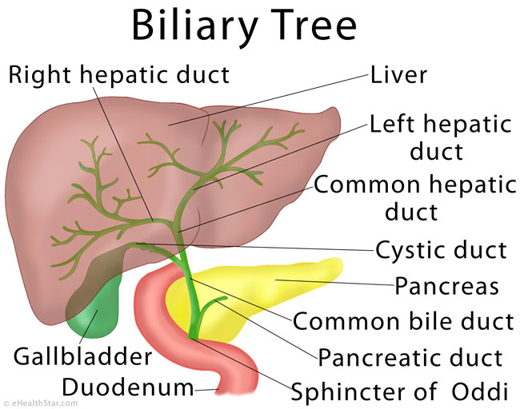
EVALUATION OF OBSTRUCTIVE JAUNDICE

Slide 2
DEFINITION
Jaundice came from the French word “jaune” which means yellow.
Yellowish discoloration of sclera, skin mucous membranes due to increased serum bilirubin level.
Typically can be detected if serum bilirubin level above 3 mg/dl.

Slide 3
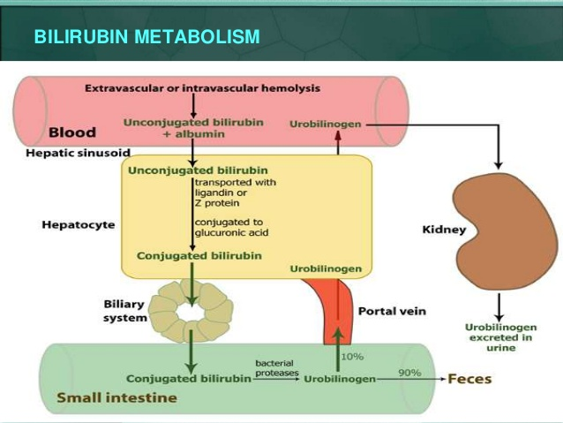
PATHOPHYSIOLOGY
Bilirubin pathophysiology is discussed in following point:
Normal source
Transport of bilirubin
Hepatic metabolism
Intestinal phase of bilirubin metabolism
Renal excretion of bilirubin

Slide 4
NORMAL SOURCE
80- 85% of bilirubin is derived from the catabolism of haemoglobin.
15-20% is derived from bone marrow due to destruction of maturing cells.
Haem liberated from above sources is oxidised to biliverdin by the enzyme haem oxygenase.
2. TRANSPORT OF BILIRUBIN
Unconjugated bilirubin is liberated in plasma. This bound to tightly to albumin in a fully reversible manner.
Conjugated bilirubin is also bound to albumin.
3. HEPATIC METABOLISM
It has three distinct phases:
a. Hepatic uptake
b. Conjugation
c. Excretion into bile

Slide 5
Hepatic uptake
Unconjugated bilirubin albumin complex is bound to liver cell i.e hepatocytes. Albumin dissociates and the
unconjugated bilirubin enters the cell. In the cell unconjugated bilirubin bound to glutathione –S- transference,
which prevent unconjugated bilirubin back to plasma.
b. Conjugation
In the hepatocytes the unconjugated bilirubin is conjugated by the enzyme bilirubin UDP glucuronosyl
transferase. Unconjugated bilirubin is water soluble and is not excreted in bile, so that it is converted
in conjugated in order to excreted in the bile.
c. Excretion or secretion of bile
It is done across the plasma membrane is by an ATP dependent transport process. It is secreted into bile.
90% is bilirubin diglucuronide and 7% is bilirubin monoglucuronide and rest 2-3 % are unconjugated Bilirubin.

Slide 6
4. Intestinal phase of bilirubin metabolism
Conjugated bilirubin reaches the intestinal lumen through bile and does not reabsorbed by the intestinal mucosa.
Some of the conjugated bilirubin is excreted in the stool in form of bilirubin monoglucuronide and bilirubin diglucuronide.
Some of the conjugated bilirubin is metabolised in the lumen to urobilinogen by intestinal bacteria.
This occur in three phase:
Part of this urobilinogen is reabsorbed from small intestine in to portal circulation.
Part of the urobilinogen is reabsorbed and excreted in the urine as urobilinogen.
Part of the urobilinogen in the intestine is excreted in the stool as sterobilinogen.
5. Renal excretion of bilirubin
Unbound fraction conjugated bilirubin is excreted in urine.

Slide 7
CLASSIFICATION
Prehepatic
Hepatic
Post hepatic (Obstructive)

Slide 8
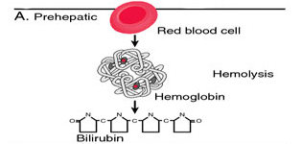
Prehepatic
The pathology is occurring prior to the liver
Causes
Malaria,
Sickle cell anemia,
Thalassemia deficiency,
Pyruvate kinase deficiency,
Glucose 6 phosphate dehydrogenase

Slide 9
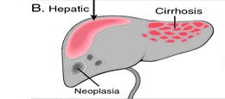
Hepatic
It occur when the problem arises within the liver.
Causes
Acute or chronic hepatitis,
Cirrhosis
Drug induced hepatitis- paracetamol, NSAIDS, Glucocorticoids, Isoniazid, Rifampin,
Alcoholic liver disease

Slide 10
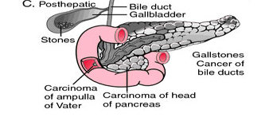
Post hepatic (Obstructive)
The pathology is located after the conjugation of bilirubin in the liver caused due to obstruction of biliary passage
Cause
They are divided in three parts:
In the lumen
In the wall
outside

Slide 11
A. In the lumen
1. Stones in the common bile duct
2. Liver fluke- fasciola hepatica, fasciola gigantica
3. Hydatid cyst
4. Stone in pancreatic duct
5. Mirizzi syndrome (gallstone becomes impacted in the cystic duct or neck of the gallbladder causing compression of the common bile duct (CBD) or common hepatic duct)
C. From outside
Carcinoma head of pancreas
Chronic pancreatitis
Lymph nodes at porta hepatis
B. In the wall
Periampullary carcinoma
Choledochal cyst (congential)
Stenosis of sphincter of oddi
Klatskin tumour- carcinoma of the bile duct
Bile duct stricture

Slide 13
Difference
Function test | Pre-hepatic jaundice | Hepatic jaundice | Post-hepatic jaundice
Total bilirubin | Normal / increased | Increased
Conjugated bilirubin | Normal | Increased
Unconjugated bilirubin | Normal / increased | Increased | Normal
Urobilinogen | Normal / increased | Decreased | Decreased / negative
Urine color | Normal | Dark (urobilinogen + conjugated bilirubin) | Dark (conjugated bilirubin)
Stool color | Normal | slightly pale | Pale
Alkaline phosphatase levels | Normal | Increased
Alanine transferase and aspartate transferase levels |  | Increased
Conjugated bilirubin in urine | Not present | Present
Splenomegaly | Present | Present | Absent

Slide 14
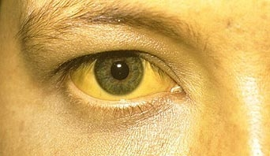
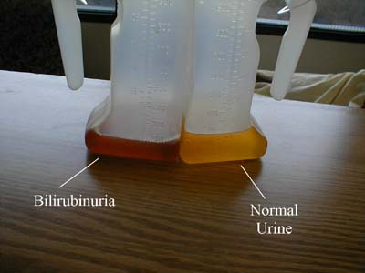
SYMPTOMS
Abdominal Pain – right upper quadrant
Yellow discolouration of skin and mucous membrane
Dark urine
Clay coloured stool
Fever
Loss of appetite

Slide 15
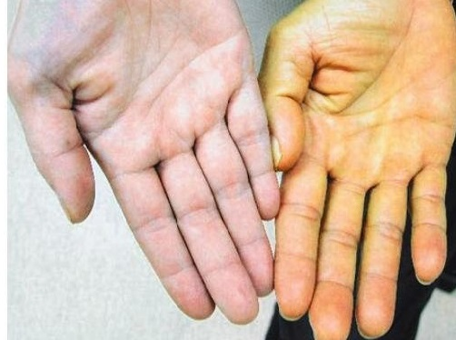
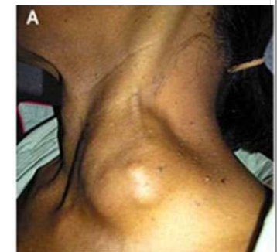
SIGN
Loss of weight
Yellowish discolouration of skin and mucus membrane
Charcot’s triad: pain (right upper quadrant), fever, jaundice in acute cholangitis
Reynold pentad – persistent pain, fever, persistent jaundice, shock, altered mental status ascending cholangitis

Slide 16
Virchow’s node: enlarged left supraclavicular node strongly indicative of the presence of cancer in the abdomen, specifically gastric cancer.
Courvoisier law: states that in the presence of a palpably enlarged gallbladder which is nontender and accompanied with mild painless jaundice. This sign implicates possible malignancy of the gallbladder or pancreas.
Abdominal mass
Ascites in malignancy

Slide 17
INVESTIGATION
Serum bilirubin: Normal value is less than 1.0 mg%. Both direct and indirect bilirubin are assessed. Direct is increased in obstructive jaundice.
2. Prothrombin time: Normal value is 12‐16 seconds. It is significant if it is more than 4 from the control or more than one and half times the control.
3. ALP, SGPT, SGOT- in hepatocellular SGPT,SGOT is raised disproportionate to ALP, but in cholestatic ALP is raised disproportionate to SGPT, SGOT
4. GGT (gamma glutamyl transpeptidase): elevated
`

Slide 18
5. Abdominal ultrasound.
6. ERCP to visualize the site of obstruction, biopsy, bile sample for analysis.
7. MRCP - Non‐invasive diagnostic tool.
8. CT scan in case of tumours to assess operability.
9. Urine tests: Fouchet's test for bile pigments, Hay's test for bile salts and test for urobilinogen in urine.

Slide 19
Approach:
Bilirubin and other tests elevated
Ultrasounds
Dilated ducts (extrahepatic cholestasis)
CT/MRCP/ERCP
Ducts not dilated (intra hepatic cholestasis)
Serology testing
AMA, Hepatitis, drugs
If negative AMA positive
MRCP/ liver biopsy Liver biopsy

Slide 20
FOUCHET'S TEST:
10 ml of urine + 5 ml of Barium chloride + pinch of MgS04 causes formation of BaS04 which is filtered over a filter paper and few drops of Fouchet's reagent (tricholroacetic acid) is added. Green or blue colour signifies presence of bile pigments in the urine.
HAY'S TEST FOR BILE SALT:
Sprinkle sulphur to 2 ml of urine. In presence of bile salts sulphur sinks to the bottom.
EHRLICH'S TEST:
5 ml of freshly voided urine + 1 ml of Ehrlich reagent (p‐dimethyl amino benzaldehyde) and wait for 5 minutes. Formation of red colour signifies presence of urobilinogen in urine. Normally it is present in traces, in obstructive jaundice it is absent and in haemolytic jaundice it is in excess.

Slide 21
MRCP (Magnetic resonance cholangiopancreatography)
Indication:
1. If cholangitis not severe and risk for ERCP is high
2. If charcot’s triad present.
Advantage:
1. Detects choledocholithiasis, neoplasm strictures, biliary dilation
2. Sensitivity of 81- 100% specificity 92 -100% of choledocholithiasis
3. Non invasive
Disadvantage:
1. Can not remove stone
2. Contraindicated in pacemaker, implants prosthetic values

Slide 22
ERCP (endoscopic retrograde cholangiopancreatography)
Gold standard for diagnosis of CBD stones, pancreatitis tumours, sphincter of oddi dysfunction
Advantage:
1. Therapeutic option when CBD stone identified
2. Stone retrieval and sphincterotomy
Disadvantge:
1. Pancreatitis,
2. Perforation of duodenum bleeding

Slide 23
MANAGEMENT
A. CONSERVATIVE MANAGEMENT
Fluid and electrolytes
Urine output monitoring
Correction of coagulation defects with vitamin K and Fresh frozen plasma
Prevention of infection with antibiotic.
Nutrition

Slide 24
B. Surgical Options
For CBD stone:
1. ERCP stone removal,
2. Choledocholithotomy,
3. Transduodenal sphincteroplasty,
4. Choledochojejunostomy or choledochoduodenostomy.
B. For Biliary stricture:
        Stenting,
        Choledochojejunostomy,
        Roux‐en‐Y hepatico jejunostomy.
C. For Carcinoma periampullary or head of pancreas:
1. Whipple's operation or triple bypass or ERCP stenting.

Slide 25
Evidence | Aim | Result | Conclusion
Siddique K¹, Ali Q, Mirza S, Jamil A, Ehsan A, Latif S, Malik AZ.Ayub Med Coll AbbottabadJ. 2008 Oct-Dec;20(4):62-6. Randomized control trial Level II | Aim of this study is to evaluate the Etiological spectrum of obstructive jaundice. | Of the 60 patients; 40 (66.66%) were male and 20 (33.33%) were female, their mean age being 49.50 years. Malignant obstructive jaundice was seen in 34 (56.66%) patients while 26 (43.33%) had benign etiology. Commonest malignancy was Carcinoma (Ca) of the head of pancreas 18/60 (30%) followed by Ca gall bladder 8/60 (13.33%), cholangiocarcinoma 7/60 (11.66%), and periampullary carcinoma 1/60 (1.66%). Choledocholithiasis 21/60 (35%) was the commonest benign cause followed by stricture of common bile duct 3/60 (5%) and acute pancreatitis 2/60 (3.33%). | Obstructive jaundice is common amongst females and the cause is mostly malignant. Ca head of pancreas is the commonest malignancy while Choledocholithiasis is the commonest benign cause. USG, ERCP and CT-Scan are important diagnostic modalities for evaluation of patient with obstructive jaundice with ERCP having the additional advantage of being therapeutic as well.

Slide 26
THANK YOU

