Slide 1
Oral conventional and newer hypoglycaemic agents

Slide 2
Overview of diabetes mellitus
Group of physiological dysfunctions characterized by hyperglycaemia resulting directly from
Insulin resistance,
Inadequate insulin secretion, or
Excessive glucagon secretion.

Slide 3
CLASSIFICATION
TYPE 1
Type 2
.

Slide 4
Type 1 diabetes mellitus (DM) ,multisystem disease with both biochemical and anatomic/structural consequences.
Chronic disease of carbohydrate, fat, and protein metabolism caused by the lack of insulin, which results from the marked and progressive inability of the pancreas to secrete insulin because of autoimmune destruction of the beta cells.
Type 2 Defined by the American Diabetes Association (ADA) as "a condition characterized by hyperglycaemia resulting from the body's inability to use blood glucose for energy…either the pancreas does not make enough insulin or the body is unable to use insulin correctly.

Slide 5
Pancreas in blood sugar control.
The endocrine function consists primarily of the secretion of the two major hormones, insulin and glucagon
A cells produce glucagon;
B cells produce insulin;
Insulin is secreted only by the B cells

Slide 6
Both insulin and glucagon are important in the regulation of carbohydrate, protein and lipid metabolism:
Insulin is an anabolic hormone,it increases the storage of glucose, fatty acids and amino acids in cells and tissues.
Glucagon is a catabolic hormone, it mobilizes glucose, fatty acids and amino acids from stores into the blood.

Slide 7
Major actions of insulin
Facilitation of glucose transport through certain membranes (e.g. adipose and muscle cells)
Stimulation of the enzyme system for conversion of glucose to glycogen (liver and muscle cells)
Slow-down of gluconeogenesis (liver and muscle cells)
Regulation of lipogenesis (liver and adipose cells) and
promotion of protein synthesis and growth (general effect)

Slide 8
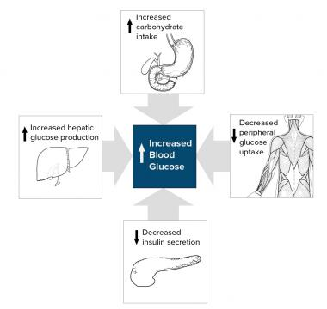

Slide 9
TREATMENT
Insulin therapy
Oral hypoglycaemic agents.

Slide 10
Oral hypoglycaemic agents
Conventional hypoglycaemic agents
Newer hypoglycaemic agents

Slide 11
CLASSIFICATION
ENHANCE INSULIN SECRETION
Sulfonylurea
Meglitinides
Glucagon like peptide -1 receptor agonists
Dipeptidyl peptides-4 inhibitor

Slide 12
OVERCOME INSULIN RESISTANCE
Biguanides
Alpha glucosidase inhibitors
Amylin analogue
Dopamine d2receptor agonists
Sodium glucose cotransport-2 inhibitor

Slide 13
SULFONYLUREA

Slide 14
In the basal state, the plasma membrane of the β cell is hyperpolarized, and the rate of insulin secretion from the cell is low.
When glucose is available, it enters the cell via GLUT2 transporters in the plasma membrane and is metabolized to generate intracellular ATP.
ATP binds to and inhibits the plasma membrane K+/ATP channel.

Slide 15
Inhibition of the K+/ATP channel decreases plasma membrane K+ conductance; the resulting depolarization of the membrane activates voltage-gated Ca2+ channels and thereby stimulates an influx of Ca2+.
Ca2+ mediates fusion of insulin-containing secretory vesicles with the plasma membrane, leading to insulin secretion.

Slide 16
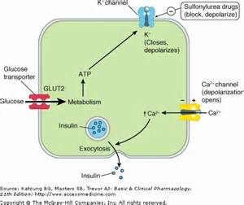

Slide 17
TYPES
Generation I: Tolbutamide, Tolazamide.
Generation II: Glibenclamide, Glipizide, Gliclazide,Glimepiride.

Slide 18
Glimipride
Initial: 1-2 mg PO after breakfast or with first meal;
may increase dose by 1-2 mg every 1-2 weeks; not to exceed 8 mg/day
Dosing considerations
Use in monotherapy or, if glycemic response to glimepiride is inadequate at maximum dose, with insulin or metformin

Slide 19
Dosing Modifications
Renal impairment: 1 mg PO qDay; titrate dose based on fasting blood glucose levels
Hepatic impairment: Not studied; not recommended in severe impairment; initiate therapy with 1 mg PO qDay and titrate carefully

Slide 20
ADVERSE EFFECTS
Hypoglycaemia
More common in elderly,liver and kidney disease patients
Weight gain
Due to insulinaemic action.
Nausea vomiting flatulence diarrhoea or constipation
Hypersensitivity
In form of rashes purpura transient leukopenia
Safety in pregnancy is not established.secreted in breast milk .nursing mothers should avoid.

Slide 21
MEGLITINIDE/D-PHENYLALANINE ANALOGUE S
These are K-ATP channel blockers with a quick and short lasting insulinemic action.
TYPES
Repaglinide
Nateglinide

Slide 22
They are quickly absorbed and rapidly metabolized.
Induces fast onset short lasting insulin release
Hence the pattern of use is different from SU’s
Administered before each major meal to control post prandial hyperglycaemia
Dose to be omitted if a meal is missed.

Slide 23
NATEGLINIDE
Monotherapy, or With Metformin
120 mg PO q8hr; 60 mg PO q8hr if patient near goal HbA1C
Take dose 1-30 minutes before meal
EXCRETION
Urine:83%
Feces: 10%

Slide 24
ADVERSE EFFECTS
Lower risk of hypoglycaemia
Mild headache
Dyspepsia
Arthralgia
Weight gain
Avoided in liver disease

Slide 25
BIGUANIDE
Now considered as first line drugs except when not tolerated and not contraindicated, they
Do not cause insulin release, but presence of insulin is essential for action.
PHENFORMIN
METFORMIN

Slide 26
ACTIONS OF METFORMIN
Supresses hepatic gluconeogenesis and glucose output from liver.
Enhances insulin mediated glucose uptake and disposal in skeletal muscle fat.
Insulin resistance exhibited by type2 diabetes is thus overcome.

Slide 27
This translates into
Glycogen storage in skeletal muscle
Reduced lipogenesis in adipose tissue and enhance fatty acid oxidation.
Interfere with mitochondrial respiratory chain and promotes peripheral glucose utilizations.

Slide 28
METFORMIN
Monotherapy or with sulfonylurea
Immediate-release tablet or solution
Initial: 500 mg PO q12hr or 850 mg PO qDay with meals;
Maintenance: 1500-2550 mg/day PO divided q8-12hr with meal
Not to exceed 2550 mg/day

Slide 29
Extended-release
Glucophage XR: 500 mg PO qDay with dinner; titrate by 500 mg/day qWeek; not to exceed 2000 mg/day
Fortamet: 500-1000 mg PO qDay; titrate by 500 mg/day qWeek; not to exceed 2500 mg/day
Glumetza: 1000 mg PO qDay; titrate by 500 mg/day qWeek; not to exceed 2000 mg/day

Slide 30
Dosage Modifications
Hepatic impairment: Avoid use; risk of lactic acidosis
Renal impairment
Obtain eGFR before starting metformin
eGFR <30 mL/min/1.73 m²: Contraindicated
eGFR 30-45 mL/min/1.73 m²: Not recommended to initiate treatment
Monitor eGFR at least annually or more often for those at risk for renal impairment (eg, elderly)
If eGFR falls below 45mL/min/1.73 m² while taking metformin, risks and benefits of continuing therapy should be evaluated
If eGFR falls below 30 mL/min/1.73 m²: while taking metformin, discontinue the drug

Slide 31
ADVERSE EFFECTS
Abdominal pain
Anorexia
Bloating
Nausea
Metallic taste
Mild diarrhoea
Tiredness
Vit b12deficiency.
In addition ,metformin is contraindicated in hypotensive states, heart failure, severe respiratory, hepatic and renal disease as well as in alcoholics because of increased risk of lactic Acidosis.

Slide 32
THIAZOLIDINEDIONE
PIOGLITAZONE
ROSIGLITAZONE

Slide 33
MECHANISM OF ACTION
Selective agonist for nuclear peroxisome proliferator activated receptor gamma
These receptors are mainly expressed in fat cells,muscle and some other cells.
Enhances transcription of several insulin responsive genes.

Slide 34
Reverse insulin resistance by enhancing GLUT4 expression and translocation.
Hepatic gluconeogenesis is suppressed.
Pioglitazone in addition lowers TGL level and raises HDL without lowering LDL,

Slide 35
Primarily used to supplement SU/metformin.
Not likely to be effective when b cell failure sets in, which may be the cause of loss of efficacy of SU/metformin.

Slide 36
PIOGLITAZONE
Indicated as monotherapy or with insulin or insulin secretagogues
15-30 mg PO with meal qDay initial; may increase dose by 15 mg with careful monitoring to 45 mg qDay maximum
Monitor ALT at start of treatment, qMonth for 12 months, q3Months thereafter

Slide 37
Dosing Considerations
Coadministration with insulin secretagogue (eg, sulfonylurea): Decrease insulin secretagogue dose
Coadministration with insulin: Decrease insulin dose by 10-25%
Coadministration with strong CYP2C8 inhibitors (eg, gemfibrozil): Limit maximum pioglitazone dose to 15 mg qDay

Slide 38
ADVERSE EFFECTS
Plasma volume expansion
Odema
Weight gain
Headache
Myalgia
Mild anaemia
CHF may be precipitated or worsened
Contraindicated in liver disease and CHF.

Slide 39
A-GLUCOSIDASE INHIBITORS
ACARBOSE
VOGLIBOSE
MIGLITOL

Slide 40
MECHANISM OF ACTION
Complex oligosaccharides which reversibly inhibits A-glucosidases,
Final enzymes for digestion of carbohydrate in the brush border of small intestine mucosa.
Slows down and decreases digestion and absorption of polysaccharide and sucrose.
In addition GLP-1 release is promoted which may contribute to effect.

Slide 41
ACARBOSE
Initially 25 mg PO q8hr, at meals (with first bite)
Can increase to 50 or 100 mg PO q8hr at 4- to 8-wk intervals based on 1 hour postprandial glucose or glycosylated hemoglobin levels, and on tolerance
Maximum Dose
<60 kg: 50 mg q8hr
>60 kg: 100 mg q8hr
mono treatment or with sulfonylurea

Slide 42
ADVERSE EFFECTS
Flatulence
Abdominal discomfort
Loose stool
Hepatic transaminase may raise but liver damage is rare.

Slide 43
NEWER ORAL HYPOGLYCAEMIC AGENTS
GLP-1 MIMETICS
DPP4 INHIBITORS

Slide 44
UDERSTANDING THE MECHANISM BEHIND THE USE OF NEWER ORAL HYPOGLYCAEMIC AGENTS

Slide 45
In 1906, extracts of mucosa from the porcine upper small intestine were used by hoping that "the pancreas secretion might be stimulated by the substance of the nature of a hormone yielded by the duodenal mucosa membrane"
In 1932, the unidentified substance thought to exert this effect "incretin" .
Thirty years later it was demonstrated that gut derived factors have a potentiating effect on insulin secretion after ingestion of glucose .

Slide 46
Some years later, a polypeptide was discovered and named gastric inhibitory polypeptide (GIP) because of its inhibitory effect on gastric acid secretion in dogs
Eventually, it was shown to be insulinotropic at elevated glucose concentrations. Its gastric inhibitory effects were weak and it was, therefore, suggested that GIP should be renamed "glucose-dependent insulinotropic polypeptide“.

Slide 47
In 1983, the gene encoding the human pancreatic hormone, glucagon, was cloned.
The gene was found to be expressed in both the pancreatic α -cells and the intestinal L-cells.

Slide 48
In the pancreas proglucagon is cleaved to glucagon, glicentin-related pancreatic peptide (GRPP) and a major proglucagon fragment . Apart from glucagon, all of these fragments seem to be biologically inactive .
In contrast, in the intestinal L-cells, the molecule is processed to GLP-1 (glucagon-like peptide-1), GLP-2 (glucagon-like peptide-2) and glicentin
GLP-1 was found to be strongly insulinotropic and GLP-2 to be a key regulator of small bowel growth .

Slide 49
Today, therefore, we have two major incretin hormones:
Glucose-dependent insulinotropic polypeptide (GIP) and
Glucagon-like peptide-1 (GLP-1)
Together are thought to be responsible for the incretin effect.
The incretin effect is quantitated by comparison of the insulin response after oral and intravenous glucose, administered in such a way that identical blood glucose concentrations are obtained .

Slide 50
Glucagon like peptide 1
30 amino acid peptide with approximately 50% homology to glucagon. GLP-1 is released in response to meal ingestion with lipids and carbohydrates being most potent in stimulating secretion
mechanism of the insulinotropic action
involves interaction with a specific receptor, located on the pancreatic β -cells, with subsequent activation of adenylate cyclase.
The actions on the β -cell seem to be related to accumulation of cAMP within the cell and include closure of K + channels, elevation of cytosolic Ca ++ concentrations and mobilization of a pool of insulin containing granules .

Slide 51
In healthy subjects, approximately 50-70% of the insulin response to oral glucose is due to the incretin hormones .
Loss of their effect contribute to the impaired postprandial insulin response in type 2 diabetic patients. An impaired incretin effect in type 2 diabetic patients could theoretically be caused by either a decreased secretion, an increased elimination or an impaired effect of the incretin hormones.

Slide 52
GLP-1 AND GIP
Exenatide synthetic version of exendin-4, a peptide discovered in the salivary secretions of the reptile Heloderma suspecttum

Slide 53
A glucagon like peptide-1 (GLP-1) that mimics incretin and promotes insulin secretion, suppresses glucagon, and slows gastric emptying
Excretion: Urine (primarily)

Slide 54
DOSING AND USAGES
Adjunct to diet and exercise to improve glycaemic control with DM type 2;
monotherapy or as an adjunct therapy with thiazolidinediones, metformin, or a sulfonylurea; or
add-on therapy to insulin glargine (a long-acting insulin), with or without metformin and/or a thiazolidinedione, in patients who are not achieving adequate glycemic control on insulin glargine alone
Immediate-release: 5 mcg SC q12hr within 60 minutes prior to meal intially; after 1 month, may increased to 10 mcg q12hr

Slide 55
Switching from immediate-release to extended-release
Initiate weekly extended-release SC injections 1 day after discontinuing immediate-release exenatide
May experience increased blood glucose levels for approximately 2 weeks after initiating extended-release therapy
May initiate extended-release exenatide without pretreating with the immediate-release dosage form

Slide 56
ADMINISTRATION
Within 60 minutes before morning and evening meals, approximately 6 hr or more apart
Administer SC only; do not administer IM or IV
Injection sites are thigh, abdomen, or upper arm

Slide 57
DOSAGE MODIFICATIONS
Renal impairment
Mild renal impairment (CrCl 50-80 mL/min): No dosage adjustment required
Moderate renal impairment (CrCl 30-50 mL/min): Caution when initiating or escalating dose
Severe renal impairment (CrCl <30 mL/min) or ESRD: Not recommended
Renal transplantation: Use with caution

Slide 58
SIDE EFFECTS
>10%
Injection-site nodule (6-77%)
Injection-site reactions (2-18%)
Nausea (8-11%)
Vomiting (4-11%)
Diarrhoea (2-11%)
1-10%
Constipation (6-10%)
Headache (5-9%)
Dyspepsia (3-7%)
Dizziness (<2%)
Asthenia

Slide 59
DI PEPTIDYL PEPTIDASE 4 INHIBITOR
under normal physiological conditions,
GLP-1 and GIP are rapidly degraded by the enzyme system DPP-IV and therefore are not themselves viable as pharmacological agents.
Therefore molecules that inhibit the activity of DPP-IV and thereby prolong the activity of endogenous GLP-1 are the second class of newer anti diabetic drugs.

Slide 60
DPP-4 inhibitor; therefore, increases and prolongs incretin hormone activity, which is inactivated by DPP-4 enzyme
Incretins increase insulin release and synthesis from pancreatic beta cells and reduce glucagon secretion from pancreatic alpha cells

Slide 61
SITAGLIPTIN
VILDAGLIPTIN

Slide 62
SITAGLIPTIN
100 mg PO qDay
Dosing Modifications
Renal impairment
CrCl >50 mL/min: Dose adjustment not necessary
CrCl 30-50 mL/min: 50 mg PO qDay
CrCl <30 mL/min: 25 mg PO qDay
ESRD: 25 mg PO qDay regardless of hemodialysis
Hepatic impairment
Mild to moderate impairment: Dose adjustment not necessary
Severe impairment: Not studied

Slide 63
1-10%
Nasopharyngitis (5%)
Diarrhea (4%)
Headache (3.6%)
Constipation (3%)
Peripheral edema (2%)
Nausea (2%)
Pharyngitis (1%)
Osteoarthritis (1%)
URI (1%)

Slide 64
<1%
Hypersensitivity reactions such as anaphylaxis, angioedema, rash, urticaria, cutaneous vasculitis, and exfoliative skin conditions (including Stevens-Johnson syndrome)
Hepatic enzyme elevations
Acute pancreatitis, including fatal and nonfatal hemorrhagic and necrotizing pancreatitis
Constipation
Vomiting
Worsening renal function, including acute renal failure (sometimes requiring dialysis)
Severe and disabling arthralgia
Myalgia
Pain in extremity
Back pain

Slide 65
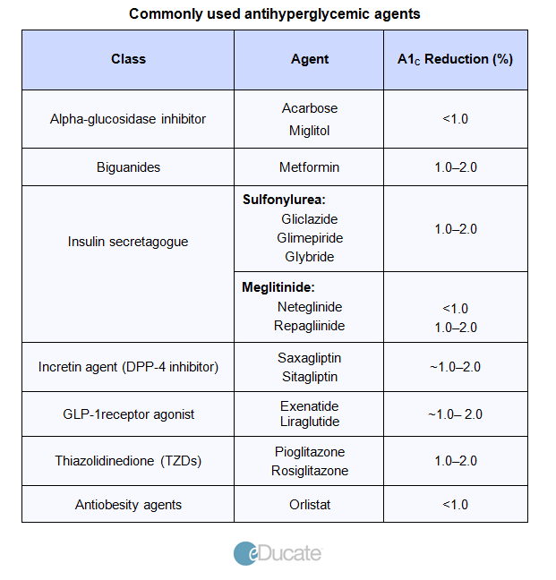

Slide 66
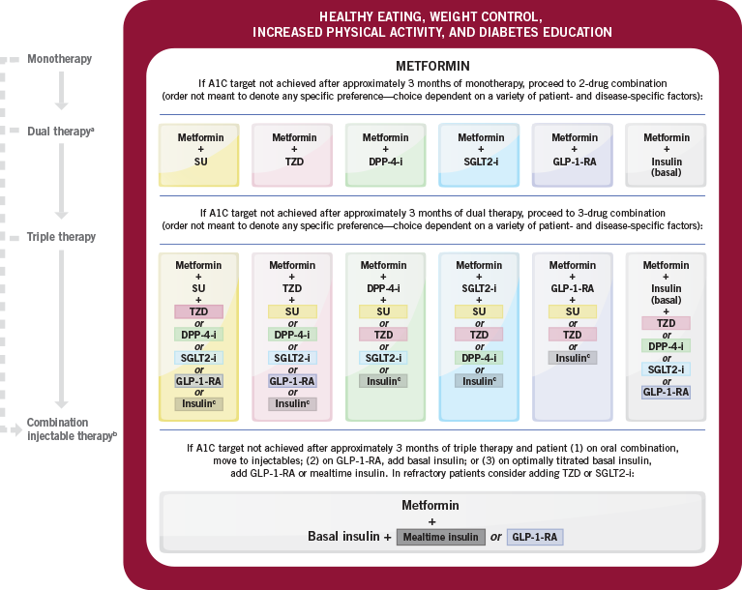

Slide 67
THANK YOU

