Slide 1
Muscular tissue
Dr. Kinjal Jethva
Assistant Professor
Department of Anatomy
S.B.K.S.M.I. & R.C.

Slide 2
Introduction
Mesodermal in origin
Interaction amongst contractile protein causes contraction
Each muscle fibers contains contractile protein, actin and myosin
Collection of muscle fibers supported by CT

Slide 3
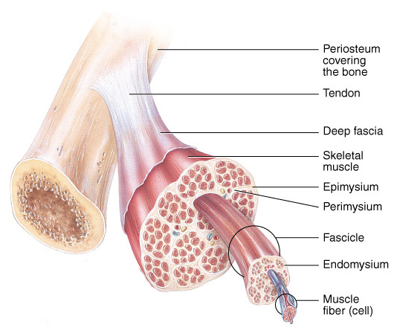
Connective Tissue Components

Slide 4
Special terms for muscular tissue:
Plasma membrane- sarcolemma
Cytoplasm- sarcoplasm
Smooth endoplasmic reticulum- sarcoplasmic reticulum
Mitochondria- sarcosomes

Slide 5
Types of the muscles
Skeletal or striated muscle
Cardiac muscle
Smooth muscle

Slide 6
Apart from the above 3 types there are contractile cells functioning as a single units, namely:
Myoepithelial cells
Myofibroblast
Myoid cells

Slide 7
Functions of Muscle Tissue
Producing body movements
Stabilizing body positions
Regulating organ volumes
  bands of smooth muscle called sphincters
Movement of substances within the body
  Blood, lymph, urine, air, food and fluids, sperm
Producing heat
  Involuntary contractions of skeletal muscle (shivering)

Slide 8
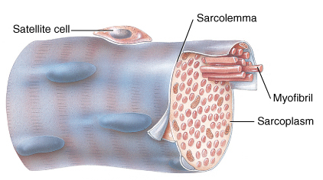
Structure of muscle fiber
Muscle cells are long, cylindrical & multinucleated
It has many flat nuclei located beneath sarcolemma
Sarcoplasm filled with tiny threads called myofibrils compactly arranged parallel to the long axis
It shows cross striations

Slide 9
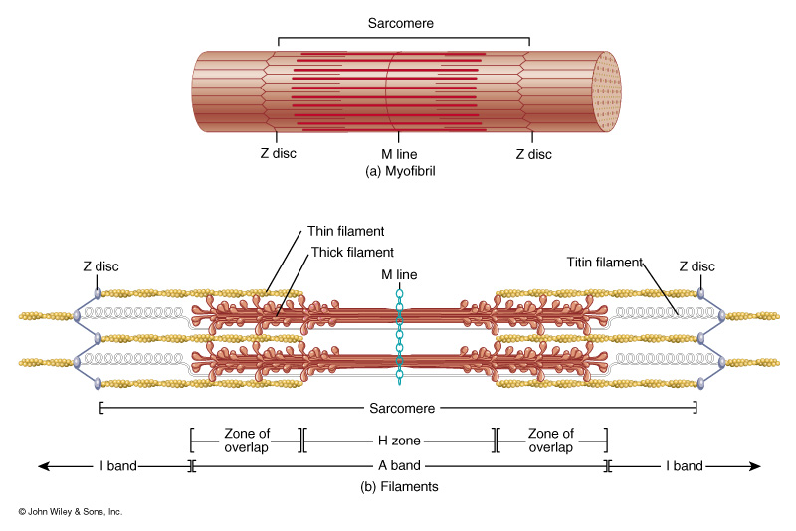
Myofibrils & Myofilaments
Cross striations seen in the myofibrils, each myofibrils shows dark(A), light(I) and Z bands
The distance between 2 Z lines is a contractile unit called sarcomere
Myofilaments (thick & thin filaments) are the contractile proteins of muscle

Slide 10
Clinical
Hypertrophy- increase in the diameter of muscle fibers
Atrophy- diameter of muscle fibers is decreased
Duchenne muscular dystrophy
Myasthenia gravis

Slide 11
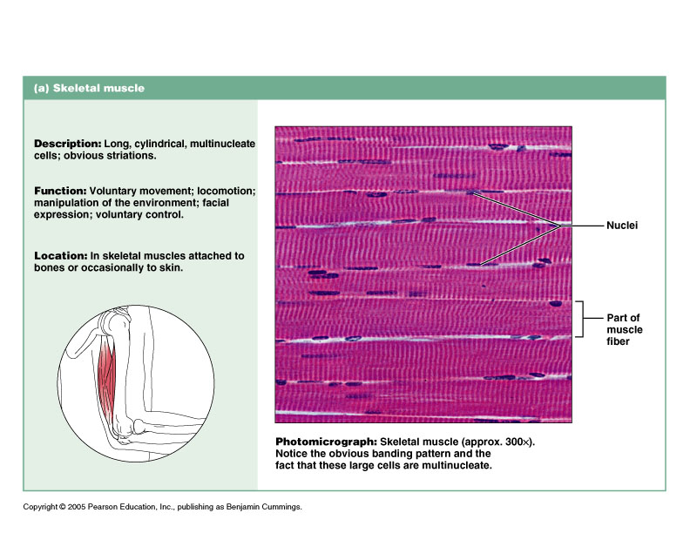
Skeletal muscle
Facts to remember
CT sheath around the whole muscle, fasciculus and muscle fibers
Transverse and longitudinal striations
Dark and light bands
Multiple peripheral , flattened nuclei

Slide 12
Skeletal Muscle Tissue
Characteristics
  Long, cylindrical cells
  Multinucleate
  Obvious striations
Function
  Voluntary movement
  Manipulation of
  environment
  Facial expression
Location
  Skeletal muscles attached to bones (occasionally to skin)

Slide 13
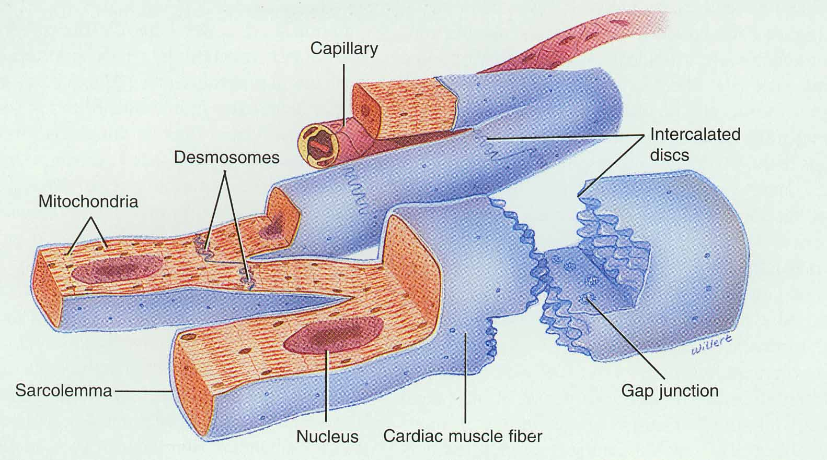
Cardiac Muscle
Striated , short, quadrangular-shaped, branching fibers
Single centrally located nucleus
Cells connected by intercalated discs with gap junctions
Same arrangement of thick & thin filaments as skeletal

Slide 14
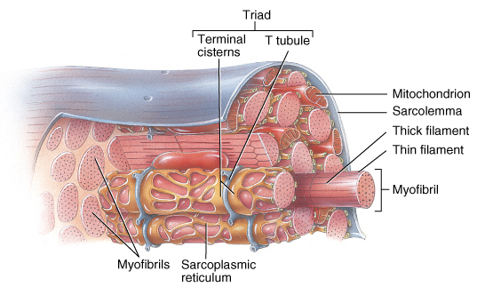
Cardiac Muscle
Striated muscle containing thick & thin filaments
T tubules located at Z discs & less SR

Slide 15
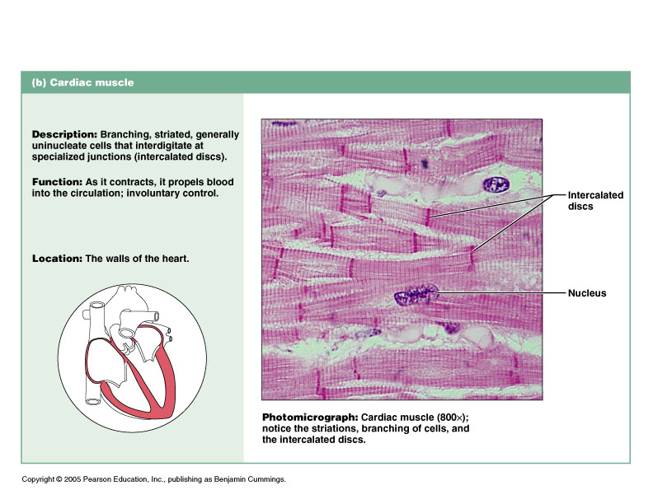
Cardiac muscle
Fact to remember
Faint longitudinal and transverse striations
Branching muscle fibers
Presence of intercalated disc

Slide 16
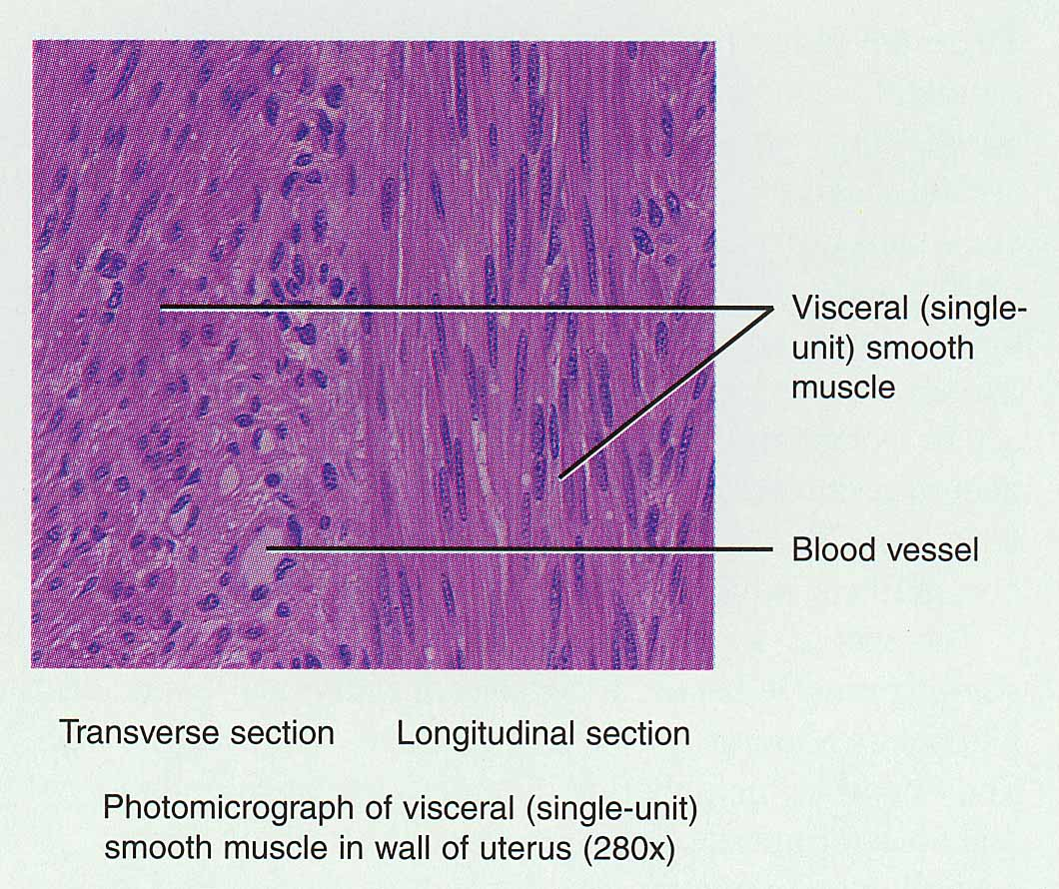
Smooth Muscle
Small, involuntary muscle cell – spindle shaped tapering at ends
Single, oval, centrally located nucleus
Lack T tubules & have little SR for Ca+2 storage
Location
  Mostly walls of hollow organs

Slide 17
Smooth muscle
Facts to remember
Longitudinal striations
Single central nucleus
T.S- shows round /oval fibers
L.S.- shows spindle shaped cells

Slide 18
Chao Wang,^{1,*} Feng Yue,¹ and Shihuan Kuang, Bio Protoc. 2017 May 20; 7(10): e2279.
doi: 10.21769/BioProtoc.2279
Chao Wang,^{1,*} Feng Yue,¹ and Shihuan Kuang | Muscle Histology Characterization Using H&E Staining and Muscle Fiber Type Classification Using Immunofluorescence Staining | we describe a protocol to examine muscle histology and myofiber types using hematoxylin and eosin (H&E) and immunofluorescence staining, respectively. H&E stain nucleus in blue and cytoplasm in red, therefore allowing for morphological analyses, such as myofiber diameter, the presence of degenerated and regenerated myofibers, and adipocytes and fibrotic cells. | Muscle fibers in adult skeletal muscles of rodents are classified into 4 subtypes based on the expression of myosin heavy chain proteins: Myh7 (type I fiber), Myh2 (type IIA fiber), Myh1 (type IIX fiber), Myh4 (type IIB fiber). | A panel of monoclonal antibodies can be used to specifically label these muscle fiber subtypes. These protocols are commonly used in the study of muscle development, growth and regeneration

