Slide 1
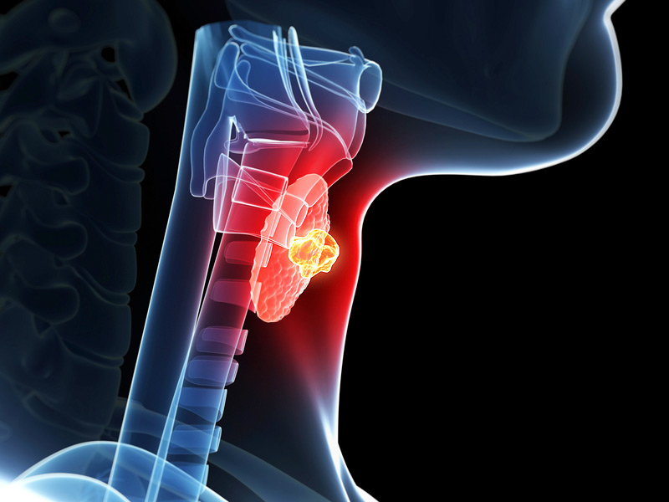
THYROID MALIGNANCY

Slide 2
INTRODUCTION
Most common malignancy of Endocrine system
Incidence 12 per 100,000 population per year
Prognosis worse in older persons (>65 years )
Twice as common in women then as men but male gender associated with worse prognosis

Slide 3
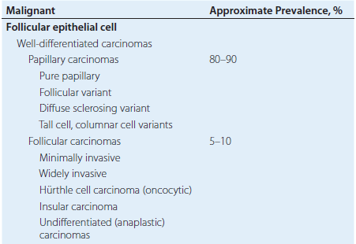
CLASSIFICATION

Slide 4
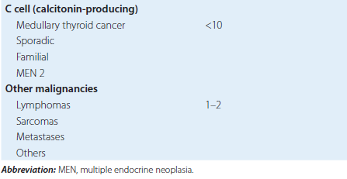
CLASSIFICATION

Slide 5
CLINICAL PRESENTATION
Painless, palpable, solitary thyroid nodule
Mostly discovered during routine palpation of neck
Palpable and nonpalpable nodules- similar risk size have same risk of malignancy

Slide 6
Age- thyroid nodules likely to be malignant in patient with >65 years and <20 years of age
Increased risk in male gender
Malignant nodules – usually painless
Sudden onset of pain- strongly associated with benign disease- eg, haemorrhage into a cyst or subacute viral thyroiditis

Slide 7
Hoarseness suggests involvement of the recurrent laryngeal nerve and vocal cord paralysis
Heat intolerance and palpitations suggest autonomously functioning nodule

Slide 8
EXAMINATION
Should include thorough head and neck examination
  with careful attention to thyroid gland and cervical soft tissues
  As well as indirect laryngoscopy
Solitary thyroid can vary from soft to hard
Hard and fixed nodules - more likely to be malignant than supple mobile nodules

Slide 9
EXAMINATION
Thyroid carcinoma usually nontender on palpation
Firm cervical masses highly suggestive of regional lymph node metastasis
Vocal cord palsy implies involvement of the recurrent laryngeal nerve

Slide 10
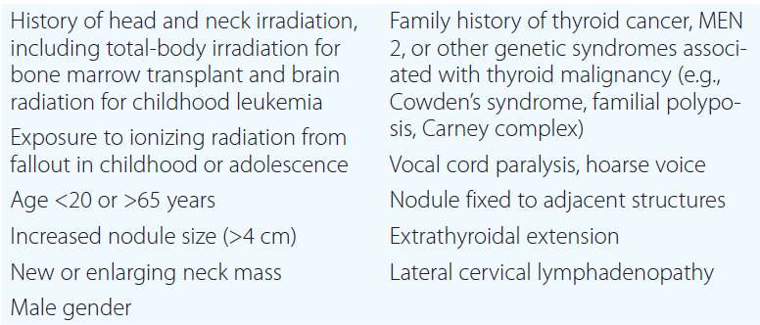
RISK FACTORS for Thyroid Carcinoma in Patients with
Thyroid Nodule

Slide 11
EVALUATION
To differentiate malignant from benign disease
FNAC
  Most imp diagnostic tool – should be the first intervention
  Inexpensive and easy to perform
  Ultrasonographic guidance to increases the accuracy of FNAC

Slide 12
  Few complications-minor hematoma, ecchymosis, local discomfort
Clinically significant hematoma and swelling rare
Inadvertent puncture of trachea, carotid artery or jugular vein not cause clinically significant problems and managed with application of local pressure

Slide 13
LABORATORY EVALUATION
S.TSH –highly sensitive measure for hyperthyroidism and hypothyroidism
Malignant lesion cannot be ruled out
S.THYROGLOBULIN not helpful diagnostically- elevated in most benign thyroid conditions

Slide 14
LABORATORY EVALUATION
S.CALCITONIN
  High levels suggests medullary thyroid carcinoma
  More sensitive pentagastrin-stimulated calcitonin used as tumour marker to monitor patients treated fot MTC

Slide 15
Accuracy of FNAC increases when sonographic guidance used
  Small or difficult-to-palpate thyroid nodules , in children
To monitor thyroid nodule serially

Slide 16
IMAGING PROCEDURES
ULTRASONOGRAPHY- most commonly used
  Noninvasive – accurate evaluation
  Highly sensitive for thyroid nodule – depict nodules only few mm in size
  Limited use to differentiate malignant vs benign
  Simple cyst benign and rare
  Cyst – complex with some solid component that could potential harbor malignancy
  Microcalcifications associated with malignancy

Slide 17
RADIO-IODINE
  Determine functional status of thyroid nodule
  Nonfunctional nodule – wont take up radio-iodine IODINE and appear cold spots (COLD NODULES)
  Hyperfunctioning nodules take up radioiodine and appear as hot spots (HOT NODULES)
  WARM NODULES- appear similar to surrounding normal thyroid tissue

Slide 18
HOT and WARM nodules – benign
COLD nodule malignant
Carcinoma cannot be excluded on radioiodine scans
  Not usually helpful for routine evaluation
  Selected situations – eg be diagnostic adjuncts
  Repeated FNAC of a nodule nondiagnostic

Slide 19
CT/MRI
  Can be used to evaluate soft tissue extension of large or suspicious mass in neck, trachea or esophagus
  To assess metastasis in cervical lymph nodes

Slide 20
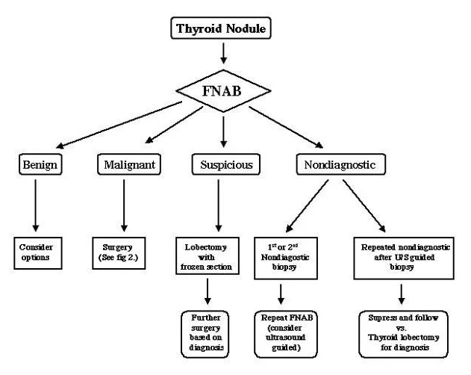

Slide 21
PAPILLARY CARCINOMA
Most common thyroid malignancy (80%)
Women develop three times more than men
Age – 30-40 years
May occur familially, either alone or in association with Gardner’s syndrome (familial adenomatous polyposis)
Radiation exposure especially during childhood associated with the development of papillary carcinoma

Slide 22
Typically occur after latency of 10-20 years
Increased incidence with patient with Hashimoto’s thyroiditis
Slow growing tumour – arising from thyroxine and thyroglobulin producing follicular cells
Cells are
  TSH sensitive-take up iodine
  produce thyroglobulin in response to TSH stimulation
  This feature has Both diagnostic and therapeutic value for managing residual disease and recurrences after surgical excision

Slide 23
PATHOLOGY
Whitish invasive neoplasm with illdefined margins
Encapsulated – characteristically grow with papillae consist of neoplastic epithelium overlying fibrovascular stalks
Presence of psammoma bodies, 50% cases
Calcific concretions with circular laminated appearance- found in stroma of tumour
May be multicentric – foci present in both inspilateral and contra lateral lobes

Slide 24
LOCAL INVASION
Can grow directly through thyroid capsule to invade surrounding tissues
Growth into trachea can ocuur – hemoptysis
Extensive involvement – airway obstruction
Propensity to spread to cervical lymph nodes 1/3 patients have clinically evident lymph node metastasis

Slide 25
FOLLLICULAR CARCINOMA
Second most common (10%)
Increased incidence where dietary intake of iodine is low
3 times more common in females
Age 40 – 60 years
Arises from follicular cells of thyroid
TSH sensitive – take up Iodine – produce thyroglobulin – has diagnostic and therapeutic value

Slide 26
PATHOLOGY
Tumour appear round, encapsulated, light brown neoplasm
Contains neoplastic follicular cells – solid, trabecular or follicular growth patterns
Local invasion can occur as papillary carcinoma
Cervical metastasis uncommon – but distant metastasis is significantly increased – Lung and bone common sites

Slide 27
TREATMENT OF WELL DIFFERENTIATED CARCINOMA
Primary treatment – Surgical excision whenever possible
Total thyroidectomy with en bloc lymph node dissection– mainstay
Major complications – recurrent laryngeal nerve injury, hypoparathyroidism,
After total thyroidectomy → undergo radioiodine scanning to detect regional / distal metastasis → radioablation of any residual disease found

Slide 28
Modifications of total thyroidectomy – to avoid complications
Subtotal thyroidectomy preferred alternative- small portion of thyroid tissue opposite the side of malignancy left in place
Patient receive post op radioiodine to ablate any remaining tissue
Few proposed thyroid lobectomy with isthmectomy alone in low risk of recurrence or metastasis

Slide 29
THYROID SUPPRESSION
After thyroidectomy and radioiodine ablation – patients maintained on thyroid suppression
T4 daily doses sufficient to suppress TSH by pituitary
Low TSH reduces tumour growth rates and reduce recurrence
Extension of TSH suppression – controversial- most suggest low but detectable -TSH 0.1- 0.5 mU/L for adequate thyroid suppression while avoiding deleterious cardiac and bone effect

Slide 30
HURTHLE CELL CARCINOMA
Variant of follicular carcinoma – rare malignancy
Almost 75-100% composed of hurthle cells- large polygonal follicular cells- contain abundant granular acidophilic cytoplasm
Hurthle cells also found in – Hoshimoto’s thyroiditis, Grave’s disease, Multi nodular goitre

Slide 31
MANAGEMENT
Aggressively behaving malignancy
High risk of recurrent and metastatic disease
Do not take up radioiodine
Rx - Complete thyroidectomy
Monitor closely after surgery
5 year survival 50-60%

Slide 32
MEDULLARY THYROID CARCINOMA
5% of all thyroid malignancy
Slight female predominance
Arises from parafollicular C cells of thyroid
C cells neural crest derivatives and produce calcitonin
75% are sporadic cases and 25% familial
Familial (FMTC) are multifocal

Slide 33
FMTC syndrome consist of MEN 2A, MEN 2B, FMTC
MEN 2A – MTC , pheochromocytoma , hyperparathyroidism
MTC in MEN 2A may appear in first decade of life and almost always in second decade

Slide 34
TREATMENT
Diagnosis – elevated calcitonin levels(pentagastrin stimulated calcitonin)
(Pentagastrin 0.5mg/kg and serial measurement of calcitonin 1.5 and 5 mins after injection)
Both sporadic and familial – total thyroidectomy and lymphatic dissection
Prognosis worse than well differentiated carcinoma

Slide 35
ANAPLASTIC CARCINOMA
Least common
Most aggressive behaviour
Worst survival rates
Women : men = 2-3:1
Sixth or seven decade
Rapidly growing thyroid mass
Associated symptoms due to local invasion – hoarseness, dyspnoea, dysphagia

Slide 36
Firm thyroid mass or masses >5 cm
30% vocal cord paralysis , cervical metastasis at time of presentation
50% patients have distant metastasis – lungs, bone, brain

Slide 37
TREATMENT
Progression rapid, most patients die from local airway obstruction or complications of pulmonary metastasis
Total or subtotal thyroidectomy with neck dissection
Tracheostomy needed in some patients
External beam radiation for local control (post op or unresectable cases)
Chemotherapy – Doxorubicin added for paliation
Prognosis poor even with multimodality therapy
Median survival 8 months

Slide 38
THYROID LYMPHOMA
2-5% cases, most are nonhodgkin B cell lymphoma
Low grade malignant lymphoma of mucosa associated lymphoid tissue(MALT)
Sixth decade of life
Female : male ratio 4:1
Associated with Hashimoto’s thyroiditis

Slide 39
Enlarged thyroid mass, clinical or serological hypothyroidism. Local complications
CT brain, neck, chest, abdomen, pelvis for stages of lymphoma
Total thyroidectomy, post op radiation
Chemo therapy
Doxorubicin or CHOP ( cyclophosphamide, hydroxydaunomycin, oncocin, prednisone)
TREATMENT

Slide 40
Evidence | Aim | Result | Conclusion
Haugen Bryan R., Alexander Erik K., Bible Keith C., Doherty Gerard M., Mandel Susan J., Nikiforov Yuri E., Pacini Furio, Randolph Gregory W., Sawka Anna M., Schlumberger Martin, Schuff Kathryn G., Sherman Steven I., Sosa Julie Ann, Steward David L., Tuttle R. Michael, and Wartofsky Leonard. Thyroid. January 2016, 26(1): 1-133. https://doi.org/10.1089/thy.2015.0020 Systemic Metanalysis Level of evidence: I | To inform clinicians, patients, researchers, and health policy makers on published evidence relating to the diagnosis and management of thyroid nodules and differentiated thyroid cancer. | The revised guidelines include recommendations regarding initial evaluation, clinical and ultrasound criteria for fine-needle aspiration biopsy, interpretation of fine-needle aspiration biopsy results, use of molecular markers, and management of benign thyroid nodules.Recommendations also include those related to surveillance for recurrent disease using imaging and serum thyroglobulin, thyroid hormone therapy, management of recurrent and metastatic disease, consideration for clinical trials and targeted therapy, as well as directions for future research. | Development of evidence-based recommendations to inform clinical decision-making in the management of thyroid nodules and differentiated thyroid cancer.

Slide 41
T hank You

