Slide 1
Nervous tissue
Dr.A.Gandotra
HOD & Professor
Department of Anatomy
S.B.K.S.M.I. & R.C.

Slide 2
NERVOUS TISSUE
Introduction
Neuron & structure
Kinds of neurons
Nerve fibres and their kinds
Wallerian degeneration

Slide 3
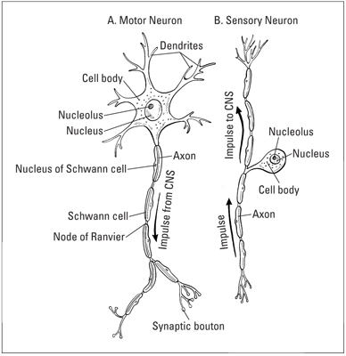

Slide 4
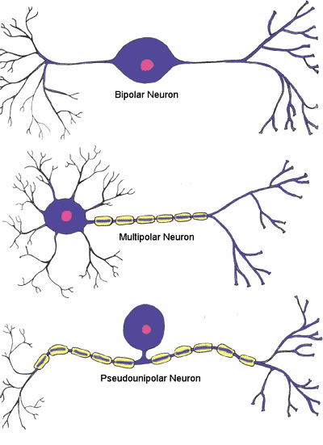

Slide 5
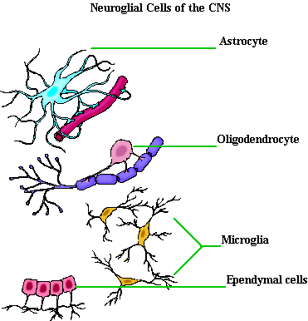

Slide 6
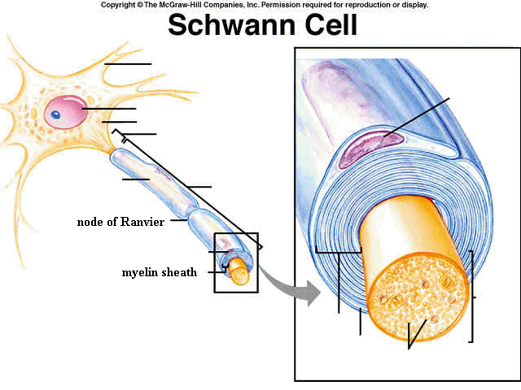

Slide 7
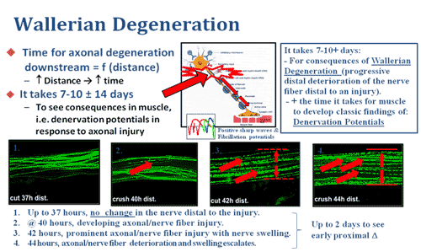

Slide 8
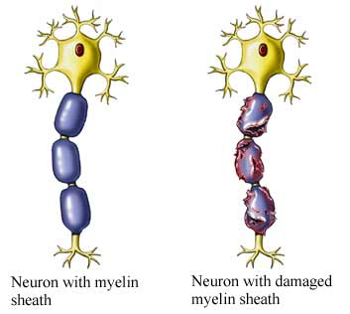

Slide 9
Kazuya Takahashi, Marco Prinz, Massimiliano Stagi, Olga Chechneva, Harald Neumann
April 2007 Issue of PLoS Medicine
Kazuya Takahashi, Marco Prinz, Massimiliano Stagi, Olga Chechneva, Harald Neumann | TREM2-Transduced Myeloid Precursors Mediate Nervous Tissue Debris Clearance and Facilitate Recovery in an Animal Model of Multiple Sclerosis Medium Level of Evidence | In multiple sclerosis, inflammation can successfully be prevented, while promoting repair is still a major challenge. Microglial cells, the resident phagocytes of the central nervous system (CNS), are hematopoietic-derived myeloid cells and express the triggering receptor expressed on myeloid cells 2 (TREM2), an innate immune receptor. | EAE was induced in mice by immunization with a myelin autoantigen. Intravenous application of TREM2-transduced bone marrow–derived myeloid precursor cells at the EAE peak led to an amelioration of clinical symptoms, reduction in axonal damage, and prevention of further demyelination. | Intravenously applied bone marrow–derived and TREM2-tranduced myeloid precursor cells limit tissue destruction and facilitate repair within the murine CNS by clearance of cellular debris during EAE.

Slide 10
The neuron theory
The theory was published in a series of papers in the main medical journal of Germany, Deutsche Medizinische Wochenschrift
Waldeyer's name is sometimes associated in the neuroscienceto the so-called "neuron theory" and for coining the term "neuron" to describe the basic structural unit of the nervous system. | The neuron theory LOW LEVEL | According to this theory the neurons remains in contiguty but not in continunity at the synapse and transmission of nerve impulse across the synapse is by the neuro transmitter. | At the synapse there is no physcial contact between the neurons, but only functional contact. | If there present physical contact then there will be no transmission of actional potional from the one point to another point.

Slide 11
Injury to axon
In 1885, researcher W. Flemming. | Chromatolysis in neuron after injury to axon . Low Level | dying cells in degenerating mammalian ovarian follicles, chromatolysis was also studied in the lactating mammary glands and in breast cancer cells. | The consistent features of chromatolysis included the condensation of the cytoplasm and chromatin, cell shrinkage, formation of “chromatin balls,” intact normal organelles, and fragmentation of cells observed by the budding of fragments enclosed in the cell membrane. These budding fragments were termed “apoptotic bodies,” thus coining the name “apoptosis” to describe this form of cell death | n 1952, research further supported the role of chromatolysis in changing the physiology of cells during cell death processes in embryo development. It was also observed that the integrity of mitochondria is maintained during chromatolysis.

