Slide 1
Ticagrelor versus Aspirin in Acute Stroke or Transient Ischemic Attack

Slide 2
WHY THIS STUDY?
The risk of subsequent ischemic events is particularly high during the first 90 days after the index cerebrovascular event
Aspirin at a dose of 50 to 325 mg daily is commonly used in this context.
The benefit of aspirin in the secondary prevention of ischemic stroke is limited;
The rate of recurrent stroke is 10 to 15% in the first 90 days,
The rate of new ischemic events with aspirin in long term is 22% lower than the rate with no preventive treatment.

Slide 3
Moderate doses of Aspirin are associated with relative risks of
  Hemorrhagic events
  Gastrointestinal bleeding.
More intensive antiplatelet therapy through a different mechanism of action may be more effective than aspirin
  at reducing the risk of recurrent ischemia after transient ischemic attack or acute ischemic stroke,
  but evidence to support this is limited.

Slide 4
Ticagrelor is a potent antiplatelet agent that is directly acting and reversibly binds and inhibits the P2Y12 receptor on platelets.
The Acute Stroke or Transient Ischaemic Attack Treated with Aspirin or Ticagrelor and Patient Outcomes (SOCRATES) trial was designed to compare Ticagrelor with Aspirin with regard to their effectiveness for the prevention of major vascular events
  A composite of stroke [ischemic or hemorrhagic],
  Myocardial infarction,
  Or death
over a period of 90 days in the treatment of patients with acute cerebral ischemia.

Slide 5
METHODS
SOCRATES a multicenter, randomized, double- blind, double-dummy, parallel-group trial
from January 7, 2014, through October 29/ 2015
Total of 13,199 Pts were enrolled at 674 sites in 33 countries.
patients with a ischemic stroke or high-risk transient ischemic attack who had not received intravenous or intraarterial thrombolysis and were not considered to have had a cardioembolic stroke were randomly assigned within 24 hours after symptom onset, in a 1:1 ratio,

Slide 6
To receive either
Ticagrelor
(180 mg loading dose on day 1
followed by 90 mg twice daily for days 2 through 90)
or
Aspirin (300 mg on day 1 followed by 100 mg daily for days 2 through 90).
At the end of 90 days of study treatment, patients were treated at the discretion of the investigator and followed for an additional 30 days.

Slide 7
The sponsor (AstraZeneca) developed the protocol, with guidance from the first author and advice from the other academic authors.
The trial was approved by the ethics committee at each trial center, and all the patients provided written informed consent.
AstraZeneca funded the trial and its analyses, performed trial monitoring and reporting, provided oversight, verified key results provided by DataMap, and had no other role in the trial.

Slide 8
INCLUSION CRITERIA
acute ischemic stroke with a National Institutes of Health Stroke Scale (NIHSS) score of 5 or lower
ABCD2 stroke risk score of ≥4 [scores range from 0 to 7 with higher scores indicating higher risk of stroke] or
symptomatic intracranial or extracranial arterial stenosis and could undergo randomization within 24 hours after symptom onset
at least 40 years of age, and had undergone CT or MRI scan before randomization to rule out intracranial bleeding or other conditions that could account for the neurologic symptoms or contraindicate study treatment.

Slide 9
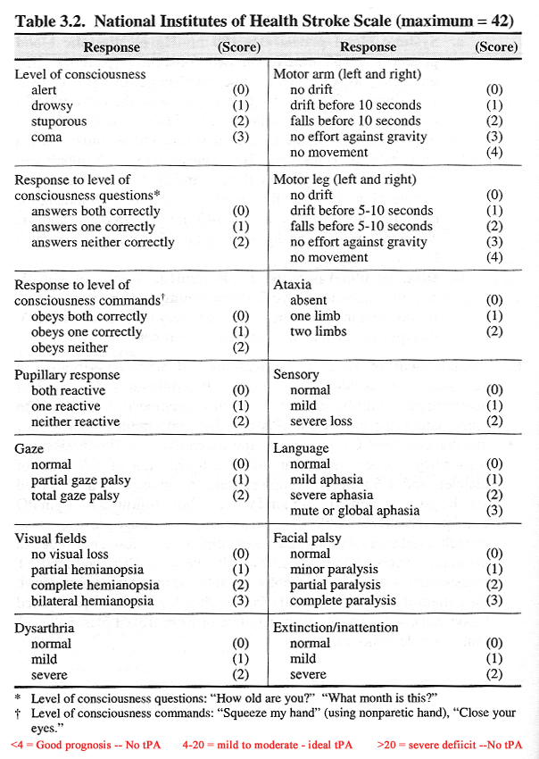
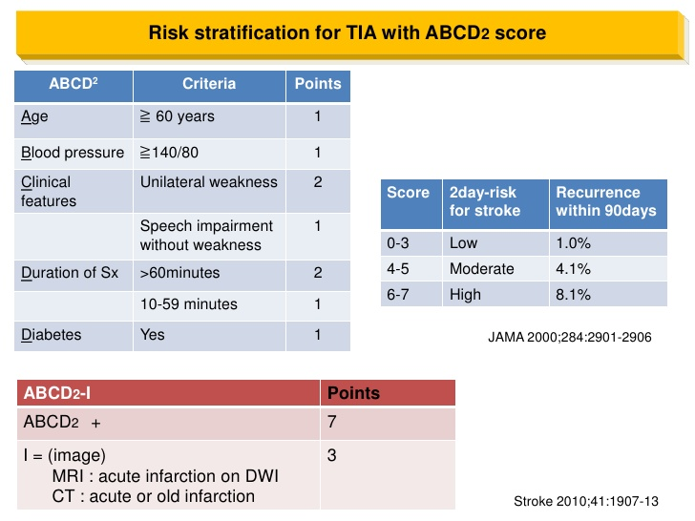

Slide 10
EXCLUSION CRITERIA
If other specific antiplatelet therapy or
Anticoagulation therapy was planned or
If carotid, cerebrovascular, or coronary revascularization was planned that would require halting study treatment within 7 days after randomization or
Hypersensitivity to ticagrelor or aspirin;
History of atrial fibrillation, ventricular aneurysm, or suspicion of cardioembolic cause for transient ischemic attack or stroke;
Underwent intravenous or intraarterial thrombolysis or mechanical thrombectomy within 24 hours before randomization;
                Conti.........

Slide 11
Required treatment with nonsteroidal antiinflammatory drugs for more than 7 consecutive days;
Had a known bleeding diathesis or coagulation disorder;
Had a history of
  Symptomatic nontraumatic intracerebral hemorrhage at any time,
  Gastrointestinal bleed within the past 6 months,
  Major surgery within 30 days;
  Had severe liver disease;
  Had renal failure requiring dialysis;
  Pregnant
  Lactating

Slide 12
PRIMARY OBJECTIVE
Whether Ticagrelor would be a more effective antiplatelet therapy than aspirin for the prevention of recurrent stroke and cardiovascular events in patients with acute cerebral ischemia.
The primary outcome was the occurrence of
  Stroke
  Myocardial infarction
  Death within 90 days

Slide 13
TREATMENT
Within 24 hours after the onset of symptoms of acute ischemic stroke or transient ischemic attack, eligible patients were randomly assigned to a treatment group The loading dose was to be given as soon as possible after randomization.
Eligible patients were randomly assigned in a 1:1 ratio to one of two treatment groups.
Patients received either ticagrelor (a loading dose of 180 mg given as two 90-mg tablets on day 1, followed by 90 mg twice daily given orally together with loading and daily doses of aspirin placebo)

Slide 14
Or aspirin (a loading dose of 300 mg given as three 100-mg tablets on day 1, followed by 100 mg daily given orally together with a loading dose and twice-daily doses of ticagrelor placebo).
Subsequent maintenance doses were taken in the morning and evening, at approximately 12-hour intervals, for the remainder of the 90-day treatment period.

Slide 15
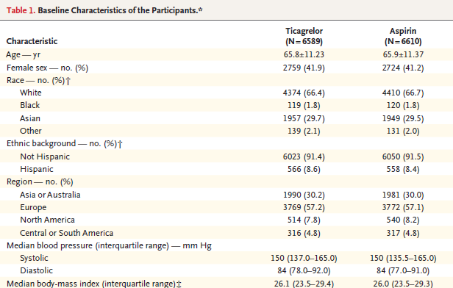

Slide 16
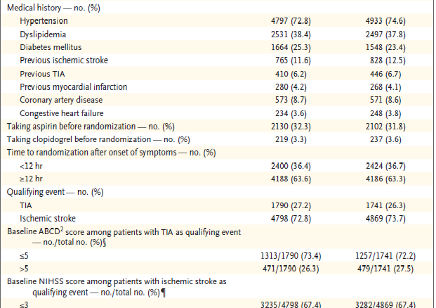

Slide 17
END POINTS
The primary end point was the time from randomization to the first occurrence of any event from the composite of stroke (ischemic or hemorrhagic), myocardial infarction , or death.
The secondary end point , if the difference between the treatment groups with regard to the primary end point was significant , was the time to ischemic stroke.

Slide 18
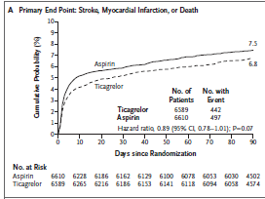

Slide 19
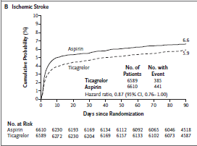

Slide 20
The safety end points included time to first major bleeding event, assessed with the use of the PLATO bleeding definition;
Time to discontinuation of study treatment as a result of any bleeding event; incidence of intracranial hemorrhage;
Incidence of fatal bleeding; and incidence of serious and selected nonserious adverse events.

Slide 21
PLATO CLASSIFICATION
MAJOR
  LIFE THREATENING
    Intracranial , Intrapericardial with Cardiac Temponade
    Bleed resulting in Hypovolemic shock or severe hypotension that requires vasopressors or surgery
    Clinically Overt or Apparent bleeding associated with decreased Hb < 5 gm/dl
    Requiring transfusion of >3 BT (whole blood or PCV)
  OTHER
    Significant disabling eg intraocular with permanent vision loss
    Drop in Hb 3 to 5 gm/dl
    Requiring 2 to 3 BT
  ANY MAJOR
    Any one of above
MINOR
    Requiring medical intervention to stop or treat bleeding ( eg Epistaxis requiring packing
MINIMAL
    As others eg bruising , bleeding gums , oozing from any injection site not requiring intervention or treatment

Slide 22
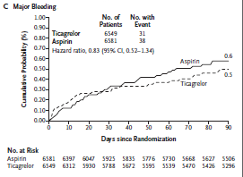

Slide 23
Secondary end points included the time to net clinical outcome, defined as the composite of
  Stroke , Myocardial infarction , Death
    Life-threatening bleeding
    The composite of cardiovascular death
    Myocardial infarction
    Ischemic stroke
    all strokes
    Disabling strokes
    Fatal strokes individually
    Death from any cause
    Death from cardiovascular causes
    Myocardial infarction individually.

Slide 24
STATISTICAL ANALYSIS
The trial was event-driven. To detect a hazard ratio of 0.80 with a final two-sided significance level of 4.98% and 88.7% power, a total of 844 primary end-point events were required.
The significance level was adjusted from 5.00% to account for a single interim analysis for efficacy and futility that was performed when half the primary end-point events had been observed.
On the basis of the pooled observed event rate, the sample size was recalculated during the trial from 9600 to 13,200 patients to accrue the target number of primary events.

Slide 25
All efficacy analyses were based on the intention- to-treat principle and included the full analysis set of patients with adjudicated events.
Safety analyses were performed with the cohort that received treatment.
The secondary end point, time to first ischemic stroke, was to be tested for confirmation only if the results of the primary analysis were significant.

Slide 26
The time from randomization to the first occurrence of any event for a given end point was compared with the use of the Cox proportional hazards model.
Interactions between treatment assignment and prespecified subgroups were evaluated by including terms for treatment, subgroup, and treatment- by-subgroup interaction in the Cox model. Interaction terms with a P value of less than 0.05 were considered to be statistically significant.

Slide 27
RESULT FROM PRIMARY OUTCOME
Overall, 13,307 patients were enrolled, and 13,199 patients underwent randomization.
A total of 494 patients (3.7%) presented with ischemic stroke within 4.5 hours after symptom onset, of whom 128 (1.0% of the total patient population) had an NIHSS score higher than .
Two patients were lost to follow-up, and we were unable to determine the vital status of 7 others after they withdrew their consent.
Event statuses for components of the primary end point were ascertained for 98.5% of the potential patient followup time

Slide 28
A primary composite end-point event occurred in 442 of the 6589 patients (6.7%) in the ticagrelor group and in 497 of the 6610 patients (7.5%) in the aspirin group (hazard ratio, 0.89; 95% confidence interval [CI], 0.78 to 1.01; P = 0.07).
The main secondary end point, ischemic stroke, occurred in 385 patients (5.8%) in the ticagrelor group and 441 patients (6.7%) in the aspirin group (hazard ratio, 0.87; 95% CI, 0.76 to 1.00; nominal P = 0.046)

Slide 29
Major bleeding occurred in 31 patients (0.5%) in the ticagrelor group and 38 patients (0.6%) in the aspirin group (hazard ratio, 0.83; 95% CI, 0.52 to 1.34)
Intracranial hemorrhage occurred in 12 patients (0.2%) in the ticagrelor group and in 18 patients (0.3%) in the aspirin group.
Fatal bleeding occurred in 9 patients (0.1%) in the ticagrelor group and in 4 patients (0.1%) in the aspirin group.
there were no significant differences in the other major safety outcomes

Slide 30
Dyspnea was more common in the ticagrelor group than in the aspirin group (6.2% vs. 1.4%).
Permanent discontinuation of study treatment occurred in 17.5% of patients in the ticagrelor group, versus 14.7% of patients in the aspirin group .
Dyspnea and bleeding events were the most frequent factors accounting for the difference, with rates of discontinuation due to dyspnea in the ticagrelor and aspirin groups of 1.4% and 0.3%, respectively, and rates of discontinuation due to any bleeding of 1.3% and 0.6%.
A net clinical outcome, defined as a composite of stroke, myocardial infarction, death, or life-threatening bleeding, occurred in 6.9% of patients in the ticagrelor group and 7.7% of patients in the aspirin group (hazard ratio, 0.90; 95% CI, 0.79 to 1.02).

Slide 31
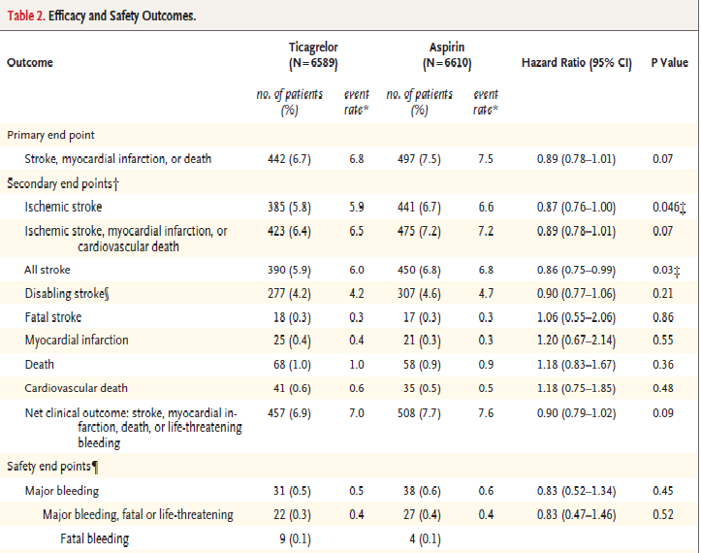

Slide 32
DISCUSSION
They tested the efficacy and safety of monotherapy with ticagrelor versus aspirin in patients who were treated within 24 hours after the onset of a cerebral ischemic event.
They concluded events included in the primary end point — a composite of stroke, myocardial infarction, or death — were not less common among patients who received ticagrelor than among patients who received aspirin during the 90-day follow-up period.

Slide 33
No evidence of a higher risk of major or intracranial hemorrhage with ticagrelor than with aspirin,
but more instances of dyspnea and minor bleeding in the ticagrelor group.
Although some studies have suggested that the risk of stroke after transient ischemic attack has decreased in recent years,
their trial confirms previous studies that have shown a high risk in the first 2 weeks, with particularly high event rates in the first 2 days.

Slide 34
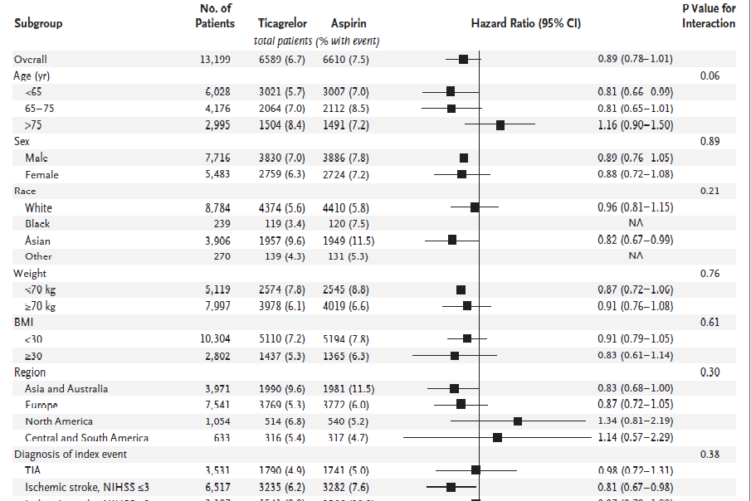

Slide 35
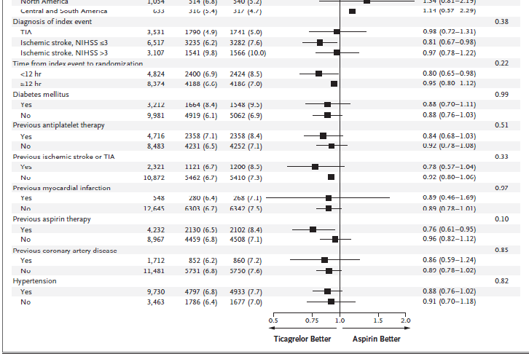
Hazard Ratios for the Primary End Point According to Predefined Subgroups

Slide 36
LIMITATION OF THIS STUDY
the limited enrollment of patients who were at especially high risk for stroke, such as those with high-grade carotid or severe intracranial stenosis.
Patients ,undergone vascular interventions or may have been treated with the combination of clopidogrel plus aspirin on the basis of the results of the Clopidogrel in High- Risk Patients with Acute Nondisabling Cerebrovascular Events (CHANCE) trial.
The primary end-point event rates in the group with transient ischemic attack were lower than expected, possibility that they enrolled some patients with nonischemic conditions mimicking a transient ischemic attack, in whom antiplatelet therapy is unlikely to be efficacious.

Slide 37
Patients who underwent thrombolysis or thrombectomy were not eligible for participation in this trial, so the results should not be generalized to them.
The rate of serious adverse events did not differ significantly between the ticagrelor and aspirin groups
discontinuation of study treatment was more common among patients who received ticagrelor, primarily due to dyspnea (known adverse effect of ticagrelor).
Other causes of the higher rate of discontinuation in the ticagrelor group were minor and minimal bleeding events.

Slide 38
Approximately one third of the patients were taking aspirin at the time of the qualifying cerebral ischemic event.
The antiplatelet effects of aspirin typically last several days, the introduction of ticagrelor represented short-term dual antiplatelet therapy.
Subgroup analysis did not reveal a significant interaction indicating a benefit of ticagrelor in patients who were taking aspirin at baseline, but further study of the combination of ticagrelor and aspirin may be warranted, given the possibility that the rates of ischemic stroke were lower in association with ticagrelor in this group of patients.

Slide 39
AUTHOR’S CONCLUSION
in their trial involving patients with acute ischemic stroke or transient ischemic attack, ticagrelor was not found to be superior to aspirin in reducing the risk of the composite end point of stroke, myocardial infarction, or death.

Slide 40
MY CONCLUSION
Further large scale studies are required in Indian set ups
Duration of the study should be longer
Aspirin to be continued to be preferred in our set up rather than costly Ticagrelor as no major benefits noted in this study

Slide 41
Citation: Ticagrelor vs Aspirin to prevent recurrent stroke and cardiovascular events in pt with acute cerebral ischemia
What question did the study ask Would Ticagrelor be a more effective antiplatelet therapy than aspirin for the prevention of recurrent stroke and cardiovascular events in patients with acute cerebral ischemia?
Intervention : Ticagrelor (a loading dose of 180 mg given as two 90-mg tablets on day 1, followed by 90 mg twice daily given orally together with loading and daily doses of aspirin placebo) Or aspirin (a loading dose of 300 mg given as three 100-mg tablets on day 1, followed by 100 mg daily given orally together with a loading dose and twice-daily doses of ticagrelor placebo) for period of 90 days.
Comparison: Ticagrelor vs Aspirin
Outcome(s): Ticagrelor would be a more effective antiplatelet therapy than aspirin for the prevention of recurrent stroke and cardiovascular events in patients with acute cerebral ischemia.
Citation: Ticagrelor vs Aspirin to prevent recurrent stroke and cardiovascular events in pt with acute cerebral ischemia
What question did the study ask? Population/problem: how to prevent recurrent strokes and cardiovascular events with acute cerebral ischemia?
Intervention : Ticagrelor VS Aspirin for 90 days period in pt with acute cerebral ischemia.

Slide 42
Assess validity of the study:
Recruitment – were the subjects representative? | yes
Was the assignment of patients to treatments randomised? Was the randomisation list concealed? | Yes yes
Was follow-up of patients sufficiently long and complete? | Yes
Were all patients analysed in the groups to which they were randomised? | yes
Were patients and clinicians kept “blind” to treatment? | yes
Were the groups treated equally, apart from the experimental treatment? | yes
Were the groups similar at the start of the trial? | yes

Slide 43
Are the valid results of this randomised trial important?
What was the sample size? | 13199
What statistical tests were used and were they appropriate? Clinical vs. statistical significance? | yes
Selection of outcomes : Does the article report all relevant outcomes including side effects? | yes
Effect size : Was there a difference between the outcomes of the treatments, and how big was the difference? | no
Impact on practice and the patients you treat? | no

Slide 44
Can you apply this valid, important evidence about therapy in caring for your patient | YES
Do these results apply to your patient? | YES
Is your patient so different from those in the study that its results cannot apply? | YES
Is the treatment feasible in your setting? | No
What are your patient’s potential benefits and harms from the therapy? | No potential benefit of the therapy

Slide 45
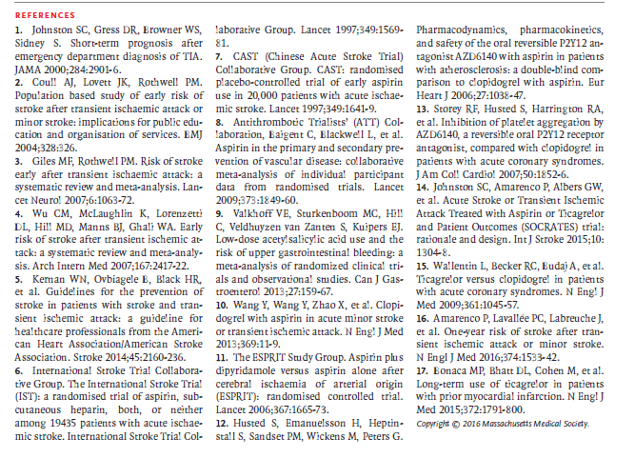

Slide 46
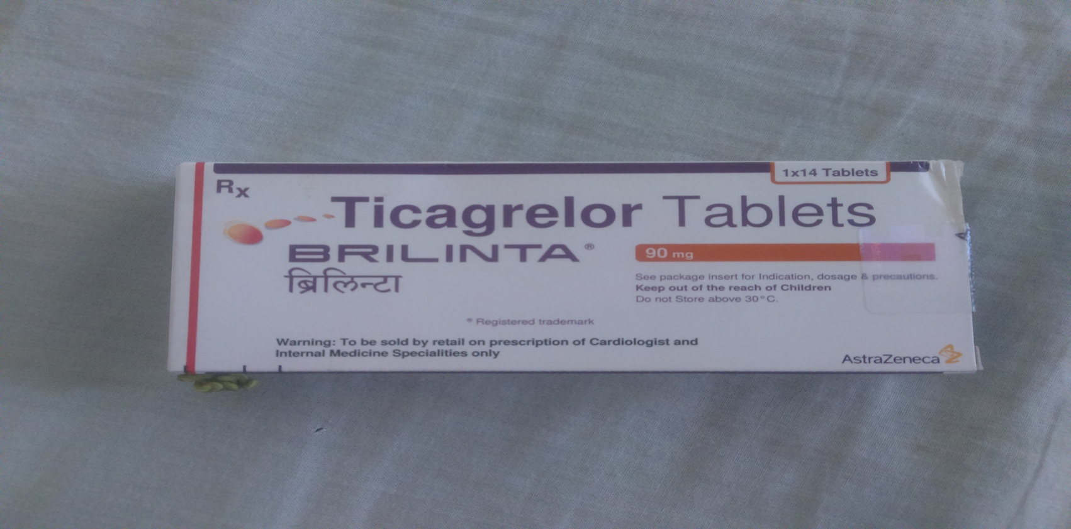
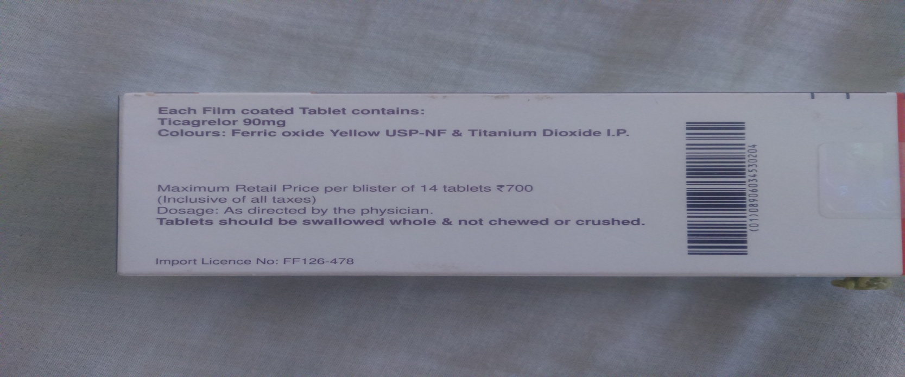
BRILINTA( Astrazeneca) & Tab Axcer (sun pharma) 90 mg , 50 RS PER TABLET

Slide 47
THANK YOU

