Slide 1
brachial plexus
Dr.Manoj Kulkarni
Professor
Department of Anatomy
S.B.K.S.M.I. & R.C.

Slide 2
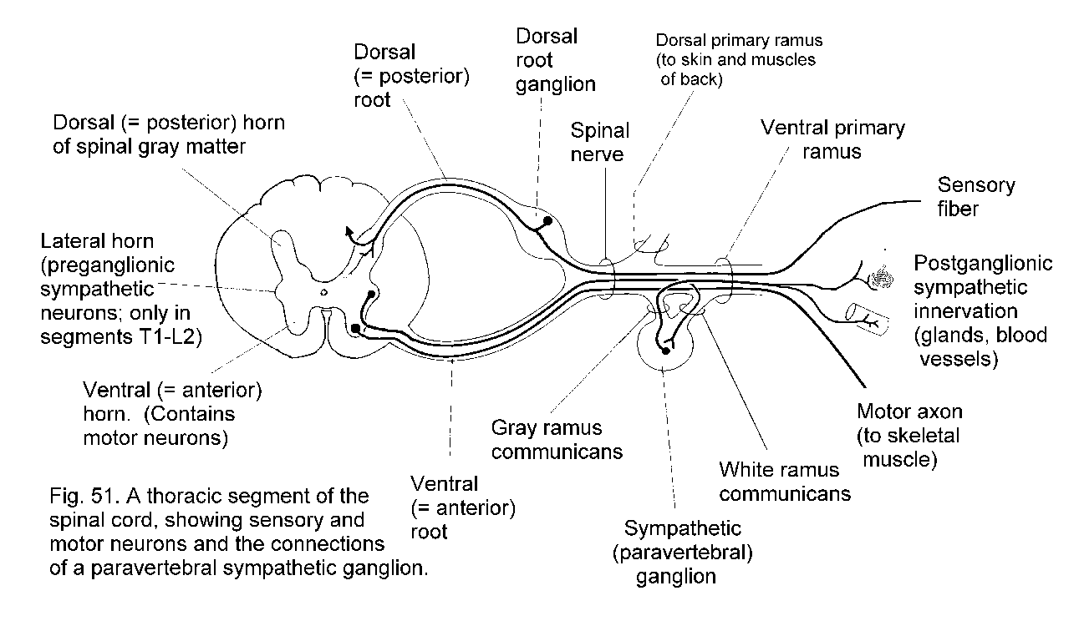
proprofs.com

Slide 3
brachial plexus
Roots
Trunks
Division
Cords- infraclavicular
supraclavicular

Slide 4
proprofs.com

Slide 5
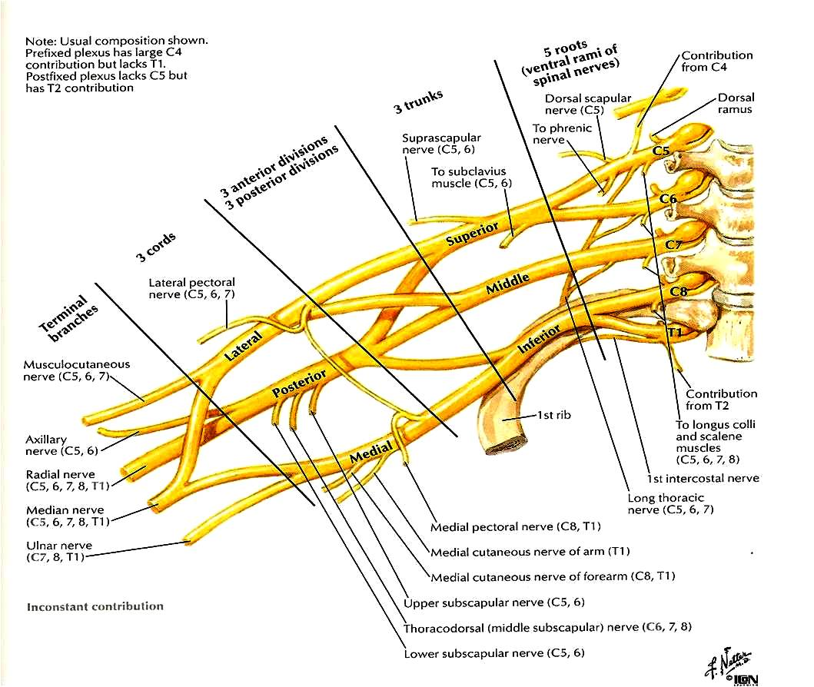
en.wikipedia.org

Slide 6
physio-pedia.com

Slide 7
en.wikipedia.org

Slide 8
Branches of the Brachial Plexus
Branches of The Roots
Nerve to Serratus Anterior (Long Thoracic Nerve) (C6,7)
Nerve To Rhomboideus (Dorsal Scapular)(C5)
Branches Of The Trunks
Suprascapular nerve(C5,6)
Nerve to Subclavius (C5,6)
40th edition of Gray’s anatomy

Slide 9
Branches of the Brachial Plexus
Branches Of The Cords
Branches of the Lateral Cord
Lateral Pectoral (C5,6,7)
Musculocutaneous (C5,6,7)
Lateral root of median nerve (C5,6,7)
40th edition of Gray’s anatomy

Slide 10
Branches of the Brachial Plexus
Branches Of The Cords
Branches of the Medial Cord
Medial Pectoral (C8,T1)
Medial Cutaneous nerve of the arm(C8,T1)
Medial Cutaneous nerve of the forearm (C8T1)
Ulnar (C7,C8 &T1) fibres reach by a communicating branch from lateral root of median nerve
Medial root of median nerve
40th edition of Gray’s anatomy

Slide 11
Branches of the Brachial Plexus
Branches Of The Cords
Branches of the Posterior Cord
Upper Subscapular (C5,6)
Nerve to latissimus dorsii (thoracodorsal) (C7,8)
Lower Subscapular (C5,6)
Axillary (Circumflex) (C5,6)
Radial (C5,6,7,8 &T1)
40th edition of Gray’s anatomy

Slide 12
Evidence of Variations in Brachial Plexus Formation

Slide 13
Walter G. Harry, John D.C. Bennett, Somes C. Guha
Issue Clinical Anatomy Volume 10, Issue 4, pages 250–252, 1997
1.Walter G.Harry, John D.C. Bennett, Somes C. Guha | Scalene muscles and the brachial plexus: Anatomical variations and their clinical significance Medium Level of Evidence | Walter G. Harry et al studied 32 female and 19 male adult cadavers.The commonly described anatomical relationship of the brachial plexus (BP) lying between the anterior scalene (AS) and middle scalene (MS) muscles was studied. | The commonly described anatomical relationship of the brachial plexus (BP) lying between the anterior scalene (AS) and middle scalene (MS) muscles was found in only 60%; of instances. Scalenus minimus was present in 46%; of instances (bilateral in 14 cadavers). The most common variation was the penetration of the AS by the C5 and/or C6 ventral rami. The C5 and C6 roots may fuse before piercing AS (15%; cases, bilateral in 4 cadavers), or the C5 root alone pierce the belly of AS (13%; cases, bilateral in 3 cadavers). The roots also may pierce AS independently (6%; cases, bilateral in 1 cadaver). In 3%;, the C5 root was found to be completely anterior to AS. | The most commonly described anatomical relationship of the brachial plexus with anterior scalene & middle scalene is prevalent in majority of cases but variations also are found in very high percentage & need to be kept in mind by the surgeons

Slide 14
James VILLAMERE [1]Shannon GOODWIN [2]Maxwell HINCKE [2]Alireza JALALI [2]
[1] Faculty of Medicine, University of Ottawa, Ottawa, CANADA; [2] Division of
Clinical and Functional Anatomy, Faculty of Medicine, University of Ottawa, Ottawa,
CANADA. 14 March, 2009 © http://www.neuroanatomy.org
James VILLAMERE [1] Shannon GOODWIN [2] Maxwell HINCKE [2] Alireza JALALI [2] | A brachial plexus variation characterized by the absence of the superior trunk A case report Low level of evidence | During routine dissection of a 55-year-old female cadaver, a variation of the brachial plexus characterized by the absence of the superior trunk on the left side was observed. | The ventral rami of the C5 and C6 nerve roots, without joining to form the superior trunk, independently divided into anterior and posterior divisions, which joined the lateral and posterior cords, respectively. Additionally, the suprascapular nerve that normally originates from the superior trunk initiated exclusively from the C5 nerve root in this variation. Similar variations in the brachial plexus were not observed on the contralateral side. | Variation of the suprascapular nerve characterized by direct origin from the C5 nerve root may have clinical implications in the setting of a cervical nerve root impingement. The absence of the superior trunk may increase the likelihood of nerve root avulsion in the context of traction injury of the brachial plexus. Moreover, the variation may have clinical implications during the anesthetic administration of an intrascalene nerve block.

Slide 15
Suruchi Singhal , Vani Vijay Rao and Roopa Ravindranath
Department of Anatomy, St John's Medical College, Bangalore – 560034, India
Journal of Brachial Plexus and Peripheral Nerve Injury 2007, 2:21doi:10.1186/1749-7221-2-21
Suruchi Singhal , Vani Vijay Rao and Roopa Ravindranath Department of Anatomy, St John's Medical College, Bangalore – 560034, India | Variations in brachial plexus and the relationship of median nerve with the axillary artery: A case report Low level of evidence | On routine dissection of an embalmed 57 year old male cadaver, variations were found in the formation of divisions and cords of the Brachial Plexus of the right side. | Some previously unreported findings observed were; direct branches to the muscles Pectoralis Minor and Latissimus dorsi from C6, innervation of deltoid by C6 and C7 roots and the origin of lateral pectoral nerve from the posterior division of upper trunk. The median nerve was present lateral to axillary artery. The left side brachial plexus was also inspected and found to have normal anatomy. | Variations assume significance during surgical exploration of the axilla and can even fail the nerve block of infraclavicular part of the brachial plexus. Though the variations that we have mentioned here may not alter the normal functioning of the limb of the individual, it is important to keep these in mind in surgical and anaesthesiological procedures.

Slide 16
Applied anatomy
Erb’s palsy:
Injury to upper trunk of brachial plexus
Causes- birth injury, fall on shoulder, during anaesthesia
Nerve roots involved- C5,6
Muscles paralysed- biceps, deltoid, brachialis, brachioradialis
Deformity: Porter’s tip/Policeman’s tip
Arm- hangs by side, adducted and medially rotated
Forearm- extended and pronated
40th edition of Gray’s anatomy

Slide 17
Erb’s point:
Suprascapular nerve
C5
Anterior division
C6
Posterior division
Nerve to subclavius
depts.washington.edu

Slide 18
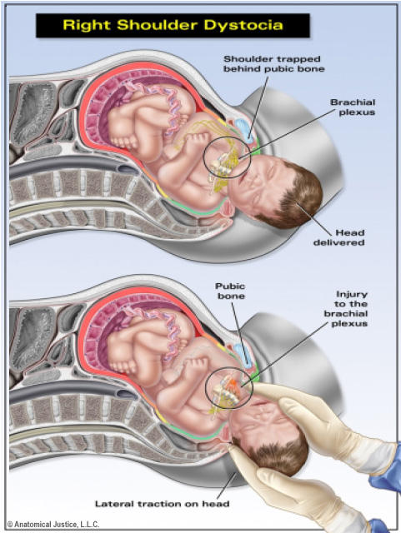
scrubnotes.com

Slide 19
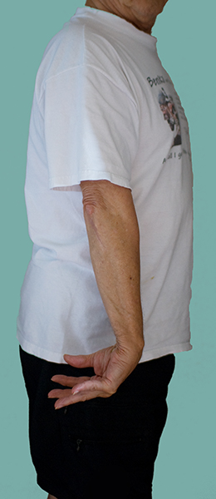
scrubnotes.com

Slide 20
Evidence on applied of the Erb’s palsy

Slide 21
K Weizsaecker, JE Deaver, WR Cohen,BJOG: An International Journal of Obstetrics & Gynaecology,Volume 114, Issue 8, pages 1003–1009, August 2007
K Weizsaecker, JE Deaver, WR Cohen* | Labour characteristics and neonatal Erb’s palsy | A total of 45 consecutive cases of Erb’s palsy and 90 controls. Pregnancies and labours of neonatal Erb’s palsy cases were compared with 90 controls using univariate and multiple logistic regression analysis. | Shoulder dystocia occurred in 67% of cases and in 2% of controls (P= 0.001). Only 46% of labours had a completely normal dilatation pattern. In a multiple logistic regression model, variables independently associated with brachial plexus injury were long deceleration phase of labour, long second stage, high birthweight, black race, and high neonatal or maternal body mass. | Erb’s palsy was frequently preceded by abnormal labour and shoulder dystocia; however, a substantial proportion of cases occurred after normal labour and delivery. Predictive models will be necessary to determine to what extent careful monitoring of the terminal portion of dilatation and of fetal descent and incorporation of maternal body mass and race will help identify fetuses at risk for brachial plexus palsy.

Slide 22
H.F. Sandmire, R.K. DeMott, International Journal of Gynecology & Obstetrics Vol. 78, Issue 3, Pages 253-256, September 2002
H.F. Sandmire, R.K. DeMott | Erb's palsy without shoulder dystocia | Prior to the last 10–12 years it was assumed that Erb's palsy occurred exclusively with and was the result of shoulder dystocia. Gonik et al. reported on a research study based on the premise that when Erb's palsies occurred there must have been shoulder dystocia present but it went undetected by the delivering physician.. | Both Gonik's and Gherman's research revealed distinct maternal and newborn differences when comparing Erb's palsy occurring with and without associated shoulder dystocia. These differences, which have nothing to do with the ability to recognize shoulder dystocia, provide conclusive evidence that Erb's palsy does occur without associated shoulder dystocia. | Therefore, Gonik's original premise, that shoulder dystocia must have been present if Erb's palsy occurred, is not supported. This brings into question the cause of Erb's palsy in those cases without shoulder dystocia. The maternal forces are the most likely cause both with and without shoulder dystocia.

Slide 23
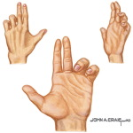
Klumpke’s paralysis
Cause - by excessive abduction of the arm as a result of someone clutching for an object when falling from a height
Nerve roots involved: C8,T1
Muscles paralysed: intrinsic mus.of the hand
ulnar flexors of the wrist and fingers
Deformity: Claw hand- hyperextension
at the metacarpophalangeal joints and
flexion at the interphalangeal joint.
40th edition of Gray’s anatomy
scrubnotes.com

Slide 24
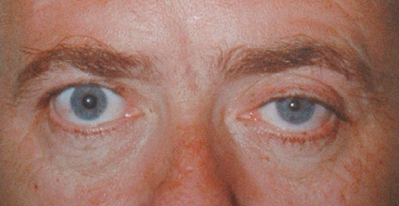
Klumpke’s paralysis
Horner’s syndrome :
Ptosis- drooping of eyelid
Miosis- constriction of pupil
Anhydrosis- lack of sweating
Enophthalmos- posterior displacement of eyeball
Sensory loss-
Vasomotor and Trophic changes
mrcophth.com
40th edition of Gray’s anatomy

Slide 25
Injury to N. to Serratus anterior
by blows or pressure in the posterior triangle of the neck or during a radical mastectomy surgical procedure or heavy load on shoulder.
‘Winging of scapula’
Loss of pushing and punching movement
Arm cannot raised above 90⁰
40th edition of Gray’s anatomy

Slide 26
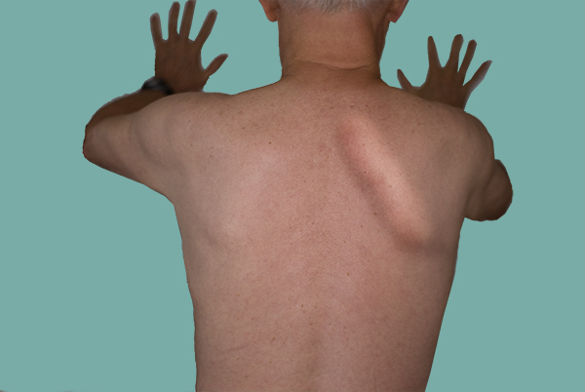
scrubnotes.com

Slide 27
Evidence on applied of the winging of scapula

Slide 28
G. J. Packer FRCSEd, G. R. McLatchie FRCS* and W. Bowden FRCS, Br J Sp Med 1993; 27(2), on September 5, 2012 - Published by group.bmj.com
G. J. Packer FRCSEd, G. R. McLatchie FRCS* and W. Bowden FRCS | Scapula winging in a sports injury clinic | Four patients with scapula winging referred to a sports injury clinic are presented. None of the patients was aware of any trauma and a traction injury to the long thoracic nerve is proposed as the etiology of this condition. | As the winging results from a neurapraxia, treatment consists of 'supervised neglect', shoulder movements being maintained under physiotherapy supervision. | The absence of precipitating trauma and the non-specific history may explain why scapula winging may be underdiagnosed.

Slide 29


