Slide 1
KARYOTYPING
Dr.Hetal Vaishnani
Associate Professor
Department of Anatomy
S.B.K.S.M.I. & R.C.

Slide 2
KARYOTYPING
Also known as: Chromosome analysis
Definition
Karyotyping is a test to examine chromosomes in a sample of cells
It can help identify genetic problems as the cause of a disorder or disease.

Slide 3
KARYOTYPING
This test can:
Count the number of chromosomes
Look for structural changes in chromosomes

Slide 4
Outline of Karyotyping
Sample collection
Induction of Mitosis
Arrest of cell division at Metaphase
Staining of metaphase chromosomes & their examination

Slide 5
How the test is performed?
The test can be performed on almost any tissue, including:
Blood
Amniotic fluid
Bone marrow
placenta

Slide 6
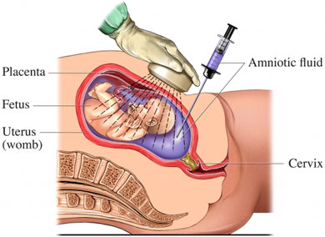
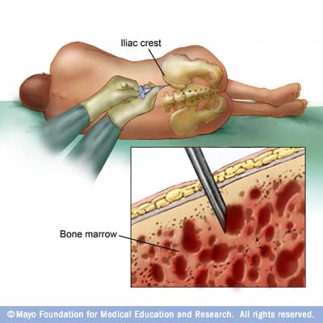
How the test is performed?
To test amniotic fluid, an amniocentesis is done.
A bone marrow specimen requires a bone marrow biopsy.

Slide 7
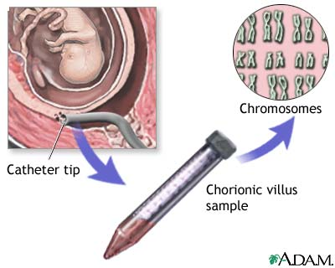
CHORIONIC VILLOUS SAMPLE

Slide 8
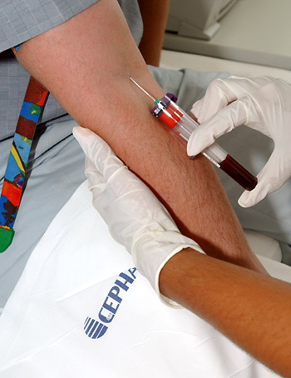
BLOOD FROM PERIPHERAL VEIN

Slide 9
PLANTING OF CELLS
Blood sample collected is transferred into 2-3 culture vial containing:
CULTURE MEDIUM: HAM F10, TC 199 etc.
Fetal calf serum/ Human AB serum
Phytohaemagglutinin: mitogenic agent extracted from French beans
Antibiotic: penicillin & streptomycin

Slide 10
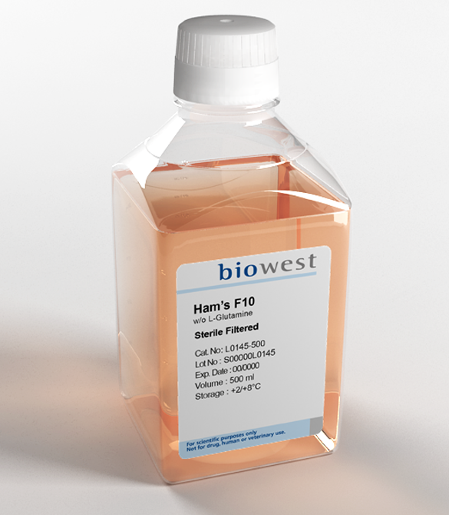
CULTURE MEDIUM: HAM F10, TC 199 etc.

Slide 11
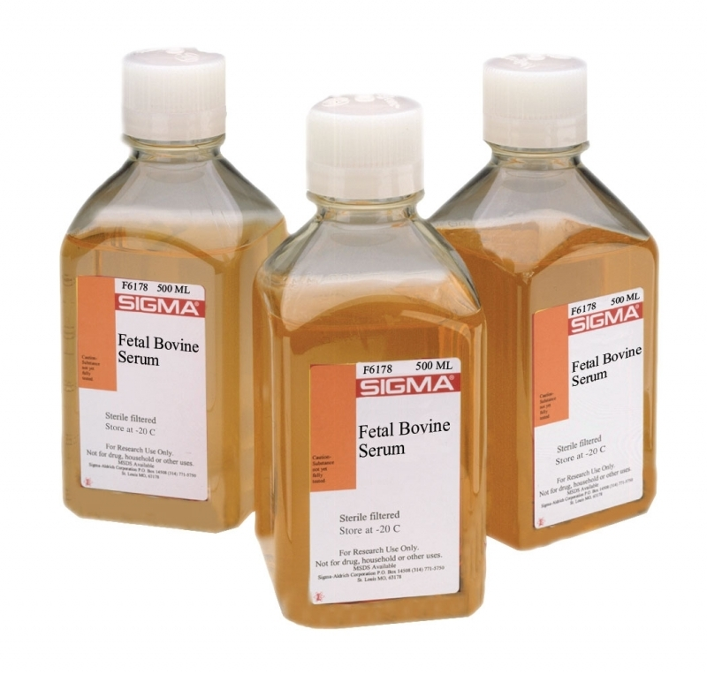
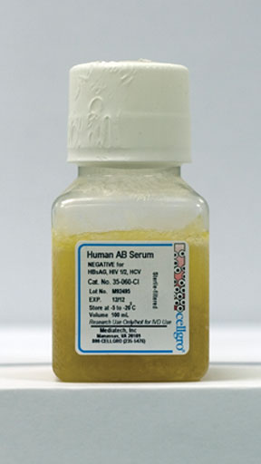
Fetal calf serum/ Human AB serum

Slide 12

Phytohaemagglutinin
mitogenic agent extracted from French beans
PROMOTES RATE OF MITOSIS

Slide 13
Antibiotic
Commonly used: penicillin & streptomycin
Prevents growth of bacteria in culture

Slide 14
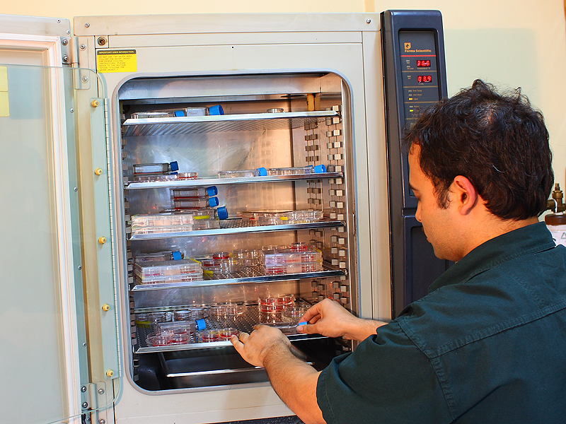
INCUBATION
37⁰ C for 3 days

Slide 15
Harvesting
Colchicine added after 70 hrs, arrests mitosis
2 hrs after addition of colchicine, centrifuge vials
Add hypotonic solution- cells swell up, chromatids separate
Fixative added
https://www.youtube.com/watch?v=yoxMGHNj3ZU

Slide 16
STAINING
1)G-banding : Slide with chromosome is treated with trypsin. It denatures proteins. Then stained with GIEMSA solution. The chromosomes show light and dark bands.
2)Q-banding: Stained with quinacrine mustard –specific banding pattern under flourescent microscope.
3)R-banding :Preheated in buffer at high temp.& then stained with Giemsa. Banding pattern reverse of Q- or G-banding
4)C-banding: Stains centromeric region

Slide 17
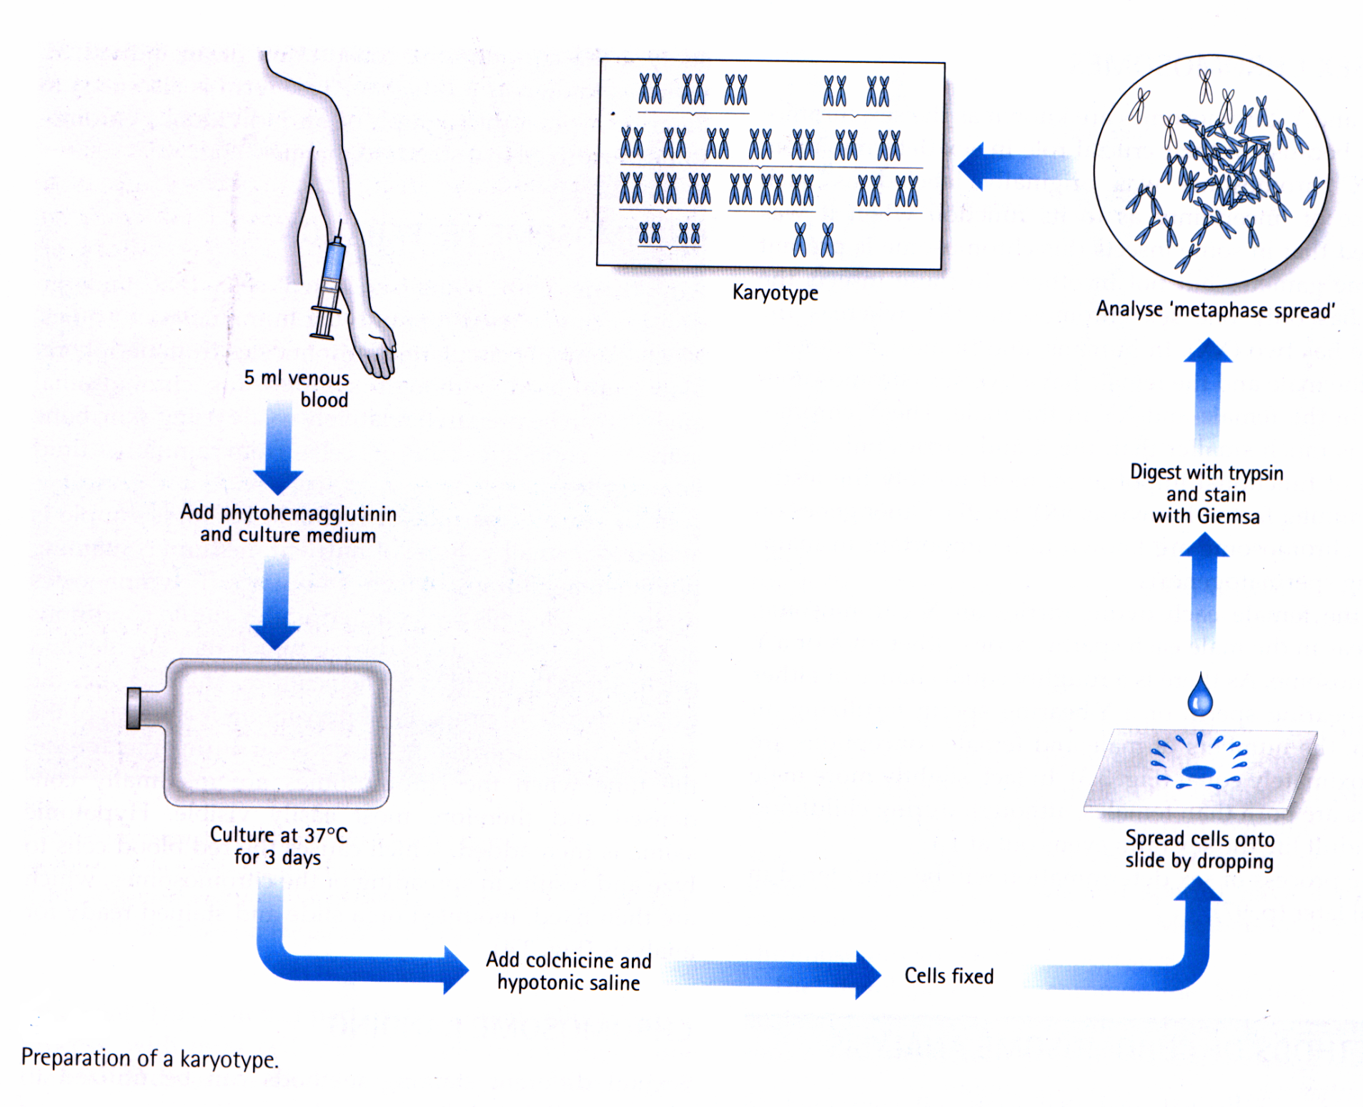

Slide 18
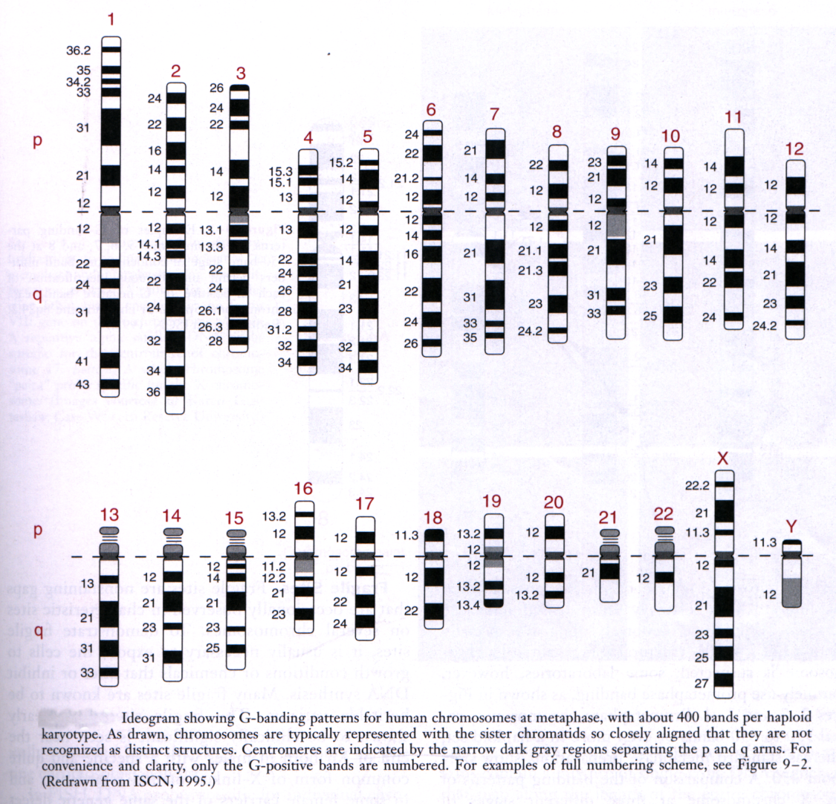

Slide 19
APPLICATIONS OF KARYOTYPING
1. Clinical diagnosis:
congenital malformation, mental retardation abnormal sexual development, Infertility, repeated miscarriage
2. Role in cancer treatment
3. Prenatal Investigation

Slide 20
SEX CHROMATIN & LYON HYPOTHESIS

Slide 21
Barr Body / Sex Chromatin
In 1949,Barr & Bertram discovered a chromatin mass in the nuclei of neurons of female cats .
It was associated with female gender only –Sex Chromatin or Barr body.
Females : chromatin + positive
Males : chromatin – negative
Mary Lyon (1961) established that Sex chromatin represents one of the inactive X- CHROMOSOME, which is condensed ,dark staining (heteropyknotic).

Slide 22
Lyon Hypothesis
Male= 46XY
Female = 46XX
The Lyon hypothesis states that in cells with multiple X chromosomes, all but one are inactivated during mammalian embryogenesis.
The process of inactivation is called as lyonization
Inactivation is random but fixed – X m or X p

Slide 23
Number of Barr bodies = Number of X chromosome - 1
Normal Female = 1 Barr Body
Normal Male = 0 Barr Body

Slide 24
GENETIC SIGNIFICANCE OF X-INACTIVATION
Dosage compensation - X -linked gene product is equivalent in both sexes
Variability of expression in heterozygous female -
Variation in expression of X-linked disorders can be ranging from completely normal to full expression of the defect.
A carrier who exhibits the X-linked trait is called a manifesting heterozygote.e.g hemophilia, color-blindness
Mosaicism –Females are mosaics in respect to X-linked genes
Definition- It is defined as the presence in an individual or tissue of at least two cell lines that differ genetically but are derived from a single zygote.

Slide 25
Procedure
Scrapping from buccal mucosa
Fixed with alcohol
Stained with Thionine or Toluidine blue.
>20%cells show the chromatin mass in the nucleus –chromatin + positive

Slide 26
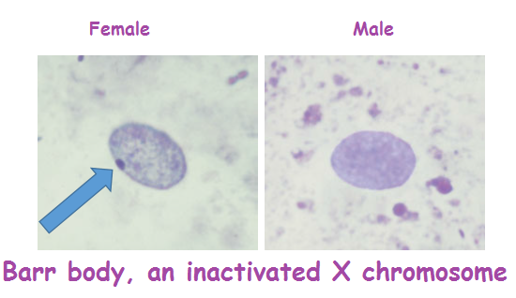

Slide 27
Barr Body Test
Interpretation
This barr body test is advised for the screening of ambiguous or doubtful sex characters.
Turner’s syndrome female (XO) will have no barr body.
Male with Klinefelter syndrome (XXY) will have the barr body.
Female with XXX chromosome will have two barr bodies.
NOTE
If needed the result should be confirmed by chromosomal karyotyping.

Slide 28
Q 1. Mitosis can be arrested at metaphase by
Phytohemagglutinin
Colchicine
Antibiotics
Any toxic drug

Slide 29
Q 2. During Karyotyping which staining results into alternate dark & light bands on Chromosomes?
Giemsa
Quinacrine musturd
H & E
None of the above

Slide 30
Q.3 Chromosomal study helps in clinical diagnosis in
mental retardation
Infertility
Congenital malformation
all of the above

Slide 31
Q 4 How may Barr bodies are present in the cell of normal male?
1
2
3
4

Slide 32
Q 5 Sex chromatin represents:
The set of active genes which will determine the sex of an individual
Y chromosome
X chromosome
One of the Inactive X chromosome in normal female

Slide 33
TITLE | AUTHOR / JOURNAL | MATERIAL | RESULT | CONCLUSION
Klinefelter's syndrome | FabioLanfrancoMDªAxelKamischkeMDªMichaelZitzmannMDªProfEberhardNieschlag Lancet Volume 364, Issue 9430, 17–23 July 2004, Pages 273-283 | Klinefelter's syndrome is the most common genetic cause of human male infertility, but many cases remain undiagnosed because of substantial variation in clinical presentation and insufficient professional awareness of the syndrome itself | However, nowadays patients with Klinefelter's syndrome, including the non-mosaic type, need no longer be considered irrevocably infertile, because intracytoplasmic sperm injection offers an opportunity for procreation even when there are no spermatozoa in the ejaculate | The genetic implications of the fertilisation procedures, including pretransfer or prenatal genetic assessment, must be explained to patients and their partners.

