Slide 1
Cerebellum
Dr. A. Gandotra
HOD & Professor
Department of Anatomy
S.B.K.S.M.I. & R.C.

Slide 2
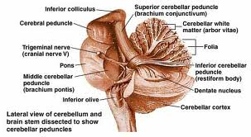
cerebellum

Slide 3
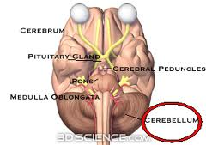

Slide 4
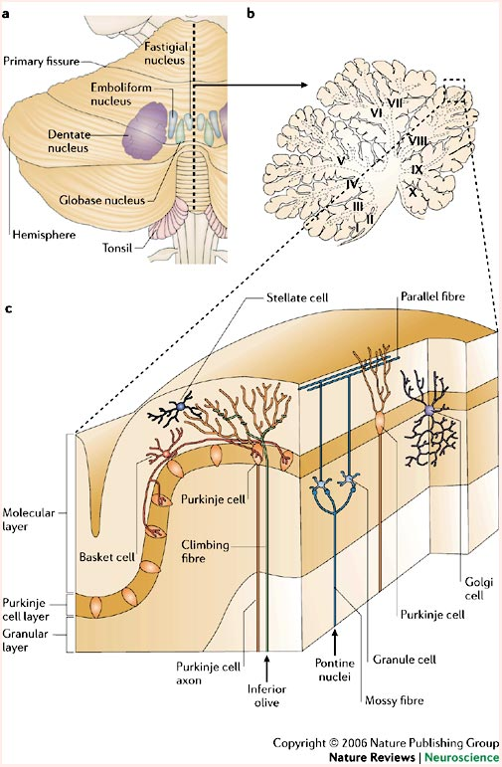

Slide 5
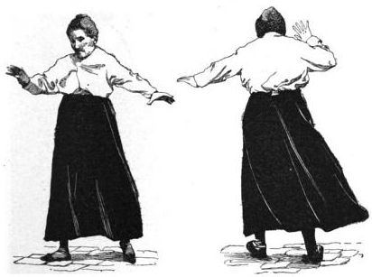
Cerebelar signs

Slide 6
Daria Riv and Cesare Giorgi, Developmental neurolgy Division and Seereotactic and Fundtional Neurosurgery Unit, Carlo Besta National Neurological Instutute, Milnn Italy. Brain (2000),123, 1051-1061
Daria Riv and Cesare Giorgi | The cerebellum contributes to higher functions during development. Evidence from a series of children surgically treated for posterior fossa tumours | This study was done on 32 children who underwent surgery for cerebellar astrocytoma and 21 for cerebellar vermis medulloblastoma.Each patient underwent a comprehensive neurological examination. MRI and EEG using Ag- AgCl electrodes postioned according to the International 10-20 system. was performed. | The patients with right cerebellar lesions showed a slight but non significant decline in verbal performance. The language tests revealed an impairment which was less pronounced and most marked in relation to measure of complex aspects of language and formulatiohnof sentences as reflected in the MLU. The children with left cerebellar lesions showed a decline in non verbal performance. | The tumours of the right cerebellar hemisphere correlated to an alteration in the processing of verbal intelligence and complex language tasks; those of the left cerebellar hemisphre correlated to a diminished capacity to process non-verbal tasks and in some cases an impairment .

Slide 7
Lisi Levisohn. Alice Cronin-Golomb and Jeremy D, Schmahmann. Department of Psychology, Boston University and Department of Neureology, Massachusetts General Hospital and Harvard Mecical School. Boston, Massachusetts, USA; Brain 2000,123,1041-1050
Lisi Levisohn. Alice Cronin-Golomb and Jeremy D, Schmahmann. | Neuropsychological consequences of cerebellar tumour resection in children . | 48 children who were treated for tumours of the cerebellum. | Impairments were noted in executive functioning including planning and sequencing and in visual spatial function expressive language verbal memory and modulation of affect. These deficits were more apparent in older than younger children. | these results reveal that clinically relevant neuropsychological changes may occur following cerebellar tumour resection in children. Age at the timeof surgery and the site of the cerebellar lesion influence the neurobehavioural outcome. The cerebellum is an essential node in the distributed neural circuity subserving higher-order behaviours.

