Slide 1
ANTERIOR PITUITARY SYNDROME

Slide 2
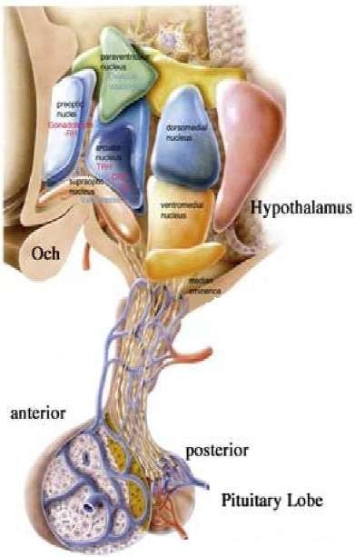
Introduction of Pituitary Gland.
Pituitary gland, or hypophysis, is an endocrine gland about the size of a pea and weighing 0.5 g (0.02 oz.).
It is a protrusion off the bottom of the hypothalamus at the base of the brain, and rests in a small, bony cavity (sella turcica) covered by a dural fold (diaphragm sellae).
The pituitary fossa, in which the pituitary gland sits, is situated in the sphenoid bone in the middle cranial fossa at the base of the brain.
The pituitary gland secretes hormones regulating homeostasis, including tropic hormones that stimulate other endocrine glands.
It is functionally connected to the hypothalamus by the median eminence via a small tube called the Pituitary Stalk.
It is considered to be the "master gland".

Slide 3
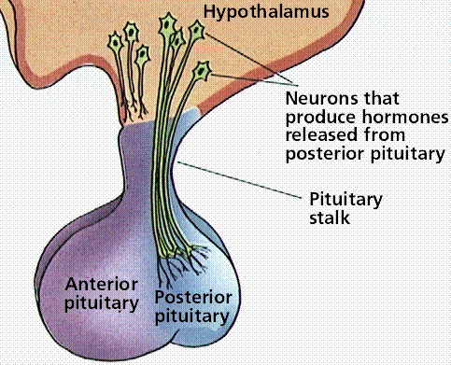
Anatomy
Anterior lobe: glandular tissue, accounts for 75% of total weight. Hormones in this lobe are controlled by regulating hormones from the hypothalmus (stimulate or inhibit)
Posterior lobe: nerve tissue & contains axons that originate in the hypothalmus. Therefore this lobe does not produce hormones but stores those produced by the neurosecretory cells in the hypothalmus. Release of hormones is triggered by receptors in the hypothalmus.

Slide 4
Anatomy and physiology of the pituitary gland:
The pituitary gland weighs about 0.5 to 1 g and is divided into anterior and posterior lobes. The pituitary gland sits in the sella turcica immediately behind the sphenoid sinus. Cavernous sinuses are located laterally on each side of the sella, inclusive of the internal carotid artery and cranial nerves III, IV, V₁, V₂ and VI. Magnetic resonance imaging (MRI) is the best method for the visualization of hypothalamic-pituitary anatomy, because the optic chiasm, vascular structures, and tumor extension to cavernous sinuses can be well visualized compared with other imaging techniques
Anterior pituitary hormones are regulated by hypothalamic releasing and inhibitory hormones and negative feedback action of the target glandular hormones at the pituitary and hypothalamic levels. Among pituitary hormones, only the secretion of prolactin is increased in the absence of hypothalamic influence, because it is mainly under tonic suppression by dopamine, the main prolactin inhibitory factor. All anterior pituitary hormones are secreted in a pulsatile fashion and tend to follow a diurnal pattern.

Slide 5
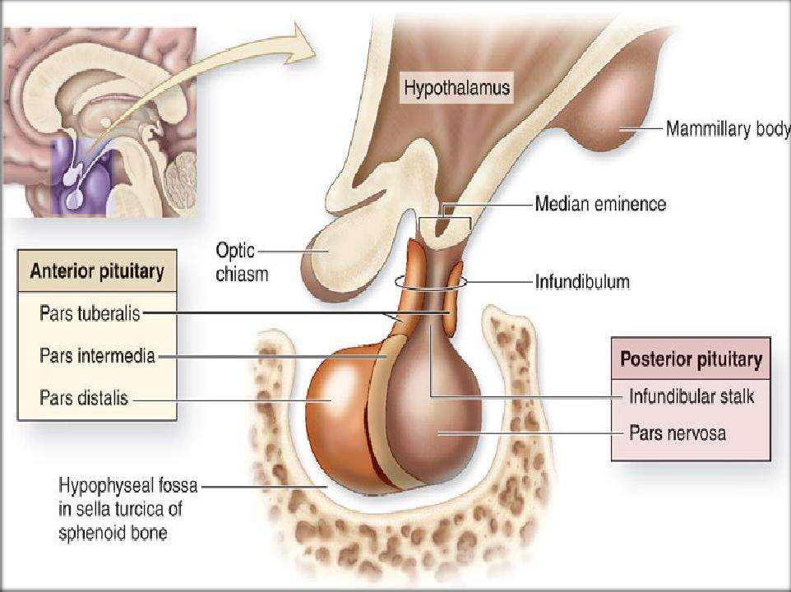

Slide 6
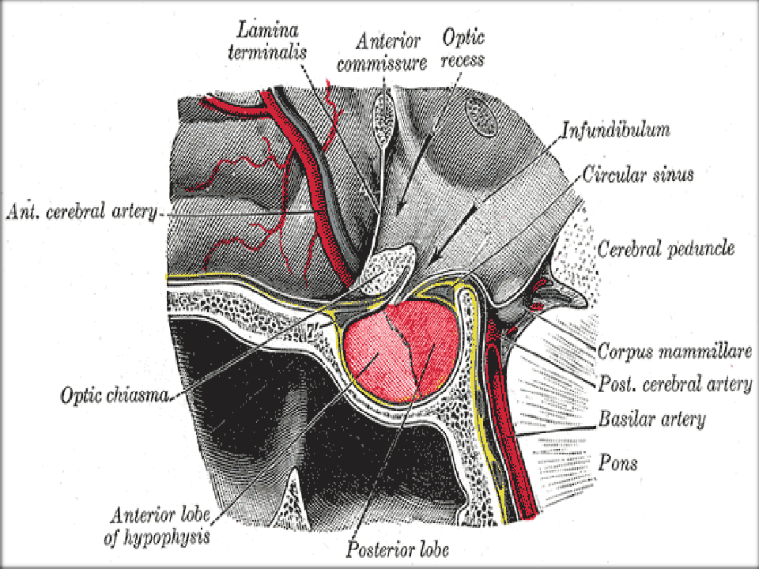


Slide 7
Major hormones secreted:
Hormone Other names Symbol(s)
Structure
Secretory cells
Staining
Target Effect
Secretion of Adrenal gland glucocorticoid
s
Adrenocorticot
Corticotropin
ACTH
Polypeptide
Corticotrophs
Basophil
ropic hormone
Lactotrophs and Mammotrophs
Ovaries, mammary glands
Secretion of estrogens/prog esterone; milk production
Prolactin
Lactogenic hormone
PRL
Polypeptide
Acidophil
Thyroid-
stimulating
Thyrotropin TSH
Glycoprotein
Thyrotrophs
Basophil
Thyroid gland thyroid
hormones
Growth of
hormone
Follicle-
stimulating
-
FSH
Glycoprotein
Gonadotrophs Basophil
Gonads
reproductive system
Sex hormone production
Promotes
hormone
Luteinizing
Lutropin
LH, ICSH
Glycoprotein
Gonadotrophs Basophil
Gonads
hormone
Growth
Somatotropin
GH, STH
Polypeptide
Somatotrophs Acidophil
Liver, adipose ^{growth; lipid}
hormone
tissue
and carbohydrate metabolism

Slide 8
Anterior Pituitary Disorders
Hormone | Increased level | Decreased level
GH | Gigantism (child) Acromegaly (adult) | Dwarfism (child) Lethargy, premature aging
ACTH | Cushing’s Disease | Addison’s Disease
TSH | Goiter, increased BMR, HR, BP Graves disease | Decreased BMR, HR, BP Cretinism (children)
Prolactin | amenorrhea | Too little milk
FSH |  | Late puberty, infertility
LH | Menstrual cycle disturbance | Amenorrhea, impotence

Slide 9
Aetiology - Hypopituitarism
Developmental/Structural
  Pituitary dysplasia/Aplasia
  Encephalocele, congenital empty sella
  Congenital hypothalamus disorder
    Septo- optic dysplasia
    Prader- willi syndrome
    Kallmann syndrome
    Laurence-moon-beidl syndrome
Neoplastic
  Pituitary adenoma
  Parasellar mass( eg: germinoma, glioma, ependymoma)

Slide 10
Contd..
Craniopharyngioma
Rathke’s cyst
Other Tm:- Mets, lymphoma, Leukemia, Meningioma
Vascular
  Pituitary apoplexy
  Seehan’s syndrome(Postpartum necrosis)
  Sickle cell disease
  Arteritis
Traumatic
Injury, surgical resection, Radiation damage

Slide 11
Contd..
Inflammatory
  Hypophisitis:- Lymhocytic & granulomatous hypophisitis
  Other causes:- Hemochromatosis,Sarcoidosis, Histiocytosis, Amyloidosis
Infections
  Fungal(Histoplasmosis)
  Parasitis(Toxoplasma)
  Tuberculosis
  Pnumocystis carinii

Slide 12

Septo-Optic Dysplasia
Hypothalamic dysfunction and hypopituitarism
ϒ may result from dysgenesis of the septum pellucidum or corpus callosum
Affected children have mutations in the HESX1 gene
These children exhibit variable combinations of:
ϒ cleft palate
syndactyly
ear deformities
optic atrophy
micropenis
anosmia
Pituitary dysfunction
Diabetes insipidus
GH deficiency and short stature
Occasionally TSH deficiency

Slide 13
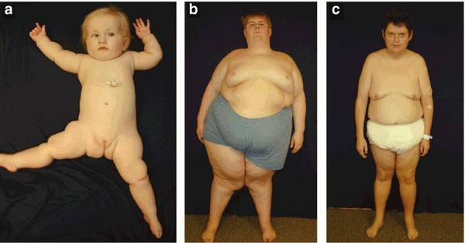
Prader Willi Syndrome
Result from deletion of patternal copy of SRNPN and NECDIN gene (chr 15q).
Clinical feature:- Hypogonadotropic Hypogonadism, Hyperphagia, obesity, muscle hypotonia , mental retardation, T2DM.

Slide 14
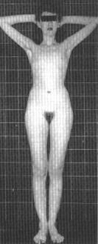
Kallman Syndrome
•
Defective hypothalamic gonadotropin-releasing hormone (GnRH) synthesis
•
Associated with anosmia or hyposmia due to olfactory bulb
agenesis or hypoplasia
•
May also be associated with: color blindness,optic atrophy, nerve deafness, cleft palate, renal abnormalities, cryptorchidism
•
GnRH deficiency prevents progression through puberty
•
Characterized by
low LH and FSH levels
low concentrations of sex steroids

Slide 15
Kallman Syndrome
•
Males patients
Delayed puberty and hypogonadism(small testis), including micropenis
Long-term treatment:
  human chorionic gonadotropin (hCG) or testosterone
•
Female patients
Primary amenorrhea and failure of secondary sexual development
Long-term treatment:
  cyclic estrogen and progestin
•
Repetitive GnRH administration restores normal fertility
•
Fertility may also be restored by the administration of gonadotropins or by using a portable infusion pump to deliver subcutaneous, pulsatile GnRH

Slide 16
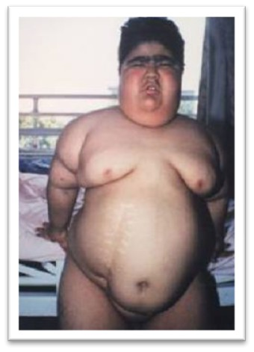
Laurence-Moon-Bardet-Biedl Syndrome
•
Rare autosomal recessive disorder
•
Clinical feature:- Retinal degenration, Renal abnormality, Retardation(Mental), obesity
other: hexadactyly/ brachydactyly/ syndactyly
•
•
Central diabetes insipidus may or may not be associated
•
GnRH deficiency occurs in 75% of males and half of affected females
•
Retinal degeneration begins in early childhood
– most patients are blind by age 30

Slide 17
Hypopituitarism
(Acquired Causes)
Neoplastic
Vascular
Pituitary Apoplexy, sheehan’s syndrome
Infiltrative/inflammatory disorder
Lymphocytic hypophysitis
Trauma, Cranial irradiation,Surgical resection
Empty Sella syndrome
Infections

Slide 18
Order of hormone deficiencies
•
•
•
•
•
•
GH
Gonadotropins (FSH, LH) TSH
ACTH
Prolactin
Posterior pituitary hormones

Slide 19
Pituitary adenoma(Non functioning)
•
•
•
Consist of 10% of all intracranial neoplasm. 25-35% are nonfunctioning .
Most of them arise from gonadotropin cells & monoclonal in origin.
Most of them are macroadenoma.
Usually discovered because of space-occupying effects, or inadvertently.
•
•

Slide 20
Management of nonfunctioning pituitary adenoma
Non functioning pit. adenoma
MRI differential diagnosis
Asses pituitary function
Nonfunctioning pituitary adenoma
Microadenoma
Macroadenoma
Observe
Transspenoidal surgery
Follow up: MRI at 1,2,5 year Reasses if symptomatic
MRI and hormone testing every 6 month for 2yr, anually thereafter, hormone replacement if required

Slide 21
Pituitary Apoplexy
Spontaneous hemorrhage in pituitary adenoma/tumor
Considered as a neurosurgical emergency
Presentation:
⎫Variable onset of severe headache
⎫Nausea and vomiting
⎫Meningismus
⎫Vertigo
Visual defects
Altered consciousness
Symptoms may occur immediately or may develop over 1-2 days

Slide 22
Pituitary Apoplexy
Risk factors:
⎫DM, HTN
⎫Sicle cell anemia
⎫Anticoagulant use:- Warfarin, Heprin
Usually resolve completely
Transient or permanent hypopituitarism is possible
⎫undiagnosed acute adrenal insufficiency
Diagnose with CT/MRI
Differentiate from leaking aneurysm
Treatment:
⎫If visual defects and altered consciousness then Surgical – Transsphenoidal decompression
Medical therapy – if symptoms are mild
⎫Corticosteroids

Slide 23
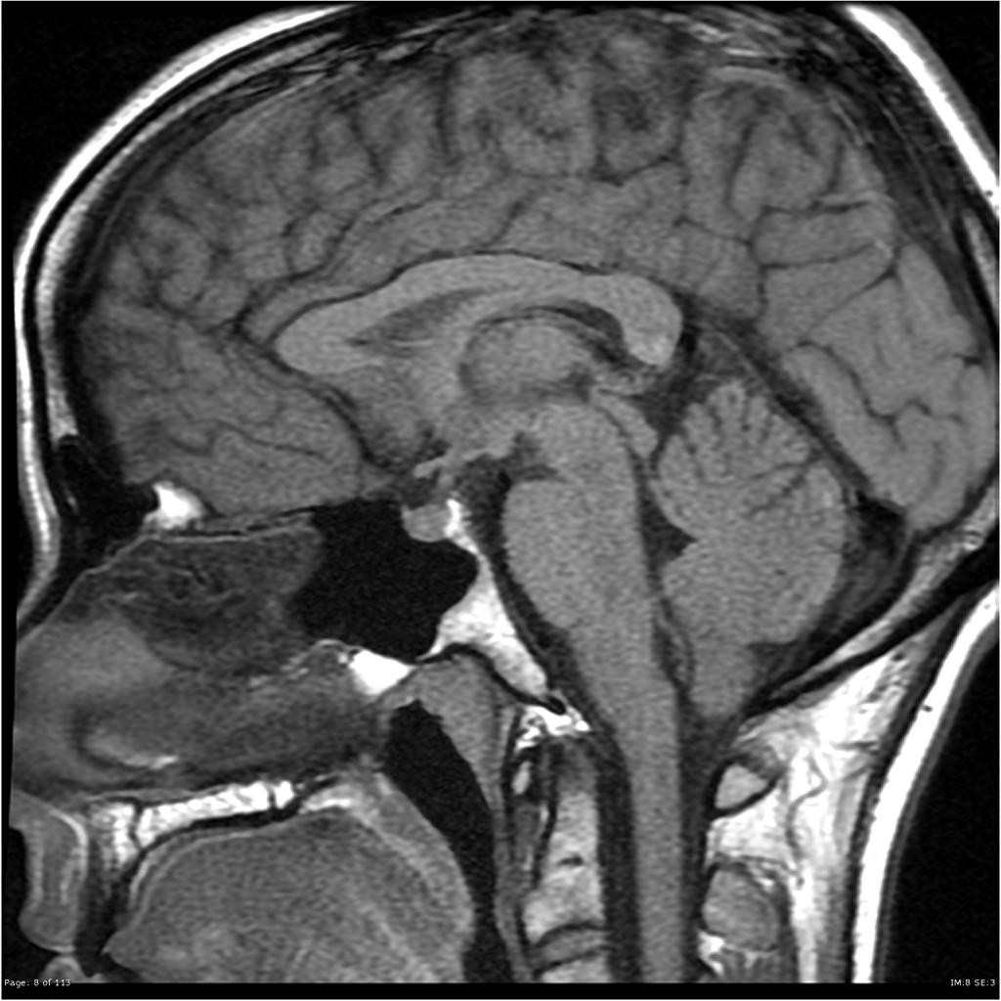
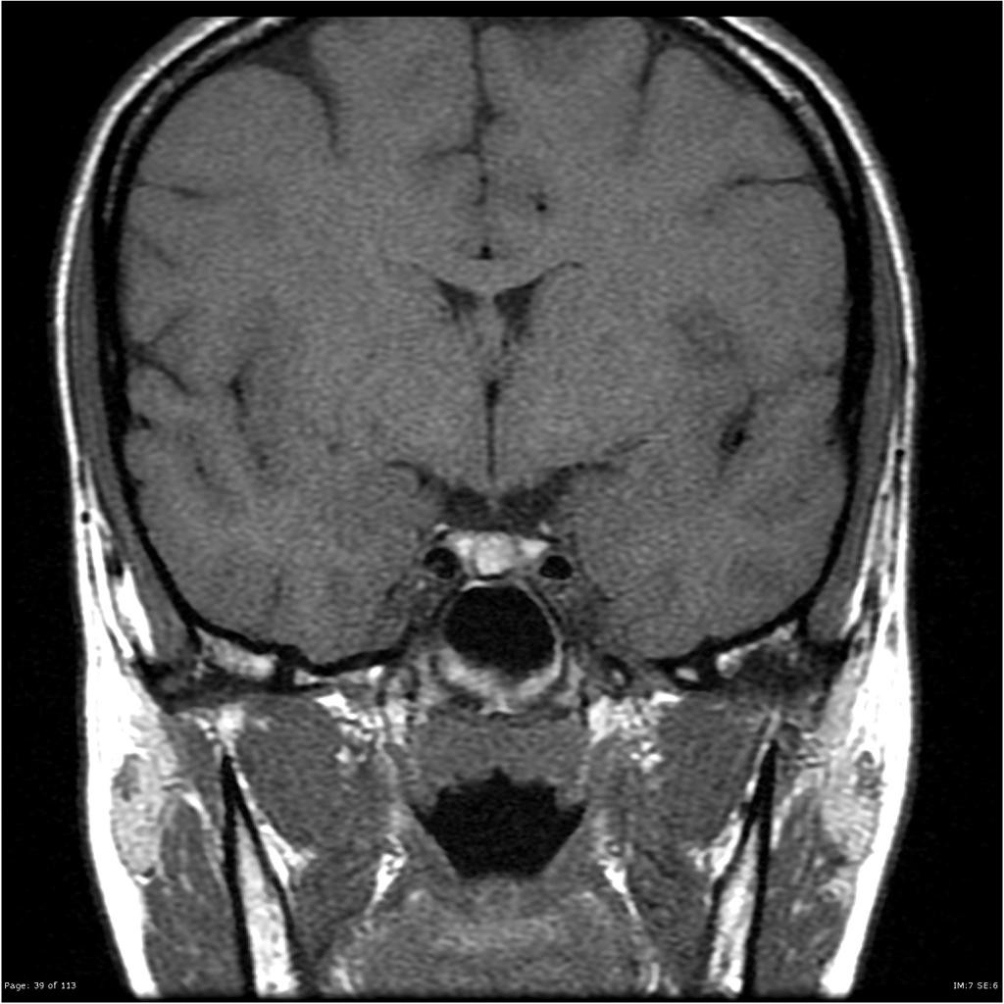
Normal MRI imaging of Pituitary
T 1 image sagittal section
T1 image coronal section

Slide 24
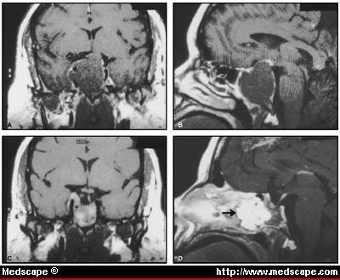
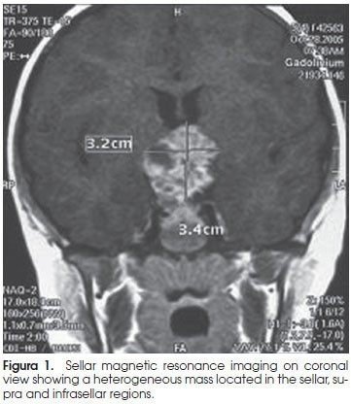
Pituitary Apoplexy
Coronal & sagittal section of brain(MRI) showing pituitary haemorrhage

Slide 25
Sheehan’s Syndrome
•
Infarction of pituitary after substantial blood loss during childbirth
•
Incidence: 3.6%
•
No correlation between severity of hemorrhage and symptoms
•
Severe: recognised month to years postpartum period
– Lethargy, anorexia, weight loss, unable to breast feeding

Slide 26
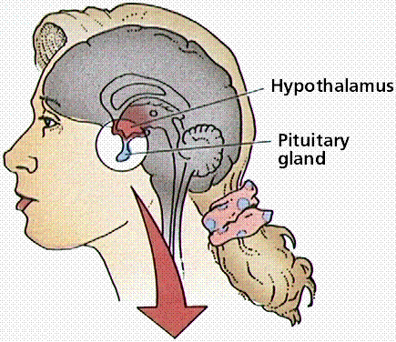
Sheehan’s Syndrome
•
Typically long interval between obstetric event and diagnosis( months to years)
•
Of total patients:
50% permanent amenorrhea
The rest had scanty-rare menses
Mostly lactation was poor to absent
•
•
Dx: MRI empty sella turcica T/t: Hormone replacement &
Corticosteroids

Slide 27
Lymphocytic Hypophysitis
•
Etiology
⎫Presumed to be autoimmune Clinical Presentation
⎫Women, during postpartum period
⎫Mass effect (sellar mass)
⎫Deficiency of one or more anterior pituitary hormones
⎫ ACTH deficiency is the most common
Diagnosis
⎫MRI - may be indistinguishable from pituitary adenoma
⎫↑ ESR Treatment
⎫Non compressive symptoms→Hormone support + Steroid
⎫Compressive symptoms→ Surgery(TSS)
•
•
•

Slide 28
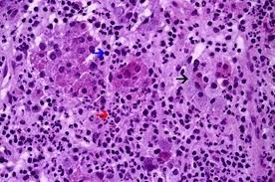
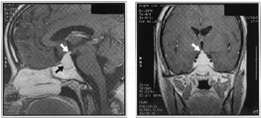
Lymphocytic Hypophysitis
HPE of Pituitary MRI brain (coronal & sagittal section)

Slide 29
Trauma
•
The pituitary may be partially or totally damaged by birth trauma, cranial hemorrhage, fetal asphyxia, or breech delivery.
Head trauma can lead to direct pituitary damage by
Sella turcica fracture,
Pituitary stalk section
Trauma-induced vasopasm, or ischemic infarction
•
The most common traumatic cause of compromised pituitary function in the adult is iatrogenic neurosurgical trauma.

Slide 30
•
Hypopituitarism following head trauma usually appears within a year after the insult.
Virtually all patients with subsequent pituitary failure have a history of loss of consciousness following trauma.
1/2 pt has documented skull fracture.
1/3rd of these patients have demonstrable signs of hypothalamic or post pituitary hemorrhage (or both) or ant lobe infarction on MRI.
Diabetes insipidus is the most common endocrine disorder, encountered in about 30% of these patients, later on other hormone deficiency may also occurs.
75% of patients have evidence of hypopituitarism, and the degree of pituitary failure correlates with severity of head trauma.
•
•
•
•
•

Slide 31
Cranial Irradiation
•
Children and adolescents, are more susceptible to pituitary & hypothalamic failure after whole-brain or head and neck therapeutic irradiation.
The development of hormonal abnormalities correlates strongly with irradiation dosage.
Up to two-thirds of patients ultimately develop hormone insufficiency after a median dose of 50 Gy (5000 rad) .
The development of hypopituitarism occurs over 5–15 years and usually reflects hypothalamic damage rather than primary destruction of pituitary cells.
GH deficiency is most common, followed by gonadotropin and ACTH deficiency.
Replace therapy instituted when appropriate .
•
•
•
•
•

Slide 32
Empty Sella Syndrome
An empty sella can develop as a consequence of a primary congenital weakness of the diaphragm Damage to the sellar diaphragm can lead to arachnoid herniation into the sella.
Usually have normal pituitary function(incidental finding)
Implying that the surrounding rim of pituitary tissue is fully functional
Hypopituitarism may develop insidiously.
Rarely, functional pituitary adenomas may arise within the rim of pituitary tissue, and these are not always visible on MRI.
Aetiology:-
Congenital
Primary hypophisitis
Pituitary Adenoma(silent infarction)
Other: Trauma, Surgery, Radiation

Slide 33
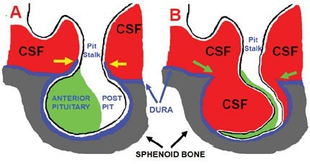
Empty Sella Syndrome
Often an incidental MRI finding

Slide 34
Clinical Presentation
•
Can present with features of deficiency of one or more anterior pituitary hormones.
•
Up to 50% of patients with primary empty sella have associated benign intracranial hypertension
•
Clinical presentation depends on:
Age at onset
Hormone affected, extent
Speed of onset
Duration of the deficiency

Slide 35
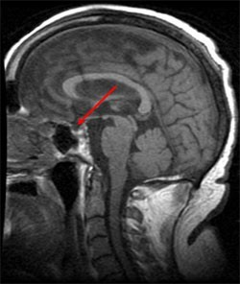
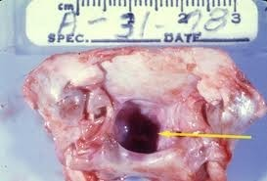
Empty Sella Syndrome
Specimen showing empty pit fossa
MRI brain(sagittal section)

Slide 36
Specific Hormone Deficiencies

Slide 37
Growth Hormone Deficiency
Children
Adult
•
•
•
•
•
Short stature Micropenis Increased fat
High-pitched voice Propensity to hypoglycemia
•
•
Reduced lean body mass
Increased fat mass with selective deposition of intra-abdominal visceral fat
Increased waist-to-hip ratio Hyperlipidemia
Left ventricular dysfunction Hypertension
Increased plasma fibrinogen levels
↓ BMD
•
•
•
•
•
•

Slide 38
Diagnosis of GH Deficiency
Test | Blood sample timing | Interpretation
Insulin tolerance test: Regular insulin(.05-.15U/kg I.V.) | -30,0,30,60,120 min for glucose & GH | Glu˂40mg/dl GH˃3µg/L-Normal
Clonidine stimulation test: Clonidine 150 µg/m2 orally | 0,30,60,90,120,150,180 min | GH >7µg/L- Normal
GHRH test: 1µg/kg I.V. | 0,15,30,45,60,120 min | GH˃3µg/L-Normal
L-Arginine test:30gm I.V. over 30min | 0,30,60,120 min | GH˃3µg/L-Normal
L-Dopa test:500mg PO | 0,30,60,120 min | GH˃3µg/L-Normal

Slide 39
GH replacement therapy
•
The starting dose Adult:- 0.1 -0.2mg/d should be titrated (up to a maximum of 1.25 mg/d) to maintain IGF-I levels in the mid- normal range for age- and sex-matched controls.
Children:- 0.02-0.05 mg/kg/day
Brand available in india:- Norditropin, Eutropin, Saizen, zomacton
•
•
Contraindication | Side effect
Active intracranial neoplasm | Hypertension ,Tachycardia
Intracranial hypertension | Headache, paresthesia, dizziness,
Diabetic retinopathy | Acne, alopecia, bullous eruption
Uncontrolled diabetes Mellitus | Gynecomastia, gastritis, abnormal urine,
Otitis media ,ear disorders , pharyngitis

Slide 40
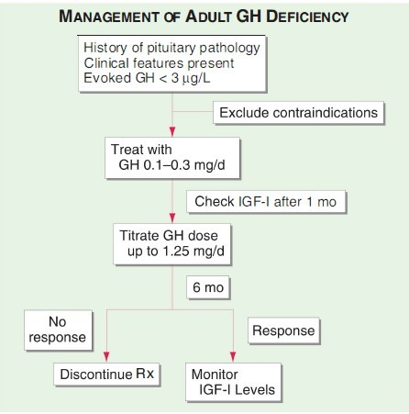

Slide 41
Gonadotropin Deficiency
Women
Men
Oligomenorrhea or amenorrhea
Loss of libido
Erectile dysfunction
Loss of libido
Infertility
Vaginal dryness or dyspareunia
Loss of secondary sex characteristics
Loss of secondary sex characteristics (estrogen deficiency)
Atrophy of the testes
Gynecomastia (testosterone deficiency)

Slide 42
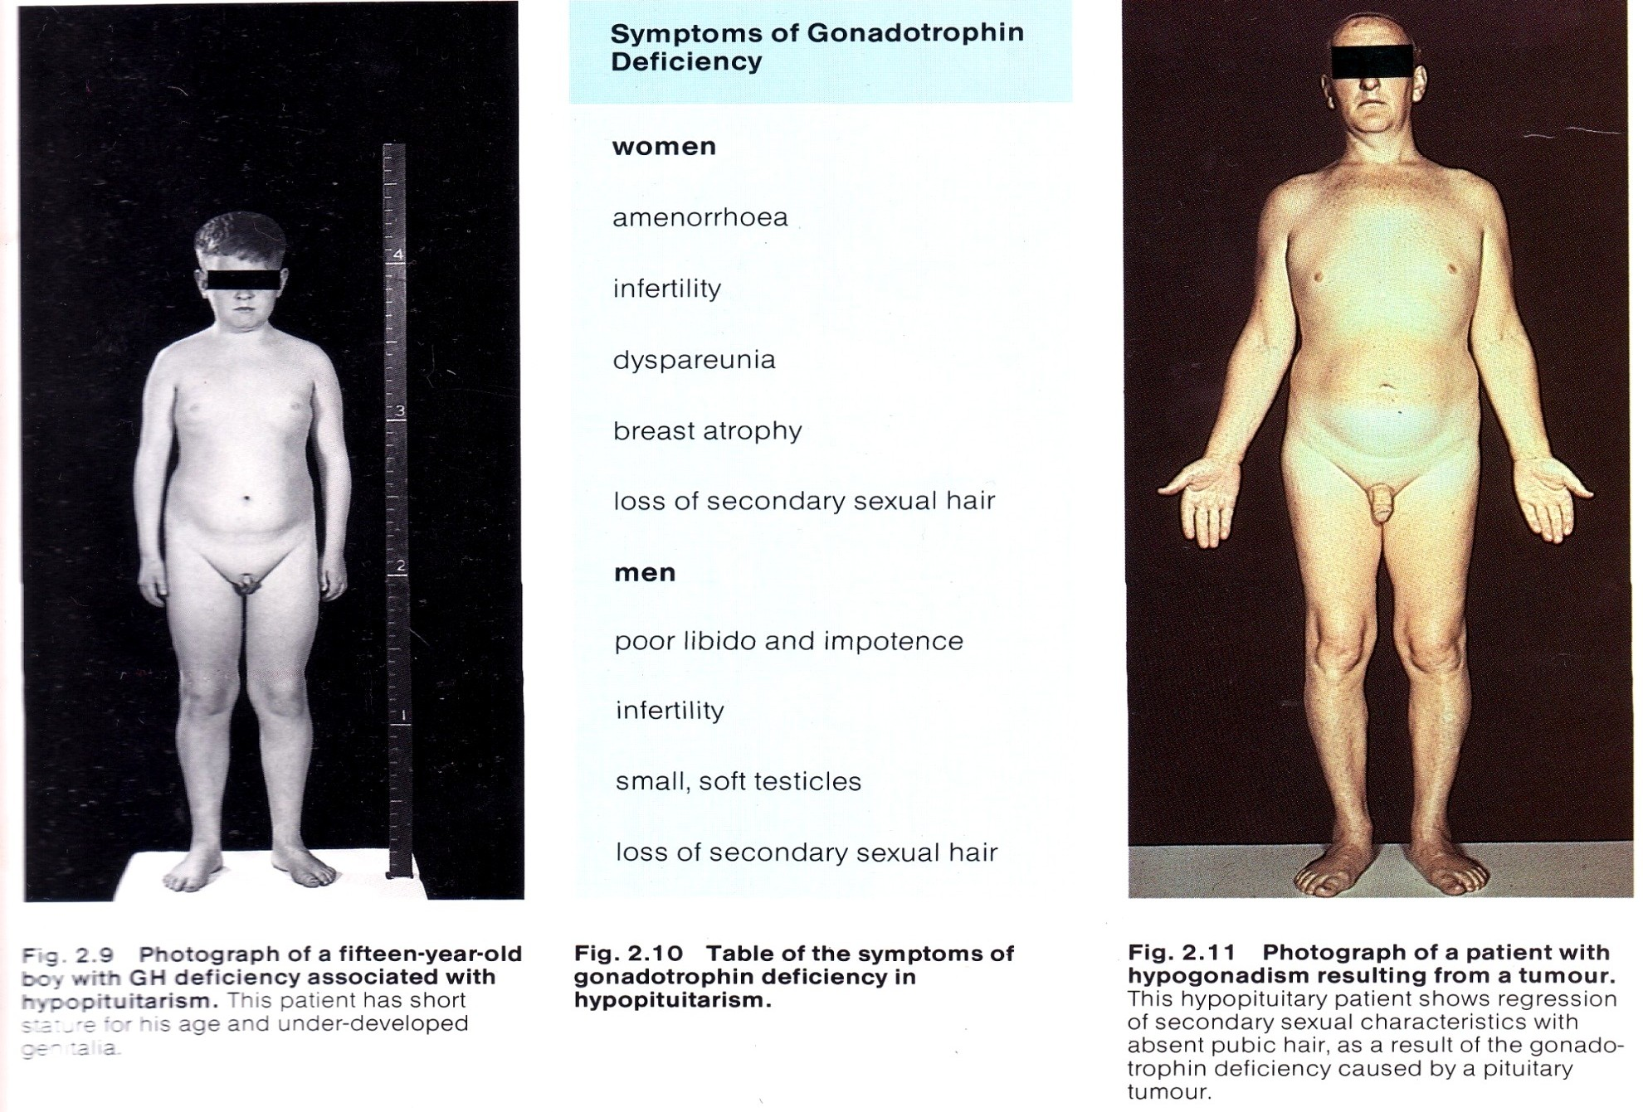

Slide 43
Diagnosis & Management
•
•
•
•
Diagnosis:
GnRH stimulation test: Intravenous GnRH ( 100ug) LH and FSH measured at 0,30,60 min
Normal response
LH ↑ by 10 IU/L FSH ↑ by 2 IU/L
Treatment:
MALE
1.Testosterone gel→ 5-10 g/d 2.Testosterone patch→ 5mg/d 3.Testosteron enanthate →
200mg IM every 2 wk
FEMALE
Cyclic estrogen and progesterone
BOTH
Gonadotropin inj(hCG or hMG) for 12-18 month for fertility
GnRH Pulse therapy → 25- 150ng/kg every 2h S.C.
•

Slide 44
ACTH Deficiency
•
Results in hypocortisolism
Malaise
Anorexia
Weight-loss,weakness
Gastrointestinal disturbances- Nausea , Vomiting
Hyponatremia , hypoglycemia, hyperkalemia
•
Pale complexion
Unable to tan or maintain a tan
Not accompanied by hyperpigmentation
No features of mineralocorticoid deficiency
Aldosterone secretion unaffected
•

Slide 45
Diagnosis of Hypocortisolism
•
Basal ACTH secretion
⎫Cortisol < 3 μg/dL, cortisol deficiency
⎫Cortisol > 18μg/dL, sufficient ACTH
⎫Cortisol > 3 μd/dL but < 18 μg/dL - test ACTH reserve

Slide 46
ACTH Reserve
Test
Time of Sample collection
Result(normal response)
ITT: regular insulin (0.05-0.15U/Kg I.V.)
-30,0,30,60,90 min for glucose and cortisol
Glucose<40mg/dl
Cortisol↑ by >7ug/dl or to>20ug/dl
CRH Test: 1ug/kg CRH I.V. at
8am
0,15,30,60,90,120 min for
ACTH and Cortisol
ACTH↑ 2 to 4 fold
Cortisol level>20-25 ug/dl
Metyrapone test: Metyrapone
30mg/kg at midnight
Plasma 11-deoxycortisol, ACTH, cortisol at 8 am
Cortisol< 4g/dl
11-deoxycortisol>7.5ug/dl
ACTH> 75pg/ml
Std ACTH stimulation test : ACTH(1-24 cosyntropin) 0.25mg IM or IV
0,30,60min for cortisol and aldosterone
Cortisol >21g/dl
Aldosterone >4ng/dl above baseline
Low dose ACTH test: ACTH 1ug IV
0,30,60 min for cortisol
Cortisol >21g/dl
3 day ACTH stimulation test: 0.25mg ACTH I.V. 8 hrly
Cortisol >21g/dl

Slide 47
Treatment of ACTH deficiency
Hydrocortisone: 10mg a.m. 5mg at noon and 5mg at evening
Cortisone acetate: 25mg a.m. and 12.5mg p.m.
Prednisone: 5mg a.m. & 2.5mg p.m.

Slide 48
TSH Deficiency
•
•
•
•
•
•
Hypothyroidism Atrophic thyroid gland
Isolated TSH measurement is not helpful FT3, FT4, TSH should be measured
Low FT3, FT4, TSH seen
Treatment - Levothyroxine ( 0.075 -0.15 mg daily)

Slide 49
Prolactin Deficiency
•
•
•
•
Inability to lactate during postpartum period. Often 1st manifestation of Sheehan syndrome. Isolated PRL deficiency is very rare.
Prevelence of hypoprolactinemia parallel the prevelence of hypopituitarism.
Normal prolactin>2ug/L and increase > 200% from baseline with TRH stimulation test.
•

Slide 50
Hyperfunction
Results in excess production and secretion of one or more hormones such as GH, PRL, ACTH.
Most common cause is a benign adenoma.

Slide 51
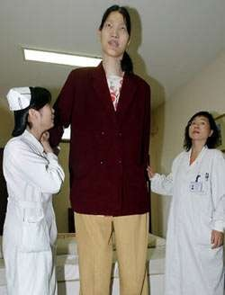
Gigantism
Pituitary disorder characterized by:
Excess growth of body
Average height is approximately 7 – 8 feet

Slide 52
Causes of Gigantism
Hypersecretion of GH in childhood or in pre – adult
Tumor of acidophilic cells of Anterior pituitary

Slide 53
Continued…
Signs and Symptoms
Huge stature : 7 or 8 feet height
Hyperglycemia , develop glycosuria , pituitary diabetes mellitus
Headache due to tumor of pituitary

Slide 54
Continued…
Visual disturbances
Gigantism ends in hypopituitarism (burning of cells of anterior pituitary )

Slide 55
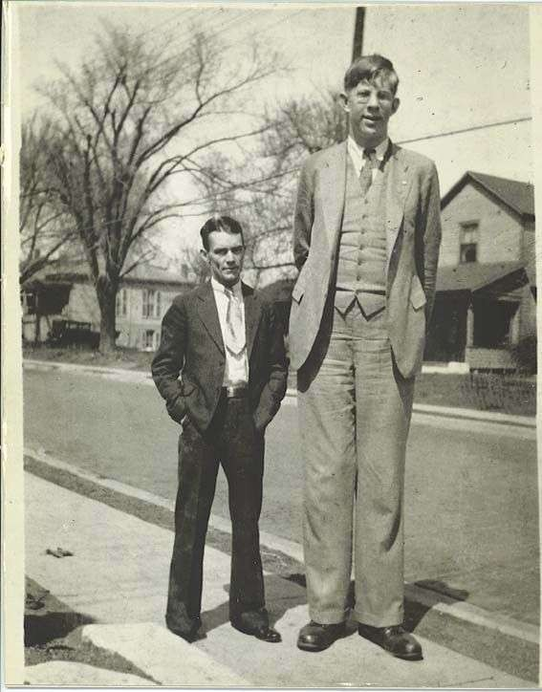

Slide 56
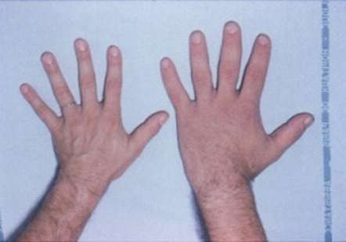
Acromegaly :
Anterior pituitary disorder characterized by:
Enlargement, thickening, and broadening of bones
Particularly extremities of the body

Slide 57
Causes of Acromegaly:
Hypersecretion of GH after fusion of epiphysis with shaft
of bone
Adenomatous tumor of anterior pituitary involving the acidophilic cells.
Signs and symptoms
Striking features are protrusion of :
  Supraorbital ridges
  Broadening of nose
  Thickening of lips
  Thickening and wrinkles formation on forehead
  Lower jaw (prognathism)
Face with these features called as acromegalic or guerilla face

Slide 58
Kyphosis : enlargement of hands and feet with bowing spine
Scalp is thickened and thrown into folds
Overgrowth of body hair
Visceral organs are enlarged
Thyroid , parathyroid and adrenal glands shows hyperactivity
Hyperglycemia and glucosuria
Hypertension
Headache
Visual disturbance – Bitemporal hemianopia

Slide 59
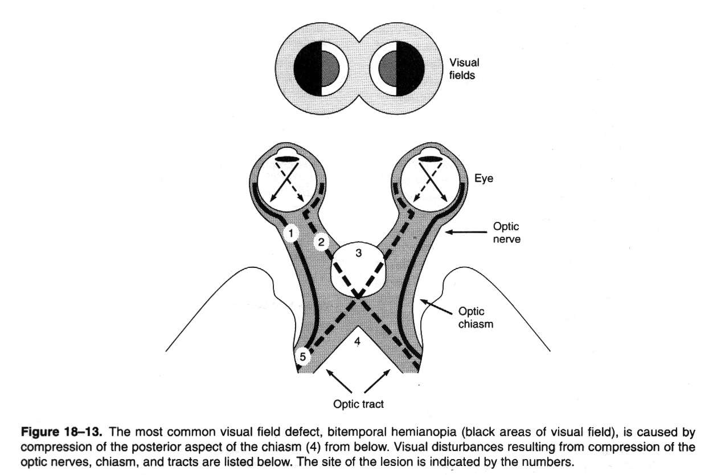
Thyroid , parathyroid and adrenal glands shows hyperactivity
Hyperglycemia and glucosuria
Hypertension
Headache
Visual disturbance – Bitemporal hemianopia

Slide 60
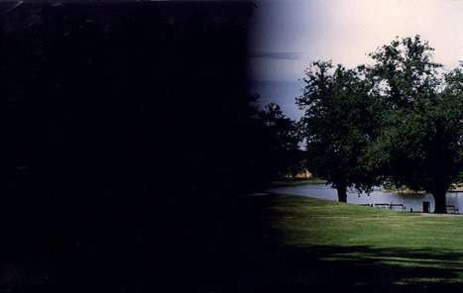

Slide 61
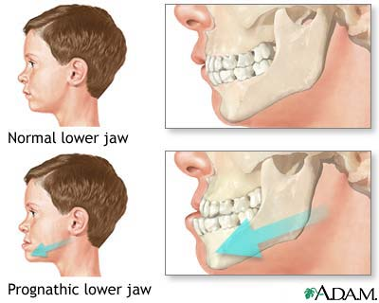
Notes:
Proghathism

Slide 62
Diagnosis
History & physical exam
Investigation includes:
  GH analysis (glucose tolerance) Normally GH concentarion falls with oral glucose; in acromegaly it does not.
  Prolactin levels as well as other pituitary function tests
  MRI or CT & visual field tests to determine size and position of the adenoma.
  Bone scan

Slide 63
Treatment
Surgery (primary choice)
Radiotherapy
Drug treatment – when surgery is not feasible
Combinations of above

Slide 64
Drug treatment of Acromegaly:-
Dopamine agonists:
  Dopamine agonists work on specialist markers (dopamine receptors) on the surface of the tumor to inhibit GH release from the tumour (Parlodel).
Somatostatin:
  growth hormone receptor antagonist decreases the action of GH on target tissues and cause tumor shrinkage. (octreocide acetate)
  Dopamine agonists are taken by mouth but in general are less effective than somatostatin analogues, which have to be injected.

Slide 65
Hyperprolactemia
Prolactin levels are normally high during pregnancy and lactation.
Symptoms of hyperprolactemia include;
  discharge from breasts (galactorrhoea)
  oligomenorrhoea or amenorrhoea in women
  reduced libido and potency in men
  pressure effects (e.g. headache and visual disturbance) - more commonly in men

Slide 66
Treatment is surgery, radiation, or medical therapy with drugs that will suppress the production of prolactin
  Urgent: deterioration in vision
  Important:
    successful RX. results in restoration of fertility
    Patients may be predisposed to problems related to osteoporosis
    Ask about erectile function & reassure client that it is part of the disease and can be treated.

Slide 67
Increased ACTH:Cushing’s Disease
Cushing's is a disorder in which the adrenal glands are producing too much cortisol (hypercotisolism).
If the source of is the pituitary gland, then disease name is Cushing's Disease whereas, if it originates anywhere else (adrenal tumors, long term steroid administration) then the correct name is Cushing's Syndrome.
Cushing’s Disease is caused by pituitary hypersecretion of ACTH.

Slide 68
Etiology - Hypercortisolism
Iatrogenic hypercortisolism resulting from medical intervention is most common cause of Cushing Syndrome.
Pituitary hyper secretion and pituitary tumors account for 70% of Cushing’s Disease. Adrenal tumors account for 30%.
Ectopic secretion of ACTH by tumors located outside the pituitary gland are rare cause of the syndrome and associated with increased morbidity/mortality (ie oat cell ca).

Slide 69
Symptoms
psychiatric disturbance (often characterized by amplification of previous personality traits)
moon face - particularly filling in of the temporal fossa
weight gain - central obesity
muscle wasting and proximal myopathy (patients have difficulty standing from a seated position without use of arms)
thin skin - tendency to bruise
hirsutism (caused by androgen excess)
violaceous striae

Slide 70
Neurological: Psychosis, emotional labiality, loss of memory, depression
Musculosketal: muscle weakness, muscle wasting, osteoporosis, buffalo hump, truncal obesity
Integumentary: ecchymosis, purple striae on abdomen, poor wound healing, skin infections, thin skin, acne.
CVs: HTN
GI: peptic ulcers
Metabolic: hyppokalemia, hypernatremia, edema, moon face, weight gain.
Classic symptoms of Cushing’s: moon face, buffalo hump, purple straie, truncal obesity.

Slide 71
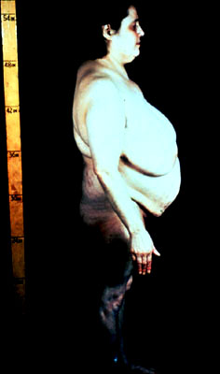
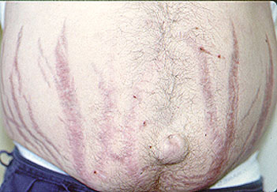
Advanced Cushing’s

Slide 72
Diagnosis
24 hr urine cortisol levels
Serum sodium levels
Serum potassium levels
Serum glucose
Serum ACTH in Cushing Disease
ACTH suppression test to identify cause
Dexamethasone supression test: cause pituitary or adrenal
Radiological exam to reveal pituitary or adrenal tumor

Slide 73
Treatment
Transphenoidal surgery if the condition is due to a pituitary tumor
Where surgery is contraindicated or fails to reduce cortisol levels, adrenalectomy and/or pituitary radiation may be necessary.
Adrenocortical Inhibitors: (metapyrone, aminogluthimide) are only effective short-term.
Diet: low calorie, carbohydrate & salt. High potassium.

Slide 74
THANK YOU

