Slide 1
CHRONIC - PANCREATITIS

Slide 2
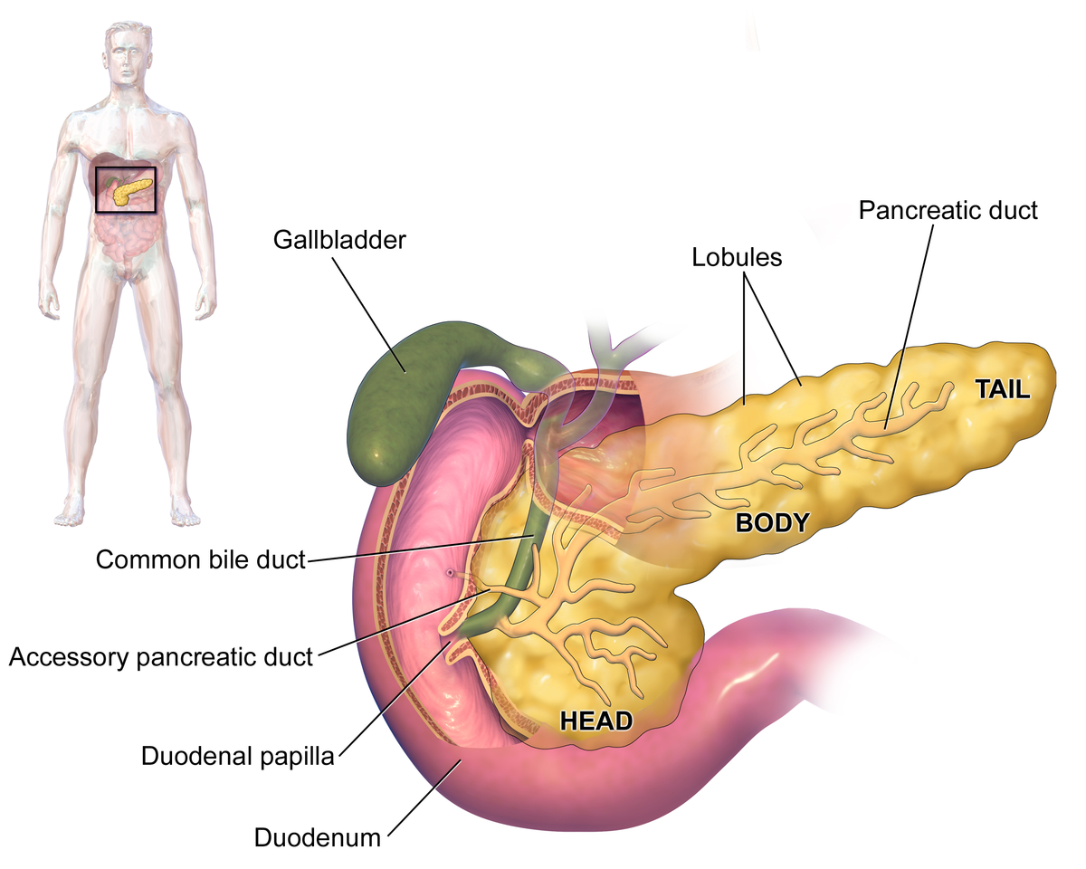
1. Weight: 75 - 125 g
2. Size: 10 to 20 cm
3. It lies in the retro peritoneum, is prismoid in shape and appears triangular on cross section with superior, inferior and anterior borders.
4. Anatomically divided into four portions, the head, neck, body and tail.
5. Embryology: Developes as 2 buds of ectoderm from primitive duodenum at junction of foregut and the midgut.
Anatomy of Pancreas

Slide 3
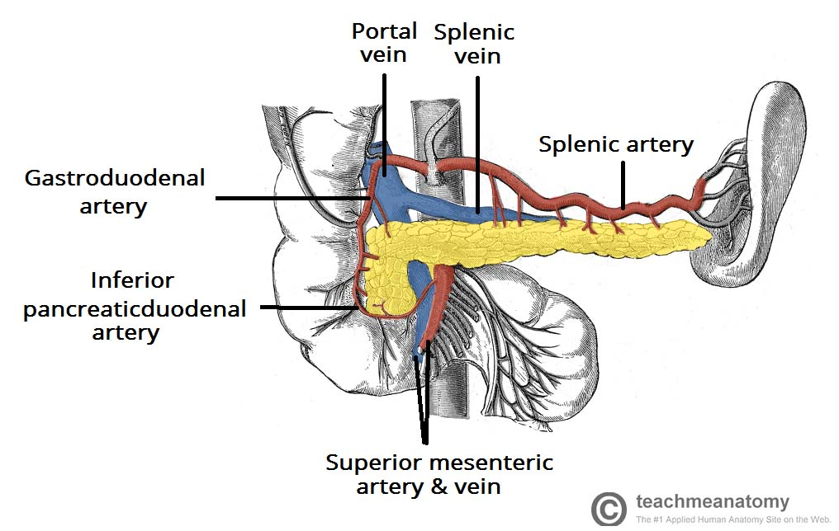
Vasculature of Pancreas:
The pancreas is supplied by the pancreatic branches of the splenic artery. The head is additionally supplied by the superior and inferior pancreaticoduodenal arteries which are branches of the gastroduodenal (from coeliac trunk) and superior mesenteric arteries , respectively.
Venous drainage of the head of the pancreas is into the superior mesenteric branches of the hepatic portal vein. The pancreatic veins draining the rest of the pancreas do so into the splenic vein.

Slide 4
Nerve supply to pancreas :-
Parasympathetic supply is from Vagus
Sympathetic innervation is from splanchnic nerves.

Slide 5
Physiology :-
The human pancreas is a complex gland, with endocrine and exocrine functions.
Which secretes 1500 – 3000 ml of alkaline fluid / day.
Which contain 20 enzymes.
Three phases of secretion :-
  Cephalic : 20%
  Gastric : 10%
  Intestinal: 70%(secretin , cholecystokinin)

Slide 6
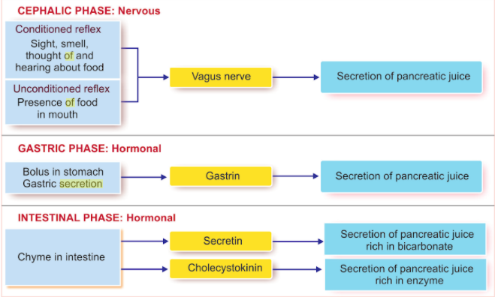

Slide 7
Different types of cells in pancreas :-
α cells secrete glucagon
β cells secrete insulin
δ cells secrete Somatostatin

Slide 8
CHRONIC PANCREATITIS :-
Defined as :- presence of histologic abnormalities, including chronic inflammation, fibrosis, and progressive destruction of both exocrine and eventually endocrine tissue (atrophy).

Slide 9
Epidemiology :-
The worldwide annual incidence rate is reported to be approximately similar in all countries.
Which is ranging between 5-14 per 1,00,000 individuals, with a prevalence rate of 30-50 per 1,00,000 individuals.
Increasing incidence of chronic pancreatitis has been reported in the past decade, which may be due to an improvement in diagnosis and changes in disease definition.

Slide 10
chronic pancreatitis is more prevalent in Asian countries (india and japan ) than in the rest of the world, with idiopathic and alcohol related pancreatitis being the more prevalent types of chronic pancreatitis.
In india prevelance of chronic pancreatitis to be 125/1,00,000 population.

Slide 11
TIGAR-O CLASSIFICATION of ETIOLOGY :-
Toxic – Metabolic | Alcoholic Tobacco – smoking Hyperlipidemia Hyperkalemia | Chronic renal failure Medication – Phenacetin Toxins
Idiopathic | Early onset | Late onset Tropical
Genetic | Cationic trypsinogen (PRSS 1) SPINK 1 | CFTR
Autoimmune | Type 1 | Type 2
Recurrent and severe acute pancreatitis | Postnecrotoic Recurrent acute pancreatitis | Vascular disease Radiation induced
obstructive | Pancreatic divisum Duct obstruction | Preampullry duodenal wall Post traumatic pancreatic duct scars

Slide 12
Mechanism of chronic pancreatitis :-
Toxic metabolic hypothesis- Alcohol Abuse
Necrosis fibrosis hypothesis
Ductal obstruction hypothesis
Genetic forms
Sentinal acute pancreatitis event
Oxidative stress

Slide 13
Toxic metabolic hypothesis- Alcohol Abuse :-
1.
Alcohol
Increase total protein in juice
Lithostathin from acinar cell
Formation of stone
Increases glycoprotein in juice
Increase protein precipitation

Slide 14
2.
Acetaldehyde, another alcohol metabolite, causes direct acinar injury
Ethylesters and reactive 02 species
fragility of intraacinar organelles ( zymogen granules and lysosomes)
abnormal pancreatic enzyme activation in acinar cells.

Slide 15
Necrosis fibrosis hypothesis :-
chronic necrosis and inflammation (necroinflammation) induce the release of inflammatory mediators such as platelet-derived growth factor, TGF-β, TNFα, IL-1, and IL-6 which are known to activate pancreatic stellate cells (PSCs)
chronic necroinflammation induced by ethanol activates PSCs and induces pancreatic fibrosis.

Slide 16
Ductal obstruction hypothesis :-
Chronic alcohol use
acinar and ductal cell
protein rich pancreatic juice, low in volume and HCO3
formation of protein precipitates – plug
calcification of ppt – ductal stone formation
ductule obstruction
parenchymal damage

Slide 17
Genetic forms :-
A. CFTR ( cystic fibrosis trans-membrane conductance regulator )
  Cystic fibrosis is assosiated with abnormalities of HCO3 secretion, ductal dilatation, ppt formation, pancreatic atrophy
  PRSS1 – cationic trypsinogen gene
  Once trypsinogen is activated to trypsin, becomes resistant to inactivation and activate other proenzymes leading to episodes of acute pancreatitis– like necrosis fibrosis theory

Slide 18
SPINK1 ( serine protease inhibitor Kazal type 1 )
  Seen in pediatric Idiopathic CP, hereditary Pancreatitis, Tropical Pancreatitis; but not in chronic alcoholic pancreatitis

Slide 19
Spectrum of Chronic Pancreatitis :-
Early chronic pancreatitis :-
- chronic inflammation of pancreas.
- normal secretary function , with biomarkers
Moderate chronic pancreatitis :-
- islet cell dysfunction.
- immune dysfunction.
- Acinar cell dysfunction.
- Pathological pain.
- Metaplasia.

Slide 20
Late chronic pancreatitis:-
- Fibrosis and sclerosis of most of the acinar cell.
- Exocrine insufficiency.
- Diabetes Mellitus type 3.
- Pancreatic ductal adenocarcinoma.

Slide 21
Types of Chronic Pancreatitis :-
Autoimmune Pancreatitis :-
Densely infiltrated with immune cell including plasma cell and CD4 positive T-cell.
Type 1 is the most common than type 2.
Patients with autoimmune pancreatitis can develop acute symptoms such as jaundice or AP, closely mimicking patients with pancreatic adenocarcinoma
D/o = mayo clinic -HISTORt criteria = 1. History 2 imagine 3. Serology 4. Other organ involvement 5. Response to steroid.

Slide 22
feature | Type 1 | Type 2
Histology | Lymphoplasmacystic infiltration periductal infiltrate without damage to ductal epithelium. Stoniform fibrosis Fibroinflammatory process may extended to peripancreatic region. | Periductal lymphoplasmacystic and neurophilic Destruction of ductal epithelium by neutrophils. Obliterative phlebitis is rare.
Age | 60-70 yr | 40-50 yr
Gender | Male | Equal
Clinical presentation | Obstructive jaundice (75%) Acute pancreatitis (15%) | Obstructive jaundice (50%) Acute pancreatitis (33%)
Pancreatic imagine | Diffuse pancreatic enlargement (40%) Focal pancreatic enlargement (60%) | Diffuse pancreatic enlargement (15%) Focal pancreatic enlargement (85%)
IgG4 | Elivated in serum. positive | Not associated
Other organ involvement | Biliary stricture Pseudotumors(kidney, lung) | Not associated
relapse | frequent | rare

Slide 23
TROPICAL PANCREATITIS :-
Tropical pancreatitis is one of the most common forms of chronic pancreatitis in certain areas of southwest India.
Tropical pancreatitis is generally a disease of youth and early adulthood, with a mean age at onset of 24 years.
Incidence is 1 in 500 to 1 in 800 population.
Tropical pancreatitis accounts for about 70% of all cases of chronic pancreatitis in southern India, whereas alcohol is a more dominant cause in the north.

Slide 24
The disease classically manifests as abdominal pain, severe malnutrition, and exocrine or endocrine insufficiency.
Pancreatic calculi develop in more than 90% of patients.
The pathology is characterized by large intraductal calculi, marked dilation of the main pancreatic duct, and gland atrophy.
The pathophysiology of tropical pancreatitis is unknown, a number of genetic mutations have been identified, with mutations in the SPINK1 and chymotrypsinogen genes being most common.

Slide 25
One striking feature is the propensity to diabetes, and endocrine insufficiency appears to be an inevitable consequence of tropical chronic pancreatitis (often classified as a specific cause of diabetes called fibrocalculous pancreatic diabetes).

Slide 26
Idiopathic Pancreatitis :-
Early onset
20yr mean age
male=female
96% pain
Calcification, exocrine or endocine insufficiency develop slowly over time – 25, 26 -27.5 yrs
CFTR, SPINK1

Slide 27
Late onset
Pain is less frequent 54%-75%
Age of onset 56yrs,
m=f
90% calcification is seen

Slide 28
Clinical features :-
  1 - Abdominal pain
  2 - Steatorrhea
  3 - Weight loss
  4 - Diabetes mellitus
  5 – Diarrhoea

Slide 29
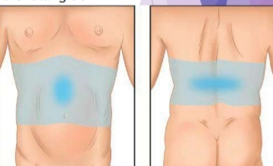
1. Pain in chronic pancreatitis :-
Pain is the most common and disabling symptom in patient with chronic pancreatitis.
Abdominal pain in chronic pancreatitis varies in terms of location , severity, and frequency.
Pain may be present intermittently or with frequent pain free intervals, or constantly.
Pain is usually located in epigastric
region and radiating back.

Slide 30
Pain is exacerbated by eating. Therefore, Patient may avoid eating due to fear of pain which may be lead to weight loss.
Intensity of pain depends on duration of alcohol , and pancreatic calcification.
In an advanced end - stage chronic pancreatitis, when inflammation is largely replaced by fibrosis and pancreatic atrophy, there remains minimal pain – the so called “ burnt-out ” chronic pancreatitis.

Slide 31
Causes of pain :-
Primary pancreatic pain :-
- pancreatic inflammation
- pancreatic ductal obstruction.
- increased pressure in ductal system
- pancreatic ductal hypertension.
- increased sympathetic drive.
- ischemia of parenchyma.
- Neuropathic pain.

Slide 32
Secondary pain :-
- By local complication ( pseudocysts , mass , small bowel strictures , adenocarcinoma )
- Obstruction of bile duct and duodenum.
- Peptic ulcer.
- Bacterial over growth.
- Mesenteric ischemia.
- Small bowel strictures.
- Visceral neuropathy due to DM.

Slide 33
Tretment related pain :-
- Adverse effect to medication ( opioid induce bowel dysfunction and hyperglycemia )
- surgical and endoscopical complication.

Slide 34
  2. Steatorrhea :-
presence of excess fat in feces .
Due to lack of exocrine insufficiency
Lack of lipase and bile salt leads to lack of micelle formation.

Slide 35
3. Diabetes :-
Patient with CP developed diabetes which is named as type 3 diabetes.
Which was caused by Mechanical obstruction which leads to Pancreatitic damage.
Also caused by chronic inflammation leading to B cell destruction and calcium salt stone.

Slide 36
Japanese pancreatology diagnostic criteria for early pancreatitis 1 :-
Recurrent upper abdominal pain.
Abnormal pancreatic enzyme levels in the serum or urine.
Abnormal pancreatic exocrine function.
Continuous heavy alcoholic drinking.
Imaging findings of early chronic pancreatitis on endoscopic ultrasonography imagine or endoscopic retrograded cholangiopancreatography.
2 out of 4 clinical symptoms and signs of pancreatitis on imagine.

Slide 37
ULTRASOUND :-
Ultrasonographic findings indicative of chronic pancreatitis include dilation of the pancreatic duct, pancreatic ductal stones, gland atrophy or enlargement, irregular gland margins, pseudocysts, and changes in the parenchymal echo texture.

Slide 38
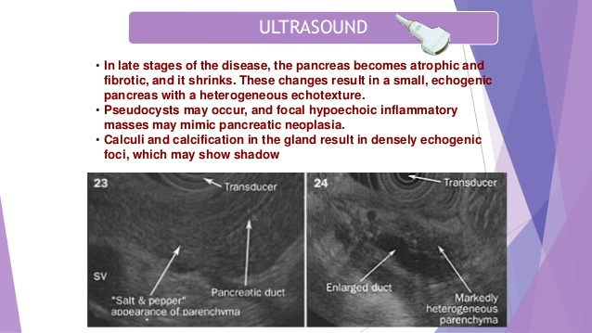

Slide 39
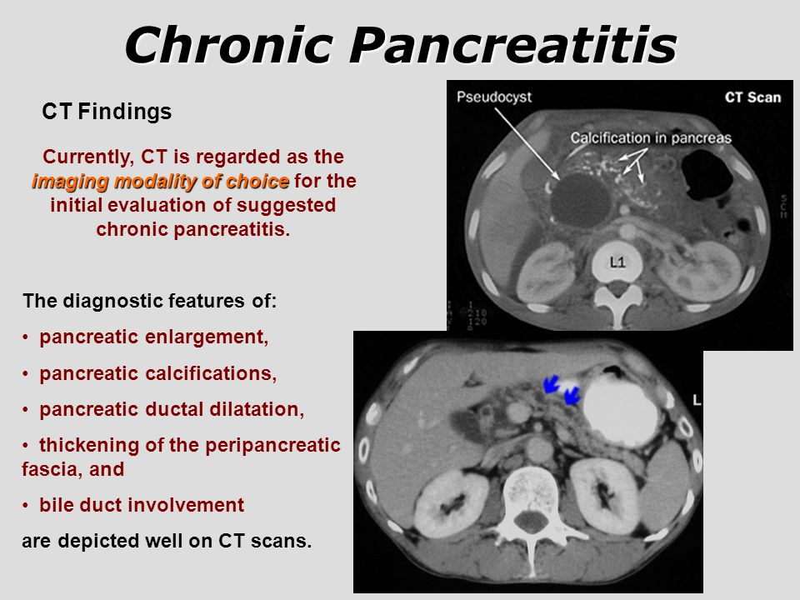

Slide 40
Grading of CP by US and CT
Grade | US and CT Findings
Normal | No abnormal findinngs
Equivocal | One of following:- Mild dilatation of pancreatic duct (2-4 mm) in the body of gland Gland enlargement (<= 2 fold) normal
Mild/ Moderate | One the precipitating finding + at least one of following:- Pancreatic duct dilatation >= 4 mm Pancreatic duct irregularity Cavity <10mm Parenchymal heterogeneity Increased echogenicity of duct wall Irregular contour of the head and body Focal necrosis or loss of parenchyma
Severe | Mild / Moderate features + or more of the following :- Cavity >10mm Intraductal filling defects Calculi/ pancreatic calcification Duct obstruction Severe duct dilatation or irregularity Contigeious organ invasion.

Slide 41
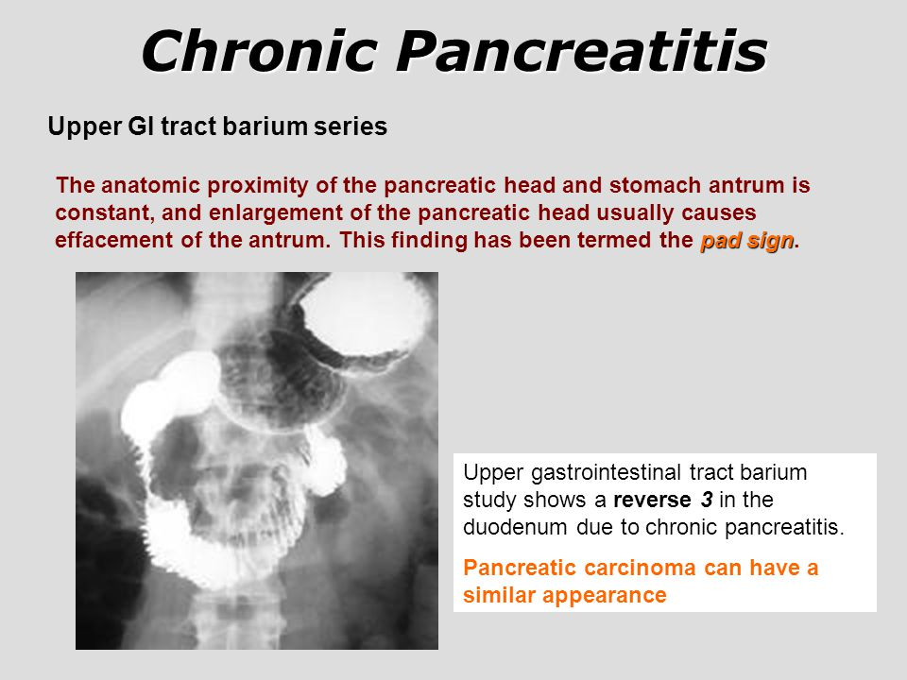
Upper GI tract barium series :-

Slide 42
MRI :-
MRI, particularly MRCP, is a noninvasive technique.
The combination of pancreatic parenchyma imaging sequences with MR angiography and secretin-enhanced MRCP offers the possibility of a comprehensive examination within a single diagnostic modality for evaluation of the full range of pancreatic diseases

Slide 43
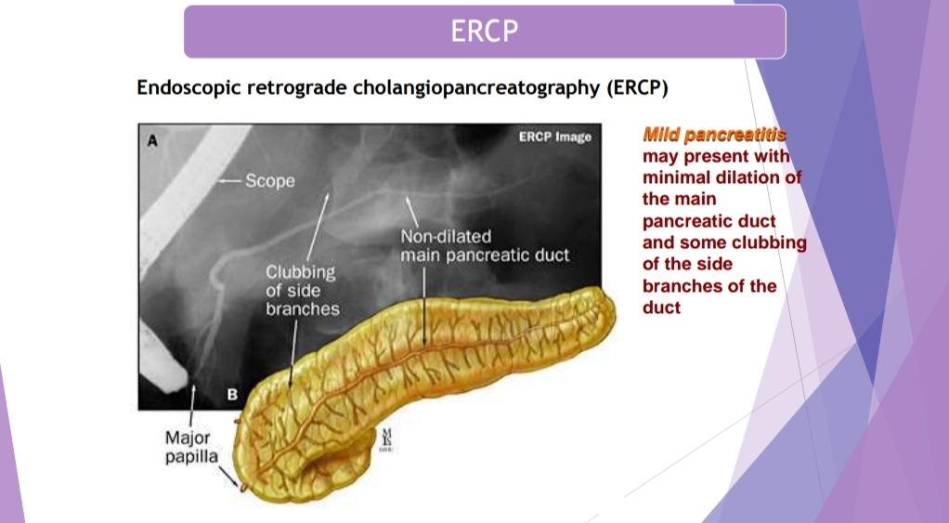

Slide 44
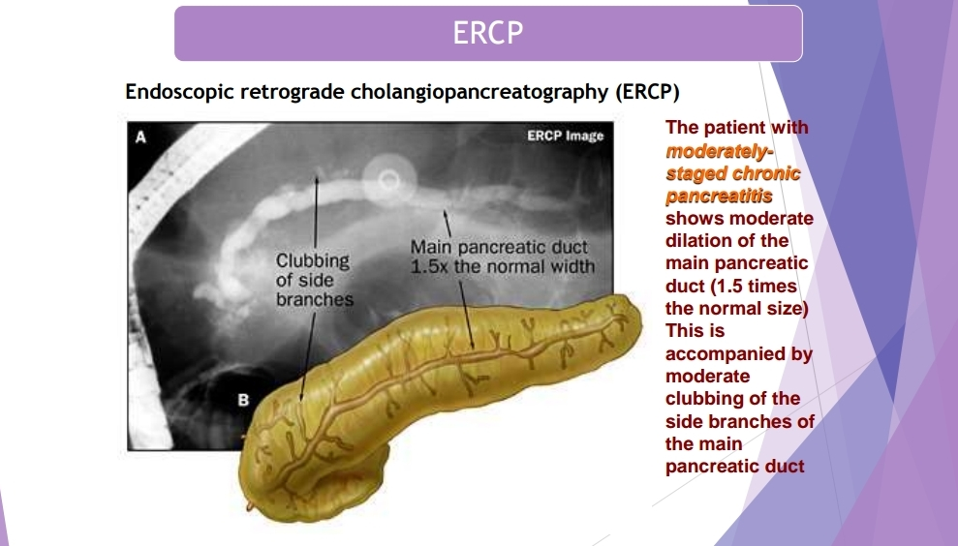

Slide 45
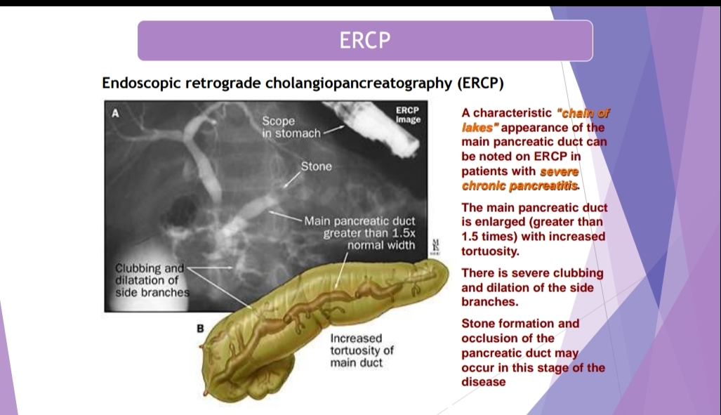

Slide 46
Investigation :-
Secretin cholecystokinin test is the gold standard for assessing pancreatic function.
After over night fasting, double lumen tube is placed into the duodenum at the level of ligament of Treitz under C ARM guidance. Gastric and duodenal juices are aspirated.

Slide 47
Continuous IV secretin 1 u/kg/hour and CCK are infused in 90 minutes. Sampling of duodenal juice is done in every 10 minutes for one hour for analysis of volume, HCO3-, amylase, lipase and proteases. It is to assess functional deficiency.
In chronic pancreatitis volume is normal - > 2 ml/kg but less bicarbonate content - < 80 m Eq/L.
In malignancy volume is reduced due to obstruction - < 2 ml/kg; bicarbonate level is normal - > 80 m Eq/L; enzyme levels are normal.

Slide 48
Functional tests :-
Measurement of the fecal elastase-1 level is the preferred noninvasive study to diagnose pancreatic exocrine insufficiency.
above 200 μg/g feces is normal
between 100 and 200 μg/g - mild to moderate pancreatic insufficiency
below 100 μg/g -severe pancreatic exocrine insufficiency.
The fecal fat and weight estimation test measures the fat content of stool after a nutritional intake of 100 g of fat/day over 3 days. If the stool fat content exceeds 7 g/day, the diagnosis of steatorrhea is established.

Slide 49
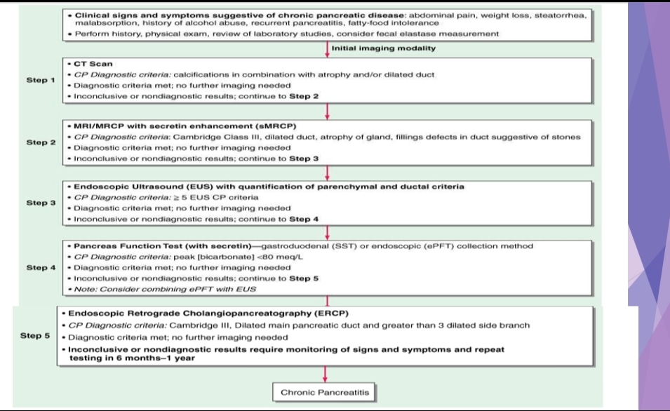

Slide 50
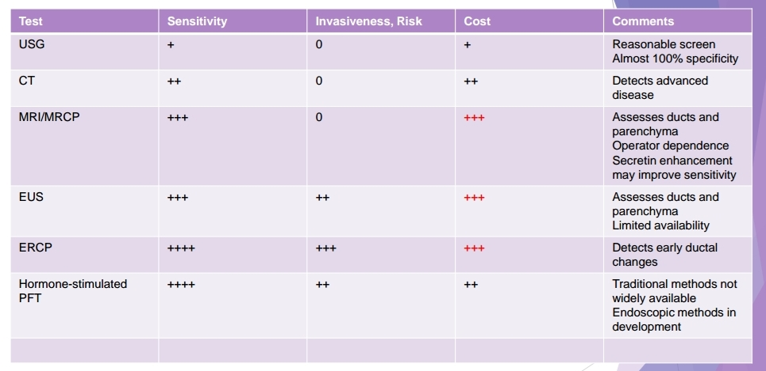

Slide 51
Complications :-
Chronic abdominal pain
Narcotic addition
Diabetes mellitus/impared glucose
Gastroparesis
Malabsorption/Maldigestion
Jaundice
Retinopathy
Biliary stricture / Biliary cirrhosis
Pseudocyst
Metabolic bone disease
Pancreatic cancer

Slide 52
Treatment :-
1 :- Medical Management :-
a > Conservative treatment
b > Amelioration of pain
c > Maintain Nutrition and control maldigestion
d > Tackle complication
2 :- Surgical Management :-

Slide 53
A :- Conservative
Avoid alcohol.
Low fat, high protein, high carbohydrate diet; small and more frequent meals.

Slide 54
B :- Amelioration of pain
Analgesics :- used for pain relief. If insufficient relief than combination a nonopioid analgesic with a weak opioid ( tramadol ) is used.
Alternative drugs useful in the treatment of other conditions associated with chronic pain, such as tricyclic antidepressants, selective serotonin reuptake inhibitors, combined serotonin and norepinephrine reuptake inhibitors.

Slide 55
Pancreatic enzymes :-
Pancreatic enzymes are proposed to improve pain by suppressing CCK release from the duodenum.
one of mechanism of pain is increased CCK level and hyper -stimulation in CP.
A meta-analysis of the six randomized, double-blind, placebo controlled trials for the treatment of CP with pancreatic enzymes showed no benefit in improving pain. It should be noted that this meta-analysis combined studies using enteric-coated and studies using nonenteric-coated preparations.

Slide 56
Uncoated preparation works well by enhancing delivery to the proximal small bowel. Uncoated pancreatic enzymes trial should be given to patients for 6–8 weeks and if effective it should be continued.
Recent data suggest that up to 80,000 to 1,00,000 units of lipase are required/ day.

Slide 57
Pancreatic enzyme
product | Lipase | Amylase | protease
Immediate release capsule:- Viokace | 10440 20880 | 391550 78300 | 39150 78300
Delayed release capsule:- creon | 3000 6000 12000 24000 | 15000 30000 60000 120000 | 9500 19000 38000 76000
Enteric coated mini tablets :- ultresa | 13800 20700 23000 | 27600 41400 46000 | 27600 41400 46000
Enteric coated beads :- zenpep | 3000 5000 10000 15000 20000 25000 | 16000 27000 55000 82000 109000 136000 | 10000 17000 34000 51000 68000 85000
Enteric coated micro tablets:- pancreaze | 4200 10500 16800 21000 | 17500 43750 70000 61000 | 10000 25000 40000 37000
Bicarbonate buffered enteric coated micreopheres :- pertzye | 8000 16000 | 30250 60500 | 28750 57500

Slide 58
3:- Antioxidants
A recent randomized, placebo-controlled trial by Bhardwaj et al. on antioxidants [mixture of selenium (600 µg), methionine (2 gm), vitamins E (270 IU) and C (540 mg), and b-carotene (9,000 IU)] demonstrated significant pain relief with antioxidants in patients of chronic pancreatitis.
Pregabalin :- Increase glutamate which in turn increases GABA.
Initial dose: 75 mg twice daily 3 days.
later: 150 mg twice daily 1 week.
later: 300 mg twice daily (till next 3 weeks) caused significant relief in pain.

Slide 59
Nerve Blocks
Miscellaneous Therapies
Following therapies have been tried:
Interferon a and b,
PPAR-gamma ligand (troglitazone),
statins,
oral protease inhibitor: camostat,
calcitonin gene related peptide antagonists,
neurokinin-1 receptor antagonists,
LT antagonist: zafirleukast,
CCK-receptor antagonist: loxiglumide and spinal cord stimulation.

Slide 60
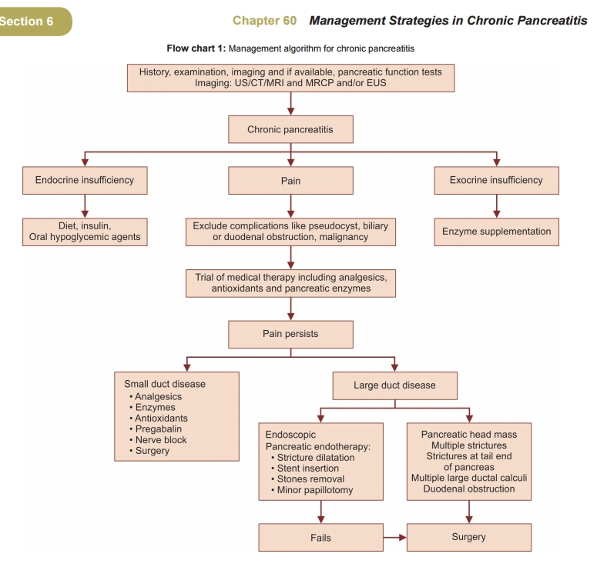

Slide 61
Limitation for use of analgesics :-
Patient often become dependent on heavy narcotic use.
Use of stronger opioid leads to side effects such as constipation , nausea, and dyspepsia.
In addition, time intervals and doses of drug application for opioids must be adapted to the individual pain pattern.
Opioid are not very effective in treating sensitization of the central nervous system and may cause hyperplasia.

Slide 62
Interventional Therapy: Endoscopic Treatment
ERCP is the primary modality for treating symptomatic pancreatic duct obstruction with dilation and polyethylene stent placement
Only after a thorough evaluation, which includes CT, MRCP, and/or EUS, has completely ruled out the possibility of malignancy should endoscopic treatment be considered.

Slide 63
Endoscopic stone extraction should be considered for patients with pain and pancreatic duct dilation secondary to stones.
Extracorporeal shock wave lithotripsy followed by therapeutic ERCP may be required for the treatment of large impacted stones.
Temporary relief of the obstruction using plastic stents is indicated for patients with cholangitis or for those who are severely malnourished.

Slide 64
Indications for surgery
Persisting pain - main indication
Severe malabsorption and Suspicion of malignant transformation
Multiple relapses
Complications like pseudocyst, segmental portal hypertension
Biliary obstruction (Wadsworth syndrome)
Pancreatic ductal dilatation > 7 mm
Pancreatic ascites/fistula
Pancreatic ductal stenosis

Slide 65
Surgerical intervention :-
Pancreatic duct drainage
Pancreatic resection
Total pancreatectomy and islet autotransplantation:
Distal pancreatectomy
Puestow’s operation
The modified Puestow procedure
Puestow and Gillesby's longitudinal pancreaticojejunostomy
Total pancreatectomy
Partington – Rochelle operatio

Slide 66
1. Kleef j, et al. Chronic pancreatitis. Nat Rev Dis Primers. 2017; 3(17060):1-18

Slide 67



