Slide 1
Congenital Heart Diseases

Slide 2
INTRODUCTION
The most common birth defects are cardiovascular origin.
These malformations are due to complex multifactorial genetic and environmental causes.
Congenital heart disease complicates about 1% of all live births but occurs most frequently in offsprings.
Owing to recent advances in treatment options available, >90% of affected neonates and children now reach adulthood and women with CHD may now successfully bear children after competent repairs.

Slide 3
FOETAL CIRCULATION
Oxygen and nutrients from the mother's blood are transferred across the placenta to the fetus. The enriched blood flows through the umbilical cord to the liver and splits into three branches. The blood then reaches the inferior vena cava, a major vein connected to the heart. Most of this blood is sent through the ductus venosus, also a shunt that passes highly oxygenated blood through the liver to the inferior vena cava and then to the right atrium of the heart. A small amount of this blood goes directly to the liver to give it the oxygen and nutrients it needs.
Waste products from the fetal blood are transferred back across the placenta to the mother's blood.

Slide 4
Inside the fetal heart:
Blood enters the right atrium, the chamber on the upper right side of the heart. When the blood enters the right atrium, most of it flows through the foramen ovale into the left atrium.
Blood then passes into the left ventricle (lower chamber of the heart) and then to the aorta, (the large artery coming from the heart).
From the aorta, blood is sent to the heart muscle itself in addition to the brain. After circulating there, the blood returns to the right atrium of the heart through the superior vena cava. About two thirds of the blood will pass through the foramen ovale as described above, but the remaining one third will pass into the right ventricle, toward the lungs.

Slide 5
In the fetus, the placenta does the work of breathing instead of the lungs. As a result, only a small amount of the blood continues on to the lungs. Most of this blood is bypassed or shunted away from the lungs through the ductus arteriosus to the aorta. Most of the circulation to the lower body is supplied by blood passing through the ductus arteriosus.
This blood then enters the umbilical arteries and flows into the placenta. In the placenta, carbon dioxide and waste products are released into the mother's circulatory system, and oxygen and nutrients from the mother's blood are released into the fetus' blood.

Slide 6
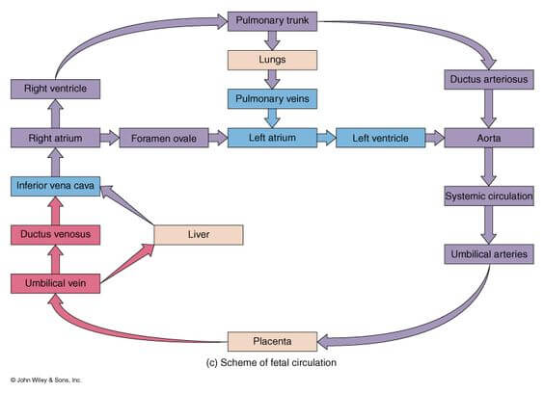

Slide 7
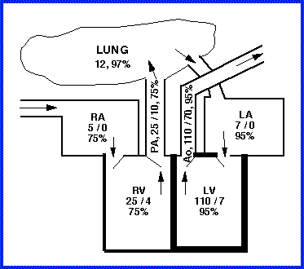
Normal Pressures in Heart Chambers

Slide 8
Classification OF CHD
A. Simple CHD:
Uncomplicated Congenital Aortic Valve Disease
Mild congenital Mitral valve Disease
Uncomplicated small atrial septal defect
Uncomplicated small ventricular septal defect
Mild Pulmonary stenosis

Slide 9
B . Complex Intermediate CHD
Ostium primum or sinus venosus atrial septal defect
Anamolous Pulmonary Venous Drainage
Atrioventricular canal defects
Ventricular septal defects, complicated (eg absent or abnormal valves)
Coarctation of Aorta
Mod to Severe Pulmonic stenosis
Mod to Severe Pulmonic Regurgitation
Patent Ductus Arteriosus
Subvaluval or supravalvular aortic stenosis.

Slide 10
C. Complex CHD
Cyanotic CHD (all forms)
Eisenmenger’s Syndrome
Ebstein’s Anomaly
Fallot’s Tetrology
Transposition Of Great Arteries
Single ventricle
Double outlet ventricle
Truncus arteriosus

Slide 11
Other Type of Classification
Cyanotic
Transposition of Great Arteries
Fallot’s Tetralogy
Acyanotic
ASD
VSD
PDA
Truncus Arteriosus
Tricuspid Valve Abnormalities
Total Anamolous Pulmonary Venous Connection

Slide 12
From above all we are about to discuss the following common anamolies :
Atrial Septal Defect
Ventricular Septal Defect
Patent Ductus Arteriosus
Tetralogy of Fallot
Transposition of Great Arteries
Coarctation Of Aorta
Pulmonary Stenosis

Slide 13
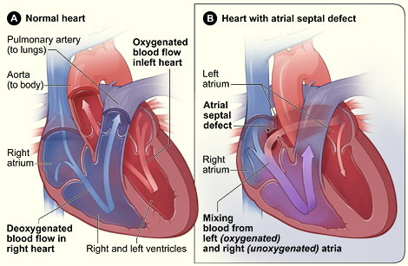
Atrial Septal Defect

Slide 14
Atrial Septal Defect
It is a common cardiac anamoly 1st encountered during adulthood and more common in females.
Types of ASD
Sinous venosus
Ostium Primum
Ostium Secundum

Slide 15
Sinous Venosus ASD : It occurs high in atrial septum near opening of SVC into right atrium.
Ostium Primum ASD :
It lies adjacent to atrioventricular valves either of which may be deformed or regurtitant
More commonly seen in Down’s Syndrome.
C. Ostium Secundum :
It is the most common ASD.
Situtated at mid septum involving fossa ovalis.

Slide 16
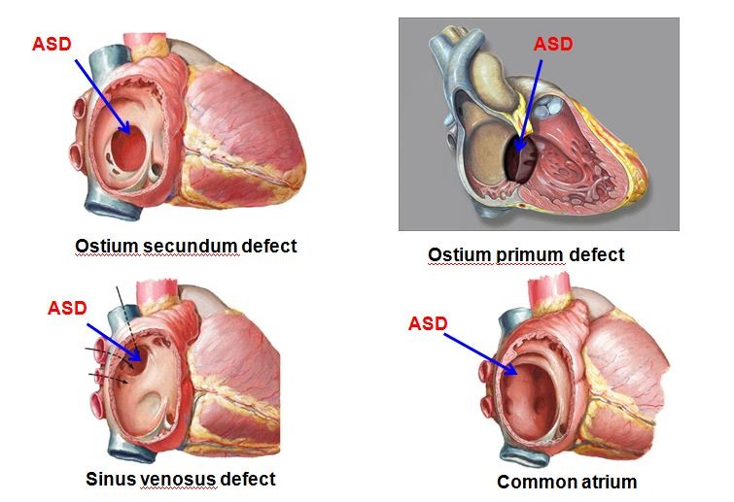

Slide 17
Clinical Features:
Generally asymptomatic during childhood but presents sympotamatic at around 4th decade of life in form :
Dyspnoea,
easy fatiguability,
syncope,
palpitations ,
atrial arrythmia,
pulmonary artrial hypertension
right heart failure.

Slide 18
Physical Examination :
Prominent RV impulse
1st heart sound is normal
2nd heart sound is widely split
Mid diastolic rumbling murmur loudest at 4th ICS.

Slide 19
Chest Xray : Enlarged RA and RV and prominent Pulmonary vascular markings.
ECG :
Ostium Secundum shows RAD .
Ostium Primum shows LAD.
2D Echocardiography :
Shows RA and RV dialation.
Left to right blood flow.

Slide 20
Treatment :
Operative repair with a patch of pericardium or prosthetic material.
Percuatneous transcatheter device closure.
Medical management includes Antiarrythmatic drugs for atrial fibrillation or SVT .

Slide 21
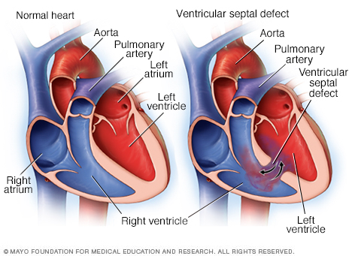
Ventricular Septal Defect

Slide 22
It is the most common of all cardiac birth defects.
It occurs either isolated or as a component of combination of anamolies.
It is usually single and is located at membranous or midmuscular portion of septum.

Slide 23
MANIFESTATIONS
  Depends on size and location
  Features of LV volume overload.

Slide 24
CLINICAL HISTORY
SMALL VSD
  Normal growth and development
  No CHF
MOD. TO LARGE VSD
  Easy fatiguability
  Delayed growth & development
  Repeated Respiratory Tract Infection
  CHF

Slide 25
PHYSICAL EXAMINATION
Low Body weight
Signs of CHF in case of large VSD
Bulging Precordium
Systolic thrill
Pansystolic murmur.

Slide 26
MANAGEMENT
MEDICAL
  DRUGS – Diuretics, Antibiotic prophylaxis
  SUPPORTIVE – NUTRITIONAL
INTERVENTIONAL CATHETERIZATION
SURGICAL
  Palliative – Pulmonary Artery Banding
  Corrective – VSD Closure

Slide 27
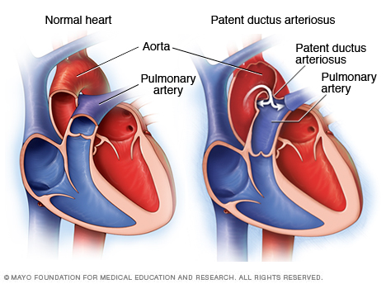
Patent Ductus Arteriosus

Slide 28
The ductus arteriosus is the vessel originating from bifurcation of pulmonary artery to aorta distal to left subclavian artery.
Generally it is open in fetus and gets closed immediately after birth.
The flow across the ductus is determined by the pressure gradient.
In most adults the pulmonary pressures are normal.

Slide 29
There is shunt from aorta to pulmonary artery which results into production of continuous “machinery murmur”.
The cause of death in patients with PDA are cardiac failure and infective endocarditis.

Slide 30
PHYSICAL EXAMINATION:
Wide pulse pressure
Dynamic precordium, Thrill
Bounding pulse
Continuous (Machinery) Murmur
Soft to increased P₂

Slide 31
ECG
  Normal
  LVH
CXR
  NORMAL
  Cardiomegaly (LV/RV)
  Hypervascular markings
  Dilated Aorta

Slide 32
MANAGEMENT
MEDICAL
  Indomethacin
  DRUGS: Diuretics , Antibiotic prophylaxis
INTERVENTIONAL CATHETERIZATION
  Coil or device closure.
SURGICAL
  Ligation
  Transection
Notes:
INDOMETHACIN – INHIBITS SYNTHESIS OF PROSTAGLANDINS COX1 AND 2 INHIBITORS
DECREASE proinflammatory cytokine activity and inhibit neutrophil aggregation

Slide 33
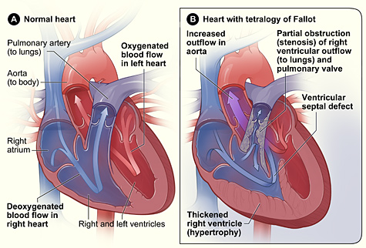
Fallot’s Tetralogy
PULMONARY VALVE STENOSIS
RIGHT VENTRICULAR HYPERTROPHY
VENTRICULAR SEPTAL DEFECT
OVERRIDING AORTA

Slide 34
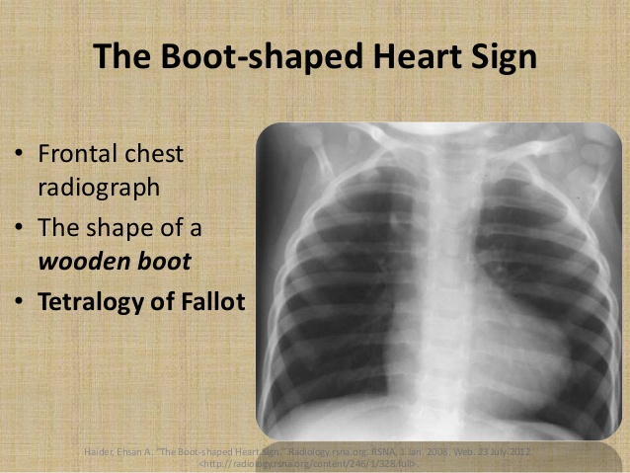
Physical Examination
  Systolic ejection murmur
  Cyanosis, clubbing of digits
ECG – RVH
CXR
  Boot shaped heart
  cardiomegaly

Slide 35
MANAGEMENT
MEDICAL
  Propranolol for Hypoxic Spells
SURGICAL
  Palliative – Blalock Taussig Shunts
  A palliative operation to increase pulmonary blood flow and reduce right to left shunting in tetralogy of Fallot. It involved resection of part of the RV infundibulum using a punch or biopsy-like instrument introduced through the right ventricle so as to reduce RV outflow tract obstruction, without VSD closure.
  Definitive – VSD Closure; Infundibulectomy; Transannular patching.

Slide 36
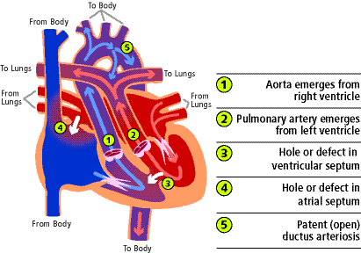
TRANSPOSITION OF GREAT ARTERIES

Slide 37
5% Of CHD
Failure Of Aortic Pulmonary Septum to Develop normally.
Left Ventricle pumps oxygenated blood into pulmonary trunk instead of systemic circulation.
Right ventricle pumps deoxygenated blood into aorta
There is no mixing of blood and has 2 closed loop circulation

Slide 38
PHYSICAL EXAMINATION
  cyanosis
  signs of CHF
  single loud S₂ ; soft systolic murmur
ECG
  RVH, right axis deviation, right atrial enlargement
CXR
  egg on string appeareance
  cardiomegaly hypervascular markings

Slide 39
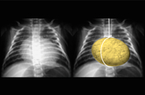
The heart appears globular due to an abnormal convexity of the right atrial border and left atrial enlargement and therefore appears like an egg.
The superior mediastinum appears narrow due to stress-induced thymic atrophy and hyperinflated lungs which give the picture of an egg suspended by a string on a chest radiograph, hence the name egg-on-a-string.

Slide 40
Management
Palliative
  Prostaglandin infusion- to maintain ductal patency
  Create interatrial communication
    Balloon Atrial Septostomy (BAS) – rashkind procedure
    Blade septostomy
    Atrial septostomy – Blalock-Hanlon procedure
Definitive
  Atrial switch
  Arterial switch
Notes:
Rashkind balloon atrial septostomy is performed during cardiac catheterization (heart cath), in which a balloon catheter is used to enlarge a foramen ovale, patent foramen ovale (PFO), or atrial septal defect (ASD) in order to increase oxygen saturation

Slide 41
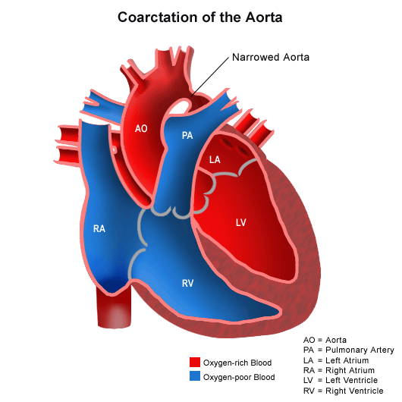
COARCTION OF AORTA

Slide 42
Congenital condition whereby the aorta is narrow, usually in the area where the ductus arteriosus (ligamentum arteriosum after regression) inserts.
Usually asymptomatic but may cause headache, fatigue, claudication of lower extremities.

Slide 43
PHYSICAL EXAMINATION
Hypertension in upper extremities, delayed femoral pulse, decreased pressure in lower extremities
Systolic murmur heard over mid upper back at left interscapular space
ECG – LV Hypertrophy
CXR- nothing of the ribs due to collateral arteries, appeareance of distal aortic arch.

Slide 44
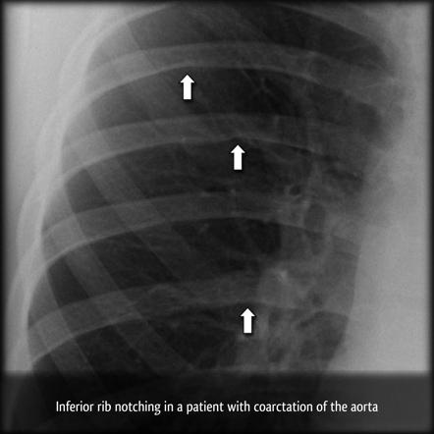

Slide 45
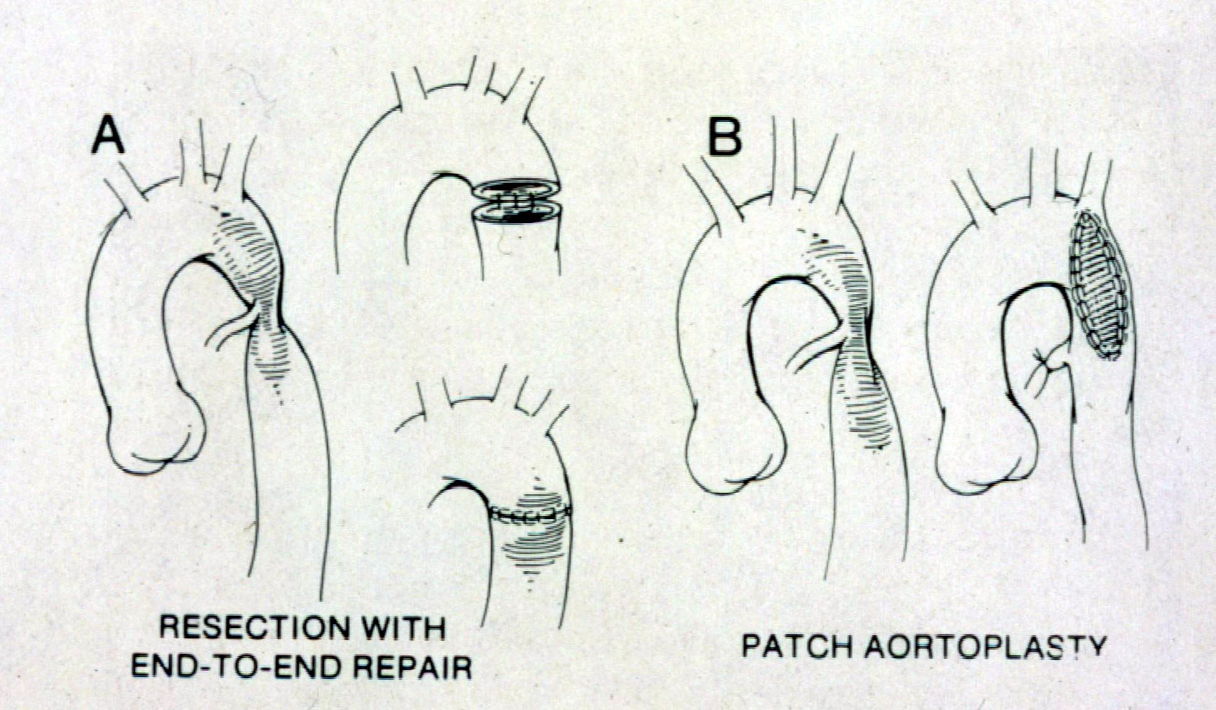
Coarctation of the Aorta: Repair

Slide 46
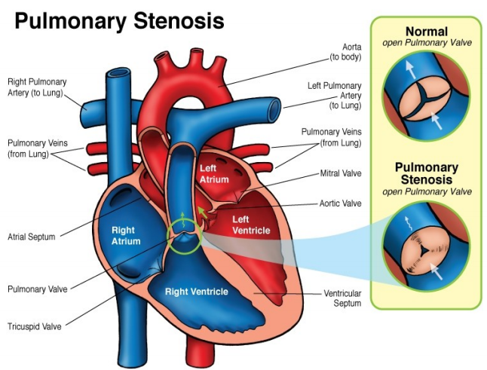
Pulmonary Stenosis

Slide 47
5 – 8% OF CHD
Associated with congenital rubella.
Types: valvular, subvalvular (infundibular), supravalvular or peripheral
Manifestations: asymptomatic unless severe
trans pulmonary valve gradient <30 mmhg – mild ps, 30-50 moderate, >50 severe ps
Pt with higher gradient manifest dyspnea , fatigue light headedness, chest pain (rv ischemia)

Slide 48
Physical examination
  jugular venous distension with prominent a wave
  systolic thrill
  systolic murmur at left upper sternal border radiating to back; soft p₂
Notes:
LUSB LEFT UPPER STERNAL BORDER
thrill
a vibration caused by the movement of fluid felt by the examiner on palpation. Created by turbulence in a fluid column passing through an incompetent valve, or from a vessel of smaller caliber to a larger.
SYSTOLIC THRILL – FELT ON VENTRICULAR SYSTOLE

Slide 49
ECG
  Normal
CXR
  Normal
Notes:
Post-stenotic aortic dilatation is defined as dilatation of the vessel wall distal to the area of a partial stenosis. It refers to dilatation of the ascending aorta, >4.0 cm, distal to a stenotic/malformed aortic valve (AV). This dilatation is usually progressive > 0.3 cm/year.

Slide 50
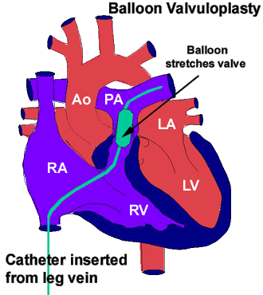
Management
INTERVENTIONAL CATHETERIZATION
  Balloon Valvuloplasty
SURGICAL
  Valvotomy
  (BROCK’S PROCEDURE)
Notes:
A palliative operation to increase pulmonary blood flow and reduce right to left shunting in tetralogy of Fallot. It involved resection of part of the RV infundibulum using a punch or biopsy-like instrument introduced through the right ventricle so as to reduce RV outflow tract obstruction, without VSD closure.

Slide 51
Congenital heart defects I- ASD, VSD, AS, PS, PDA and PFO (1).mp4

Slide 52
THANK YOU

