Slide 1
CELL
DR. TEJAS SHAH

Slide 2
The cell is the structural and functional unit of all known living organisms.
Some organisms, such as most bacteria, are unicellular (consist of a single cell).
Other organisms, such as humans, are multicellular.
All cells contain the hereditary information.
Surrounded by a plasma membrane.
The cytoplasm contains a number of specialized organelles

Slide 3
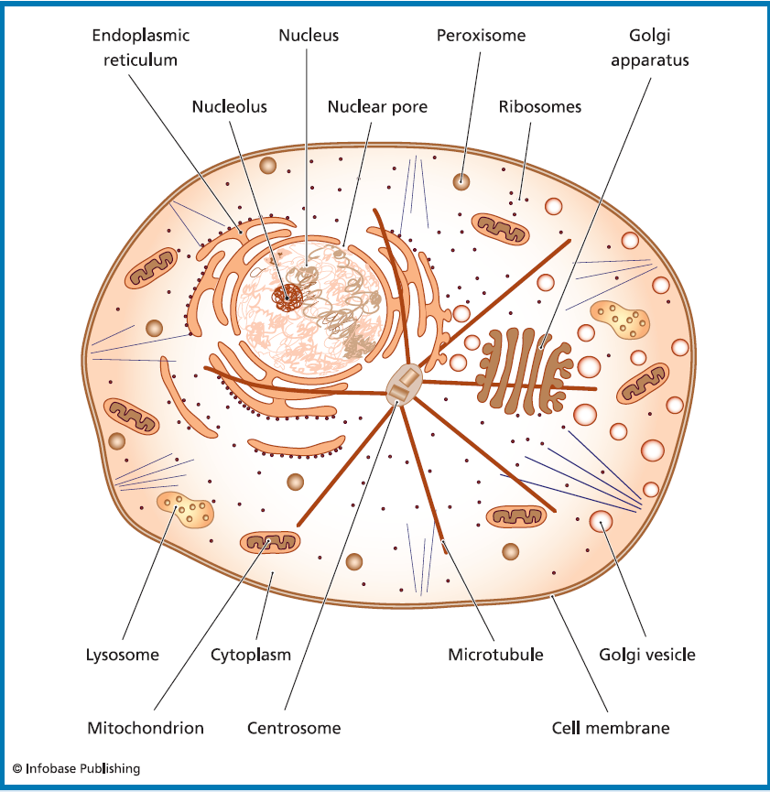

Slide 4
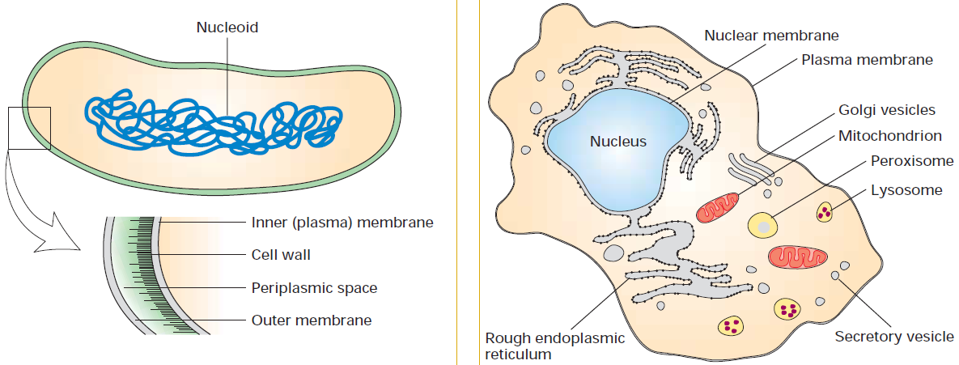
What’s the difference???
Prokaryotic cell
Eukaryotic cell

Slide 5
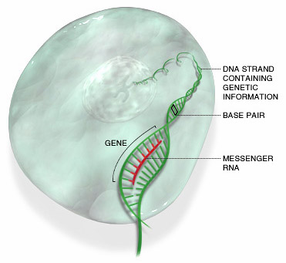
Nucleus
(pl. nuclei; from Latin nucleus or nuculeus, "little nut")

Slide 6
Most prominent organelle & control centre of cell.
All cell in the body contain nucleus, except mature RBCs.
It contains most of the cell's genetic material
Two membranes : inner perinuclear membrane with numerous pores and outer one is continuous with endoplasmin reticulum.
Lighter shaded area is called nucleolus.

Slide 7
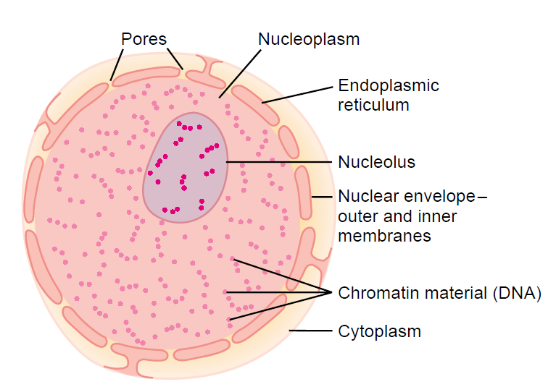

Slide 8
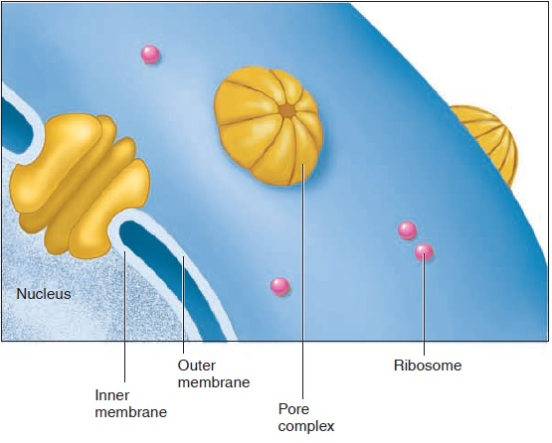

Slide 9
Functions:
DNA replication
RNA synthesis (transcription)

Slide 10
ENDOPLASMIC RETICULUM
Network of tubular and vesicular structure.
Vesicles and tubules are interconnected with one another.
2 forms: Smooth and Rough
Surface of Rough ER is coated with the Ribosomes while Smooth is not coated.
ER will be very prominent in cells actively synthesising proteins, e.g. immunoglobulin secreting plasma cells.

Slide 11
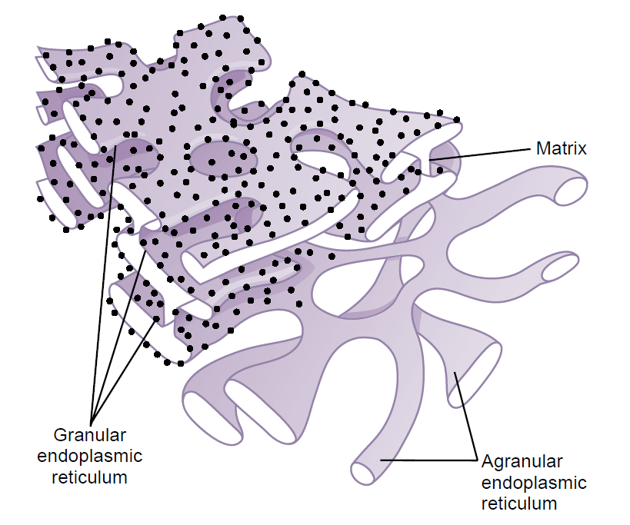

Slide 12
Functions of ER:
Mechanical transport of substances.
Lipid synthesis by smooth ER.
Protein synthesis by rough ER.
Detoxification of various drugs.

Slide 13
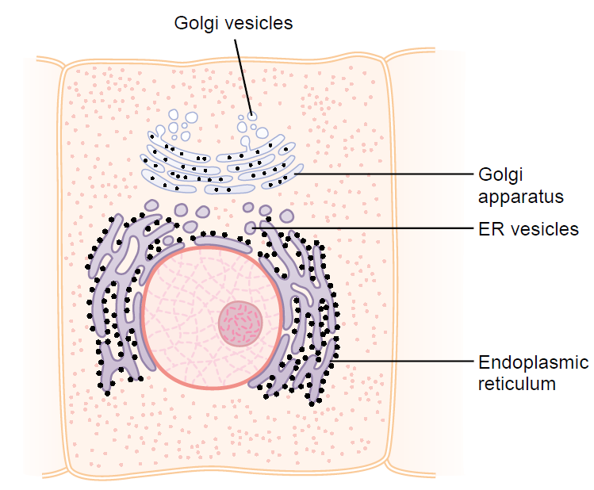
GOLGI APPARATUS

Slide 14
It is a network of flattened smooth membranes and vesicles.
It’s a converging area of ER.
Carbohydrates groups are added to the nascent proteins while passing from the ER.
These glycoproteins passed first to cis golgi →medial golgi→trans golgi→transport vesicles→destination.

Slide 15
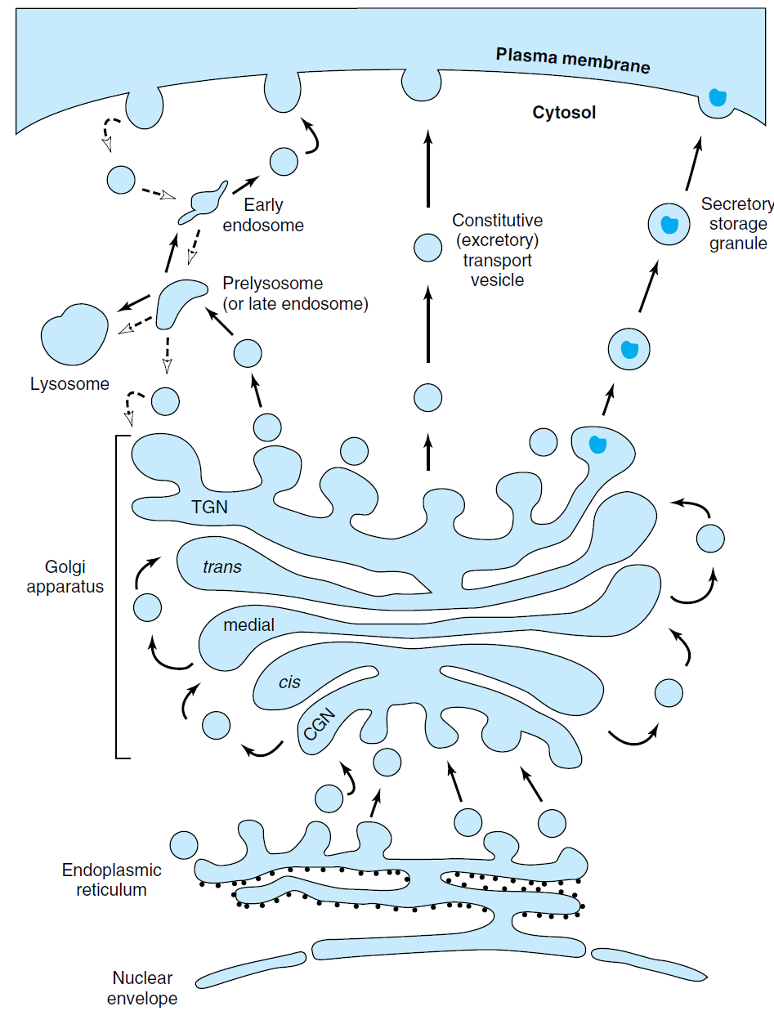

Slide 16
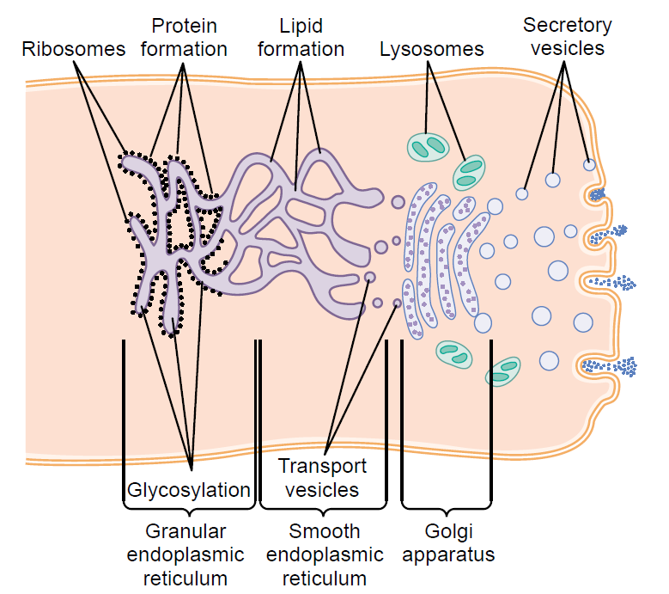
Finished product 1) direct secretion to surrounding medium 2) become integral part of plasma membrane but not secreted 3) stored and secreted upon stimulus 4) collected into lysosome packets.

Slide 17
Functions:
1. Maturation of synthesized protein by sorting, packaging and secretion.

Slide 18
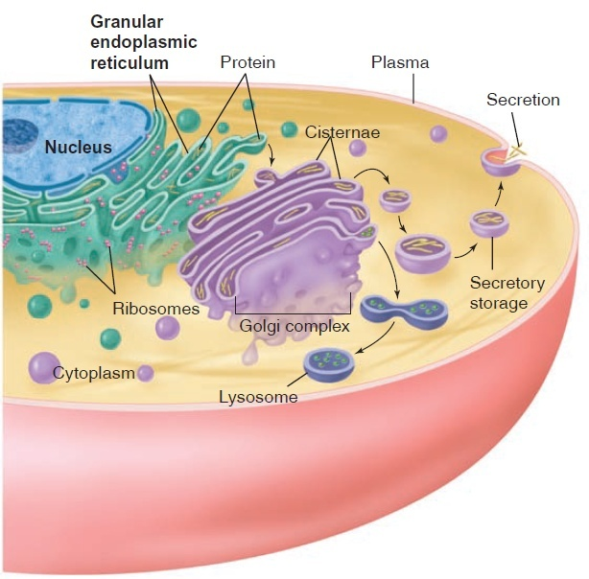

Slide 19
LYSOSOMES
Lysosomes are tiny organelles known as incinerator of cell.
They are bags of enzymes.
The lysosomal enzymes have an optimum pH around 5.
These enzymes are:
Polysaccharide hydrolysing enzymes:α-glucosidase, α-frucosidase.
For protein: cathepsin, collagenase, elastase, peptidase.
For nucleic acid: ribonuclease, deoxyribonuclease

Slide 20
    Functions:
    Allow the cell to digest:
    1. Damaged cellular structure.
    2. Food particles ingested by the cell.
    3. Digestion of bacteria.
    4. Sometimes digests self organelles k/a 'suicide bags').

Slide 21
Clinical applications:
Gout : phagocytosed urate crystals causes rupture of lysosome → release of enzymes → arthritis.
Post mortem autolysis: cell death→ lysosomes rupture releasing hydrolytic enzymes.
Genetic diseases: absent of lysosomal enzymes → accumulation of lipids/ polysaccharides.
Silicosis : phagocytosed silica particles in lung→ lysosome rupture→ decreased lung elasticity

Slide 22
PEROXISOMES
Contains Granular matrix
Contains peroxidase and catalase
They are prominent in leucocytes and platelets
Function : destroys the unwanted peroxides and other free radicals.

Slide 23
MITOCHONDRIA
It is Spherical & membrane-enclosed.
‘Cellular power plants’ or ‘Power house of the cell’
Two membranes: inner membrane turns into folds/cristae and outer membrane contains the enzymes of citric acid cycle, urea cycle and heme synthesis.

Slide 24
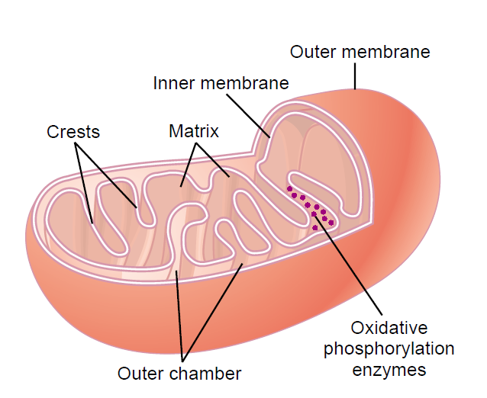

Slide 25
Functions :
Electron transport chain
ATP generation
Metabolic pathways: TCA cycle, beta oxidation of fatty acids, ketogenesis,
Part of urea synthesis, heme synthesis, gluconeogenesis, pyrimidine synthesis.
Role in apoptosis

Slide 26
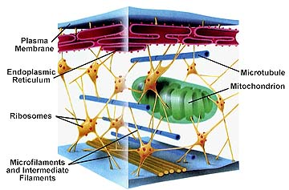
CYTOSKELETON

Slide 27
Known as Molecular Motors
Maintain shape of cell.
Also responsible for cell movement.
Type: 1. Microtubule 2. Microfilament
Microtubule
Long ,hollow structure.
Made up of two subunits Alpha and Beta tubulin.
At one End where assembly is taking place is k/a + end.
where disassembly is taking place is k/a - end.
Because of constant assembly and disassembly
microtubules are a dynamic portion of the cell skeleton.

Slide 28
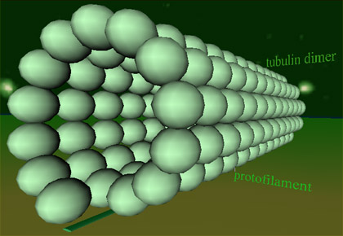

Slide 29
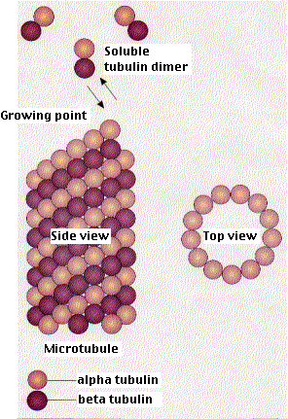

Slide 30
Provide tracks for:
1.Transport of vesicles.
2. Mitochondria.
3.Secretory granules.
4.Organeles. From one part of the cell to another.
5. form the “spindle” which move chromosome in mitosis.

Slide 32
THE CYTOPLASM
Three major elements; the cytosol, organelles and inclusions.
The cytoplasm holds organelles and protects them, such as the vacuole, endoplasmic reticulum, etc.
The inclusions are chemical substances that store nutrients, secretory products and pigment granules.

Slide 33
PLASMA MEMBRANE
It separates the cell from the external environment.
Membranes are mainly made up of lipids, proteins and small amount of carbohydrates.
The carbohydrates are present as glycoproteins and glycolipids.
Phospholipids are the most common lipids present and they are amphipathic in nature. Cell membranes also contain cholesterol.

Slide 34
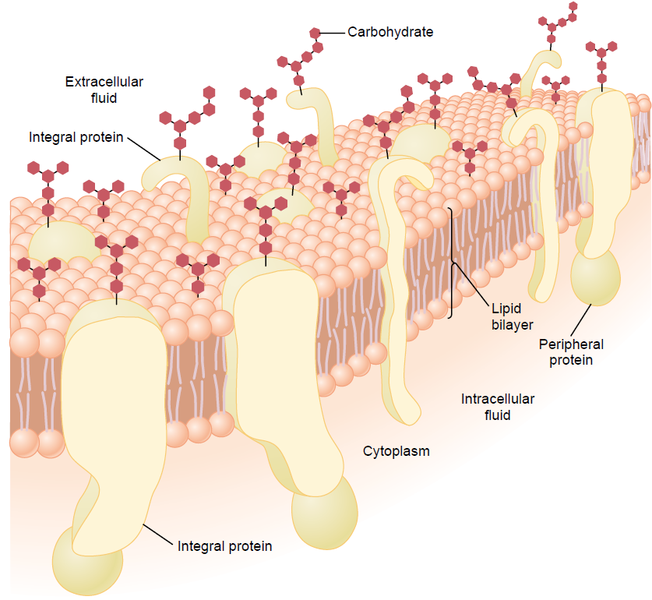

Slide 35
FLUID MOSAIC MODEL
The phospholipids are arranged in bilayers with the polar head groups oriented towards the extracellular side and the cytoplasmic side with a hydrophobic core.
The distribution of the phospholipids is such that choline containing phospholipids are mainly in the external layer and ethanolamine and serine containing phospholipids in the inner layer.
The lipid bilayer shows free lateral movement of its compounds, hence the membrane is said to be fluid in nature.

Slide 36
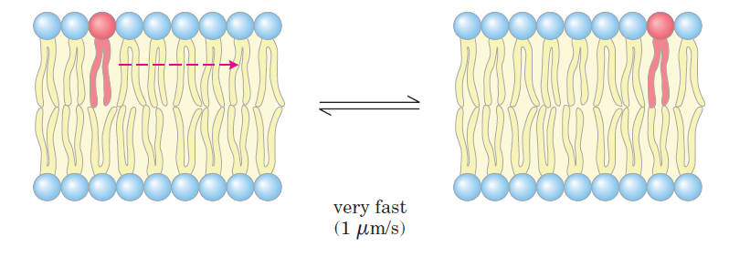

Slide 37
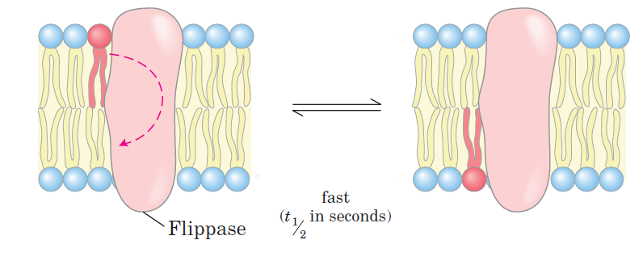
However, the components do not freely move from inner to outer layer, or outer to inner layer (flip-flop movement is restricted).

Slide 38
Fluidity enables the membrane to perform endocytosis and Exocytosis.
Cholesterol is dissolved in the bilayer of the membrane.
Their main function is to determine degree of permeability of membrane to the water soluble substances.
The nature of the fatty acids also affects the fluidity of membrane, the more unsaturated cis fatty acids increase the fluidity.

Slide 39
Membrane proteins
Proteins are embedded in the membrane.
Two types:
1. Integral Proteins- they pass through the membrane. Some proteins span the whole membrane called transmembrane proteins.
2. Peripheral Protein-Present either inside or outside the membrane.

Slide 41
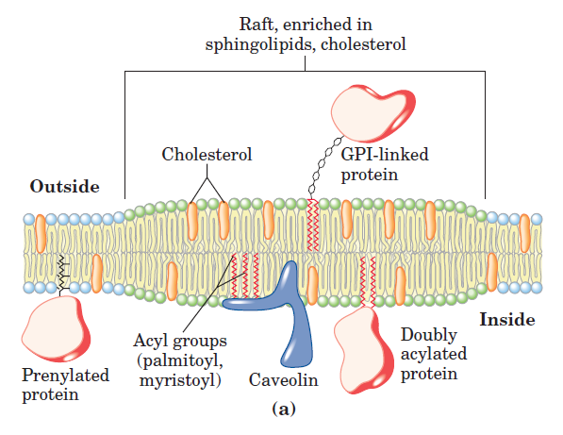

Slide 42
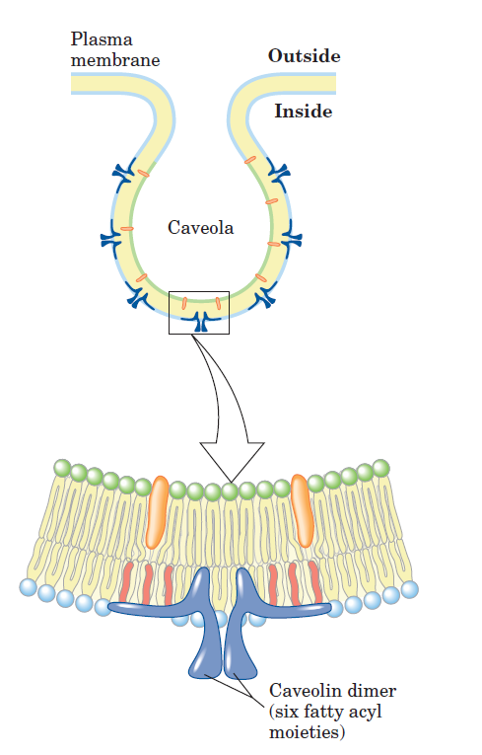

Slide 43
Proteins acts as
Adhesion molecules
Pumps: Transporting ions
Carrier protein: transporting substances like Glucose
Channels: diffusion of substances.
Receptors: Bind Hormones & Transmitters thus causing physiological changes inside the cell.
Enzymes: catalyzing reactions on the cell surface

Slide 44
CELL TRANSPORT MECHANISMS

Slide 45
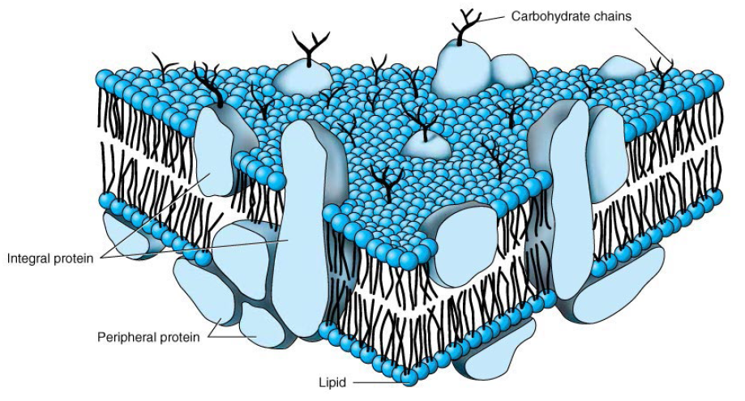
Permeability of substances across the cell membrane depends on
Solubility in lipids
Not on their molecular size
Water soluble substances required carrier

Slide 46
Transport Mechanism
Active
Transport
Passive Transport
Uniport
Symport
Antiport
Simple Diffusion
Facilitated Diffusion
E.g.
Na⁺-K⁺ ATPase pump
Aquaporin
Ion Channel
Ionophores
Mobile Ion Carrier
Ligand Gated Channel
Voltage Gated Channel
Channel Former

Slide 47


Identify the type of transport
ACTIVE TRANSPORT
PASSIVE TRANSPORT

Slide 48
Transport is based on
Concentration Gradient
Concentration= Number of molecules in a given unit of volume (e.g. grams / liter; moles / liter)
Gradient= Difference between two regions of space such that molecules move from one region to the other

Slide 49
Passive Transport
cell uses no energy
molecules move randomly
Molecules spread out from an area of high concentration to an area of low concentration.
(High→Low)
Three types:

Slide 50
3 Types of Passive Transport
Simple Diffusion
Facilitative Diffusion – diffusion with the help of transport proteins
Osmosis – diffusion of water

Slide 51
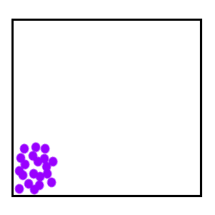
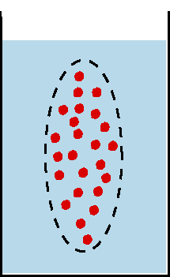
Passive Transport:
1. Diffusion
Simple Diffusion Animation
Diffusion: random movement of particles from an area of high concentration to an area of low concentration.
(High to Low)
Diffusion continues until all molecules are evenly spaced (equilibrium is reached)-Note: molecules will still move around but stay spread out.
http://bio.winona.edu/berg/Free.htm

Slide 52
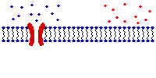
Passive Transport:
2. Facilitated Diffusion
A
B
2. Facilitated diffusion: diffusion of specific particles through transport proteins found in the membrane
  Transport Proteins are specific – they “select” only certain molecules to cross the membrane
  Transports larger or charged molecules
  Bidirectional
  Rapid
  Ping-pong mechanism
Facilitated diffusion (Channel Protein)
Diffusion (Lipid Bilayer)

Slide 53
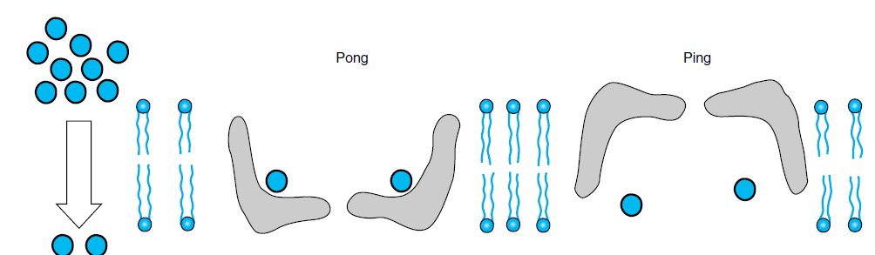

Slide 54
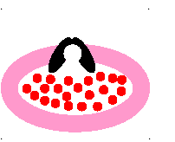

Slide 55
Passive Transport:
3. Osmosis
3.Osmosis: diffusion of water through a selectively permeable membrane
Water moves from high to low concentrations

Slide 56
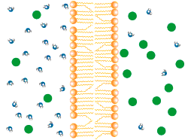
Osmosis

Slide 57
Aquaporins
Water channels
Tetramer
More than 10 aquaporins found in human
AQP 1 – Choroid plexus of lateral ventricle & Play role in formation of CSF
AQP 4 – Predominant water channel in brain
In several disease, it’s function impaired.
Nephrogenic diabetes insipidus.

Slide 58
Effect of osmosis on life
Isotonic solution
Hypotonic solution
Hypertonic solution

Slide 59
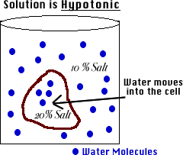
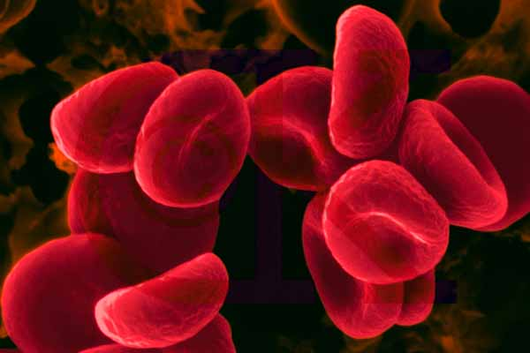
Hypotonic Solution
Hypotonic: The solution has a lower concentration of solutes and a higher concentration of water than inside the cell. (Low solute; High water)
Result: Water moves from the solution to inside the cell): Cell Swells and bursts open (cytolysis)!

Slide 60
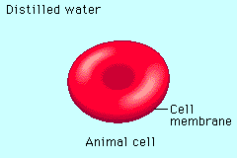

Slide 61
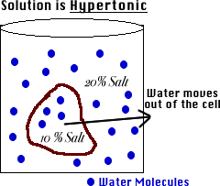
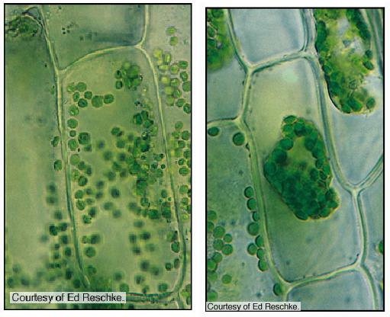
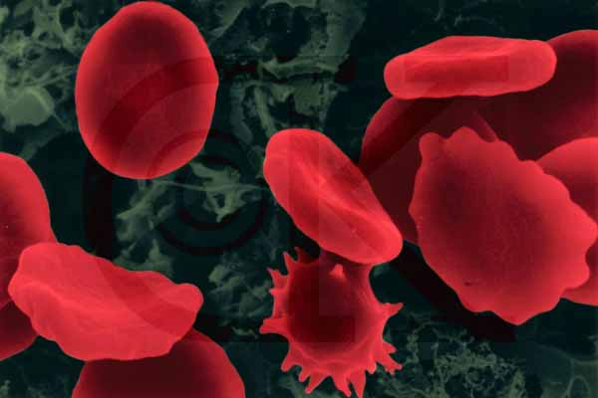
Hypertonic Solution
Hypertonic: The solution has a higher concentration of solutes and a lower concentration of water than inside the cell. (High solute; Low water)
shrinks
Result: Water moves from inside the cell into the solution: Cell shrinks (Plasmolysis)!

Slide 62
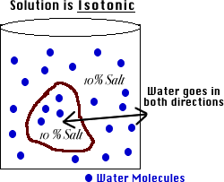
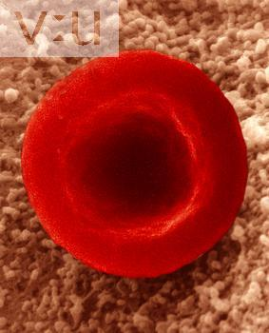
Isotonic Solution
Isotonic: The concentration of solutes in the solution is equal to the concentration of solutes inside the cell.
Result: Water moves equally in both directions and the cell remains same size! (Dynamic Equilibrium)

Slide 63
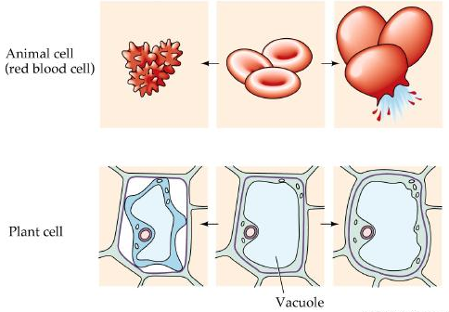
What type of solution are these cells in?
A
B
C
Hypertonic
Isotonic
Hypotonic

Slide 64
ION CHANNELS
(Cation conductive channels)
Quick transporter
For electrolyte like Ca⁺, K⁺ ,Na⁺ ,Cl⁻
Important for
Nerve impulse conduction,
Synaptic transmission,
Secretion biologically active substance

Slide 65
1.Voltage gated channels
- which open by membrane depolarization
- Involve in nerve impulse conduction
- e.g. Na⁺ channels, K⁺ channels

Slide 66
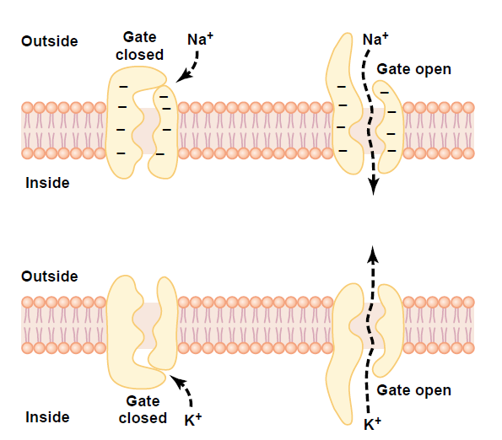

Slide 67
2. Ligand gated channels
- Open by binding of effector
- Acetyl choline which open Na⁺ channel & generate action potential in post synaptic membrane.
- Inositol triphosphate opens Ca⁺ channel in sarcoplasmic reticulum
- Amelogenin in enamel acts as a Ca⁺ channel

Slide 68
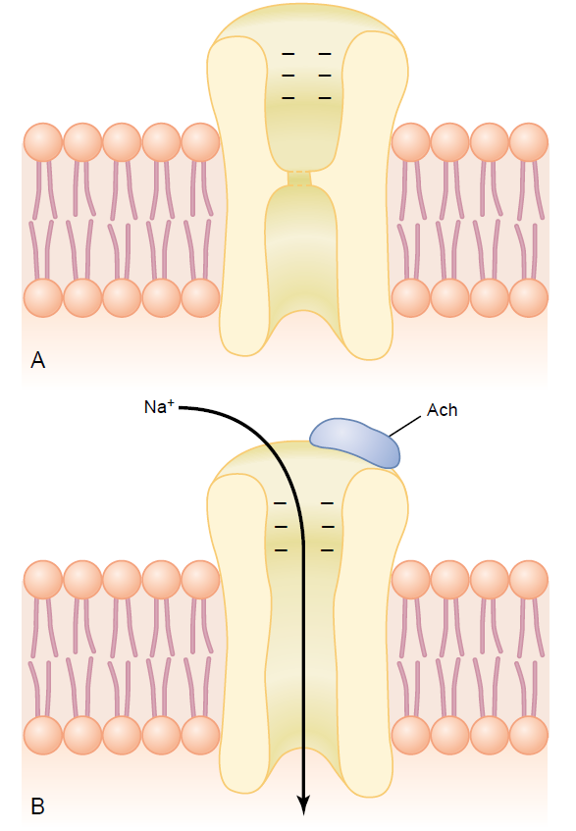

Slide 69
Ionophores
These are the membrane shuttles for specific ions
Transport antibiotic
Mobile ion carriers – Valinomycin, it allows K+ ions to permeate the mitochondria and thus disrupt the proton gradient
Channel formers – Gramicidin
They are produced by micro-organisms and are used as antibiotics.

Slide 70
Active Transport
cell uses energy
actively moves molecules to where they are needed
Movement from an area of low concentration to an area of high concentration
(Low → High)
Requires transporters
Three Types:

Slide 71
Types of Active Transport
1. Protein Pumps -transport proteins that require energy to do work
  Example: Sodium / Potassium Pumps are important in nerve responses.
  Ca++ pump in muscle contraction

Slide 72
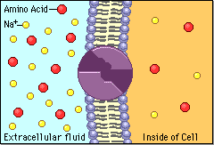
Protein changes shape to move molecules: this requires energy!

Slide 73
Types of Active Transport
2. Endocytosis: taking bulky material into a cell
  Uses energy
  Cell membrane in-folds around food particle
  “cell eating”
  forms food vacuole & digests food
  This is how white blood cells eat bacteria!

Slide 74
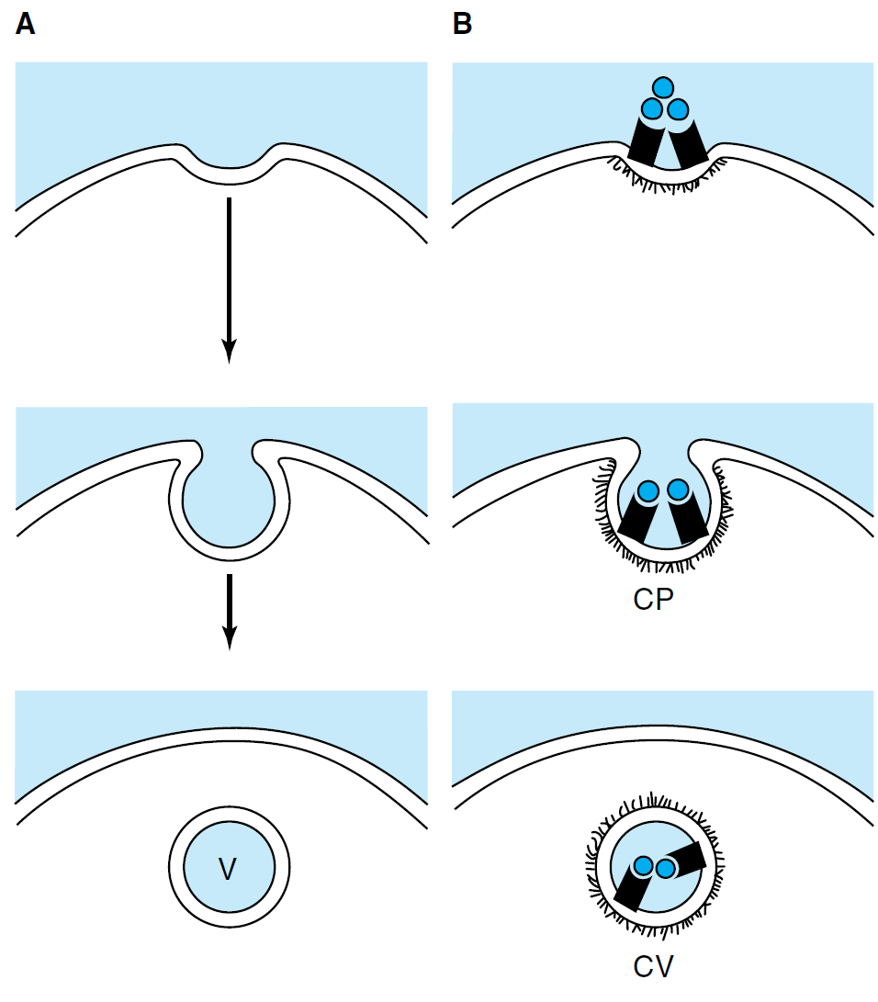

Slide 75
Types of Active Transport
3. Exocytosis: Forces material out of cell in bulk
  membrane surrounding the material fuses with cell membrane
  Cell changes shape – requires energy
  EX: Hormones or wastes released from cell

Slide 76
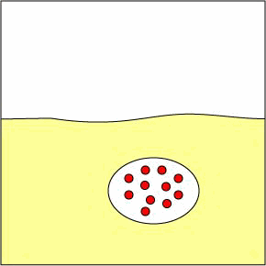

Slide 77
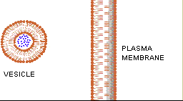

Slide 78
Uniport, Symport and Antiport
Uniport :carries single solute across the membrane
glucose transporter in most of the cells.
Co-transport: transfer of one molecule depends on simultaneous or sequential transfer of another molecule
Two types: Symport and Antiport

Slide 79
In symport, the transporter carries two solutes in the same direction. E.g., sodium dependent glucose transport
The antiport system carries two solutes or ions in opposisite direction :e.g. sodium pump.

Slide 80
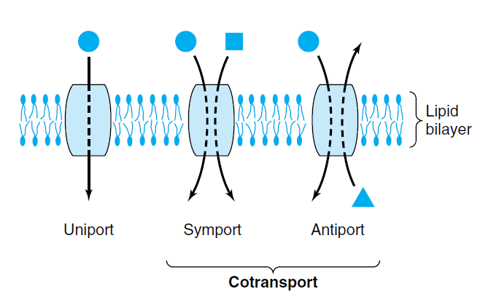

Slide 81
Marker Enzyme
Mitochondria – ATP synthase
Lysosome – Cathepsin
Golgi complex – Galactosyl transferase
Microsomes – Glucose 6 phosphatase
Cytoplasm – LDH
Peroxime – Catalase
Plasma membrane – 5’Nucleiotidase

Slide 83
THANK
U

