Slide 1
NEWER CLASSIFICATION OF EPILEPSY & ITS PATHOGENESIS AND CILINICAL FEATURES

Slide 2
SEIZURES :- IT IS A PAROXYSMAL EVENT DUE TO ABNORMAL EXCESSIVE OR SYNCHRONOUS NEURONAL ACTIVITY IN THE BRAIN. ₁
5-10 % OF THE POPULATION WILL HAVE ATLEAST ONE SEIZURE , WHICH OCCURE IN EARLY CHILDHOOD AND LATE ADULTHOOD.₁
EPILEPSY :- TWO OR MORE UNPROVOKED EPISODE OF SEIZURE . ₁
INCIDENCE OF EPILEPSY IS 0.3 – 0.5 % In DIFFERENT POPULATION (5-30 PERSON PER 1000) ₁
1- harrison

Slide 3
Pathogenesis :-
The 19th century neurologist Hughlings Jackson suggested “a sudden excessive disorderly discharge of cerebral neurons“ as the causation of epileptic seizures.
Recent studies in animal models of focal epilepsy suggest a central role for the excitatory neurotransmiter glutamate (increased in epi) and inhibitory gamma amino butyric acid (GABA) (decreased)

Slide 4
Endogenous factor :-
Neuronal propensity to burst
Intrinsic : conductance to ion channel, receptor response, etc.
Extrinsic : neuro transmitter, receptor .
Epileptogenesis :-
Lowered seizure threshold
Lost inhibition

Slide 5
Seizure initiation and propagation :-
Initiation: Bursts of action potential , Hyper -synchronization
Propagation: Extracellular K⁺ , Presynaptic Ca²⁺, Cortical connections & Commissural fibers.
Bursting activity in individual neuron is caused by long lasting depolarization of the neuronal membrane due to influx of extra cellular calcium
Opening of voltage dependent sodium channels.

Slide 6
It cause influx of sodium and generation of repetitive action potentials.
Which if followed by hyperpolarization after potetional ( GABA receptors and potassium channels)
Spike discharge on eeg Because of burst of sufficient number of neurons.

Slide 7
Seizure wavefront is slowed and ultimetly halted by intact hyperpolarization and surround inhibition created by feed forward activation of inhibitory neurons.
Which is held by synaptic and non synaptic mechanisms :-
1. increase in extra cellular potassium , which blunts hyperpolarization and depolarization neighboring neurons.
2. accumulation of calcium in presynaptic terminals, leading to enhance neurotransmitter release.

Slide 8
3. depolarization induce activation of n - methyl – d - aspartate , which cause additional calcium influx and neuronal activation.
4. ephaptic interactions related to changes in tissue osmolarity and cell swelling.

Slide 9
NEWER CLASSIFICATION OF EPILEPSY
The new basic seizure classification is based on 3 key features.
Where seizures begin in the brain.
2. Level of awareness during a seizure.
3. Other features of seizures.

Slide 10
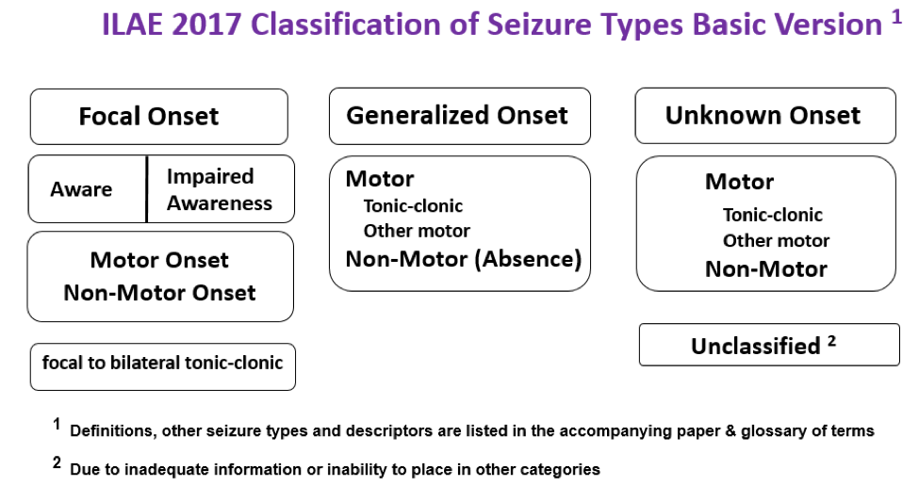

Slide 11
(1) "partial" becomes "focal"; (2) awareness is used as a classifier of focal seizures; (3) the terms dyscognitive, simple partial, complex partial, psychic, and secondarily generalized are eliminated; (4) new focal seizure types include automatisms, behavior arrest, hyperkinetic, autonomic, cognitive, and emotional; (5) atonic, clonic, epileptic spasms, myoclonic, and tonic seizures can be of either focal or generalized onset; (6) focal to bilateral tonic-clonic seizure replaces secondarily generalized seizure; (7) new generalized seizure types are absence with eyelid myoclonia, myoclonic absence, myoclonic-atonic, myoclonic-tonic-clonic; and (8) seizures of unknown onset may have features that can still be classified. The new classification does not represent a fundamental change, but allows greater flexibility and transparency in naming seizure types.
Wiley Periodicals, Inc. © 2017 International League Against Epilepsy.

Slide 12
Generalised seizures
Tonic - clonic
Tonic
Clonic
Atonic
Absence
Myoclonus
Focal (partial) seizures
Simplex partial
Complex partial
Partial onset with secondary generalisation

Slide 13
Focal onset seizures:
Focal seizures can start in one area or group of cells in one side of the brain. It begin in a very discrete region of cortex and than slowly invade in surrounding regions.
  Focal onset aware seizures : When a person is awake and aware during a seizure, it’s called a focal aware seizure. This used to be called a simple partial seizure.
  Focal onset impaired awarness : When a person is confused or their awareness is affected in some way during a focal seizure, it’s called a focal impaired awareness seizure. This used to be called a complex partial seizure.

Slide 14
Focal seizures without dyscognitive features :-
Clinical features :-
Change in somatic sensation ( e.g. paresthesia )
Vision ( flashing lights , hallucinations )
Equilibrium ( sensation of falling or vertigo )
Autonomic function ( Flushing , sweating , piloerection )
Intense odors , sounds
Epigastric sensation

Slide 15
Focal seizures with dyscognitive features :- during seizure :-
Positive features
Negative features
Chewing
Lip smacking
Swallowing
Picking movement of hand
Unable to respond visual or verbal commands.
Behavioral arrest
Motionless stare
Anterograde amnesia.

Slide 16
post aura phase :-
Abnormal motor movements (jacksonian march )
2. Localized paresis ( todd’s paralysis )
3. Seizures may cont. for hours or days ( epilepsia partialis continua )

Slide 17
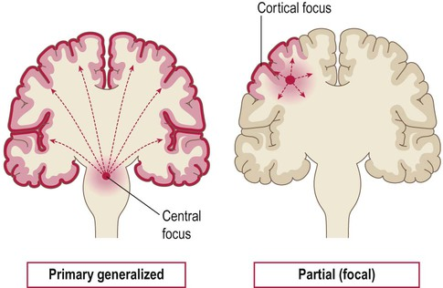

Slide 18
Generalized onset seizures
These seizures affect both sides of the brain or groups of cells at the same time.
Arise from some point in brain but immidediately engage in neuronal networks in both cerebral hemispheres.
This term was used before and still includes seizures types like tonic-clonic, absence, or atonic.

Slide 19
Absence seizures :
typical absence seizures :-
characterized by sudden , brief lapses of consciousness without loss of postural control . Associated with age of 4-8 years or early adolescence .
Incidence is 15-20% of children with epilepsy.
Lasts for few seconds and may occure 100 times per day.
Child remain unaware of it.
No postictal confusion.

Slide 20
Clinical features :-
Day dreaming and decline in school performance
rapid blinking of eyelids
chewing movements
cloning movements of hands

Slide 21
2. atypical absence seizures.
they may be longer, have a slower onset and offset, and involve different symptoms and start with blank look.
There is usually a change in muscle tone and movement. You may see
  Blinking over and over that may look like fluttering of the eyelids
  Smacking the lips or chewing movements
  Rubbing fingers together or making other hand motions
  An atypical absence seizure lasts longer, up to 20 seconds or more.

Slide 22
Generalized tonic clonic seizures:-
The attack or fit occurs suddenly at any place or time.
The patient falls down and loses awareness of his surroundings
Convulsion proceeds as follows:
Aura :
Is a warning signal prior to onset of seizures e.g sensation of peculiar test or smell, spots before eyes, dizziness and feeling of weakness.

Slide 23
Epileptic cry:
Patient loses consciousness with an epileptic cry, it is caused by spasm of thoracic and abdominal muscles expelling air through the glottis.
Tonic stage:
Patient falls to the ground with all his muscle in an increased tone with rigidity.
The skin become pale and cyanotic, the respiration ceases.
Pupil dilated and fixed. It lasts for 10-30 sec.

Slide 24
Clonic stage:
Is characterized by rhythmic, jerking movements that follow the tonic stage.
Usually start at one place and become generalized, including the muscle of the face.
There is frothing at the mouth and incontinence of urine and faeces.
Duration is approximately 1-5 min.

Slide 25
Post ictal stage:
It refers to the recovery period after a seizure
The patient may sleep deeply for 30 min to several hours.
Following this deep stage, patient may complain of headache, confusion, fatigue.
patient may realize that they had a seizure but not remember the event itself.

Slide 26
Myoclonic seizure :-
Are characterized by sudden, excessive jerking of the arms, legs or entire body.
on some occasions, the muscle activity is so severe that the patient falls to the ground
These seizures are brief.

Slide 27
Partial seizure
It begins in a specific area of the cerebral cortex.
A partial seizure can progress to a generalized seizure.
It begins as a localized motor seizure, with convulsions starting in one part of the body eg. From the thumb and gradually involving hand and arms, face and other parts.

Slide 28
Status epilepticus :-
It is characterized by at least 30 min of repetitive seizure activity without return to consciousness.
In other words, it is state in which a person has continuous seizures lasting at least 30 min.
This is medical emergency and requires prompt intervention to prevent irreversible neurological damage.
Abrupt cessation of anticonvulsant therapy is the usual cause of status epilepticus.

Slide 29
Unknown onset seizures :-
When the beginning of a seizure is not known, it’s now called an unknown onset seizure. A seizure could also be called an unknown onset if it’s not witnessed or seen by anyone, for example when seizures happen at night or in a person who lives alone.
  As more information is learned, an unknown onset seizure may later be diagnosed as a focal or generalized seizure.

Slide 30
Management :-
APPROACH CONSIDERATIONS:
THE GOAL OF TREATMENT IN PATIENTS WITH EPILEPTIC SEIZURES IS TO ACHIEVE A SEIZURES FREE STATUS WITHOUT ADVERSE EFFECTS.
THIS GOAL IS ACCOMPLISHED BY IN MORE THAN 60% OF PATIENTS WHO REQUIRE TREATMENT WITH ANTI-CONVULSANTS.

Slide 31
ANTICONVULSANT THERAPY :-
THE MAINSTAY OF SEIZURE TREATMENT IS ANTICONVULSANT MEDICATION. THE DRUG OF CHOICE DEPENDS ON AN ACCURATE DIAGNOSIS OF THE EPILEPTIC SYNDROME, AS RESPONSE TO SPECIFIC ANTICONVULSANTS VARIES AMONG DIFFERENT SYNDROMES.

Slide 32
ANTI CONVULSANTS CAN BE DIVIDED INTO LARGE GROUP BASED ON THEIR MECHANISM, AS FOLLOWS:
BLOKERS OF REPETITIVE ACTIVATION OF THE SODIUM CHANNEL : PHENYTOIN, CARBAMAZEPINE.
ENHANCER OF SLOW INACTIVATION OF THE SODIUM CHANNEL : LACOSAMIDE, RUFINAMIDE.
GABA-A RECEPTOR ENHANCERS : PHENOBARBITAL.

Slide 33
N AND L- CALCIUM CHANNEL BLOCKERS: LAMOTRIGINE, VALPORATE
H- CURRENT MODULATORS: GABAPENTIN, LAMOTRIGINE.
BLOCKERS OF UNIQUE BINDING SITES: GABAPENTIN
NEURONAL POTASSIUM CHANNEL OPENER: EZOGABINE.

Slide 34
First line drugs are :-
Generalized onset tonic-clonic | focal | Typical absence | Atypical absence, myoclonic, atonic
lamotrigine | lamotrigine | Valproic acid | Valproic acid
Valproic acid | carbamazepine | ethosuximide | lamotrigine
 | oxcarbazepine | lamotrigine | topiramate
 | phenytoin
 | leveteracetam

Slide 35
Newer antiepileptic drugs :-
Oxcarbazepine
Zonisamide
Pregabalin
Lacosamide
Eslicarbazepine
Retigabine
Felbamate
Gabapentin
Lamotrigine
Topiramate
Tiagabine
Levetiracetam

Slide 36
NON PHARMACOLOGICAL
MANAGEMENT :-
THE TWO METHODS ARE:
A KETOGENIC OR MODIFIED ATKINS DIET( LOW CARBOHYDATE DIET)
VAGAL NERVE STIMULATION (VNS)

Slide 37
SURGICAL
MANAGEMENT
LOBECTOMY
LESIONECTOMY

Slide 38
