Slide 1
ENZYMES
DR. TEJAS SHAH

Slide 2
Effect of gestational age on levels of serum alkaline phosphatase isoenzymes in healthy pregnant women
Boinapalli sudhakar

Slide 3
Author/year | Study design | Level | Results | Outcome
Okesina AB¹, Donaldson D, Lascelles PT, Morris P. | Randomized control study | Level II | RESULTS: At both 31-32 weeks and 38 weeks of gestation, serum activities of bone ALP were increased significantly (P < 0.05 and P < 0.001, respectively) when compared with controls. The percentage contribution of bone ALP to the total was higher at 31-32 weeks and lower at 38 weeks when compared with the contribution from placental ALP | CONCLUSION: Knowledge of time of elevation of serum bone ALP activity in normal pregnancy will be helpful in the interpretation of elevated serum total ALP activity during pregnancy

Slide 4
Other factors effecting on enzyme activity
Temperature :Enzyme-catalyzed reaction rates are extremely sensitive to temperature changes; to ensure accuracy, the temperature of the reaction mixture must not deviate by more than ±0.1° C from the assigned temperature.

Slide 5
There is a limit to the amount of temperature increase that can be used; most enzymes start to denature and become inactive as the temperature is increased. For example, CK starts to denature at 37° C, and amylase begins to denature at 45° C. On the other hand, some enzymes remain stable at extremely high temperatures. As an extreme case, the Taq polymerase used in the polymerase chain reaction is stable at 95° C.

Slide 6
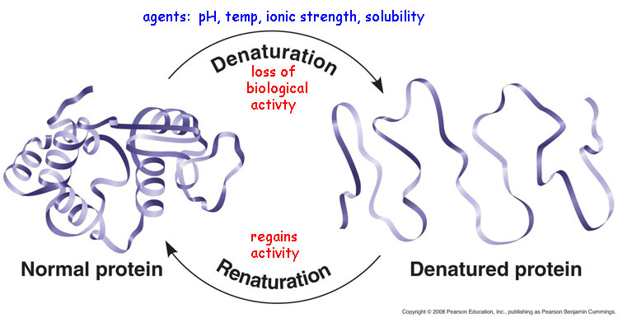
Denaturation

Slide 7
Other factors effecting on enzyme activity
pH
Enzymes have a pH optimum for maximal activity; usually, the pH of the reaction conditions is chosen to be that at which the enzyme exhibits the greatest activity

Slide 8
Other factors effecting on enzyme activity
Salt and Protein Concentrations
The ionic strength of solutions affects enzyme activity; if ionic strength is too high, enzyme activity drops. The activity of many enzymes is also affected by protein concentration. When enzyme activity is over the linear limits of the assay, dilution of plasma typically requires use of enzyme diluents containing plasma proteins. Human plasma contains about 70 g protein/L, but normal urine has almost no protein; use of proteins such as albumin increases the activity of urinary amylase and standardizes its measurement. In protein-free solutions, enzymes lose activity rapidly either by denaturation or by adsorption to the walls of the container.

Slide 9
Other factors effecting on enzyme activity
Inhibitors and Interferences
Typically, enzymes are measured in serum samples. Heparinized plasma is generally considered an equivalent sample to serum for most routine analytes, but this may not be the case for enzymes. Heparin may inhibit the activity of some enzymes, notably amylase and AST (using some, but not all, methods).
Citrate, used in evacuated collection tubes for coagulation testing and as a preservative in blood products, complexes divalent cations; citrate-containing specimens may cause falsely low results for enzymes such as CK and ALP.

Slide 10
Other factors effecting on enzyme activity
Ethylenediaminetetraacetic acid (EDTA) and fluoride inhibit the activity of many enzymes and should almost never be used for specimens for enzyme analysis. An exception is in measurement of renin, where EDTA inhibits the action of enzymes that convert prorenin to the active enzyme renin and prevents artifactual increase in renin activity

Slide 11
Km value and v-max
1. Km value is substrate concentration (expressed in
moles/L) at half-maximal velocity.
2. It denotes that 50% of enzyme molecules are
bound with substrate molecules at that particular
substrate concentration.
3. Km is independent of enzyme concentration. If
enzyme concentration is doubled, the Vmax will be
double. But the Km will remain exactly same. In other words, irrespective of enzyme concen-tration, 50% molecules are bound to substrate at that particular substrate concentration.

Slide 12
4. Km is the Signature of the Enzyme. Km value is thus a constant for an enzyme. It is the characteristic feature of a particular enzyme for a specific substrate.
5. The affinity of an enzyme towards its substrate is
inversely related to the dissociation constant, Kd for
the enzyme–substrate complex.
K1 K3
E + S -----® E–S complex ---------® E + P
K2
Kd = K2 and Km = K2 + K3
K1 K1

Slide 13
Therefore, the smaller the tendency for the dissociation of the complex, the greater is the affinity of the enzyme for the substrate.
6. Km denotes the affinity of enzyme for substrate.
The lesser the numerical value of Km, the affinity of the enzyme for the substrate is more.

Slide 14
Normal enzyme Reaction
A. Normal (uninhibited)
k1 k2
E + S E S E P
k-1

Slide 15
INHIBITION
The inhibition of enzymes may be reversible or irreversible.
In irreversible inhibition, a covalent bond is formed between the inhibitor and the enzyme, and enzyme activity cannot be restored by dissociation of the inhibitor.
Examples include the inhibition of acetylcholinesterase (AChE) and pseudocholinesterase (PChE) by chemical warfare agents such as sarin and tabun that irreversibly phosphorylate the side chain OH group of the active-site serine residue.

Slide 16
irreversible inhibition
The first fluorinated anesthetic, fluroxene (CF3CH2OCH=CH2) proved to be too toxic for use as a general anesthetic because it irreversibly alkylated a heme ring N atom in the cytochrome P450 monooxygenase responsible for its detoxification. This alkylation led to complete loss of enzyme activity.

Slide 17
Competitive inhibhition
Succinyl choline is a widely used muscle relaxant. It is a structural analogue of ACh, and so competitively fixes on post-synaptic receptors of ACh. Succinyl choline is hydrolysed by the liver ChE within 2–4 minutes. But in certain persons the ChE activity may be absent; this is a genetically trans-mitted condition. In such individuals when succinyl choline is given during surgery, it may take hours to get the drug metabolised. Very prolonged ‘scoline apnea' may result in ‘nightmare of anesthetist'.

Slide 18
Reversible inhibition
Reversible inhibition is one of three types: competitive, uncompetitive, and noncompetitive. As noted earlier, if the presence of an inhibitor is suspected in an enzyme assay of a patient’s sample, such as by observation of a nonlinear [P] versus time curve, an effective strategy is to dilute the sample, so that the effect of the inhibitor is reduced.
Even if this procedure concurrently dilutes the enzyme, the enzyme assay can still be effectively performed, especially if the substrate is present at saturating conditions

Slide 19
COMPETITIVE INHIBITION
Competitive inhibition occurs when the inhibitor binds at the same site as the substrate. The molecular basis for the binding of competitive inhibitors at the active site is that the substrate and the inhibitor are structurally similar .

Slide 20
COMPETITIVE INHIBHITION
k1 k2
E + S E S E P
+ I k-1
KI = [E] [I]
EI KI

Slide 21
Competitive Inhibition
i. Here inhibitor molecules are competing with the normal substrate molecules for binding to the active site of the enzyme, because the inhibitor is a structural analog of the substrate.
Since effective concentration of enzyme is
reduced, the reaction velocity is decreased

Slide 22
Competitive Inhibition
Competitive inhibition is usually reversible.
Or, excess substrate abolishes the inhibition.
In the previous example of 100 moles of E and
100 moles of I, if 900 moles of S are added,
only 1/10th of enzyme molecules are attached
to inhibitor and 90% are working with substrate.
Thus 50% inhibition in the first example is now
decreased to 10% inhibition

Slide 23
Competitive Inhibition
the Km is increased in presence of competitive inhibitor.
In other words, the affinity of the enzyme
towards substrate is apparently decreased in
presence of the inhibitor.
But Vmax is not changed.

Slide 24
Competitive Inhibition
Examples of competitive inhibition include the inhibition of trypsin by α-1-antitrypsin, chymotrypsin by α-1-antichymotrypsin .
Dihydrofolate reductase by the chemotherapeutic agent methotrexate, and the Krebs cycle enzyme succinic dehydrogenase by malonate

Slide 25
Competitive Inhibition
Sulphonamides: They are commonly employed antibacterial agents.
Bacteria synthesise folic acid by combining PABA with pteroyl glutamic acid.
Bacterial wall is impermeable to folic acid. Sulpha drugs, being structural analogues of PABA, will inhibit the folic acid synthesis in bacteria, and they die.
The drug is nontoxic to human cells, because human beings cannot synthesise folic acid. Preformed folic acid is essential for man. Antibacterial effect of sulpha drug was studied by Gerhard Domagk, (Nobel prize
1939).

Slide 26
Competitive Inhibition
Methotrexate: It is 4-amino-N10 -methyl folic acid. It is a structural analogue of folic acid, and so can competitively inhibit folate reductase enzyme . This is essential for DNA synthesis and cell division. Therefore, methotrexate is used as an anticancer drug

Slide 27
Competitive Inhibition
Dicoumarol: It is structurally similar to vitamin K and can act as an anticoagulant by competitively inhibiting the vitamin K activity
Isonicotinic acid hydrazide (INH): It is a commonly used antituberculous drug. It is structurally similar to pyridoxal, and prolonged use of INH may cause pyridoxal deficiency and peripheral neuropathy.

Slide 28
Competitive Inhibition
In some reactions, the product of the reaction, which may be structurally similar to the substrate, may competitively inhibit the reaction, a phenomenon known as end-product inhibition .
Not infrequently, drugs are used as competitive inhibitors of targeted enzymes. For example, antihypertensive drugs is angiotensin-converting enzyme (ACE)

Slide 29
NON COMPETITIVE
The inhibitor usually binds to a different domain on the enzyme, other than the substrate binding site. Since these inhibitors have no structural resemblance to the substrate, an increase in the substrate concentration generally does not relieve this inhibition.

Slide 30
NON COMPETITIVE
Non-competitive Inhibition (Irreversible)
i. A variety of poisons, such as iodoacetate,
heavy metal ions (lead, mercury) and
Oxidising agents act as irreversible noncompetitiveinhibitors.
There is no competition betweensubstrate and inhibitor.

Slide 31
NON COPMPETITIVE
SIMPLE
k1 k2
E + S E S E P
+ I k-1 + I
KI=[E][I] KI=[ES][I]
[EI] [ESI]
EI+S ESI
KI=KI’

Slide 32
NON COMPETITIVE
MIXED
KI=[E][I] = KI’=[ES][I]
[EI] [ESI]
KI = KI’

Slide 33
NON COPMPETITIVE
The inhibitor usually binds to a different domain on the enzyme, other than the substrate binding site.
Since these inhibitors have no structural resemblance to the substrate, an increase in the substrate concentration generally does not relieve this inhibition

Slide 34
NON COPMPETITIVE
Examples are:
iia. Cyanide inhibits cytochrome oxidase.
iib. Fluoride will remove magnesium and manganese ions and so will inhibit the enzyme, enolase, and consequently the glycolysis.
iic. Iodoacetate would inhibit enzymes having-SH group in their active centers.
iid. BAL (British Anti Lewisite; dimercaprol) is used as an antidote for heavy metal poisoning. The heavy metals act as enzyme poisons by reacting with the SH group. BAL has several SH groups with which the heavy metal ions can react and thereby their poisonous effects are reduced

Slide 35
NON COMPETITIVE INHIBHITION
The inhibitor combines with the enzymes by
forming a covalent bond and then the reaction
becomes irreversible. The velocity (Vmax) is
reduced. But Km value is not changed,
because the remaining enzyme molecules
have the same affinity for the substrate.
iv. Increasing the substrate concentration will
abolish the competitive inhibition, but will not
abolish non-competitive inhibition.

Slide 36
Uncompetitive Inhibition
Here inhibitor does not have any affinity for free enzyme.
Inhibitor binds to enzyme–substrate complex; but not to the free enzyme. In such cases both Vmax and Km are decreased . Inhibition of placental alkaline phosphatase
(Regan iso-enzyme) by phenylalanine is an example of uncompetitive inhibition

Slide 37
UN COMPETITIVE INHIBITION
k1 k2
E + S E S E P
k-1 + I
KI= [ES][I]
ESI [ESI]

Slide 38
Suicide Inhibition
Suicide Inhibition
i. It is a special type of irreversible inhibition of enzyme activity. It is also known as mechanism based inactivation. The inhibitor makes use of the enzyme's own reaction mechanism to inactivate it (mechanism based inactivation).

Slide 39
Suicide Inhibition
ii. In suicide inhibition, the structural analog is converted to a more effective inhibitor with the help of the enzyme to be inhibited. The substrate-like compound initially binds with the enzyme and the first few steps of the pathway are catalyzed.

Slide 40
Suicide Inhibition
For example, ornithine decarboxylase (ODC) catalyses the conversion of ornithine to putrescine which is necessary for polyamine synthesis. When the ODC in trypanosoma is inhibited multiplication of the parasite is arrested.
Therefore, inhibitors of ODC enzyme such as difluro methyl ornithine (DFMO) have been found to be effective against trypanosomiasis (sleeping sickness).

Slide 41
Mechanism
DFMO is initially inert, but on binding with the enzyme, forms irreversible covalent complex with the co-enzyme (pyridoxal phosphate) and the amino acid residues of the enzyme. In mammalian cells, the turnover rate of ODC is very high, and so the inhibition by DFMO is only transient.
So DFMO kills the parasites with no side-effects to the patient.

Slide 42
Suicide Inhibition
A similar mechanism is observed in the case of
Allopurinol which is oxidised by xanthine oxidase to alloxanthine that is a strong inhibitor of xanthine oxidase

Slide 43
Suicide Inhibition
The anti-inflammatory action of Aspirin is also based on the suicide inhibition.
Arachidonic acid is converted to prostaglandin by the enzyme Cyclo-oxygenase . Aspirin acetylates a serine residue in the active center of cyclo-oxygenase, thus prostaglandin synthesis is inhibited, and so inflammation subsides.

Slide 44
Clinical Enzymology
Cardiac Biomarkers
A biomarker is a clinical laboratory test which is useful in detecting dysfunction of an organ

Slide 45
Markers for Cardiac Diseases
Serial testing of the following cardiac enzymes is usually done to guide the prognosis.
No single marker can successfully identify or exclude acute MI within the first 6 hr

Slide 46
i. Creatine kinase (CK)
ii. Lactate dehydrogenase (LDH)
iii. Aspartate amino transferase (AST)
iv. Cardiac troponin I (CTI) and Cardiac troponin
T (CTT). These are not true enzymes.
v. Brain Natriuretic Peptide (BNP). It is a reliable
marker of congestive cardiac failure.

Slide 47
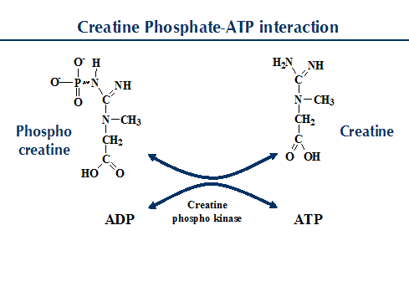
CREATINE KINASE (CK)

Slide 48
CREATINE KINASE (CK)
CK activity is greatest in striated muscle and heart tissue, which contain some 2500 and 550 U/g of protein, respectively.
Other tissues, such as the (1) brain, (2) gastrointestinal tract, and (3) urinary bladder, contain significantly less activity, and the liver and erythrocytes are essentially devoid of activity .

Slide 49
CREATINE KINASE (CK)
It was called as creatine phosphokinase in old literature.
Normal serum value for CK is 15–100 U/L for males and 10–80 U/L for females.
CK value in serum is increased in myocardial
Infarction.

Slide 50
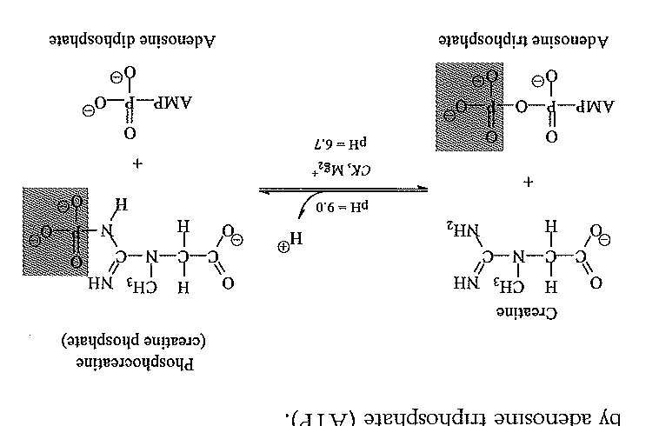

Slide 51
The CK level starts to rise within 3-6 hours of infarction.
Therefore, CK estimation is very useful to
detect early cases, where ECG changes
may be ambiguous. A second peak may
indicate another ischemic episode

Slide 52
ISOENZYMES OF CK-TOTAL
CK-MM (CK3) Least Skeletal muscle 80%
CK-MB (CK2) Intermediate Heart 5%
CK-BB (CK1) Maximum Brain 1%

Slide 53
CK and Muscle Diseases
i. The level of CK in serum is very much elevated in muscular dystrophies (500 -1500 IU/L),
ii. In female carriers of X-linked muscular dystrophy (heterozygous), CK is moderately raised.
iii. CK level is highly elevated in crush injury,fracture and acute cerebrovascular accidents.
iv. Estimation of total CK is employed in muscular dystrophies and MB iso-enzyme is estimated in myocardial infarction.

Slide 54
LACTATE DEHYDROGENASE (LDH) (LD)
LDH will convert pyruvate to lactate.
Normal value of LDH in serum is 100-200 U/L.
Values in the upper range are generally seen in
children. Strenuous exercise will slightly increase
the value. LDH level is 100 times more inside
the RBC than in plasma, and therefore minor
amount of hemolysis will result in a false positive
test.

Slide 55
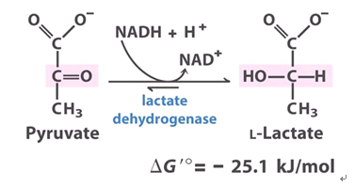
LACTATE DEHYDROGENASE (LDH) (LD)

Slide 56
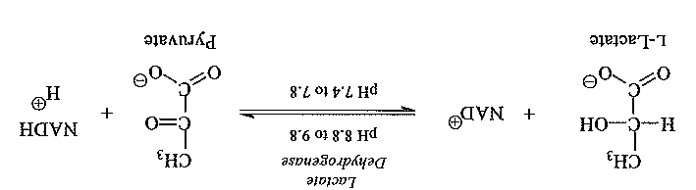

Slide 57
LACTATE DEHYDROGENASE (LDH) (LD)
In cardiac muscle, kidneys, and eryth-rocytes, the electrophoretically faster moving isoenzymes LD-1 and LD-2 predominate,.
Isoenzymes of intermediate mobility account for the
LD activity from sources such as (1) spleen, (2) lungs, (3)
Lymph nodes, (4) leukocytes, and (5) platelets.

Slide 58
LACTATE DEHYDROGENASE (LDH) (LD)
whereas in liver and skeletal muscle,the more cathodal LD-4 and LD-5 isoenzymes predominate— although skeletal muscle damage may also result in anodic LD patterns

Slide 59
LACTATE DEHYDROGENASE (LDH) (LD)
In myocardial infarction, total LDH activity is
increased, while H4 iso-enzyme is increased 5–10 times more. The time course of LDH level after a heart attack.
3. Differential Diagnosis
Increase in total LDH level is seen in hemolytic anemias, hepatocellular damage, muscular dystrophy, carcinomas, leukemias, and any condition which causes necrosis of body cells. Since total LDH is increased in many conditions, the study of iso-enzymes of LDH is of more significance.

Slide 60
Isoenzymes of LDH
LDH-1 H4 Heart muscle 30%
LDH-2 H3M1 RBC 35%
LDH-3 H2M2 Brain 20%
LDH-4 H1M3 Liver 10%
LDH-5 M4 Skeletal muscle 5%

Slide 61
flipped pattern.
Normally LDH-2 (H3M1) concentration in blood is greater than LDH-1 (H4); but this pattern is reversed in myocardial infarction; this is called flipped pattern.

Slide 62
ASPARTATE AMINO TRANSFERASE (AST)
i. In old literature it was called as serum glutamate oxaloacetate transaminase (SGOT). AST needs pyridoxal phosphate (vitamin B6) as co-enzyme.
ii. Normal serum level of AST ranges from 8 to 20 U/L. It is a marker of liver injury and shows moderate to drastic increase in parenchymal liver diseases like hepatitis and malignancies of liver.
iii. AST was used as a marker of myocardial ischemia in olden days. The level is significantly elevated in myocardial infarction.
iv. But troponins have replaced AST as a diagnostic marker in ischemic heart disease

Slide 63
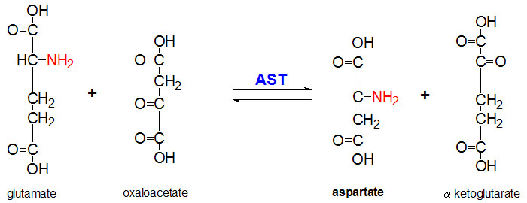
ASPARTATE AMINO TRANSFERASE (AST)

Slide 64
ALANINE AMINO TRANSFERASE (ALT)
i. In old literature, it was called as serum glutamate pyruvate transaminase (SGPT). The enzyme needs pyridoxal phosphate as coenzyme.
ii. Normal serum level of ALT for male is 13-35 U/L and for female is 10-30 U/L. Very high values (300 to 1000 U/L) are seen in acute
hepatitis, either toxic or viral in origin.
iii. Both ALT and AST levels are increased in liver disease, but ALT > AST. Rise in ALT levels may be noticed several days before clinical
signs such as jaundice are manifested.
iv. Moderate increase (50 to 100 U/L) of ALT may be seen in chronic liver diseases such as cirrhosis, hepatitis C and non-alcoholic steatohepatitis (NASH).

Slide 65
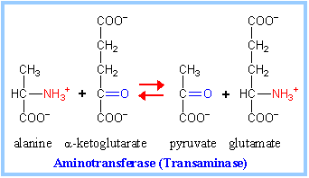
Serum Glutamate Pyruvate Transminases(SGPT)

Slide 66
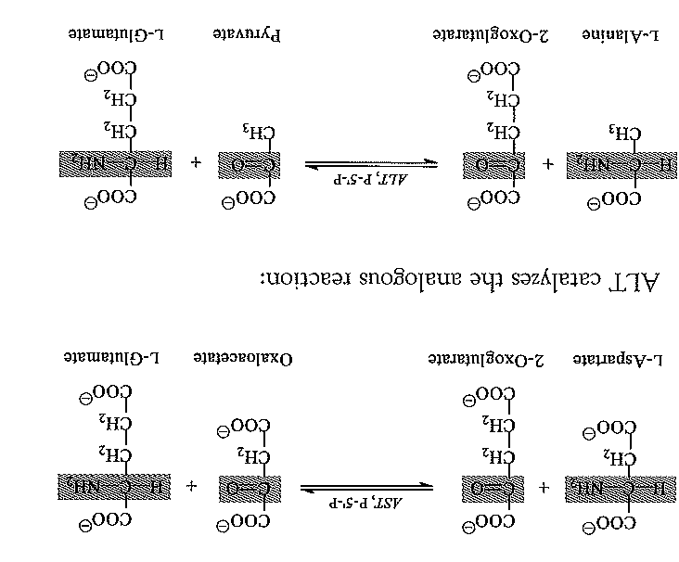

Slide 67
In most types of liver disease, ALT activity is higher than that of AST.
Excep-tions may be seen in (1) alcoholic hepatitis, (2) hepatic cirrhosis,and (3) liver neoplasia.
serum AST and ALT concentrations are elevated even before the clinical signs and symptoms of disease (such as jaundice) .

Slide 68
Although serum activities of both AST and ALT become elevated whenever disease processes affect liver cell integrity, ALT is the more liver-specific enzyme. Serum elevations of ALT activity are rarely observed in conditions other than parenchymal liver disease.
Moreover, elevations of ALT activity persist Longer than do those of AST activity.

Slide 69
After acute myocardial infarction, increased AST activity appears in serum. AST activity also is increased in progressive muscular dystrophy and dermatomyositis, reaching concentrations up to eight times the upper reference limit. They are usually within the reference interval in other types of muscle diseases, especially in those of neurogenic origin. Slight to moderate AST elevations are noted in hemolytic disease.

Slide 70
ALKALINE PHOSPHATASE (ALP)
i. ALP is a nonspecific enzyme which hydrolyses aliphatic, aromatic or heterocyclic compounds. The pH optimum for the enzyme reaction is between 9 and 10. It is activated by magnesium and manganese. Zinc is a constituent ion of ALP.
ii. It is produced by osteoblasts of bone, and is associated with the calcification process. It is localised in cell membranes (ecto-enzyme), and is associated with transport mechanisms in liver, kidney and intestinal mucosa.
iii. Normal serum value of ALP is 40–125 U/L . In children the upper level of normal value may be more, because of the increased osteoblastic activity in children.
iv. Moderate (2-3 times) increase in ALP level is seen in hepatic diseases such as infective hepatitis, alcoholic hepatitis or hepatocellular carcinoma.

Slide 71
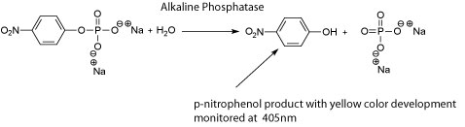
ALKALINE PHOSPHATASE (ALP)

Slide 72
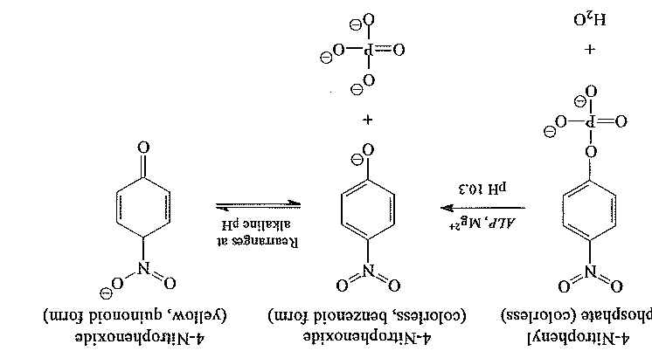

Slide 73
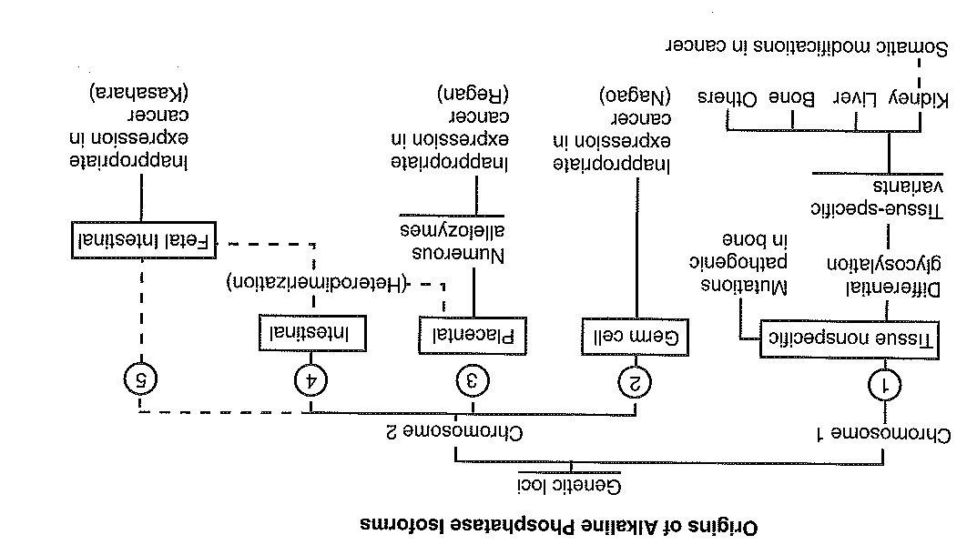

Slide 74
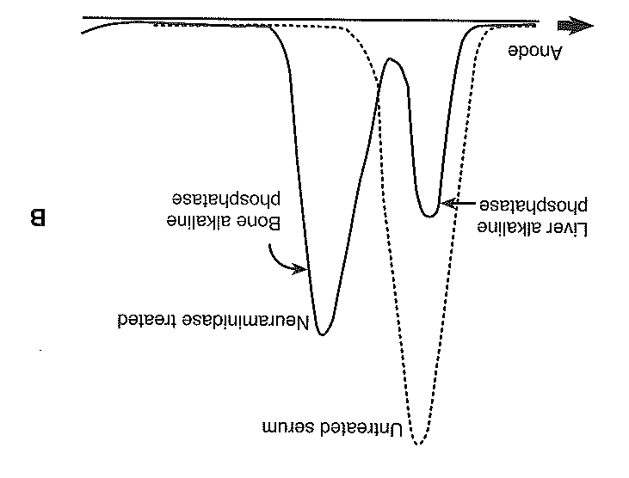

Slide 75
ALKALINE PHOSPHATASE (ALP)
v. Very high levels of ALP (10-12 times of upper limit) may be noticed in extrahepatic obstruction (obstructive jaundice) caused by gallstones or by pressure on bile duct by carcinoma of head of pancreas. Intrahepatic cholestasis may be due to virus (infective hepatitis) or by drugs (chlorpromazine).
ALP is produced by epithelial cells of biliary canaliculi and obstruction of bile with consequent irritation of epithelial cells leads to secretion of ALP into serum.
vi. Drastically high levels of ALP (10-25 times of upper limit) are also seen in bone diseases where osteoblastic activity is enhanced such as Paget's disease (osteitis deformans), rickets, osteomalacia, osteoblastoma, metastatic carcinoma of bone and hyperparathyroidism.

Slide 76
Enzymes commonly studied for diagnosis of liver diseases are:
1. Alanine amino transferase (ALT)
2. Alkaline phosphatase (ALP)
3. Nucleotide phosphatase (NTP)
4. Gamma glutamyl transferase (GGT)

Slide 77
Gama-glutamyl transferase
GGT is present (in decreasing order of abundance) in (1)
proximal renal tubule, (2) liver, (3) pancreas, and (4) intestine.
The enzyme is present in cytoplasm (microsomes), but the
larger fraction is located in the cell membrane and may trans-
port amino acids and peptides into the cell across the cell
membrane in the form of gamma-glutamyl-peptides.

Slide 78
Gama-glutamyl transferase
Even though renal tissue has the highest concentration of GGT, the enzyme present in serum originates primarily from the hepatobiliary system.
High elevations of GGT are also observed in patients with
either primary or metastatic liver neoplasms.

Slide 79
Gama-glutamyl transferase
It is a sensitive indicator of the presence of hepatobiliary disease, being elevated in most subjects with liver disease regardless of cause. Its clinical utility, however, is limited by the lack of specificity.
Like ALP, it is highest in cases of intrahepatic or posthepatic biliary obstruction, reaching activities some 5 to 30 times the upper reference limit.

Slide 80
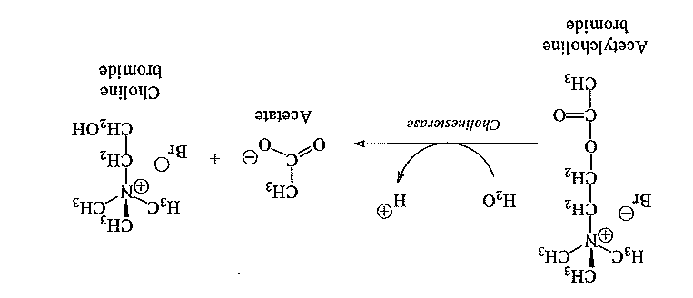
Cholinesterase

Slide 81
Cholinesterase
Two related enzymes have the ability to hydrolyze acetylcho-line. One is acetylcholinesterase (EC 3.1.1.7, acetylcholine acetylhydrolase.
True cholinesterase is found in (1) erythrocytes, (2) the lungs and spleen, (3) nerve endings, and (4) the gray matter of the brain. It is responsible for the prompt hydrolysis of acetylcholine released at the nerve endings to mediate transmission of the neural impulse across the synapse.

Slide 82
Cholinesterase
The Degradation of acetylcholine is required for the depolarization of the nerve so that it is repolarized in the next conduction event.

Slide 83
Cholinesterase
The second cholinesterase is acylcholine acylhydrolase (EC 3.1.1.8, acylcholine acylhydrolase, CHE). It is also called (1) pseudocholinesterase, (2) serum cholinesterase, (3) butyryl-cholinesterase, or (4) choline esterase II. Although it is found in the (1) liver, (2) pancreas, (3) heart, (4) white matter of the brain, and (5) serum, its biological role is unknown. The type of reaction catalyzed by both cholinesterases

Slide 84
Cholinesterase
Clinical Significance
Measurements of CHE activity in serum are used ( I ) As a test of liver function,
(2) As an indicator of possible insecticide poisoning, and
(3) For the detection of patients with atypical
forms of the enzyme who are at risk of prolonged responses to certain muscle relaxants used in surgical procedures.

Slide 85
PANCREATIC ENZYMES
Assays of serum (1) amylase (AMY), (2) lipase (LPS), (3) trypsin (TRY), (4) chymotrypsin (CHY), and (5) elastase 1 (El) are applied to investigation of pancreatic disease. Pancreatic function .

Slide 86
Amylase
The AMY activity present in normal serum and urine is of pancreatic (P-AMY) and salivary gland (S-AMY) origin.
These isoenzymes are products of two closely linked loci on chromosome 1. AMY isoenzymes also undergo posttransla-tional modification of deamidation, glycosylation, and deglycosylation to form a number of isoforms. These isoforms have been separated in both serum and urine using isoelectric focus-ing or electrophoresis.

Slide 87
Blood AMY activity is physiologically low and constant and greatly increases in acute pancreatitis and salivary gland inflammation. In acute pancreatitis, a rise in serum AMY activity occurs within 5 to 8 hours of symptom onset.
Activities return to normal by the third or fourth day.

Slide 88
AMYLASE
Normal levels 31-110 I U/L

Slide 89
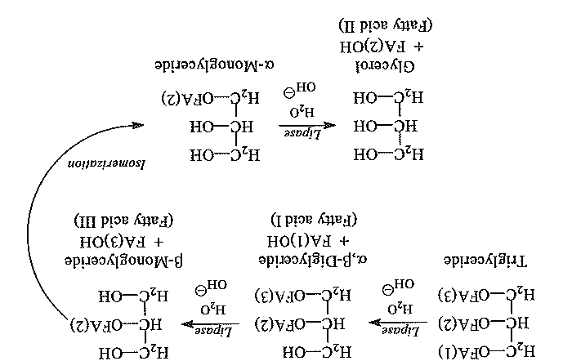
LIPASE

Slide 90
LIPASE
Most of the LPS activity found in serum derives from the pancreas, but some is also secreted by the gastric and intestinal mucosa. LPS concentration in the pancreas is about 9000-fold .
< 60 IU/L

Slide 91
LIPASE
The clinical specificity is 80% to 100% depending upon the mix of patient population studied.
After an attack of acute pancreatitis, serum LPS activity (1) increases within 4 to 8 hours, (2) peaks at about 24 hours, and (3) decreases over 8 to 14 days. Concentrations often remain elevated longer than those of AMY. Elevations between 2 and 50 times the upper reference limit have been reported. The increase in serum LPS activity is not necessarily proportional to the severity of the attack.

Slide 92
LIPASE
Biliary tract diseases, such as acute cholecystitis, may cause an increase in serum LPS activity. Obstruction of the pancreatic duct by a calculus or by carcinoma of the pancreas or investigation of the biliary tract by endoscopic retrograde pancreatography may also increase serum LPS activity. Finally, in patients with a reduced glomerular filtration rate, the serum LPS activity is increased. Thus care should be exercised in the interpretation of elevated serum LPS values in the presence of renal insufficiency.

Slide 93
